Slide 1

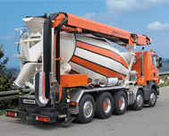



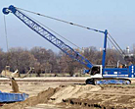







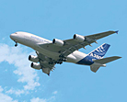

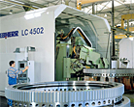
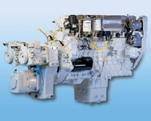

Sculi 2 / Lidec 2 - Sontheim
01.06.2012

Slide 2
Agenda
ASAM D-Server Architecture
Sontheim MDT Architecture
D-PDU vs. J2534
Sculi 2 / Lidec 2 with Sontheim – Architecture
Proof of Concept
Conclusion

Slide 3
ASAM – D-Server Architecture
D-Server
ASAM MCD-3
ODX 2.2.0 ASAM MCD-2
D-Server
D-PDU
ASAM MCD-1

Slide 4
Sontheim Architecture
MDT Server
Owner
ODX 2.0.1
MDT-Server (85’000 €)
J2534 (12’000 €)

Slide 5
D-PDU vs. J2534
D-PDU (Part of the D-Server Automotive Standard)
The D-PDU API will address the generic software interface, the protocol abstraction, its exchangeability as well as the compatibility towards existing standards such as SAE J2534-1 and RP1210a.
The definition of the D-PDU API is closely related to SAE J2534-1 and RP1210a to allow mapping of functionality in both directions. However, it extends their definitions to cover the full width of enhanced diagnostics.

Slide 6
Sculi 2 / Lidec 2 with Sontheim - Architecture
.Net/C#
Sculi 2
ODX
2.2.0
ODX Parser
J2534 Layer
D-PDU Layer
C/C++
J2534 Sontheim
J2534 ETAS
D-PDU Vector
D-PDU DSA
CAN Cards
CANFox
CANUSB
ES581.3
CaseXL
DSA
→ Proof of concept

Slide 7
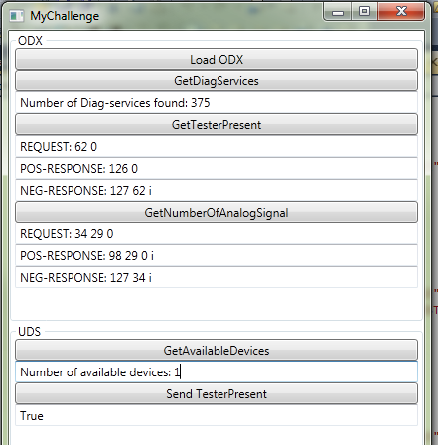
Proof of concept
My Challenge
ODX
Load ODX file
Return the number of Services
Read the “UDS Tester Present” request and responses
Read a “Value” request and responses
→ 1H15
(without Sontheim MDT Server : 85’000 €)
UDS
Get available CAN Interfaces
Send and Receive “UDS TesterPresent”
→ 2 days (because of non-knowledge of CAN & J2534)
(with Sontheim J2534: 12’000 €)

Slide 8
Conclusion
The proof of concept works !!
Sontheim offer
MDT-Server : 85’000 €
UDS Library : 12’000 €
CANFox: ~80€ / st.
The MDT-Server is not necessary for our purpose (parsing XML file) and this has been demonstrated by a proof of concept
The UDS Library is in reality a J2534 Library (does not contain the UDS Services). This library is necessary if we would like to work with CANFox cards and use an abstraction layer allowing the support of other cards which have a J2534 driver (e.g. ETAS).
CANFox cards have the lowest price and also contains an USB→RS232 connection (the current W&T cable will no more be necessary)
Suggestion: invest the 85’000 € in infrastructure (PC-Workstation / Softwares) instead of MDT-Server
Next steps: taking contact with Softing and doing a proof of concept (because they use a D-PDU interface)
evaluate the global price (Sculi 2 – UDS/ODX + Lidec 2 UDS Stack)

