Slide 1


















Sculi & PAMS
06.06.2012

Slide 2
Agenda
Planning – PAMS integration in Sculi
Planning - Security migration process
Scenario: New user process
Open questions

Slide 3
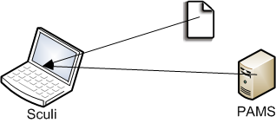
Planning – PAMS integration in Sculi
Phase 1: 1st July 2012
Usage of PAMS License file
Pin code request (smartcard or dongle)
Possibility to import a new license file through a “browse” process
Phase 2: To be planned
Importation of PAMS license file using Internet Web service
(1)
(2)

Slide 4
Planning - Security migration process
Send “beta” version to key users for test purpose (Q3 2012)
The smartcard has to be previously defined
The users have to be inserted into PAMS
We have to define the key user list (Company Product Leads ?)
All the users in LiCA have to be inserted into PAMS (Q3-Q4 2012)
Who will do it ?
Double security will be available in Sculi until all users have received a smartcard or dongle (Q1 2013)
A message as startup should inform the user that he has to receive the new security infrastructure
Who will do the support ?
Which company will be responsible for the acquisition of smartcard / dongle ? LBH ?
Which company will be responsible to send smartcard / dongle to users ?
Remove the Marx-Dongle security management in Sculi (Q2 2013)

Slide 5

Scenario: new user process
A participant want to follow a Sculi course
A trainer will provide him what he needs
3 roles
Trainer
Participant
Sale

Slide 6
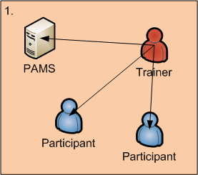
New user process (1)
The trainer should be able to provide a PAMS license with a validity of 3 months
(Usage of Wizard)
The trainer should be able to provide smartcard / dongle to participants

Slide 7
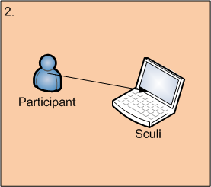
New user process (2)
The participant can use Sculi during 3 months

Slide 8
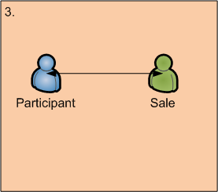
New user process (3)
As soon as a new trial license version has been delivered, the sales should send a bill to the participant.
The participant has to pay within the 3 months, otherwise he will not receive a new license file and Sculi will be blocked

Slide 9
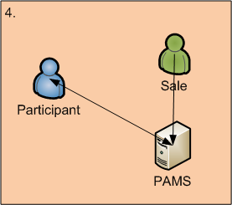
New user process (4)
As soon as the bill has been paid, the sales should update his license validity on PAMS
The participant can download the new license file

Slide 10

New user process (5)
Then, the participant can use Sculi for the license validity.

Slide 11
Open questions
Which dongle ? (Gemalto vs. Aladdin)
Who will test the version of Sculi with PAMS security ? Company Product Leads ?
Who will import current user list from LiCA to PAMS ?
Where will be the sales of Sculi ? LMB ?
Who will pay for the sales person ? ITM ?
What is the process in order that each location receive a set of smartcard / dongle ?
Who will send the new smartcard / dongle to users ?
What is the process in order to replace the current smartcard ? Do we have to ?
What do we do with Marx Dongle ?

