Slide 1


















PAMS library protection
11.06.2012

Slide 2
Agenda
Definition of security level
Usage of PAMS library
“Man in the middle” attack
How to prevent “Man in the middle” attack
Obfuscation discussion with Mrs. Karl Zerlauth & Andreas Jung

Slide 3
Definition of security
It should not be possible to replace the security.dll by another one (signed with an other private key than the official one)
It should not be possible to come-between Sculi.exe and the security.dll
It should not be possible to mock the certificate security chain (same certificate names, created with Makecert for instance)
It should not be possible to modify a license file
It should not be possible to use a license file from another user (corresponding to the dongle)
Trust any binary file which has been signed by the Sculi private key
Trust the Sculi private key is kept safe and is not distributed to any unnecessary party.
Do NOT trust the machine configuration, even if it takes admin rights to change it.
We do not rely on secret only, to keep the application secure. i.e. Read-Only access to the source code is not enough to circumvent the security
We do not protect ourselves from attempts at hooking Win32 APIs (Win32 native crypto API) and accessing uncyphered data kept in-memory by the dll or the program to protect from an application with the same level of trust as the program to protect.

Slide 4
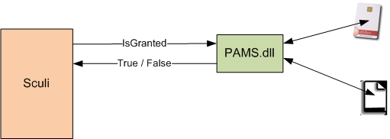
Usage of PAMS library
Sculi ask the library if an action/feature is granted
The library answers with true of false

Slide 5

“Man in the middle” attack
Risk
Another library can be placed in between

Slide 6
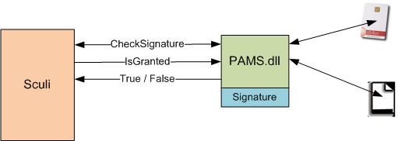
How to prevent the “man in the middle” attack
The PAMS.dll is signed
The application must check the signature of the library before using it

Slide 7
Obfuscation discussion with Mr. Karl Zerlauth & Mr. Andreas Jung
1) What can the attacker achieve if he learns from the code of PAMS.dll
if he can attack PAMS license files or other systems behind, there is a need to obfuscate
2) What can the attacker achieve if he alters the code of PAMS.dll
e.g. if he can create custom PAMS files, which appear valid to the systems relying on PAMS.dll,
there is a need of true verification of integrity (cannot be changed easily, -> roundtrip validation)
3) What can the attacker achieve if he creates his own PAMS.dll only containing method stubs returning the desired values/objects
e.g. if the attacker can create a custom pams.dll with a method which grants him the highest admin level,
it is necessary to "hard link" PAMS.dll to each application using it (SCULI etc.).

Slide 8
Disadvantage of obfuscation
When the library uses reflection, the business logic will be broken.
When the library is obfuscated, the Test Project must use obfuscated methods/members
Test readability is broken
In BDD, tests are used to define specifications

