Slide 1
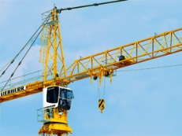
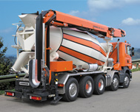


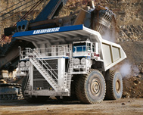
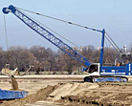
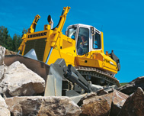
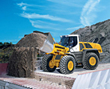






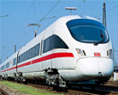
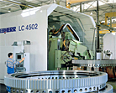
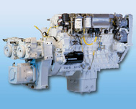

Sculi 2
Requirement analysis
Notes:
XX.XX.XXXX
Präsentationstitel eingeben

Slide 2
Agenda
08:00
  Besuch des Schulungsraums
08:30
  Kennenlernen
  Status von Sculi 1
  Warum Sculi 2 ?
  Information Sammlung
    Diagnostik Use Case
    Dongle Level
10:00
  Pause
10:15
  Vorschläge für Sculi 2
12:00
  Mittagessen
13:00
  Vorschläge für Sculi 2 (Fortsetzung)
  Offene Diskussion
14:00 – 15h00
  Ende
Sculi 2 – Requirements analysis

Slide 3
Before staring
What are the scenarios where you need to do a diagnostic ?
  Use Cases
What are you expecting from you diagnostic tool ?
  Functionalities
Sculi 2 – Requirements analysis
Notes:
XX.XX.XXXX
Präsentationstitel eingeben

Slide 4
Sculi 1 - Feedback
What do you think about Sculi ?
  Usability
  Complexity
  Stability
  Functionalities
Sculi 2 – Requirements analysis
Notes:
XX.XX.XXXX
Präsentationstitel eingeben

Slide 5
Plugins in Sculi 1
Which plugins are you using ?
  Variable Editor
  Message Analyzer
  Message Finder
  Oscilloscope
  Wizard
  SCOTTI
  LiFT
  Code Gen
  LiDAT
  Module Editor
  Application Manager
  Monitor Emulation
  Terminal
  Dashboard
  Motor Tools (Click Test, …)
Sculi 2 – Requirements analysis
Notes:
XX.XX.XXXX
Präsentationstitel eingeben

Slide 6
Dongles
Dongle levels
  User
  Authorized user
  Customer
  Keyswitch
  Litronic 3
  Service
  System
  Inspector
  Supervisor
Which levels are really used ?
Sculi 2 – Requirements analysis
Notes:
XX.XX.XXXX
Präsentationstitel eingeben

Slide 7
Agenda
Sculi 2
Sculi 2 – Requirements analysis
Notes:
XX.XX.XXXX
Präsentationstitel eingeben

Slide 8
Agenda – Sculi 2
Sculi 2
  Current situation
  Proposition for hardware
  Proposition for software
Sculi 2 – Requirements analysis
Notes:
XX.XX.XXXX
Präsentationstitel eingeben

Slide 9
Sculi 2 – Current situation
Sculi 1
  Technology (Delphi)
    Hard for the maintenance on new platform (Windows 7)
    Hard to find qualified people (with Delphi knowledge)
  User experience
    Oriented for developer instead of mechanical ☹
    Complicated to use
Sculi 2
  New Technology (Microsoft .Net, cross platform)
  Focused on end users
  Lessons learned have to been applied for Sculi 2
Sculi 2 – Requirements analysis
Notes:
XX.XX.XXXX
Präsentationstitel eingeben

Slide 10
Sculi 2 – Suggested hardware
Sculi 1 is working on:
  Windows XP / 7
  Laptop / Workstation
Sculi 2 – Requirements analysis
Notes:
XX.XX.XXXX
Präsentationstitel eingeben

Slide 11
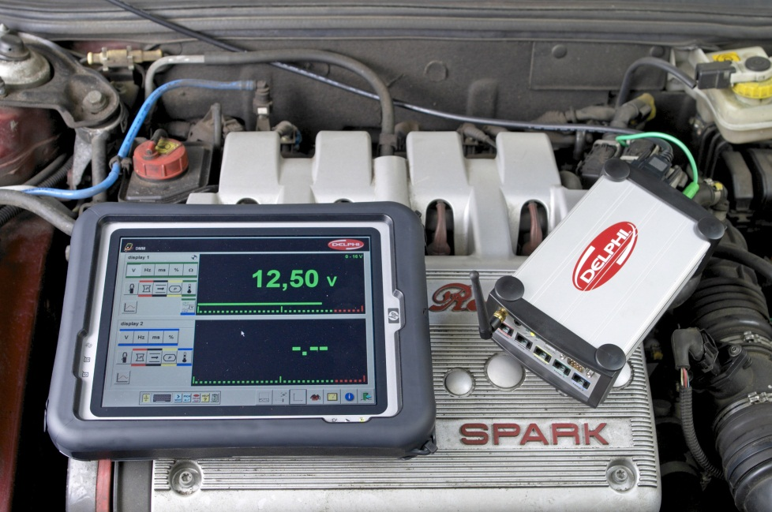
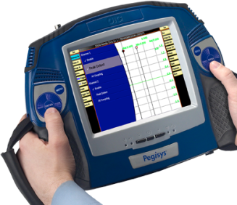
Sculi 2 – Suggested hardware
Automotive industry
  Tablet are commonly used
Sculi 2 – Requirements analysis
Notes:
XX.XX.XXXX
Präsentationstitel eingeben

Slide 12
Sculi 2 – Suggested hardware
Future of Sculi
  Can we imagine to focus the usage of Sculi 2 for Tablet ?
    Windows 7 / Windows 8
    Touch-screen
  Can we imagine sell Sculi 2 with a Tablet ?
Sculi 2 – Requirements analysis
Notes:
XX.XX.XXXX
Präsentationstitel eingeben

Slide 13
Sculi 2 – Suggested software
The “information” must take the whole place on the screen
  The general size of a tablet is 10’’
The options/actions must be visible only when requested/needed
  If a button is not always clicked, it should not always be present on the screen
→ Focus on the information instead of the options
Sculi 2 – Requirements analysis
Notes:
XX.XX.XXXX
Präsentationstitel eingeben

Slide 14
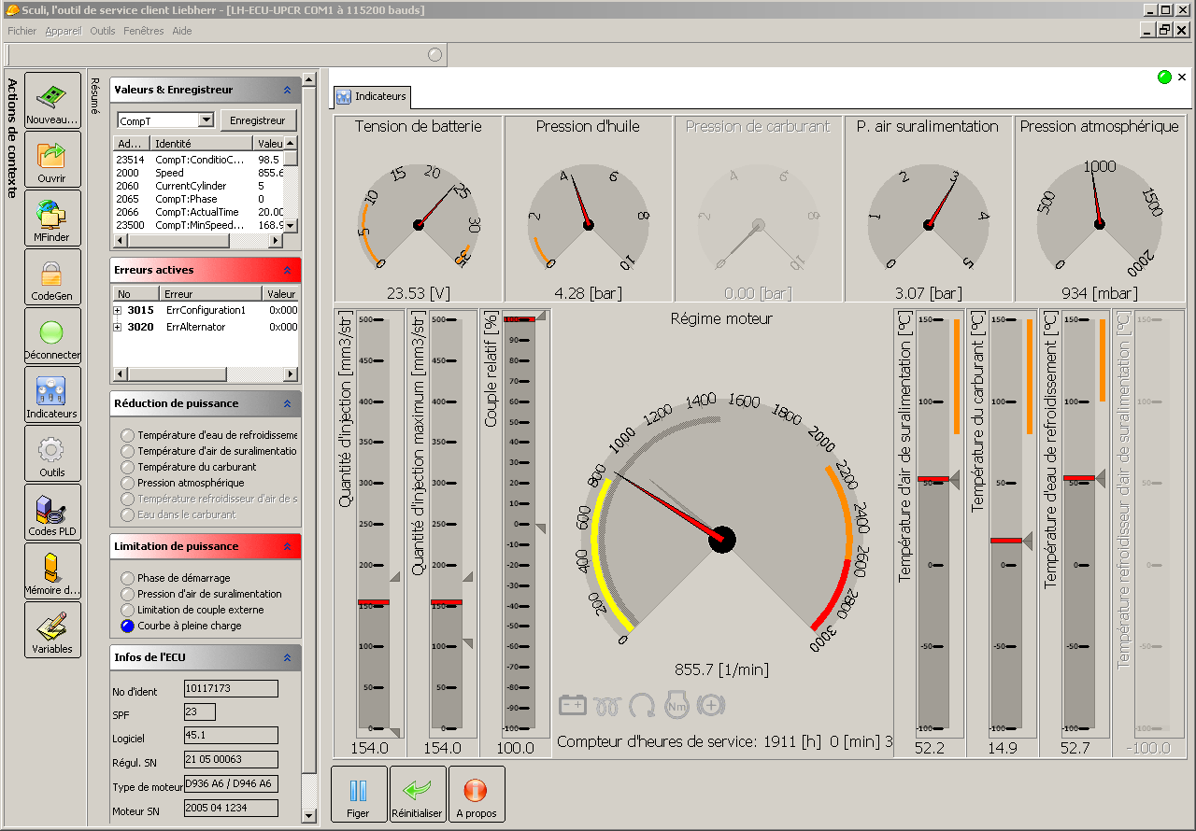
Sculi 2 – Suggested software
Sculi 2 – Requirements analysis

Slide 15
Sculi 2 – Suggested software
Sculi 2 – Requirements analysis

Slide 16
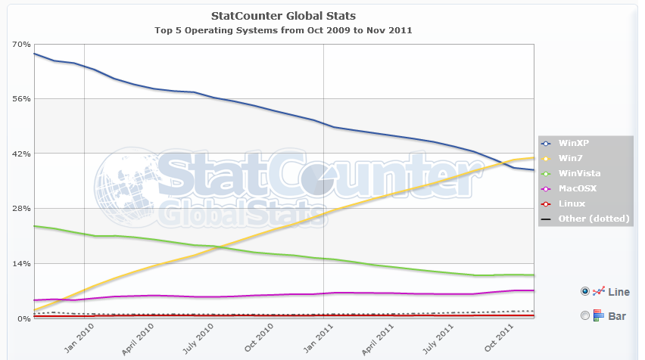
Sculi 2 – Suggested software
Windows 7 vs. Windows XP
Sculi 2 – Requirements analysis

Slide 17
Sculi 2 – Suggested software
The development of Sculi 2 will need 3-4 years
What will be the user interface of the future applications ?
  Ribbon à la Office 2010 ?
  What about Windows 8 ?
Movie
  02:43 : Start Menu
  06:20 : General Look & Feel of all applications
  14:35 : Availability of options
  → Prototype
Sculi 2 – Requirements analysis
Notes:
XX.XX.XXXX
Präsentationstitel eingeben

Slide 18
Sculi 2 - Prototype
What do you think about this prototype ?
Sculi 2 – Requirements analysis
Notes:
XX.XX.XXXX
Präsentationstitel eingeben

Slide 19
Sculi 2 – Development process
Iterative approach
  Define the basis structure of the application
  For each functionalities/plugin, define the functional requirements with the Company Product Lead
  After the development of each functionalities, the Company Product Lead will distribute the prototype on his location for approval.
Message Analyzer
Oscilloscope
…
Sculi 2 – Requirements analysis
Notes:
XX.XX.XXXX
Präsentationstitel eingeben

Slide 20
Agenda
General questions
Sculi 2 – Requirements analysis
Notes:
XX.XX.XXXX
Präsentationstitel eingeben

Slide 21
Thank you for your attention
Sculi 2 – Requirements analysis

