Slide 1
Adapting reading tests from English to Meetei Mayek
Gairan Pamei, Tomohiro Inoue
Department of Psychology
The Chinese University of Hong Kong

Slide 2
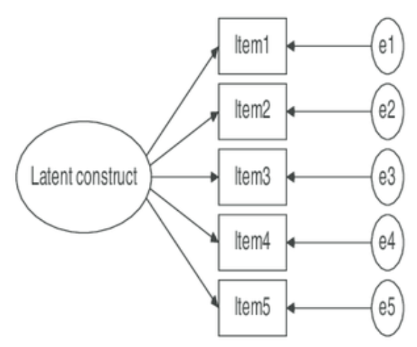
The present study
Two objectives
Adapt the existing English reading measures into Manipuri (Meetei Mayek)
Examine the psychometric properties of Meetei Mayek and English measures
Method
Measurement model: reflective
Variables | Measures | Total items
Phonological processing | Elision subtest (CTOPP) | 34
Receptive vocabulary | PPVT | 30

Slide 3
Background of the study sample
N= 113​
Students in schools of Manipur
Grade: 1 to 6​
Age: 7 to 15​
Gender: Male= 49, Female= 64​
Language background: Meetei = 24 (21%), non-Meetei = 89 (79%)

Slide 4
Analysis
Why IRT?
Less biased difficulty estimates
More parsimonious dimensionality estimates
A wide continuum of the latent variable
Why non-parametric and Bayesian IRT?
Sample size
Less biased than EFA
Priors
Evaluating psychometric properties
Item analysis: two approaches
Non-parametric IRT model– Mokken scale analysis (MSA):
Bayesian IRT model

Slide 5
Results
Item-level descriptive: response category and/or inter-item correlations
Mokken scale analysis (MSA)
Bayesian IRT

Slide 6
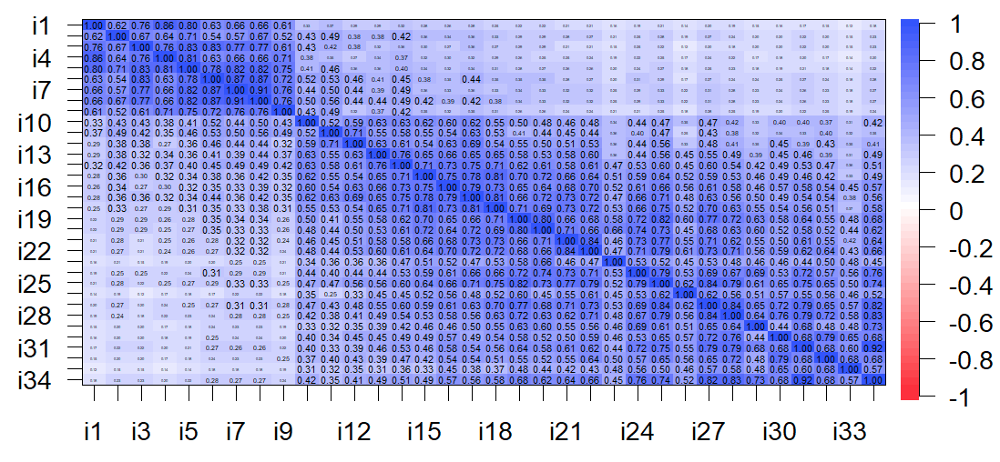
MM elision items correlogram

Slide 7
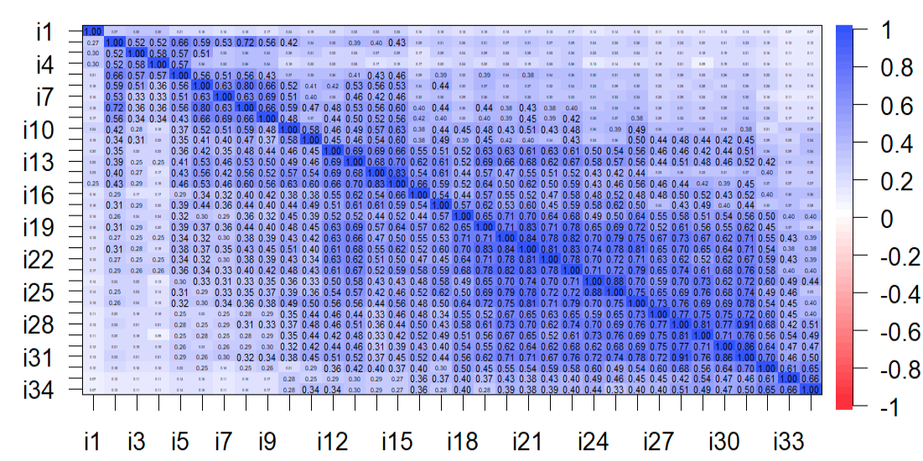
English elision items correlogram

Slide 8
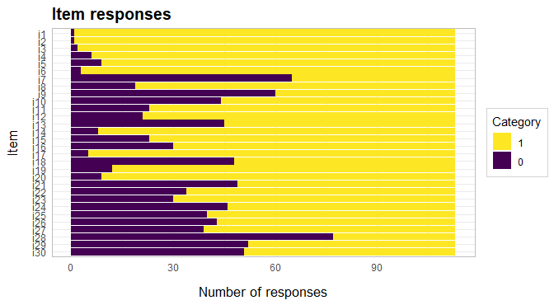
English PPVT Response Category

Slide 9
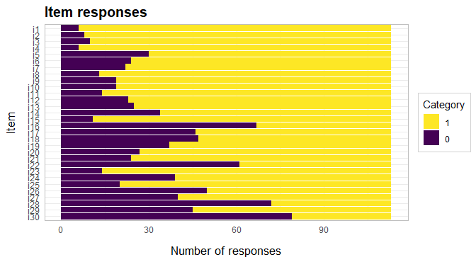
Response Category English PPVT Meetei Mayek PPVT

Slide 10
Summary of the Mokken scale analysis (MSA)
* three removed items
** two removed items
Method Manifest Invariant Item Ordering
Measure | Scalability, H (SE) | Invariant Item Ordering, HT
MM elision | 0.81 (0.02) | 0.76
English elision | 0. 78 (.03) | 0.74
MM PPVT | 0.39 (0.05) | 0.32*
English PPVT | .35 (.05) | 0.38**

Slide 11
Bayesian IRT: elision
Elision (both languages): the two log-parameter (2PL) model is a better fit
PPVT (both languages): similar result, 2PL model
2PL model: easiness/difficulty and discrimination item estimates
Focus on MM measures

Slide 12
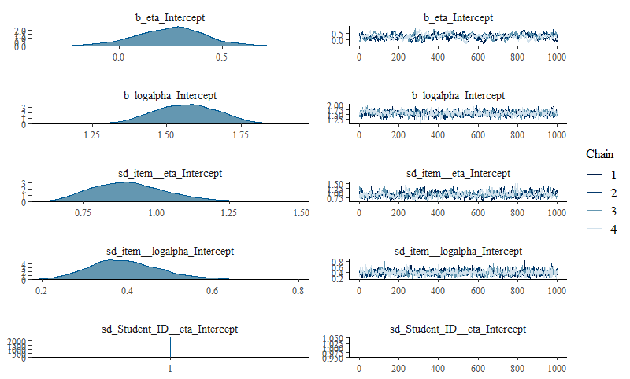
2PL model convergence for MM elision

Slide 13
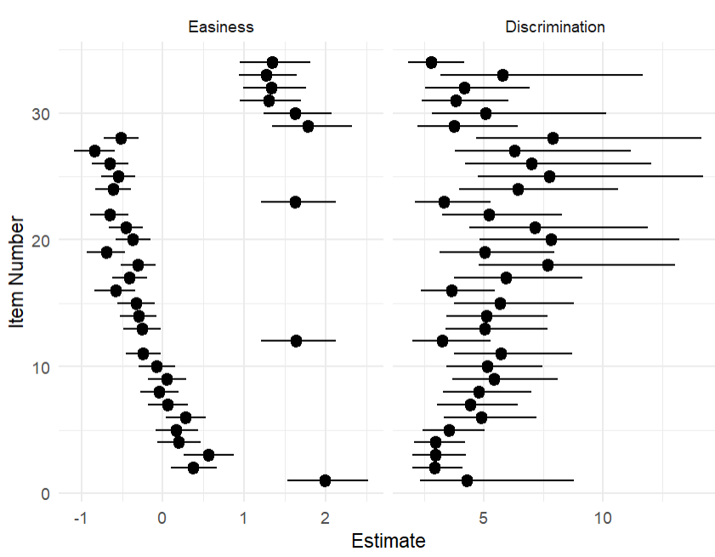
Posterior means and 95% credible intervals of item parameters: MM elision

Slide 14
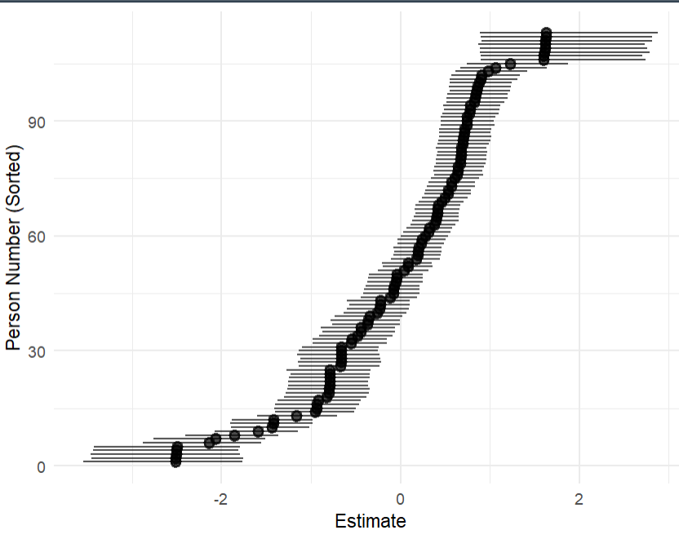
Person parameters: MM elision 2PL model

Slide 15
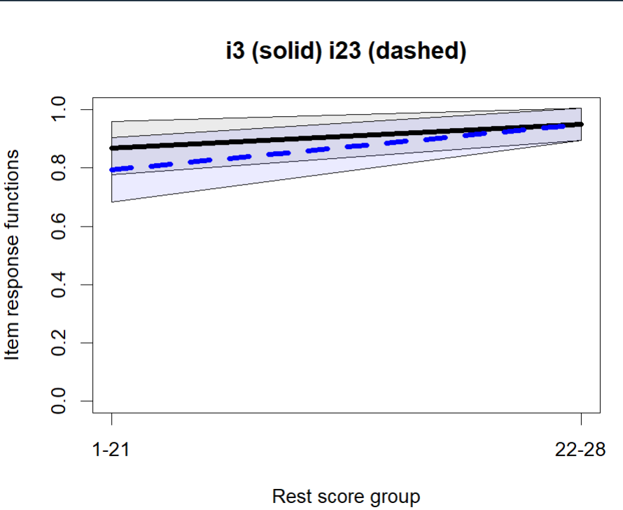

Slide 16
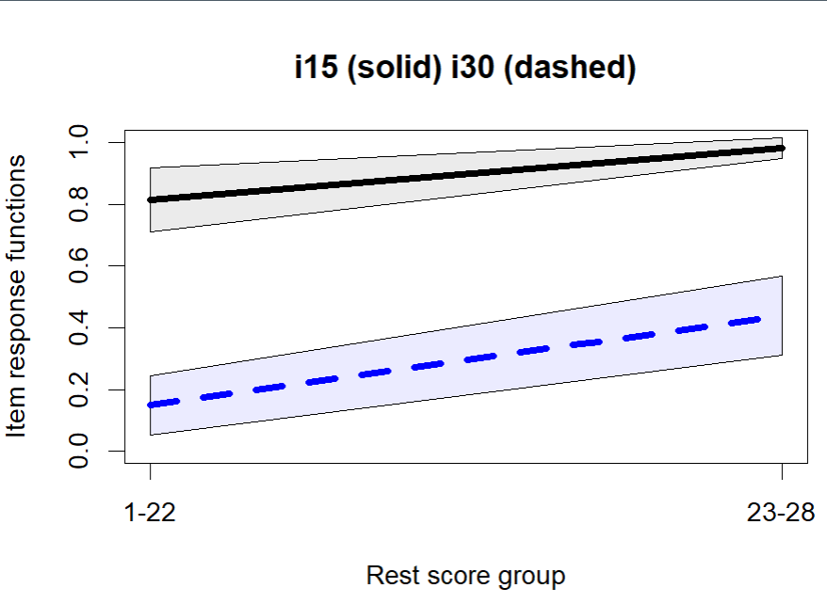

Slide 17
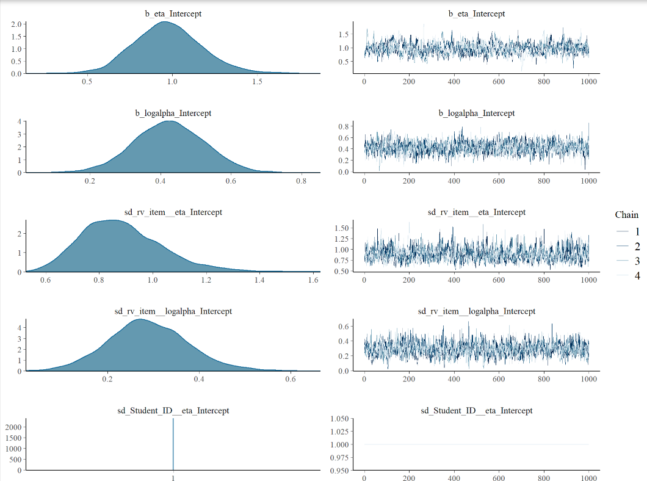
MM PPVT: Summary of the posterior distribution obtained by Bayesian 2PL model

Slide 18
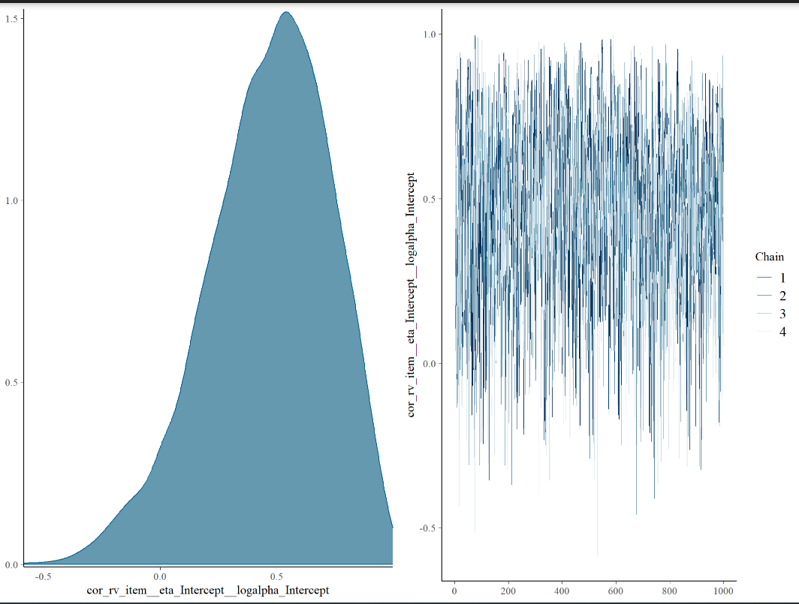

Slide 19
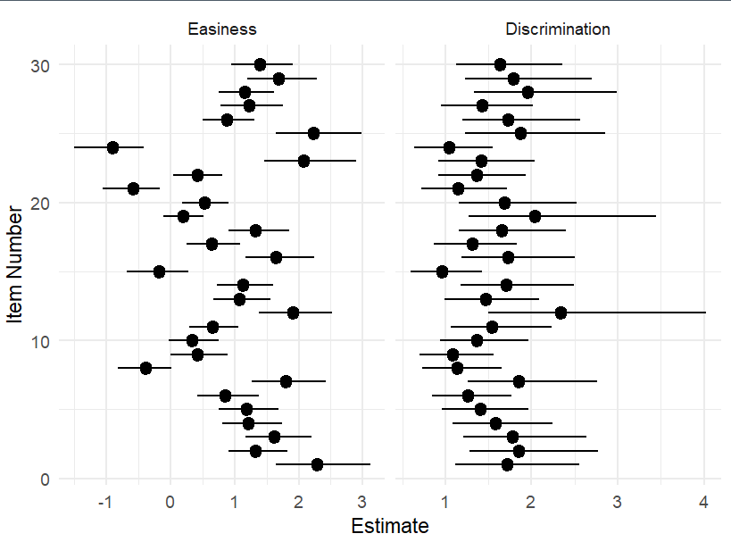
Posterior means and 95% credible intervals of item parameters: MM PPVT

Slide 20
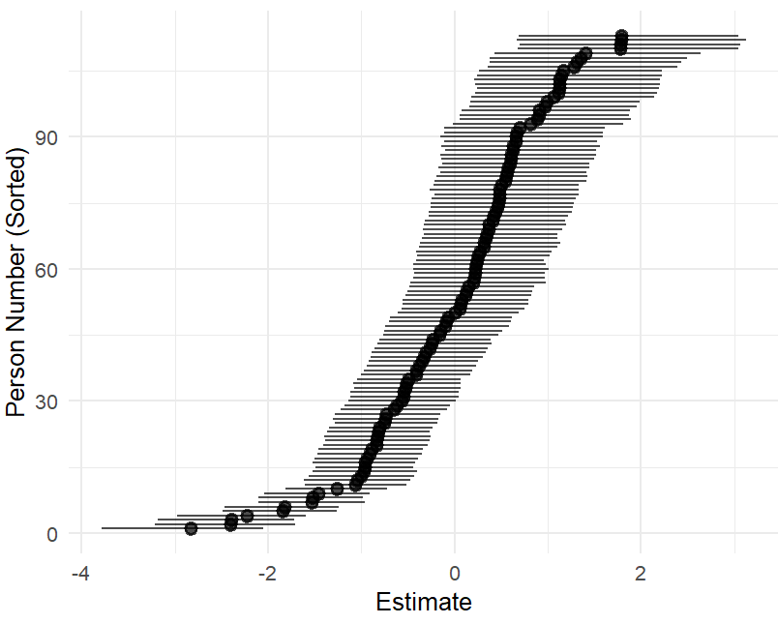
2PL: Person parameters

Slide 21
Summary: Reliability coefficients
Measures | Cronbach’s alpha | Omega
Meetei Mayek elision | .96 | .97
English elision | .97 | .97
Meetei Mayek PPVT | .90 | .92
English PPVT | .87 | .91

