Slide 1
Web fundamentals Checkpoint project

Slide 2
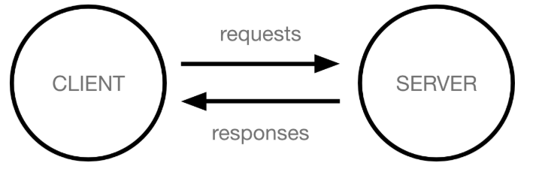
How does the web works ?
When you type a web address into your browser :
The browser goes to the DNS server, and finds the real address of the server that the website lives on.
The browser sends an HTTP request message to the server, asking it to send a copy of the website to the client ,This message, and all other data sent between the client and the server, is sent across your internet connection using TCP/IP.
If the server approves the client's request, it starts sending the website's files to the browser as a series of small chunks called data packets
The browser assembles the small chunks into a complete web page and displays it to you

Slide 3
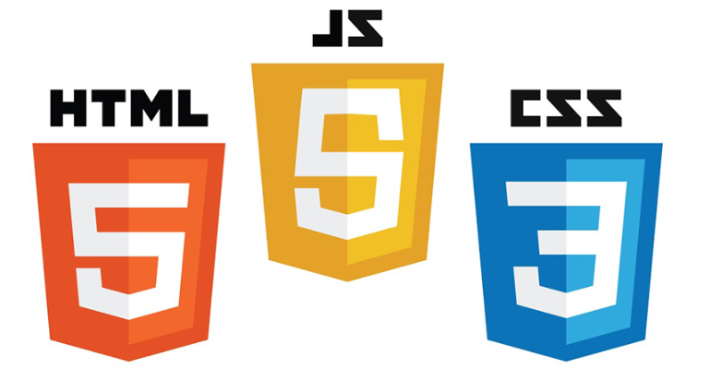
What do you need to be a web developer?
The developer needs to be professionally trained on:
Front-end development languages ( css ,html, javascript,,,)
Back-end (Node js, Express js,,,)

Slide 4
What’s the role of a web developer?
The role is responsible for designing, coding and modifying websites, from layout to function and according to a client's specifications. Strive to create visually appealing sites that feature user-friendly design and clear navigation.

