Slide 1
ModalitySort
Gaithtry Rameswaran
MBP 1413H – AI Course Project

Slide 2
Overload of imaging data in clinical/ research settings
Non-Contrast CT
CT Angiography
MR Angiography
T1-weighted MRI
T2-weighted MRI
Fluid attenuated inversion recovery (FLAIR)
Notes:
ncCT – gold standard, immediately ordered quick within the hour they come in – detect injuries that need surgical attention
CTA – if a vascular injury is suspected, based on the symptoms the person presents
As follow up MRA to look at similar vascular
FLAIR – tell if there are areas of damage (edema etc)
T2 – will show brainstem and grey matter injuries
T1 – used for general anatomy/ structural image as a basis

Slide 3
ModalitySort: Medical Image Modality Sorter Tool
ModalitySort
CT
MRI
ncCT
CTA
MRA-TOF
T2
FLAIR
T1

Slide 4
ModalitySort: Medical Image Modality Sorter Tool
ModalitySort
CT
MRI
ncCT
CTA
MRA-TOF
T2
FLAIR
T1
VBAI

Slide 5
Methodology

Slide 6
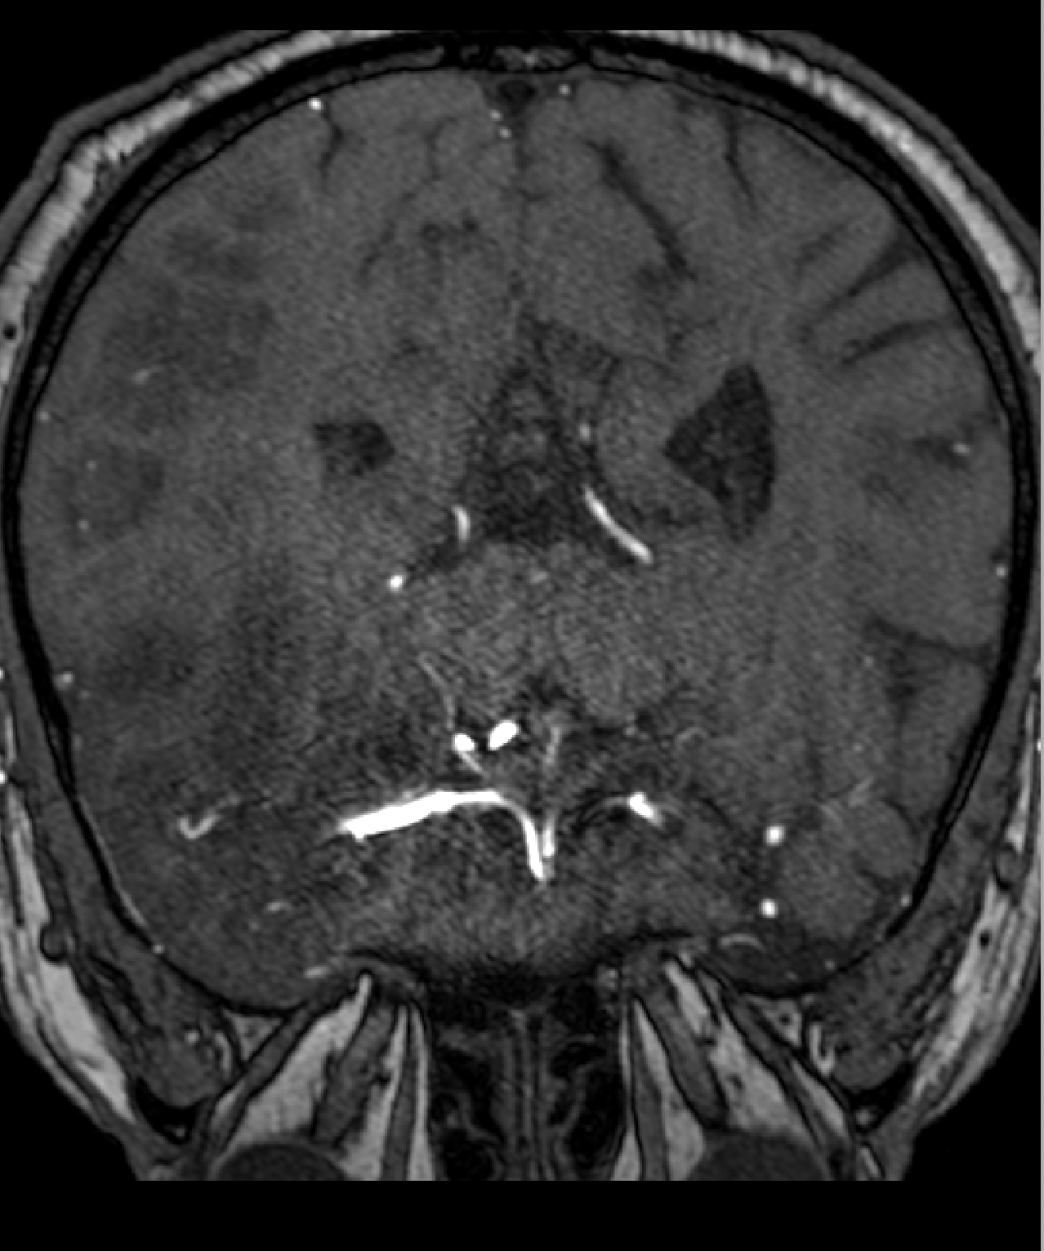
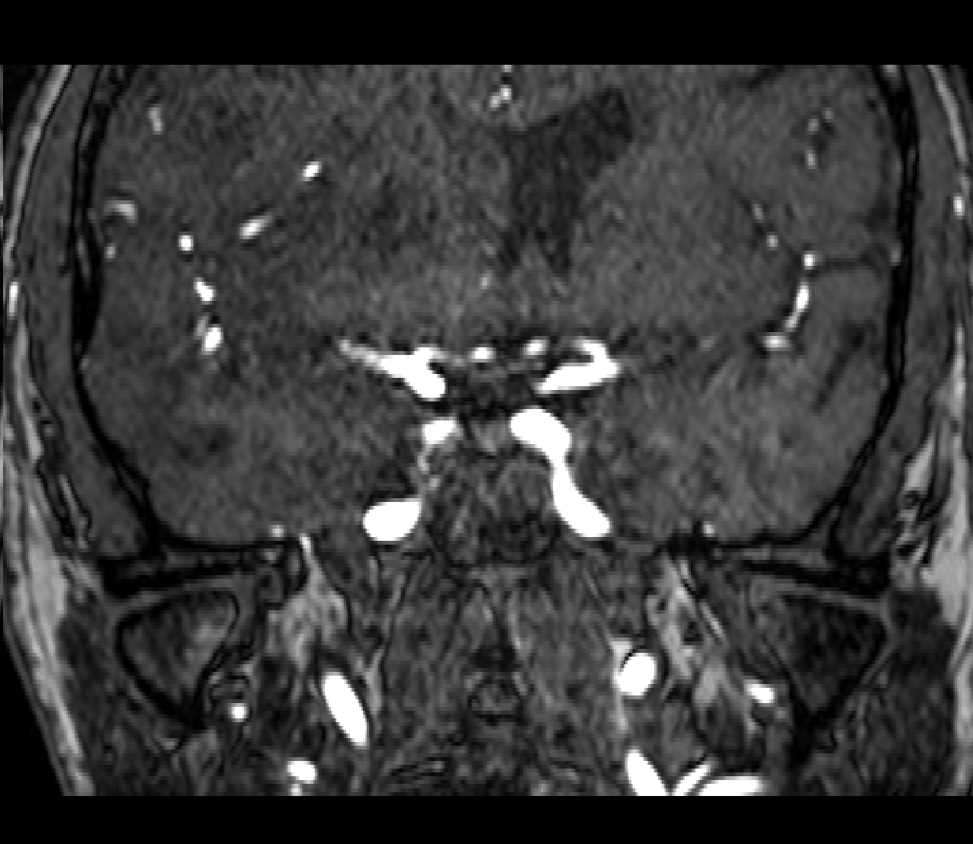
Decomposing 3D Neuroimaging Volumes into 2D Axial Slices as input for Classification
Notes:
Data loading: NIfTI files + Class labels
Slice extraction: NiBabel (keeps label from volume)

Slide 7
Decomposing 3D Neuroimaging Volumes into 2D Axial Slices as input for Classification
Data Sources | Image Modality | Total nifti volumes | Training 2D slices (80%) | Test 2D slices (20%) | Total number of 2D slice cases
Stroke SOOP | T1w | 10 | 1985 | 496 | 2481
BraTS | T2w | 10 | 1240 | 310 | 1550
BraTS | FLAIR | 10 | 1240 | 310 | 1550
TopCoW | MRA | 10 | 1536 | 384 | 1920
CQ500 | ncCT | 10 | 2411 | 603 | 3014
Large IA | CTA | 10 | 4687 | 1172 | 5859
Total |  | 60 | 13099 | 3275 | 16374
Notes:
Data loading: NIfTI files + Class labels
Slice extraction: NiBabel (keeps label from volume)

Slide 8

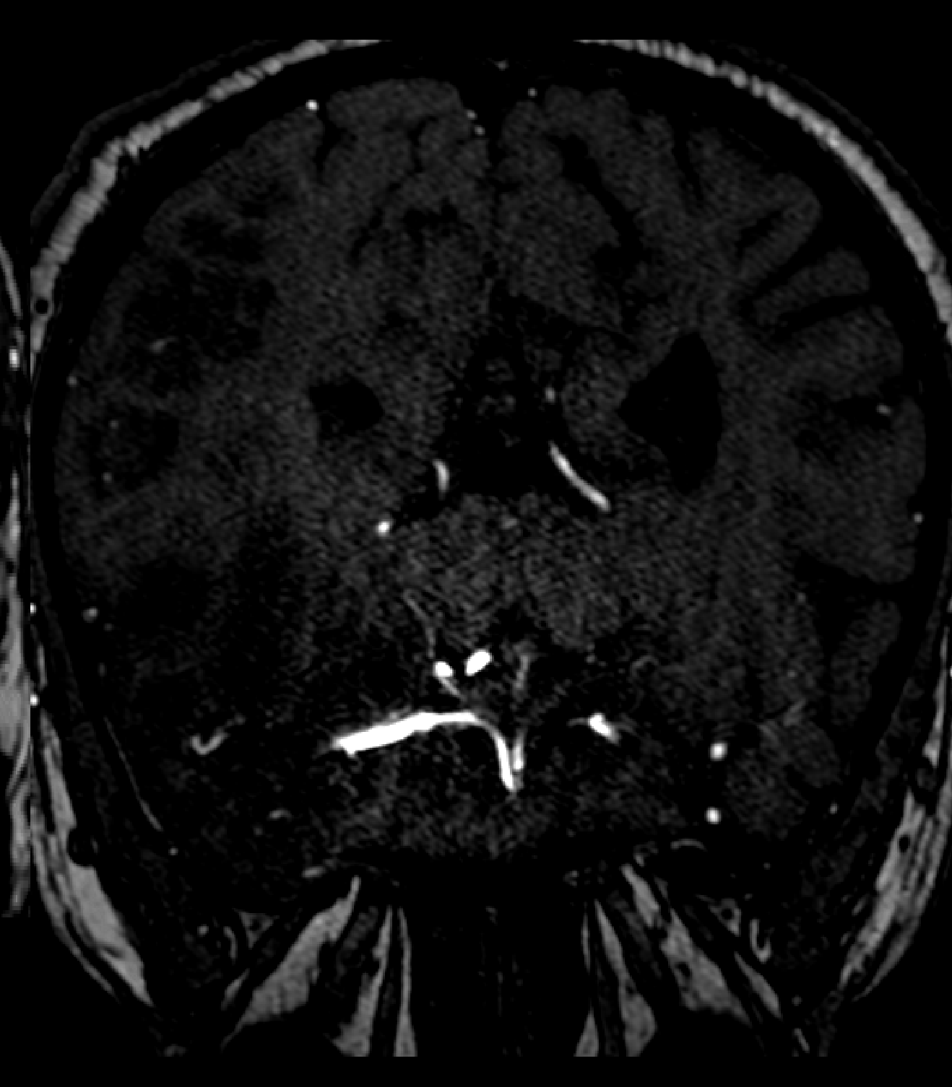
Data Augmentation Strategies Applied During Model Training
Original
RandFlipd
RandZoomd
RandAffined
RandGaussianNoised
RandAdjustContrastd

Slide 9
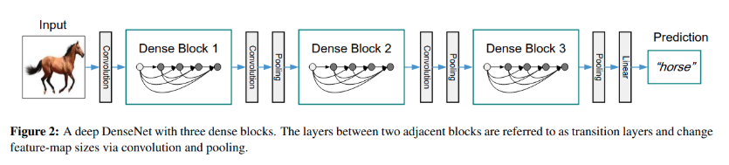
Model Architecture: DenseNet-121 for Multi-Class Neuroimaging Classification
Densely connected convolutional neural network (CNN) widely used for image classification
Notes:
Remembers the features and allows better reuse to help it’s training
Less parameters, gets input from the layers beforehand to help it’s overall prediction
Started with randomly initialized weights to build off of

Slide 10
Training & Validation Configuration
20 epochs
Adam optimizer
Fixed learning rate
Cross Entropy Loss
No Data Augmentations on the Validation set

Slide 11
Results

Slide 12
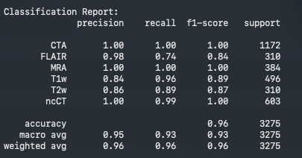
Classification Performance: Overall, 96% Accuracy Across Test set

Slide 13
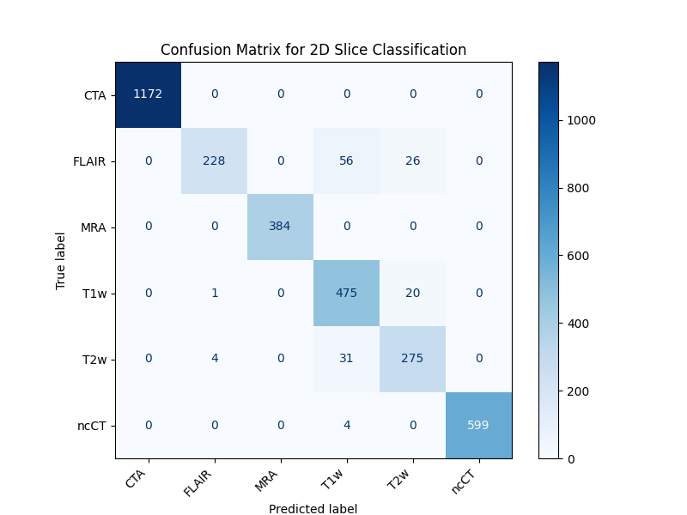
Classification Performance: Observed in a Confusion Matrix

Slide 14
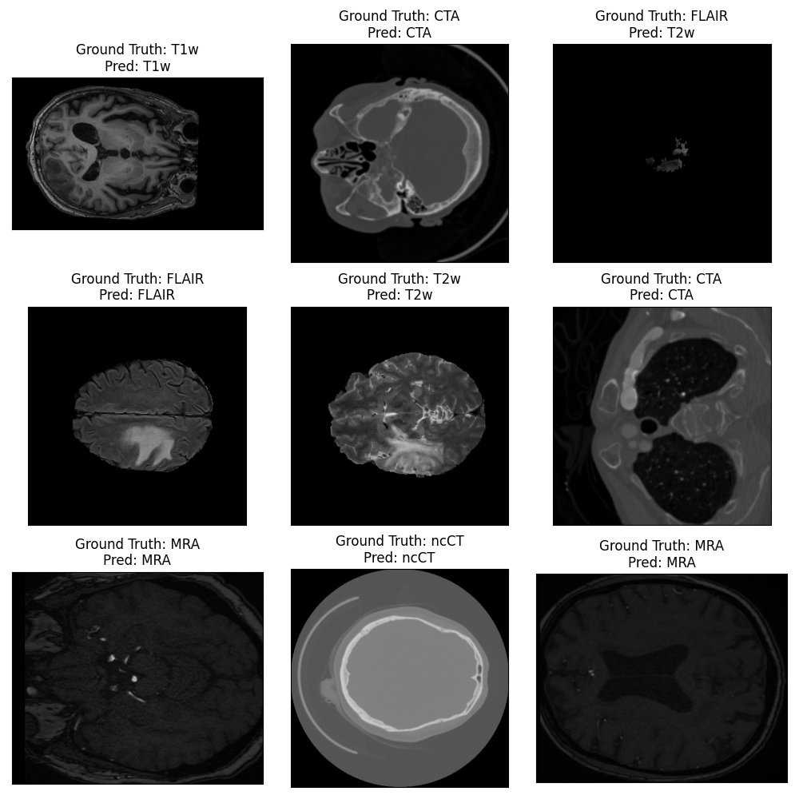
Comparing Ground Truth Labels Against Model Predictions

Slide 15
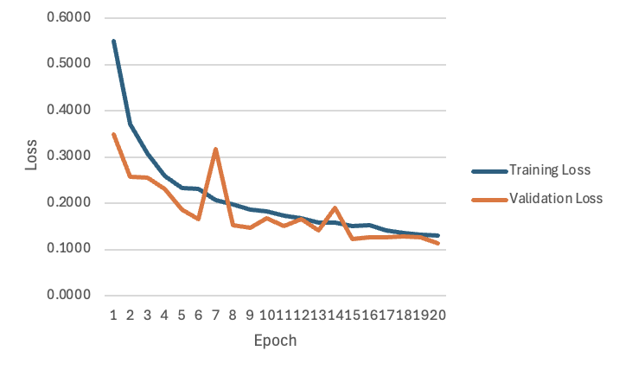
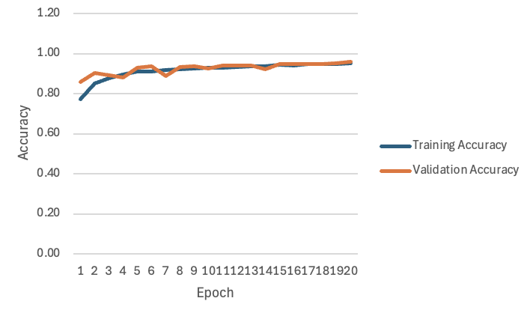
Monitoring Model’s Learning through Training & Validation Loss/ Accuracy Over 20 Epochs

Slide 16
20 of 24 Unseen Volumes were Correctly Classified with Confidence Scores
Ground Truth Label | Predicted Modality Label | Average Confidence Score | Correct Prediction?
CTA | CTA | 0.9996 | Yes
CTA | CTA | 0.9901 | Yes
CTA | CTA | 0.9966 | Yes
CTA | CTA | 0.9999 | Yes
FLAIR | T1w | 0.6521 | No
FLAIR | FLAIR | 0.9487 | Yes
FLAIR | T1w | 0.7476 | No
FLAIR | T1w | 0.7651 | No
MRA | MRA | 1 | Yes
MRA | MRA | 1 | Yes
MRA | MRA | 1 | Yes
MRA | MRA | 1 | Yes
ncCT | ncCT | 0.9988 | Yes
ncCT | ncCT | 0.9989 | Yes
ncCT | ncCT | 0.5178 | Yes
ncCT | ncCT | 0.9748 | Yes
T1w | T2w | 0.7492 | No
T1w | T1w | 0.7198 | Yes
T1w | T1w | 0.4887 | Yes
T1w | T1w | 0.5216 | Yes
T2w | T2w | 0.7895 | Yes
T2w | T2w | 0.6398 | Yes
T2w | T2w | 0.8602 | Yes
T2w | T2w | 0.8047 | Yes

Slide 17
Investigating Misclassifications through a Per-Slice Prediction Breakdown of the External Volumes
3 FLAIR volumes were misclassified as mostly T1w with some slices as T2w.
Case 1 Prediction: T1w
Ground Truth: FLAIR
Case 2 Prediction: T1w
Case 3 Prediction: T1w

Slide 18
Investigating Misclassifications through a Per-Slice Prediction Breakdown of the External Volumes
1 T1w volume was misclassified as T2w mostly with some correctly identified T1w slices.
Ground Truth: FLAIR
Prediction: T1w

Slide 19
Discussion

Slide 20
Discussion: Modality Classification Performance
Model achieved good overall classification performance with an accuracy of 96% across 6 modalities.
Errors lie within the T1w, T2w, and FLAIR modalities.
Best performing modalities were CTA, ncCT, T1w.
Possibly due to highly attenuated profiles in CTA.

Slide 21
Discussion: Limitations - Training
Training loss did not fully plateau by epoch 20.
May indicate underfitted model.

Slide 22
Discussion: Limitations – Data
Model was limited to predefined modality categories
Does not account for modalities outside of the 6 categories.
Small number of specific open-access datasets.
May not capture the true variability in images.
Disproportionate number of training slices between classes.
May lead to biased classifications.
Data Sources | Image Modality | Total nifti volumes | Training 2D slices (80%) | Test 2D slices (20%) | Total number of 2D slice cases
Stroke SOOP | T1w | 10 | 1985 | 496 | 2481
BraTS | T2w | 10 | 1240 | 310 | 1550
BraTS | FLAIR | 10 | 1240 | 310 | 1550
TopCoW | MRA | 10 | 1536 | 384 | 1920
CQ500 | ncCT | 10 | 2411 | 603 | 3014
Large IA | CTA | 10 | 4687 | 1172 | 5859
Total |  | 60 | 13099 | 3275 | 16374
Notes:
Eg. Phantom or non brain images or other images that made it’s way into the model
Images from different scanners, field strength, acquisition and patient population
More time to train and look at certain images over the others, hence t1,t2,flair struggles

Slide 23
Image-Based Deep Learning Classification as an Effective Preprocessing Step for Neuroimaging Pipelines
Through expansion of data diversity and increasing train duration, the model can be significantly improved and generalized for usage as a preprocessing step.
ModalitySort
CT
MRI
ncCT
CTA
MRA-TOF
T2
FLAIR
T1

