Slide 1
Mini Project- E-Library Management System
Group 4
7 Jan,2019
Notes:
Copyright © 2011 IGATE Corporation (a part of Capegemini Group). All rights reserved.
No part of this publication shall be reproduced in any way, including but not limited to photocopy, photographic, magnetic, or other record, without the prior written permission of IGATE Corporation (a part of Capegemini Group).
IGATE Corporation (a part of Capegemini Group) considers information included in this document to be confidential and proprietary.

Slide 2
Team Members
Pearl Merlyn (164313)
Prachiti Gawad (164314)
Raju Gupta (164316)
Rudrendra Ambike (164323)
Sahana Sreedhar (164326)
Saaili Kashyap (164331)
Raksha Chavhan (164333)

Slide 3
Project Details
Electronic Library is a focused collection of digital objects that can include materials stored as electronic media formats along with means for organizing, storing and retrieving the files and media contained in the library collection.
Functions for users:
Log in
Search Documents
Download Documents(Freebie and Premium)
Buy Documents
Functions for Admins
Login
Manage Users

Slide 4
Advantages of E-Library
Easier to access
Wider variety of sources of information
Grant access at any time or place
Less Budget
Millions of people can enter the e-library compared to a real library, which has a limited capacity.

Slide 5
Disadvantages of E-library
Any one can edit the content on the E-library.
Information cannot be assured or taken professionally.
More crashes and collapses of server with E-library.

Slide 6
Diagram Depicting Entire Project

Slide 7
Use Case Diagram

Slide 8
Class Diagram

Slide 9
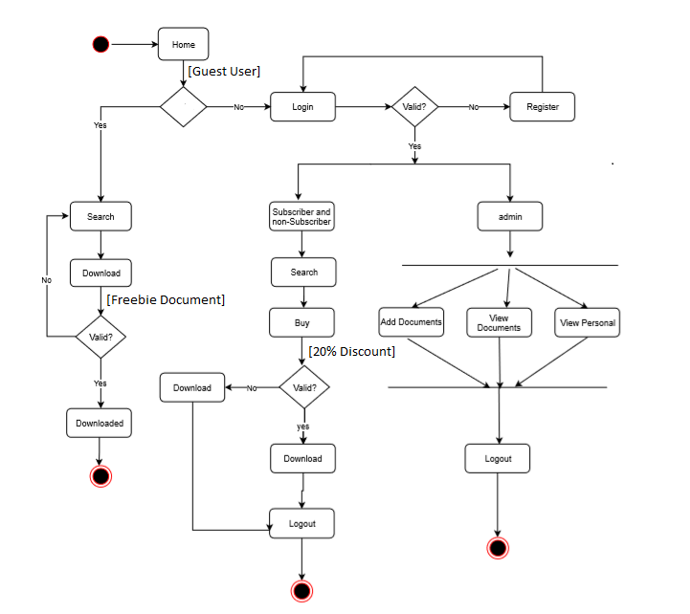
Sequence/Activity Diagram

Slide 10
Screen shots

Slide 11
Screen shots

Slide 12
Future Enhancements
Create Android, iOS mobile application.
Add objects in text, visual, audio and video formats for more surreal view.
Create Web Application

Slide 13
Thank You

