Slide 1
Honors Discrete Math

Slide 2
Course Topics
Logic and Proofs
Sets, Functions and Relations
Recursion
Counting
Probability

Slide 3
Really what I want to convey
How to think about problems
How to model things happening in the real world through logic
How to be able to think critically, and be consistent
Build a solid base so that future classes are much easier
MATH IS AWESOME !!!!!

Slide 4
Course Details
Location: NSC O102
Time: 9:00 – 10:15 (Tuesday and Thursday)
Office Hours: 10-11 (Wednesday) [HEC 245E]
Email: karthik.complexity+discrete@gmail.com
ATTENDANCE IS COMPLETELY OPTIONAL

Slide 5
Course Breakdown
Quiz 1 [1%]
Course Evals [1%]
Homework [15%]
Project [15%]
Scribe [10%]
3 Exams [20% each]

Slide 6
AI
Outside of exams you are free to use AI as much as you’d like
It is important to understand these tools, and how to navigate them
My expectation is you will use AI to output work better than if you had not used AI.

Slide 7
Homework
They will be graded mostly for participation and not correctness
Strongly recommend taking time to do HWs, even if you need AI assistance
If you don’t submit assignment, you lose points

Slide 8
Scribe Note
Each Student is responsible for scribe notes for one class
Your job is to make a nice pdf document outlining what was taught in class
Give context, show details that might be glossed over and fill in the gaps
Each Scribe is responsible for also coming up with 5 questions about the topic they are writing scribe notes for.
Best Scribe gets 1% extra credit
Volunteer at beginning of class

Slide 9
Projects
Do a deep dive in a topic that goes beyond the scope of the class
Should be unique
Could be a mix of implementation and analysis

Slide 10
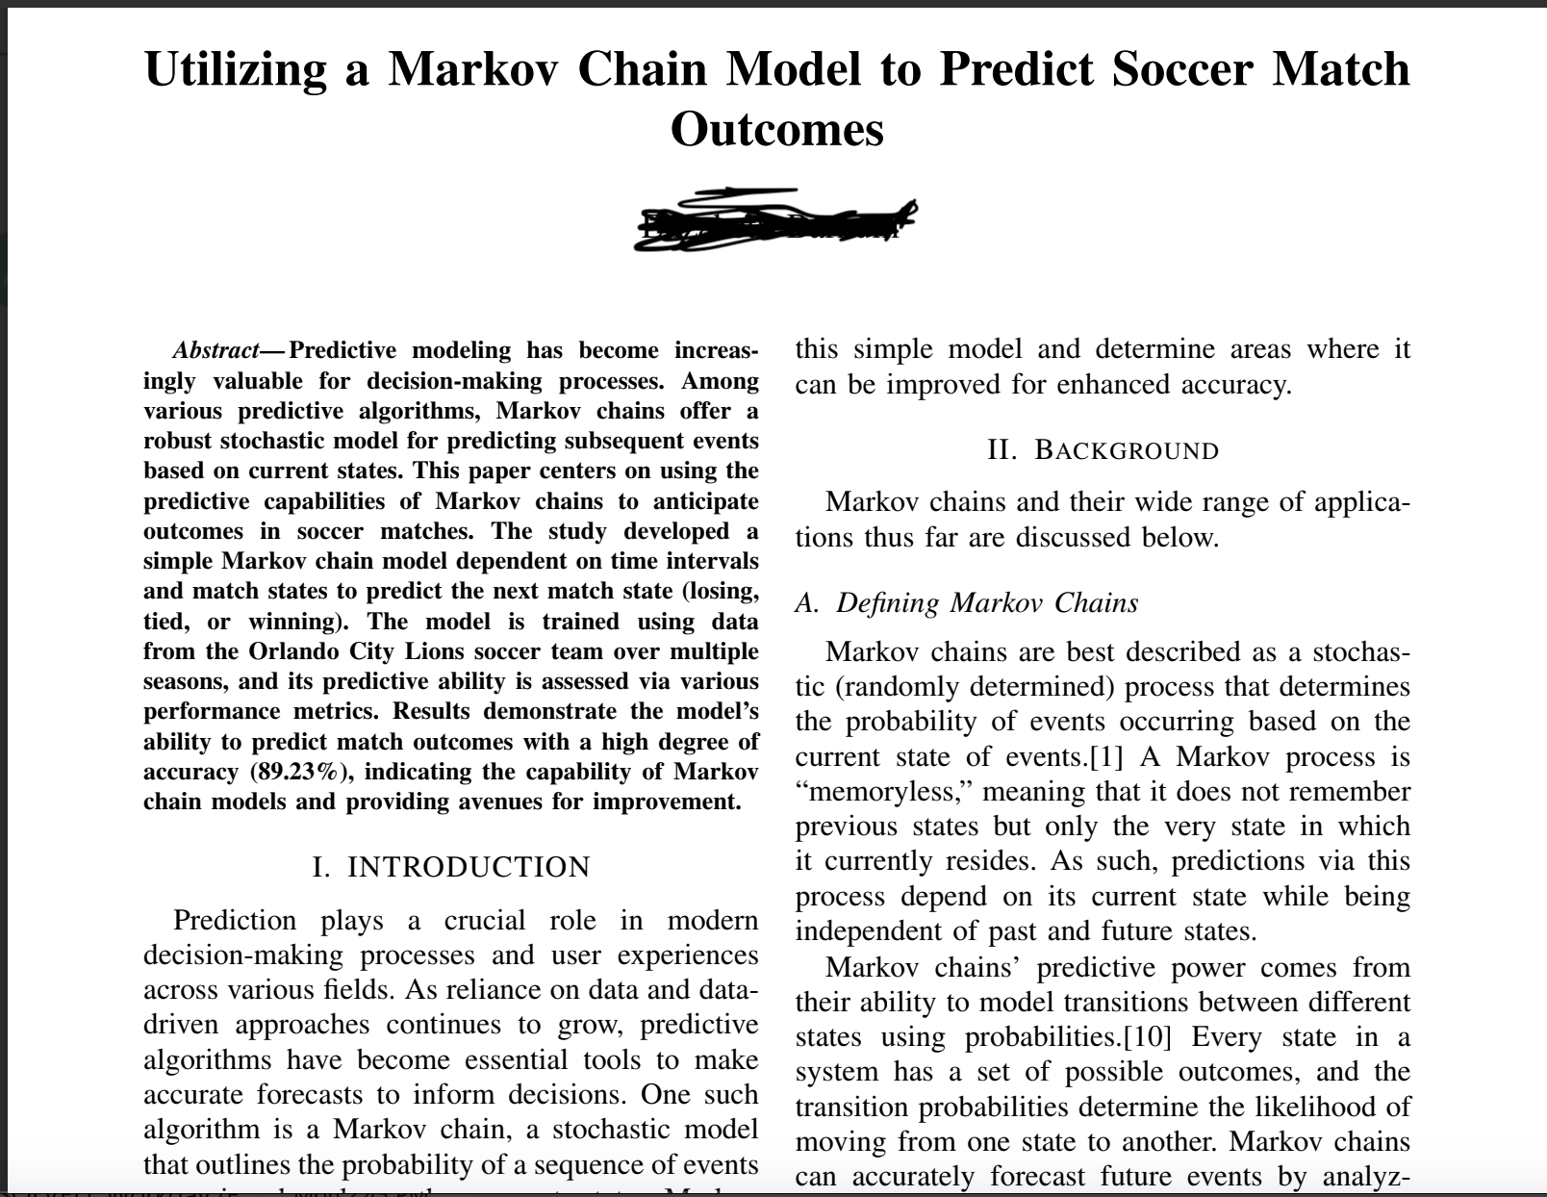
Example1

Slide 11
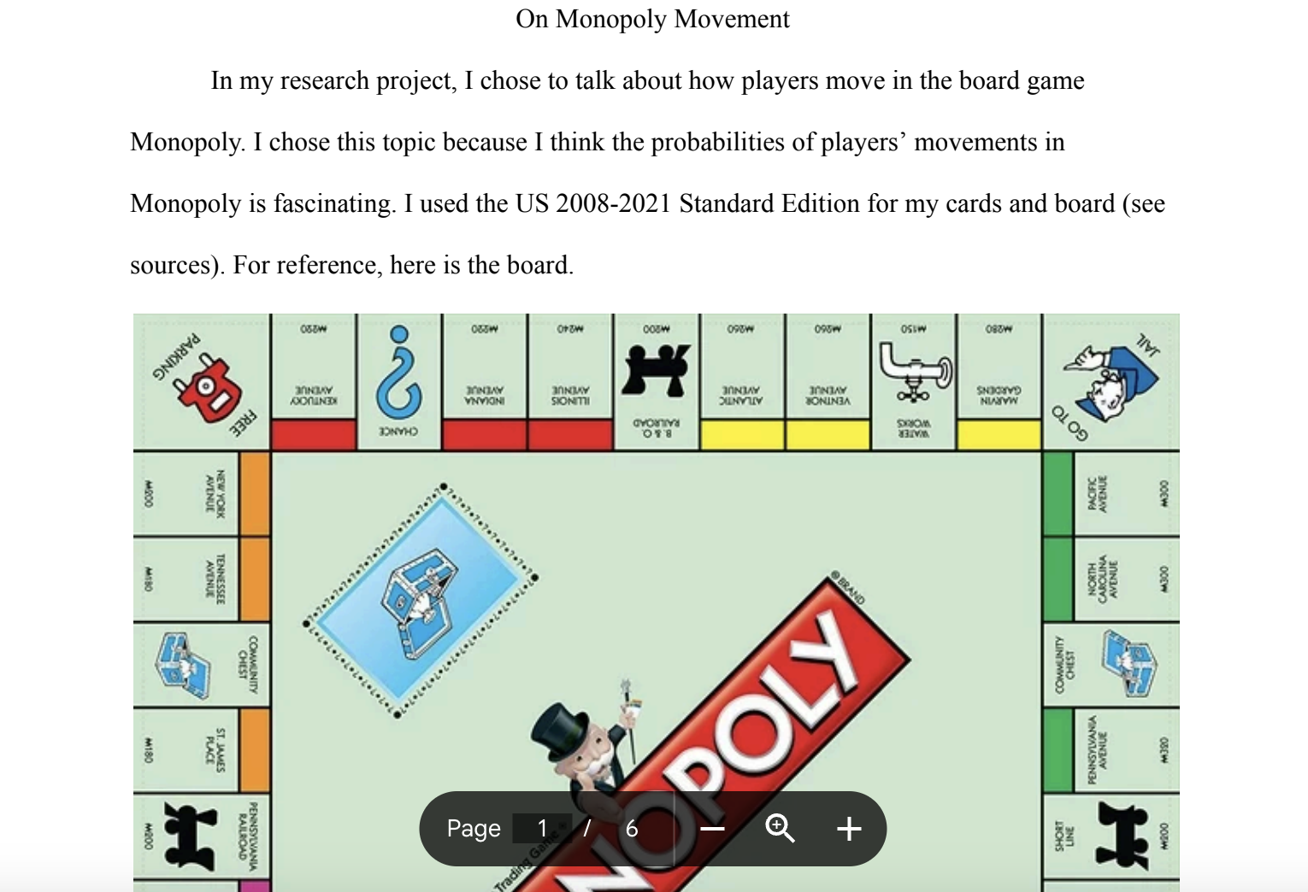
Example 2

Slide 12
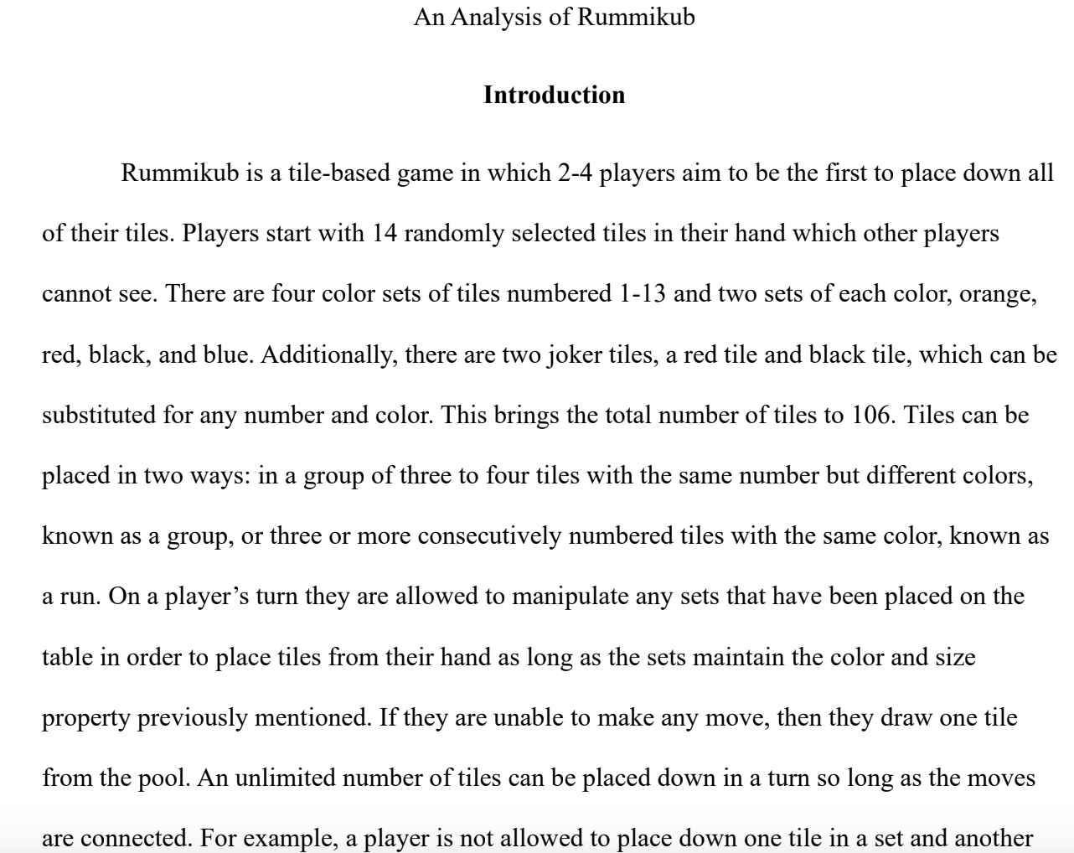
Example 3

Slide 13
Exams
3 Exams in Class
Each exam is worth 20%
You can bring a printed sheet of material
All exams are comprehensive of topics covered until exam
Please let me know before if you will need any special accommodations

Slide 14
Exams
Second and Third Chance Policy
If Casey scores:
Exam 1: 85 Exam 2: 90 Exam 3: 60 (score becomes: 90, 90, 60)
Exam 1: 90 Exam 2: 60: Exam 3: 75 (score becomes 90, 75, 75)
Exam 1: 0 Exam 2: 0 Exam 3: 100 (score becomes 100, 100, 100)
Curve at the end after all grades come in

Slide 15
Tentative Schedule
Week 1
Intro, Boolean Logic
Week 2
Proofs, Proofs, Proofs
Week 3
Proofs, Proofs, Proofs
Week 4
Induction
Week 5
Sets

Slide 16
Tentative Schedule
Week 6
Functions and Relations
Week 7
Exam 1 (Oct 6), Recursion
Week 8
More Recursion, Combinatorics
Week 9
Combinatorics, Combinatorics
Week 10
Special Topics (Trees), Exam 2 (Oct 29)

Slide 17
Tentative Schedule
Week 11
Probability
Week 12
Graphs, Number Theory
Week 13
Number Theory, Special Topic RSA
Week 14
Thanksgiving Break
Week 15
Project Presentations, Exam 3 (December 3)

Slide 18
Emails
Please keep emails short, direct and without AI verbosity
Feel free to just use Hi Karthik and not something overly formal
Please don’t ask for extensions, leniency so on. It’s not fair to the class.
Sick, emergencies are a part of life. I’ve given enough slack in the course.
But If life really throws a curveball send me an email, we can always figure something out

Slide 19
Class Etiquette
Participate by interrupting and asking questions. If something doesn’t make sense SPEAK UP
As much as you can please avoid using phones, or computers
(If you want to take notes, I’d prefer writing things down)
No food
Feel free to take a nap if class is boring

Slide 20
Shark Tank Game
N investors
N innovators
Match investors to innovators
Goal: Come up with an assignment of investors to innovators that is good???

Slide 21
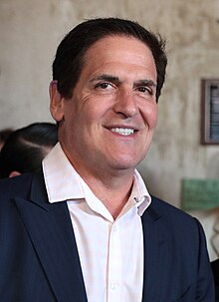
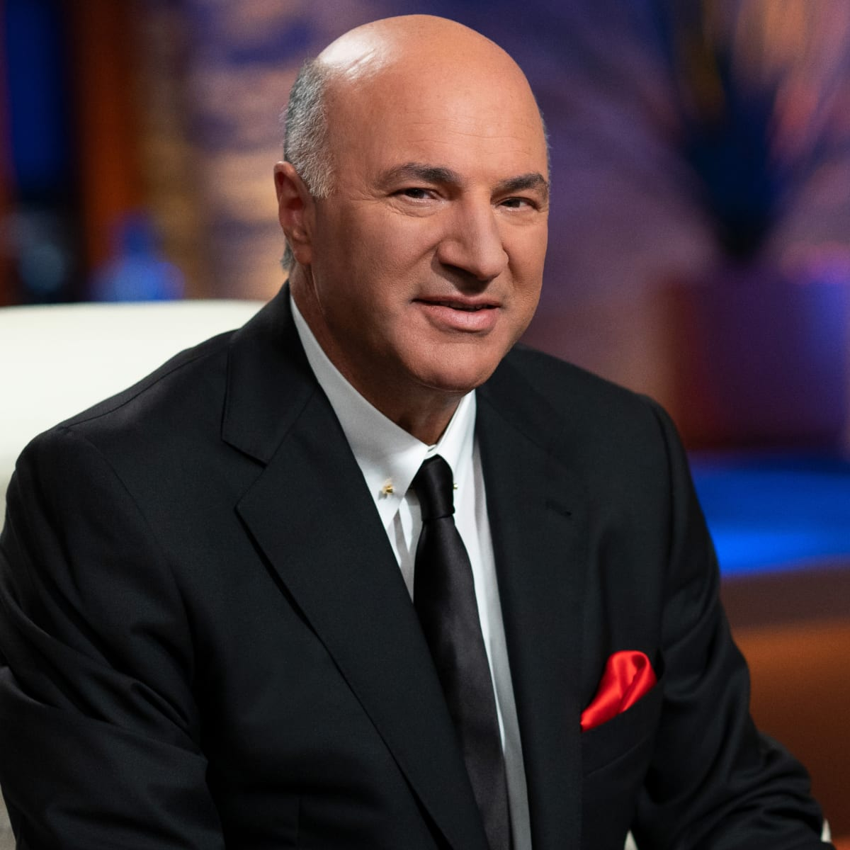
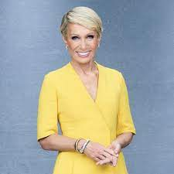
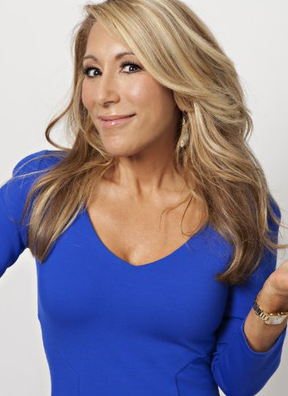
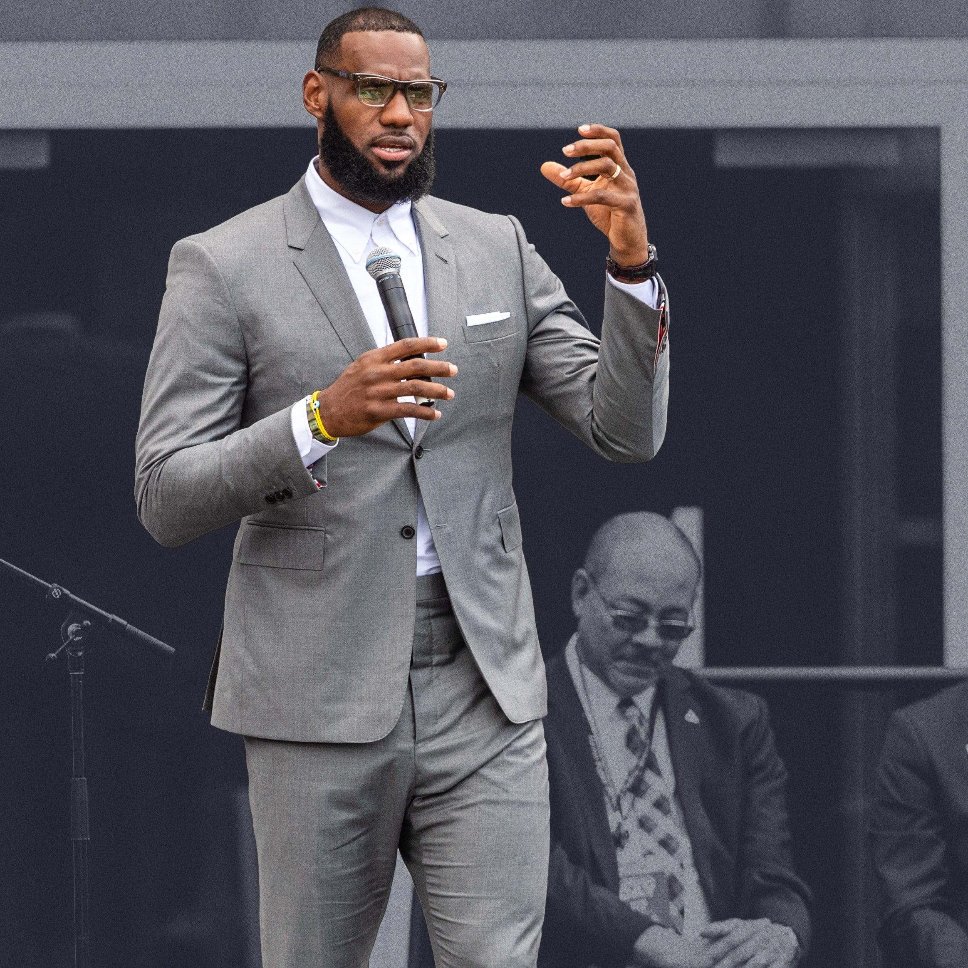
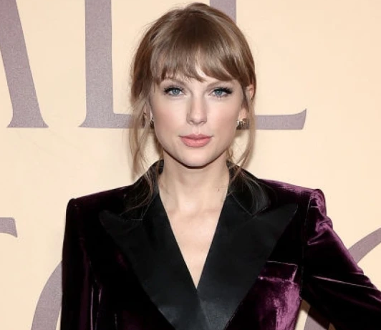
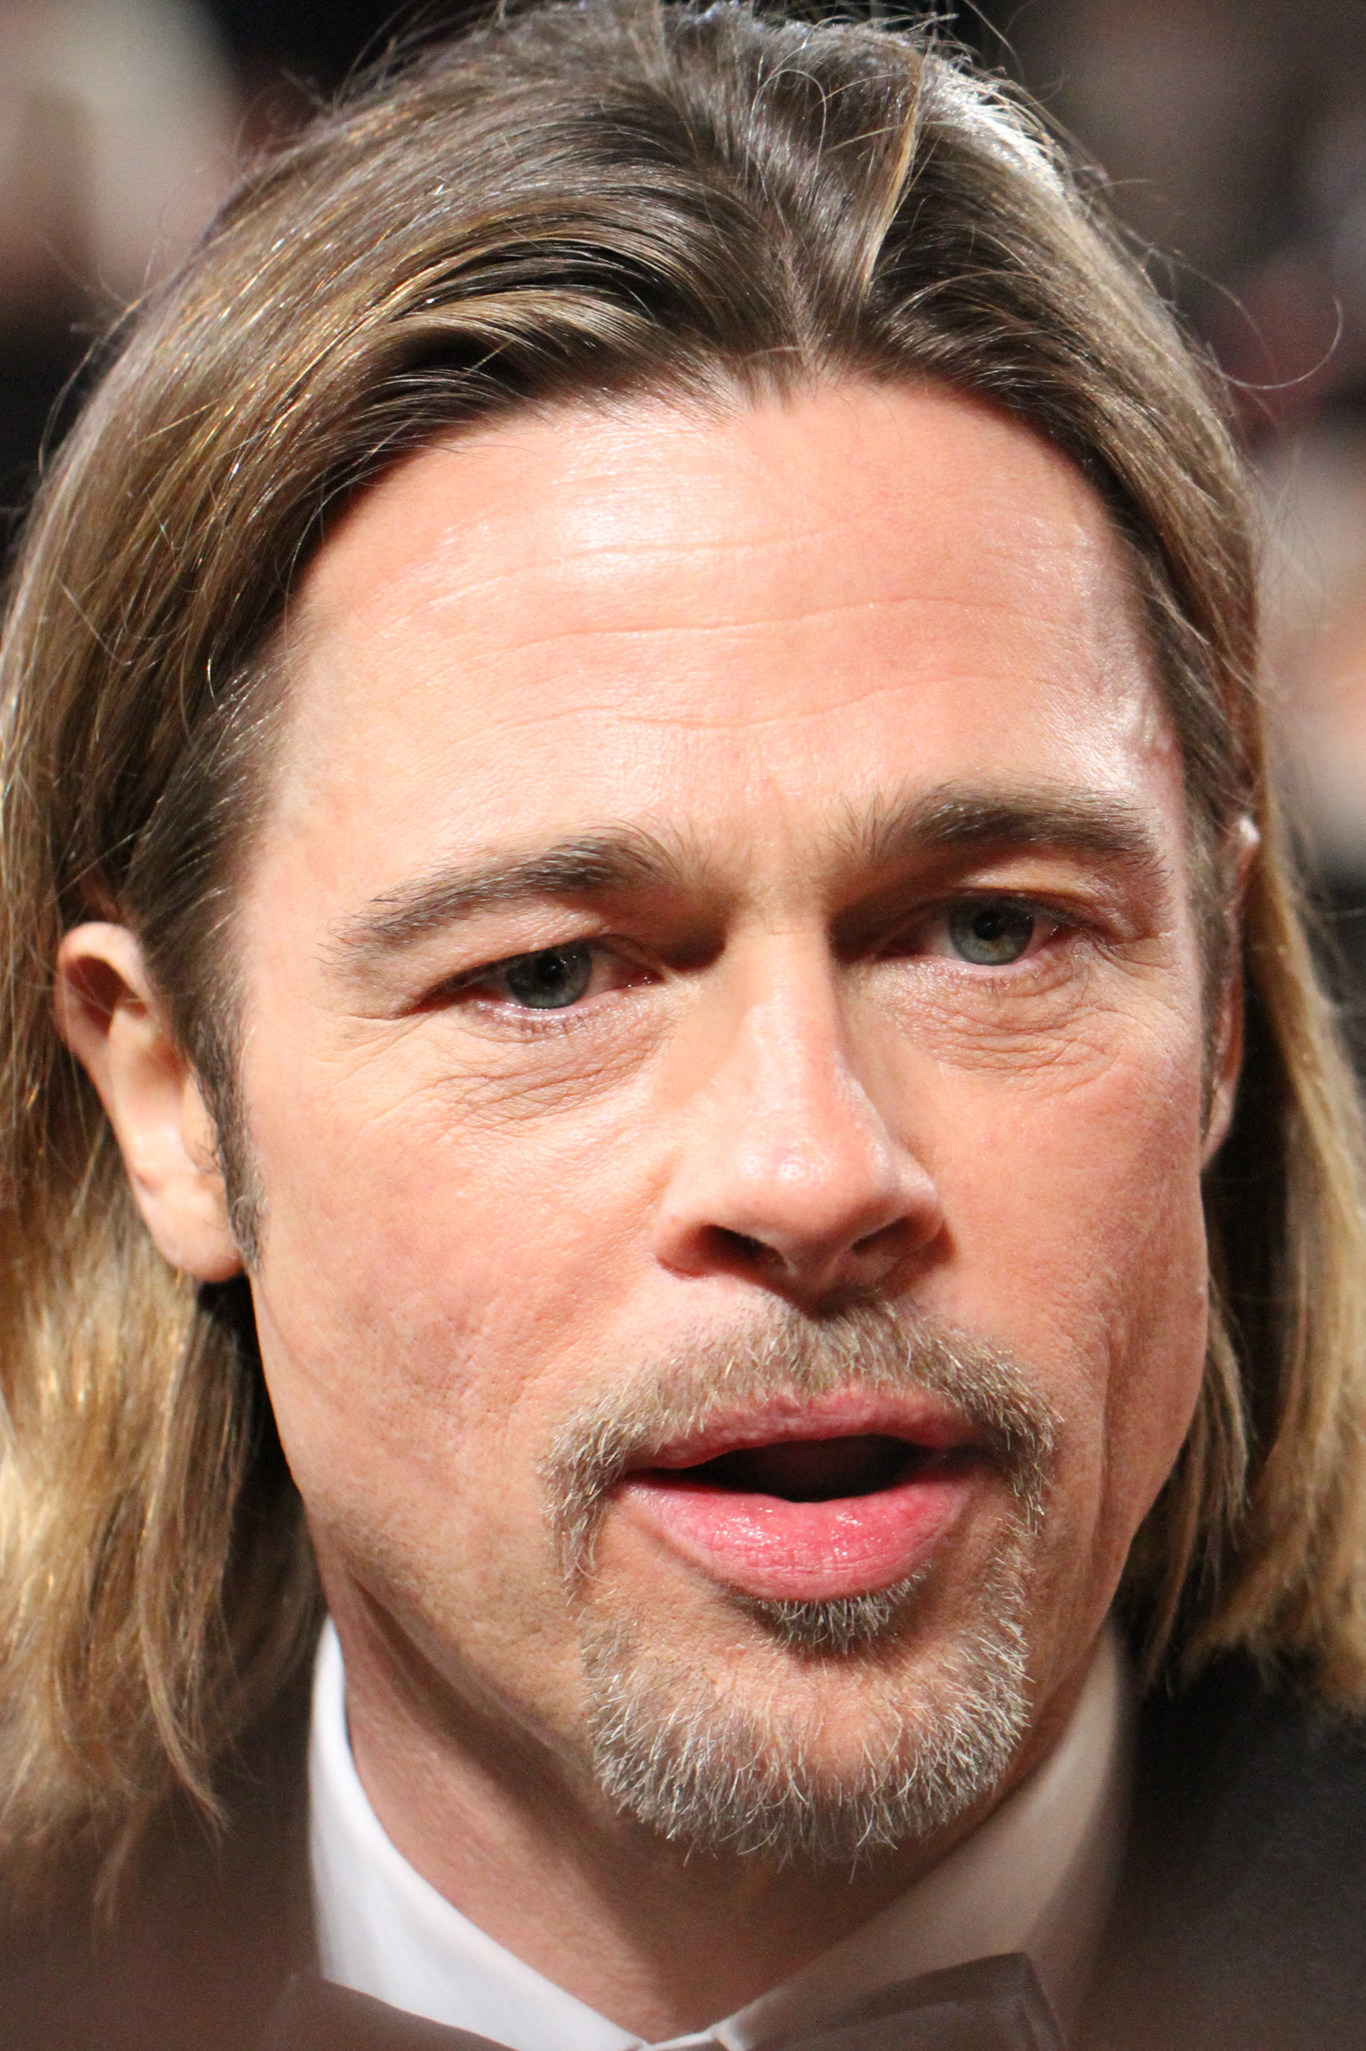
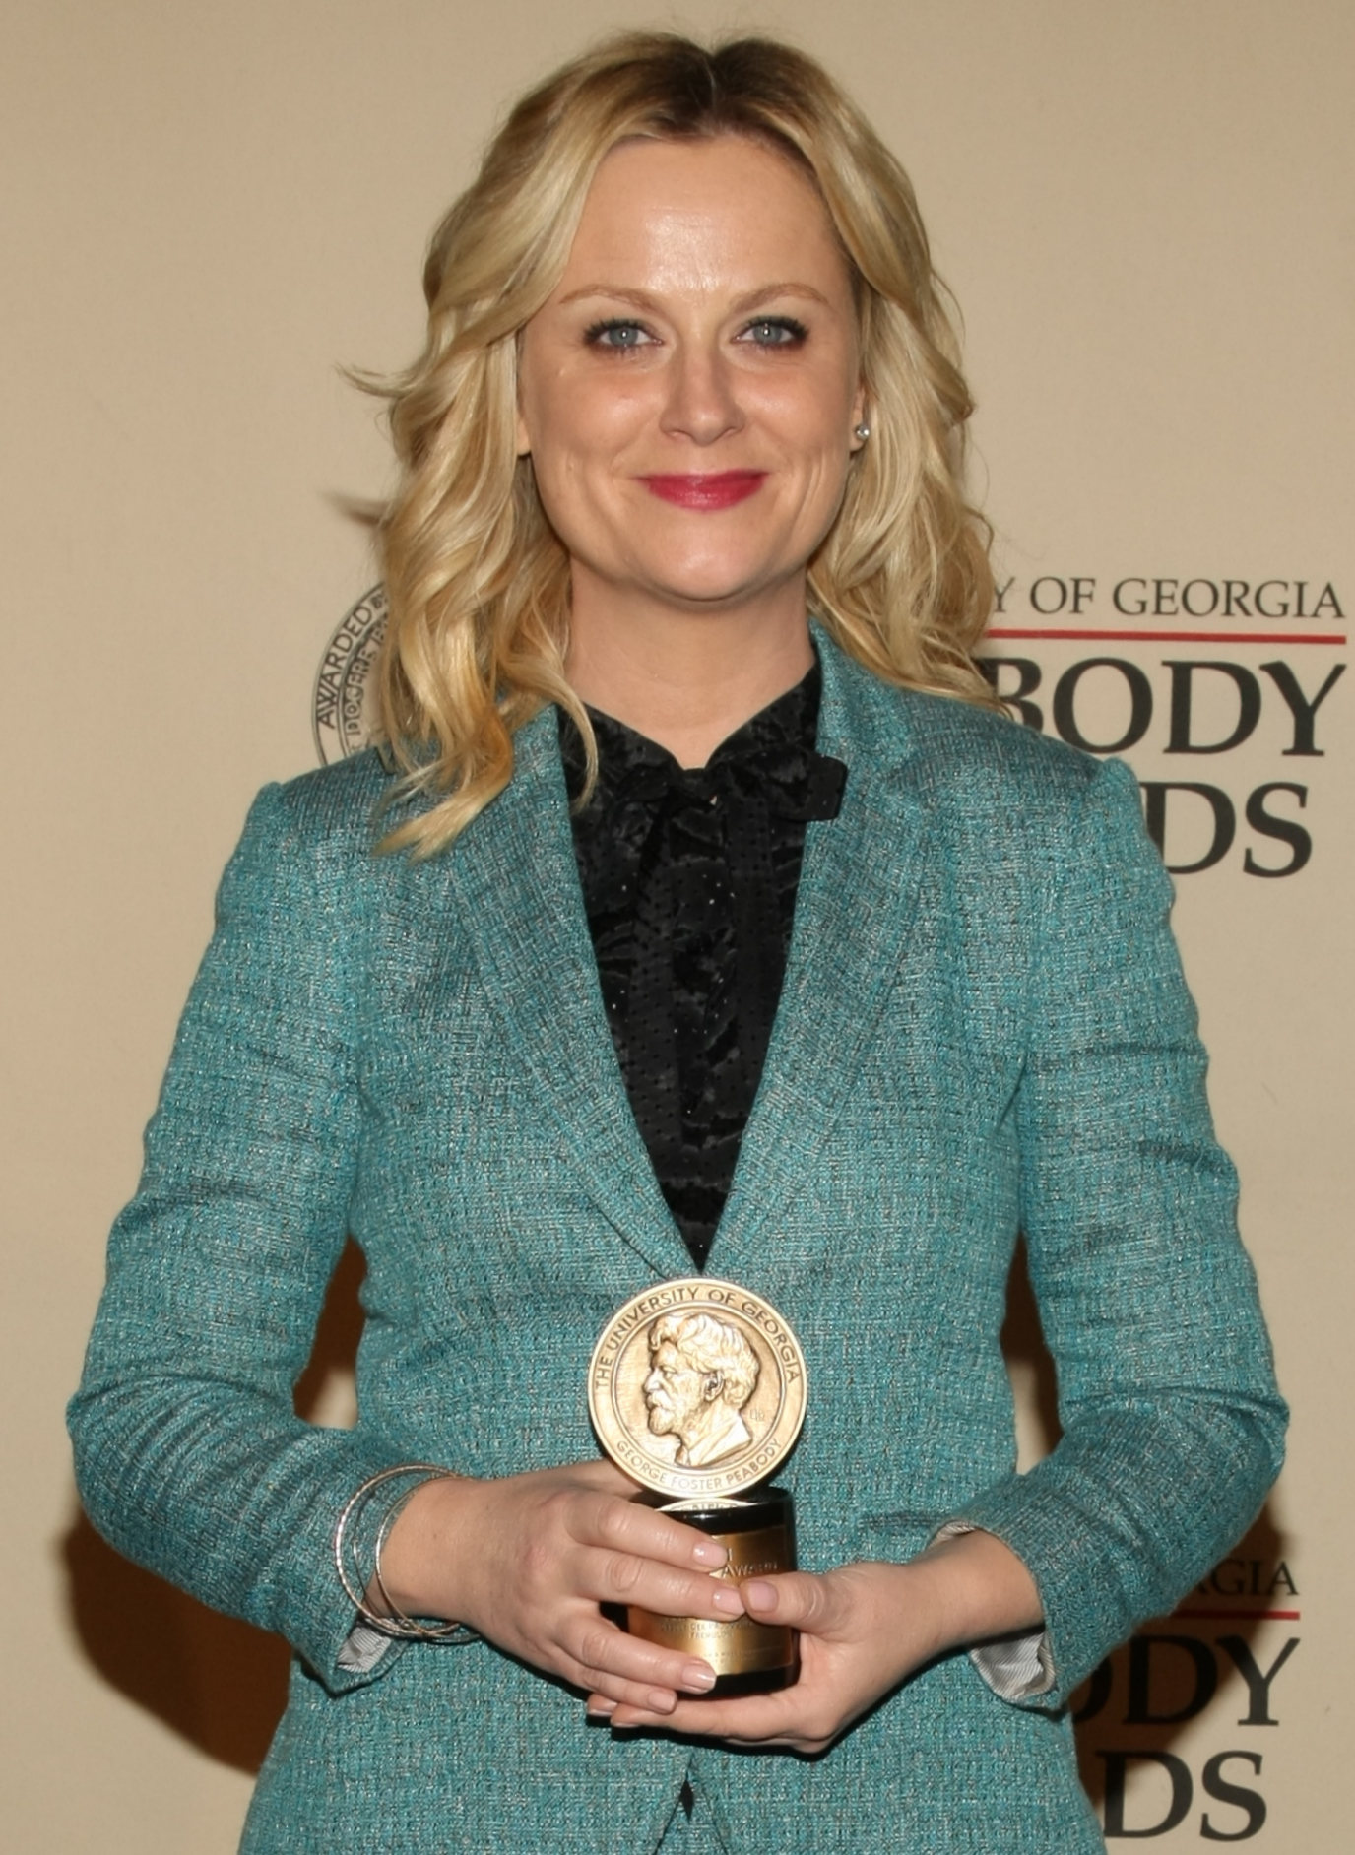
Investors
Mark
Kevin
Barbara
Lori
Innovators
LeBron
Taylor
Brad
Amy

Slide 22
Preference Lists
Investors
Mark | Lebron | Taylor | Amy | Brad
Kevin | Taylor | Brad | Amy | Lebron
Barbara | Brad | Lebron | Taylor | Amy
Lori | Amy | Taylor | Lebron | Brad
Innovators
Lebron | Mark | Barbara | Kevin | Lori
Taylor | Lori | Mark | Barbara | Kevin
Brad | Mark | Kevin | Lori | Barbara
Amy | Mark | Kevin | Lori | Barbara

Slide 23
Anything wrong with this assignment?
Mark | Lebron | Taylor | Amy | Brad
Kevin | Taylor | Brad | Amy | Lebron
Barbara | Brad | Lebron | Taylor | Amy
Lori | Amy | Taylor | Lebron | Brad
Lebron | Mark | Barbara | Kevin | Lori
Taylor | Lori | Mark | Barbara | Kevin
Brad | Mark | Kevin | Lori | Barbara
Amy | Mark | Kevin | Lori | Barbara
Lebron and Mark form a blocking pair

Slide 24
Stable Matching
Assignment with no blocking pair
Mark | Lebron | Taylor | Amy | Brad
Kevin | Taylor | Brad | Amy | Lebron
Barbara | Brad | Lebron | Taylor | Amy
Lori | Amy | Taylor | Lebron | Brad
Lebron | Mark | Barbara | Kevin | Lori
Taylor | Lori | Mark | Barbara | Kevin
Brad | Mark | Kevin | Lori | Barbara
Amy | Mark | Kevin | Lori | Barbara

Slide 25
One More example
Mark | Lebron | Taylor | Amy | Brad
Kevin | Taylor | Brad | Amy | Lebron
Barbara | Brad | Lebron | Taylor | Amy
Lori | Amy | Taylor | Lebron | Brad
Lebron | Mark | Barbara | Kevin | Lori
Taylor | Lori | Mark | Barbara | Kevin
Brad | Mark | Kevin | Lori | Barbara
Amy | Mark | Kevin | Lori | Barbara

Slide 26
Stable Matching
Stable Matching: Find an assignment with no blocking pair (GOOD!!!)
Does there always exist a stable matching?
If it does exist, is there an efficient way to find it?

Slide 27
Two Sided Matching Markets
Examples:
Hospital And Residents (NRMP)
Students and Schools (Chicago, Boston, NYC)
Kidney Exchange
Speed Dating
Labor Markets
Both parties care about where they get matched

Slide 28
Gale-Shapley (Differed Accept Algorithm) [DA]
Initially we start with an empty matching
While (there exists an unmatched innovator)
Unmatched innovator (Alice) proposes to highest ranked investor on list (Bob) who hasn’t rejected them
Case 1: Bob is currently unmatched and now tentatively accepts Alice
Case 2: Bob is currently matched to Carol, but prefers Alice to Carol (Alice is now matched to Bob, and Carol is unmatched)
Case 3: Bob is currently matched to Carol, but prefers Carol to Alice (Alice remains unmatched)

Slide 29
Visual Example of DA
Mark | Lebron | Taylor | Amy | Brad
Kevin | Taylor | Brad | Amy | Lebron
Barbara | Brad | Lebron | Taylor | Amy
Lori | Amy | Taylor | Lebron | Brad
Lebron | Mark | Barbara | Kevin | Lori
Taylor | Lori | Mark | Barbara | Kevin
Brad | Mark | Kevin | Lori | Barbara
Amy | Mark | Kevin | Lori | Barbara

Slide 30
Visual Example of DA
Mark | Lebron | Taylor | Amy | Brad
Kevin | Taylor | Brad | Amy | Lebron
Barbara | Brad | Lebron | Taylor | Amy
Lori | Amy | Taylor | Lebron | Brad
Lebron | Mark | Barbara | Kevin | Lori
Taylor | Lori | Mark | Barbara | Kevin
Brad | Mark | Kevin | Lori | Barbara
Amy | Mark | Kevin | Lori | Barbara

Slide 31
Visual Example of DA
Mark | Lebron | Taylor | Amy | Brad
Kevin | Taylor | Brad | Amy | Lebron
Barbara | Brad | Lebron | Taylor | Amy
Lori | Amy | Taylor | Lebron | Brad
Lebron | Mark | Barbara | Kevin | Lori
Taylor | Lori | Mark | Barbara | Kevin
Brad | Mark | Kevin | Lori | Barbara
Amy | Mark | Kevin | Lori | Barbara

Slide 32
Visual Example of DA
Mark | Lebron | Taylor | Amy | Brad
Kevin | Taylor | Brad | Amy | Lebron
Barbara | Brad | Lebron | Taylor | Amy
Lori | Amy | Taylor | Lebron | Brad
Lebron | Mark | Barbara | Kevin | Lori
Taylor | Lori | Mark | Barbara | Kevin
Brad | Mark | Kevin | Lori | Barbara
Amy | Mark | Kevin | Lori | Barbara

Slide 33
Visual Example of DA
Mark | Lebron | Taylor | Amy | Brad
Kevin | Taylor | Brad | Amy | Lebron
Barbara | Brad | Lebron | Taylor | Amy
Lori | Amy | Taylor | Lebron | Brad
Lebron | Mark | Barbara | Kevin | Lori
Taylor | Lori | Mark | Barbara | Kevin
Brad | Mark | Kevin | Lori | Barbara
Amy | Mark | Kevin | Lori | Barbara

Slide 34
Visual Example of DA
Mark | Lebron | Taylor | Amy | Brad
Kevin | Taylor | Brad | Amy | Lebron
Barbara | Brad | Lebron | Taylor | Amy
Lori | Amy | Taylor | Lebron | Brad
Lebron | Mark | Barbara | Kevin | Lori
Taylor | Lori | Mark | Barbara | Kevin
Brad | Mark | Kevin | Lori | Barbara
Amy | Mark | Kevin | Lori | Barbara

Slide 35
Visual Example of DA
Mark | Lebron | Taylor | Amy | Brad
Kevin | Taylor | Brad | Amy | Lebron
Barbara | Brad | Lebron | Taylor | Amy
Lori | Amy | Taylor | Lebron | Brad
Lebron | Mark | Barbara | Kevin | Lori
Taylor | Lori | Mark | Barbara | Kevin
Brad | Mark | Kevin | Lori | Barbara
Amy | Mark | Kevin | Lori | Barbara

Slide 36
Visual Example of DA
Mark | Lebron | Taylor | Amy | Brad
Kevin | Taylor | Brad | Amy | Lebron
Barbara | Brad | Lebron | Taylor | Amy
Lori | Amy | Taylor | Lebron | Brad
Lebron | Mark | Barbara | Kevin | Lori
Taylor | Lori | Mark | Barbara | Kevin
Brad | Mark | Kevin | Lori | Barbara
Amy | Mark | Kevin | Lori | Barbara

Slide 37
Visual Example of DA
Mark | Lebron | Taylor | Amy | Brad
Kevin | Taylor | Brad | Amy | Lebron
Barbara | Brad | Lebron | Taylor | Amy
Lori | Amy | Taylor | Lebron | Brad
Lebron | Mark | Barbara | Kevin | Lori
Taylor | Lori | Mark | Barbara | Kevin
Brad | Mark | Kevin | Lori | Barbara
Amy | Mark | Kevin | Lori | Barbara

Slide 38
Visual Example of DA
Mark | Lebron | Taylor | Amy | Brad
Kevin | Taylor | Brad | Amy | Lebron
Barbara | Brad | Lebron | Taylor | Amy
Lori | Amy | Taylor | Lebron | Brad
Lebron | Mark | Barbara | Kevin | Lori
Taylor | Lori | Mark | Barbara | Kevin
Brad | Mark | Kevin | Lori | Barbara
Amy | Mark | Kevin | Lori | Barbara

Slide 39
Why does this work???
Check 3 things
1) Algorithm Terminates
2) Everybody is assigned a partner
3) Assignment is stable

Slide 40

DA runs in polynomial time
At every step one proposal is made
Only $n^{2}$ proposals
So at most $n^{2}$ steps

Slide 41
DA returns a perfect matching (All innovators are assigned an investor)
Proof by contradiction
Let there be an innovator (Alice) who has not been matched
This means that there is also an investor (Bob) who is currently unmatched
But DA ensures that Alice proposes to all investors including Bob during its iteration
Hence Bob must have been matched to someone better than Alice when she proposed
But in DA once an investor is assigned a partner, they are never unmatched (they can only get better)
Contradiction !!!!

Slide 42
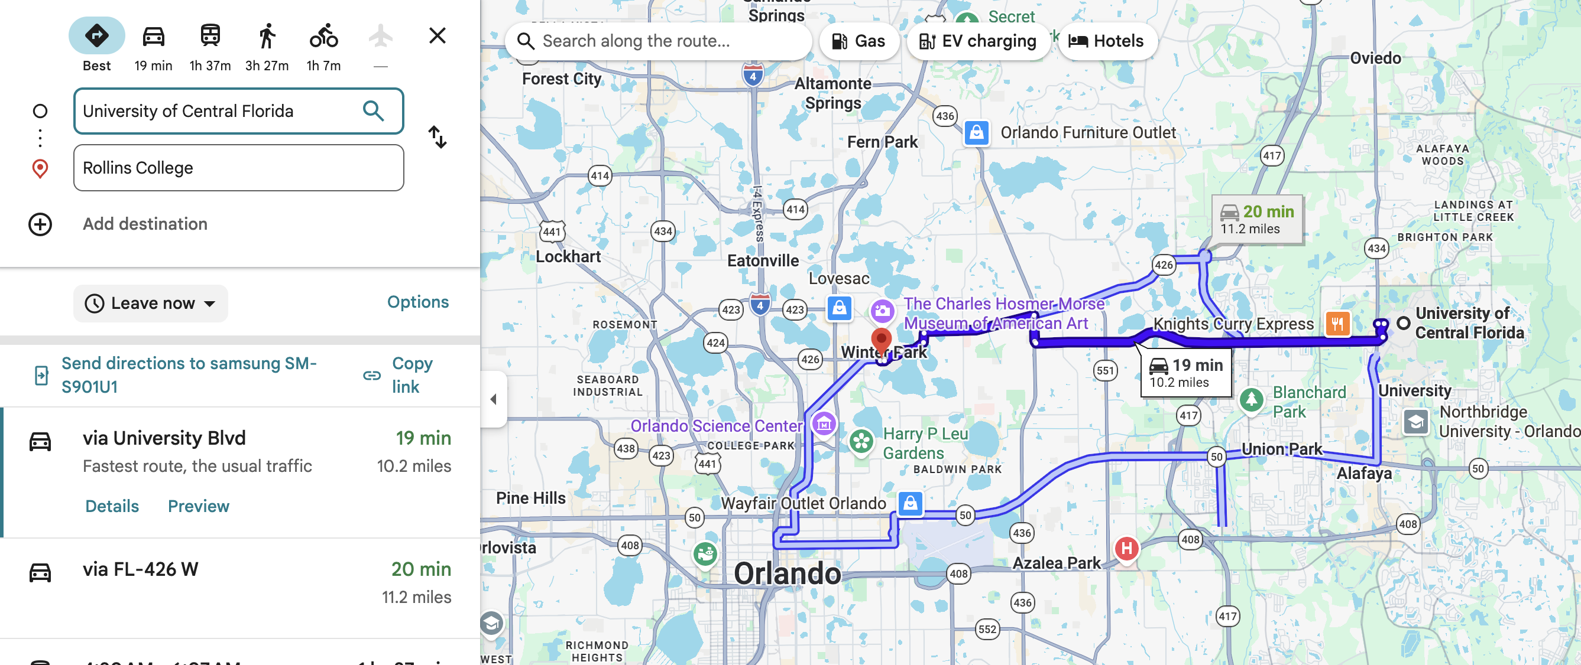
Google Maps

Slide 43
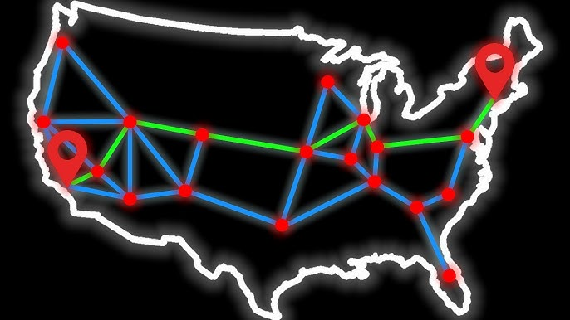
Graphs

Slide 44
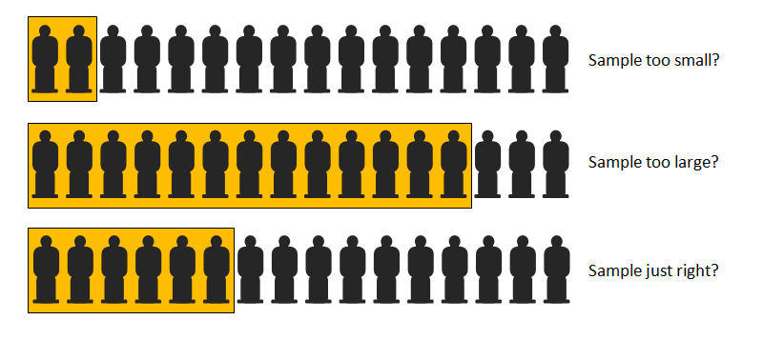
Pick the largest number in a stream
How much should you explore before you make a decision:
Secretary Problem

Slide 45

Cryptography (Black Magic)
How do you ensure that hackers don’t steal your money from the bank?
How would you send a secret message to your friends
Lot more beautiful stuff: Obfuscation, Secure Multiparty Computation, Differential Privacy

Slide 46
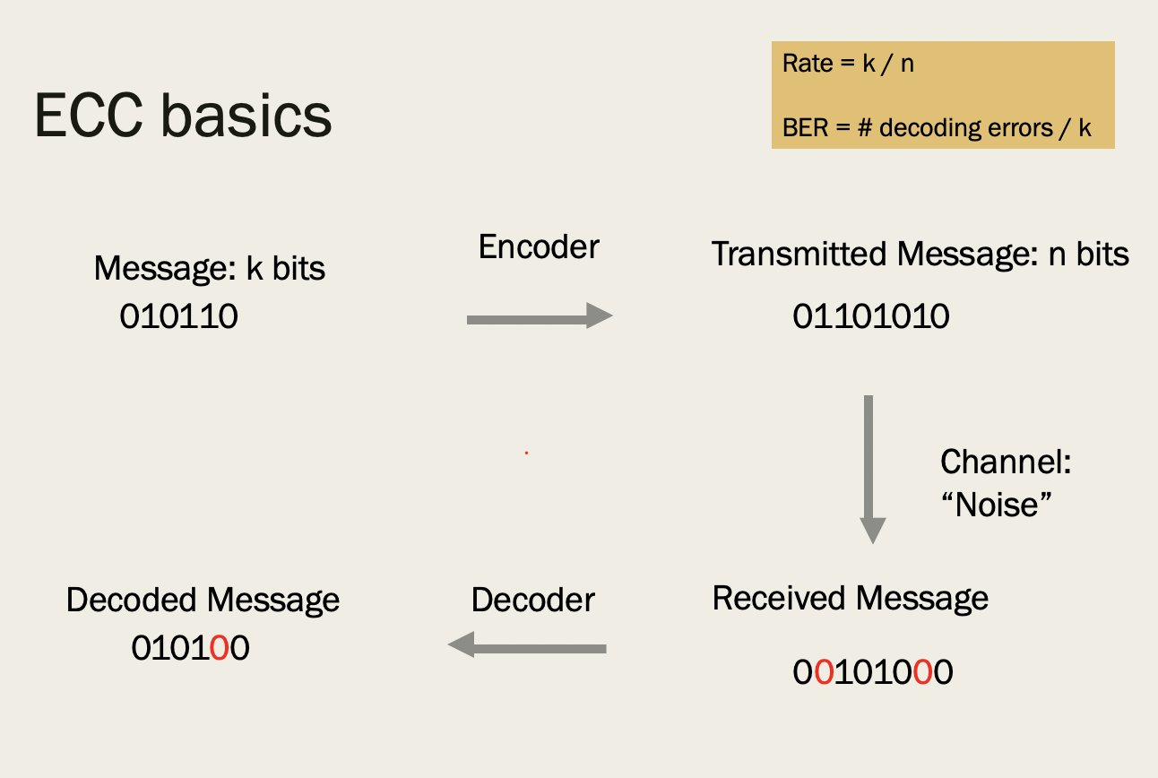
Coding Theory
Send a message
80% of message is corrupted
Can still recover whole message, with minimum redundancy

Slide 47

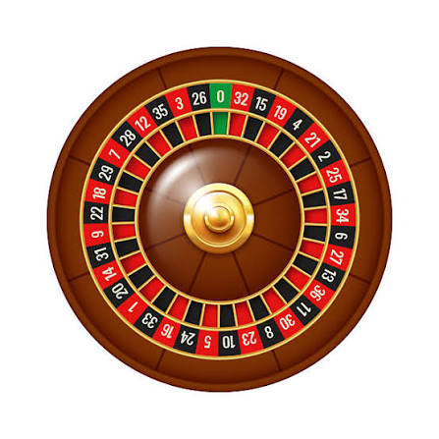
Sports Betting
When should you quit
Why Parlays are TERRIBLE
Martingale’s don’t work

Slide 48
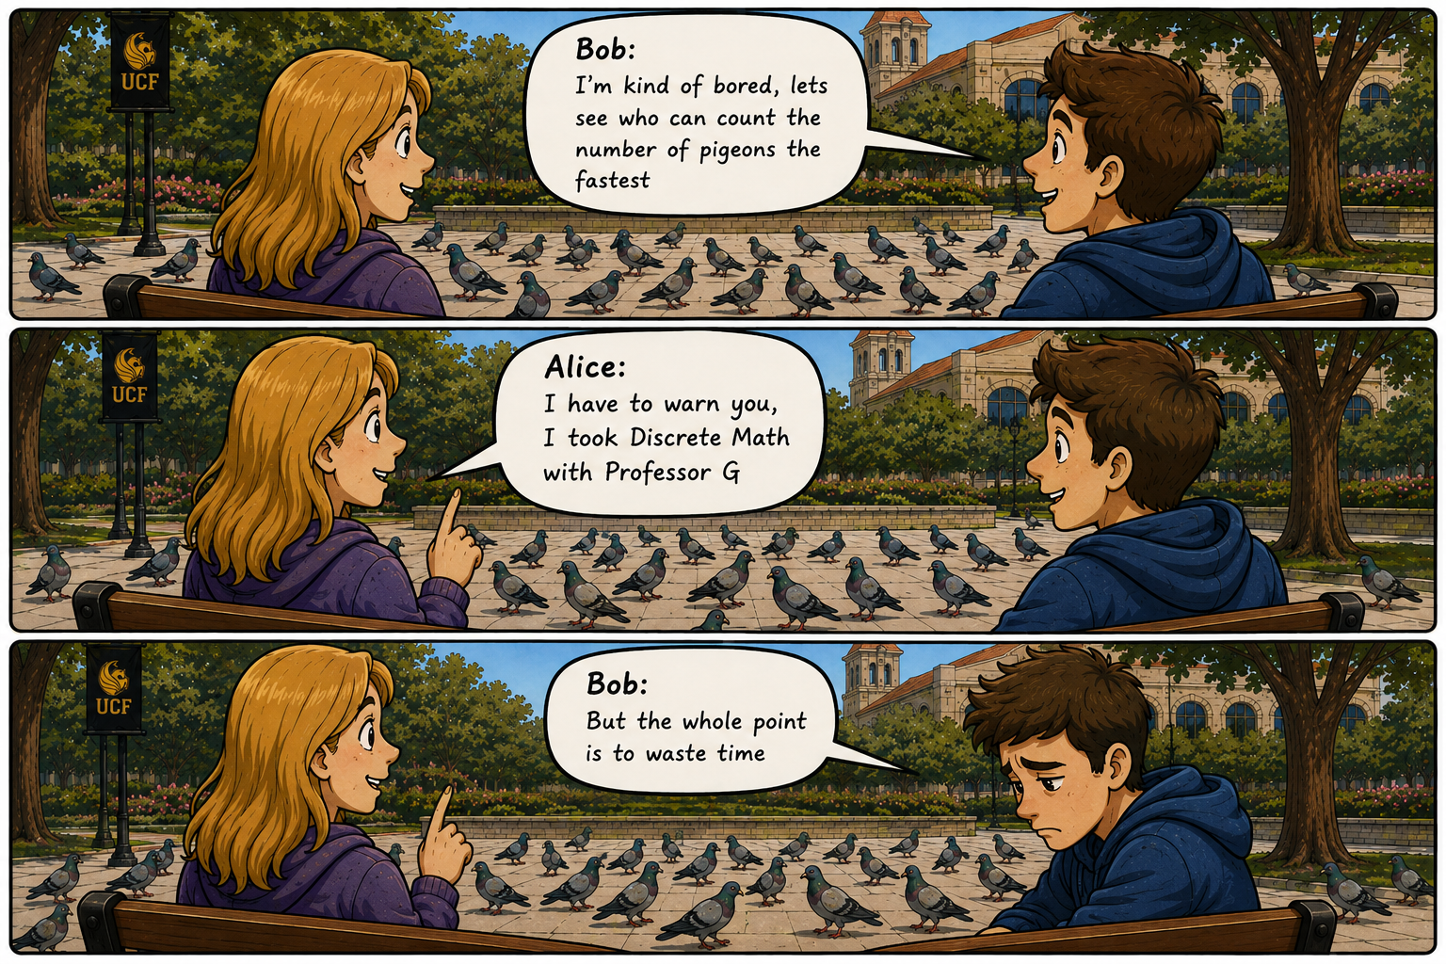
Boredom

Slide 49
Pros and Cons of Discrete Math with me
Pros:
You will learn a lot of if you put in the effort
Only 18 students, I’ll try giving you big picture view of why you should care
You’ll see the benefits when you take future classes and have strong fundamentals
If you put in the work, you will get a good grade
Attendance is voluntary, and exams are high stakes high reward
Cons:
EXAMS WILL BE HARD
If you want an easy A, then take the non-honors version (you can coast)
You have to really be ACCOUNTABLE

Slide 50
