Slide 1
DIGITAL PORTFOLIO
STUDENT NAME : R.GAJALAKSHMI
REGISTER NUMBER AND NMID : astvu36336324u18011
DEPARTMENT : COMPUTER SCIENCE
COLLEGE : SREE ABIRAAMI ARTS AND SCIENCE COLLEGE FOR WOMEN
/ THIRUVALLUVAR UNIVERSITY

Slide 2
PROJECT TITLE
DIGITAL PORTFOLIO IN FRONT END DEVELOPMENT

Slide 3
AGENDA
1.Problem Statement
2.Project Overview
3.End User
4.Tools and technologies
5.Portfolio design and Layout
6.Features and Functionality
7.Results and Screenshots
8.Conclusion
9.GitHub Link

Slide 4
PROBLEM STATEMENT
In today’s digital era, individuals need an effective way to showcase their skills, achievements and experience to others. I have developed my digital portfolio using HTML, CSS, JAVASCRIPT through a interactive design and responsive layouts. My digital portfolio clearly Presents my personal details, skills, certificates and projects

Slide 5
PROJECT OVERVIEW
1.It is a brief summary of my project involves creating a personal digital portfolio. It contains Home/ About me, certificates, skills, conference and contact.
2.The main idea of this project is to build an interactive platform and serves as a professional profile to present my skills, achievements in structured manner.

Slide 6
WHO ARE THE END USERS?
1. Students : To showcase their skills, certificates and projects.
2. Teachers/ professors : For academic assessments, project review or showcasing
students work.
3. Potential Employers/Companies : To understand the creativity and to
see the students talent for jobs or internship.
4.Clients(Freelance/Project –based) : To see your past work and decide
whether to hire you for web development project.
5.The Developer : As a self-reflection tool to showcase achievements, and maintain
a personal brand.

Slide 7
TOOLS AND TECHNIQUES
1.HTMsible For structuring the contents for portfolio.
2.CSS : For styling, layout and responsive design.
3.JAVASCRIPT : For interactivity and dynamic features.
4.Text editor and Version control : codepen and git & github.
5.Responsive web design : Making the portfolio accessible desktop,
tablet and mobile devices.
6.Navigation & Linking : Smooth scrolling and easy section access.
7.Hover & Transition effects : For interactivity and improved user experience.

Slide 8
PORTFOLIO DESIGN AND LAYOUT
1.Typography : Clear fonts for heading and body texts.
2.Interactive Elements : Hover effects, transition and smooth scrolling.
3.Home/About me : Short intro with name and brief description.
4.Certificate section : Display of earned certificates.
5.Skills section : Badges or icons for technical and professional skills.
6. Conference section : Timeline or list format to showcase participation.
7.Contact section : Simple form with name, email and message fields.

Slide 9
FEATURES AND FUNCTIONALITY
1.Navigation bar : Sticky header with quick links to all sections.
2.Contact form : Allow visitors to send message easily.
3.Smooth scrolling : Navigation links take the user directly to the chosen
section.
4.Hover effects : Visual feedback on skills, certificates and buttons.
5.Form Handling : Simple validation and confirmation when a user
submits contact form.
6. Responsive Grid/Flex layout : Automatically adjusts content for different
screen sizes

Slide 10
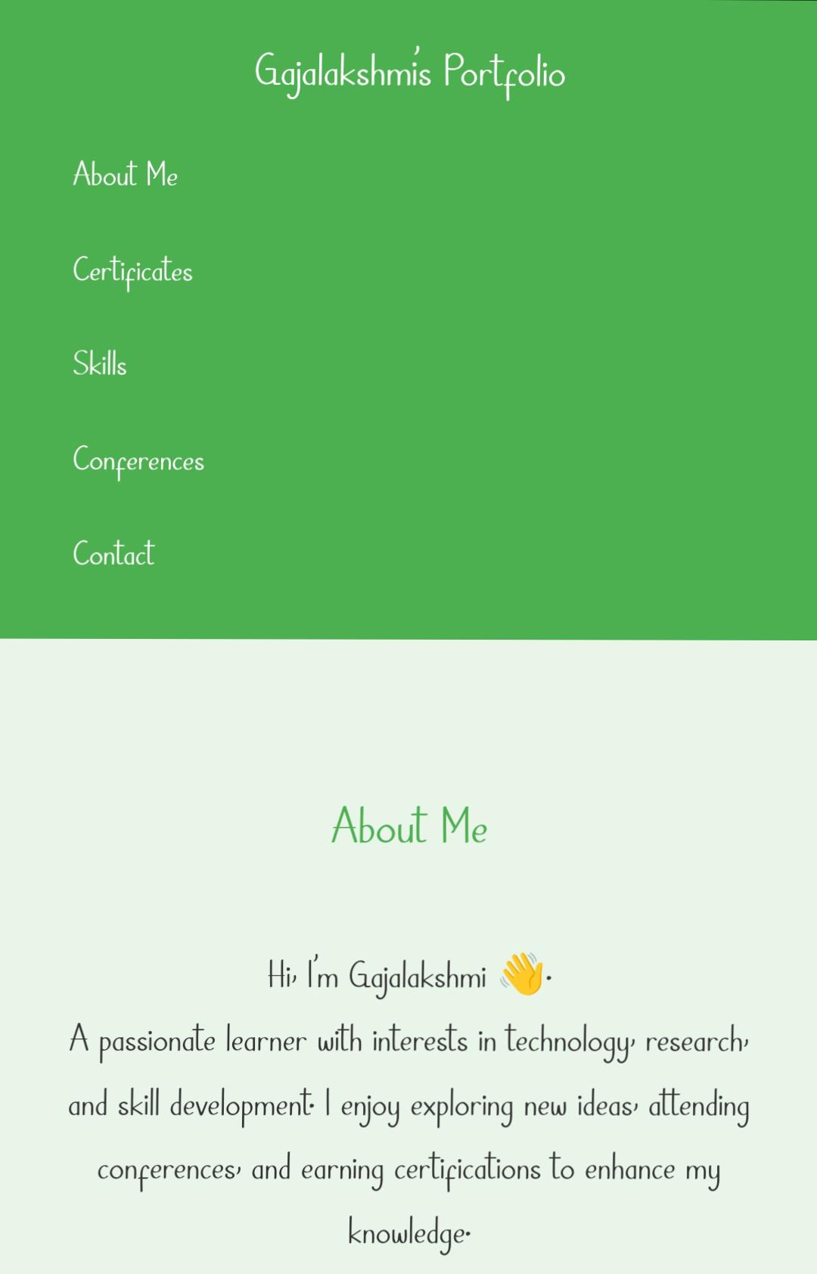
RESULTS AND SCREENSHOT

Slide 11
SKILLS AND CERTIFICATES
Skills :
▪️ C++
▪️ HTML
▪️ PYTHON
▪️ JAVASCRIPT
Certificates and Conference :
▪️Artificial intelligence – A National level
Conference.
▪️English communication - Lanquill
▪️Web development – IBM Skills build
▪️Cloud computing – IBM Skills build

Slide 12
GITHUB LINK
◾ PORTFOLIO LINK :
https://gajalakshmi0812.github.io/Gajalakshmiportfolio/

Slide 13
CONCLUSION
My portfolio is not just a webpage – it’s a living profile that grows
with my skills, and achievements. This project improve my creativity,
coding and problem solving skills. It is a platform to express my ideas
and capabilities, helping me connect with future opportunities in web
development.

