Slide 1
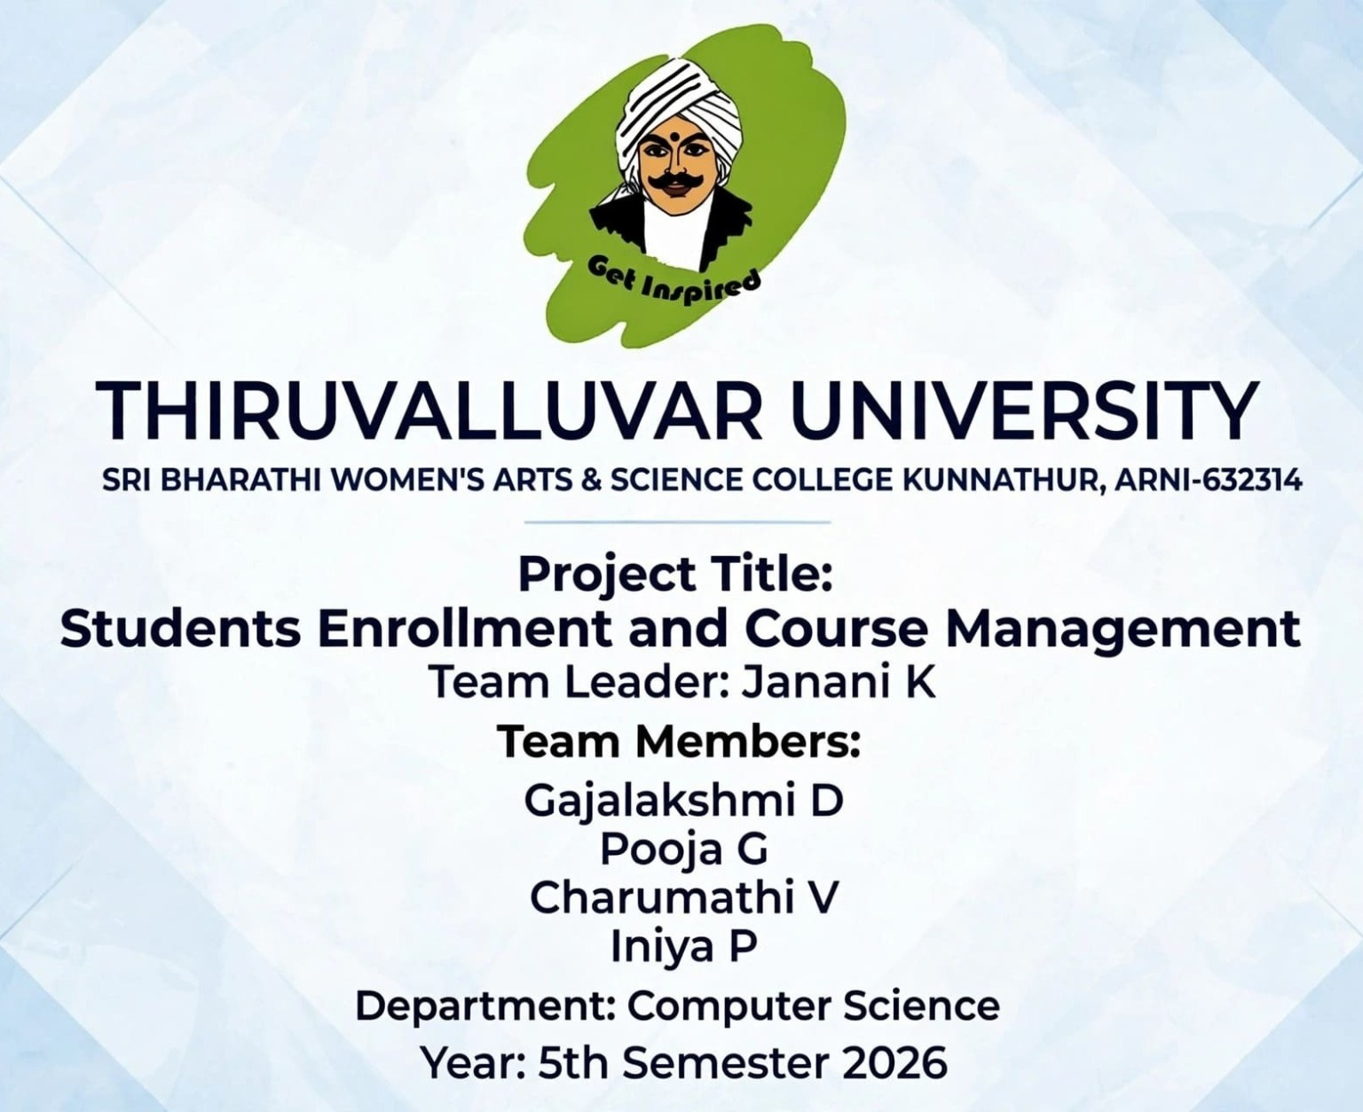

Slide 2
2. Introduction
2
• Student Enrollment and Course Management is a computerized system for managing student and course information.
• It reduces manual paperwork and keeps academic records organized.
• The system supports student registration, course selection, enrollment tracking and reporting.
• It provides a centralized database for authorized users.
Student Enrollment and Course Management | B.Sc. Computer Science

Slide 3
3. Problem Statement
3
• Manual enrollment requires repeated data entry and physical records.
• Finding student or course details can be time-consuming.
• Duplicate records and data-entry errors may occur.
• Course availability and enrollment status are difficult to monitor manually.
• Reports may take more time to prepare.
Student Enrollment and Course Management | B.Sc. Computer Science

Slide 4
4. Need for the System
4
• To maintain student information in a structured database.
• To simplify course creation and course allocation.
• To make enrollment faster and more accurate.
• To reduce paperwork and duplication.
• To provide quick access to academic information.
Student Enrollment and Course Management | B.Sc. Computer Science

Slide 5
5. Objectives
5
• Create a centralized student database.
• Manage courses, departments and course capacity.
• Allow students to enroll in available courses.
• Track enrollment status and course details.
• Provide useful reports for administrators and staff.
• Improve accuracy, security and efficiency.
Student Enrollment and Course Management | B.Sc. Computer Science

Slide 6
6. Scope of the Project
6
• Student registration and profile management.
• Course creation and course details.
• Course enrollment and withdrawal.
• Department and faculty information.
• Search and report generation.
• Basic user authentication and role-based access.
Student Enrollment and Course Management | B.Sc. Computer Science

Slide 7
7. Existing System
7
• Student records are often maintained using paper files or separate spreadsheets.
• Course information may be stored in multiple places.
• Enrollment verification may require manual checking.
• Generating reports can require repeated data collection.
• Data sharing and consistency can be difficult.
Student Enrollment and Course Management | B.Sc. Computer Science

Slide 8
8. Proposed System
8
• A centralized web/database-based management system.
• Student and course information is stored in related tables.
• Enrollment is recorded using a unique enrollment relationship.
• Validation rules reduce invalid and duplicate data.
• Authorized users can search, update and generate reports.
Student Enrollment and Course Management | B.Sc. Computer Science

Slide 9
9. Advantages of Proposed System
9
• Faster student enrollment.
• Reduced manual work.
• Better data consistency.
• Easy search and retrieval.
• Improved reporting.
• Better control over course capacity.
• Scalable for future modules.
Student Enrollment and Course Management | B.Sc. Computer Science

Slide 10
10. Users of the System
10
• Administrator – manages users, courses and system settings.
• Department Staff – maintains student and course records.
• Faculty – views assigned course and student information.
• Student – views courses and manages enrollment.
• Management – accesses summary reports.
Student Enrollment and Course Management | B.Sc. Computer Science

Slide 11
11. Functional Requirements
11
• User login and authentication.
• Add, edit, view and delete student records.
• Add and manage course records.
• Display available courses.
• Enroll or withdraw students.
• Validate prerequisites/capacity where applicable.
• Generate student and course reports.
Student Enrollment and Course Management | B.Sc. Computer Science

Slide 12
12. Non-Functional Requirements
12
• Performance – common operations should respond quickly.
• Security – only authorized users can access protected data.
• Usability – screens should be simple and understandable.
• Reliability – records should be stored consistently.
• Maintainability – modules should be easy to update.
• Scalability – system should support increasing users and courses.
Student Enrollment and Course Management | B.Sc. Computer Science

Slide 13
13. System Architecture
13
• Presentation Layer – login, forms, course and enrollment screens.
• Application Layer – validation, business rules and processing.
• Database Layer – stores students, courses, users and enrollments.
• Reports – converts stored data into useful summaries.
Student Enrollment and Course Management | B.Sc. Computer Science

Slide 14
14. Technology Stack
14
• Frontend: HTML, CSS and JavaScript.
• Backend: PHP / Python / Java can be used depending on implementation.
• Database: MySQL or another relational database.
• Server: XAMPP/WAMP or a suitable local/web server.
• Development tools: VS Code or another code editor.
Student Enrollment and Course Management | B.Sc. Computer Science

Slide 15
15. Database Overview
15
• The database stores related information in structured tables.
• Primary keys uniquely identify records.
• Foreign keys connect related tables.
• Constraints help maintain data integrity.
• SQL is used for creating, updating and retrieving data.
Student Enrollment and Course Management | B.Sc. Computer Science

Slide 16
16. Main Database Tables
16
• STUDENT – student personal and academic details.
• COURSE – course code, title, credits and capacity.
• DEPARTMENT – department information.
• FACULTY – faculty details.
• ENROLLMENT – links students with courses.
• USER – login and role information.
Student Enrollment and Course Management | B.Sc. Computer Science

Slide 17
17. ER Model – Main Entities
17
• Student has a one-to-many relationship with Enrollment.
• Course has a one-to-many relationship with Enrollment.
• Department can have many Students and Courses.
• Faculty can be assigned to one or more Courses.
• Enrollment acts as the bridge between Student and Course.
Student Enrollment and Course Management | B.Sc. Computer Science

Slide 18
18. Student Registration Module
18
• Collects student ID, name, date of birth, contact and department.
• Validates mandatory fields.
• Checks uniqueness of student ID.
• Stores the record in the STUDENT table.
• Allows authorized users to update student information.
Student Enrollment and Course Management | B.Sc. Computer Science

Slide 19
19. Course Management Module
19
• Creates and updates course details.
• Stores course code, title, credits, department and capacity.
• Maintains course status such as active/inactive.
• Helps staff monitor available seats.
• Supports future additions such as prerequisites.
Student Enrollment and Course Management | B.Sc. Computer Science

Slide 20
20. Enrollment Module
20
• Displays available courses to students.
• Checks whether the student and course exist.
• Checks duplicate enrollment.
• Checks course capacity and other rules.
• Creates an enrollment record after successful validation.
Student Enrollment and Course Management | B.Sc. Computer Science

Slide 21
21. Enrollment Workflow
21
Student Login
View Available Courses
Select Course
Validate
Confirm Enrollment
Store Record
Student Enrollment and Course Management | B.Sc. Computer Science

Slide 22
22. Withdrawal Workflow
22
Open Enrollment
Select Course
Request Withdrawal
Validate Status
Update Enrollment
Confirm
Student Enrollment and Course Management | B.Sc. Computer Science

Slide 23
23. Data Validation
23
• Student ID must be unique.
• Required fields cannot be empty.
• Course code must be unique.
• Enrollment should reference valid Student and Course IDs.
• Course capacity should not be exceeded.
• Duplicate enrollment should be prevented.
Student Enrollment and Course Management | B.Sc. Computer Science

Slide 24
24. SQL Operations
24
• CREATE TABLE – creates database tables.
• INSERT – adds new records.
• SELECT – retrieves records.
• UPDATE – modifies existing records.
• DELETE – removes records when permitted.
• JOIN – retrieves related data from multiple tables.
Student Enrollment and Course Management | B.Sc. Computer Science

Slide 25
25. Sample SQL – Student Table
25
• CREATE TABLE Student (
• student_id INT PRIMARY KEY,
• name VARCHAR(100) NOT NULL,
• department VARCHAR(50),
• email VARCHAR(100)
• );
Student Enrollment and Course Management | B.Sc. Computer Science

Slide 26
26. Sample SQL – Enrollment
26
• CREATE TABLE Enrollment (
• enrollment_id INT PRIMARY KEY,
• student_id INT,
• course_id INT,
• enrollment_date DATE,
• FOREIGN KEY (student_id) REFERENCES Student(student_id),
• FOREIGN KEY (course_id) REFERENCES Course(course_id)
• );
Student Enrollment and Course Management | B.Sc. Computer Science

Slide 27
27. Sample Query – Course Enrollment
27
• SELECT s.name, c.course_name, e.enrollment_date
• FROM Student s
• JOIN Enrollment e ON s.student_id = e.student_id
• JOIN Course c ON e.course_id = c.course_id;
• Purpose: displays student names with their enrolled courses.
Student Enrollment and Course Management | B.Sc. Computer Science

Slide 28
28. User Interface Screens
28
• Login Page
• Dashboard
• Student Registration Form
• Course Management Page
• Course List / Search Page
• Enrollment Page
• Reports Page
Student Enrollment and Course Management | B.Sc. Computer Science

Slide 29
29. Security Features
29
• Username and password authentication.
• Role-based access for administrator, staff, faculty and student.
• Input validation to reduce invalid data.
• Database access should use protected credentials.
• Sensitive information should not be exposed to unauthorized users.
• Regular backup helps protect important records.
Student Enrollment and Course Management | B.Sc. Computer Science

Slide 30
30. Testing Strategy
30
• Unit Testing – tests individual modules.
• Integration Testing – checks communication between modules.
• System Testing – tests the complete application.
• Validation Testing – checks rules and required fields.
• User Acceptance Testing – confirms that the system meets user needs.
Student Enrollment and Course Management | B.Sc. Computer Science

Slide 31
31. Test Cases
31
• Valid student registration → record should be created.
• Duplicate student ID → system should reject the entry.
• Valid course enrollment → enrollment record should be created.
• Full course → enrollment should be prevented.
• Duplicate enrollment → system should show an appropriate message.
• Invalid login → access should be denied.
Student Enrollment and Course Management | B.Sc. Computer Science

Slide 32
32. Reports Generated
32
• Student List Report.
• Course List Report.
• Course-wise Enrollment Report.
• Department-wise Student Report.
• Student Enrollment History.
• Available Seat / Course Capacity Report.
Student Enrollment and Course Management | B.Sc. Computer Science

Slide 33
33. Benefits and Real-Time Applications
33
• Useful for colleges, universities and training institutes.
• Can support online course registration.
• Helps departments monitor enrollment numbers.
• Reduces repeated manual record maintenance.
• Can be extended with attendance, fees, examination and timetable modules.
Student Enrollment and Course Management | B.Sc. Computer Science

Slide 34
34. Future Enhancements
34
• Mobile application support.
• Online fee payment integration.
• Attendance management.
• Examination and result management.
• Email/SMS notifications.
• Advanced analytics and dashboards.
• Cloud deployment and automated backup.
Student Enrollment and Course Management | B.Sc. Computer Science

Slide 35
35. Conclusion
35
• Student Enrollment and Course Management provides a structured way to manage academic records.
• It connects student, course and enrollment information through a relational database.
• The system reduces manual effort and improves data organization.
• It provides a foundation for a larger college management system.
• Thank You
Student Enrollment and Course Management | B.Sc. Computer Science

