Slide 1

Digital Portfolio
STUDENT NAME: B. Gajalakshmi
REGISTER NO AND NMID: 30324U09021, 3E26AA7AFA061D897134F07E255AFEC1
DEPARTMENT: Batchelor of Computer Application
COLLEGE: COLLEGE/ UNIVERSITY
Thiruvalluvar University, Arcot Sri Mahaalakshmi Women’s College
1

Slide 2


PROJECT
Int^{T}era^{IT}cti^{L}ve^{E}digital portfolio using frontend development
2

Slide 3


AGENDA
Problem Statement
Project Overview
End Users
Tools and Technologies
Portfolio design and Layout
Features and Functionality
Results and Screenshots
Conclusion
Github Link
3
3/21/2024 Annual Review

Slide 4

PROBLEM STATEMENT
Students and professionals often lack a structured and creative way to showcase their skills, academic achievements, and projects. Traditional resumes are limited and do not highlight practical knowledge effectively. Hence, there is a need for a digital portfolio to display personal details, skills, and projects in an interactive manner
4

Slide 5
PROJECT OVERVIEW
This project focuses on creating a Digital Portfolio Website using HTML, CSS, and JavaScript. The portfolio presents personal information, education, technical skills, certifications, projects, and contact details in a user- friendly and visually appealing design. It helps individuals demonstrate their capabilities to recruiters, teachers, and peers.
5

Slide 6
💡 Main idea
It serves as a professional platform where an individual can showcase academic qualifications, technical expertise, creative talents, and project work. The portfolio emphasizes not only technical skills such as programming and web development but also soft skills, extracurricular activities, and certifications. By presenting achievements and experiences digitally, it creates a stronger impact than traditional resumes. This project provides a space to reflect personal growth, demonstrate capabilities, and build confidence for future career opportunities.
6

Slide 7
WHO ARE THE END
USERS?
Students who want to showcase their projects and skills.
Job seekers applying for internships or placements.
Professionals who want to display achievements and experiences .
Recruiters and employers who need a quick overview of candidates
7

Slide 8
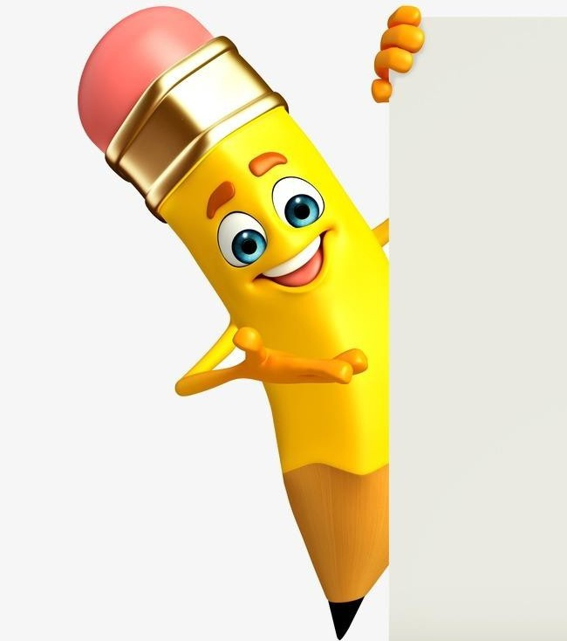



TOOLS AND TECHNIQUES
Frontend Languages : HTML, CSS, JavaScript Editor : Visual Studio Code Version Control : Git G GitHub (for hosting and code management)
8

Slide 9

Design Techniques: Responsive web design (works on mobile G desktop)
CSS styling and layouts (flexbox, grid) JavaScript interactivity (menus, animations, validation)
Clean and structured coding practices

Slide 10

POTFOLIO DESIGN AND LAYOUT
Home Page
Introduction with name, course, and a short tagline
About Me
Personal details Educational background, Hobbies and interests
Skills Technical
skills (HTML, CSS, JavaScript, etc.) ,Soft skills (communication, teamwork, problem-solving)
Projects / Achievements
List of projects with short descriptions, Academic and extracurricular achievements
6. Contact
Phone number and email
10

Slide 11
The design and layout of the Interactive Digital Portfolio are created to provide a clean, responsive, and user-friendly interface. The portfolio is structured into sections such as Home, About Me, Education, Skills, Projects, Achievements, and Contact. A navigation bar ensures smooth movement across pages, while CSS is used for styling with modern layouts like flexbox and grid. The color scheme, fonts, and icons are chosen to maintain a professional yet attractive look. The layout adapts to different screen sizes to ensure mobile and desktop compatibility. Overall, the design focuses on clarity, accessibility, and an engaging user experience.

Slide 12




FEATURES AND FUNCTIONALITY
Responsive design (mobile and desktop view)Easy navigation with menus Organized sections for clarity
Interactive buttons and animations
GitHub link integration for project source code

Slide 13
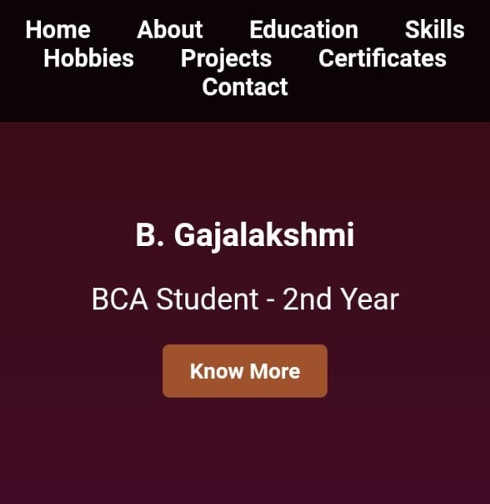
RESULTS AND SCREENSHOTS
HOME Page :
Purpose:
This section gives a brief introduction about me as a BCA 2nd-year student. It tells about my college, my academic background, my interests, and my future goals.
Content: Name: V. Lavanya
College: Arcot Sri Mahaalakshmi Women’s College University: Thiruvalluvar University
Academic Background: Completed 10th and 12th at Swamy Vivekananda Matric Higher Secondary School Interests: Learning new technologies, exploring creative ideas, building functional projects
Goal: To become a skilled software developer with strong problem-solving abilities
Technical Details: Created using HTML for structure
CSS gradient background for a modern look
Center-aligned text with responsive design for mobile and desktop
3/21/2024 Annual Review
13

Slide 14
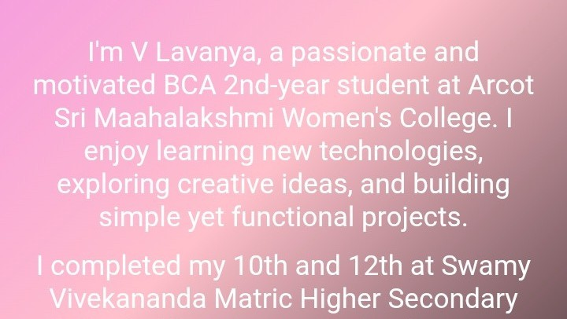
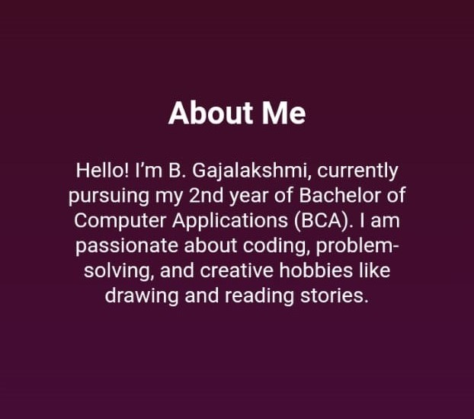
Screenshot 2
About me section :
Purpose:
This section gives a brief introduction about me as a BCA 2nd-year student. It tells about my college, my academic background, my interests, and my future goals.
Content: Name: V. Lavanya
College: Arcot Sri Mahaalakshmi Women’s College University: Thiruvalluvar University
Academic Background: Completed 10th and 12th at Swamy Vivekananda Matric Higher Secondary School
Interests: Learning new technologies, exploring creative ideas, building functional projects
Goal: To become a skilled software developer with strong problem-solving abilities
Technical Details: Created using HTML for structure
CSS gradient background for a modern look
Center-aligned text with responsive design for mobile and desktop

Slide 15
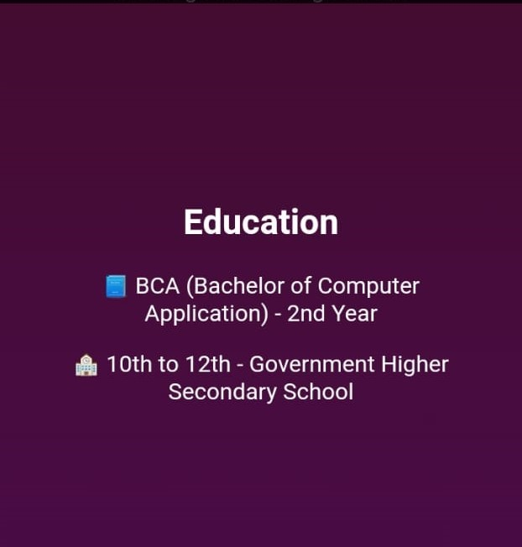

Screenshot 3
Education section :
Purpose:
The Skills section highlights the technical abilities and programming knowledge I have gained as part of my BCA studies.
Content:
Python: Basic programming and problem-solving
C++: Object-oriented programming concepts and coding fundamentals
Technical Details:
Created using HTML headings and list tags for simple text representation CSS gradient background for design consistency across the portfolio Minimal text layout to keep the section clean and focused
Responsive design to ensure readability on all devices

Slide 16
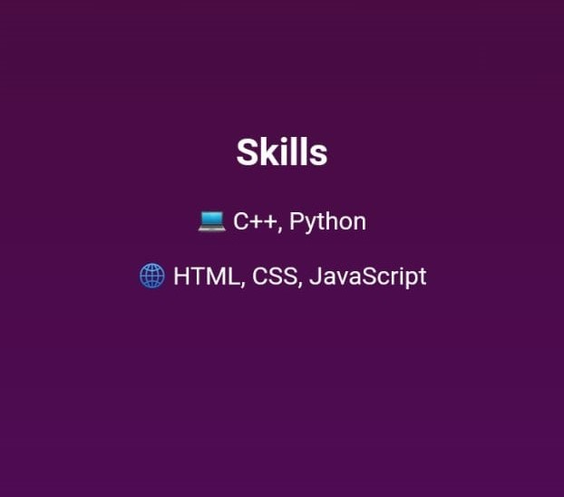

Screenshot 4
Skills section :
Purpose:
The Skills section highlights the technical abilities and programming knowledge I have gained as part of my BCA studies.
Content:
Python: Basic programming and problem-solving
C++: Object-oriented programming concepts and coding fundamentals
Technical Details:
Created using HTML headings and list tags for simple text representation CSS gradient background for design consistency across the portfolio Minimal text layout to keep the section clean and focused
Responsive design to ensure readability on all devices

Slide 17
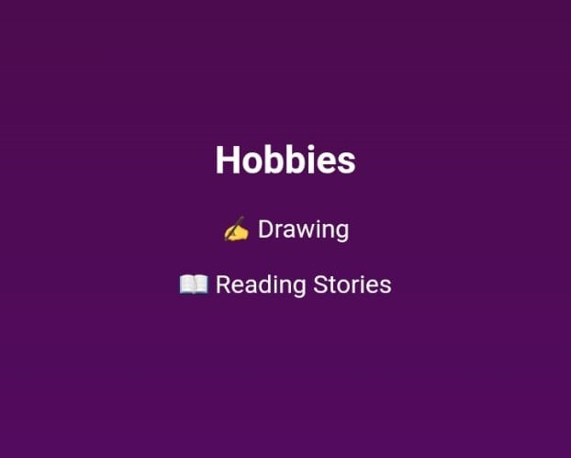
Screenshot 5
Hobbies Section
Purpose:
The Hobbies section gives a quick view of my personal interests outside academics, showing creativity and personality.
Content:
Drawing – I enjoy creating art and designs as a creative outlet.
Listening to Music – Helps me relax and stay focused while studying or coding.
Listening to Stories – I love learning through storytelling and exploring creative narratives.
Technical Details:
Designed using HTML headings and list elements for neat structure.
CSS gradient background ensures design consistency with the entire portfolio.
Used center alignment for a simple, clean layout.
Optimized for responsive display on both mobile and desktop

Slide 18
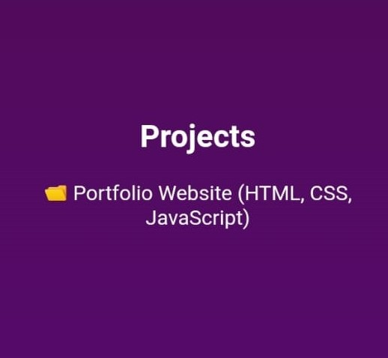
Screenshot 6
Projects Section:
Purpose:
The Projects section highlights the practical work I have done to apply my programming and web development skills. It shows my ability to create real-time applications and websites.
Content:
Portfolio Website: Built using HTML, CSS, and JavaScript to display personal details, skills, and achievements interactively.
(You can also list other projects here, like Student Management System or Calculator App, if applicable.)
Technical Details:
Designed with HTML for structure, CSS for styling, and JavaScript for interactivity.
Used responsive web design techniques to make the project mobile and desktop-friendly.
Simple layout focusing on clarity and user experience.

Slide 19
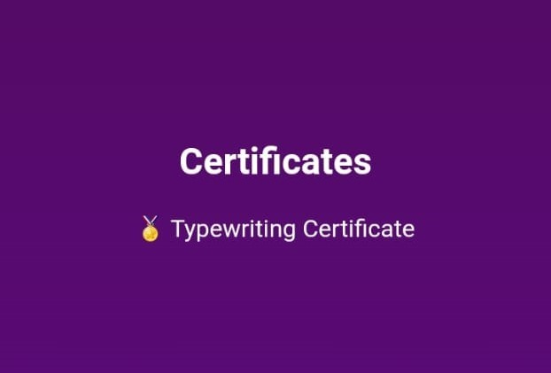
Screenshot 7
Certificates Section:
Purpose:
The Certificates section displays the courses and certifications I have completed to show my additional learning and skill-building efforts.
Content:
Beautician Course Certificate: Completed a professional beautician course to gain creative and practical skills outside academics.
(You can also list other certifications like coding workshops, internships, or online courses if you have them.)
Technical Details:
Made using HTML headings and paragraph tags for content organization.
CSS gradient background for a colorful and consistent design.
Center-aligned text for neat and simple layout.
Fully responsive for both mobile and desktop screens.

Slide 20
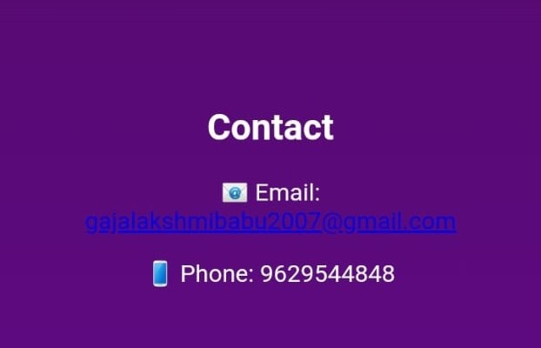
Screenshot 8
Contact Section:
Purpose:
The Contact section allows people to connect with me for collaborations, projects, internships, or learning opportunities.
Content:
Email: lavanya2222007@gmail.com
A short message inviting people to connect for opportunities and discussions related to technology and creativity.
Technical Details:
Created using HTML headings and paragraph tags.
The email address is added using an HTML anchor tag to make it clickable. CSS gradient background for design consistency with the rest of the portfolio.
The layout is kept minimal and professional with centered alignment.
Fully responsive design for better viewing on both desktop and mobile screens.

Slide 21
Benifits
Showcases Skills Professional Identity Practical Learning Personal Branding Easy Updates Interview/Academic Advantage Encourages Creativity

Slide 22
Showcases Skills
Displays knowledge of HTML, CSS, and JavaScript in a real- world project.
Demonstrates both design and coding abilities.

Slide 23
Professional Identity
Acts as a digital resume/portfolio that highlights education, skills, projects, and achievements. Can be shared with employers or academic evaluators.

Slide 24
Practical Learning
Improved understanding of frontend development, UI/UX design, and responsive layout. Hands-on practice in web development tools and coding techniques.

Slide 25
Personal Branding
Builds a unique online presence to stand out in academic and professional opportunities.

Slide 26
Easy Updates
Information like new projects, achievements, or skills can be updated anytime.

Slide 27
Interview/Academic Advantage
Helpful during job interviews, internships, and viva presentations as it gives a structured view of your capabilities.

Slide 28
Encourages Creativity
Combines technical knowledge with creativity through design, writing, and content presentation.

Slide 29
CONCLUSION
The project demonstrates how a Digital Portfolio can effectively present skills, achievements, and projects in a structured and professional way. It helps students and professionals enhance their career opportunities by showcasing their work online.
25

Slide 30
Github Link
https://github.com/gajalakshmibabu2007-coder/Gajalakshmi.-B

