Slide 1
Introduction to
GCE
Dec 2017

Slide 2
What’s inside?
GCE
Modules of GCE
Partner Systems
EOD and SOD
External Feeds

Slide 3
GCE:
Why is it needed…?
Sweep cash from where it is to where it is desired
Minimize deficit positions to reduce funding costs
Maximize the return on surplus cash position
Offer readymade or highly-customized solutions
Operate on a true end of day basis
Mobilize liquidity within the Citi network
Provide interest reallocation strategy between participating entities
How it helps Citi…
Pools the customer’s fund and utilizes for internal and treasury needs
Billing from customer for utilizing liquidity solution of GCE

Slide 4
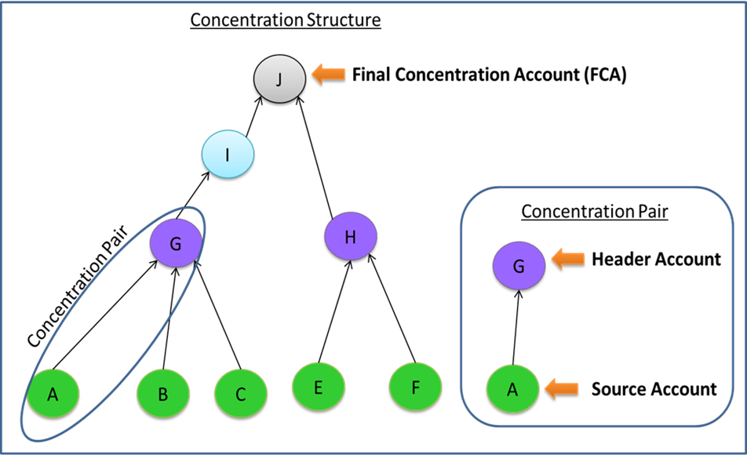
GCE - Terminologies
Product: Services offered by CITI to its customers through GCE with pre-defined or customized solutions.
Pair: The grouping of two accounts is called pair.
Structure: The hierarchy of accounts constitutes a structure. A pair will have top account called Final Concentration Account (FCA) and sub accounts (Header/ Source). Parent accounts are called header accounts and child accounts are called source accounts.
Strategies: Defining movement of money from one account to another to achieve target balance (TBA)or zero balance (ZBA) at EOD.
Constraints: Conditions that control or restrict the movement of funds between header and source accounts or across the entire structure. Could be determined by client/ regulatory needs.

Slide 5
GCE - Terminologies
Some of existing constraints are as below:
    Minimum Amount
    Maximum Amount
    Lot Amount
    Sweep Counter
    Frequency
Dates: (applicable at arrangement-pair level)
    Arrangement - Start Date/End Date
    Effective - Start Date/End Date
    Suspended - Start Date/End Date
Arrangement: Association of product, structure, dates, billing, interest is called an arrangement.
Maker-Checker: Ensures control on addition/amendments in process. So, if an arrangement pair is changed by one user (maker), it must be reviewed and approved by other user (Checker). In some cases there could be an additional check of Super checker.

Slide 6
Modules of GCE
Admin: The Admin module of GCE is used for administrative activities such as user/role management, branch set up in GCE, currency setup etc.
APS: Account posting services module is used for bulk posting of sweeps manually and for enquiring postings sent by GCE.
GCE: This module provides functionalities such as sweep enquiry, re-do EOD, loan position checking etc.
GLSM: In GLSM, products, arrangements, structure, constraints etc. are defined. This is an important part since the sweeps in EOD/SOD will be posted based on the configurations defined here.
GFP: GFP is generic file processer used for processing of files.
Report: Report module has scheduled and manual reports created for regulatory/operations purpose.

Slide 7
Partner Systems
Flex/DDA: Flex cube is the system that would provide details of transactions and balances for each account of a branch to GCE. Also the sweeps calculated by GCE are send to flex for further processing.
GIW: Global information warehouse is a central repository for account level information. It is like a consolidated repository, which is connected to all other citi systems and would have comprehensive information for each account and transaction. For GCE, if balance information for an account is not received from Flex, then it can be fetched from GIW. Also, information related to active structures in GCE, sweep generation and limit utilization is sent to GIW for its record and for any need of this data by other systems.
GBNP: GBNP is global system for calculation of interests. Since, GCE sweeps also involve inter company lending, the GBNP is used to perform interest calculation based on internal interest rates for such lending. Thus, the information of inter company lending is shared with GBNP and it does further processing to calculate and post interests.
GBS: GBS is global billing system. Citi charges its GCE customers based on sweep performed for each customer. Thus, GBS calculates charges and bills them to customer, based on sweep information sent by GCE.
Account Posting Services: APS acts as an interface to post financial transactions to core ledger systems. It retrieves transactions from GCE and GBNP at EOD. It also checks whether sweep currency is valid and creates transaction legs (debit/credit) accordingly.

Slide 8
EOD (End of Day processing)
Each day, as soon as a particular branch of CITI is closed for operations, the EOD process is performed in GCE to post the sweeps for that branch. The process is triggered in GCE at branch level, as soon as it receives s signal of branch close from Flex. The process is performed in GCE in below 5 steps:
PL (Preloading): In pre-loading process, the active accounts for a particular branch are identified and loaded that shall be participating in EOD for that branch. A participating account shall be active, belonging to the branch (for EOD) and eligible to run for that day (as per its schedule).
TX (Transaction Loading): This process is performed with i7 file from flex. The file contains value date transactions for all account of a branch and of those the data is loaded to GCE for accounts identified during preloading.
BL (Balances Loading): Similar to TX, the BL process loads value dated balances to GCE for participating accounts of a branch as per i11 file received from flex. If balance for a participating account is not available in i11, those will be fetched from GIW.
XD (Sweep Creation): Once Balances and transactions are loaded for participating accounts, the sweeps are generated as per concentration strategy and constraints for each account pair. The sweeps could be for same/cross currency and for domestic/international movement.
PP (Post Processing): This process will create an output file i11 of sweeps, which will be send to flex for further processing.

Slide 9
SOD (Start of day processing)
Each morning, as soon as a particular branch of CITI is open for operations, the SOD process is performed in GCE to reconcile sweeps performed for prior business day and update the limits, loan positions, principal amount etc. for each account of that particular branch. The process is triggered in GCE for a branch, as soon as it receives signal of branch opening from Flex. The process is performed in GCE in below 4 steps:
RE (Recon) : A reconciliation is performed between sweeps posted for this branch for previous business day with APS. All the pending transactions are marked as failed and all the previous day’s transactions that were not posted due to closure of branch are posted and reconciled with APS.
LP (Loan Position Posting): In this process, GCE computes and updates the loan position for all successful sweeps of a branch. The loan position is maintained by value date. Based on the cumulative loan position of each value date, interest is calculated and posted on month end.
PR (Principle Reset): In this process, the principle amount as per the constraints is reset as and when applicable.
RV (Reverse Sweep): In this process, the reverse sweep leg of a sweep is posted and is sent to flex for intraday posting. This leg acts as recovery sweep, which is handled by operations team.

Slide 10
External Feeds
SB Feed – The Structure Broker feed is sent to GIW and contains details about active structures in GCE. The file is sent four times in a day and is send using NDM file transfer mechanism. The purpose of feed is to keep GIW updated about the information of structures in GCE.
LM Feed – The Liquidity Mart feed is sent to GIW and contains list of all successful sweeps in GCE. Similar to SB feed the file is transferred using NDM mechanism. The purpose of feed is to keep GIW updated about the sweeps processed in GCE for a given date and branch.
LU Feed – The Limit Utilization feed contains details of sweep limits utilized for each account/structure. Since, the sweep constraints might cap the amount and frequency of a sweep for an account pair, this information is useful to assess, how much of sweep limit has been utilized. The feed is sent to GIW
IRL Feed – The Interest reallocation feed is sent to GBNP. GCE sends parameters in this feed, which are used by GBNP to calculate interest for intercompany lending performed as part of achieving target balancing in GCE.
BIS & MBBS Feed – The Billing feeds are sent to GBS (global billing system) for calculation of billing for the services (sweeps) provided by GCE.

