Slide 1
Introduction to
“Treasury & Trade Solutions”
Dec 2017

Slide 2
What’s Inside:
Introduction to banking services provided by Citi
What is Treasury function of a business?
How does CITI-TTS helps Treasury of a business?
Major services provided by TTS
Insights on liquidity management with TTS and GCE

Slide 3
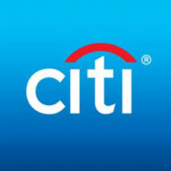
Consumer Businesses
Institutional Businesses
Capital Market Origination
Retail Banking
Securities Services
Credit Cards
Investment Banking
Private Banking
Commercial
Treasury and Trade Solutions (TTS)

Slide 4
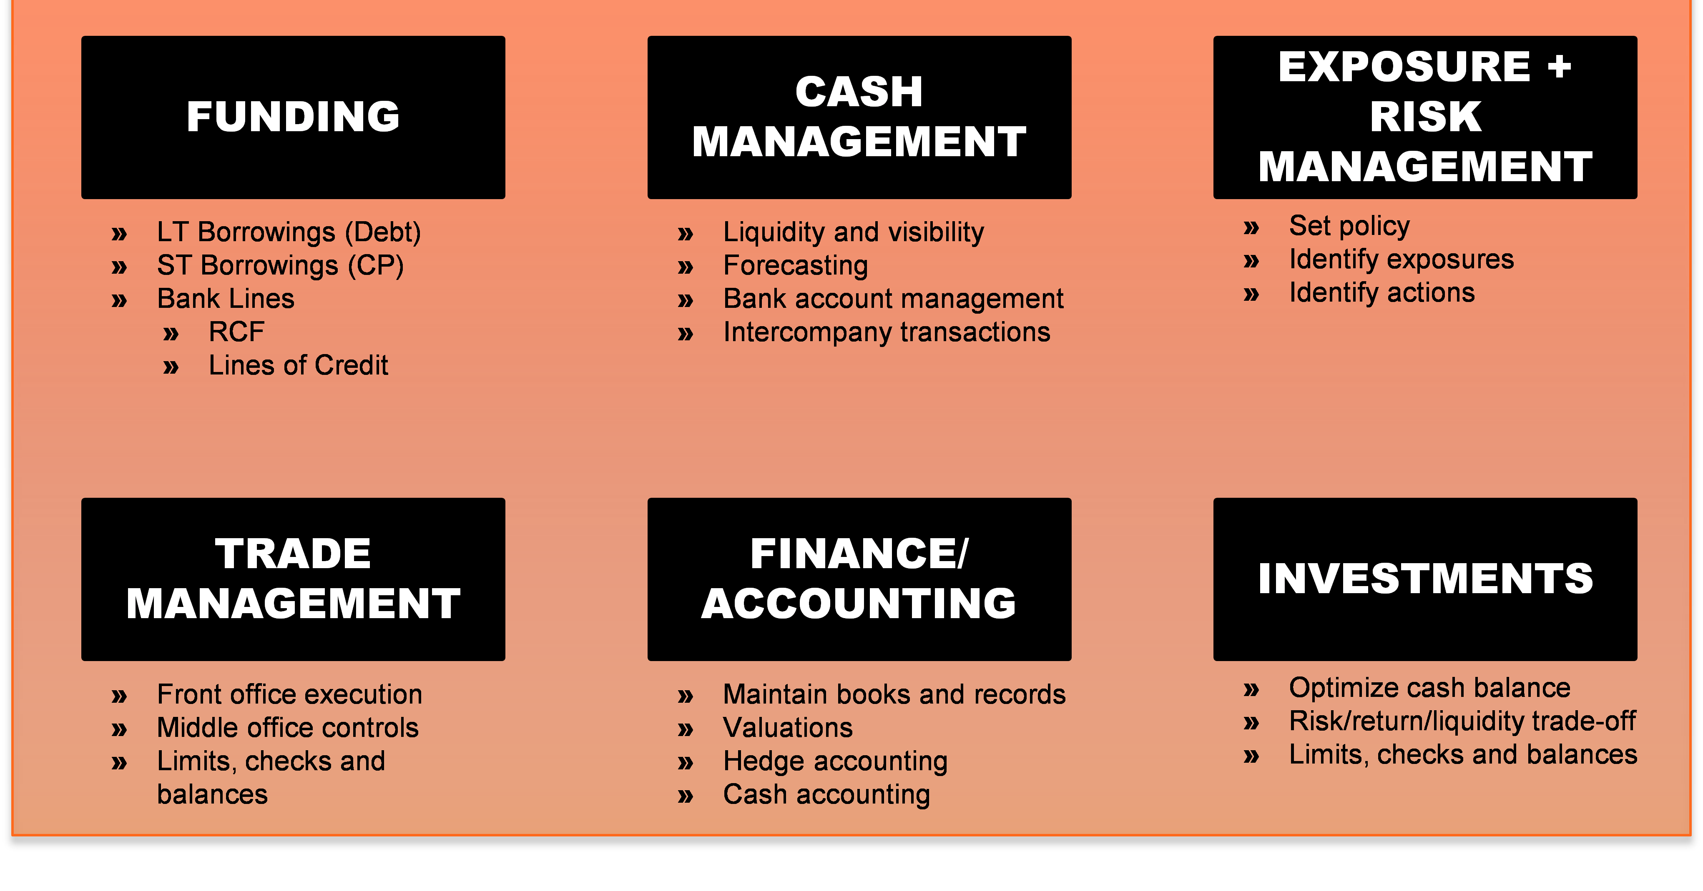
Treasury and its major activities:
Treasury Management is core finance function of any business. It includes management of an enterprise's holdings, with the ultimate goal of managing the firm's liquidity and mitigating its operational, financial and reputational risk. Treasury Management includes a firm's collections, disbursements, concentration, investment and funding activities.

Slide 5
Treasury and Trade Solutions (TTS):
Treasury and Trade Solutions (TTS) business provides integrated cash management and trade finance services to multinational corporations, financial institutions and public sector organizations across the globe.
Channel Services
Payments
Liquidity Management
Commercial Cards
Receivables
Integrated Payables
Trade Finance

Slide 6
TTS:
Commercial Cards: Comprehensive Solutions for Travel & Entertainment, Purchasing & B2B, and Administrative business activities.
Trade Finance: As part of the Treasury and Trade Solutions (TTS) group, Citi offers an integrated trade platform that incorporates Trade Services (including Specialized Trade programs) and Export and Agency Finance products working together to create end-to-end solutions ranging from short- and medium-term financing to complex structured trade models.
Integrated Payables: Citi® Integrated Payables Solutions is a holistic suite of leading-edge analytics, core and emerging payment services, supplier enrollment and other capabilities to help optimize working capital and maximize efficiencies across an organization’s complete supply chain.
Receivables: Citi’s global receivables solutions streamline receivables processing and increase operational efficiencies to reduce costs and help organizations achieve their financial goals.
Payments: Citi offers products and solutions to help you effectively manage your payments. Whether for invoices, payroll and taxes, or settlement of treasury activities, you gain from our presence in 100 countries. Domestic and cross-border transaction initiation, Online real-time information, Integration with ERP and Treasury

Slide 7
Liquidity Management:
Moving, managing and investing funds – when and where ever needed – is critical to treasury operation. So is having a trusted partner who understands what it takes to optimize liquidity while controlling risks – whether a business operates in a single market or around the globe.
Investment Services: Investment of excess funds to maximize returns and minimize costs.
Notional Pooling: Pool participant accounts in a single currency are aggregated for interest compensation purposes. Funds are not physically moved, but are instead notionally combined. There is no commingling of funds, and the integrity of the individual account position is maintained
Target Balancing: Automated process that concentrates end-of-day balances from a source account to a target account. These services are maintained in-country, regionally and globally, and encompass structures operating within a single branch or multiple branches throughout the Citi network.
Advisory Services:

