Slide 1

Sprocket Central Pty Ltd
Data analytics approach

Slide 2
Agenda
Introduction
Data Exploration
Model Development
Interpretation

Slide 3
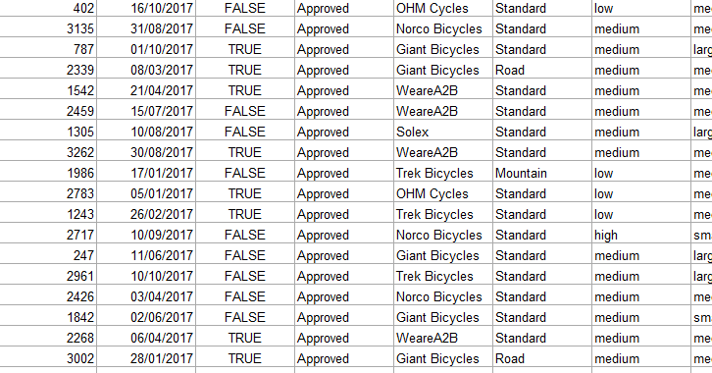

Introduction
Here we shall be discussing about the various methodology we are going to apply on the data provided by you to something best out of it which will be helpful for decision making in the upcoming business years.
Data exploration
Model Development
We will be following the same path as stated earlier also which is:
Interpretations

Slide 4
Data Exploration
First of all Understanding the characteristics of given fields in the underlying data such as variable distributions.
The dataset is skewed towards a certain demographic and the data validity of the fields.
How will this impact your results when using it to predict over the remaining customer base.
There are some limitations in the given datasets like some values are missing and some data types are different according to their value.
Ensuring that the data types are appropriate and rolling data up to an aggregated level.
Joining in already aggregated ABS data at a geographic level to create additional variables.

Slide 5
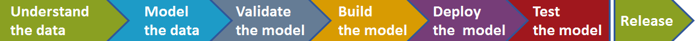
Model Development
First of all, we have to determine a hypothesis related to the business question that can be answered with the help of existing data. Perform statistical testing to determine if the hypothesis is valid or not.
Create calculated fields based on existing data, for example, convert the D.O.B into an age bracket.
Test the performance of the model using factors like residual deviance, AIC, ROC curves, R Squared). Appropriately according to the model performance, assumptions and limitations.

Slide 6
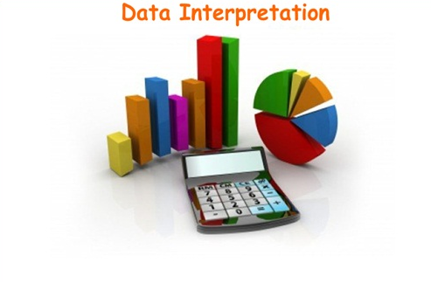
Interpretation
Visualizing the and presentation of findings. This may involve interpreting the significant variables and co-efficient from a business perspective.
With the help of visualization, we get an idea around the business issue and support our case with quantitative and qualitative observations.

Slide 7
Thank You

