Slide 1


What are the trends in the underlying data?
Which customer segment has the highest customer value?
What do you propose should be Sprocket Central Pty Ltd ’s marketing and growth strategy?

Slide 2
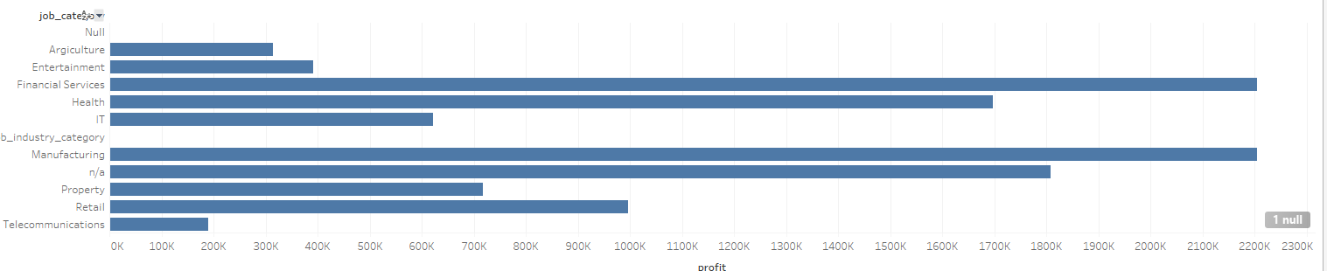
Trends in the provided dataset

Slide 3
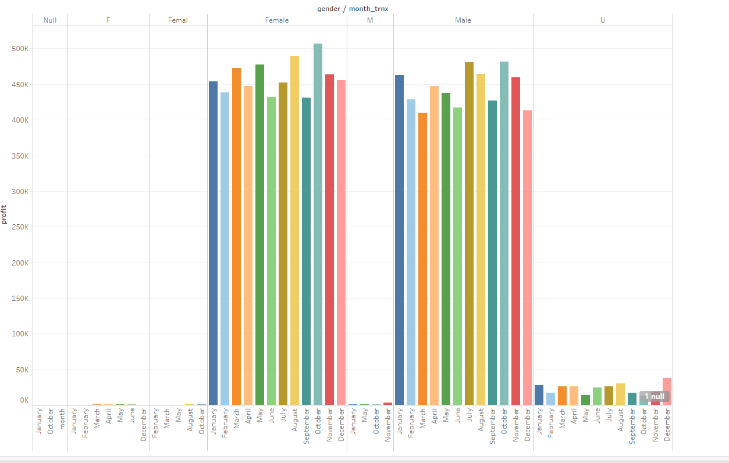

Slide 4
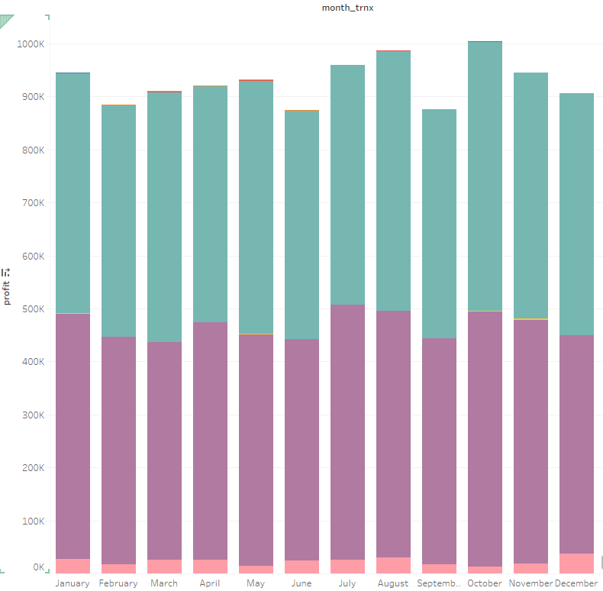
What are the

Slide 5
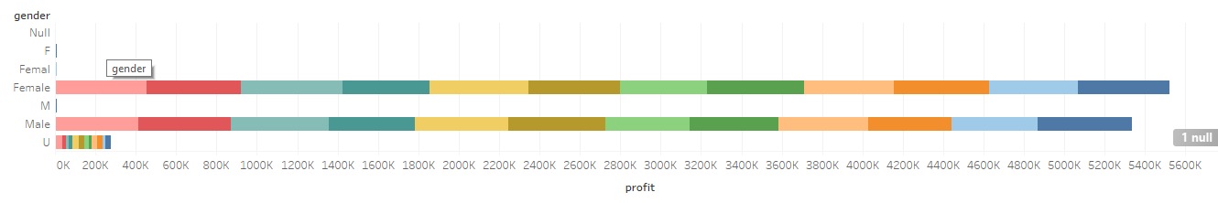
Gender trends which decides the profit of company

Slide 6
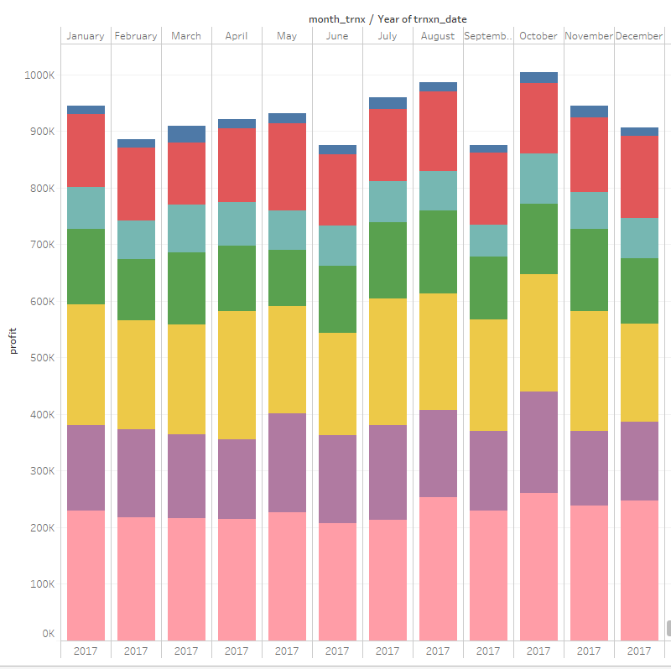
Monthly transaction value analysis brands wise

Slide 7
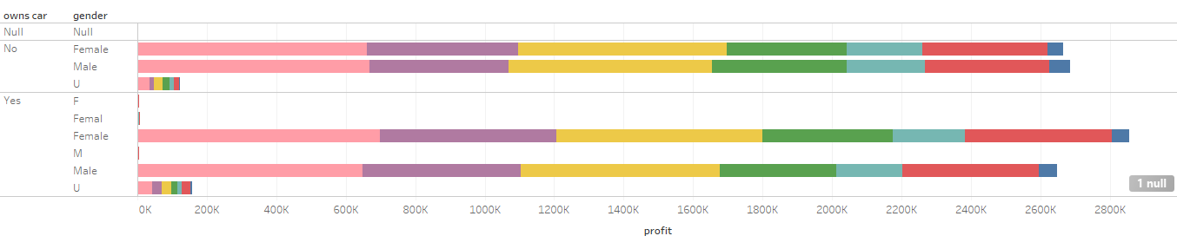
Customer segment valuation

Slide 8
Thank you

