Slide 1
Fachprojekt 1
Phil Seißelberg, Gajann Sivarajah, Jan Schulte

Slide 2
Table of Contents
Foundation
Algorithm 1 : kWPO-JointHeur
Algorithm 2 : Topo_kWP-JointHeur
Algorithm 3 : Nodes_kWP-JointHeur
Conclusion
Replication: Other Group

Slide 3
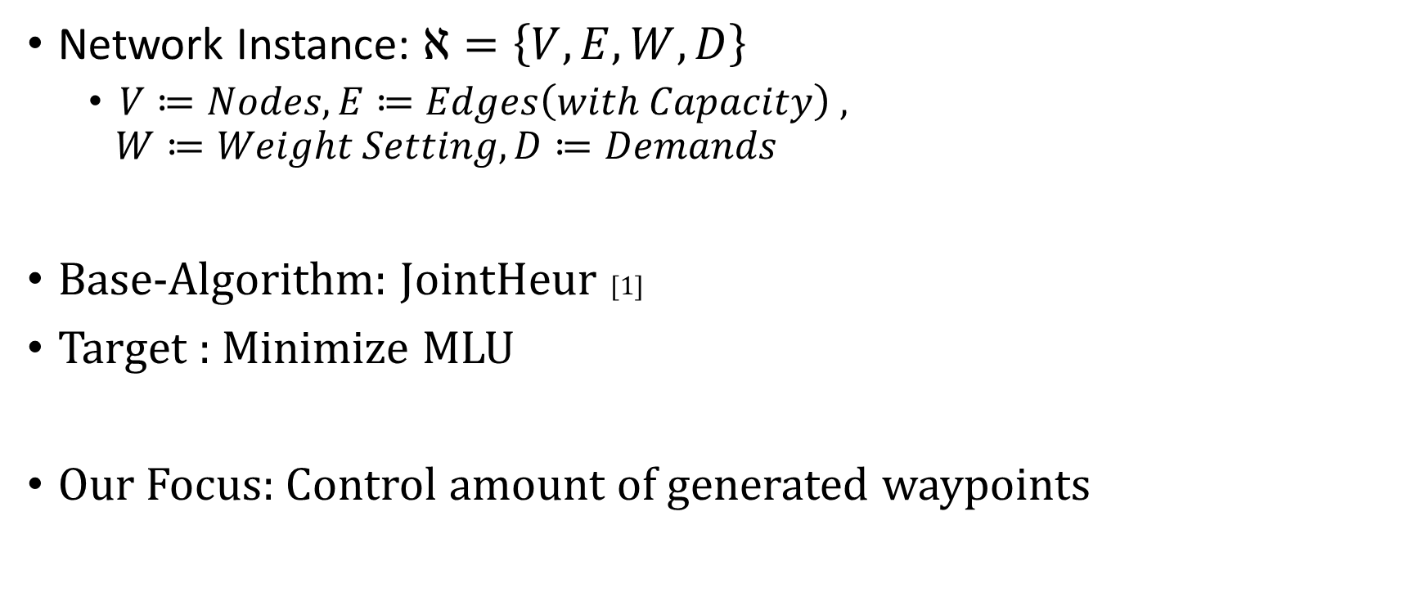
Foundation
Network Instance: $ℵ=\left\{V,E,W,D\right\}$
$V≔Nodes, E≔Edges\left(with Capacity\right) ,$
$$W≔Weight Setting, D≔Demands$$
Base-Algorithm: JointHeur [1]
Target : Minimize MLU
Our Focus: Control amount of generated waypoints

Slide 4





kWPO-JointHeur: Iterate GreedyWPO
Algorithm 1
JointHeur
$$V,E,D$$
HeurOSPF
$$V,E,D$$
$$W_{OSPF}$$
GreedyWPO
$$V,E$$
$$D_{WP}$$
$$W_{OSPF}$$
[1]

Slide 5
kWPO-JointHeur: Iterate GreedyWPO
Algorithm 1
JointHeur
Motivation:
Allow multiple waypoints per demand
$$V,E,D$$
HeurOSPF
$$V,E,D$$
$$W_{OSPF}$$
GreedyWPO
$$V,E$$
$$D_{WP}$$
$$W_{OSPF}$$
[1]

Slide 6

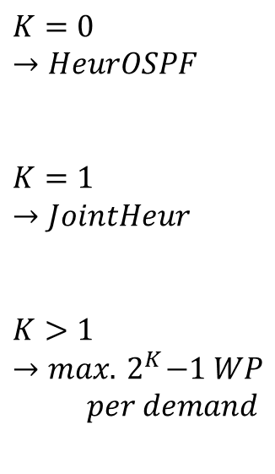





kWPO-JointHeur: Iterate GreedyWPO
Algorithm 1
JointHeur
kWPO-JointHeur
$$K=0$$
$$→HeurOSPF$$
$$K=1$$
$$→JointHeur$$
$$K>1$$
$$→max.{ 2}^{K}−1 WP$$
$$per demand$$
$$V,E,D$$
$$V,E,D$$
HeurOSPF
HeurOSPF
$$V,E,D$$
$$W_{OSPF}$$
$$V,E,D$$
$$W_{OSPF}$$
$$D_{WP}^{k}$$
GreedyWPO
K- times
GreedyWPO
$$V,E$$
$$D_{WP}$$
$$W_{OSPF}$$
$$V,E$$
$$D_{WP}^{K},W_{OSPF}$$
[1]

Slide 7
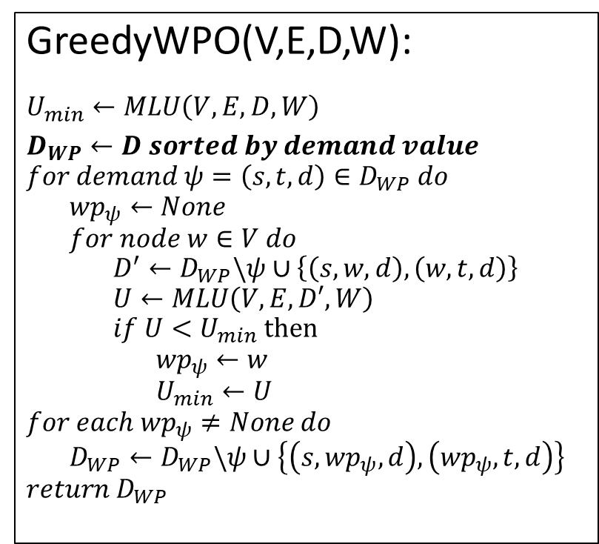
kWPO-JointHeur: Sort by Capacity
Algorithm 1
GreedyWPO(V,E,D,W):
$$U_{min}←MLU\left(V,E,D,W\right)$$
$$D_{WP}←D sorted by demand value$$
$$for demand ψ=\left(s,t,d\right)∈D_{WP} do$$
$${wp}_{ψ}←None$$
$$for node w∈V do$$
$$D^{′}←D_{WP}\backslash ψ∪\left\{\left(s,w,d\right),\left(w,t,d\right)\right\}$$
$$U←MLU\left(V,E,D′,W\right)$$
$$if U<U_{min} then$$
$${wp}_{ψ}←w$$
$$U_{min}←U$$
$$for each {wp}_{ψ}≠None do$$
$$D_{WP}←D_{WP}\backslash ψ∪\left\{\left(s,{wp}_{ψ},d\right),\left({wp}_{ψ}, t,d\right)\right\}$$
$$return{ D}_{WP}$$
Motivation:
Order of demands influences performance
Use topology-dependent criteria
[2]

Slide 8

kWPO-JointHeur: Sort by Capacity
Algorithm 1
$$≔c(e)$$
GreedyWPO(V,E,D,W):
$$U_{min}←MLU\left(V,E,D,W\right)$$
$$D_{WP}←D sorted by demand value$$
$$for demand ψ=\left(s,t,d\right)∈D_{WP} do$$
$${wp}_{ψ}←None$$
$$for node w∈V do$$
$$D^{′}←D_{WP}\backslash ψ∪\left\{\left(s,w,d\right),\left(w,t,d\right)\right\}$$
$$U←MLU\left(V,E,D′,W\right)$$
$$if U<U_{min} then$$
$${wp}_{ψ}←w$$
$$U_{min}←U$$
$$for each {wp}_{ψ}≠None do$$
$$D_{WP}←D_{WP}\backslash ψ∪\left\{\left(s,{wp}_{ψ},d\right),\left({wp}_{ψ},t,d\right)\right\}$$
$$return{ D}_{WP}$$
S
T
Stärkere Entlastung
WP
Schwächere Entlastung
S
T
[2]

Slide 9
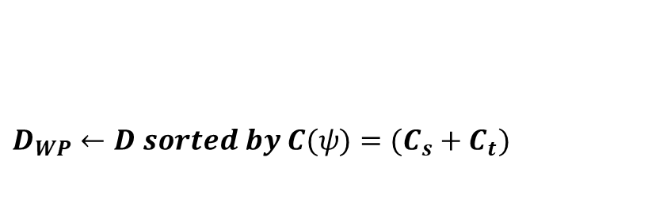
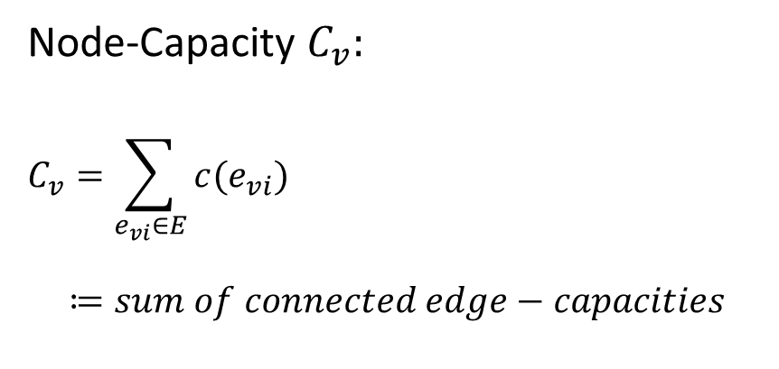
kWPO-JointHeur: Sort by Capacity
Algorithm 1
GreedyWPO(V,E,D,W):
$$U_{min}←MLU\left(V,E,D,W\right)$$
$$D_{WP}←D sorted by demand value$$
$$for demand ψ=\left(s,t,d\right)∈D_{WP} do$$
$${wp}_{ψ}←None$$
$$for node w∈V do$$
$$D^{′}←D_{WP}\backslash ψ∪\left\{\left(s,w,d\right),\left(w,t,d\right)\right\}$$
$$U←MLU\left(V,E,D′,W\right)$$
$$if U<U_{min} then$$
$${wp}_{ψ}←w$$
$$U_{min}←U$$
$$for each {wp}_{ψ}≠None do$$
$$D_{WP}←D_{WP}\backslash ψ∪\left\{\left(s,{wp}_{ψ},d\right),\left({wp}_{ψ},t,d\right)\right\}$$
$$return{ D}_{WP}$$
$$D_{WP}←D sorted by C(ψ)=(C_{s}+C_{t})$$
Node-Capacity $C_{v}:$
$$C_{v}=\sum_{e_{vi}∈E}{c(e_{vi})}$$
$$≔sum of connected edge−capacities$$
[2]

Slide 10
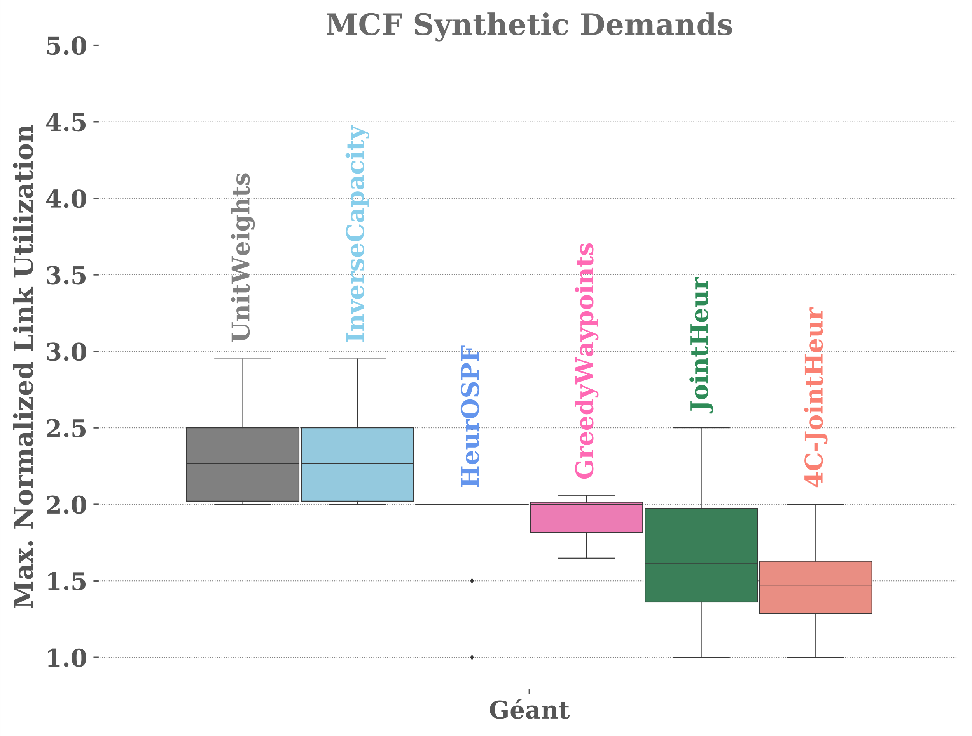
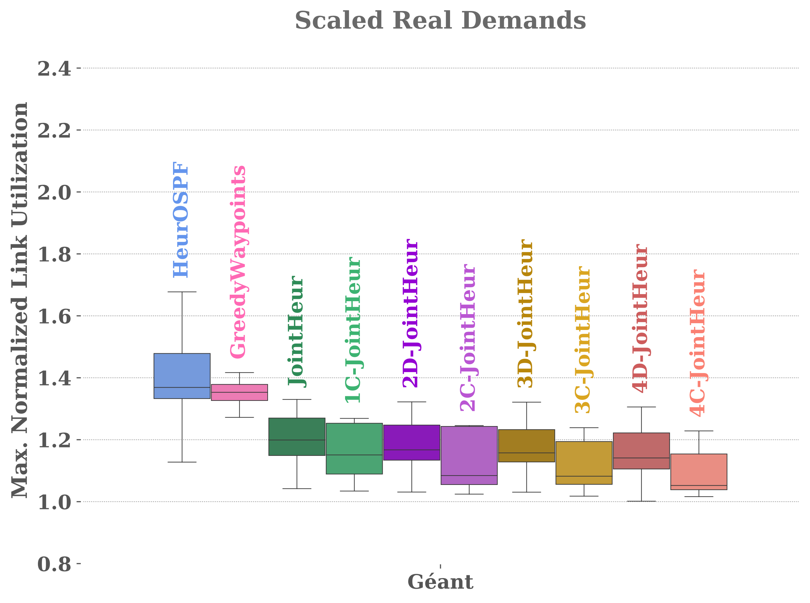
kWPO-JointHeur: Results
Algorithm 1

Slide 11
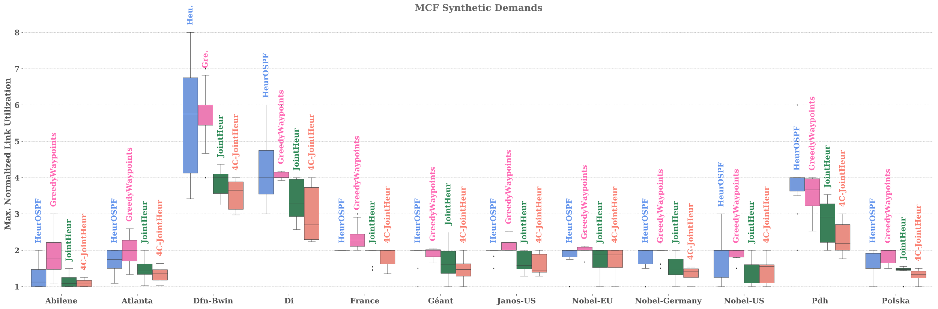
kWPO-JointHeur: Results
Algorithm 1

Slide 12
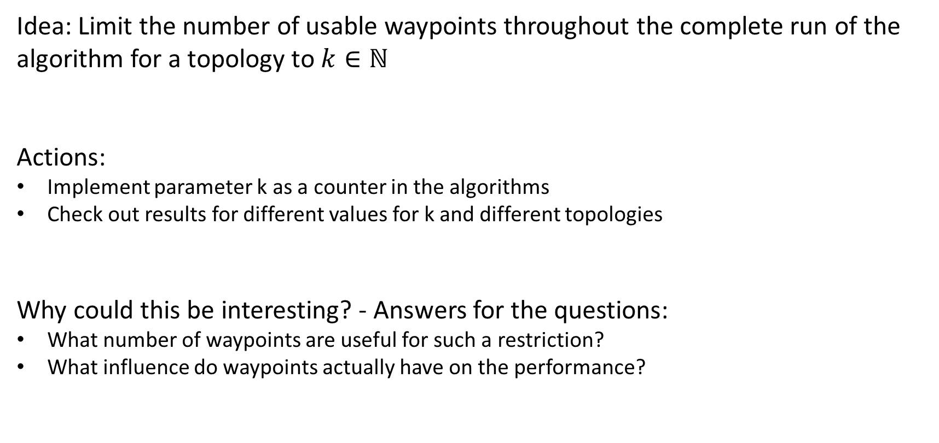
kWP per Topology: Concept
Algorithm 2
Idea: Limit the number of usable waypoints throughout the complete run of the algorithm for a topology to $k∈ℕ$
Actions:
Implement parameter k as a counter in the algorithms
Check out results for different values for k and different topologies
Why could this be interesting? - Answers for the questions:
What number of waypoints are useful for such a restriction?
What influence do waypoints actually have on the performance?

Slide 13
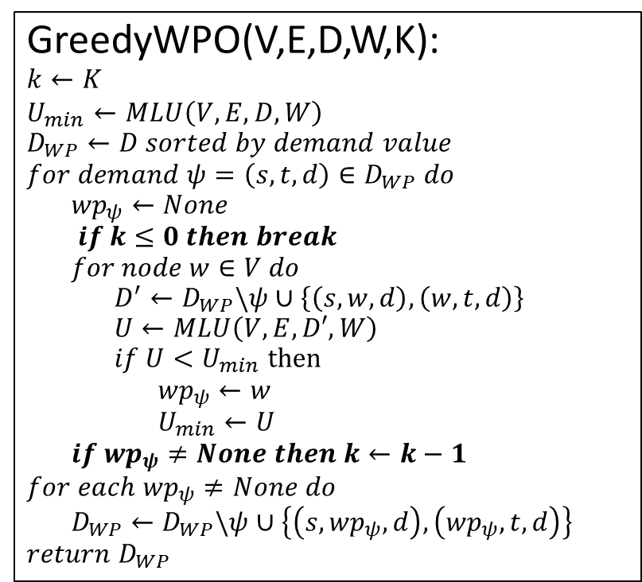
kWP per Topology: Prototype
Algorithm 2
GreedyWPO(V,E,D,W,K):
$$k←K$$
$$U_{min}←MLU\left(V,E,D,W\right)$$
$$D_{WP}←D sorted by demand value$$
$$for demand ψ=\left(s,t,d\right)∈D_{WP} do$$
$${wp}_{ψ}←None$$
$$if k≤0 then break$$
$$for node w∈V do$$
$$D^{′}←D_{WP}\backslash ψ∪\left\{\left(s,w,d\right),\left(w,t,d\right)\right\}$$
$$U←MLU\left(V,E,D′,W\right)$$
$$if U<U_{min} then$$
$${wp}_{ψ}←w$$
$$U_{min}←U$$
$$if {wp}_{ψ}≠None then k←k−1$$
$$for each {wp}_{ψ}≠None do$$
$$D_{WP}←D_{WP}\backslash ψ∪\left\{\left(s,{wp}_{ψ},d\right),\left({wp}_{ψ},t,d\right)\right\}$$
$$return{ D}_{WP}$$
[2]

Slide 14
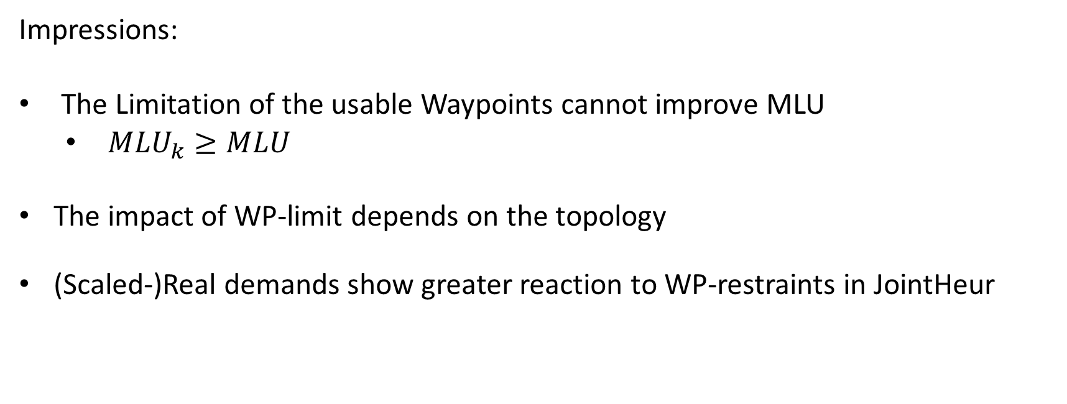
kWP per Topology: Results
Algorithm 2
Impressions:
The Limitation of the usable Waypoints cannot improve MLU
${MLU}_{k}≥MLU$
The impact of WP-limit depends on the topology
(Scaled-)Real demands show greater reaction to WP-restraints in JointHeur

Slide 15
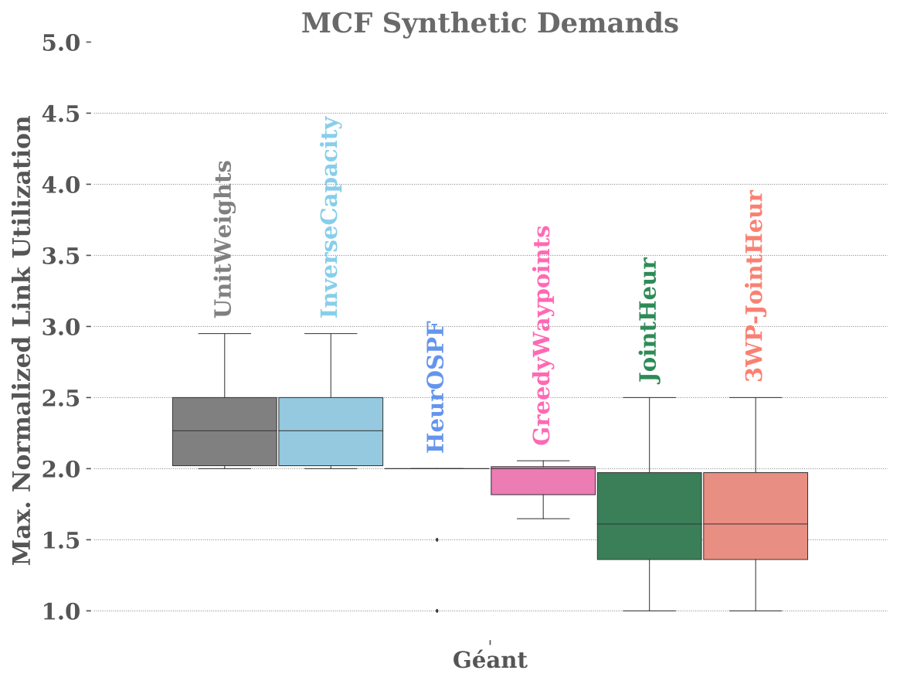
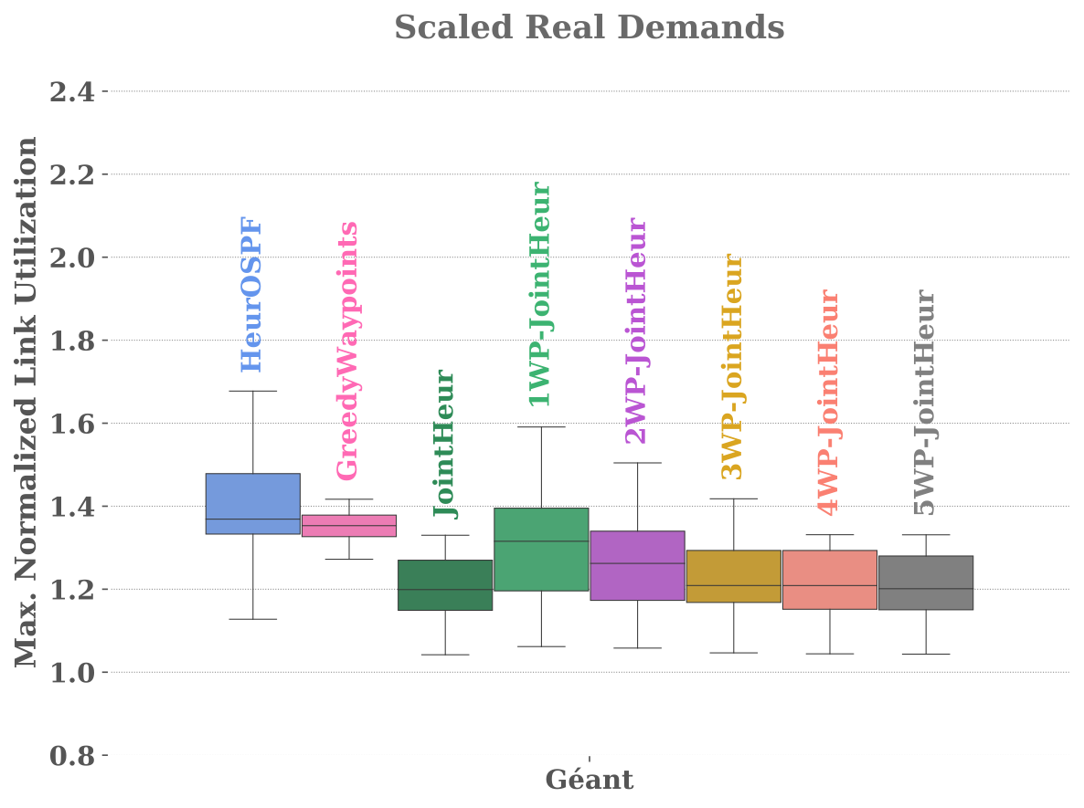
kWP per Topology: Results
Algorithm 2
Synthetic Demands :
Limitation seems to not affect MLU

Slide 16
kWP per Topology: Results
Algorithm 2
Real Demands :
MLU improves with each waypoint
JointHeur shows measurable reaction to limit

Slide 17
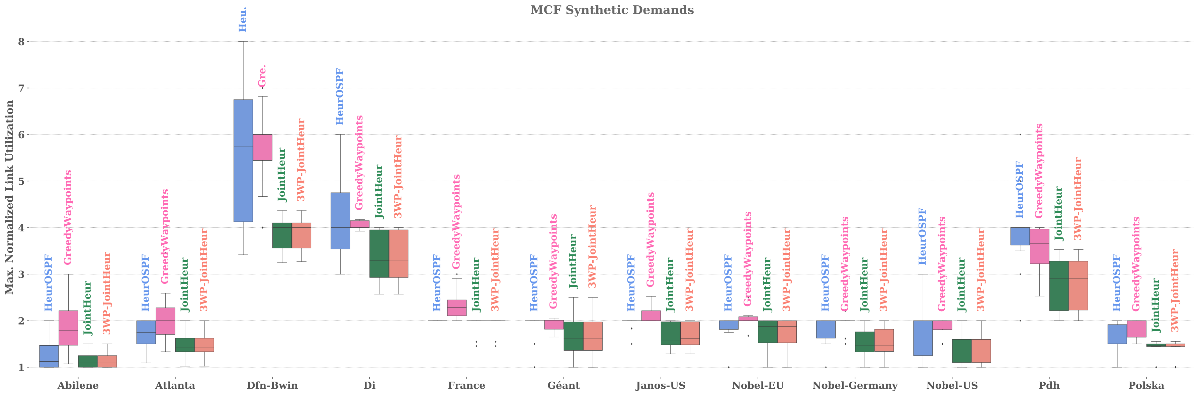
kWP per Topology: Results
Algorithm 2

Slide 18
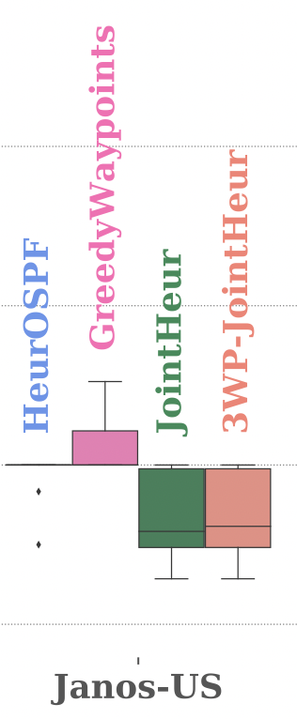
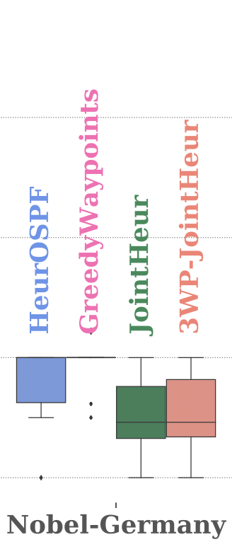
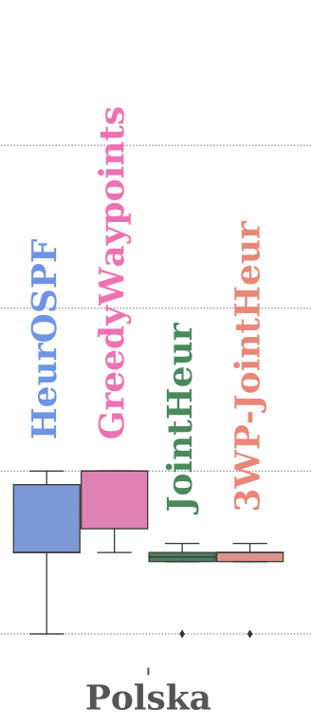
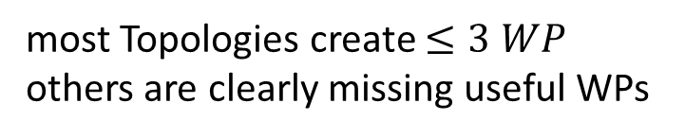
kWP per Topology: Results
Algorithm 2
Test over multiple Topologies:
most Topologies create $≤3 WP$
others are clearly missing useful WPs

Slide 19
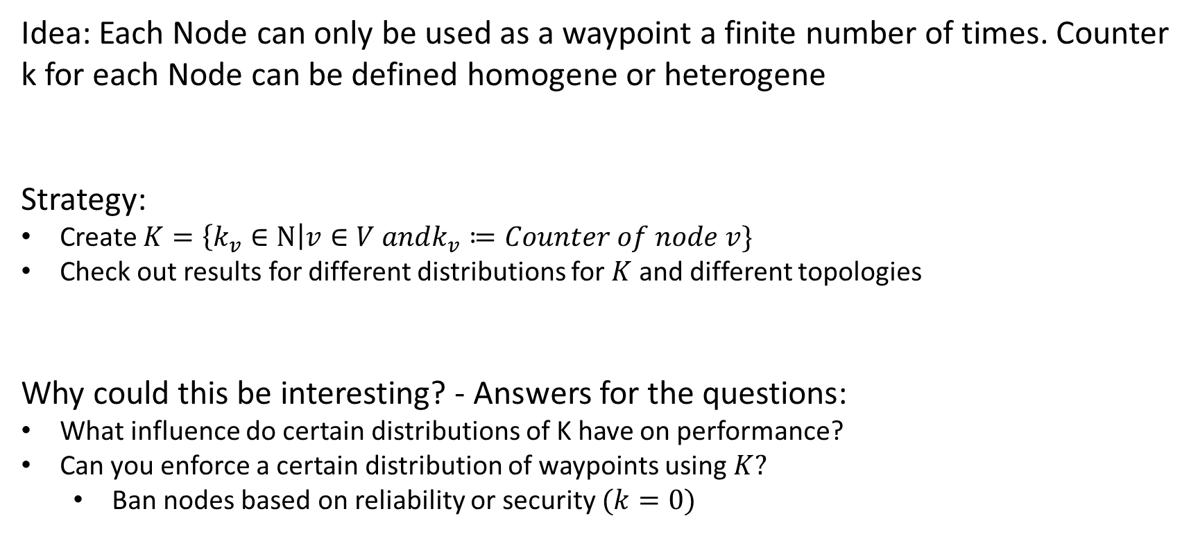
kWP per Node: Concept
Algorithm 3
Idea: Each Node can only be used as a waypoint a finite number of times. Counter k for each Node can be defined homogene or heterogene
Strategy:
Create $K=\left\{k_{v}∈Ν\right|v∈V andk_{v}≔Counter of node v\}$
Check out results for different distributions for $K$ and different topologies
Why could this be interesting? - Answers for the questions:
What influence do certain distributions of K have on performance?
Can you enforce a certain distribution of waypoints using $K?$
Ban nodes based on reliability or security $(k=0)$

Slide 20
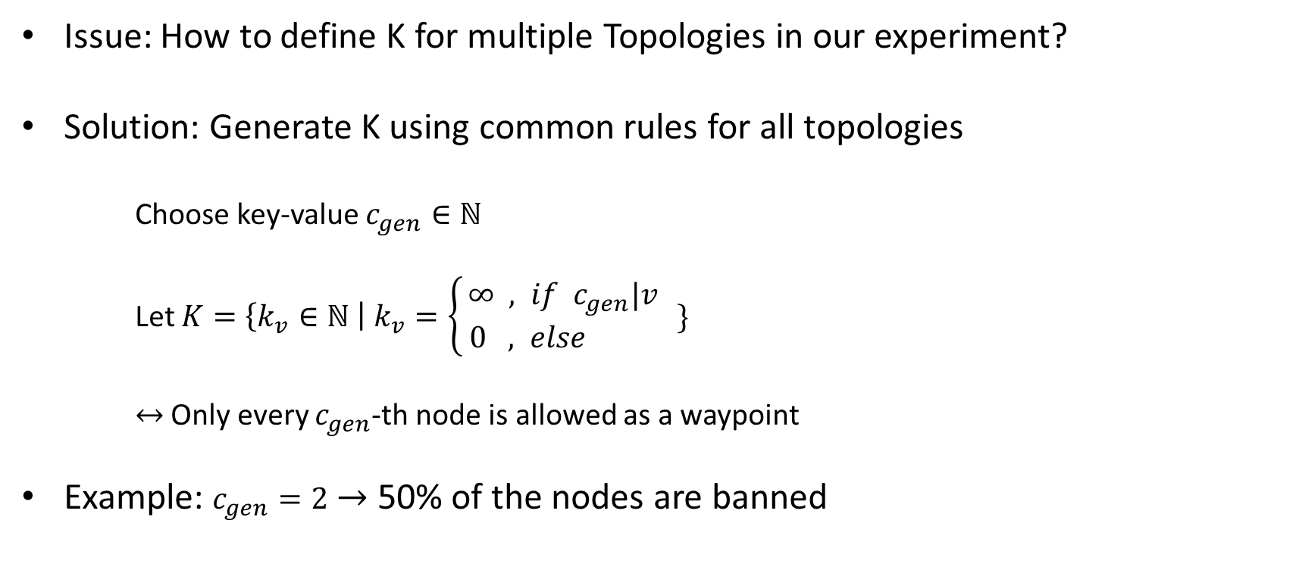
kWP per Node: Practical
Algorithm 3
Issue: How to define K for multiple Topologies in our experiment?
Solution: Generate K using common rules for all topologies
Choose key-value $c_{gen}∈ℕ$
Let $K=\left\{k_{v}∈ℕ \right| k_{v}=\left\{\begin{aligned}∞ , if c_{gen}|v \\ 0 , else \end{aligned}\right. \}$
$↔$ Only every $c_{gen}$-th node is allowed as a waypoint
Example: $c_{gen}=2$ $→$ 50% of the nodes are banned

Slide 21
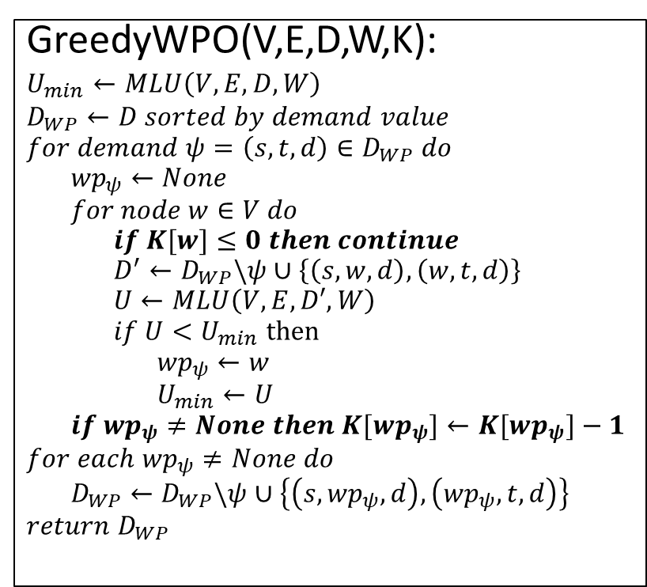
kWP per Node: Prototype
Algorithm 3
GreedyWPO(V,E,D,W,K):
$$U_{min}←MLU\left(V,E,D,W\right)$$
$$D_{WP}←D sorted by demand value$$
$$for demand ψ=\left(s,t,d\right)∈D_{WP} do$$
$${wp}_{ψ}←None$$
$$for node w∈V do$$
$$if K[w]≤0 then continue$$
$$D^{′}←D_{WP}\backslash ψ∪\left\{\left(s,w,d\right),\left(w,t,d\right)\right\}$$
$$U←MLU\left(V,E,D′,W\right)$$
$$if U<U_{min} then$$
$${wp}_{ψ}←w$$
$$U_{min}←U$$
$$if {wp}_{ψ}≠None then K[{wp}_{ψ}]←K[{wp}_{ψ}]−1$$
$$for each {wp}_{ψ}≠None do$$
$$D_{WP}←D_{WP}\backslash ψ∪\left\{\left(s,{wp}_{ψ},d\right),\left({wp}_{ψ},t,d\right)\right\}$$
$$return{ D}_{WP}$$
[2]

Slide 22
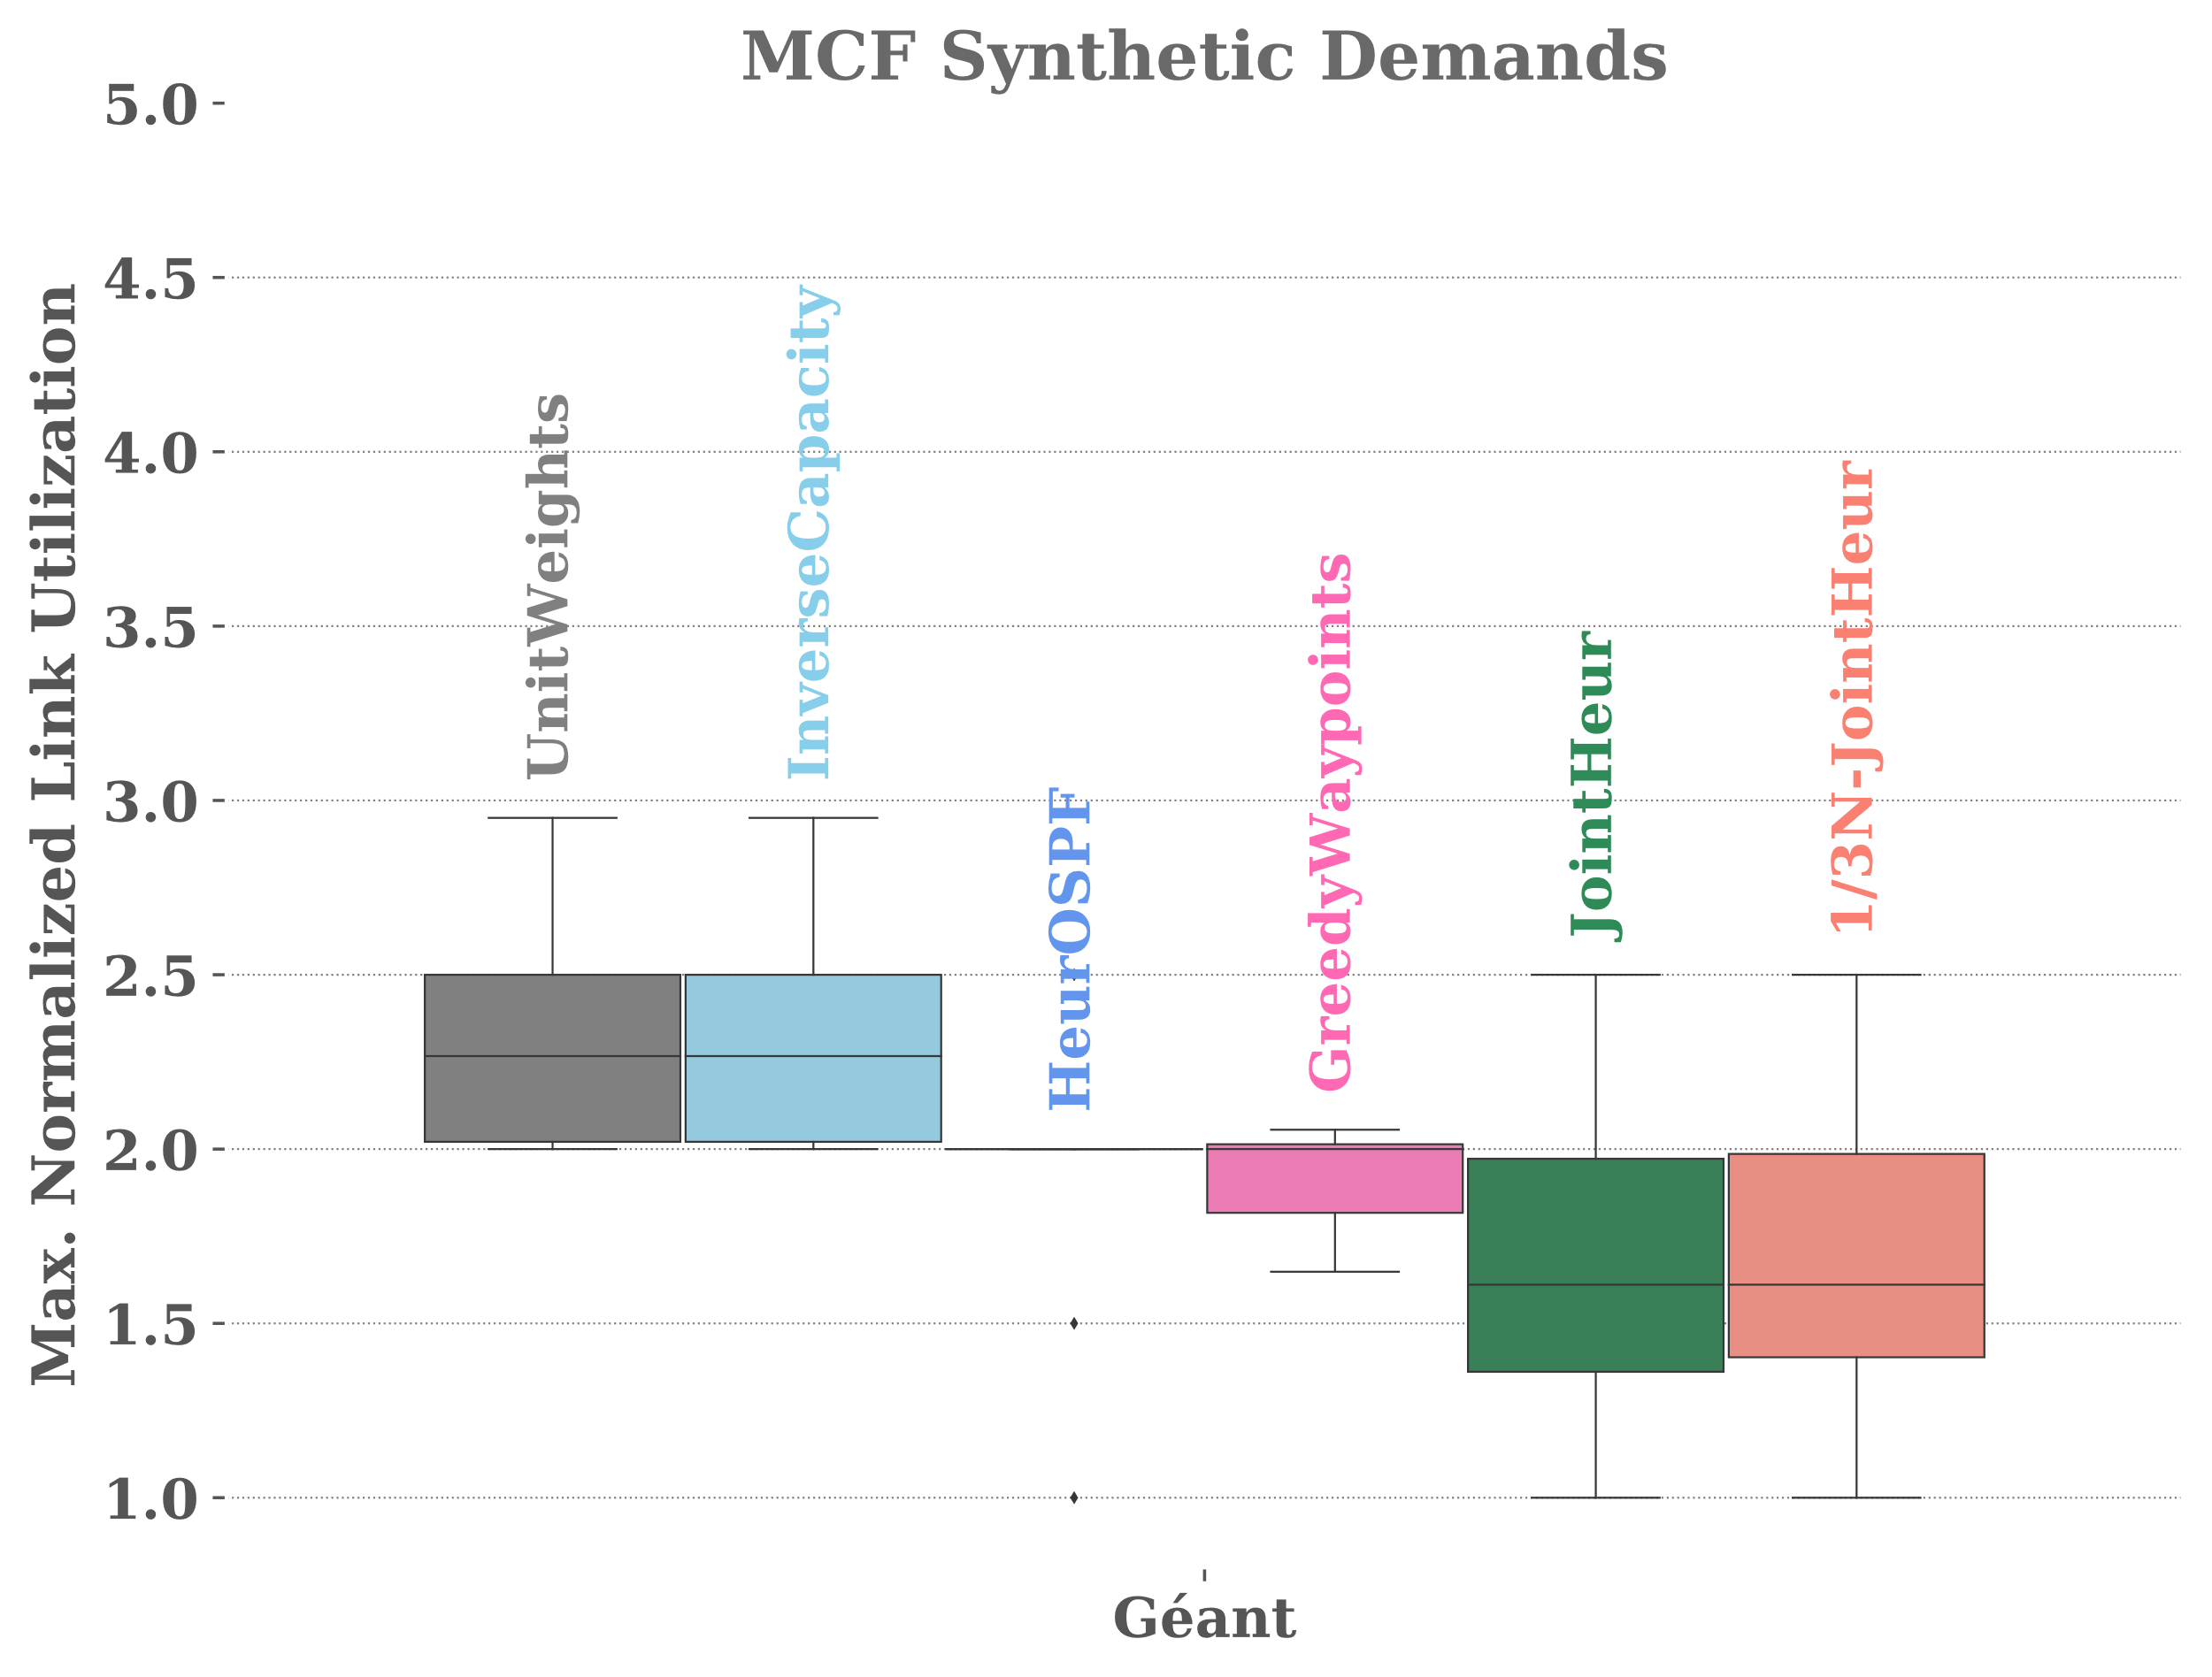
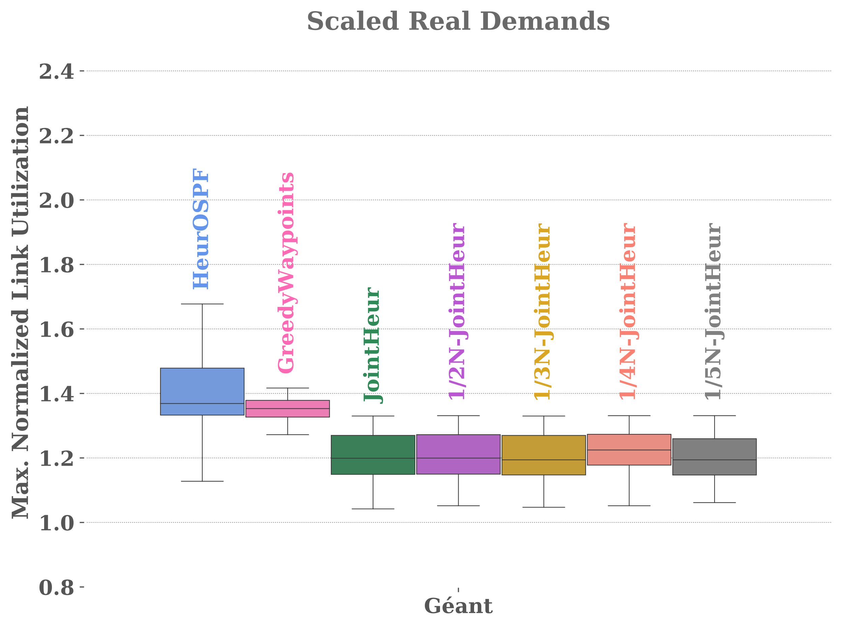
kWP per Node: Results

Slide 23
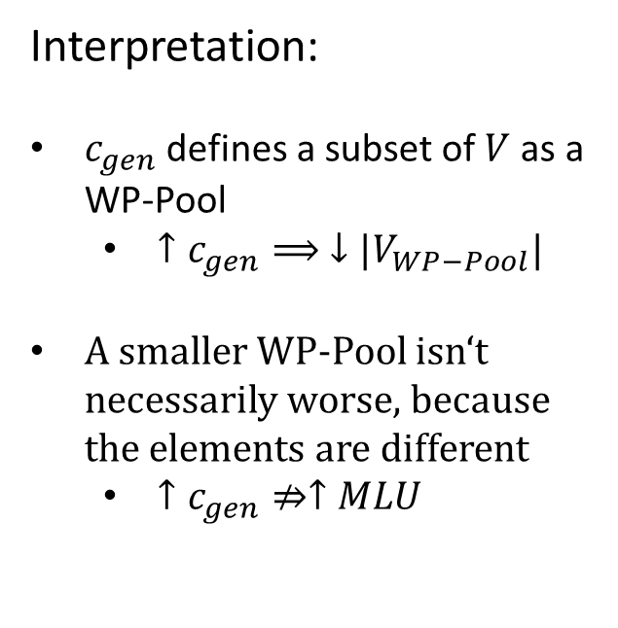
kWP per Node: Results
Interpretation:
$c_{gen}$ defines a subset of $V$ as a WP-Pool
$↑c_{gen}⟹ ↓|V_{WP−Pool}|$
A smaller WP-Pool isn‘t necessarily worse, because the elements are different
$↑c_{gen}⇏↑MLU$

Slide 24
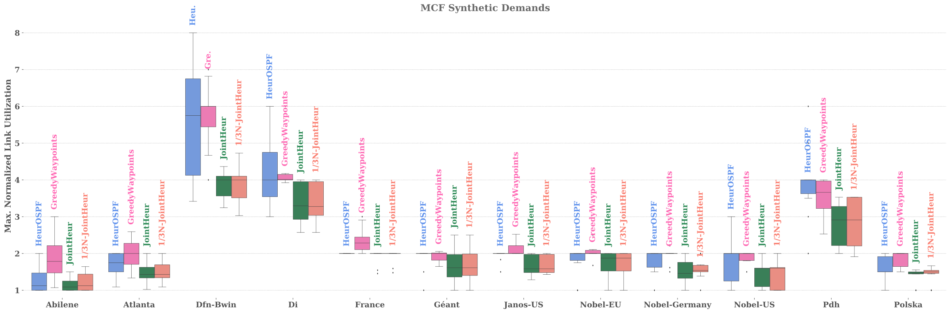
kWP per Node: Results

Slide 25
Conclusion
Topology‘s susceptibility towards waypoints determines whether our constraints have a measurable influence
Some topologies didn‘t react to our algorithms at all
Future Idea
Combine all algorithms and constraints

Slide 26
Future Idea - Combination
ALG1: kWPO
Benefit: Eliminate upper limit of possibly generated waypoints
Problem: Number of waypoints per iteration not predictable $→$ How many iterations?
ALG2: Topo-kWP
Solution: Keep iteration high, but cap actually generated waypoints
Problem: Risk of cutting off „desirable“ waypoints
ALG3: Nodes-kWP
Solution: Etch prioritisation into waypoint generation
Problem: Which criterias to consider when choosing a distribution?

Slide 27
Replication – Code
Distribution
Public Repository on Github
Additional preconfigured VM-Image
Execution
No errors
high(to be expected) runtime
Results
Additional algorithms were added to existing plots
Plots illustrating processing time

Slide 28
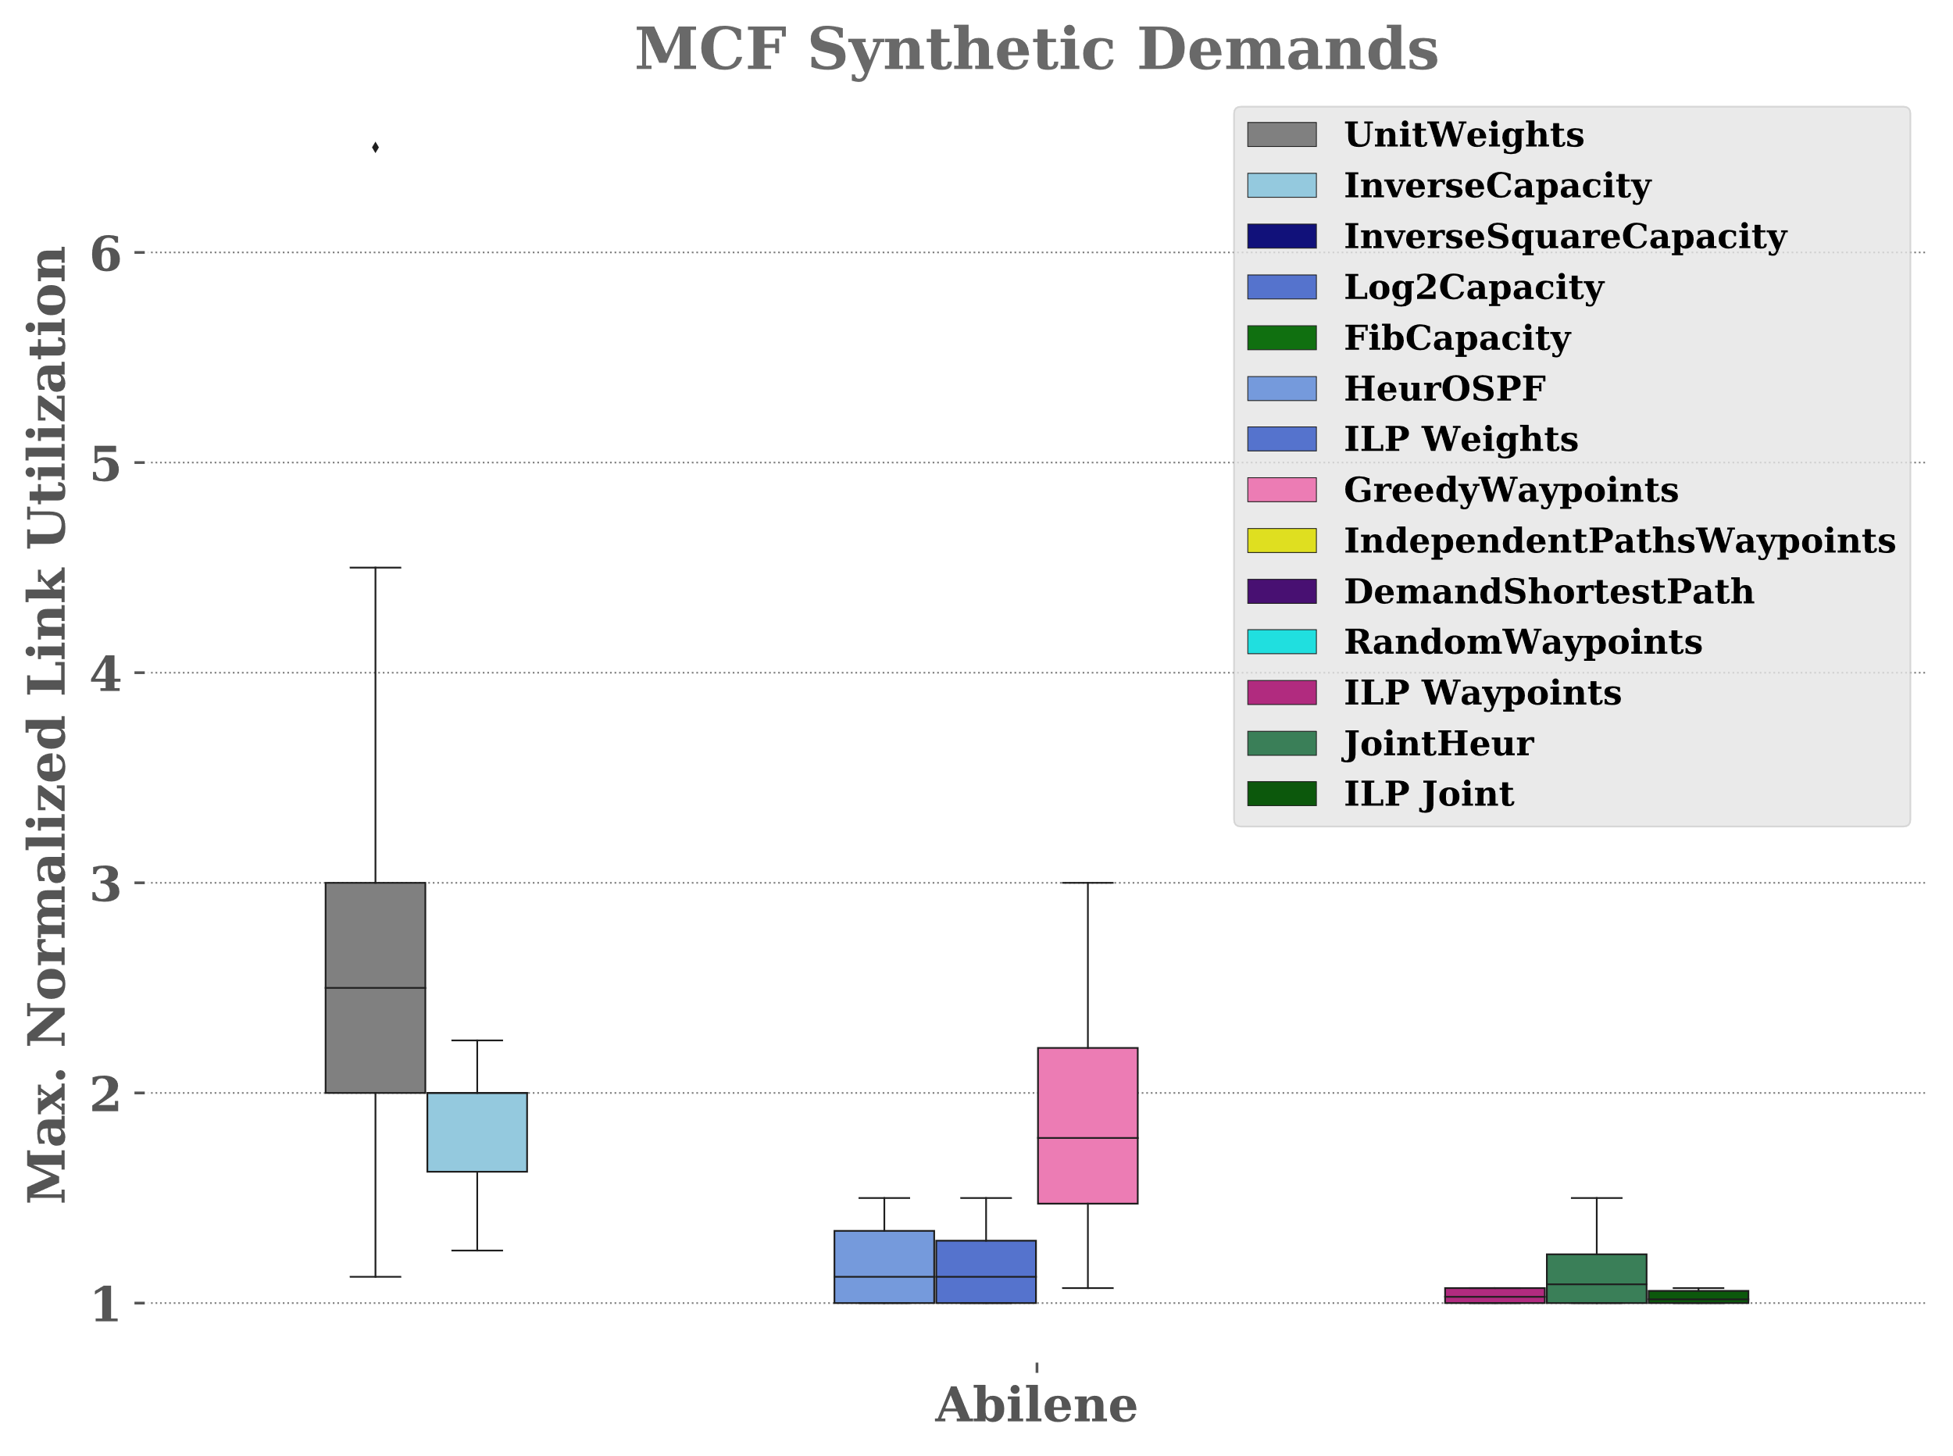
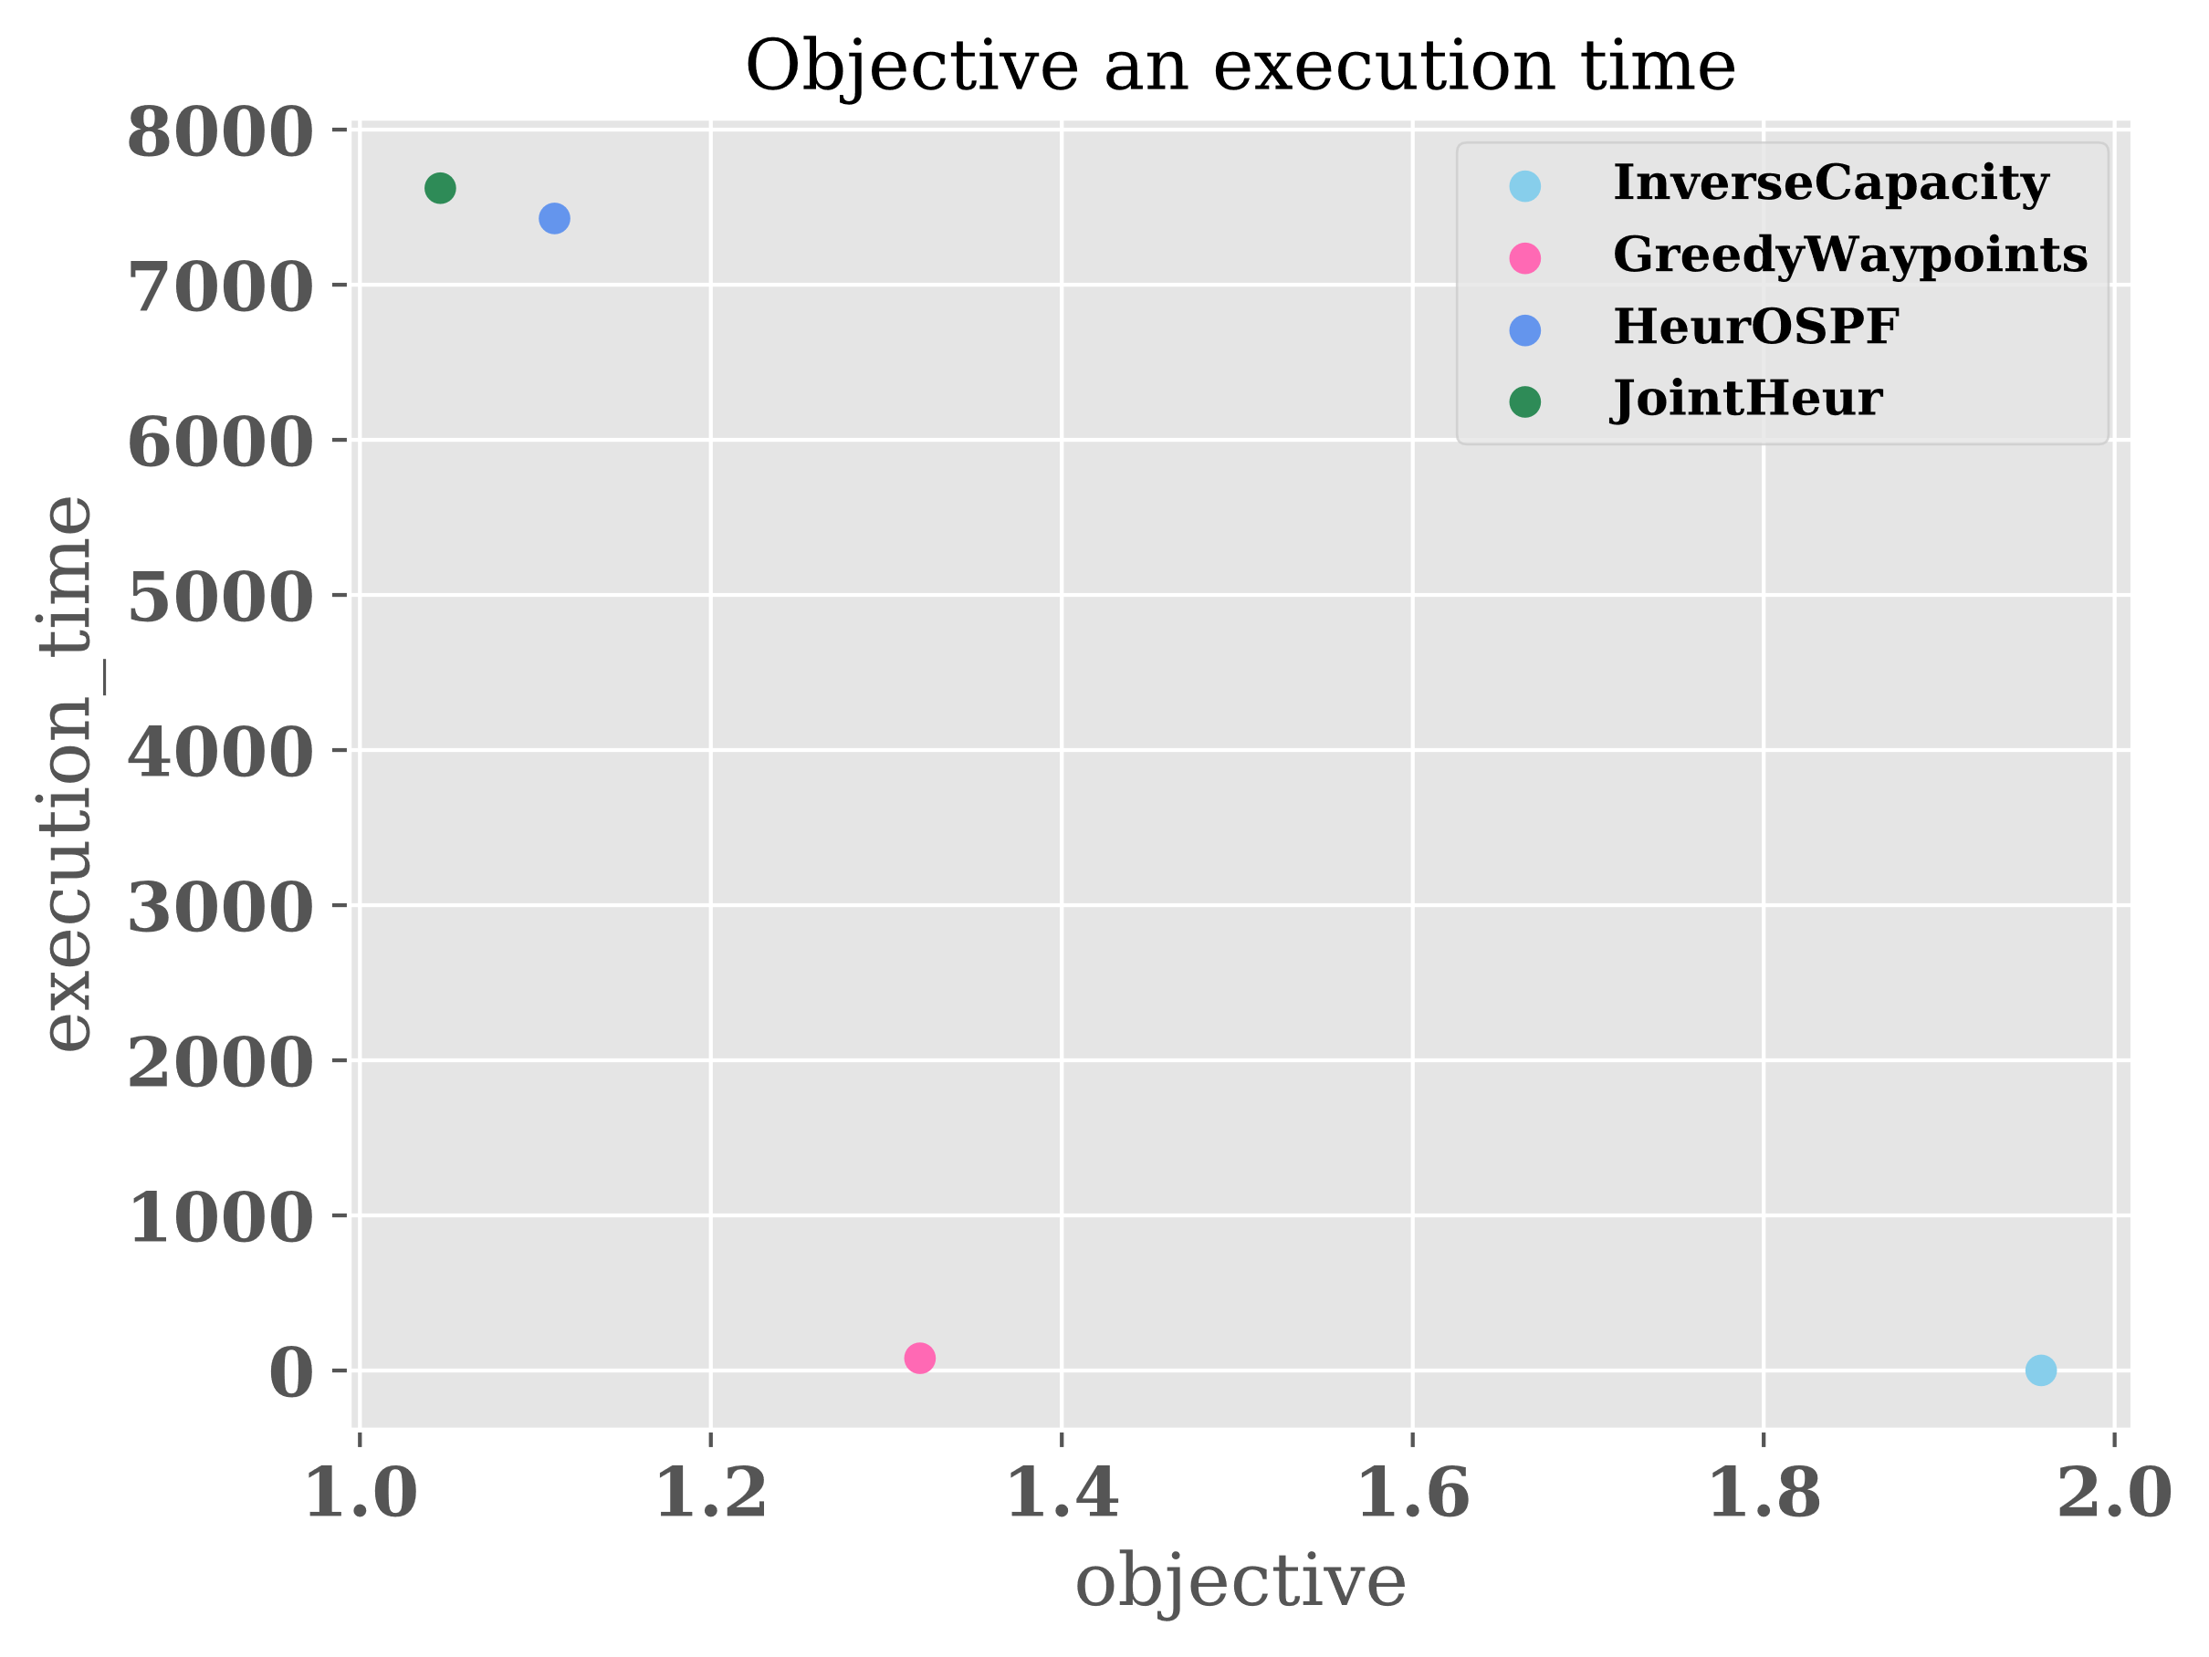
Replication - Plots

Slide 29
Sources
[1]: Thomas Fenz, Klaus-Tycho Förster, Mahmoud Parham, Stefan Schmid, Nikolaus Süß:
Traffic Engineering with Joint Link Weight and Segment Opitmization: Algorithm 2
[2]: Thomas Fenz, Klaus-Tycho Förster, Mahmoud Parham, Stefan Schmid, Nikolaus Süß:
Traffic Engineering with Joint Link Weight and Segment Opitmization: Algorithm 3

