Slide 1
COMPUTATIONAL FORENSICS · PROGRESS UPDATE, WEEKS 1–8
The Paradox of
Authorial Identity
T0
›
T1
›
T2
›
T3
Human original
First paraphrase
Repeated AI paraphrasing keeps a text's meaning while replacing its author's style. We now measure how fast, feature by feature.
Second paraphrase
Third paraphrase
Measured after three ChatGPT rounds (700 documents)
Meaning kept
85%
Style kept (best feature group)
≤34%
TEAM 5
Preethi Gajawada • Tanmayee Durga Bulusu • Madhu Babu Cherukuri • Teja Papadasu
NLP Project | Northeastern University | Ship of Theseus paraphrased corpus (Tripto et al., ACL 2024)
Notes:
We study what happens to a text's authorial identity when an LLM paraphrases it again and again. Headline result so far: after three rounds of ChatGPT, about 85% of the meaning is still there, but even the most durable style feature group keeps at most a third of its original signal. This update covers Weeks 1 to 8: the data pipeline, the baseline similarity metrics, and a first answer to RQ1.

Slide 2
02
Where we are
Weeks 1–8 complete; checkpoints met for Weeks 2, 4, 6 and 8
WEEKS 1–4
WEEKS 5–8
WEEKS 9–12
WEEKS 13–14
Data and baselines
Feature profiling · RQ1
Identity forensics · RQ2, RQ3
Synthesis
• Corpus loaded: 7 datasets, 14 files
• Cleaning, chain alignment, splits
• BLEU, ROUGE-L, BERTScore, SBERT
• Lexical + syntactic features (spaCy)
• Per-document decay on one scale
• Preliminary answer to RQ1
• Attribution: SVM + RoBERTa
• Point of no return per paraphraser
• Paraphraser fingerprinting
• Identity-trajectory visuals
• Streamlit dashboard
• ACL-format paper
Done
Done
Next
Planned
Repository
src/ (data · features · similarity · visualization) • experiments/ • figures/ • notebooks/ 01–05 • paper/ — every step runs from the README
Checkpoints: Week 2 data loads + T0→T3 shown · Week 4 baseline similarity · Week 6 five stylometric features + decay plot · Week 8 RQ1 drafted
Notes:
We have finished the first two phases. Phase one built the data pipeline and the baseline similarity metrics; phase two built lexical and syntactic feature profiles and gave us a preliminary answer to RQ1. Next are the attribution experiments for RQ2 and the paraphraser-fingerprint experiments for RQ3.

Slide 3
03
Research questions
One corpus, three questions about identity under iterative paraphrasing
RQ1
RQ2
RQ3
Style vs. content decay
The point of no return
Paraphraser fingerprints
Which “planks” are replaced first: stylistic features (POS, dependency depth, punctuation, vocabulary) or semantic content (SBERT, BERTScore)?
At which iteration does the text lose its original identity? Does attribution accuracy drop sharply at T1 or gradually?
Do ChatGPT, PaLM2, Pegasus and DIPPER leave distinct “wood grain”? Can we tell which model replaced the planks?
Preliminary answer today
Weeks 9–11
Weeks 10–12 · early signal today
Contribution: a decay curve that separates human-author signal loss from model-fingerprint gain
Notes:
Our three research questions. Today we can give a preliminary answer to RQ1, and the RQ1 analysis already gives an early signal for RQ3. RQ2 is the next phase.

Slide 4
04
The Ship of Theseus corpus
Tripto et al., ACL 2024 — three dimensions, two kinds of files
7
datasets
Two kinds of files per dataset
xsum · yelp · cmv · eli5 · sci_gen · tldr · wp
news, reviews, opinion, Q&A, science, summaries, stories
 | Paraphrased files | Train files
Contents | T0 + 21 paraphrases | Originals only
Rows | ≈ 420,000 | ≈ 19,500
Used for | RQ1, RQ3, RQ2 test | RQ2 training
7
sources (who wrote T0)
Human + 6 LLMs: OpenAI, LLaMA, PaLM,
Tsinghua, BigScience, Eleuther-AI
7
paraphraser settings
ChatGPT · PaLM2 · DIPPER (default, low, high)
· Pegasus (full, slight) — each applied 3×
No document appears in both (verified) → leakage-free RQ2 design
16,386
19,200
700
aligned T0→T3 chains
training texts
Human docs analysed (100 / domain)
Each record: source, key (links every version to its origin), text, version_name (original, chatgpt, chatgpt_chatgpt, …)
Notes:
The corpus has three dimensions: seven datasets from different domains, seven sources that wrote the original text — one human and six LLMs — and seven paraphraser settings from four models, each applied three times. Each dataset comes with a paraphrased file and a train file. They share no documents, which gives us a clean train/test design for RQ2. After preprocessing we have 16,386 complete chains and 19,200 training texts; today's analyses use a fixed sample of 100 human documents per domain.

Slide 5
05
Preprocessing pipeline
One logged script for all 14 files: src/data/preprocess.py
1
2
3
4
5
6
Load
Clean
Align
Filter
Sanity-check
Split
420k rows,
7 sources,
22 versions
›
Unicode, quotes,
whitespace,
HTML — ≈44% of
rows fixed
›
One row per doc
with all 21
paraphrases;
complete chains
›
Drop T0 with
< 30 words
(≈2%)
›
No-op steps;
unrelated
outputs flagged
›
Train/val by key
(85/15) +
leakage check
WHY CLEAN?
WHAT WE DELIBERATELY DON'T DO
Sources format text differently (DIPPER outputs start with a space; some models use curly quotes). Without cleaning, punctuation features would measure formatting, not style.
No lower-casing, stop-word removal, stemming or truncation: they would destroy the stylistic signal we measure, and truncating T0 would misalign it with its paraphrases.
Chain retention 90–97% for most domains; SciGen 58% and WP 69% (many PaLM chains missing). Log: experiments/logs/preprocess.log
Notes:
Six steps, each logged with before-and-after counts. Cleaning matters because different sources format text differently, which would otherwise show up as fake style differences. We keep only documents with complete chains for all seven paraphrasers, so every paraphraser is compared on the same texts. And we split the training files by key, so a human text and the LLM texts generated from its prompt never end up on both sides.

Slide 6
06
A data-quality finding: DIPPER (high)
Our sanity check caught unusable chains in the released corpus
54–95%
EXAMPLE · XSUM-8070
T0 (BBC news)
of T1 outputs share < 10% of their words with T0, in 5 of 7 domains
“Galvani Bioelectronics hopes to bring a new treatment based on the technique before regulators within seven years…”
0.06
T1 by DIPPER (high)
“At the end of the same season when I was admitted to the pramite, the doctor received me, and introduced me into the world…”
SBERT similarity to T0 at T3 — the level of unrelated text
Excluded
Fluent text — but unrelated to the source.
from all interpretation; kept in tables, marked †
Detected automatically in step 5 of preprocessing; recorded in data/metadata/paraphraser_labels.json
Notes:
One finding worth flagging: the high-diversity DIPPER chains in the released corpus are largely unrelated to their source. Here a BBC news article comes back as 19th-century-style fiction. Our preprocessing check flags this automatically, and the similarity scores confirm it — SBERT 0.06, which is what unrelated text gets. We exclude it from all conclusions.

Slide 7
07
Baseline: wording is replaced, meaning stays
Week 4 checkpoint · each Tk compared with its own T0 · ChatGPT chains, 700 docs
SURFACE — HOW MUCH WORDING IS KEPT
BLEU-4 (n-gram overlap) · ROUGE-L (longest common subsequence)
ONE PASS DOES MOST OF IT
94% of the total BLEU drop happens at T1. Later rounds barely move the scores.
MEANING — HOW MUCH CONTENT IS KEPT
BERTScore (rescaled so unrelated text ≈ 0) · SBERT cosine
Gen. | BLEU-4 | ROUGE-L | BERTScore* | SBERT
T1 | 0.192 | 0.506 | 0.653 | 0.900
T2 | 0.164 | 0.461 | 0.615 | 0.884
T3 | 0.137 | 0.425 | 0.592 | 0.875
Drop T0→T3 | 86% | 58% | 41% | 12%
BLEU IS NOT A MEANING METRIC
A faithful paraphrase scores low on BLEU. We read BLEU and ROUGE-L only as “wording kept”.
MEANING IS LARGELY INTACT
SBERT keeps 88% of its value after three rounds; the ship's hull survives.
* rescaled with BERTScore's official baseline (raw score gives unrelated text ≈ 0.67)
All 7 paraphrasers + a rule-based WordNet baseline in experiments/baseline_results/paraphraser_comparison.csv
Notes:
Our baseline uses two kinds of metrics. BLEU and ROUGE measure how much wording is kept; BERTScore and SBERT measure how much meaning is kept. For ChatGPT, BLEU loses 86% while SBERT loses only 12%. And 94% of the BLEU drop already happens in the first round. Note we rescale BERTScore, because raw BERTScore gives even unrelated text about 0.67.

Slide 8
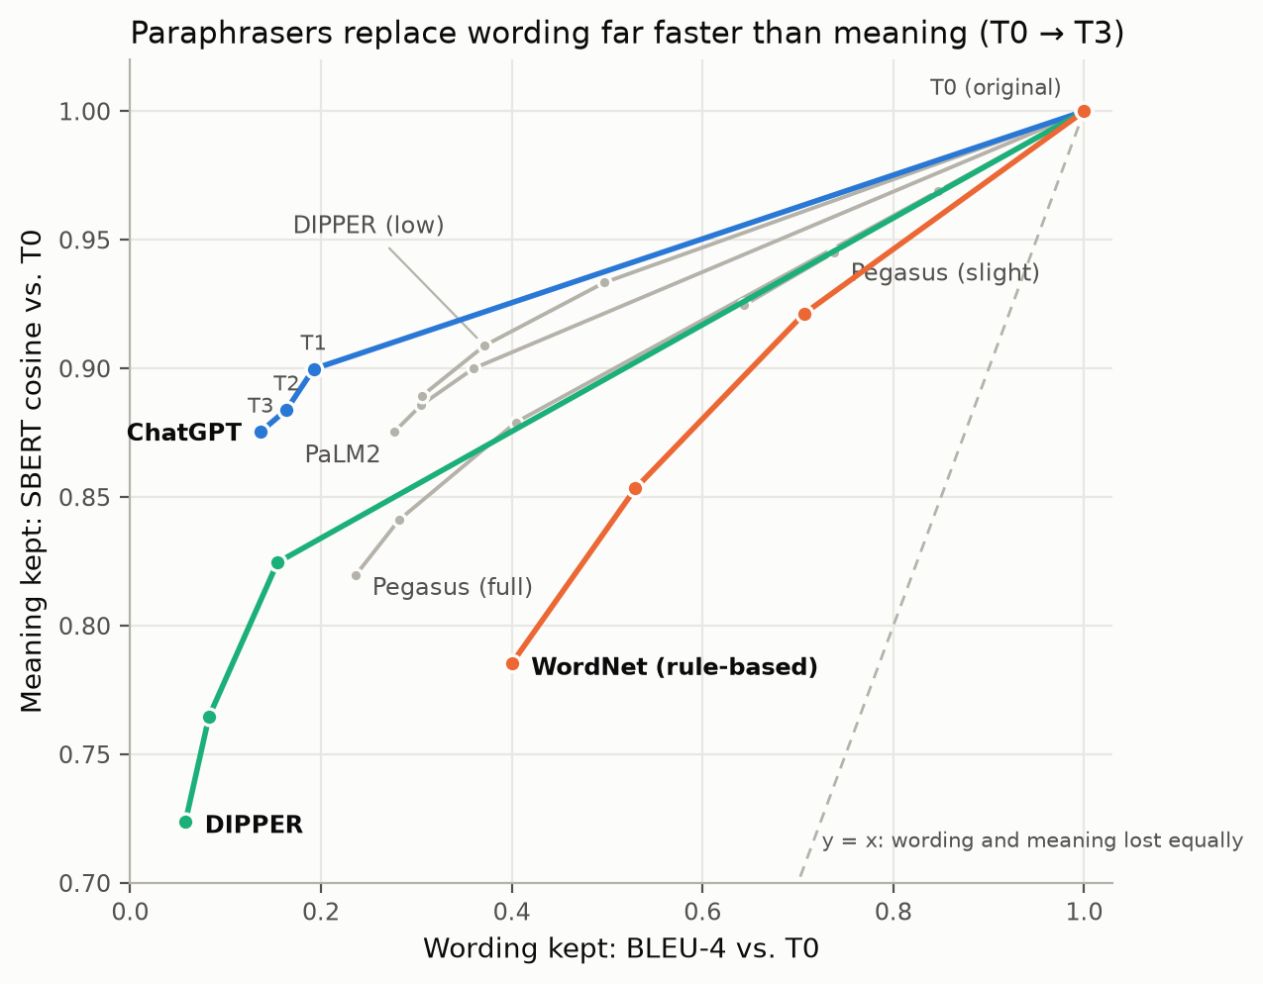
08
Every paraphraser discards wording faster than meaning
Path T0 → T3 per paraphraser: wording kept (x) vs. meaning kept (y)
CHATGPT
Moves almost straight left: same meaning as PaLM2 (SBERT 0.875 vs 0.876) with half the word overlap (BLEU 0.14 vs 0.28).
RULE-BASED WORDNET
Keeps the most wording (BLEU 0.40) but loses more meaning (0.79): synonym swaps keep structure, break meaning.
DIPPER
Loses the most of both (SBERT 0.72). Paraphraser choice matters as much as the number of rounds.
DIPPER (high) omitted (unrelated outputs). 700 Human documents, 7 domains.
Notes:
This figure shows every paraphraser's path. All of them stay well above the diagonal, meaning they lose wording much faster than meaning. ChatGPT rewrites the most aggressively at no semantic cost. The rule-based WordNet simulator behaves the opposite way to the LLMs, which is why we use the real LLM chains rather than a simulation.

Slide 9
09
Domain matters
Meaning kept at T3 (SBERT) by domain, 100 Human documents per domain
Domain | ChatGPT | PaLM2 | DIPPER (low) | Pegasus (full)
Science (SciGen) | 0.947 | 0.969 | 0.925 | 0.857
Summary (TLDR) | 0.924 | 0.944 | 0.906 | 0.813
News (XSUM) | 0.888 | 0.912 | 0.870 | 0.787
Review (Yelp) | 0.854 | 0.859 | 0.887 | 0.831
QA (ELI5) | 0.850 | 0.828 | 0.867 | 0.827
Opinion (CMV) | 0.848 | 0.808 | 0.906 | 0.822
Story (WP) | 0.817 | 0.810 | 0.863 | 0.801
TECHNICAL TEXT HOLDS MEANING
Science, summaries and news keep the most: terms, entities and numbers must be copied, anchoring the meaning.
CREATIVE TEXT DRIFTS
Stories and opinions keep the least: room to restructure narrative and rhetoric.
DOMAIN × PARAPHRASER
PaLM2 copies heavily in science (BLEU 0.50) but rewrites opinion almost fully (0.11).
Long CMV and WP documents partly exceed SBERT's 256-token window — a possible contributor
Notes:
Domain also matters. Technical and factual text keeps the most meaning, creative and argumentative text the least. And the domain effect depends on the paraphraser: PaLM2 copies a lot in science and news, but almost fully rewrites opinion texts.

Slide 10
10
RQ1 method: ten planks, one scale
Weeks 7–8 · each document compared with its own T0, per feature family
LEXICAL — THE SKIN
• Word choice (word-set overlap)
• Function-word profile (198 words)
• Punctuation profile (12 marks)
• Lexical richness (MATTR, word length)
Putting style and meaning on one scale
Divide each distance by the distance between the T0 and 5 unrelated documents from the same domain:
SYNTACTIC — THE SKELETON
Retention = 1 − d(Tk, T0) / d(unrelated, T0)
• Sentence shape (mean, variance)
• POS-tag distribution
• Dependency-label distribution
• Tree depth, dependency distance
• Readability (Flesch–Kincaid)
< 0
pushed beyond
another author
0
like an unrelated
document
1
unchanged
MEANING — THE HULL
• SBERT embedding
Plus: 95% bootstrap CIs · paired Wilcoxon tests (Holm-corrected) · effect sizes
Parsed once with spaCy; distributions compared with Jensen–Shannon distance, scalars with z-score differences
Averages hide change: a feature can keep its corpus mean while every document moves — so we measure per document
Notes:
For RQ1 we needed to compare very different features — a punctuation profile, a parse-tree depth, a meaning embedding — on one scale. We compare each document with its own original, and divide the distance by how different the original is from unrelated documents in the same domain. That gives retention: one means unchanged, zero means the paraphrase is as different from its source as another author's document is, and below zero means the paraphraser pushed it even further.

Slide 11
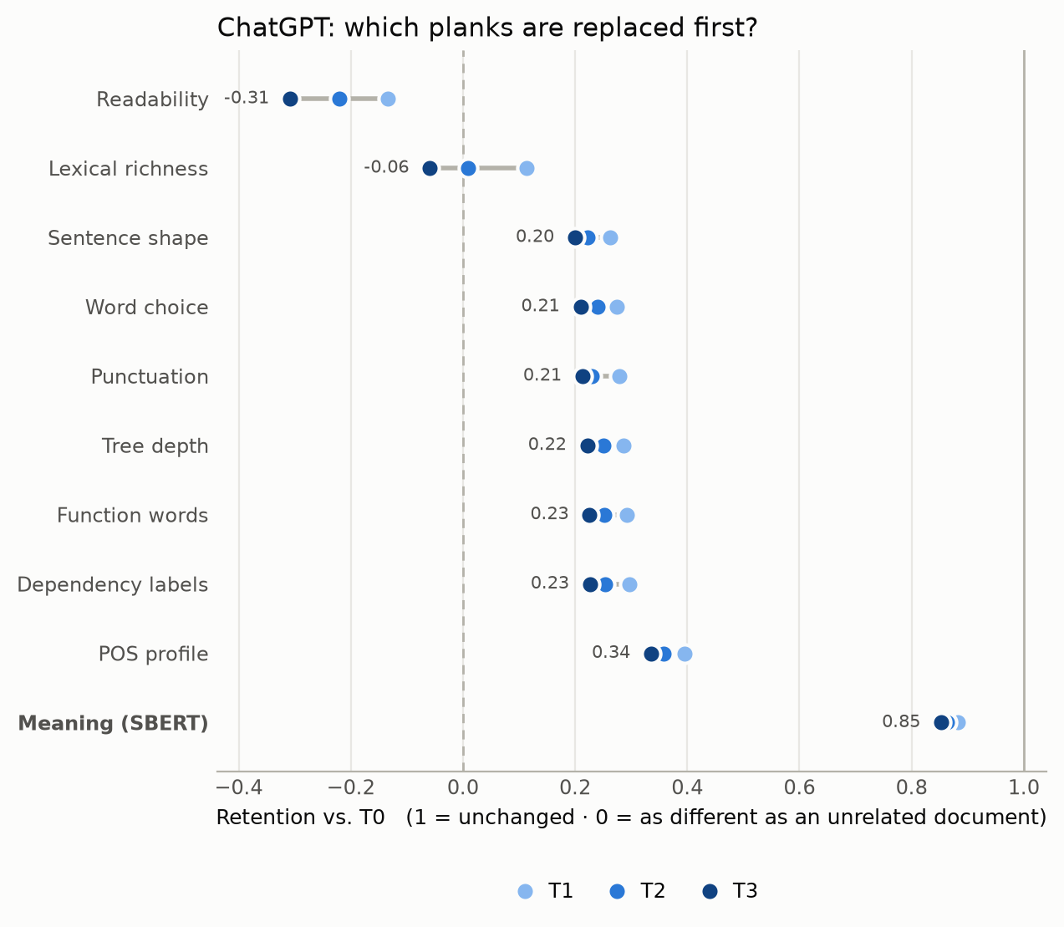
11
RQ1: which planks are replaced first?
ChatGPT, 700 documents · retention at T1, T2, T3 (first-replaced on top)
STYLE GOES, MEANING STAYS
Every style family keeps ≤ 0.34 at T3; meaning keeps 0.85 (95% CI 0.85–0.86).
GONE IN THE FIRST PASS
82–92% of each style family's three-round loss happens at T1 (ChatGPT, PaLM2).
OVERWRITTEN, NOT JUST ERASED
Readability (−0.31) and lexical richness (−0.06) move beyond another author's level.
1 = unchanged · 0 = as different as an unrelated document · experiments/stylometry_results/rq1/
Notes:
Here is the answer for ChatGPT. Every style family has lost most of its signal after one round, while meaning stays at 0.85. Two families even go below zero: ChatGPT pushes readability and lexical richness further from the original than another human author would be. Most of this happens in the first pass.

Slide 12
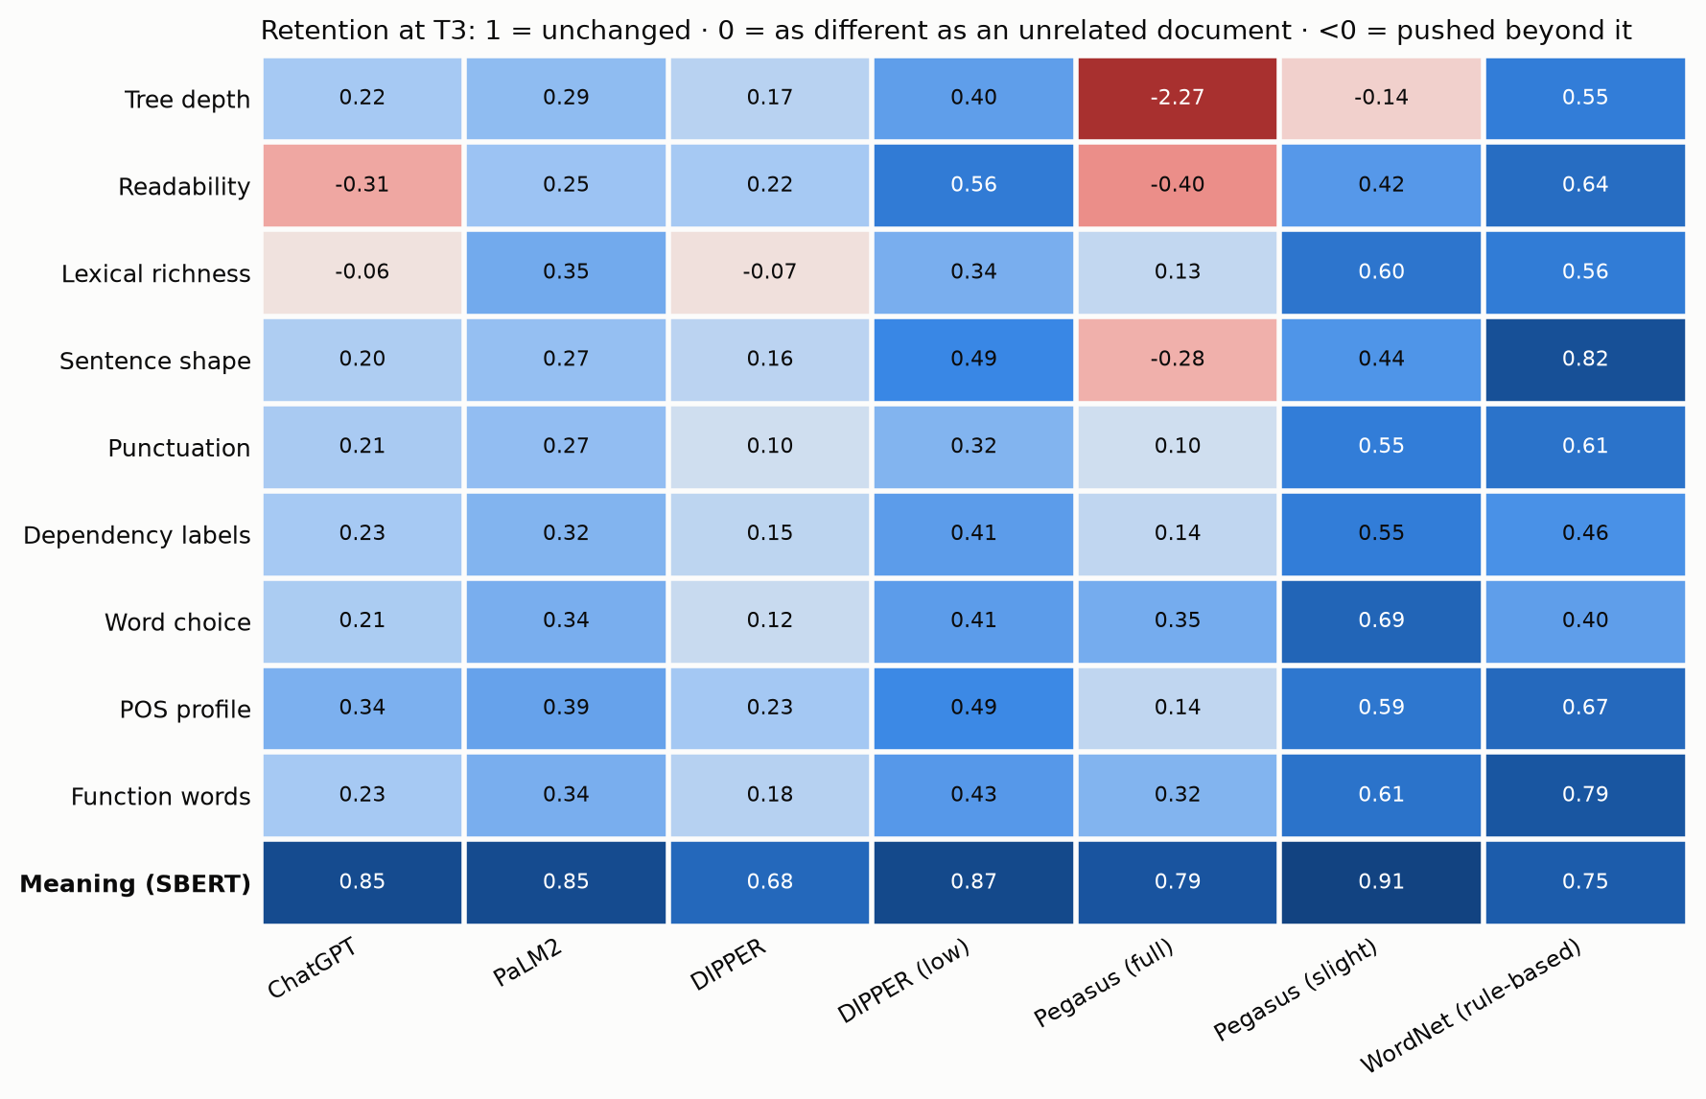
12
The pattern holds for every LLM paraphraser
Retention at T3, feature family × paraphraser (blue = kept, red = pushed beyond)
MEANING ALWAYS ON TOP
Most retained family for every LLM paraphraser; 61/63 tests: style changes significantly more (Holm p < 0.05).
SKELETON = SKIN
Syntax goes as fast as vocabulary — ChatGPT 0.14 vs 0.15, PaLM2 0.30 vs 0.33.
PEGASUS RESTRUCTURES
Syntactic retention −0.53: splits sentences, flattens parse trees.
Exceptions to style > meaning: two WordNet families (function words, sentence shape) — word swaps leave them in place
Notes:
Across paraphrasers, meaning is always the most retained row. In 61 of 63 tests the style change is significantly larger than the meaning change; the two exceptions are WordNet, which only swaps words. Interestingly, the syntactic skeleton is replaced about as fast as the lexical skin — we expected syntax to be more durable.

Slide 13
13
Paraphrasers write in their own style
Mean change T0 → T3, paired over documents (effect size d)
Feature | Human T0 | ChatGPT T3 | DIPPER T3 | Pegasus (full) T3
Reading grade (Flesch–Kincaid) | 9.8 | 12.4 ↑ | 9.2 | 6.6 ↓
Average word length | 4.68 | 5.21 ↑ | 4.42 ↓ | 4.47 ↓
Lexical richness (MATTR) | 0.81 | 0.83 ↑ | 0.77 ↓ | 0.78 ↓
Sentence length (words) | 18.3 | 18.9 | 19.0 | 12.7 ↓
Parse-tree depth | 5.2 | 5.7 | 5.1 | 4.0 ↓
Pronouns (share of tokens) | 0.079 | 0.064 ↓ | 0.087 | 0.081
Determiners (share of tokens) | 0.083 | 0.087 | 0.105 ↑ | 0.094
CHATGPT
Formalises: longer words, higher grade (d = 1.05–1.50).
DIPPER
The reverse: shorter words, more determiners.
PEGASUS
Splits sentences, flattens trees (d = −1.36).
The direction of change identifies the paraphraser — an early signal for RQ3: authorial identity is not just erased, it is replaced.
↑/↓ = significant change with |d| ≥ 0.5 (Holm-corrected Wilcoxon). Full table: experiments/stylometry_results/rq1/feature_shifts.csv
Notes:
Negative retention means a consistent push in one direction. ChatGPT formalises text: longer words and a reading grade that rises from about 10 to over 12. DIPPER goes the other way, and Pegasus splits sentences and flattens parse trees. Because each paraphraser pushes in its own direction, this is our first evidence for RQ3.

Slide 14
14
Preliminary answer to RQ1
Week 8 checkpoint
Under LLM paraphrasing, style is replaced long before meaning — and the syntactic skeleton goes as fast as the lexical skin.
55–90%
79–88%
61 / 63
< 0
of the way to an unrelated author's style after one pass (ChatGPT, PaLM2, DIPPER; some beyond)
of the meaning retained after that same pass
paired tests: style distance > meaning distance at T1 (Holm p < 0.05)
retention for several features: style is overwritten with the paraphraser's own
Paper section “RQ1: Which Planks Are Replaced First?” · notebook 03 · src/run_rq1.py
Notes:
So our preliminary answer to RQ1: style is replaced long before meaning. After one pass, documents are already most of the way to looking like a different author, while most of the meaning is intact. Syntax is not a safe haven — it changes as fast as vocabulary. And several features are not just erased but overwritten with the paraphraser's own style.

Slide 15
15
Limitations and next steps
LIMITATIONS
NEXT
• Human-written T0 only so far; LLM-written originals not yet analysed
• Paraphrases are shorter, and short texts give noisier profiles — may inflate style distances
• SBERT reads only the first 256 tokens of long documents
• Small spaCy parser; heuristic syllable count for readability
• DIPPER (high) chains unusable as released
Weeks 9–11 · RQ2
Train stylometric SVM + RoBERTa on the train files; test on T0–T3; locate the point of no return per paraphraser
Weeks 10–12 · RQ3
Paraphraser classifier on T1–T3 (key-level split); t-SNE trajectories with quantitative cluster measures
Weeks 13–14 · Synthesis
Streamlit decay dashboard; final ACL-format paper
Code, data pipeline and results: README.md · docs/weekly_progress.md · docs/final_checklist.md
Notes:
Main limitations: we have only analysed human-written originals so far; paraphrases are shorter, which can make style profiles noisier; and SBERT only reads the start of long documents. Next we move to RQ2 — training attribution models on the train files and testing them on each generation — and then to paraphraser fingerprinting for RQ3. Thank you.

