Slide 1
Computer Vision
Fall 2016
Problem Set #3
Nikhil Gajendrakumar
nikhil.g@gatech.edu
Computer Vision @ GT

Slide 2


1a: Disparity Images (pair0)
D_{L}(y,x) [matching from left to right] - ps3-1-a-1.png
D_{R}(y,x) [matching from right to left] - ps3-1-a-2.png
Computer Vision @ GT

Slide 3
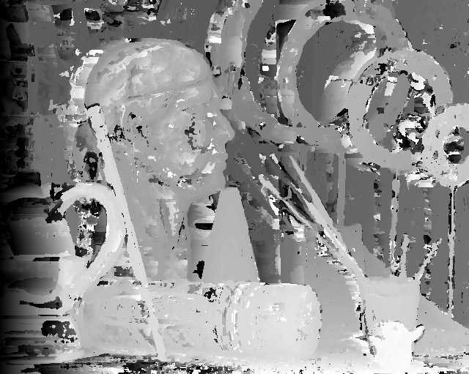
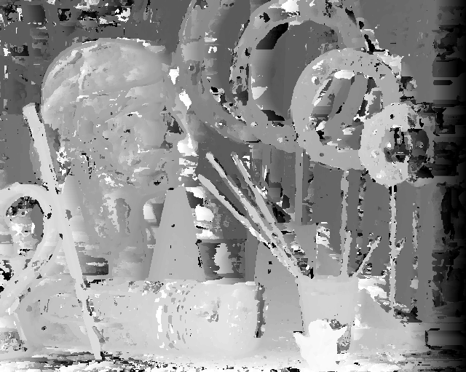
1b: Disparity Images (pair1)
D_{L}(y,x) [matching from left to right] - ps3-1-b-1.png
D_{R}(y,x) [matching from right to left] - ps3-1-b-2.png
Computer Vision @ GT

Slide 4
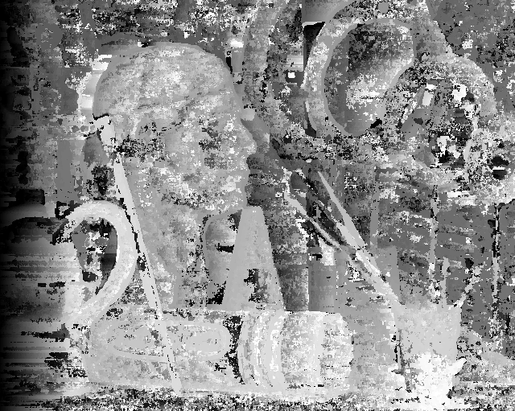
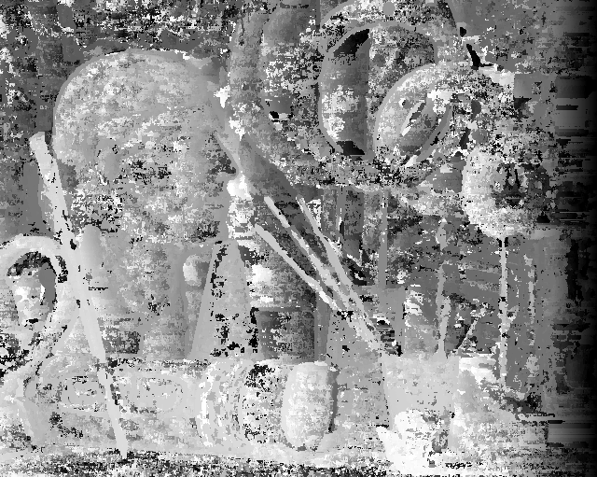
2a: Disparity Images (pair1 noise)
D_{L}(y,x) [matching from left to right] - ps3-2-a-1.png
D_{R}(y,x) [matching from right to left] - ps3-2-a-2.png
Computer Vision @ GT

Slide 5


2b: Disparity Images (pair1 contrast)
D_{L}(y,x) [matching from left to right] - ps3-2-b-1.png
D_{R}(y,x) [matching from right to left] - ps3-2-b-2.png
Computer Vision @ GT

Slide 6
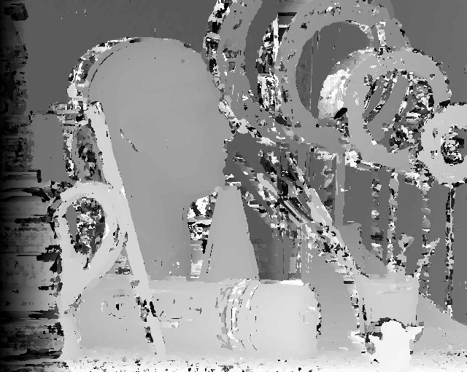
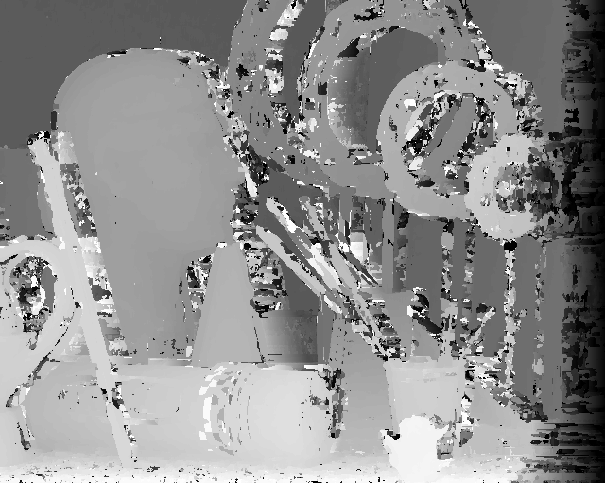
3a: Disparity Images (pair1 normcorr)
D_{L}(y,x) [matching from left to right] - ps3-3-a-1.png
D_{R}(y,x) [matching from right to left] - ps3-3-a-2.png
Computer Vision @ GT

Slide 7
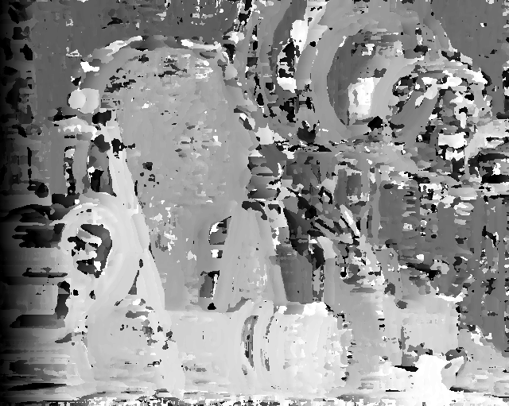
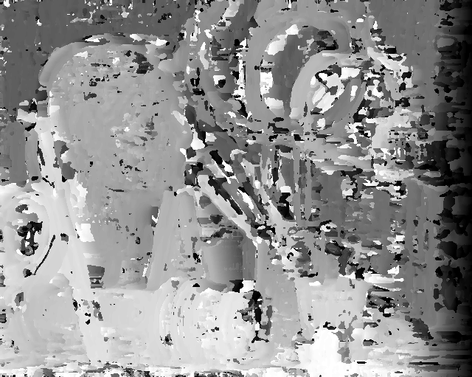
3b: Disparity Images (pair1 normcorr)
using Gaussian noise
D_{L}(y,x) [matching from left to right] - ps3-3-b-1.png
D_{R}(y,x) [matching from right to left] - ps3-3-b-2.png
Computer Vision @ GT

Slide 8


3b: Disparity Images (pair1 normcorr)
using increased contrast
D_{L}(y,x) [matching from left to right] - ps3-3-b-3.png
D_{R}(y,x) [matching from right to left] - ps3-3-b-4.png
Computer Vision @ GT

Slide 9
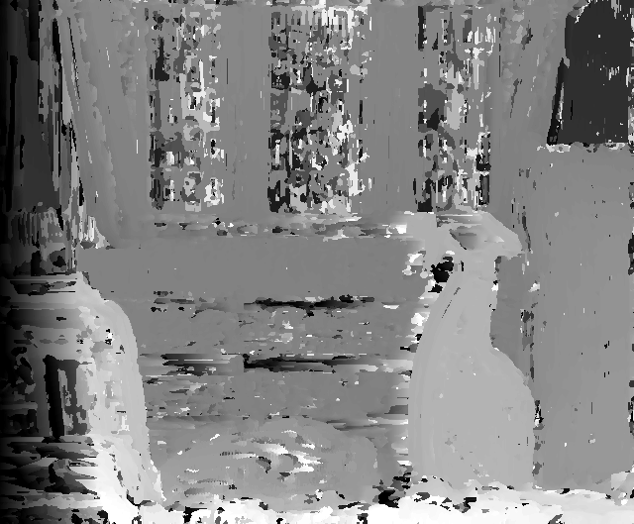
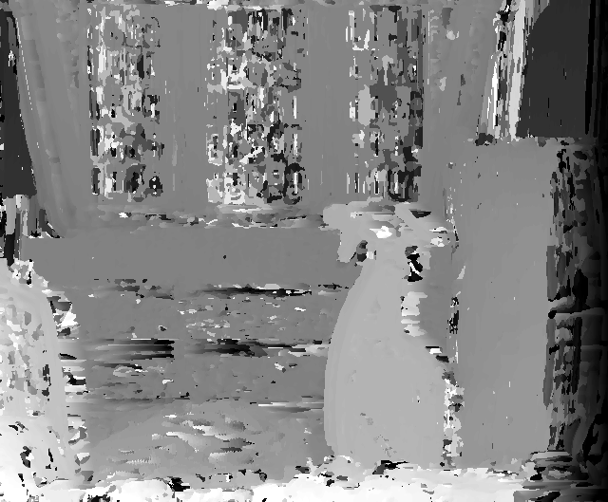
4a: Disparity Images (pair2)
D_{L}(y,x) [matching from left to right] - ps3-4-a-1.png
D_{R}(y,x) [matching from right to left] - ps3-4-a-2.png
Computer Vision @ GT

Slide 10
5: Discussion
Answer the questions below:
In the input directory are ground truth disparity images pair1-D_L .png and pair1-D_R .png. Compare your results of the SSD images of 1b and the ground truth. What are the differences that you see? Ans: SSD image does a pretty good job of identifying closer and farther objects. SSD image has lot of white/black strips around the edges of objects, ground truth doesn’t have these strips. These strips can be removed either by increasing the window size and maxd.
Now, compare your results of the noisy SSD images of 2a and the ground truth. What are the differences that you see? Ans: Noisy SSD image is slightly dark. It also removes few white/black strips.
How do your normalized correlation image results compare with the SSD image results and with the ground truth? Ans: Discuss the differences that you observe. Normalized correlation image assigns same brightness over all the pixels in an object. Normalized correlation performs better for inputs with higher contrast.
Compare your results of 3a with noisy and contrast-boosted images of 3b. Are there any differences? Ans: Normalized correlation doesn’t perform well on noisy images, but it performs well on higher contrast images.
Finally, from this exercise, please discuss what you take away. What it takes to make stereo work using a window based approach. Ans: Sum of squared distances to find stereo, Normalized correlations to find stereo. Stereo works with window based approaches, only if we can follow the dream.

