Slide 1
Explainable
Fraud Radar
Synthetic transaction risk and investigation platform
PORTFOLIO CASE STUDY / OCTOBER 2026
Notes:
A local software demonstration using synthetic banking data. No public deployment or real-bank efficacy claim.

Slide 2
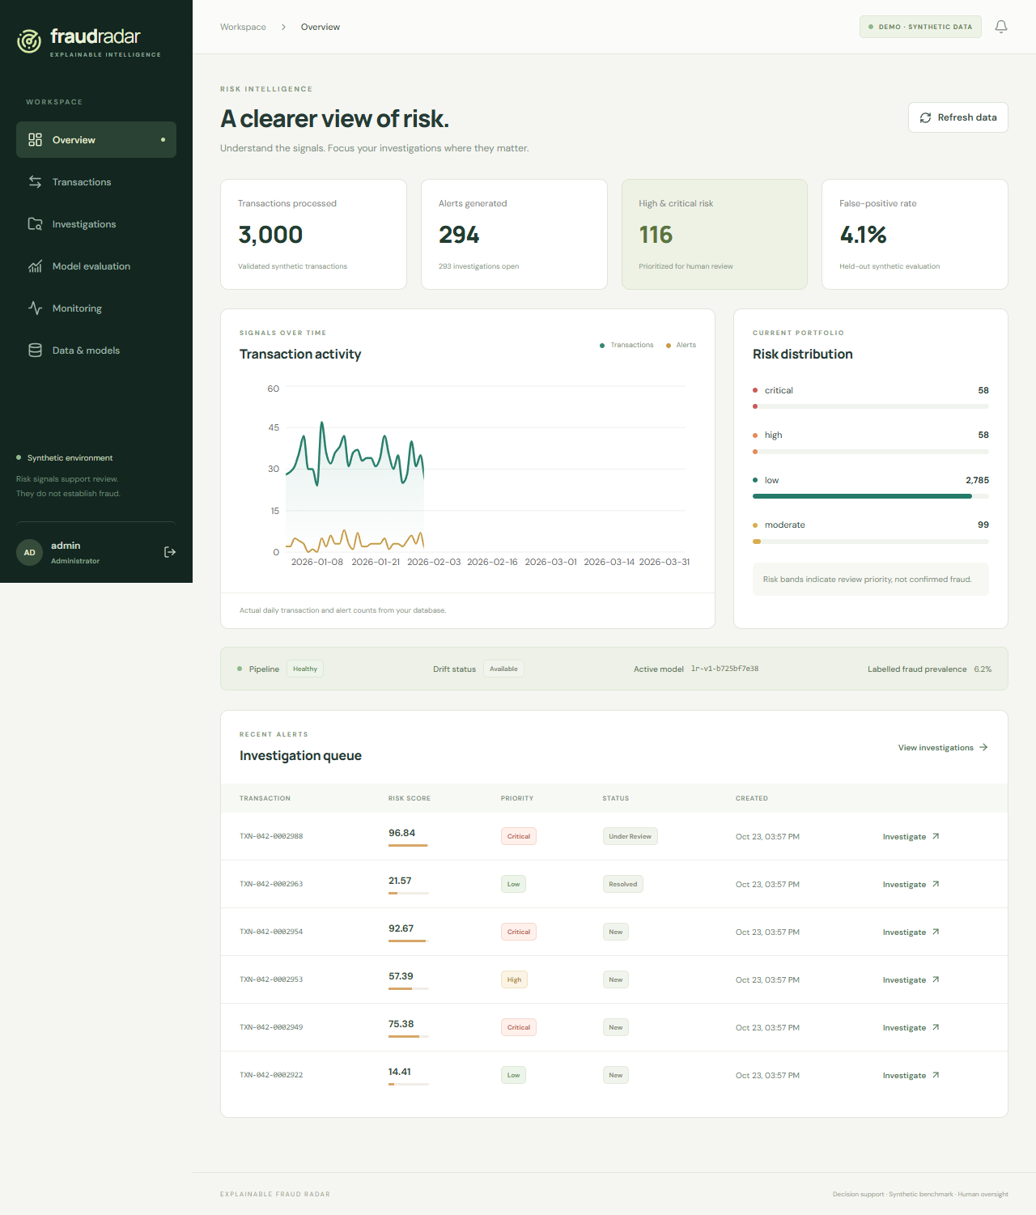
The investigator workspace
A connected review workflow
Browse transactions, inspect model contributions and record investigation outcomes through the same application.
React and TypeScript
FastAPI and SQLAlchemy
PostgreSQL deployment configuration
EXPLAINABLE FRAUD RADAR
02
Notes:
Source: reports/screenshots/overview.png. Genuine local 3,000-row demo capture. These dashboard values are separate from the 100,000-row benchmark on slide 5.

Slide 3
System architecture
01 Data pipeline
Seeded records, schema checks and quarantine
02 Model pipeline
Chronological features, versioned training and evaluation
03 Application API
Authenticated scoring, persistent predictions and case actions
04 Review and monitoring
React workspace, transactional audit trail and drift reports
EXPLAINABLE FRAUD RADAR
03
Notes:
Source: docs/architecture.md and implemented backend/app, frontend/src and ml packages. PostgreSQL is the container target. SQLite supports local verification.

Slide 4
Reproducible synthetic data
100,000
transactions across 1,000 synthetic customers
60,000 training records
20,000 validation records
20,000 untouched test records
History uses strictly earlier events.
Equal timestamps stay within one split.
Labels remain separate from features.
Seed 42. Configurable prevalence, customer count and historical period.
EXPLAINABLE FRAUD RADAR
04
Notes:
Sources: reports/benchmark-100k/config.json, model.json, scenario_distributions.json and pipeline_performance.json. The full pipeline processed 100,000 records in 36.7689714 seconds on the local environment.

Slide 5
Held-out synthetic performance
74.6% recall
47.1% precision
1,808 alerts
957 false positives
289 missed positives
PR-AUC comparison. 20,000 test records. Synthetic benchmark only.
EXPLAINABLE FRAUD RADAR
05
Notes:
Source: reports/benchmark-100k/evaluation.json. Model lr-v1-652d1d411f. Threshold 0.15 selected on validation. Test prevalence 5.7%. PR-AUC is average precision. All comparators use the same test samples, with model-specific operational thresholds.

Slide 6
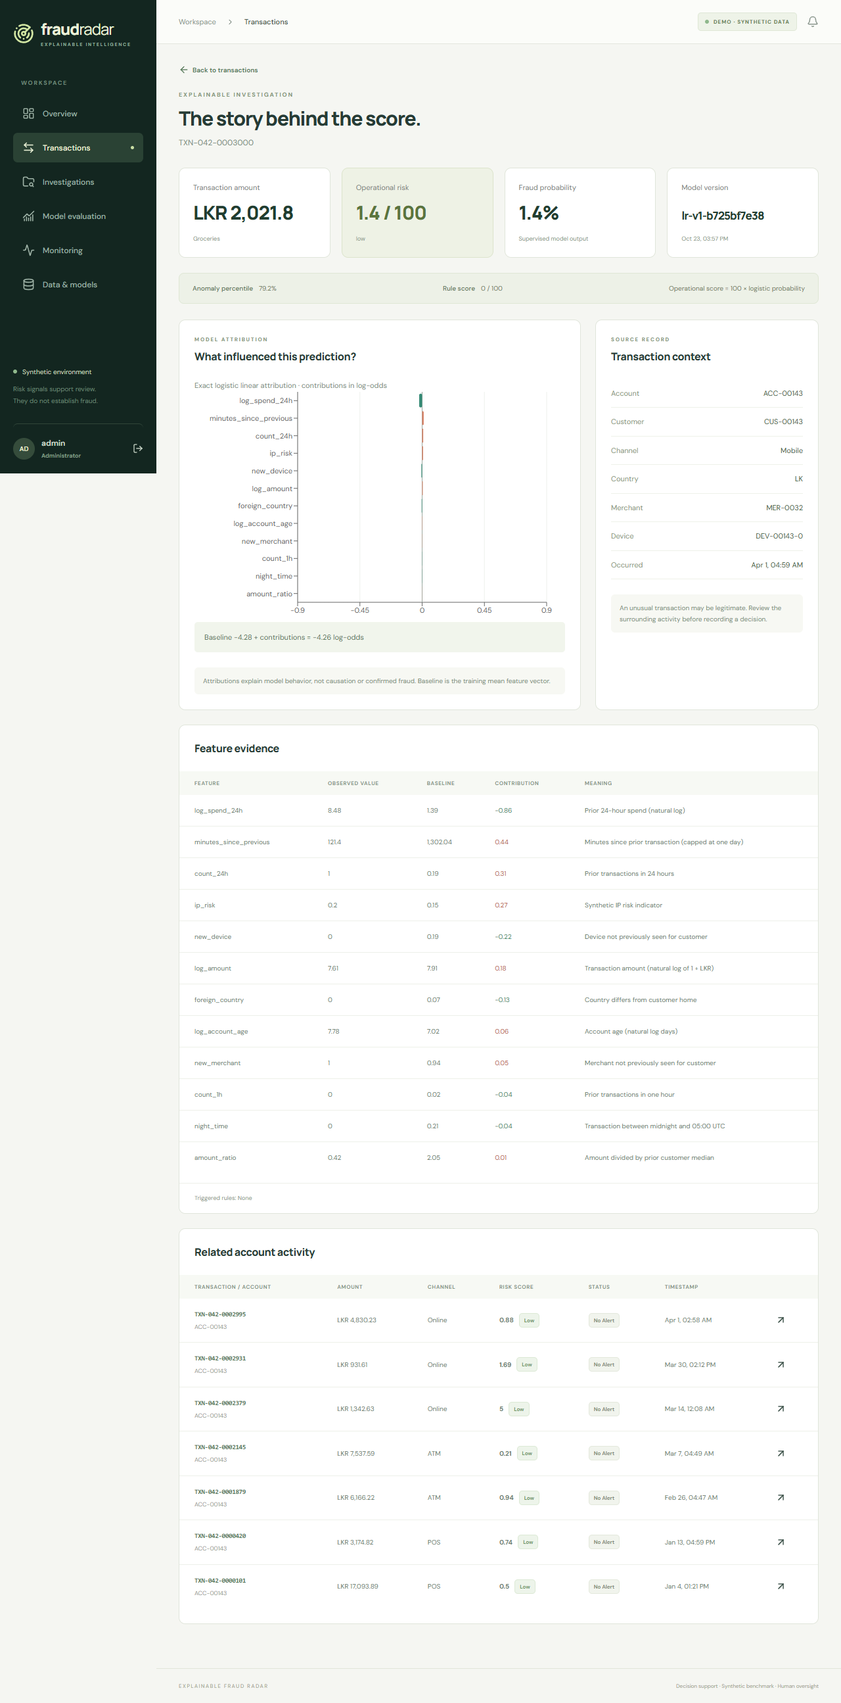
Explanations reproduce the score
Baseline + feature contributions
= model log-odds
The sigmoid converts log-odds into the displayed probability. Operational risk equals probability multiplied by 100.
Anomaly percentiles and rule scores remain separate context. Attribution does not establish causation or confirmed fraud.
EXPLAINABLE FRAUD RADAR
06
Notes:
Sources: ml/explainability/__init__.py, docs/ml_methodology.md and reports/screenshots/explanation.png. The screenshot uses the separate 3,000-row demo model. Exact logistic attribution sums in log-odds.

Slide 7
Investigation and audit history
Each case preserves a review trail
Assignment identifies the reviewer.
Notes capture evidence and reasoning.
Escalation routes unresolved concerns.
Disposition records the review outcome.
Database transactions keep case changes and audit events consistent.
The application does not freeze accounts or move money.
EXPLAINABLE FRAUD RADAR
07
Notes:
Sources: docs/architecture.md and backend case-action implementation. Role checks protect changes. Predictions, investigator opinions and synthetic verified labels remain separate.

Slide 8
Validation and remaining limits
Verified locally
Before real financial use
100,000-record pipeline execution
27 passing ML tests
Additive explanation reconstruction
Training and inference feature parity
Drift detection on shifted samples
Independent data and calibration review
Security and operational assessment
Mature verified outcome monitoring
Deployment and resilience verification
Synthetic demonstrations cannot establish real-bank effectiveness or regulatory readiness.
EXPLAINABLE FRAUD RADAR
08
Notes:
Sources: backend/tests/test_ml.py (27 passing ML tests at deck creation), docs/model_card.md, docs/data_card.md and docs/deployment.md. No claim that Docker or cloud deployment completed.

