Slide 1
S GAJENDRAN 2021506305 B.TECH IT MIT
PRESENTED BY
3/21/2024 Annual Review

Slide 2
Next Word Prediction
3/21/2024 Annual Review

Slide 3

AGENDA
Problem Statement Introduction Objective Methodology Model Architecture Training Process Results Applications
Output demo Conclusion
3/21/2024 Annual Review

Slide 4
PROBLEM STATEMENT
Develop an algorithm or model capable of accurately predicting the next word in a given sequence of text, based on the context and language patterns, to enhance user experience in typing, text generation, or other natural language processing tasks. The solution should efficiently handle various language structures, adapt to diverse contexts, and provide reliable predictions across different domains and languages.
3/21/2024 Annual Review

Slide 5
Introduction:
In the digital age of text-based communication, the evolution of language interfaces has revolutionized the way we interact with technology. Among the myriad advancements in this field stands the concept of "Next Word Prediction." This innovative feature harnesses the power of machine learning and natural language processing to anticipate and suggest the next word a user might type or speak, enhancing efficiency, convenience, and overall user experience. This introduction aims to explore the intricacies of next word prediction, its underlying mechanisms, applications across various domains, and its profound impact on modern communication paradigms.
3/21/2024 Annual Review

Slide 6
OBJECTIVE
The objective of next word prediction is to enhance text input efficiency and user experience by employing predictive algorithms to anticipate and suggest the most likely word or phrase that the user intends to type next. This technology aims to streamline the process of text composition across various platforms and applications, including messaging, email, document creation, and web browsing. By analyzing context, language patterns, and user behavior, next word prediction systems strive to provide accurate and timely suggestions, thereby reducing typing effort, minimizing errors, and increasing typing speed. Additionally, these systems may incorporate machine learning techniques to continually adapt and improve prediction accuracy based on user feedback and evolving language usage trends. Ultimately, the objective is to facilitate seamless and intuitive communication while empowering users to compose text more efficiently.
3/21/2024 Annual Review

Slide 7

METHODOLOGY
Data collection: Gather a large corpus of text data.
Preprocessing: Clean the text data by removing noise and irrelevant information.
Tokenization: Break down the text into individual words or tokens.
Model training: Utilize machine learning or deep learning techniques to train a language model on the tokenized text data.
Prediction: Given a sequence of words, use the trained model to predict the most likely next word(s) based on the context.
Evaluation: Assess the performance of the model using metrics such as accuracy, perplexity, or other relevant measures.
Deployment: Integrate the trained model into an application or system where it can provide real-time next word predictions.
3/21/2024 Annual Review

Slide 8
ARCHITECTURE:
The model architecture for Next Word Prediction typically involves recurrent neural networks (RNNs), specifically Long Short-Term Memory (LSTM) or Gated Recurrent Unit (GRU) networks. These architectures are trained on large text corpora to learn patterns and dependencies between words, enabling them to predict the most likely word to follow a given sequence of words.
3/21/2024 Annual Review

Slide 9

TRAINING PROCESS:
Data Collection: Gathering large amounts of text data from various sources.
Data Preprocessing: Cleaning and formatting the text data for training.
Tokenization: Breaking down the text into smaller units such as words or characters.
Model Selection: Choosing a suitable machine learning or deep learning model architecture.
Training: Training the selected model on the tokenized text data to learn the patterns and relationships between words.
Evaluation: Assessing the performance of the trained model using validation data.
Fine-tuning: Adjusting model parameters or architecture to improve performance.
Deployment: Integrating the trained model into an application or system for real-time prediction.
3/21/2024 Annual Review
9

Slide 10
Results and Evaluation
Accuracy: The percentage of correct predictions made by the system.
Speed: The time taken by the system to generate predictions.
Diversity: The range of words predicted by the system.
Adaptability: The ability of the system to adjust to different writing styles and contexts.
User Satisfaction: Feedback from users regarding the usefulness and effectiveness of the predictions.
3/21/2024 Annual Review
10

Slide 11
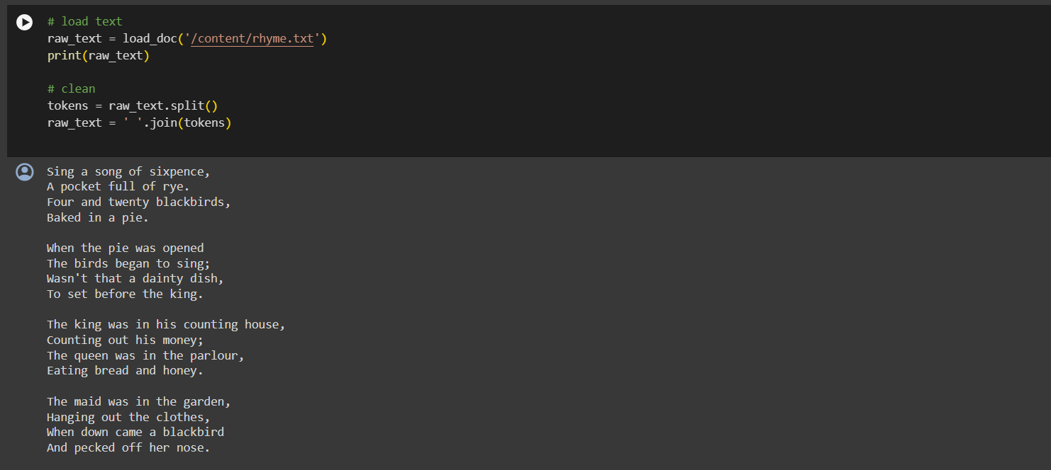
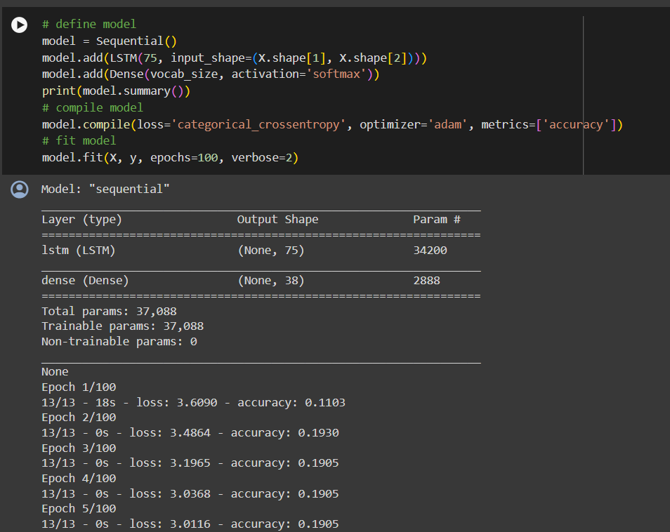
OUTPUT DEMO

Slide 12
Applications
Mobile Keyboards: Next word prediction is commonly integrated into mobile keyboard apps like Gboard, SwiftKey, and Fleksy to help users type faster with fewer keystrokes.
Text Messaging Apps: Messaging platforms such as WhatsApp, Messenger, and Telegram often incorporate next word prediction to facilitate rapid communication, especially on mobile devices.
Email Clients: Email applications like Gmail, Outlook, and Apple Mail may utilize next word prediction to streamline the process of composing emails, enabling users to draft messages more efficiently.
Note-taking Apps: Productivity tools such as Evernote, Microsoft OneNote, and Google Keep may include next word prediction features to assist users in quickly jotting down ideas or taking notes with minimal typing.
Search Engines: Some search engines like Google and Bing may offer next word prediction suggestions as users type in search queries, enhancing the search experience by providing relevant suggestions in real-time.
3/21/2024 Annual Review

Slide 13
CONCLUSION
In conclusion, Next Word Prediction serves as a valuable tool in enhancing text input efficiency and user experience. By leveraging algorithms and language models, it anticipates and suggests the most probable word or phrase that follows a given input, streamlining communication and reducing typing effort. Its implementation across various digital platforms contributes significantly to improved productivity and convenience in everyday tasks such as messaging, writing, and data entry. As technology continues to evolve, Next Word Prediction stands as a testament to the advancement of natural language processing and its seamless integration into our digital lives.

