Slide 1
Steinbeis Team
OGC ISG SPRINT YEAR 2

Slide 2
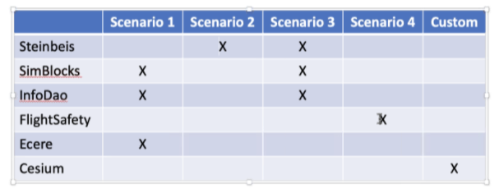
SCENARIOS AND DELIVERABLES
Scenario 2
Scenario 3

Slide 3
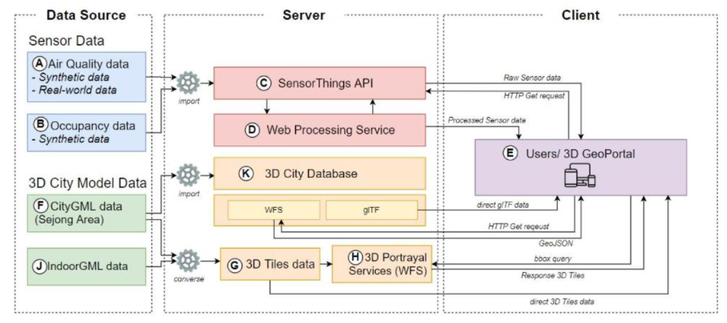
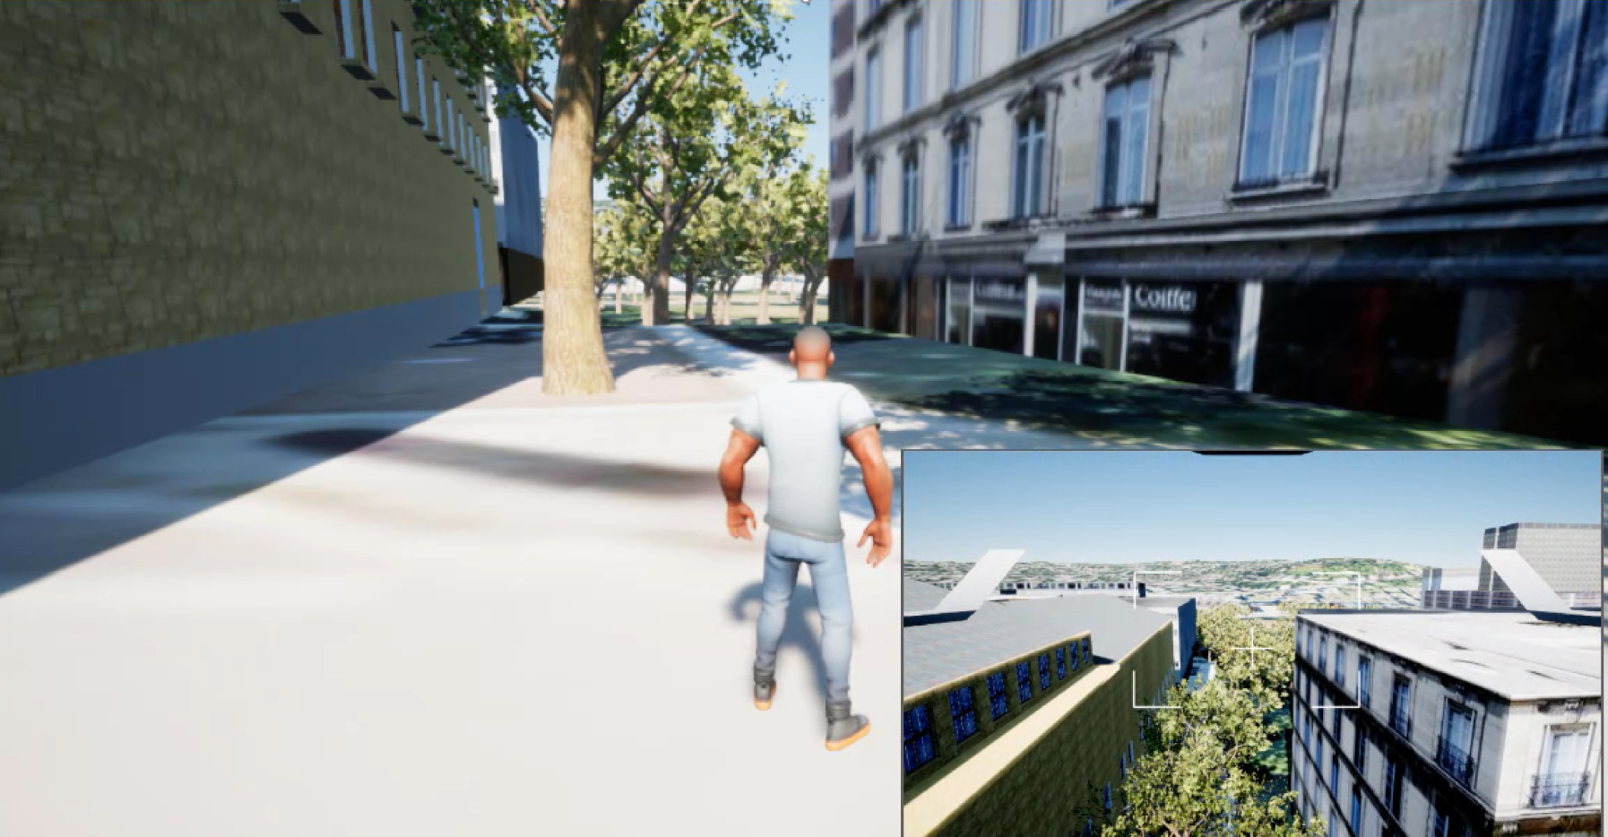
SCENARIO 2
Data visualization client using the Unreal client fetching the 3D data from the GeoVolume server.
As a Use-Case we propose to use the 3D Buildings of the HFT Stuttgart. These have been modeled with interiors and are available in different formats such as skp or x3d. From there they can be converted to gltf/glb or 3D Tiles. To use the indoor space, we plan to integrate measurements of the CO2 concentration inside the rooms. These measurements come from the Sensors placed in Rooms at the HFT.
Proposed Unreal Engine 4 based Application
Steinbeis’ s System Architecture in OGC 3D IoT Pilot

Slide 4
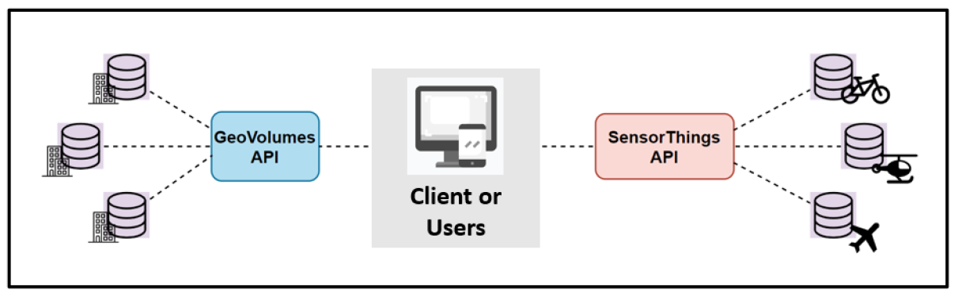
SCENARIO 3
The dynamic data from the moving sensors from different types of vehicles can be managed using the SensorThings API. Then, the client can access and render these datasets from SensorThings to simulate the 3D urban mobility. Also, the GeoVolumes from Scenario 1 can be integrated in the same client to illustrates the 3D building models.
The 3D data visualization is integrated on the web client via the GeoVolumes server in 3D Tiles or i3s format. The web
client is implemented with (but not limited to) CesiumJS or ArcGIS for JavaScript API. The internet bandwidth will be
tested for metering the data performance on different type of devices. This test can be done with Google Chrome debug tool.
The 3D data visualization of the Traffic/ land- or air-based transportation networks and other 3D models can be
visualized on the web client in the same way fetching the data from the SensorThings server and GeoVolume server.

Slide 5






System Architecture
Steinbeis’ s System Architecture for OGC ISG-2
DATASOURCE
SERVER
Client
3D Models
(3D Tiles/i3s)
3DPS, GeoVolumes
Unreal Engine
Sensor Data (Dynamic Moving Sensor)
Sensor Things Server
Web-base Application
ArcGIS for JS

Slide 6
Contact
Name | Email
Volker Coors | volker.coors@stw.de
Joe T. Santhanavanich | thunyathep.s@outlook.com
Patrick Würstle | patrick.wuerstle@gmx.de
Rushikesh Padsala | rushikesh.padsala@hft-stuttgart.de
Athanasios Koukofikis | koukofikis-athanasios@hotmail.com

