Slide 1

Multivariate Regression Model For
Housing Price Prediction
Gajendra Gurung & Rohan Ruthvik Kendyala
Statistical Theory & Applications 5303
Group 4
April 30, 2024
gajendra.gurung@uta.edu
rxk6181@mavs.uta.edu

Slide 2
Outline
Introduction
Data set
Analysis Technique
Results
Further Treatment of Data
Summary

Slide 3
Introduction & Objectives
Regression Analysis:
Assessing its accuracy in predicting housing prices.
Influencing Factors:
Identifying critical determinants of housing costs.
Market Valuation:
Determining correct housing prices based on
market data.

Slide 4
Data set information
Price:
Area:
Bedrooms:
Bathrooms:
Stories:
Parking:
Mainroad:
Guestroom:
Basement:
Hot Water Heating:
Air Conditioning:
Prefarea:
Boolean Type
Integer Type
Categorical
Furnishing Status:
Data Treatment: Replace all missing data (N/A) values with mean
[Source: https://www.kaggle.com/datasets/harishkumardatalab/housing-price-prediction]

Slide 5
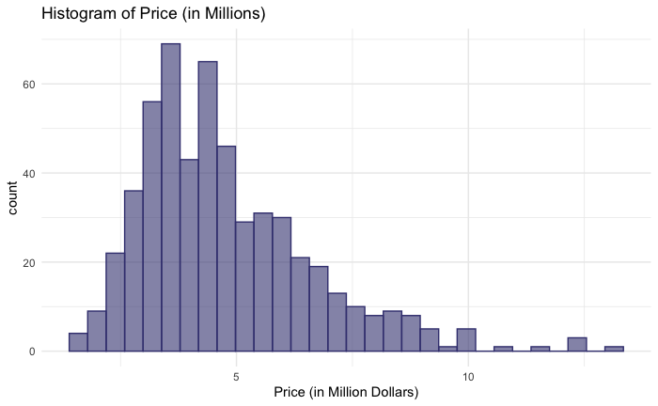
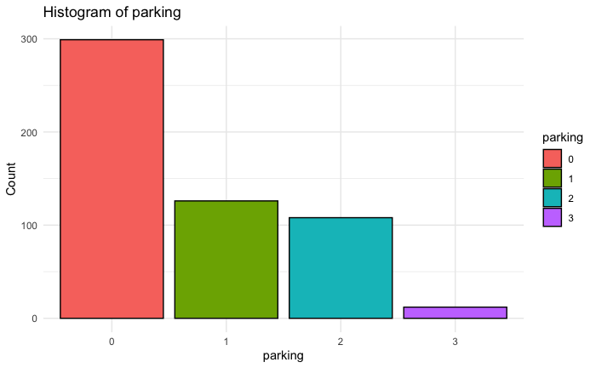
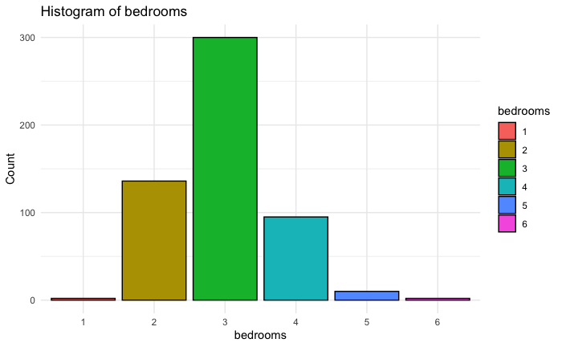
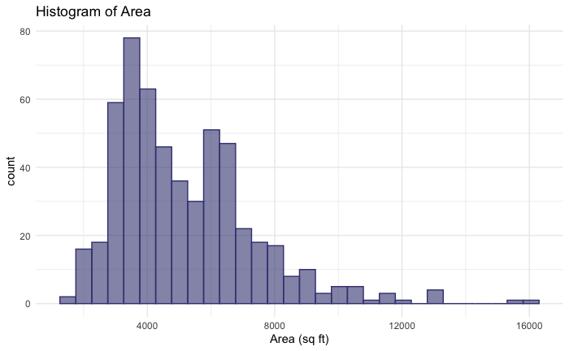
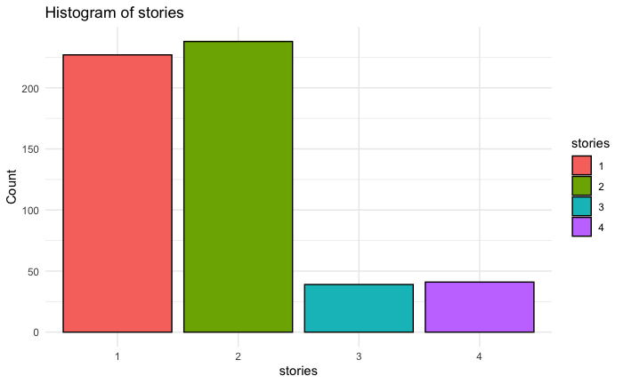
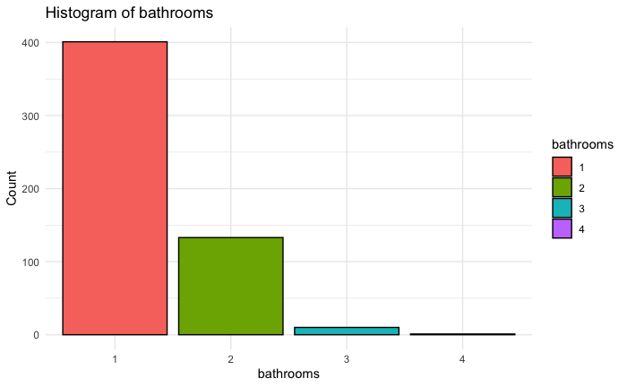
Data summary and plots

Slide 6
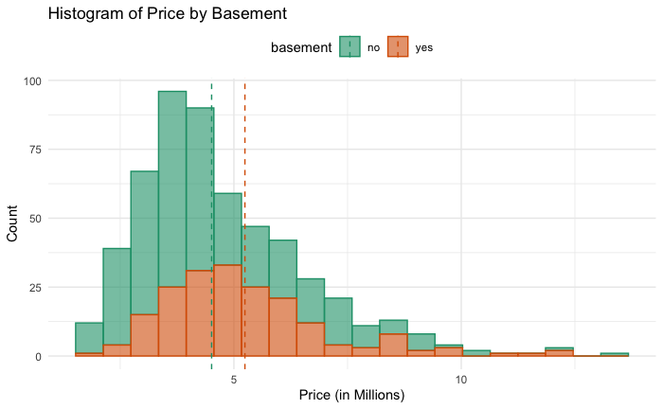
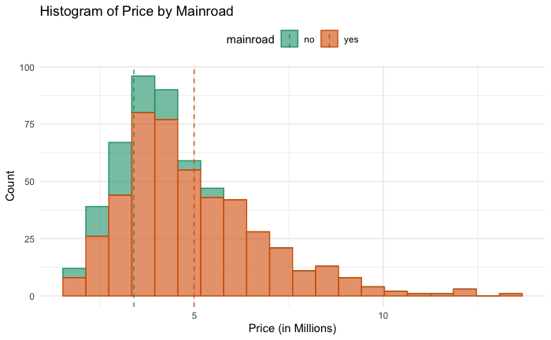
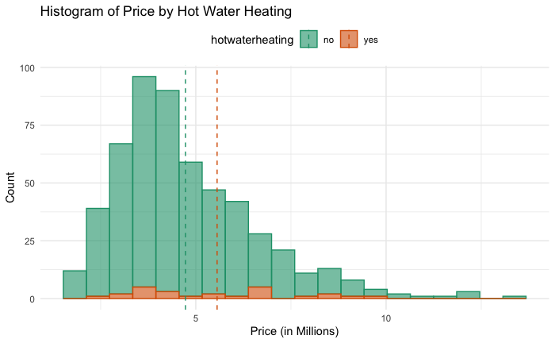
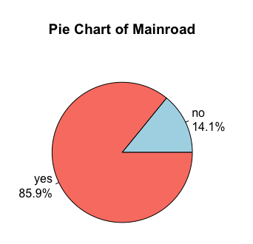
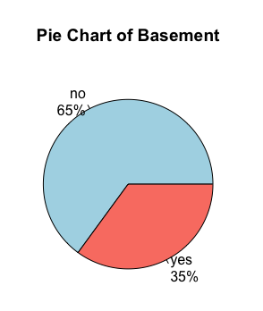
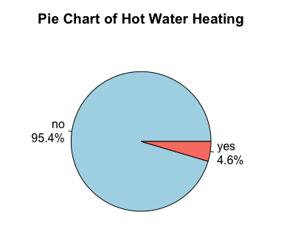
Data summary and plots

Slide 7
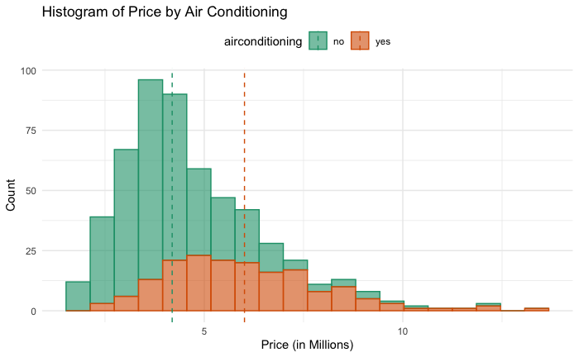
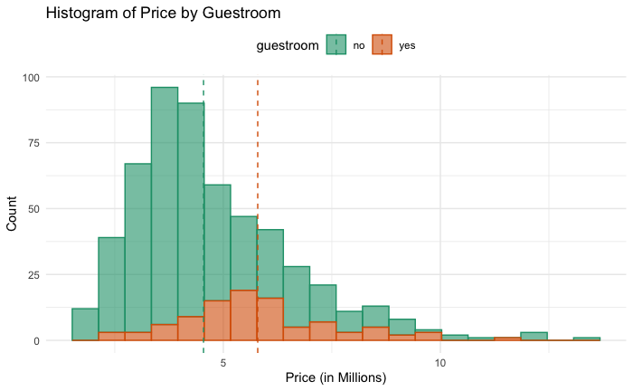
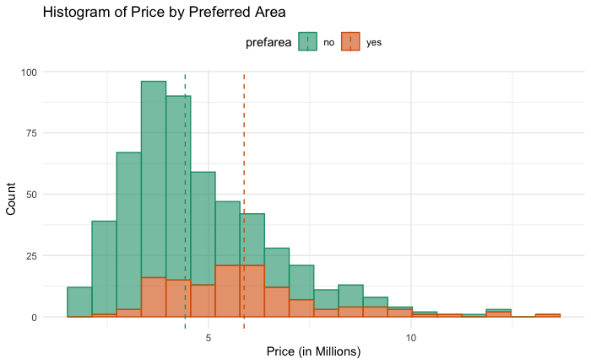
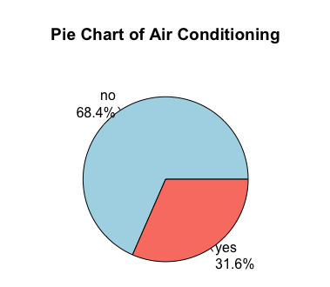
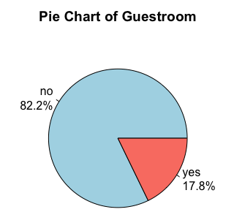
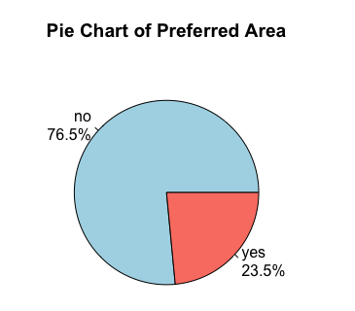
Data summary and plots

Slide 8
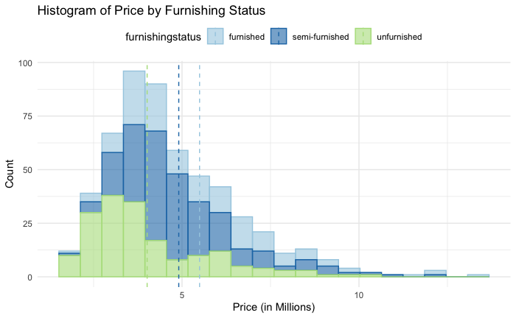
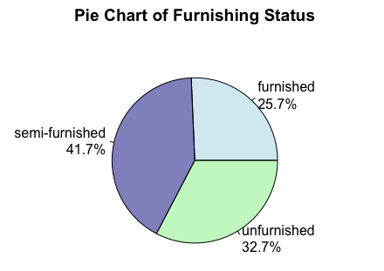
Data summary and plots

Slide 9
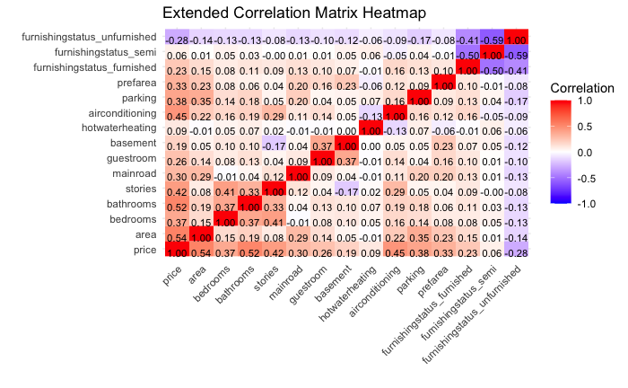
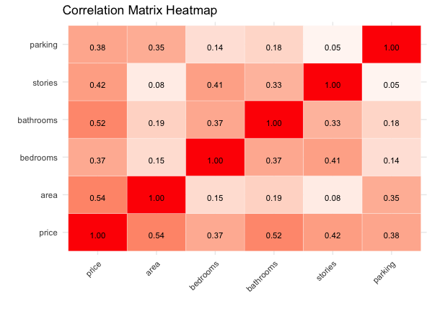
Correlation Matrix

Slide 10
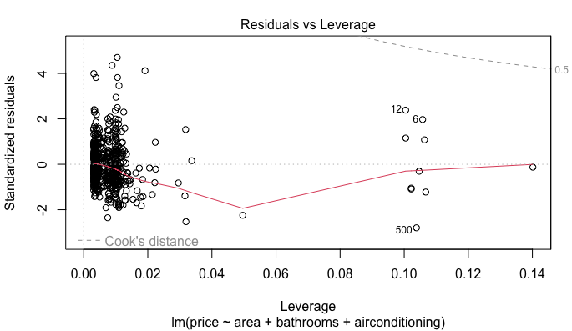
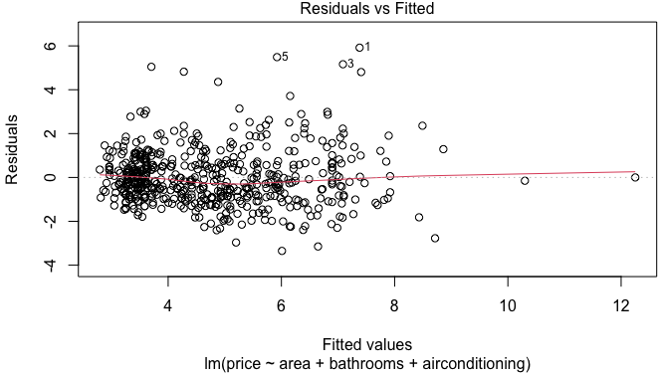
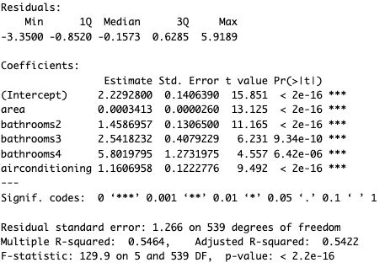
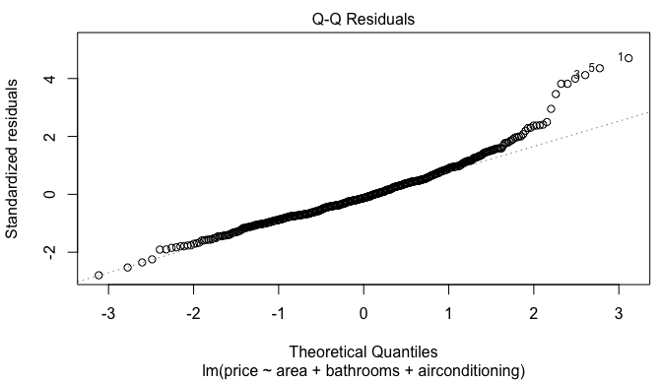
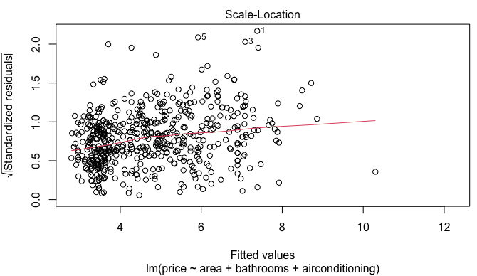
Results

Slide 11
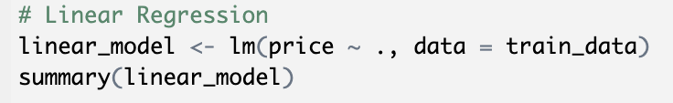
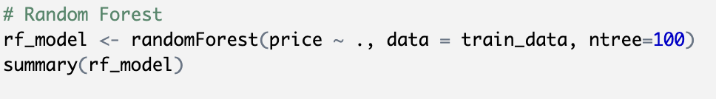
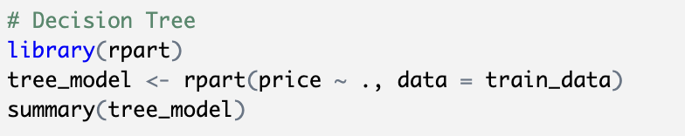
Further Treatment of Data

Slide 12
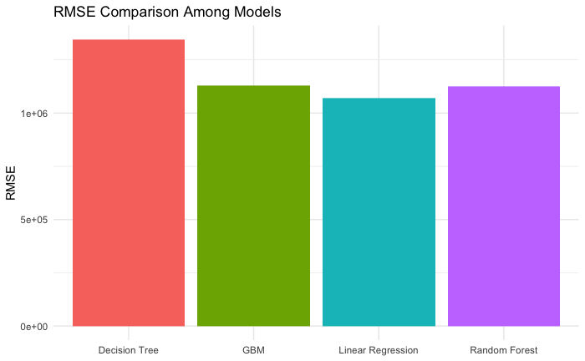
Model Comparisons
Comparison Parameter:
Root Mean Square Error (RMSE)

Slide 13

Summary
Area, Number of Bathrooms, and availability of air-conditioning impact the price of the house the most.
A linear (simple) regression model works best to describe the data.
To improve the model:
We need more data
More parameters like location, number of supermarkets within a mile, school nearby, etc.
[github.com/gajjugrg/asds_final]

