Slide 1
Code Refactoring and Bug Fixing
Bug 1
@app.route('/', methods=["POST"])
I have added the name of the route as magic

Slide 2
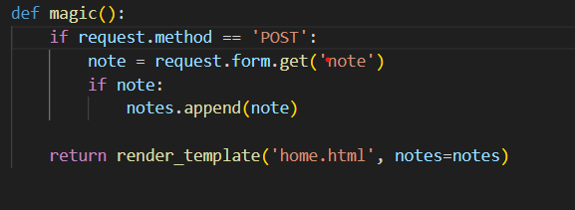
Bug 2

Slide 3

Bug 3 <form action=""> <input type="text" name="note" placeholder="Enter a note"> <button>Add Note</button> </form>

Slide 4
