Slide 1

THEN?

Slide 2
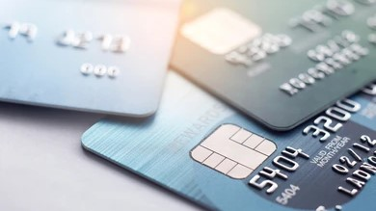
CREDIT CARD

Slide 3
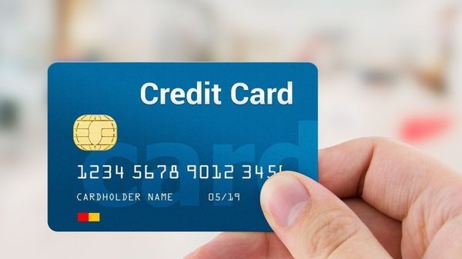
CREDIT CARD PAYMENT APPLICATION

Slide 4
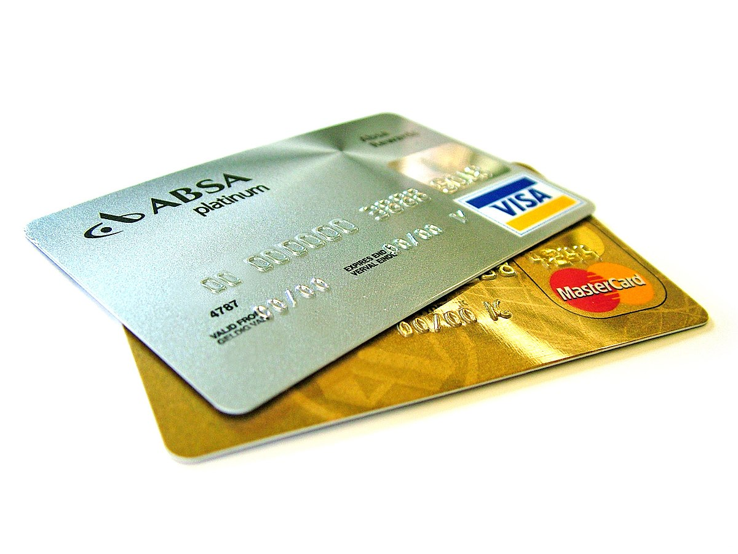
OBJECTIVE
Customer should be able to view credit card payment due date and amount.
Customer can able to pay the bill due amount or he can pay different amounts.
Customer can able to view statement history.
Customer can able to view payment history.
This Photo by Unknown Author is licensed under CC BY-SA

Slide 5
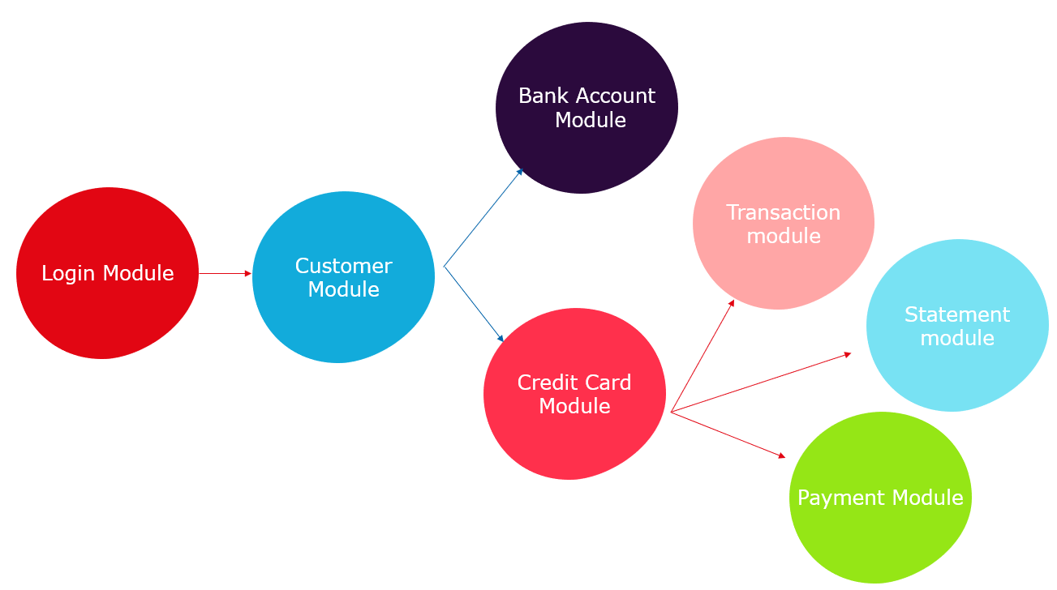
Flow

Slide 6
