Slide 1
PRESTO-R
Predictive, Stability-Aware Reinforcement Learning Routing
A clear explanation of the project, experiments, and actual results
Faculty presentation • Evidence from the completed simulator experiments
Notes:
Opening: PRESTO-R is a research prototype for choosing network routes. Evidence comes from this project simulator, not a production network. Sources: README.md; results/report.md.

Slide 2
The routing problem
A route may become slow, crowded, or unavailable while data is travelling.
•
A reactive router waits for visible trouble, then changes route.
•
A predictive router may leave early, but can change routes too often.
•
The project tests whether prediction plus a switching cost balances delivery and stability.
Route flapping means switching back and forth too frequently.
PRESTO-R • Faculty presentation
Notes:
Use a delivery-van analogy: choose among four roads. PRESTO-R tries to use warning clues without overreacting. This is the project motivation, not a universal claim about every routing system. Source: results/report.md sections 1–2.

Slide 3
Aim and scope
What this repository actually studies
IN SCOPE
OUT OF SCOPE OR NOT COMPLETED
•
One managed flow plus background traffic.
•
Production deployment or real traffic validation.
•
Python fluid simulator; synthetic congestion and failures.
•
Multiple managed flows or multipath splitting.
•
GRU risk predictor + DQN route choice + switch penalty.
•
NS-3 packet simulation (optional Phase 7, incomplete).
•
NSFNET and generated RGG; five scenarios.
•
One prediction × penalty ablation cell was not run.
PRESTO-R • Faculty presentation
Notes:
Fluid means traffic rates rather than individual packets. Failures are synthetic and may include designed precursors. Missing ablation is no-prediction plus switch penalty (reactive_dqn_pen). Sources: results/report.md sections 2,6; Phase 7 plan.

Slide 4
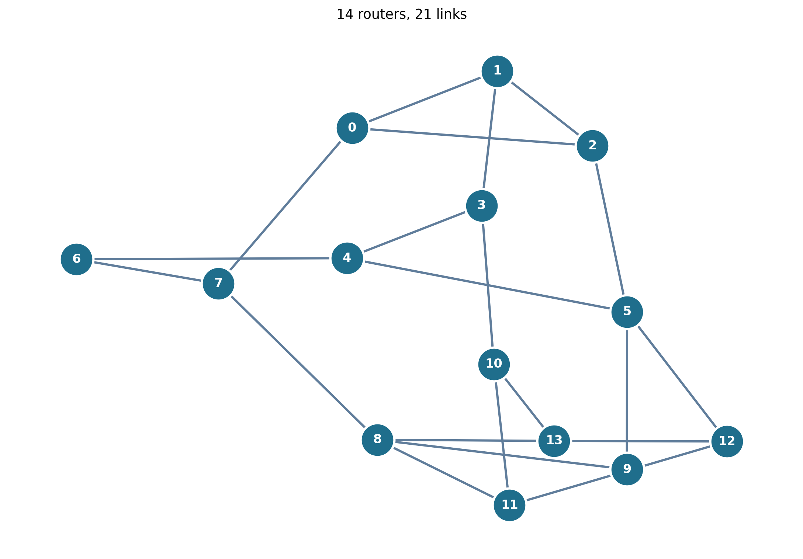
The NSFNET topology
A topology is a map of routers and the links connecting them.
14 routers
21 links
Fixed standard test map
PRESTO-R • Faculty presentation
Notes:
Each circle is a router/node; each line is a link. The graph layout is for readability, not geography. Exact node pairs are listed in presto/sim/topology.py as NSFNET_EDGES. Source: presto/sim/topology.py.

Slide 5
What NSFNET means here
A benchmark-style topology, not a live network being simulated.
•
The code builds 14 numbered nodes and 21 fixed undirected links.
•
NSFNET is the primary experiment topology; RGG is the second map.
•
The project creates its own traffic, link delays, and failure events.
•
Graph: presto/sim/topology.py • Settings: configs/topo/nsfnet.yaml
PRESTO-R • Faculty presentation
Notes:
NSFNET historically names a U.S. research network. This project uses a standard graph topology as a repeatable benchmark-style test map; it does not recreate historical traffic or operations. Sources: configs/topo/nsfnet.yaml; results/report.md T1.

Slide 6
How PRESTO-R decides
The same loop repeats each simulation tick.
1 SIMULATE
2 OBSERVE
3 PREDICT
4 CHOOSE
5 SCORE
traffic + events
noisy measurements
link risk
one of 4 paths
service + cost
1 tick = 100 ms • 200 ticks = 20 simulated seconds
PRESTO-R • Faculty presentation
Notes:
Simulator advances; agent gets telemetry and path features; predictor emits risk; DQN chooses an integer path action; reward is returned for learning. Future schedule and true link health are hidden from learned agents. Sources: presto-r-plan/00_overview.md; results/report.md T1.

Slide 7
Project phases
Phases 0–6 form the core; Phase 7 is optional.
PHASE 0
PHASE 1
PHASE 2
PHASE 3
PHASE 4
PHASE 5
PHASE 6
PHASE 7
Setup
Simulator
Predictor
Baselines
PRESTO-R
Experiments
Report
NS-3 optional
•
After Phase 1, predictor and baseline work can proceed in parallel.
•
Each phase adds a component needed by the next one.
•
Phase 7 would use packet-level NS-3, but its checks remain incomplete.
PRESTO-R • Faculty presentation
Notes:
Roadmap from presto-r-plan/00_overview.md and README. Phases 0–6 are the core; optional Phase 7 is not in final results.

Slide 8
Five simulated scenarios
Different conditions test different routing challenges.
STEADY
Normal conditions
CONGESTION
A link gets crowded
NODE FAILURE
A router and its links go down
FLUCTUATION
Link quality changes over time
MIXED
A combination of events
PRESTO-R • Faculty presentation
Notes:
Generated scenarios, not recorded production events. Some failures have warning precursors; others may be sudden. Sources: configs/scenario/*.yaml; results/report.md.

Slide 9
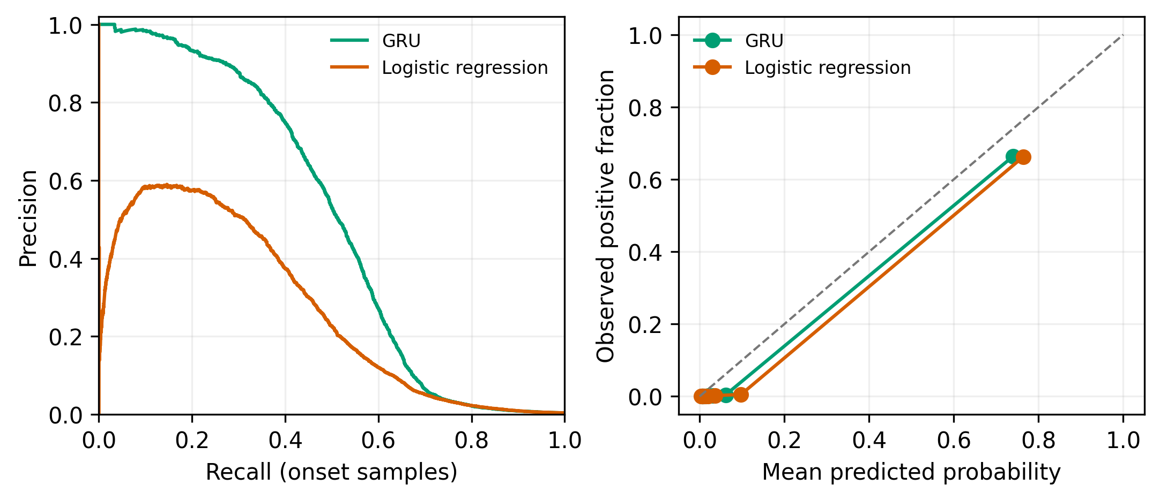
Phase 2 — Link-risk predictor
A GRU reads recent measurements and estimates near-future risk.
10 past ticks
5 link measurements
→ risk in next H ticks
Overall onset F1
0.5296
Precursor-only F1
0.7476
Overall onset target = 0.70 → did not pass
PRESTO-R • Faculty presentation
Notes:
Standard W=10, H=5. Bad link if down, true loss >.05, or true delay >3× base delay. Final held-out overall onset F1=.5296; precursor-only subgroup=.7476. All-sample metrics are easier because already-bad links are included. Sources: results/report.md T2; results/success_criteria.md; presto/predictor/gru.py.

Slide 10
Phase 3–4 — Routing methods
Baselines help isolate what prediction and the switch penalty contribute.
Shortest-path failover
Stays unless current route fails
Reactive DQN
Learns using current conditions
Predictive DQN
Adds predicted risk, λ = 0
PRESTO-R
Adds predicted risk, λ = 0.5
Oracle PRESTO
Diagnostic with future knowledge
PRESTO-R • Faculty presentation
Notes:
DQN = Deep Q-Network. Stable-Baselines3 supplies DQN, trained by presto/agents/train.py. Oracle sees future schedule and is not deployable. The reactive policy is an internal inspired baseline, not a full external RQSMR reproduction. Sources: phase-3 and phase-4 plans.

Slide 11
The reward formula
It tells the agent which trade-offs matter.
R = −αD − βL + γT − λS − μE
D
L
T
S
E
normalized delay
loss fraction
delivered/offered
1 when route changes
hops / max hops
PRESTO-R λ = 0.5 → each route change costs 0.5 reward points
Too little: route flapping. Too much: may stay on a failing path.
PRESTO-R • Faculty presentation
Notes:
Formula from presto/reward.py. Standard α=1, β=4, γ=0, μ=.05; PRESTO λ=.5. D normalized delay; L loss; T delivered/demand; S switch indicator; E normalized hops. With γ=0 there is no separate throughput bonus. λ selected on validation.

Slide 12
What was tested
Checks cover components, learned behavior, and final comparisons.
•
Unit/integration checks: topology, simulator, failures, telemetry, state, reward, environment.
•
Predictor checks: split leakage, output shape, save/load, held-out metrics.
•
Policy checks: heuristic choices, deterministic rollouts, training smoke, risk-use diagnostic.
•
Experiment checks: held-out grid, paired statistics, robustness, rerun hashes.
•
Release checkpoint records 74 tests; a later Phase 5 note records 97 tests.
PRESTO-R • Faculty presentation
Notes:
Counts 74 and 97 refer to different checkpoints, not one combined run. Repository test files are under tests/. Sources: README; phase-5 and phase-6 plans.

Slide 13
Phase 5 — Held-out experiment design
Methods see the same scenarios for fair paired comparisons.
•
2 topologies × 5 scenarios × 200 held-out seeds per scenario/topology.
•
Test seeds 10000–10199; λ tuned on validation, not test data.
•
5 training seeds for learned NSFNET agents; 3 for RGG agents.
•
38,400 episode-metric rows; Wilcoxon tests with Holm correction.
•
Also tested horizons H=3/H=10, 2× noise, +50% load, and sudden failures.
PRESTO-R • Faculty presentation
Notes:
Seeds match across methods for paired testing. Across-training-seed standard deviation describes learned-agent variation. Sources: results/report.md; README.md; configs/grid/main.yaml.

Slide 14
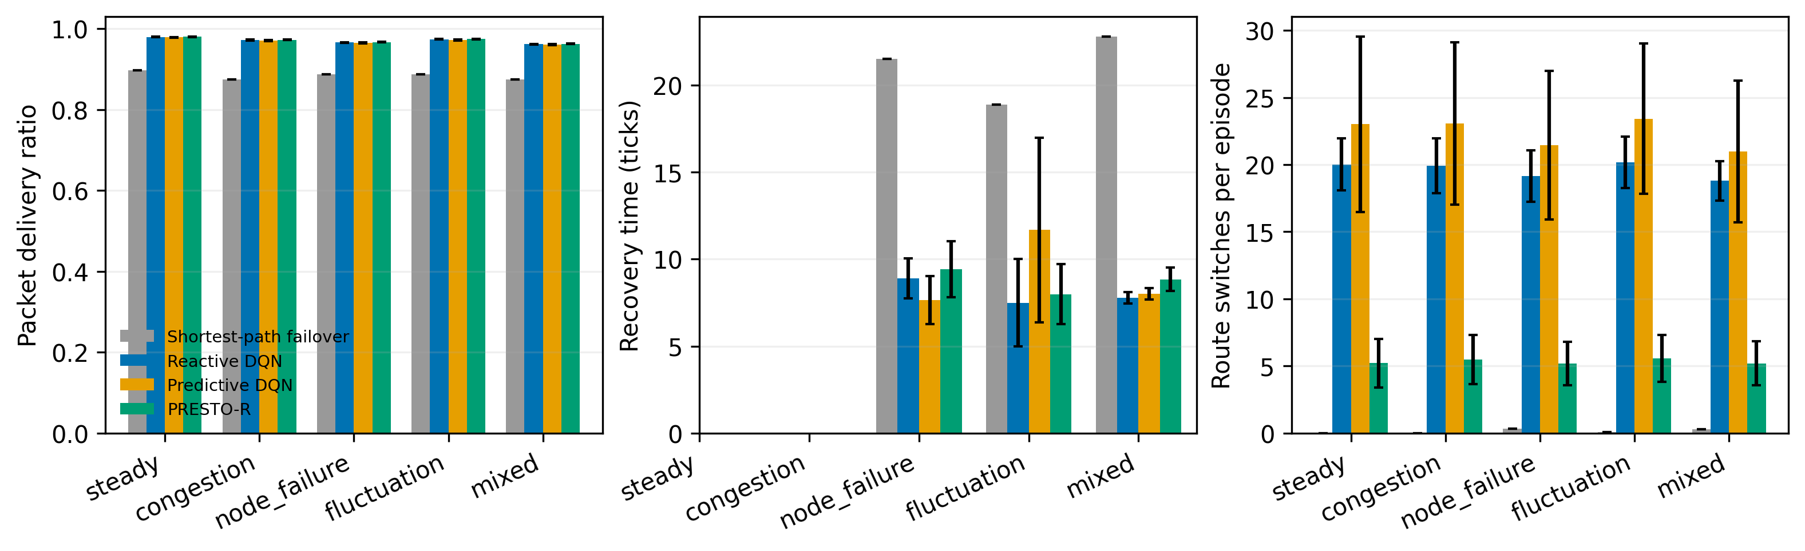
Main result — fewer switches, similar delivery
NSFNET • mixed scenario • held-out results
PDR
Reactive 0.9619
Predictive 0.9608
PRESTO-R 0.9625
Switches / episode
Reactive 18.799
Predictive 20.988
PRESTO-R 5.197
75.2% fewer switches than Predictive DQN; PDR difference +0.0017.
PRESTO-R • Faculty presentation
Notes:
Exact values: report.md T3, mixed NSFNET. Reduction (20.988−5.197)/20.988 ≈75.2%. PDR difference .0017 = .17 percentage points. Phrase conclusion as a simulator result.

Slide 15
Success criteria — mixed outcome
The final report includes passes and failures.
Switching vs predictive DQN
PASS
mixed + fluctuation
Steady delay ≤110% of reactive
PASS
46.28 ms vs 50.94 ms limit
PDR + recovery vs reactive
FAIL
failure targets not fully met
Overall onset F1 ≥0.70
FAIL
measured 0.5296
Fresh rerun hashes match
PASS
reproducibility check
PRESTO-R • Faculty presentation
Notes:
Source results/success_criteria.md. PRESTO did not meet the predeclared significant PDR-and-recovery comparison to reactive on failure cases. Slightly higher average PDR does not satisfy the full criterion.

Slide 16
Limitations and next work
This is evidence about the simulator, not proof about real networks.
•
Fluid model: no individual packet timing or full protocol behavior.
•
One managed flow; synthetic failures and designed precursor patterns.
•
Predictor trained on simulator telemetry may face distribution shift.
•
No-prediction + switch-penalty ablation was not run.
•
NS-3 packet validation and real traffic traces remain future work.
Takeaway: clear stability benefit, with important prediction and recovery limits.
PRESTO-R • Faculty presentation
Notes:
Sources: results/report.md discussion; Phase 7 optional plan. Suggested next steps: improve onset prediction, finish the missing ablation, and validate with NS-3 and real traces.

