Slide 1

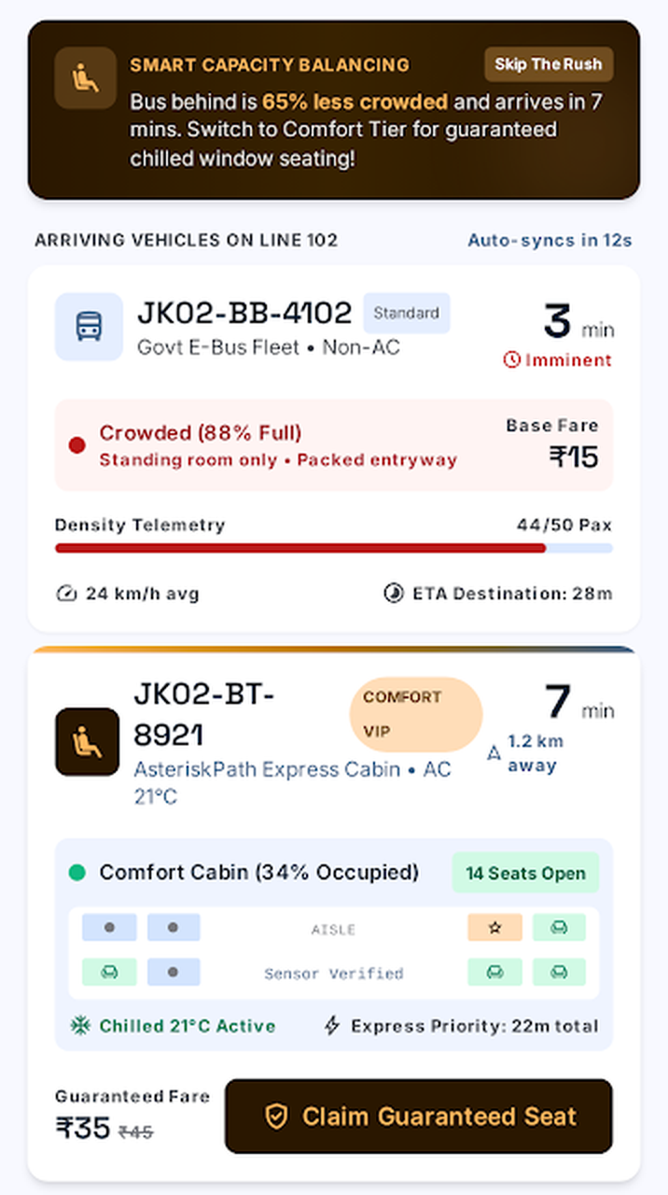
AsteriskPath
JAMMU SMART CITY HACKATHON
A Seat, a Time, a Choice.
Comfortable, predictable bus travel for passengers —
and extra earnings for bus owners.
Live GPS tracking
Crowd level
Comfort seats
Owner dashboard
Notes:
Introduce AsteriskPath: an app that makes bus travel in Jammu less crowded and more predictable, while giving bus owners a new way to earn.

Slide 2


THE PROBLEM
Buses are packed, but owners fear change
Passengers suffer
Bus owners lose out
SAME ROUTE, SAME TIME
88%
Overcrowding
Uneven load
Standing, pushing and no seat — even for long trips.
One bus is packed while the next one runs half empty.
full — Bus 1 arriving in 3 min
34%
No information
Fear of loss
No idea where the bus is or when it will arrive.
Less crowding looks like fewer tickets and less money.
full — Bus 2 just 4 min behind
Wasted time
No demand data
The seats exist. Passengers just can't see them.
Waiting at stops without knowing the journey time.
Owners guess peak hours and busy stops.
Example: Line 102, Jammu Bus Stand ⇄ Bari Brahmana (app demo data)
AsteriskPath · Jammu Smart City Hackathon
02 / 10

Slide 3





OUR SOLUTION
One app, two winners
For passengers
For bus owners
See live bus location and arrival time
Earn extra from comfort seats
AsteriskPath
Check how crowded each bus is
Fill empty buses, ease packed ones
GPS · crowd data · booking · payments
Pick standard or comfort travel
See demand, peak hours and busy stops
Board with a digital pass
Get digital payments, no cash leaks
Passengers get a comfortable, predictable journey. Owners get smarter bus management and new income.
AsteriskPath · Jammu Smart City Hackathon
03 / 10

Slide 4





PASSENGER APP
Know before you board
Live bus location
Arrival time (ETA)
Track every bus on your route through GPS.
See exactly how many minutes until the bus reaches your stop.
Journey time
Crowd level
Know how long the ride to your destination will take.
Green = comfortable, amber = moderate, red = crowded.
Travel options
CROWD LEVEL
Compare buses and choose standard or comfort travel.
Under 60%
60–89%
90%+
Live app screen: the app nudges riders to the less-crowded bus behind.
AsteriskPath · Jammu Smart City Hackathon
04 / 10

Slide 5
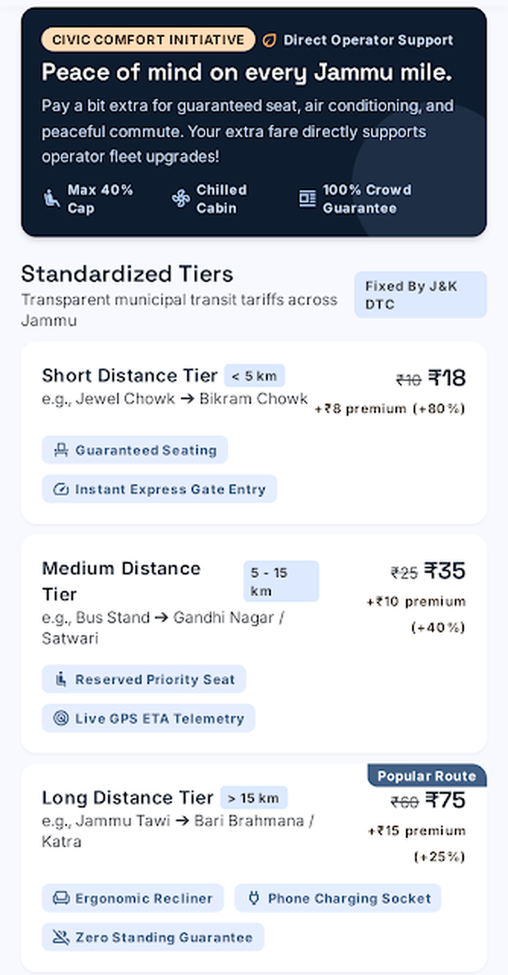


COMFORT TRAVEL
Pay a little more, travel a lot better
Passengers can choose a comfort seat: a guaranteed seat, less crowd and live tracking. The extra charge depends on distance.
Short trip
Medium trip
Long trip
Under 5 km
5 – 15 km
Over 15 km
+80%
+40%
+25%
₹10 → ₹18
₹25 → ₹35
₹60 → ₹75
Only ₹8 extra
₹10 extra
₹15 extra
Max 40% seats
Seat guarantee
Comfort seats capped, so regular fares stay available.
No seat? The extra amount is refunded to UPI.
Example fares are for illustration; final prices will be decided with operators and the transport department.
AsteriskPath · Jammu Smart City Hackathon
05 / 10

Slide 6
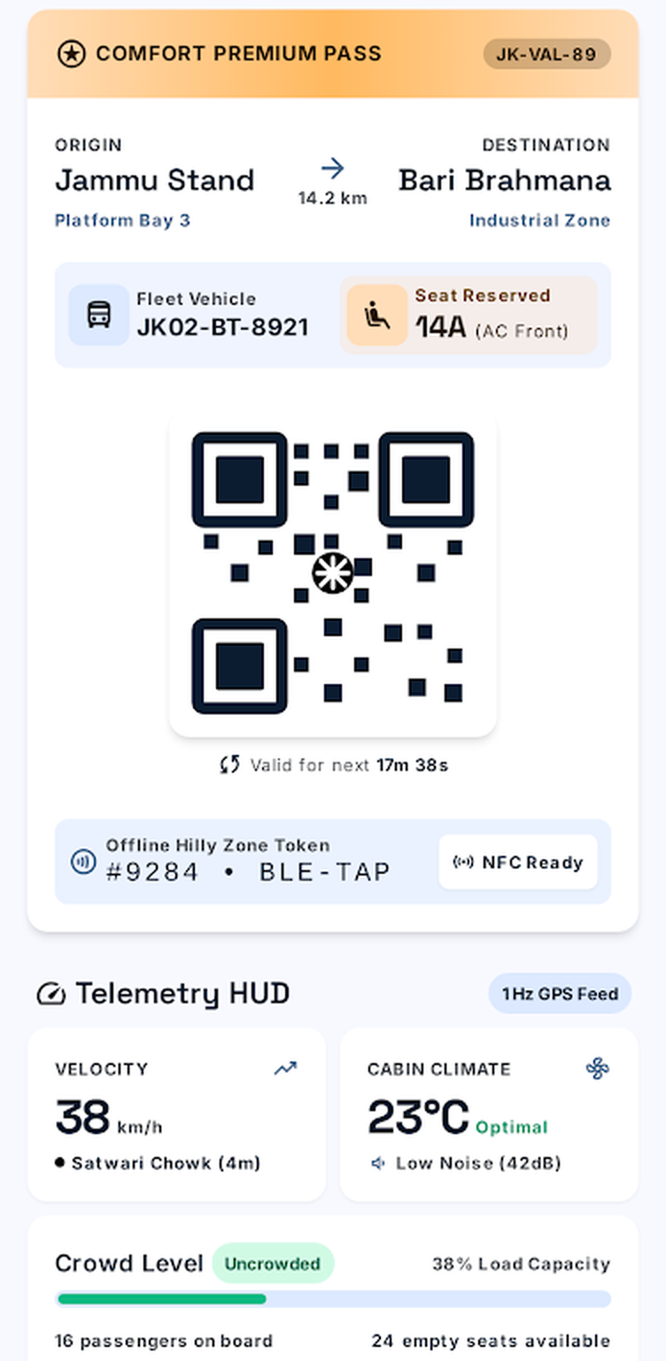





HOW IT WORKS
From search to seat in 4 steps
1
2
3
4
Search
Compare
Choose & pay
Board
Enter where you want to go, e.g. Bus Stand to Bari Brahmana.
See each bus: arrival time, journey time and crowd level.
Pick standard or comfort. Pay by UPI in one tap.
Show the QR pass or 4-digit PIN to the conductor.
Bus too crowded mid-route? The pass can be moved to the next bus on the same route.
AsteriskPath · Jammu Smart City Hackathon
06 / 10

Slide 7
FOR BUS OWNERS
Less crowding does not mean less money
1. Same passengers, better spread
2. Plus new comfort income
Two buses on the same route, 50 seats each
Per bus, medium route (₹25 fare, +40%)
TODAY
20 comfort seats × ₹10 extra
₹200 / trip
Bus A
70 riders
Owner's share (75%)
₹150 / trip
Bus B
20 riders
× 8 trips a day
₹1,200 / day
WITH ASTERISKPATH
Bus A
45 riders
≈ ₹36,000
Bus B
45 riders
90 riders either way, so ticket income stays the same. Riders move to the next bus, they don't leave.
extra per bus, per month
Illustrative numbers. 40% seat cap and 75/25 split are our proposal, open to discussion with operators.
AsteriskPath · Jammu Smart City Hackathon
07 / 10

Slide 8
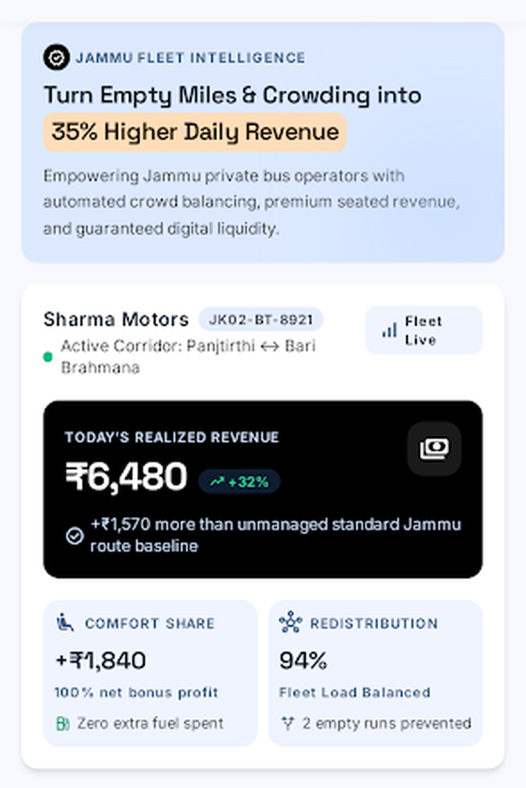





WHY OWNERS JOIN
Six reasons to register with us
Extra income
Balanced buses
75% of every comfort premium goes to the owner.
Fewer empty runs, fewer overloaded trips.
Demand insights
Daily digital payout
See peak hours, busy stops and route demand.
UPI money straight to the bank. No cash leaks.
Better reputation
Easy to join
Ratings and trust bring back regular riders.
Register the bus; driver's phone app shares GPS.
Owner dashboard: earnings, comfort share and load balance.
AsteriskPath · Jammu Smart City Hackathon
08 / 10

Slide 9
BUSINESS & ROLLOUT
How we earn, and how we grow
Rollout plan
Where the comfort premium goes
1
Pilot Phase 1
2–3 busy routes, e.g. Bus Stand ⇄ Bari Brahmana. Onboard a few owners, measure results.
2
City-wide Phase 2
All major Jammu corridors, more operators and comfort buses.
3
Smart City link Phase 3
Connect with Smart City e-buses and share demand data for planning.
We earn only when owners earn. No fee to register.
BUILT WITH
Flutter app (Android / iOS / Web)
GPS tracking
UPI payments
Dart backend
AsteriskPath · Jammu Smart City Hackathon
09 / 10

Slide 10


THE IMPACT
Everyone rides better
Passengers
Bus owners
Jammu city
A seat when they want one, a bus they can track, and a trip they can plan.
Same riders, extra comfort income, fewer empty runs and clear demand data.
Less overcrowding, safer buses and real data to plan public transport.
Thank you
Questions welcome · AsteriskPath, Jammu Smart City Hackathon

