Slide 1

BCoal: Bucketing-based Memory Coalescing for Efficient and Secure GPUs
Gurunath Kadam, William & Mary
Danfeng Zhang, Penn State University
Adwait Jog, William & Mary
Notes:
Good Morning everyone! My name is Gurunath, and I will be presenting our paper titled “BCoal … “.
This work was done at William and Mary and with our collaborator at Penn State.

Slide 2

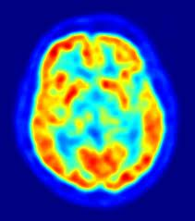

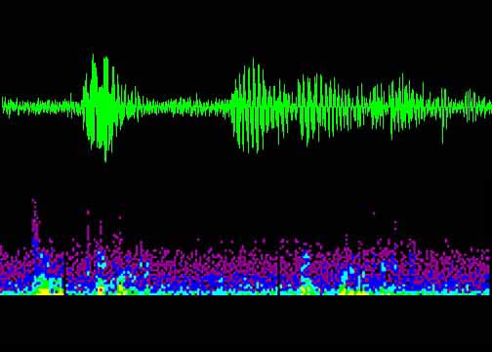


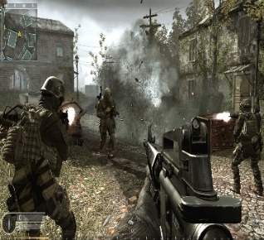


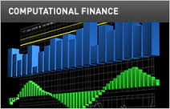
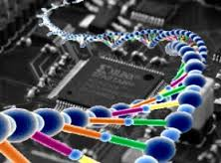
GPUs are Everywhere!
Astronomy
Medical
Imaging
Physics
Simulation
Audio
Processing
Machine
Learning
High Data-Level
Parallelism
Fast and
Energy Efficient
Games
Image
Processing
Encryption
Financial
Computing
Genomics
Secure GPU against attacks!!

Slide 3


Previously at HPCA…
Correlation Timing Attack
Recovers AES Key
Exploits Deterministic GPU Coalescing Logic
[Jiang+, HPCA’16]
RCoal
Randomizes GPU Coalescing Logic
[Kadam+, HPCA’18]
Notes:
Previously one such attack, called correlation timing attack, was demonstrated to recover the AES encryption Key.
This attack exploited the deterministic GPU coalescing, used for memory access optimization.
In response, we presented a defense scheme, RCoal, which randomized the GPU coalescing logic to mitigate the attack.

Slide 4


Previously on HPCA…
Now … HPCA’20
Correlation Timing Attack
Recovers AES Key
Exploits Deterministic GPU Coalescing Logic
[Jiang+, HPCA’16]
RCoal
Randomizes GPU Coalescing Logic
Not Secure with MSHRs and Caches
~9.4x Performance Overhead
RCoal
Randomizes GPU Coalescing Logic
[Kadam+, HPCA’18]
BCoal
Bucket-based Coalescing Logic
Secure with MSHRs and Caches
Better Security and Performance Tradeoff
Notes:
However, RCoal is not secure with MSHRs and caches, and result in high performance degradation.
Now, we present a performance efficient defense scheme, BCoal.
BCoal employs a Bucket-based coalescing logic to thwart the timing attack. BCoal is secure with MSHRs and caches.
BCoal offers a good security and performance tradeoff compared to the state-of-the-art.

Slide 5
Outline
Introduction
Background
Prior Defense Scheme: RCoal
BCoal Defense Scheme
Evaluation
Conclusion
Notes:
Outline of my talk. I will present some background on the GPU memory optimization techniques and correlation timing attack.
Then, I will discuss the previous defense scheme, RCoal and its shortcomings.
Following that I will present new performance efficient denfese scheme, BCoal and its evaluation.
…leading to the conclusion.

Slide 6
Outline
Introduction
Background
Memory Access Optimization in GPU
Correlation Timing Attack on GPU
Prior Defense Scheme: RCoal
BCoal Defense Schemes
Evaluation
Conclusion
Notes:
Bigger font – merge if possible

Slide 7
Memory Access Optimizations in GPUs
Bandwidth is Precious!
Different Optimizations to exploit Locality
Coalescing Unit
Caching
Miss-Status Handling Registers (MSHRs)
# of Accesses α Execution Time
Notes:
Bandwidth is an important resource on GPUs, as a result, different optimization techniques are used to exploit the access locality.
The first optimization is access coalescing, which merges accesses going to the same memory block to generate as few accesses as possible.
Next, GPUs used caching at two levels, L1 and L2, to exploit temporal and spatial locality.
The cache missed accesses going to the next memory level are further optimized in MSHRs, which merges the accesses going to the same memory block.
If fewer accesses are generated then the execution time is short, otherwise with large number of accesses the execution time increases.
The number of accesses govern the execution time.

Slide 8




Timing Attack Model [Jiang+, HPCA’16]
Recovers AES Key on GPUs
Plaintext
Ciphertext | Time
Ciphertext₁ | T₁
Ciphertext₂ | T₂
… | …
Ciphertext
Notes:
Next, we look at the correlation timing attack. We begin with the attack model.
The goal is to recover the AES encryption key.
The model assumes that the attacker can remotely access the encryption server, which stores the encryption key.
The attacker can send plaintexts to the server for encryption and time the execution time for each encryption.
The attacker then receives the ciphertext. The attacker can repeat the process to collect multiple cipertexts and related execution time.

Slide 9

Timing Attacks on GPUs [Jiang+, HPCA’16]
Recovers AES Key on GPUs
Last Round Execution
$c_{j}^{tid}=T_{4}\left[t_{i}^{tid}\right]⊕ k_{j}$
Round Key
XOR
Input to the Round
T₄ Table Lookup
Encryption Output to Attacker
Notes:
Now, we see the attack in detail: The attack focuses on the last round of the AES encryption.
The last round can be summarized in following equation.

Slide 10


Timing Attacks on GPUs [Jiang+, HPCA’16]
# of Accesses α Execution Time
Last Round Execution
Invert Table Lookup
1
$c_{j}^{tid}=T_{4}\left[t_{i}^{tid}\right]⊕k_{j}$
Execution Time [Real Key Byte]
2
$${t′}_{i}^{tid}=T_{4}^{−1}\left[c_{j}^{tid}⊕k_{j}′\right]$$
Mem Address
Guess Key Byte
4
Correlation?
+
3
GPU Memory Configuration
# of coalesced accesses [Guess Key Byte]
Correlation is HIGHEST for REAL key
Notes:
To begin the attack, the attacker executes the encryption on the server and observes the execution time.
This execution time corresponds to the real key byte value, which attack is unaware of.
In second step, the attacker performs an invert table lookup. She then plugs in a guess key byte value to deduce the memory addresses generated.
The attack assumes that the attacker is aware of the memory layout.
With the help of the memory layout and the memory addresses, attacker can find out the number of coalesced accesses corresponding to the guess key byte.
For the final step the attacker exploits the relationship between the # of accesses and the execution time.
To do so, she correlates the # of coalesced accesses with the observed execution time. Among the guess key byte values, the correlation is higher for the correct guess.

Slide 11
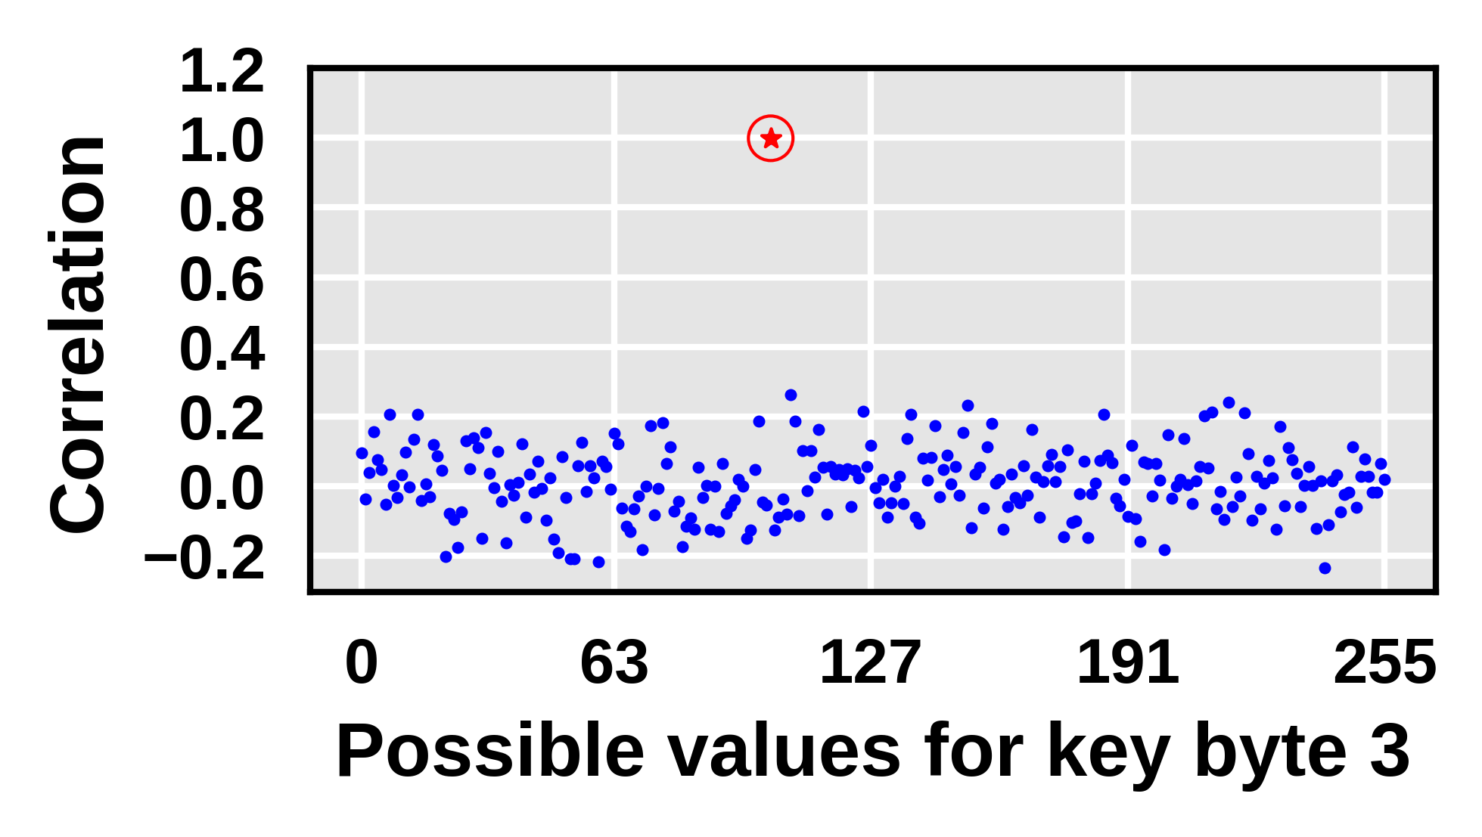
Timing Attacks on GPUs [Jiang+, HPCA’16]
Correct Guesses
Incorrect Guesses

Slide 12
Outline
Introduction
Background
Prior Defense Scheme: RCoal
BCoal Defense Scheme
Evaluation
Conclusion
Notes:
Bigger font – merge if possible

Slide 13
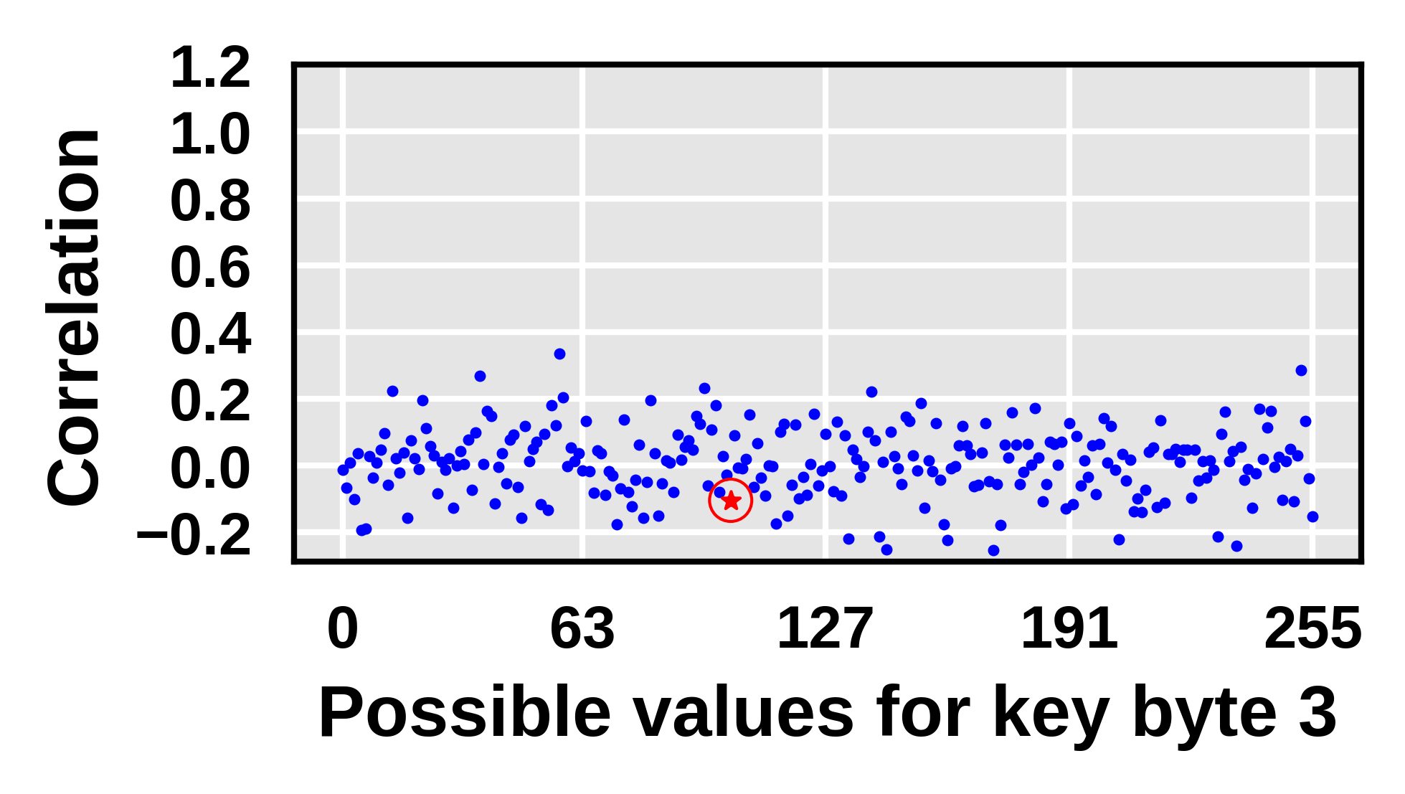
RCoal: Randomized Coalescing Scheme
Attack exploits Deterministic Coalescing
RCoal Randomizes Coalescing Logic
Randomly generates Duplicate Accesses

Slide 14
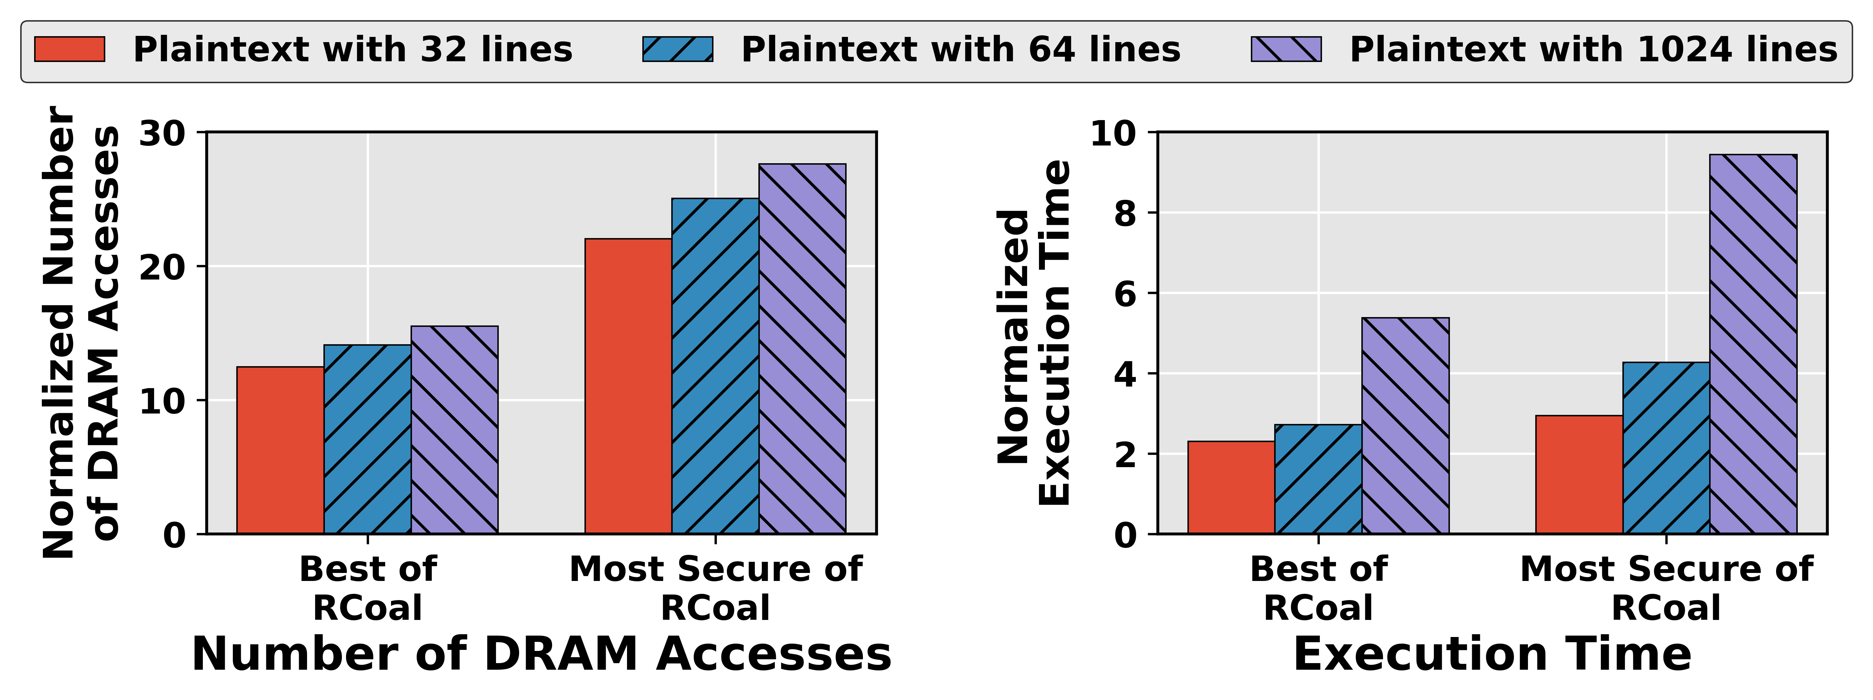
RCoal Shortcomings
High Performance Degradation
Inefficient Coalescing
MSHRs and Caches Disabled
RCoal suffers ~27x increase in DRAM Accesses
RCoal suffers ~ 9.4x increase in Execution Time

Slide 15

RCoal Shortcomings
High Performance Degradation
Inefficient Coalescing
MSHRs and Caches Disabled
Insecure with MSHRs and Caches
Need for Performance Efficient Defense Scheme!
SECURE
INSECURE
Without MSHRs and Caches
With MSHRs and Caches
Notes:
Check order

Slide 16
Outline
Introduction
Background
Prior Defense Scheme: RCoal
BCoal Defense Scheme
Evaluation
Conclusion
Notes:
Bigger font – merge if possible

Slide 17
Bucketing for Coalesced Accesses
Performance Efficient Secure Coalescing
# of Coalesced Accesses α Execution Time
Reduce Variance
# of Coalesced Accesses
12
13
14
15
16
Execution Time
E₁
E₂
E₃
E₄
E₅
Correlation
Notes:
We start by examining what bucketing means.
We aim to devise a performance efficient secure coalescing, which eliminates the relationship between the # of coalesced accesses and observed execution time.
It can be achieved by reducing the variance in the execution time.
Lets look at an example of 5 different encryptions generating 5 distinct number of coalesced accesses.
The corresponding execution time will be different as well.
Since, the execution time is governed by the # of coalesced accesses, the attacker can correlate them to recover the key.

Slide 18

Bucketing for Coalesced Accesses
Performance Efficient Secure Coalescing
# of Coalesced Accesses α Execution Time
Reduce Variance
# of Coalesced Accesses
12
13
14
15
16
16
16
16
16
Execution Time
E₁
E₂
E₃
E₄
E₅
E₅
E₅
E₅
E₅
No Correlation
Notes:
To eliminate the correlation, we want to reduce the variance in the execution time.
This can be achieved by always generating same number of coalesced accesses.
The result is no correlation.

Slide 19
Bucketing for Coalesced Accesses
Performance Efficient Secure Coalescing
# of Coalesced Accesses α Execution Time
Reduce Variance
Bucketing
Padded Accesses
# of Coalesced Accesses
12
13
14
15
16
16
16
16
16
B₁₆
Fewer Buckets: Best Security, Performance Overhead

Slide 20
Bucketing for Coalesced Accesses
Performance Efficient Secure Coalescing
# of Coalesced Accesses α Execution Time
Reduce Variance
Bucketing
Fewer Buckets: Best Security, Performance Overhead

Slide 21
Bucketing for Coalesced Accesses
Performance Efficient Secure Coalescing
# of Coalesced Accesses α Execution Time
Reduce Variance
Bucketing
Fewer Buckets: Best Security, Performance Overhead
More Buckets: Less Security, Low Performance Overhead
Padded Accesses
# of Coalesced Accesses
12
14
14
16
13
15
16
B₁₂
B₁₄
B₁₆

Slide 22
Bucketing for Coalesced Accesses
Performance Efficient Secure Coalescing
# of Coalesced Accesses α Execution Time
Reduce Variance
Bucketing
Fewer Buckets: Best Security, Performance Overhead
More Buckets: Less Security, Low Performance Overhead
Bucketing offers Security/Performance Tradeoff
How to select Bucketing Features?

Slide 23
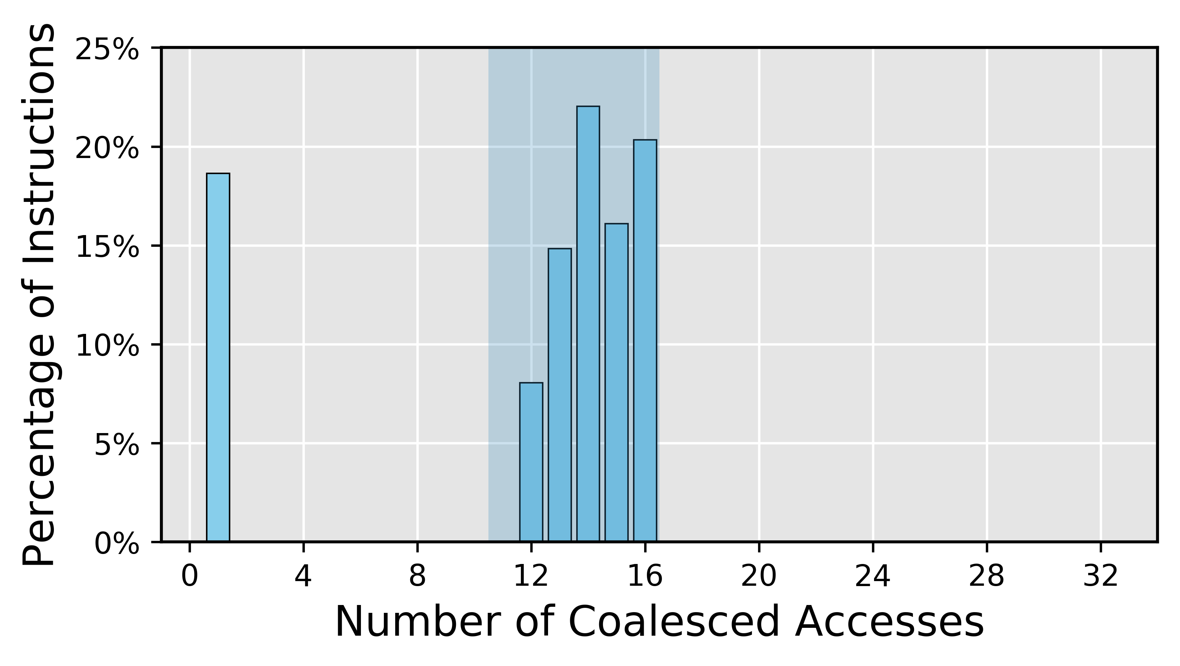
Selecting Bucketing Features
Desired Security / Performance Tradeoff
Single Bucket
Two Buckets
Best Security
Performance
Good Security
Performance
Bucket Size 1
Bucket size 16
Bucket Size 16
BCoal(16)
BCoal(1, 16)

Slide 24
Padded Access Generation (I)
MSHRs and Caches must not degrade the security
Learning from RCoal:
Randomly Generates Duplicate accesses
Disables MSHRs and Caches
Padded Accesses must be
Unique: No optimization
Random: Effect on Execution Time is unpredictable
Observation I: The Padded Accesses should be Unique and Random

Slide 25
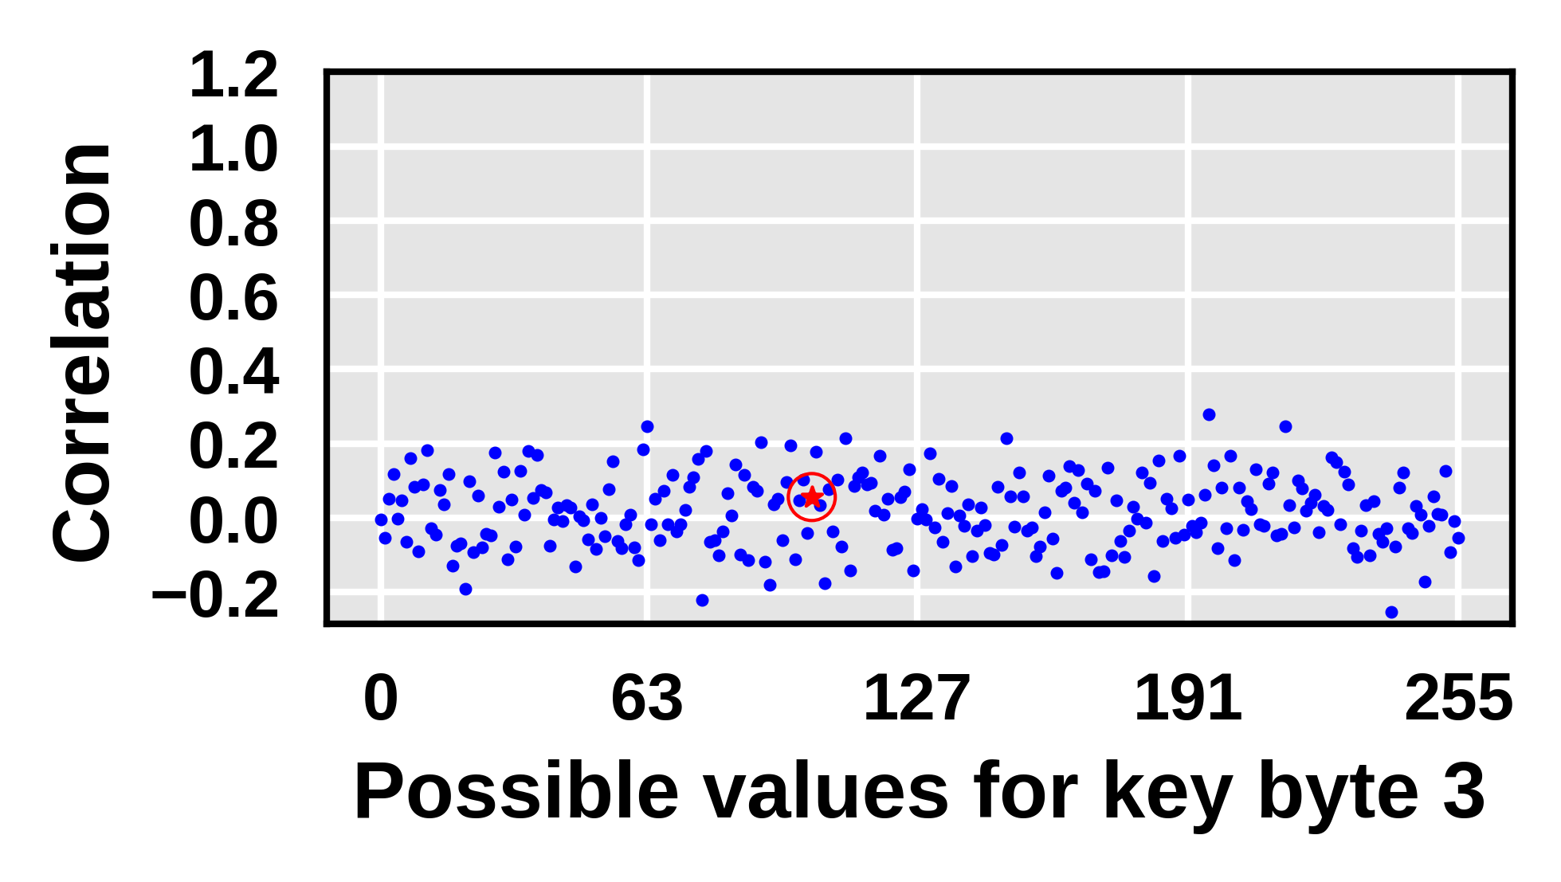

Evaluation of Unique and Random Padded Accesses on Security
Bucketing with 1 Bucket of Size 16
Multi-warp
Why Security degrades due to MSHRs and Caches?
SECURE
INSECURE
Without MSHRs and Caches
With MSHRs and Caches

Slide 26
Security degradation with MSHRs and Caches
Padded vs. Real Accesses
Different Merging and Caching Patterns
Different Address Ranges
Padded accesses: Entire address space
Real accesses: Table T₄ alone
Affect Execution Time at Different Rates
Effect of Padded Accesses can be filtered out
Observation II: The Padded and Real Accesses should be Homogeneous in terms of caching and merging patterns
Notes:
Think of the transition from the previous slide

Slide 27
Putting Everything Together …
Goals of Defense Scheme
# of Coalesced Accesses α Execution Time
Reduce variance
Bucketing
Secure with MSHRs and Caches
Padded accesses should be
Unique and Random
Same address space as Real accesses
BCoal: Bucket-based Coalescing
BCoal(16): Single bucket of size 16
BCoal(1, 16): Two buckets of sizes 1 and 16
BCoal: A Performance-Efficient Defense Scheme
Notes:
Rework this

Slide 28
Outline
Introduction
Background
Prior Defense Scheme: RCoal
BCoal Defense Scheme
Evaluation
Conclusion
Notes:
Bigger font – merge if possible

Slide 29
BCoal Security & Performance Evaluation
Experimental Setup
GPGPUSIM simulator
Plaintext sizes
32 Lines (Single Warp)
64 Lines (Multi Warp)
1024 Lines for Performance
Security evaluation
Same number of plaintext samples as that of the attack

Slide 30
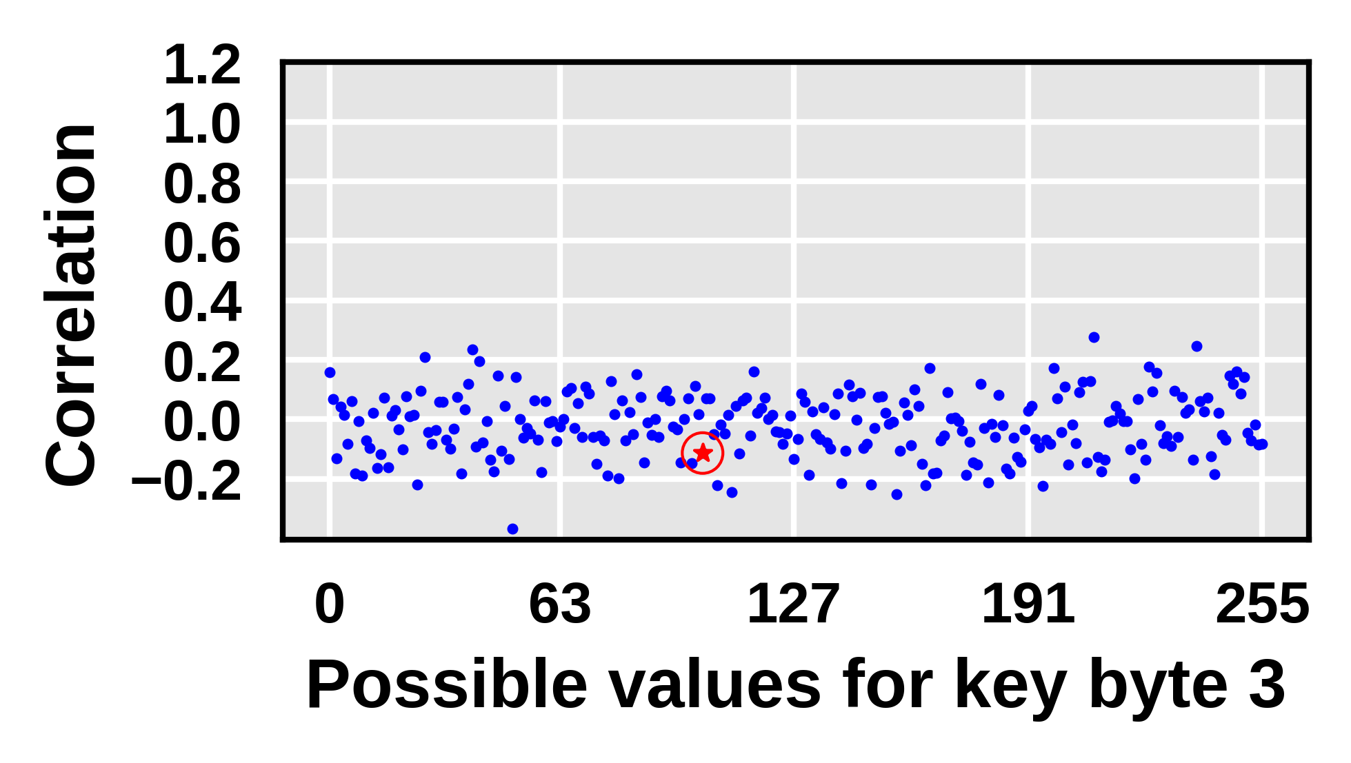
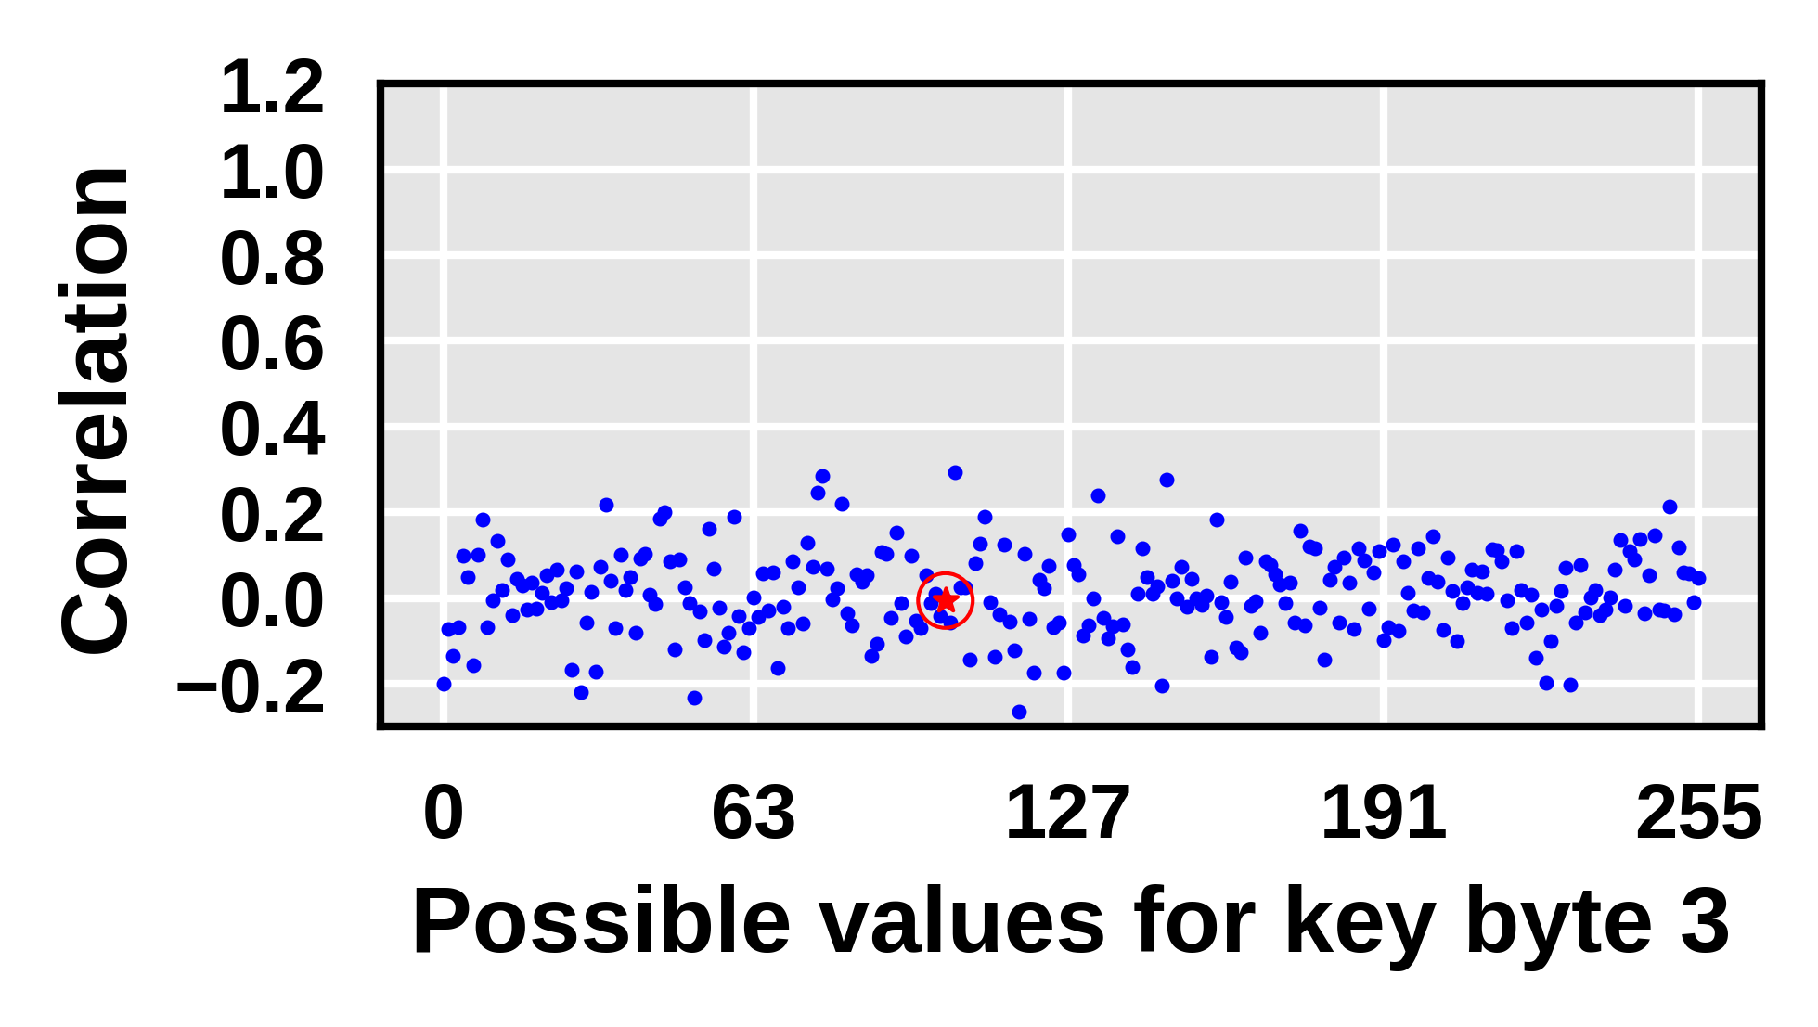
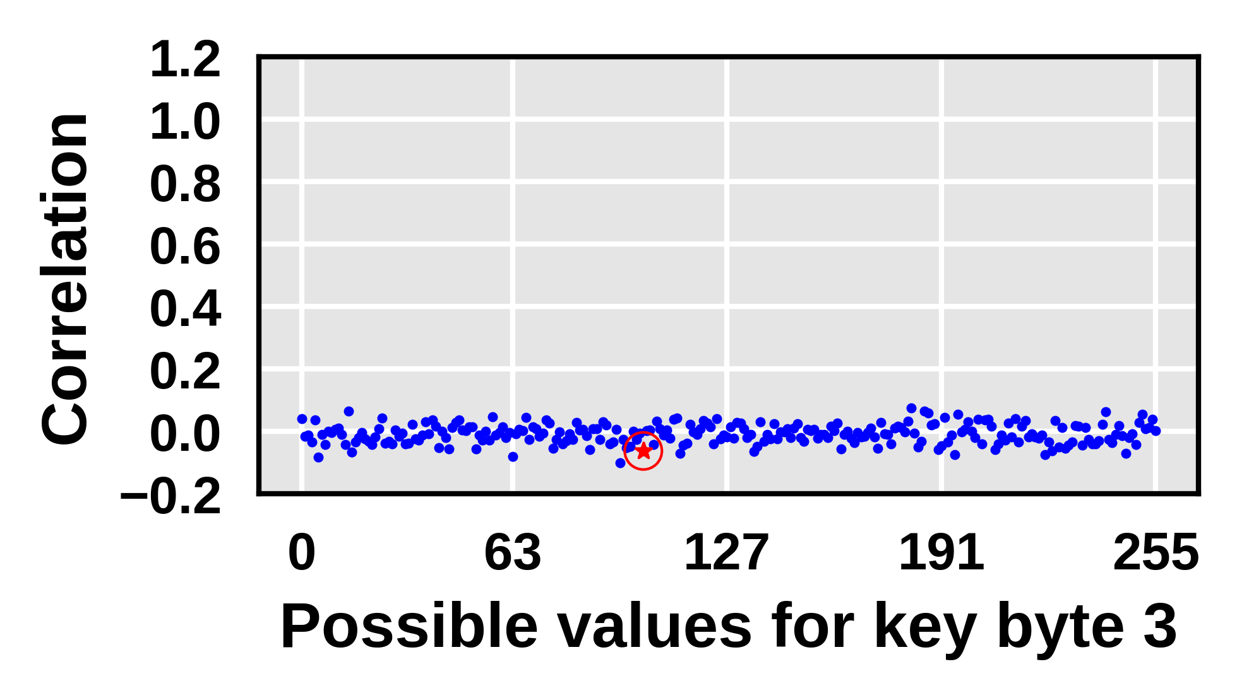
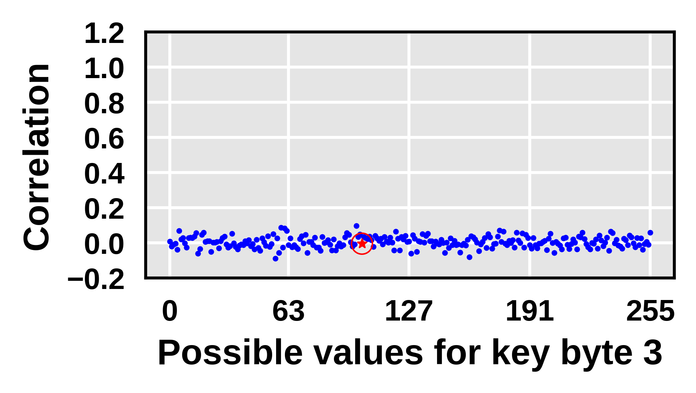
BCoal Security Evaluation: Empirical
Plaintext with 32 lines (Single Warp)
Plaintext with 64 lines (Multi Warp)
BCoal(16) + MSHRs + Caches
BCoal(1, 16) + MSHRs + Caches
BCoal(16) + MSHRs + Caches
BCoal(1, 16) + MSHRs + Caches

Slide 31
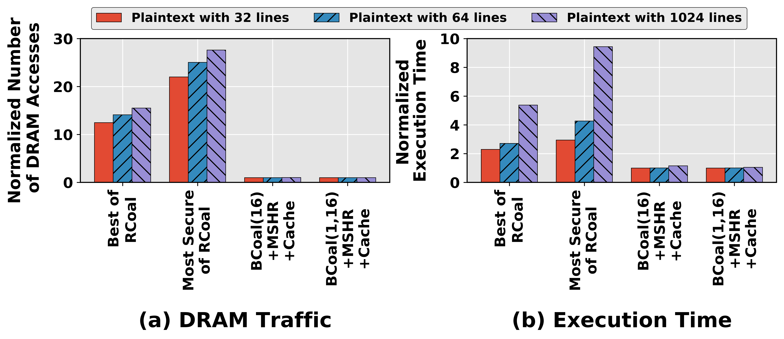
BCoal Performance Evaluation
BCoal generates less DRAM Traffic
Optimal number of coalesced accesses
Secure with MSHRs and Caches
BCoal is Performance Efficient

Slide 32
Further Details in Paper
Theoretical security analysis
Hardware Overhead
Performance evaluation of BCoal for various GPGPU applications
Bucket sizes vs Number of buckets
Generalized BCoal configuration
~1.2% Average Performance Loss

Slide 33
Outline
Introduction
Background
Prior Defense Scheme: RCoal
BCoal Defense Scheme
Evaluation
Conclusion
Notes:
Bigger font – merge if possible

Slide 34
Conclusion
BCoal: Bucketing Based Coalescing
Efficient and Secure Coalescing
Secure with MSHRs and Caches
Better Security/Performance Tradeoff
Generalized BCoal Configuration
Incurs minimal Performance Degradation
Thank You!!
Questions?!
Notes:
In conclusion, BCoal employs a Bucketing Based Coalescing for Efficient and Secure Coalescing.
It is secure with MSHRs and Caches…

