Slide 1


Supply-Voltage Optimization to Account for Process Variations in High-Volume Manufacturing Testing
Gurunath Kadam^{[1]} Markus Rudack^{[1]} Krishnendu Chakrabarty^{[2]} Juergen Alt^{[1]}
^{[1]}Intel Deutschland GmbH, Munich, Germany ^{[2]}Duke University, NC, USA

Slide 2
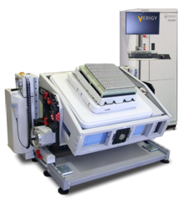
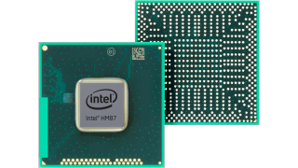
Objective
Process variation impacts testing
How to set testing limits?
How to set the voltage levels on the tester?
Voltage level??
Pass/Fail??

Slide 3
Outline
Introduction
Related prior work
Proposed method
Design of Experiments
Voltage-Level Calculations
Results
Discussion

Slide 4
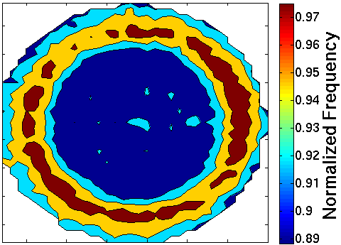
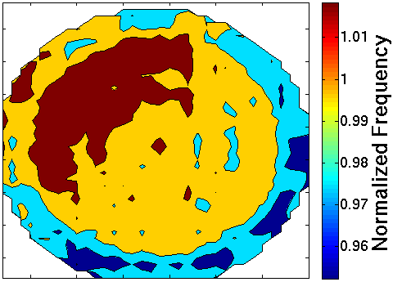
Introduction
On-chip process variations: Intra-die vs Inter-die
Intra-die (local) process variations: difficult to predict
Global process variations: easier to model
Foundry A
Foundry B

Slide 5
Introduction (Contd.)
Problems due to on-chip process variations
Chip performance difficult to predict
Testing limits: pessimistic versus relaxed
Yield loss versus test escape

Slide 6
Related Prior Work
V_{DD} level manipulation
Very-Low-Voltage (VLV) to target delay faults [Chang 1996]
MINVDD: low voltage at-speed testing [Tseng 2001]
Reduced power-supply voltage to detect gate-oxide failures [Qian 2012]
Drawback: On-chip process variations not considered
System voltage of individual chip
Process-window information [Lichtensteiger 2012, IBM]
Drawback: requires on-chip variable supply, time consuming
Binning
Speed: Correlation between ring oscillator frequency and transient delay faults [Brand 2004]
Voltage: Slack time, leakage as function of process variations [Zolotov 2009, IBM]
Drawback: Speed/Voltage binning is not always desirable

Slide 7
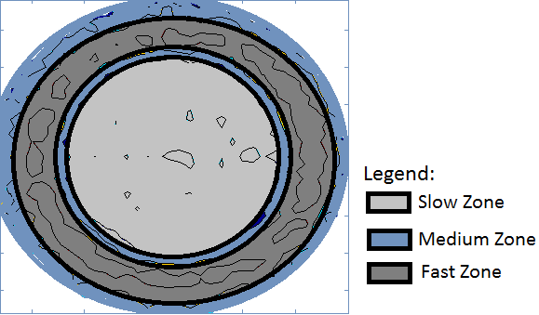
Proposed Method
Test voltage?
Process variation zones on wafer
Process Control Monitoring
Ring Oscillators (RO)
Test voltage?
Test voltage?
Notes:
Rough RO Length: 41 stages

Slide 8
Proposed Method (Contd.)
Goal: SPICE parameters emulating on-wafer process variations for each zone
Statistical model to represent process variation zone
Response of interest: RO output frequency (frequency)
Variables: process parameters mapped to SPICE parameters
Frequency, f = ϕ (SPICE parameter1, SPICE parameter2, …)
Notes:
SPICE parameters can be varied with precision unlike process parameters.
Toy formulae f = phi(proc para)

Slide 9
Proposed Method (Contd.)
Obtain SPICE parameters for each zone
Verify SPICE RO frequency output
Update SPICE models per zones
Find the voltage levels for each zone
Condition: Maintain required performance
Voltage
Frequency
SLOW
Nominal
Nominal
FAST
Notes:
Verification is done by comparing the “normalized” o/p of SPICE RO frequency vs Wafer RO frequency values

Slide 10
Proposed Method (Contd.)
RO SPICE Models
Divide wafer map into frequency zones
Desired output response: RO frequency
Extract process parameter values zone-wise
Monte Carlo simulation of RO SPICE model
Create independent RO models for each zone
Screening for input process parameters
Find VDD per zone with updated SPICE models
Build DoE model
Test devices with new VDD with respect to its location on wafer
Process parameters variation ranges

Slide 11
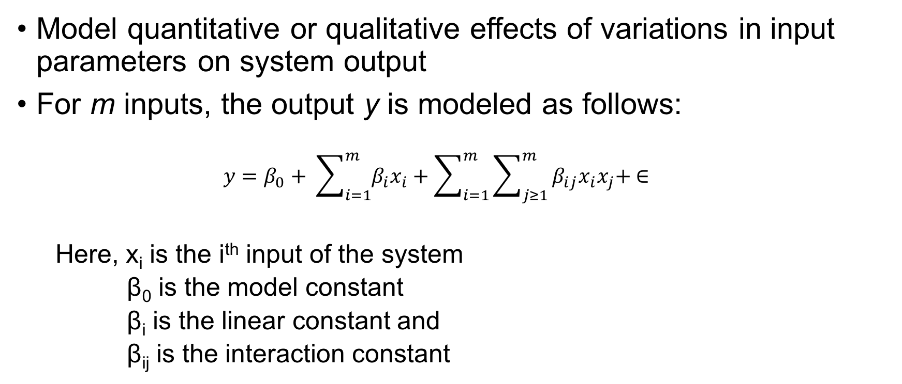
Proposed Method: Design of Experiments
Model quantitative or qualitative effects of variations in input parameters on system output
For m inputs, the output y is modeled as follows:
$$y=β_{0}+ \sum_{i=1}^{m}{β_{i}x_{i}}+\sum_{i=1}^{m}{\sum_{j≥1}^{m}{β_{ij}x_{i}x_{j}+ ∈}}$$
Here, x_{i} is the i^{th} input of the system
β₀ is the model constant
β_{i} is the linear constant and
β_{ij} is the interaction constant
Notes:
In above equation, x_{i} is the i^{th} input of the system, while β₀ is the model constant, β_{i} is the linear constant and β_{ij} is the interaction constant.

Slide 12
Design of Experiments (Contd.)
Computer simulations, SPICE?
Time consuming
Deterministic
Solution: Design and Analysis of Computer Experiments (DACE)
Space-filling designs
Represent the whole experimental region
Observation points spread evenly across the experimental region
Latin Hypercube Design (LHD)
Notes:
Computer simulations: Deterministic: No need for repeated measurements at one observation point

Slide 13
Design of Experiments (contd.)
1
1
0.8
0.8
0.6
0.6
Input 1
Input 1
0.4
0.4
0.2
0.2
0
0
0.2
0.4
0.6
0.8
1
0.2
0.4
0.6
0.8
1
Input 2
Input 2

Slide 14
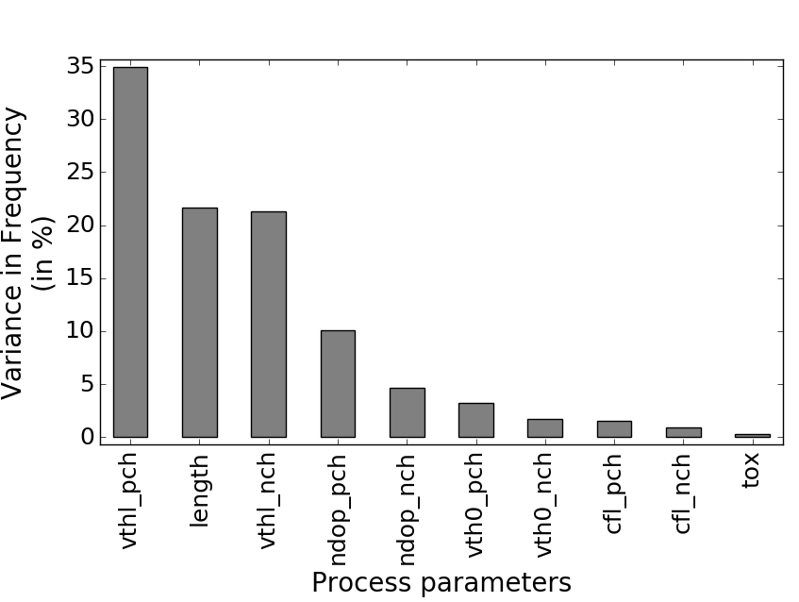
Voltage-Level Calculations
Dominant parameters
Model construction
Parameter screening
To limit the number of runs
Monte Carlo Simulations: 10000 runs
Parameter variation range: ±3σ
Confidence-interval analysis: 10000 runs are sufficient
Pareto analysis
Notes:
The number of runs required for the LHD model increase with the number of input parameters.
Screening -> limit # of input parameters -> limit # required runs

Slide 15

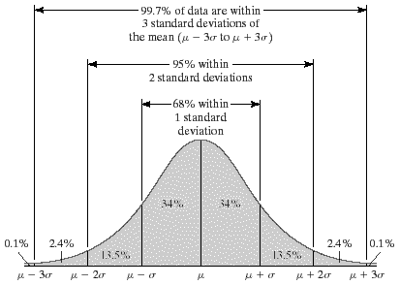
Voltage-Level Calculations (Contd.)
Model construction (Contd.)
Model building
Statistical Analysis Software, JMP
Process parameter variation limit ±3σ
70 runs provide acceptable value for design discrepancy metric
Normalization across SPICE and on-wafer frequency values
Notes:
Process parameter variation limit ±3σ -> Covers 99.7% of devices
Design discrepancy -> measure of the design space coverage (increases with the # of observation points -> more # runs)

Slide 16
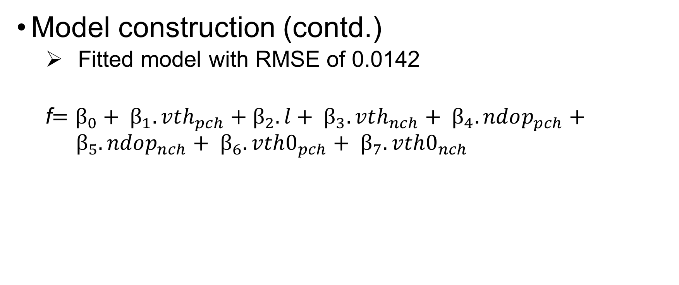
Voltage-Level Calculations
Model construction (contd.)
Fitted model with RMSE of 0.0142
f$=β_{0}+ β_{1}.vth_{pch}+β_{2}.l+ β_{3}.vth_{nch}+ β_{4}.ndop_{pch}+ β_{5}.ndop_{nch}+ β_{6}.vth0_{pch}+ β_{7}.vth0_{nch}$
Notes:
This equation represents the whole wafer area

Slide 17
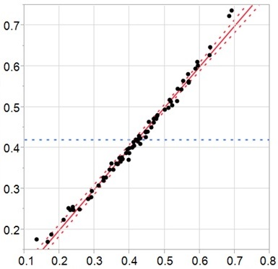
Voltage-Level Calculations (Contd.)
Model verification
SPICE vs LHD
Quantile-quantile plot
Normalized frequency output from SPICE simulations
Normalized frequency output predicted by LHD model
Notes:
First verification between SPICE and LHD models, run-by-run: SPICE vs LHD Predicted

Slide 18

Voltage Level Calculations (Contd.)
Voltage levels
$$Y=BX$$
Where,
$${Y=(f − β_{0})}_{1x1}$$
$$B={(β_{1} β_{2} β_{3} β_{4} β_{5} β_{6} β_{7})}_{1x7}$$
$$X^{T}={(vthl_{pch} l vthl_{nch} ndop_{pch} ndop_{nch} vth0_{pch} vth0_{nch})}_{1x7}$$
Notes:
Think?

Slide 19
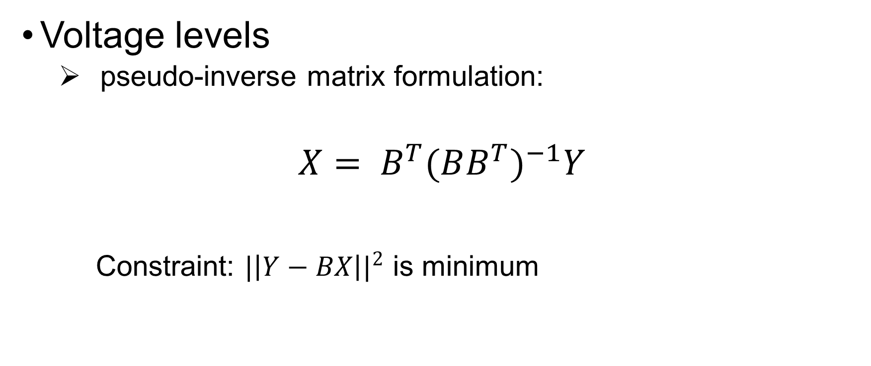
Voltage Level Calculations (contd.)
Voltage levels
pseudo-inverse matrix formulation:
$$X= B^{T}{(BB^{T})}^{−1}Y$$
Constraint: ${|\left|Y−BX\right||}^{2}$ is minimum

Slide 20
Voltage Level Calculations (Contd.)
Voltage levels
Wafer RO frequency values
Next find the SPICE parameters for each zone
Zones | Normalized RO frequency
Slow zone | 0.2157
Medium-fast zone | 0.4079
Fast zone | 0.6001

Slide 21
Voltage-Level Calculations (Contd.)
SPICE parameters | Slow zone | Medium-fast zone | Fast zone
vthl_pch | 0.5976 | 0.0357 | -0.5262
l | 0.4561 | 0.0272 | -0.4016
vthl_nch | 0.4667 | 0.0279 | -0.4109
ndop_pch | 0.2626 | 0.0157 | -0.2312
ndop_nch | 0.1787 | 0.0107 | -0.1573
vth0_pch | 0.1484 | 0.0089 | -0.1307
vth0_nch | 0.1156 | 0.0069 | -0.1018
Voltage levels
SPICE parameters for each zone
Notes:
SPICE parameters after solving fitted model equation for each wafer zone RO frequency values.
Parameter values are normalized between -1 to 1

Slide 22
Voltage-Level Calculations (Contd.)
Voltage levels
RO frequency values for updated SPICE models for each zone
‘Updated’ SPICE vs On-wafer
Zones | on-Wafer RO frequency (normalized) | Frequency computed using RO SPICE model (normalized) | Error
Slow | 0.2157 | 0.2274 | 5.4%
Medium-fast | 0.4079 | 0.4028 | -1.24%
Fast | 0.6001 | 0.6053 | 0.87%

Slide 23
Voltage-Level Calculations (Contd.)
Voltage levels
Voltage sweep to find the nominal frequency output
Zones | Voltage Levels (V)
Slow | 1.06
Medium-fast | 0.99
Fast | 0.92

Slide 24
Experimental Evaluation
Silicon devices under test
28nm, from Foundry A
LTE FDD/TDD slim modem baseband SoC, high-volume
Main focus: Digital logic
Set-up
All devices from ‘passed’ bin of previous testing
Aim: find test escapes
Ambient temperature
Screening: performance and leakage tests
Test patterns are unchanged from previous testing
Advantest 93K tester
Notes:
Main focus: digital logic, , hence the mixed-signal and SRAM testing is not considered

Slide 25
Results
Fails in zone Medium-fast and Fast
Failed devices do not match the other devices in that zone
Pass/Fail | Number of devices
 | Slow zone | Medium-fast zone | Fast zone | Total
Pass | 89 | 80 | 65 | 234
Fail | 0 | 7 | 9 | 16
Total | 89 | 87 | 74 | 250

Slide 26
Results
Scan diagnosis
Faults at same pins and around the same clock cycle
Points towards the same subsystem block: Systemic nature
Further analysis needed!
Previous one-for-all approach does not work well

Slide 27
Limitations & Scope for Improvement
Considers only transistor variations
Interconnects??
LHD model is first-order approximation
Newer technologies might demand higher-order models
Extend model by adding aging and temperature effects

Slide 28
Conclusion
Theoretical framework for determining voltage levels for production testing
Incorporate process variations
Design of experiments solution (Latin Hypercube Design)
Validated using fabricated devices and on-tester experiments

