Slide 1
Holistic Consistency Models For Faster Applications & Systems
Preliminary FPO
Jeffrey Helt
Committee:
Wyatt Lloyd (Advisor)
Mike Freedman, Zak Kincaid, Amit Levy, Ravi Netravali
Notes:
Hello everyone and thanks for coming!
Today I’d like to tell you about some of the work I’ve completed as part of my PhD
On designing new consistency models and building new systems to implement them.

Slide 2





Distributed Applications and Services
App
Web
Database
Service
Consistency Model
Notes:
Web applications today execute across a bunch of different machines.
Users interact with these applications on their devices, such as a laptop or phone, and these devices will then send requests to one or more Web servers.
These machines collectively execute a distributed application.
These applications are often supported by a set of services, such as a distributed database.
And as part of a service’s interface, it provides some set of guarantees, called a consistency model, about how it behaves in the face of concurrent operations.

Slide 3


Consistency Models Offer Trade-Offs
App
Web
Database
Service
Strict Serializability
Notes:
The choice of a service’s consistency model has implications for both the service and the application built on top of it.
Strong consistency models, such as strict serializability, limit the set of behaviors that a service can exhibit.
This simplifies the job of application programmers because they need to consider and handle fewer cases in their code.
Making it easier for them to build correct applications.
But the same limiting of behaviors also limits the design space for services.
In practice this means that these services offer worse performance.

Slide 4



Consistency Models Offer Trade-Offs
App
Web
Database
Service
Serializability
Notes:
On the other hand, comparable services with weaker consistency, such as a serializable database, offer better performance.
But the cost is that moving an application to a service with a weaker model may cause that application to break.
For example, an application process may crash because serializability allowed for new cases that its code doesn’t expect and handle.

Slide 5
Existing Work Takes A Limited View
App
Web
Database
Service
Notes:
Despite having consequences for both applications and services, existing work on consistency models has often taken a limited view.
Much of the focus in the systems community has been on changing a service’s consistency model, often weakening it, to unlock better performance.
But this largely ignores the implications of these decisions for applications and users

Slide 6
Existing Work Takes A Limited View
App
Web
Database
Service
Notes:
A smaller body of work has also looked at how application correctness is affected by the choice of consistency models.
But this work largely ignores the implications of these models for service designers and implementers.

Slide 7
Existing Work Introduces Trade Offs
Strict Serializability
Service
Latency
Serializability
Eventual
Application Correctness
Notes:
These existing approaches have resulted in trade-offs that application developers and service designers must navigate.
For instance, consider the trade-off between application correctness and service latency.
On one end we have strict serializability, which offers the simplest programming model for application developers
but high service latency.
To get lower latency with serializability, we also have to trade application correctness.
And finally at the far end of the spectrum we have eventually consistent services that offer very low latency but basically no guarantees about
The behaviors they may exhibit.

Slide 8
A Holistic Approach
App
Web
Database
Service
Notes:
In contrast, the work in my thesis has taken a holistic approach, designing better consistency models by considering applications and services simultaneously.

Slide 9
New Frontiers
Strict Serializability
Regular Sequential
Serializability
Service
Latency
Serializability
Eventual
Application Correctness
Notes:
Looking back at our trade-off graph, using this approach, the consistency models in this thesis aim to push us onto
new frontiers.
For example, in the first part of the talk, I’ll discuss a consistency model we designed that
Offers the same correctness guarantees as strict serializability while still allowing for better-performing services.

Slide 10
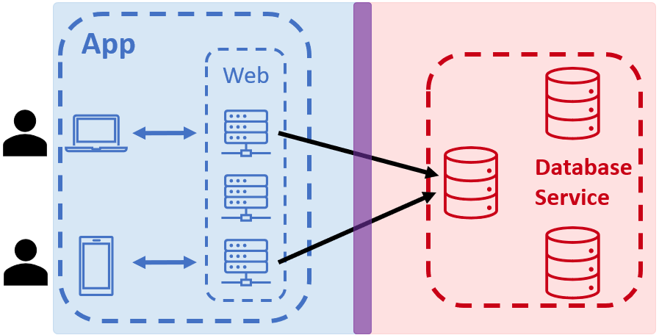
Agenda
Regular Sequential Serializability & Regular Sequential Consistency:
Applications: Invariant equivalence
Services: Lower read latency
Notes:
This talk is going to have two parts:
In the first, as I just hinted at, we’ll introduce two consistency models
That are just as strong for applications as strict serializability and linearizability.
A property we call “invariant equivalence.”
And yet the two models also enable services with lower read latency.

Slide 11
Agenda
Regular Sequential Serializability & Regular Sequential Consistency:
Applications: Invariant equivalence
Services: Lower read latency
Multi-dispatch Linearizability:
Applications: External equivalence
Services: Lower end-to-end latency
Notes:
In the second, I’ll introduce Multi-dispatch Linearizability, which relaxes Linearizability’s assumption that each
application client only issues one operation at a time.
This will allow services to offer lower end-to-end latency to applications.
I will also describe how to transform applications to take advantage of MDL services while giving strong guarantees
About their behavior, a property called “external equivalence.”

Slide 12
Part 1: RSS & RSC
Regular Sequential Serializability & Regular Sequential Consistency:
Applications: Invariant equivalence
Services: Lower read latency
Multi-dispatch Linearizability:
Applications: External equivalence
Services: Lower end-to-end latency
Notes:
Ok, so let’s start with invariant equivalence and the two regular sequential consistency models.

Slide 13

Motivating Example: Photo-Sharing App
Unique keys for photos and albums
Photo:
R(P) -> binary blob
Album:
R(A) -> [P1, P2, … ]
App
KV
Q
Notes:
To help make terms like “invariant” more concrete, I’ll use a simple motivating example, which we’ll come back to a few times throughout the talk.
The application allows users to upload and view photos, which are organized into albums.
The application is backed by a transactional key-value store.
Each photo and album is placed under a unique key.
A photo’s key maps to a binary blob, and an album’s key maps to a list of the keys of the photos it contains.
We’ll assume that if the application tries to read a non-existent key, then the store simply returns null.
The application uses a second service, a distributed message queue, to enqueue photos for asynchronous processing, like creating low-resolution thumbnails.

Slide 14
Motivating Example: Photo-Sharing App
To upload photo P to album A:
Insert P at key hash(P)
Append P to A
Enqueue hash(P)
[Ins(P), App(A, P)]
Enq(P)
KV
Q
Notes:
When a user uploads a photo to an album, a request is sent from their device to a Web server.
The Web server then issues a read-write transaction to
first create a new key-value mapping for the photo, and
then append the photo’s key to the album.
Lastly, the server enqueues a request with the photo’s ID for any needed asynchronous processing.

Slide 15
Motivating Example: Photo-Sharing App
To upload photo P to album A:
Insert P at key hash(P)
Append P to A
Enqueue hash(P)
To create thumbnails for photo P:
Dequeue P’s key from Q
Read photo from KV
Perform processing
R(P)
Deq(P)
KV
Q
Notes:
A worker then processes the photo by first reading its key from the message queue
And then using the key to read the photo’s blob from the key-value store.
It can then perform any needed processing.

Slide 16
Application Invariants
Invariant: Predicates that hold for all states of an application
Example: If worker receives a photo’s key, the photo exists in the KV store.
Formally:
∀W, ∀k : W.nextp = k ∧ W.p_key = k ⇒ W.p_val ≠ null
KV
Q
Notes:
Ok so with this context, application invariants are logical predicates that hold for all states of an application.
For example, we can write an invariant that reflects the statement that if a worker receives a photo’s key through the messaging service,
then the key-value store won’t return null when it fetches the photo.
We can turn this into a formal statement about the state of the application processes like so:
Here W is an application process that is acting as a worker and k is a key.
W.nextp is the local variable that W uses to store the returned value of the read from the head of the message queue
and W.p_key and W.p_val are the local variables it uses to store the key and returned value of the read of the photo.

Slide 17
Service Consistency Affects Invariants
Invariant: If worker receives a photo’s key, the photo exists in the KV store.
Holds When Service Guarantees…
…Strict Serializability?
KV
Q
Notes:
Let’s see how this example invariant is affected when we use services with different consistency models.
Let’s assume first that the key-value store guarantees strict serializability.
Intuitively what this guarantees is that the service reflects some total order of transactions.
And importantly, the order is consistent with the transaction’s real-time order.
So if a Web server issues one transaction, it finishes, and then a worker issues another transaction,
the worker’s transaction will always be ordered after the Web server’s.
This ensures that the worker’s read of the photo will never return null, so the invariant holds.

Slide 18
Service Consistency Affects Invariants
Invariant: If worker receives a photo’s key, the photo exists in the KV store.
Holds When Service Guarantees…
…Strict Serializability?
…Serializability?
KV
Q
Notes:
Now assume we relax the consistency model to serializability, which has the same total order guarantee as strict serializability
But without the real-time order part.
Basically we lose the guarantee that the worker’s transaction will always be ordered after the Web server’s,
So now it is possible for the worker’s read to return null, which would break our example application.
Thus, although a serializable key-value store may offer better performance, this would come at a price.

Slide 19


Regular Sequential Serializability (RSS)
Application
Invariants
Strict Serializability
Serializability
W.p_data != null
Consistency Model
Serializability
Strict Serializability
Service
Design Space
Notes:
Again visualizing this trade-off we see that
On one hand, strong consistency models ensure a large set of invariants hold, while weaker models guarantee fewer invariants.
And on the other, weaker models allow for more service designs, meaning they can achieve better performance
While stronger models restrict the design space.

Slide 20

Regular Sequential Serializability (RSS)
Application
Invariants
Strict Serializability
Strict Serializability/RSS
Serializability
W.p_data != null
Consistency Model
Serializability
RSS
Spanner-RSS
Spanner-RSS
Strict Serializability
Spanner
Service
Design Space
Notes:
Regular sequential serializability aims to ease this trade-off and move us onto a new trade-off frontier.
It does so by both being invariant-equivalent to strict serializability while opening up new service designs.
This means that invariants that hold with strict serializability will also hold with RSS.
But also that RSS services can achieve better performance than their strictly serializable counterparts.
For example, we’ll talk later about how we can do this with a variant of Google’s Spanner database.

Slide 21
Definition of Strict Serializability
Guarantees a total order of transactions
Order must be consistent with the real-time order of transactions
If T1 finishes before T2 starts, then T1 must be ordered before T2
Notes:
Before giving the definition of RSS, let’s first review the definition of strict serializability, which provides two guarantees:
First, it guarantees that the service reflects some total order of transactions.
Second, it guarantees this order is consistent with the real-time order of transactions.
So for any pair of transactions, if one transaction finishes before another starts, then the first transaction is guaranteed to be ordered before the second.
This for example means that if a read-write transaction finishes, the all future reads will see this write.

Slide 22
Definition of Regular Sequential Serializability
Guarantees a total order of transactions
Order must respect some real-time constraints
If T1 finishes before T2 starts, then T1 must be ordered before T2 if
T1 and T2 are both read-write transactions
T2 is a read-only transaction and T1 is a conflicting read-write transaction
Order must respect causality
Within each application process
Across messages
Across service interactions
Notes:
Moving now to regular sequential serializability, we can break its guarantees into three pieces:
First, like strict serializability, it guarantees a total order of transactions.
Second, we weaken the set of real-time constraints, so instead of between all pairs of transactions,
RSS just guarantees real-time order between pairs of read-write transactions and a read-write transaction and its conflicting read-only transactions.
Lastly, we supplement these removed real-time constraints with weaker causal constraints, so the order must also respect causality
Between all pairs of transactions.

Slide 23
Definition of Regular Sequential Serializability
Guarantees a total order of transactions
Order must respect some real-time constraints
If T1 finishes before T2 starts, then T1 must be ordered before T2 if
T1 and T2 are both read-write transactions
T2 is a read-only transaction and T1 is a conflicting read-write transaction
Order must respect causality
Within each application process
Across messages
Across service interactions
Opens up new
service designs
Regain invariant equivalence
Notes:
To give you some intuition for the next bit of the talk,
The fact that RSS removes some of the real-time constraints compared to strict serializability is what allows
us to design new, better-performing services.
And the addition of the causal constraints is to then regain invariant equivalence.

Slide 24
Example: RSS vs. Strict Serializability
W₁(X = 1, Y = 1)
RSS gives more flexibility
to read-only transactions
R₁(X = 1)
R₂(Y = 1)
R₂(Y = 0)
RSS only requires
causally later read-only transactions
to return new value
Strict serializability requires
all future read-only transactions
to return new value
Notes:
To help make the difference between these two models more concrete, let’s look at an example.
Suppose we have some application process updating keys X and Y from zero to 1.
Here, time is flowing from left to right and the vertical bars denote the beginning and end of the transaction.
Now suppose some other process reads the write of X.
Strict serializability requires all future read-only transactions to also see W1’s writes, so the other read R2 of Y here must also return 1.
On the other hand, while a write is in progress, RSS only requires causally later read-only transactions to return the new writes, so R2 can return one or zero.
RSS thus gives more flexibility to read-only transactions.

Slide 25

App
Invariant Equivalence Theorem:
Any application invariant that holds
with a strictly serializable service
also holds with an RSS service
Strict Serializability
RSS
DB
DB
Notes:
Despite this extra flexibility for read-only transactions, it is also invariant-equivalent to strict serializability.
Informally, we prove that any application invariant that holds while an application runs on a
strictly serializable service will also hold while the same application runs on an RSS service.
This means that if I build a correct application using a strictly serializable database, …
And then I swap out the database for one that guarantees RSS, the application will still be correct.

Slide 26
Invariant Equivalence Proof Intuition
Key Idea: Transform RSS executions into indistinguishable, strictly serializable ones
Total order: R₂, W₁, R₁
W₁(X = 1, Y = 1)
R₁(X = 1)
R₂(Y = 0)
Notes:
The key idea in our proof is that we can transform any RSS execution into one that satisfies strict serializability.
And importantly, the two executions will be indistinguishable to the application processes.
Let’s consider the example we showed previously.
We can model each process as a state machine and think of each process’s execution as a sequence of steps, like instructions, that
Transition it through a sequence of states.
For any RSS execution, we know that the processes service interactions will reflect some total order of transactions.
In this case, R2, W1, R1.
To transform this into a strictly serializable execution, what we’re going to do is stretch and shrink the time between events at each process,
Basically space them out or push them closer together, until two things happen: First, …

Slide 27
Invariant Equivalence Proof Intuition
Key Idea: Transform RSS executions into indistinguishable, strictly serializable ones
Transform RSS executions into indistinguishable, strictly serializable ones
Same invariants hold under RSS and strict serializability
Total order: R₂, W₁, R₁
W₁(X = 1, Y = 1)
R₁(X = 1)
R₂(Y = 0)
Notes:
First, the transactions don’t overlap in real time, and second, the order of transactions matches the total order.
Because the total order we’re using satisfied RSS, we know it respected causality,
Which is what allows us to achieve these two things without reordering any steps at any of the processes,
This means that to the processes, this execution looks the same as the original RSS one.
And now that the transactions don’t overlap in real time, this execution trivially satisfies strict serializability.
Although I don’t have time to go into the details, we can use this transformation to show that RSS and strict serializability are invariant equivalent.

Slide 28

Spanner (Strict Serializability)
W₁(X = 1, Y = 1)
X
Y
Corbett et al., Spanner: Google's globally distributed database. TOCS, 2013.
Notes:
We’ll now turn to talking about new service designs, starting with Spanner-RSS
So let’s start with some background on Spanner’s protocol.
Its read-write transactions use two-phase locking and a variant of two-phase commit.
For example, suppose we have two shards, and an application process that is writing keys X and Y. For simplicity, we’ll ignore replication here.
To commit, the process sends a message to each shard. The participant then acquires its locks and sends a message to the coordinator that it is prepared to commit.
The coordinator then acquires its locks, commits the write of X, and unlocks.
It then notifies the application process and the participant, which then commits the write of Y and also unlocks.
Spanner also has fast read-only transactions to support read-heavy workloads.

Slide 29
Spanner (Strict Serializability)
W₁(X = 1, Y = 1)
R₁(X = 1)
X
Y
R₂(Y = 1)
Strict serializability forces read-only transactions to sometimes block
Notes:
For example, process R1 can read key X in one round trip.
But during conflicting read-write transactions, read-only transactions must sometimes block.
For instance, suppose process R2 wants to read key Y.
Ideally, we’d like it to return immediately, but this is not safe under strict serializability.
Since R1 already read the new value of X, R2 must also return the newly written value.
But since it doesn’t know whether there is some other process reading these writes at another shard,
it has to be conservative, and so it blocks until its learns that the read-write transaction committed.

Slide 30
Spanner-RSS
W₁(X = 1, Y = 1)
R₁(X = 1)
X
Y
R₂(Y = 0)
RSS allows lower read-only transaction latency
Notes:
On the other hand, under RSS, only reads that causally follow R1’s read must include the new values of X and Y.
Thus, R2’s read can return immediately, reducing its latency.

Slide 31
Safely Reading in Spanner-RSS
Safe for RO transactions to return older snapshot (than Spanner) when:
No unobserved writes from already finished RW transactions
RW transactions use TrueTime to include an estimate of “earliest end time”
No causal constraints require more recent values
Client track and send minimum required timestamp for RO transaction
Results across all shards are consistent with total order
Client uses timestamps to ensure values reflect a consistent snapshot
Notes:
In that example, it was safe for R2 to return immediately, but that’s not always the case.
In particular, it’s only safe to return the older snapshot when three things are true,
And for each, Spanner-RSS ensures it with a different mechanism.
First, we must ensure there are no unobserved writes from a read-write transaction that’s already finished.
To prevent this, read-write transactions use TrueTime to estimate an earliest time at which they will complete.
And if a read-only transaction’s timestamp is later that this, it will block, similar to what currently happens in Spanner.
Second, there cannot be any causal constraints that require the read-only transaction to return more recent values
To ensure this, clients track a minimum required timestamp for RO transactions and send this to the shards when they issue the transaction.
And third, the returned results must reflect a snapshot across all shards that is consistent with a total order
Here, shards send the timestamps associated with each value and a client uses these timestamps to ensure it’s seeing a consistent snapshot.

Slide 32
Evaluation of Spanner-RSS
Our evaluation demonstrates:
Spanner-RSS improves tail read-only transaction latency
Spanner-RSS’s protocol changes impose minimal overhead
Experimental Setup:
Compared against re-implementation of Spanner’s protocol
Ran on Amazon’s EC2
Retwis (Twitter-like) workload
Keys generated using Zipfian distribution
Notes:
Our evaluation of Spanner-RSS answers two questions about its performance.
First, it demonstrates that it improves tail latency for read-only transactions, and second, it shows that its protocol changes impose little overhead.
For our evaluation, we reimplemented Spanner’s protocol.
Our experiments ran on Amazon’s EC2, and we used the Retwis workload with keys generated according to a Zipfian distribution.

Slide 33
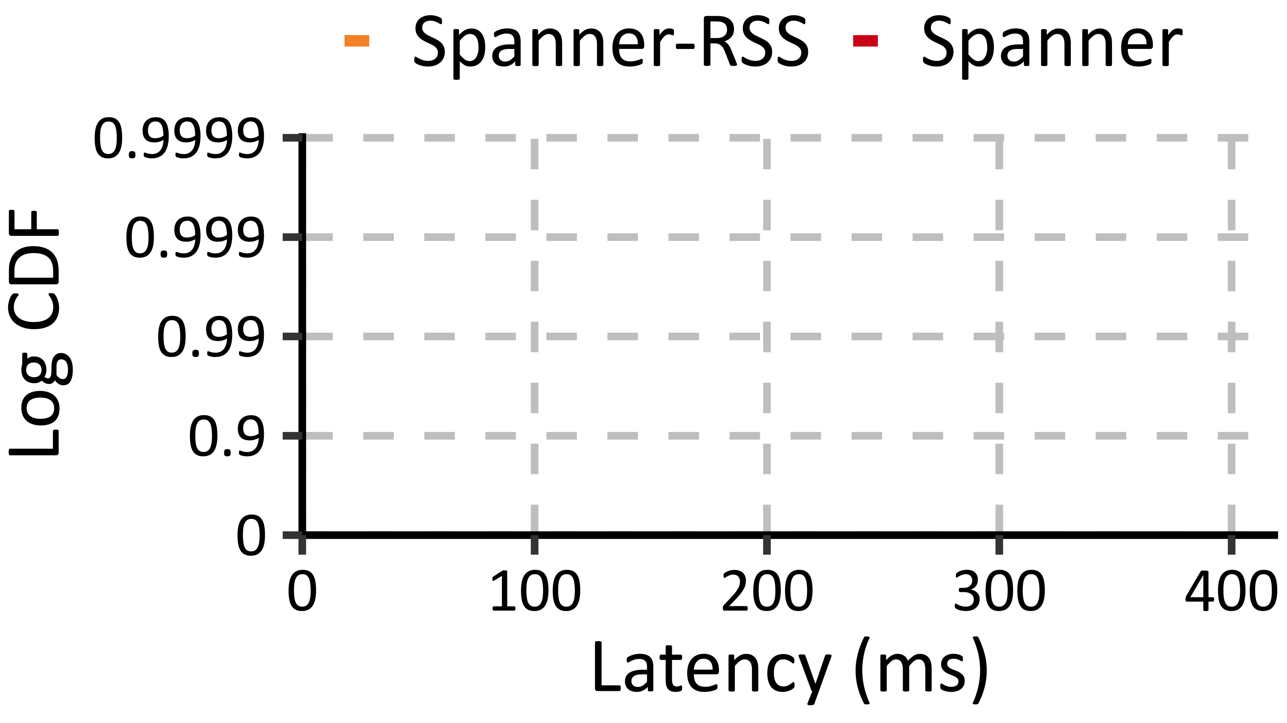
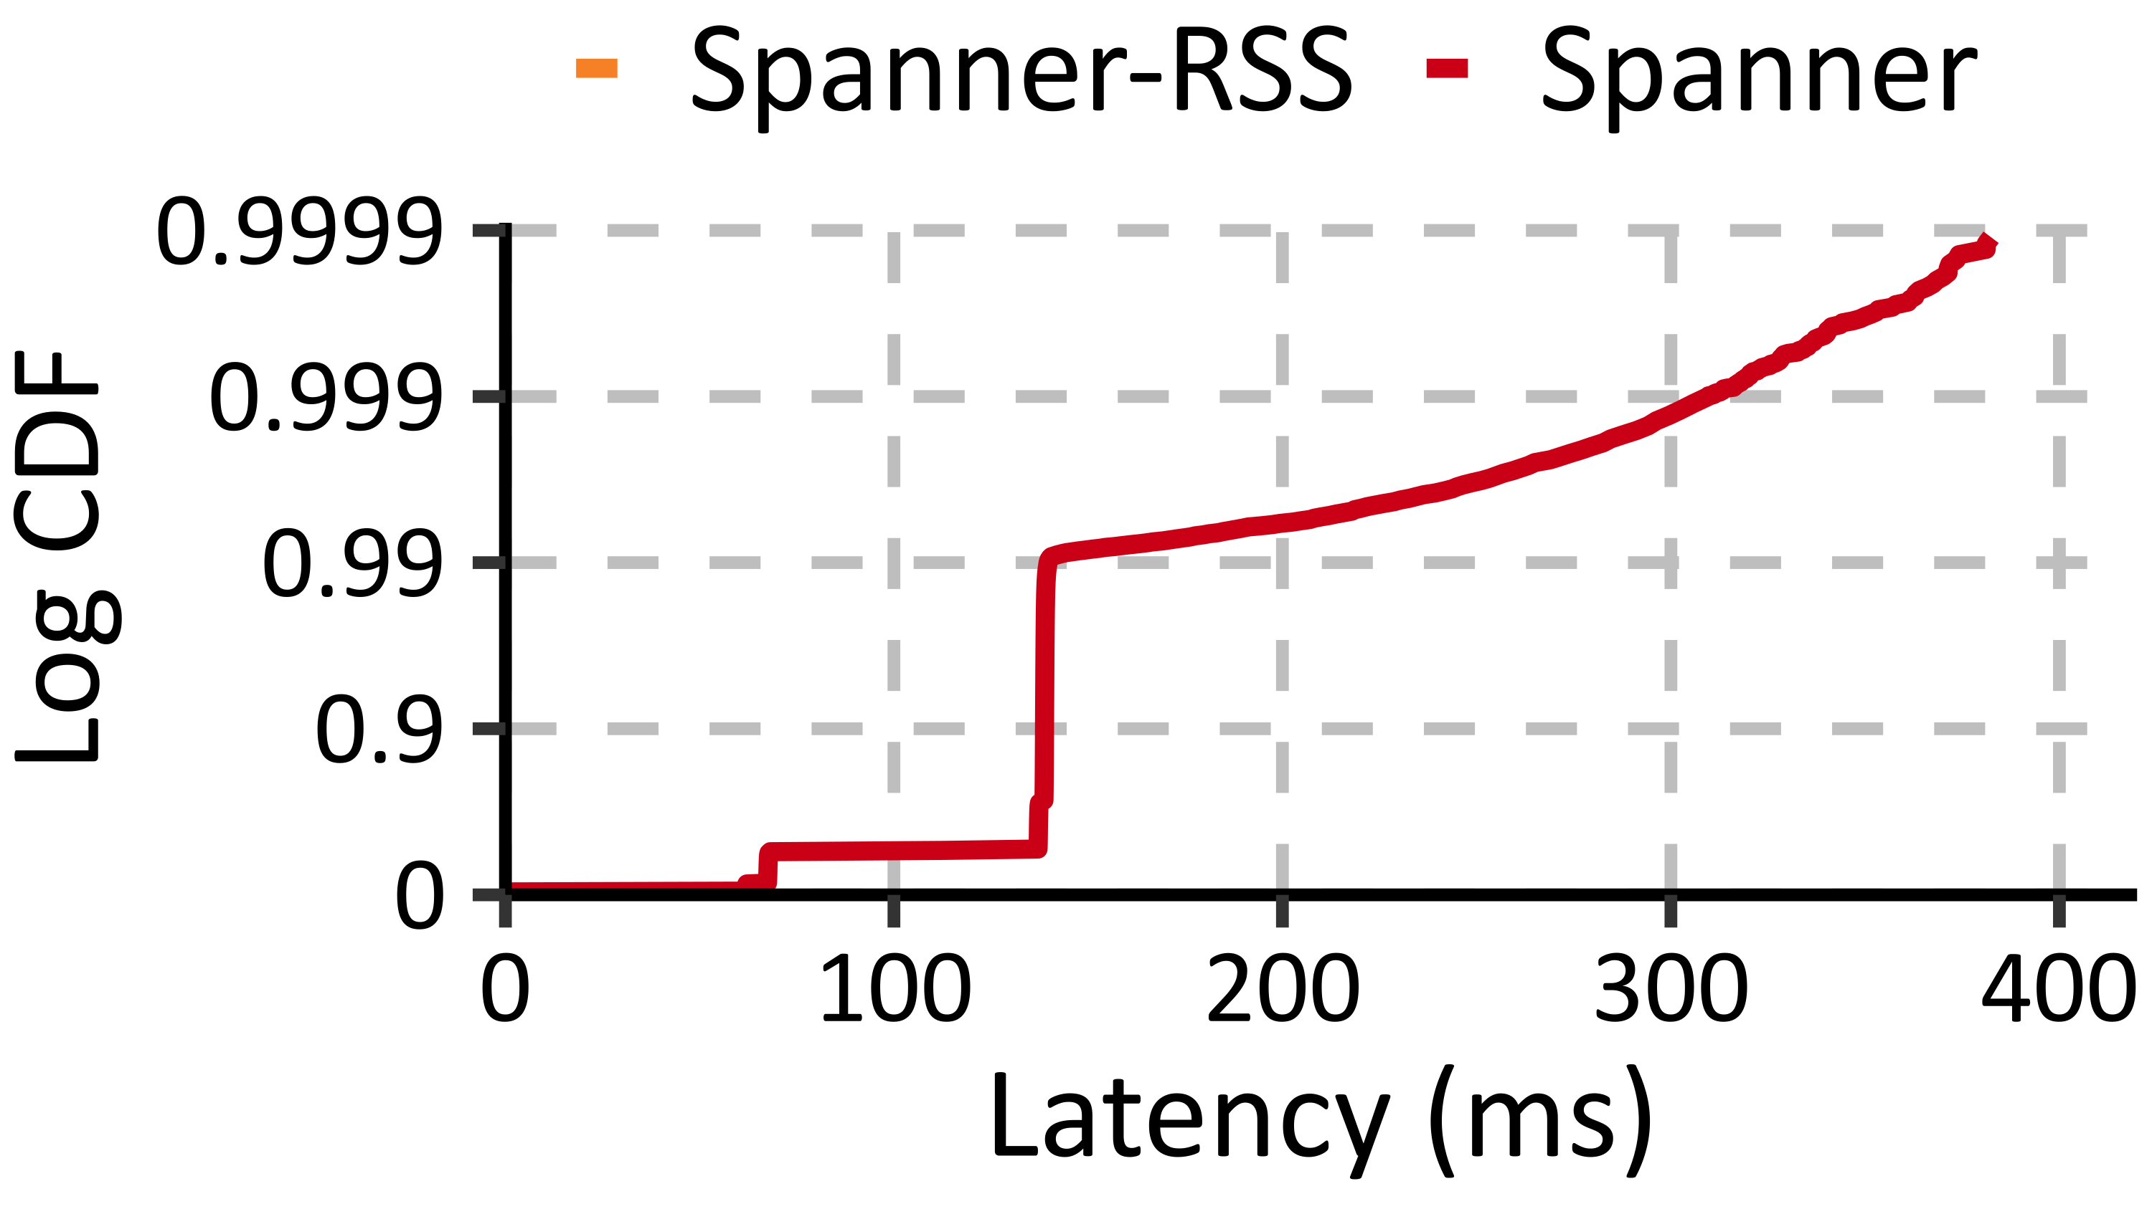
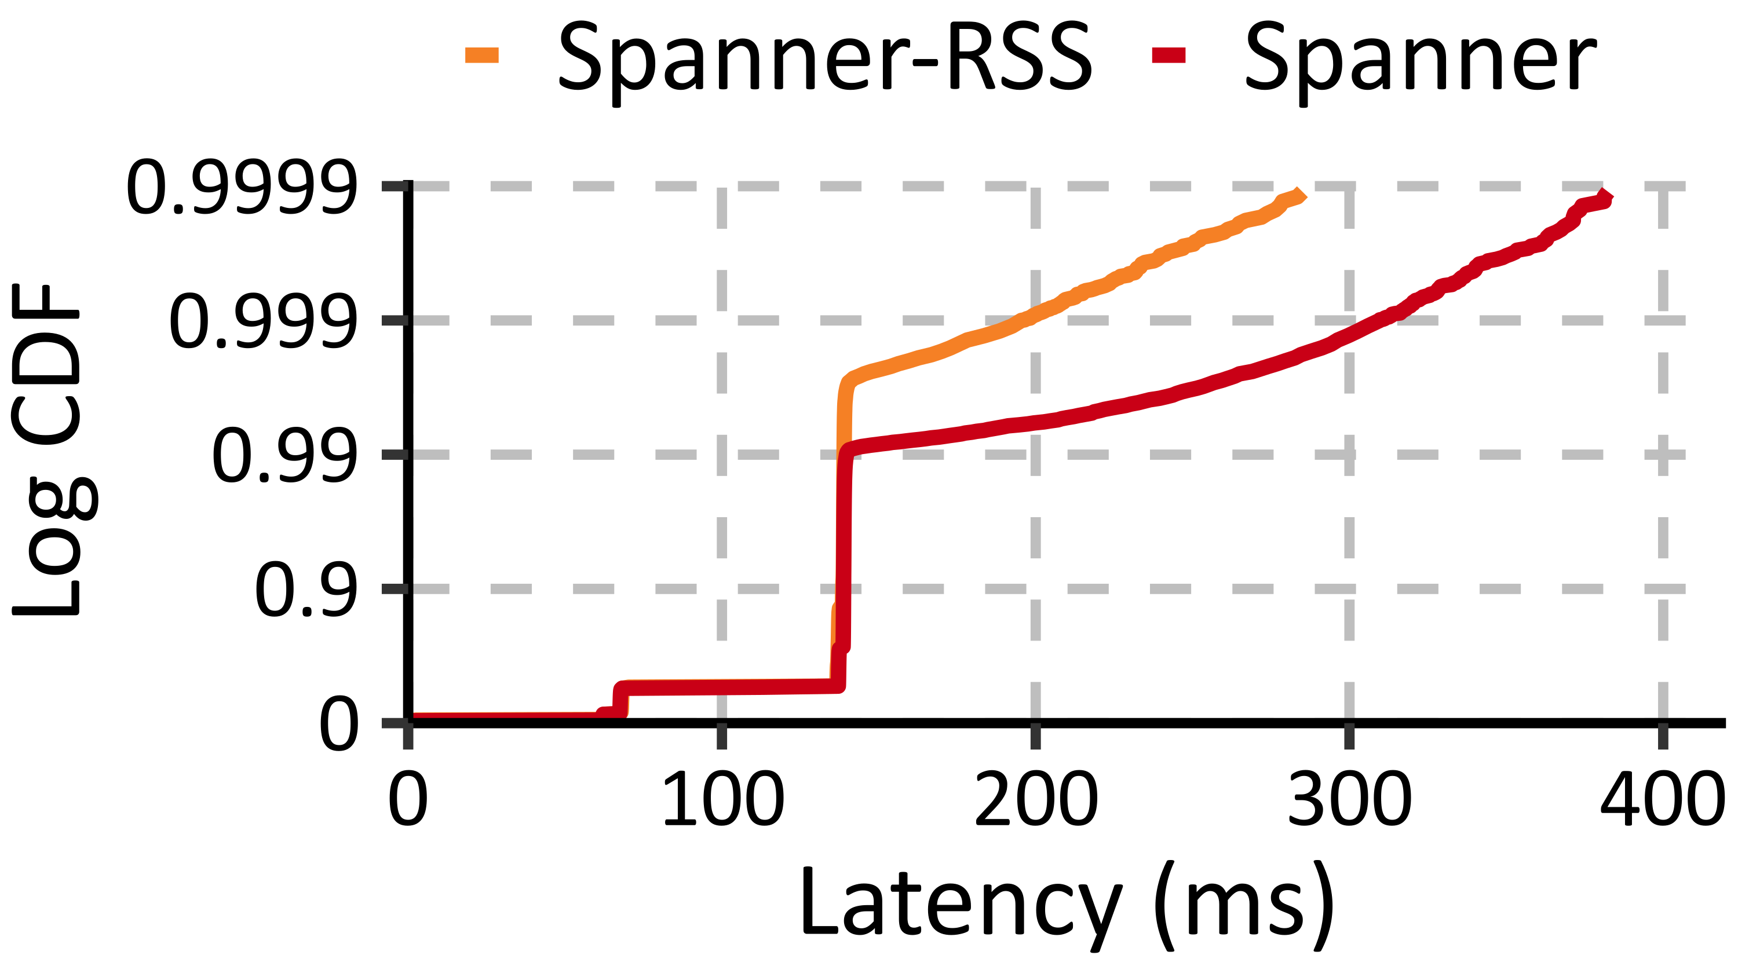
Spanner-RSS Improves Tail RO Latency
45%
Read-only transactions
start blocking
Skew 0.7
Notes:
We compare the latency distributions for read-only transactions when plotted on a log scale.
We first plot Spanner’s distribution.
While its read-only transactions are fast most of the time, their latency starts increasing around p99.
Because it can avoid blocking in some cases, Spanner-RSS improves this latency.
And at this skew, Spanner-RSS reduces latency by up to 45%.

Slide 34
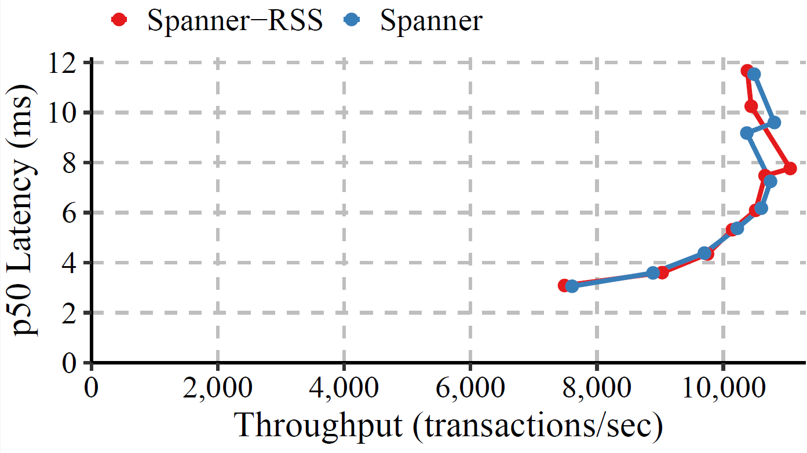
Spanner-RSS Imposes Minimal Overhead
Uniform
Notes:
Finally, we see that despite some additional complexity in passing around extra timestamps to detect when
Its safe for RO transactions to return an older snapshot, Spanner-RSS can achieve the same maximum throughput
as the original Spanner protocol.

Slide 35
Regular Sequential Consistency (RSC)
Definition:
Guarantees a total order of operations
Order must respect some real-time constraints
Order must respect causality
Properties:
Invariant equivalent to Linearizability
Enables better performance for reads
Gryff-RSC: Allows reads to return value before it reaches a quorum
Notes:
We’ll now turn to the non-transactional equivalent of RSS, which we call regular sequential consistency.
The only difference in the definition is that instead of read-only and read-write transactions, we just have single-key operations.
And as a result, the concepts and results we just talked about apply equally to RSC except that we have linearizability instead of strict serializability.
We’ll now talk about how this new model enables lower-latency reads for the Gryff key-value store by
Allowing them to return values before a write has made it to a quorum of replicas.

Slide 36
Gryff/ABD (Linearizability)
(4,0)
W₁(X = 1)
(1,1)
(4,0)
(3,3)
(4,0)
Phase 1
Phase 2
Attiya, Bar-Noy, Dolev, Sharing Memory Robustly in Message-Passing Systems. JACM, 1995.
Burke et al., Gryff: Unifying Consensus and Shared Registers. NSDI, 2020.
Notes:
To start, let me just first give some quick background on the relevant parts of Gryff’s protocol.
And actually the parts we’re focusing on here are the same as the ABD shared register protocol from the mid-90s.
Let’s first walk through the write protocol, so suppose we have one writer and three replicas.
The protocol proceeds in two rounds:
First, the writer send messages to a quorum of replicas to ask what the latest timestamp is that they’ve seen.
Timestamps are tuples comprising a version number and a process ID.
When the writer receives timestamps from a quorum of replicas, it then takes the max of them, increments the version number by one, and sets the correct process ID.
This becomes the timestamp of its write, which it sends along with the key and value of the write to a quorum of replicas in the second round.
The replicas apply the write if the version number is greater than that of its current write for the key.

Slide 37
Gryff/ABD (Linearizability)
(4,0)
W₁(X = 1)
(4,0)
R₁(X = 1)
(1,1)
(4,0)
(4,0)
(3,3)
(4,0)
(4,0)
Phase 1
Write-Back
Phase
Attiya, Bar-Noy, Dolev, Sharing Memory Robustly in Message-Passing Systems. JACM, 1995.
Burke et al., Gryff: Unifying Consensus and Shared Registers. NSDI, 2020.
Notes:
Reads similarly work in two rounds:
First, the reader send messages to a quorum of replicas to ask what the latest timestamp is that they’ve seen.
And replicas respond with the timestamp and the associated value.
The read then takes the maximum timestamp among those returned and the associated value.
This becomes the value that will be returned by the read.
But before doing so, the reader sends a second round of messages, called the write-back phase, where
It sends the max timestamp and value to a quorum, which then apply just like in the second round of a write.
In this case, both of the replicas already had the most up-to-date value.
TODO

Slide 38

Gryff/ABD (Linearizability)
(4,0)
W₁(X = 1)
(4,0)
R₁(X = 1)
(1,1)
(4,0)
(4,0)
(3,3)
(3,3)
(3,3)
(3,3)
R₂(X = 0)
(3,3)
Linearizability requires future reads to see X = 1
Notes:
The reason we need the second write-back phase for reads is to satisfy linearizability’s real-time guarantees.
For instance, consider the case similar to the one shown on the previous slide,
except that the second of the writer’s messages in its second round gets dropped, so the second round is still ongoing.
Now we have the same reader trying to read X, and it issues its first round.
Like on the previous slide, the returned value will be X=1.
But if the reader returned here, without the second round, linearizability would mandate that all future readers see X=1.
But Since that write has not yet made it to a quorum of replicas, a second reader could come in and still see an older write.
Violating linearizability’s guarantees.

Slide 39
Gryff/ABD (Linearizability)
(4,0)
W₁(X = 1)
(4,0)
R₁(X = 1)
(1,1)
(4,0)
(4,0)
(4,0)
(3,3)
(3,3)
(4,0)
(3,3)
R₂(X = 1)
(4,0)
Linearizability requires future reads to see X = 1
Notes:
Thus, the write-back phase of the read is needed to ensure that all futures reads see at least the returned value
When a write is in progress.
In this case, it ensures the second reader returns X=1.

Slide 40
Gryff-RSC
(4,0)
W₁(X = 1)
(4,0)
R₁(X = 1)
(1,1)
(4,0)
(4,0)
(3,3)
(3,3)
(3,3)
(3,3)
R₂(X = 0)
(3,3)
RSC only requires causally related reads to see X = 1
Notes:
Fortunately, this is exactly the kind of case where RSC and linearizability differ.
So if we rewind a bit, we have our writer and the first reader.
Unlike linearizability, if the first read returns at this point, RSC only requires causally later reads to return the same write.
This allows the read to return in one round.
When the second read comes in, it will a return an older write, but that is allowed by RSC.

Slide 41
Evaluation of Gryff-RSC
Our evaluation demonstrates:
Gryff-RSC offers better tail read latency
Gryff-RSC’s protocol changes have minimal performance costs
Experimental Setup:
Implemented in Go in same framework as Gryff
Ran on CloudLab, 5 replicas in emulated wide-area environment
YCSB workload
Vary rate of conflicts and read-write ratio
Notes:
Our evaluation of Gryff-RSC is similar to the one for Spanner-RSS.
We show it improves tail latency for reads and that its protocol changes impose little overhead.
For our evaluation, we implemented Gryff-RSC in the same framework as Gryff.
Our experiments ran on CloudLab, where we emulated a five-replica system in a wide-area network.
We used the YCSB workload with varying conflict rates and read-write ratios.

Slide 42
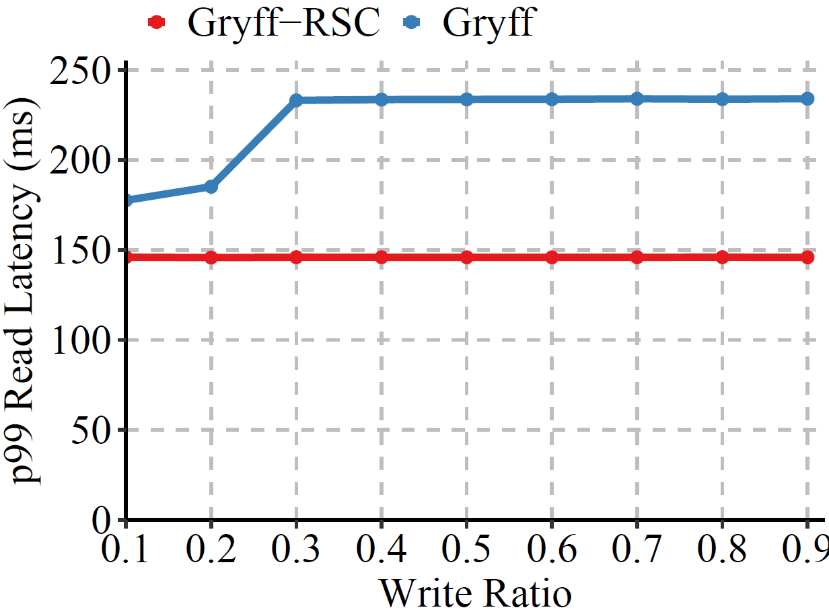
Gryff-RSC Improves Tail Read Latency
40%
10% Conflicts
Notes:
Here we compare the p99 read latency of the two systems as we vary the read-write ratio.
This is with a fixed 10% conflict rate.
As expected, Gryff-RSC’s reads return in 145 milliseconds, which is the time it takes for messages to travel to a quorum of replicas and back.
In general, Gryff requires two rounds for its reads, but it also has an optimization over the base protocol I just explained
where if all of the messages in the first round of a read return the same timestamp and value, then the read can finish
in one round because we already know that the write is at a quorum.
This is why at low write ratios, Gryff’s latency is closer to Gryff-RSC’s.
When there are sufficient writes, above a ratio of 0.3, its read latency increases to 234 milliseconds,
so Gryff-RSC generally offers about a 40% reduction in read latency.
Lastly, just so we can finish up this section, I’ll just mention that we have similar results
that Gryff and Gryff-RSC have comparable maximum throughputs.

Slide 43
Related Work
Consistency Models:
Strict serializability & serializability (Papadimitriou 1979), process-ordered serializability (Daudjee & Salem, 2004), CRDB (Taft et al., 2020), strong snapshot isolation (Daudjee & Salem, 2006)
Linearizability (Herlihy & Wing, 1990), sequential consistency (Lamport 1979), OSC (Lev-Ari et al., 2017), causal (Ahamad et al., 1995), causal+ (Lloyd et al., 2011) real-time causal (Mahajan et al., 2011), MW-Reg (Shao et al., 2003)
Equivalence Results:
Attiya & Welch, 1994. Fischer et al., 1985. Goldman & Yelick, 1993. Lundelius & Lynch, 1984.
Reasoning About Explicit Invariants:
SIEVE (Li et al., 2014), CISE (Najafzadeh et al., 2016), Ogre & Pythia (Alglave & Cousot, 2017)
Notes:
Before finishing this part of the talk, I just want to briefly discuss the related work in this area.
As we’ve already talked a bit about, there are a lot of existing consistency models but all of these offer
Some sort of trade-off between application correctness and service performance.
RSS & RSC are the first to move off us onto a new trade-off frontier.
There are also a bunch of more theoretical works that use equivalence results that were the inspiration
for our work on invariant equivalence.
Next we have tools for reasoning about explicit application invariants.
The main difference between these and our work is that they require programmers to explicitly state
The invariants that must hold for application correctness
But because RSS & RSC ensure all invariants hold, programmers don’t need to state explicit invariants.

Slide 44
Related Work (Continued)
Strictly Serializable Services:
Spanner (Corbett et al., 2013), MDCC (Kraska et al., 2013), Replicated Commit (Mahmoud et al., 2013), Rococo (Mu et al., 2014), Janus (Mu et al., 2016), SLOG (Ren et al., 2019) CRDB (Taft et al., 2020), TAPIR (Zhang et al., 2015), Calvin (Thomson et al., 2014)
Linearizable Services:
Gryff (Burke et al., 2020), Multi-Paxos (Lamport, 1998), Viewstamped Replication (Oki & Liskov, 1988), EPaxos (Moraru et al., 2013), Mencius (Mao et al., 2008), Co-Pilot (Ngo et al., 2020), Raft (Ongaro & Ousterhout, 2014)
Notes:
On the systems side, there are many existing strictly serializable and linearizable services.
But of these, Spanner has the lowest-latency read-only transactions
And Gryff similarly has the lowest latency reads.
The other works in both categories have for the most part worked on improving the write protocol, so
They’re improvements are orthogonal to the ones we showed here,
And hopefully future work could combine their techniques with ours.

Slide 45
RSS Summary
New Consistency Models:
Regular Sequential Serializability and Regular Sequential Consistency
Correct Applications:
RSS is first model that is invariant equivalent to Strict Serializability
RSC is first model that is invariant equivalent to Linearizability
Better Services:
Spanner-RSS reduces tail read-only transaction latency by up to 50%
Gryff-RSC reduces tail read latency by up to 50%
Notes:
So just to summarize, this part of the talk presented two new consistency models to ease the trade-off between application correctness and service performance.
RSS and RSC are the first consistency models that are invariant-equivalent to strict serializability and linearizability. This allows developers to move their applications to use RSS and RSC services with the guarantee that their applications won’t break.
Further, because RSS and RSC relax the constraints on reads, they enable new service designs.
We showed two examples, variants of Spanner and Gryff, which both offer significant reductions in tail read latency.

Slide 46
Part 2: MDL
Regular Sequential Serializability & Regular Sequential Consistency:
Applications: Invariant equivalence
Services: Lower read latency
Multi-dispatch Linearizability:
Applications: External equivalence
Services: Lower end-to-end latency
Notes:
Ok, so before we move on to the next section, I’ll pause here to see if anyone has any questions.
Ok, then if not, let’s continue on to multi-dispatch linearizability and external equivalence.

Slide 47
Models Assume Single Dispatch
Ins(P₁)
Notes:
So one quick note before we dive in is that we’re no longer talking about multi-key, multi-operation transactions.
Like we were when discussing Gryff, we’ll just be talking about single-key operations.
Ok so with that let’s go back to our example photo-sharing app. Even though we don’t have transactions, we can imagine
Writing the application on top of a linearizable key-value store.
We perform uploads in a similar way where a Web server will first insert the photo.
And then append its key to the list of keys associated with the album.

Slide 48
Models Assume Single Dispatch
Append(A, [P₁])
Notes:
And then append its key to the list of keys associated with the album.

Slide 49
Models Assume Single Dispatch
Models assume processes are sequential
Increases end-to-end latency of modern applications
Example: Bulk uploading photos with Linearizable KV store
Ins(P₁), Ins(P₂), …, Append(A, [P₁, P₂, …])
Append(A, [P₁, P₂, …])
Ins(P₁)
Ins(P₂)
Notes:
But like most other consistency models, linearizability assumes processes only have at most one operation outstanding at a time.
When applications need to perform multiple operations, this can significantly increase their end-to-end latency.
For example, imagine our application supports bulk uploads by having
The client first insert each photo and then append all of those keys to the album.
Since it must abide by linearizability’s assumptions, the Web server must perform all of these operations one at a time,
Leading to increased end-to-end latency.
We could imagine trying to optimize the upload path to issue the inserts and append in parallel…

Slide 50
Parallelizing Apps Is Error-Prone
Example: Viewing an album
R(A = [P₁, P₂, …]), R(P₁ = B₁), R(P₂ = B₂), …
With single-dispatch uploader:
Photo reads never return null
With parallel uploader:
Photo reads may return null
Notes:
But we can see the dangers of this naïve approach if we look at the reading side of things.
Suppose that to view an album, a Web server first reads an album,
and then subsequently uses the returned keys to read each photo’s binary blob.
With a single-dispatch uploader, since the inserts all precede the append in real-time, if the viewer sees
Any photo keys in its read of the album, the subsequent read of the photo’s blob is guaranteed to never return null.
This breaks down with the parallel, multi-dispatch uploader. In this case, because the inserts and append are
Issued concurrently, linearizability does not guarantee an ordering between them, so the viewer’s read of the
Album may include a photo’s key whose corresponding insert hasn’t taken effect yet. As a result, the subsequent read of the
Photo’s blob could return null.

Slide 51
Holistic Approach: MDL
Method for parallelizing applications to preserve
external equivalence
New MDL system: Ellis
Multi-Dispatch Linearizability
Notes:
So here again we see a tension between performance and correctness.
And again we take a holistic approach.
In particular, we design a new consistency model, called multi-dispatch linearizability that explicitly
Allows a client to issue multiple concurrent operations.
On the application side, we also describe how to transform an app that interacts with a linearizable service into one that can interact with an MDL service
While giving strong guarantees about the transformed application’s behavior, something we call external equivalence
On the system side, we also show how to design and implement a system to guarantee MDL.
We’ll now talk about each of these.

Slide 52
Multi-Dispatch Linearizability
MDL Definition:
Guarantees a total order of operations
Order respects real-time order across processes
Order respects invocation order within each process
Notes:
Let’s start by defining multi-dispatch linearizability.
First, it guarantees a total order of operations.
And like linearizability, it guarantees that this order respects the real-time order across processes.
The new part is that since we’re allowing a client to issue multiple operations concurrently, we also want to give some ordering guarantee about
Those operations, so within each process, MDL guarantees the total order respects the invocation or dispatch order of the operations.

Slide 53
Multi-Dispatch Linearizability
MDL Definition:
Guarantees a total order of operations
Order respects real-time order across processes
Order respects invocation order within each process
Suffix-Closed Failures:
If an op fails, concurrent ops invoked after it must fail, too
Notes:
One somewhat subtle thing that is implied by this definition is something we call suffix-closed failures,
which I’m mentioning now because it will become relevant when we start talking about our new system Ellis.
What this means is that if an operation can fail, the system must ensure that subsequent operations must also fail
Or at least cannot be exposed to other clients until the operation succeeds.
This can become a bit tricky when clients have multiple outstanding operations.

Slide 54
Transforming Apps For MDL
To parallelize an app to take advantage of MDL:
Change blocking system-facing I/O to futures
Can move statements earlier provide we maintain:
Data dependencies
Control flow
Operation invocation order
Order of non-system-facing I/O (e.g., inter-process messages)
Order between non-system-facing I/O and operation I/O
Notes:
Now that we have our definition of multi-dispatch linearizability, we can talk about how we can transform
An existing application that is designed to interact with a single-dispatch linearizable service into one that can interact with
A comparable MDL service.
To do so we do two things:
First, we replace all blocking system-facing I/O with something like futures,
which allow us to issue multiple operations concurrently and then later block until we receive their result.
This will then allow us to move the invocation and Responses around within the application.
We can then move statements earlier in the application provided we maintain a few things.
First we need to ensure the data dependencies and control flow between statements is preserved.
Next we need to ensure that invocation order across operations reflects the original order of operations.
Finally we need to respect the order between system-facing and non-system-facing I/O, such as inter-process messages.

Slide 55
Transformation Example
req = recv(user_sock)
aid = req.album_id
a = sys.get_album(aid)
results = []
for pid in a.photo_ids:
p = sys.get_photo(pid)
results.append(p.blob)
send(user_sock, results)
Notes:
I think this is best understood through an example, so we again look at the photo-sharing app.
Here we’ll show pseudo-code for handling a view album request, first for the single-dispatch app
And then the transformed code.
The first thing that happens is that the Web server receives a request from a user.
This an example of what we called non-system-facing I/O.
Next we get the album’s list of photo keys.
We then use those keys to read each photo’s blob.
And finally we send the results back to the user.

Slide 56
Transformation Example
req = recv(user_sock)
aid = req.album_id
a = sys.get_album(aid)
results = []
for pid in a.photo_ids:
p = sys.get_photo(pid)
results.append(p.blob)
send(user_sock, results)
req = recv(user_sock)
aid = req.album_id
a_fut = exec.submit(sys.get_album, aid)
a = a_fut.get()
p_futs = []
for pid in a.photo_ids:
p_fut = exec.submit(sys.get_photo, pid)
p_futs.append(p_fut)
results = [p_fut.get() for p_fut in p_futs]
send(user_sock, results)
Notes:
The transformed starts the same since we’re keeping non-system-facing I/O the same.
The request for the album would be converted to a future but would be otherwise the same
Since there’s a data dependency between this read and the subsequent reads of the photos.
To issue the photo reads, we use a future for each, so they happen in parallel, but the order of the loop
Maintains the invocation order.
The aggregated results are then sent back to the user.

Slide 57
App
App*
External Equivalence Theorem:
Any external behavior possible with
a transformed application
running on an MDL service
is also possible with
the original application
running on a Linearizable service
Linearizability
MDL
KV
KV
Notes:
What we show in this work is that if you transform an application following these rules, then the new and old applications will be externally equivalent.
Informally, what our theorem shows is that any external visible behavior of a transformed application
running on an MDL service would also have been possible with the
original application running on a single-dispatch linearizable service.
This means that if I have a single-dispatch application running on a Linearizable key-value store,
And then I swap out the back-end store for one that guarantees MDL and also transform the application according to the rules we just discussed,
then this pair of transformed application and MDL store will behave the same as the original application as far as users can tell.

Slide 58
Why A Different Type Of Equivalence?
To take advantage of MDL, we must modify the application:
Unlike benefits offered by RSC (compared to Linearizability)
Invariant equivalence is very conservative:
Any invariant must hold, even if not actually necessary for correctness
Example: app only has one outstanding service operation
Notes:
To make sure we get through everything, I don’t have time to go into detail about the external equivalence proof.
But I do want to briefly touch on why we’re introducing another type of equivalence here and not just using invariant equivalence.
The crux of the problem is that we need to change applications in order to take advantage of the performance benefits of MDL services and
This creates a problem when using invariant equivalence, which is very conservative.
Intuitively, invariant equivalence requires any invariant in any application to hold, even if it isn’t really necessary for an application’s correctness.
To see how this can cause problems, one such invariant that we can encode in an application’s variables is that the application has
Only one outstanding operation at a time. Well that’s exactly what we’re trying to get rid of with multi-dispatch linearizability.

Slide 59
MDL On One Shard
Leader-based RSM protocols can guarantee MDL on one shard:
Clients send all operations to leader with sequence number
Leaders track next per-client sequence numbers
Each client’s operations enter log in sequence number order
Leaders replicate next sequence number table along with other state
Notes:
Ok, so now let’s turn to the systems side of things.
What we found in doing this work is that there are some existing systems that guarantee MDL
But all of them only do so for one shard.
For example, leader-based replicated state machine protocols, like Raft or multi-Paxos, can guarantee MDL by doing roughly the following:
When clients send operations to the leader they include a per-client sequence number.
The leaders then track the next expected sequence number from each client and if queue any operations that arrive out of order.
This way, even if a client issue multiple operations concurrently, the leader ensures they will always enter the log in the operation’s invocation order.
This can work across leader failures as long as the next sequence number table is replicated along with the protocol’s other state.
But this approach does not extend to multiple shards.

Slide 60
Challenges For Multi-Shard MDL: Ordering
Ins(P₁), App(A, [P₁])
A
App
R₁
P₁
R₂
Ins
R₁(A = [P₁]), R₂(P₁ = null)
Notes:
To gain some intuition about why, let’s look at an example.
Suppose we have two shards running a leader-based protocol like multi-Paxos.
Here we’re showing the leaders and the replicas for each shard.
We’ll have one writer that’s uploading a photo, and one reader that’s concurrently trying to view the album.
The uploader sends its two invocations to the corresponding shards: first the insert of the photo and then the append.
But suppose that because of the network the insert is slow to arrive.
This opens up the potential for problems. On the reader, it will first read the album.
Suppose that its read arrives at the shard after the writer’s append. So when the leader orders and commits these two operations
In the log, they will be in the order of first append, then R1.
The reader then takes the result of this read, which includes P1 and issues a read for P1’s blob.
Suppose this read actually arrives before the delayed insert from the writer.
So when this leader commits and orders the two operations it will be R2 then the insert.
As a result, R2 will return null.
But under MDL, the insert must be before the append by invocation order,
The append was ordered before R1 at the first shard, and finally R1 must be before R2 by invocation order,
So R1 must reflect the changes made by the insert.

Slide 61
Challenges For Multi-Shard MDL: Failures
Ins(P₁), App(A, [P₁])
A
App
R₁
P₁
R₂
R₁(A = [P₁]), R₂(P₁ = null)
Notes:
Failures, even if temporary, can induce similar types of problems.
If we instead change the example slightly such that the insert invocation message is dropped instead of just delayed, we run into the same problem.
We can again have R1 arrive after the append as on the previous slide.
Then when R2 gets invoked, it will be the only operation at the other shard, so it will again return null.

Slide 62
Ellis Design Overview
Key Idea: Decouple fault-tolerance from ordering
Three phase protocol:
Parallel replication of operations across shards
Sequential coordination to ensure correct total order
Parallel ordering of operations across shards
Suffix-closed failures
MDL order
Notes:
Ellis is our system to guarantee MDL across multiple shards.
It tackles the problems of handling failures and cross-shard ordering with one key idea.
Unlike existing protocols that couple ordering and fault-tolerance into a single commit round,
Ellis decouples fault-tolerance from ordering.
The result is a three-phase protocol:
First, operations are replicated concurrently at their respective shards to guarantee fault-tolerance.
Second, there is a sequential coordination phase where the leader handling an operation will send a message
To the leader handling its successor operation.
Third, after its made fault-tolerant and is “coordinated,” an operation is then ordered by being placed in the shard’s log.
Together the first two phases ensure Ellis guarantees suffix-closed failures. And second and third phases ensure an MDL ordering across shards.

Slide 63
Ellis Protocol Example
Coordination message
Ins(P₁), App(A, [P₁])
A
App
App
P₁
Ins
Ins
Rep
phase
Coord
phase
Order
phase
Notes:
So let’s see an example of how Elli’s protocol works for the same uploader we saw a few minutes ago.
The uploader first sends the insert and append to the shard leaders.
However, for the append, since it has a concurrent predecessor, the client also sends a coordination message to the
Leader of the insert operation indicating that it should later send a coordination response to the leader handling the append.
Each shard can then make the operations fault-tolerant in parallel.
This places the operations into an unordered operation set at each shard.
Once the insert is fault-tolerant, it sends the coordination response to the append leader.
Also since it doesn’t have a predecessor, the insert can immediately proceed to the ordering phase, which takes
Another quorum round trip to put the insert in the shard’s log.
Once the append leader receives the response it can similarly be ordered in the log.
After this the shards then respond back to the client.

Slide 64
Ellis Protocol Example
Coordination message
Ins(P₁), App(A, [P₁])
A
App
R₁
App
App
R₁
P₁
Ins
Ins
R₁(A = [P₁]), R₂(P₁ = B₁)
Notes:
To see how this prevents the problematic example we showed earlier, let’s now add in the reader.
We’ll rewind the execution a bit back to where the insert leader has just sent the coordination response to the append leader.
Ellis’s protocol guarantees that once an operation is made fault-tolerant and is coordinated by its predecessor,
then any operation that arrives at the shard after this point, will be ordered after it in the log.
So for R1 to be ordered after the append, it will arrive after this point.
The shard will then eventually order R1 after the append in two subsequent quorum round trips.
But the important thing to note is that once an operation is fault-tolerant and coordinated,
this implies that all of its predecessors are fault-tolerant and coordinated because the predecessor only sends the coordination response
Once it has been made fault-tolerant and was coordinated.
In this example, the insert was trivially coordinated since it did not have a predecessor.
As a result, once the reader has received the results of R1 that include P1, we know that the insert of P1 at the other shard
Is already about to be ordered in the log.
And so there’s not chance for a later R2 to be ordered before it.

Slide 65
Evaluation of Ellis
Our evaluation demonstrates:
Ellis improves end-to-end application latency
Ellis has lower throughput than leader-based RSM protocols
Experimental Setup:
Compared to Multi-Paxos, both implemented in Go
Ran on CloudLab in one data center
Synthetic benchmark: 1 app request = N service operations
Vary degree of fanout, skew (Zipf), and number of shards
Notes:
Moving on to our evaluation, we show two things:
On the good side, we show that Ellis improves end-to-end application latency.
On the currently not so good, we’ll see that Ellis has has lower maximum throughput than leader-based protocols.
For our experimental setup we compared against multi-Paxos and both protocols were implemented within the same framework in Go.
Our experiments ran on CloudLab within one data center
And we used synthetic workloads where we have 1 app request equal to a varying number of operations.
We also vary the skew and number of shards in our experiments.

Slide 66
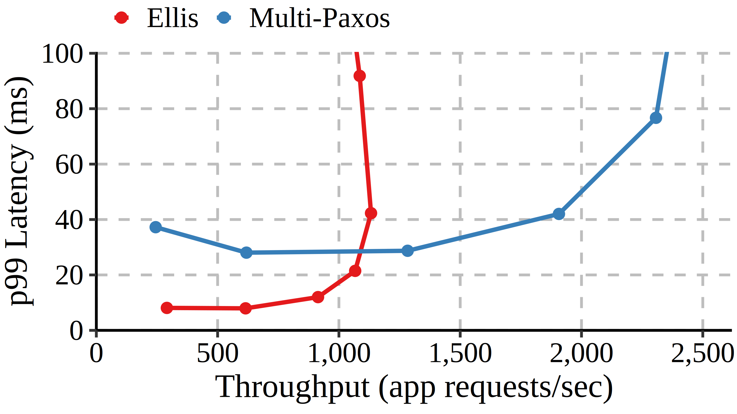
Ellis Reduces End-To-End App Latency
9 shards
Fanout 100
Uniform skew
66%
Notes:
We can see the difference in latency between Ellis and multi-Paxos if we compare their throughput-latency curves.
Here we plot their p99 application request latency versus throughput, which is measured in application request per second.
This is with 9 shards, a fanout of 100 (so 100 system operations per application request) and uniform skew.
We see that Ellis’s offers about a 66% reduction in latency compared to multi-paxos.
This is approaching the ideal improvement of a 75% reduction
because for each operation multi-Paxos must wait for the messages between client and leader, leader to quorum and back, and leader back to the client
So 4 one-way delays.
While the only sequential part of Ellis’s protocol is the one-way delay between shard leaders for the coordination messages.

Slide 67
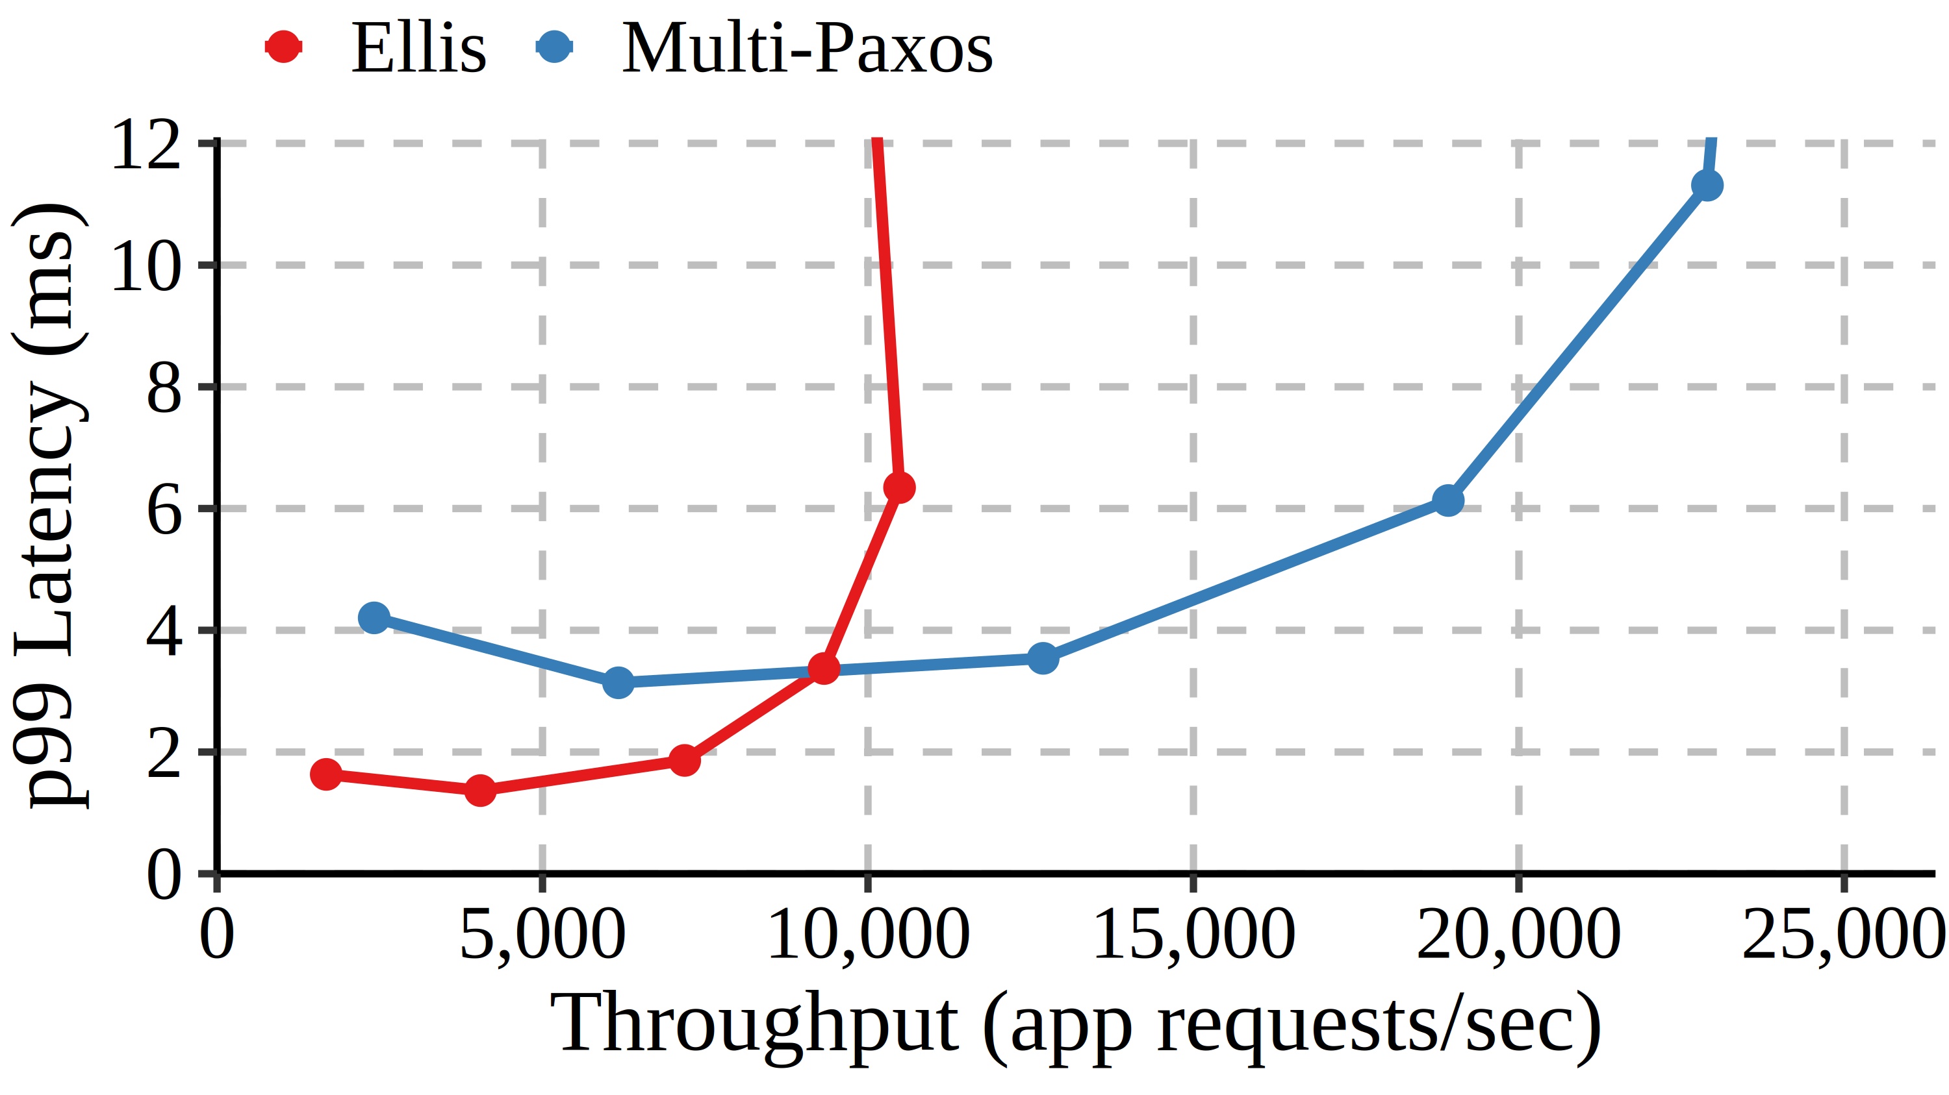
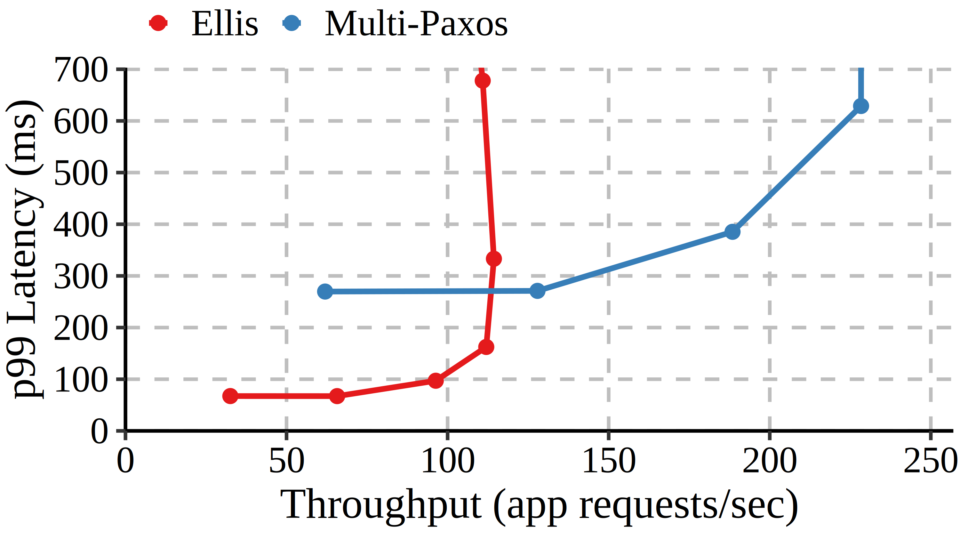
Ellis Reduces End-To-End App Latency
39%
75%
Fanout 10
Fanout 1000
Notes:
We can see that Ellis’s latency improvement trends towards the ideal as we increase the fanout.
With a fanout of 10, less than the 100 shown on the previous slide, Ellis offers less of improvement, only 39%.
But with a fanout of 1000, Ellis achieves the ideal improvement of 75%.

Slide 68
Ellis Reduces Per-Shard Throughput
52%
9 shards
Fanout 100
Uniform skew
Notes:
Ellis achieves this lower end-to-end latency by trading maximum throughput because
The leader has to do send more messages to process each individual operation.
Here we see throughput fall from about 2300 to about 1100, which is about a 52% reduction.
So while there’s currently a trade-off here between end-to-end latency and throughput, we’re
currently working on implementing batching within Ellis shards.
And once we finish, we expect that Ellis should be able to get comparable throughput to multi-Paxos
while still keeping the majority of its latency improvement.

Slide 69
Related Work
Consistency Models:
Linearizability (Herlihy & Wing, 1990), OSC (Lev-Ari et al., 2017), causal (Ahamad et al., 1995), causal+ (Lloyd et al., 2011) real-time causal (Mahajan et al., 2011), MW-Reg (Shao et al., 2003)
Sequential consistency (Lamport 1979), A-Linearizability (Hunt et al., 2010)
Equivalence Results:
Attiya & Welch, 1994. Fischer et al., 1985. Goldman & Yelick, 1993. Lundelius & Lynch, 1984.
Linearizable Services:
Gryff (Burke et al., 2020), Multi-Paxos (Lamport, 1998), Viewstamped Replication (Oki & Liskov, 1988), EPaxos (Moraru et al., 2013), Mencius (Mao et al., 2008), Co-Pilot (Ngo et al., 2020), Raft (Ongaro & Ousterhout, 2014)
Notes:
The related work for MDL is pretty similar to the works we talked about for RSS & RSC.
There are a lot of existing consistency models but almost all of them make the same assumption about clients being single dispatch.
It could be interesting future work to try to create multi-dispatch variants of these other models.
The two exceptions are sequential consistency and A-Linearizability, which were both defined to allow for multi-dispatch clients.
But unlike MDL, both of these models offer a trade-off for application programmers compared to linearizability.
And as before, existing equivalence results served as some of the inspiration for external equivalence.
Finally, there are many existing linearizable services. In our evaluation, multi-Paxos served as our representative for leader-based RSM
Protocols. And as a leader-based procotol, Ellis suffers from the same downsides as these protocols.
It would be interesting to try to incorporate some of the techniques from leader-less protocols, like E-Paxos,
To design new MDL services.

Slide 70
MDL Summary
New Consistency Model:
Multi-dispatch Linearizability
Well-Behaved Applications:
MDL is first model that is externally equivalent to Linearizability
Better Services:
Ellis is first service to guarantee multi-shard MDL
Ellis reduces end-to-end application latency by up to 75%
In exchange, Ellis trades 50% maximum throughput
Notes:
This part of the talk presented a new consistency model, multi-dispatch linearizability.
MDL is the first consistency model that is externally equivalent to linearizability.
And despite this we show, through the design and implementation of Ellis, that it can enable services offering lower end-to-end application latency.
But this reduction in latency came at some cost in maximum throughput.

Slide 71

Summary: A Holistic Approach
Invariant Equivalence
RSS & RSC
Spanner-RSS & Gryff-RSC
External Equivalence
MDL
Ellis
Notes:
So just to conclude, this thesis took a holistic approach to designing new consistency models
and showed how this could lead to new models that pushed us onto new trade-off frontiers.
In the first part, we presented RSS & RSC which had the nice property of invariant equivalence as well as
Enabled new better-performing services.
In the second part, we presented MDL, which we showed was externally equivalent to linearizability assuming
we properly transformed our applications. We similarly showed that MDL enables better services.

Slide 72
Thank You!
Advisor: Wyatt
Collaborators:
RSS: Matt Burke, Amit Levy
MDL: Anja Kalaba, Amit Levy
C5: Dan Abadi, Jose Faleiro, Abhinav Sharma
Thermopylae: Jennifer Lam, Haonan Lu
Notes:
So that’s the end of the research part of my presentation.
So I just wanted to take a moment to thank everyone who has helped me along the way in completing this work for my PhD.
In particular Wyatt as my advisor and mentor. And Amit, Anja, Jennifer, and others as my collaborators
On a bunch of different projects.

Slide 73
My Other Work
C5: Cloned Concurrency Control that Always Keeps Up
Jeffrey Helt, Abhinav Sharma, Daniel J. Abadi, Wyatt Lloyd, Jose M. Faleiro
In Proc. 49th International Conference on Very Large Data Bases (VLDB), 2023
Morty: Scaling Concurrency Control with Re-Execution
Matthew Burke, Florian Suri-Payer, Jeffrey Helt, Lorenzo Alvisi, Natacha Crooks
In Proc. 18th European Conference on Computer Systems (EuroSys), 2023
Conquering Skewed Workloads with Throughput Multipliers in the Thermopylae Distributed Database
Jennifer Lam, Jeffrey Helt, Haonan Lu, Wyatt Lloyd
Under submission
Notes:
Yeah these are those other works that I’ve been involved in.

Slide 74
Questions?
Notes:
And now I’ll just conclude by saying thank you all for attending my pre-fpo! And I’d be happy to answer any last questions.

Slide 75
FPO Timeline
Now
05/2023
Start Google internship
07/10/2023
Return
10/15/2023
Thesis early draft
11/15/2023
FPO
01/2024
Proposed TODOs:
Formalize relationship between invariant and external equivalences
Define and prove external equivalence for MD Strict Serializability
(Reach Goal) Define and prove equivalence for MD-RSS and MD-RSC
(Reach Goal) Design, implement, and evaluate Ellis-TrueTime
Notes:
I also have my proposed FPO timeline and TODOs to discuss with the committee.

Slide 76
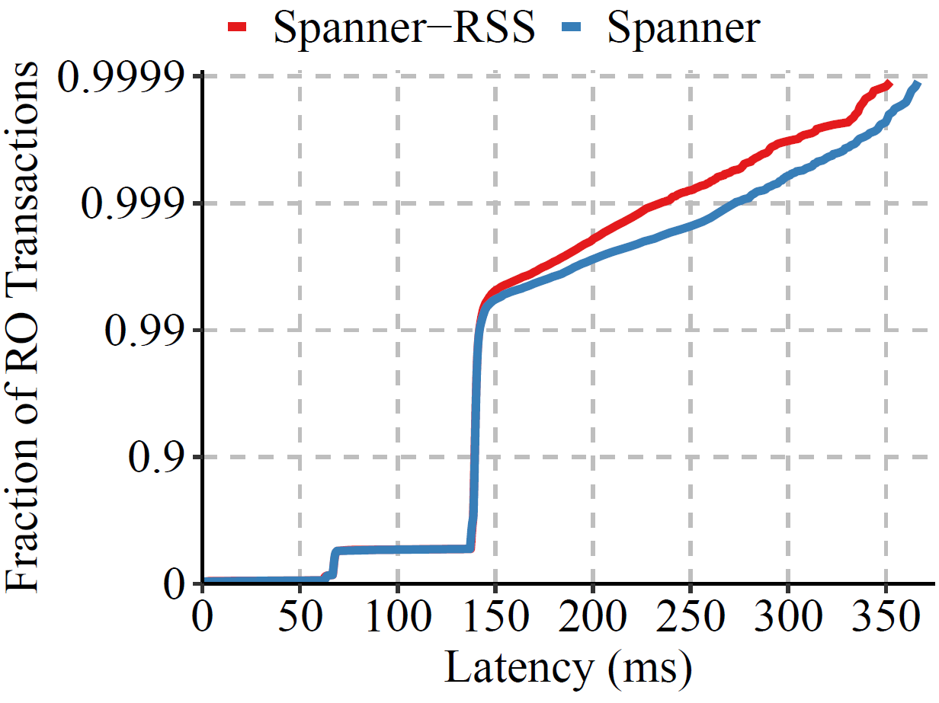
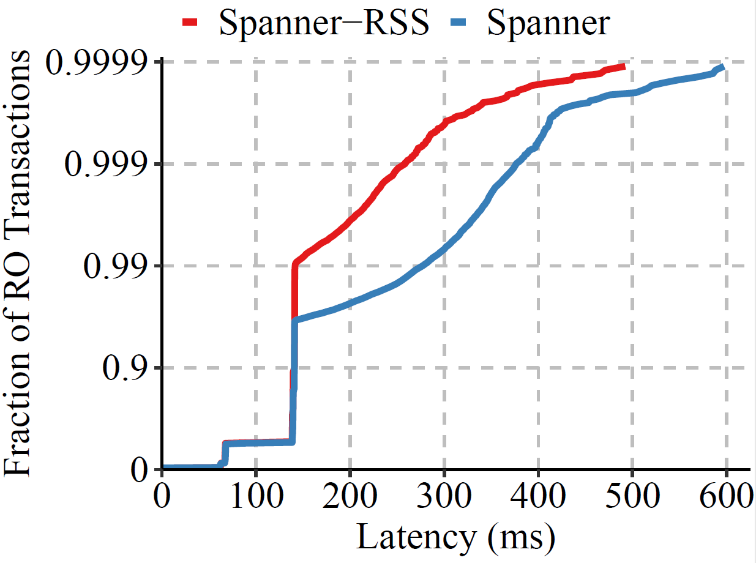
Skew Increases RO Latency Improvement
Skew 0.5
Skew 0.9
Notes:
We can see that Spanner-RSS’s improvement in tail latency generally increases with skew, at least up to a point.
With skew 0.5, less than the 0.7 shown on the previous slide, Spanner-RSS offers only small improvement.
This is because Spanner’s RO transactions are already pretty good and don’t need to block much when there are few conflicts.
As skew increases, for instance to 0.9, we see that Spanner-RSS offers a larger improvement of up to about 50%.

Slide 77
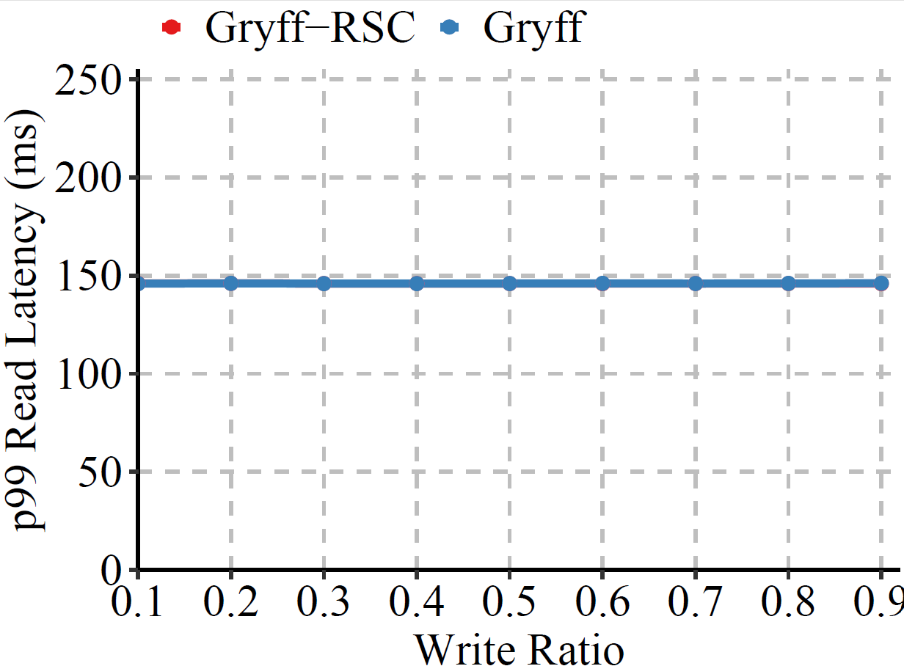
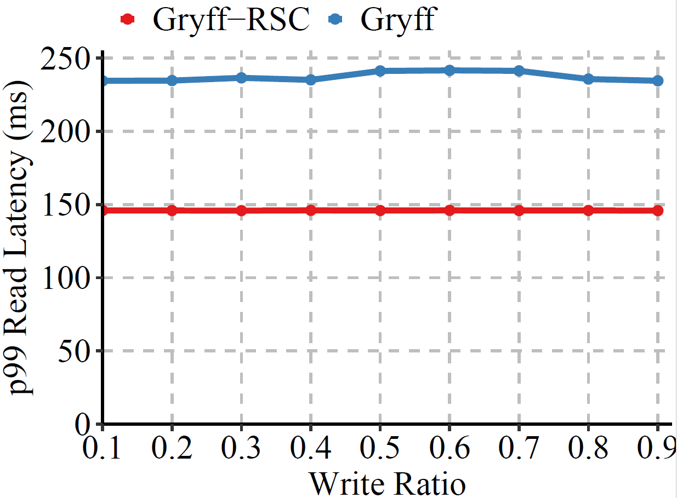
Conflict Rate Increases Latency Improvement
2% Conflicts
25% Conflicts
Notes:
Similar to the effects with saw for skew on Spanner-RSS, we see here with the conflict rate.
When the number of conflicts is low, Gryff’s reads can already mostly finish in one rounds, so Gryff-RSC doesn’t have room for improvement.
And with a high rate of conflicts, we see that Gryff-RSC’s improvements start at lower read-write ratios, that is, it requires fewer writes in the workload
To start offering benefits.

Slide 78
Key Idea: Relax Read Protocol
W₁(X = 1, Y = 1)
R₁(X = 1)
R₂(Y = 1)
R₂(Y = 0)
Spanner-RSS: Allow read-only transactions to return an older snapshot (than Spanner)
Gryff-RSC: Will discuss in a few slides
Notes:
Now that we have our definition of regular sequential serializability and we’ve given an idea of how it is invariant equivalent to strict serializability,
We’ll now turn to talking about the new service designs that it and regular sequential consistency enable.
We’re going to show two systems:
In both, the key idea is that we’ll exploit the relaxed consistency model to modify or remove some mechanisms that are meant to address cases
Exactly like the example we’ve been discussing.
The first is Spanner-RSS.
Here we’re going to allow read-only transactions like R2 to return immediately with a slightly older snapshot than what Spanner would have returned.
The second is Gryff-RSC, which is a variant of the Gryff key-value store, which I’ll give the intuition for when we get to it in a few slides.

Slide 79
Invariant-Equivalence Proof Steps
Step 1: Assume some invariant I holds for all executions of an application when using a strictly serializable service
→ Invariant I holds for final state of all executions
Step 2: Assume an arbitrary RSS execution α with final state S
Step 3: Use previous slide to transform it to an SS execution β with final state S’
Step 3: Since sequence of steps at each process is the same in α and β,
each goes through the same sequence of states
→ This implies S = S’
Step 4: Since I is true of S’ by assumption, must also be true of S
Notes:
We can use this transformation to show that RSS and strict serializability are invariant equivalent.
The key ideas of the proof are as follows:
We assume an arbitrary application invariant holds for all states of an application built atop a strictly serializable service.
Without getting too technical, what this means formally is that the invariant predicate is true for the final state of all possible application executions
when its interactions with the service satisfy strict serializability.
Next, we take an arbitrary RSS execution alpha. At the end of this execution, the processes are in some final state S.
To finish the proof, we need to show that I holds for S.
To do this, we first use the transformation from the previous slide to turn the execution into a strictly serializable one.
At the end of this new execution, the processes are in some state S’.
Since each process still proceeds through the same sequence of steps, each individual process’s final state is the same, so
that means the application’s final state is also the same.
By our assumption, since the second execution satisfies strict serializability, the invariant holds in S’. Thus, it must also hold in S.

Slide 80
Future Directions
Other Performance Metrics: Throughput
Other Definitions of Application Correctness:
Can we focus on maintaining only necessary invariants?
What is the relation between external and invariant equivalences?
New Consistency Models: MD-*
New Systems: RSS & RSC systems from scratch
Notes:
I think this work also opens up some new, interesting directions.
For example, we mostly focused on latency but could expand the scope to consider other performance metrics.
We could also explore different definitions of application correctness, as we briefly touched on that invariant equivalence may be a bit too strong.
There’s also the more natural follow-up work to be done, which would be developing other multi-dispatch models
And exploring new systems with these models.

Slide 81
Proof Intuition
Key Idea: Transform RSS executions into strictly serializable ones
Total order: r₂, w₁, r₁
w₁(x=1, y=1)
P1
r₁(x=1)
P2
r₂(y=0)
P3
Notes:
The key idea in our proof of invariant equivalence is that we can transform any RSS execution into one that satisfies strict serializability.
Let’s consider the example we showed previously, where we had P2 reading a new value of X and P3 reading an old value of Y. Suppose the processes are also sending and receiving some messages.
The definition of RSS guarantees that the system reflects some total order of transactions that respects causality.
In this case, since r2 reads an old value, the order is r2, w1, r1.
To transform this into a strictly serializable execution, we can stretch and shrink the time between events until the order of transactions matches the total order and the transactions don’t overlap in real time.
Because RSS respects causality, we’re guaranteed this can be done without reordering any of the execution steps at any of the processes.
And because now the transactions don’t overlap in real time, this execution satisfies strict serializability.
We describe in our paper how to leverage this insight to show that any application invariant that holds with a strictly serializable service also holds with an RSS service.

Slide 82
Proof Intuition
Step 0: Assume invariant I holds with strictly serializable system
Step 2: Since sequence of steps at each process remains the same,
S’ = S
Step 3: Since I is true of S’, must also be true of S
Step 1: Transform RSS execution into SS execution:
w₁(x=1, y=1)
P1
r₂(y=0)
S
P2
r₁(x=1)
P3
r₂, w₁, r₁
w₁
P1
r₂(y=0)
S’
P2
r₁(x=1)
P3
Notes:
The key ideas of the proof the invariant-equivalence theorem are as follows:
We assume an arbitrary application invariant holds for all states of an application built atop a strictly serializable system.
Next, we take an arbitrary RSS execution, such as the one we discussed previously where r1 returns P1’s write of x but r2 return the old value y=0, and suppose the processes are also sending and receiving messages.
At the end of this execution, the processes are in some state S. To finish the proof, we need to show that I holds in S.
The first step is to observe that we can transform this RSS execution into a strictly serializable one by leveraging the definition of RSS, which guarantees there is some total order of transactions. In this case, since r2 reads an old value, the order is r2, w1, r1, so we reorder the events in the execution such that the operations do not overlap in real time. We then shift the other events in the process such that they are still in the same order.
This new execution is strictly serializable because none of the operations overlap in real time. At the end of this execution, the processes are in some state S’.
Observe that since each process still proceeds through the same sequence of steps, each process’s final states must be the same, so S is equal S’.
By our assumption, since the second execution satisfies strict serializability, our invariant holds in S’. Thus, it must also hold in S.

