Slide 1

GROUP 3
CLASS CP2396H04
*Members:
A22088 - Thach Chanh Mo Ni
A22081 - Do Thanh Trong
A22084 - Nguyen Hoang Khang
*Instructor:
Mr. Nguyen Vo Thong Thai
CLINIC MANAGEMENT SYSTEM

Slide 2
CLINIC MANAGEMENT SYSTEM

Slide 3
CLINIC MANAGEMENT SYSTEM
CLINIC MANAGEMENT SYSTEM
01
02
03
04
Introduce
Usecase
Database
Module &
Activities

Slide 4
CLINIC MANAGEMENT SYSTEM
Introduce
The Clinic Management System (CMS) is a comprehensive software solution designed to streamline the operations of medical clinics. It facilitates efficient patient management by digitizing patient records, appointment scheduling, billing, and inventory management. The system enhances patient care by enabling quick access to medical histories and lab results. Additionally, it supports administrative functions such as staff management and financial reporting. The CMS improves clinic workflow, reduces paperwork, and enhances overall service quality, ensuring a seamless experience for both patients and healthcare providers.
01
02
03
04
Introduce
Usecase
Database
Module &
Activities

Slide 5

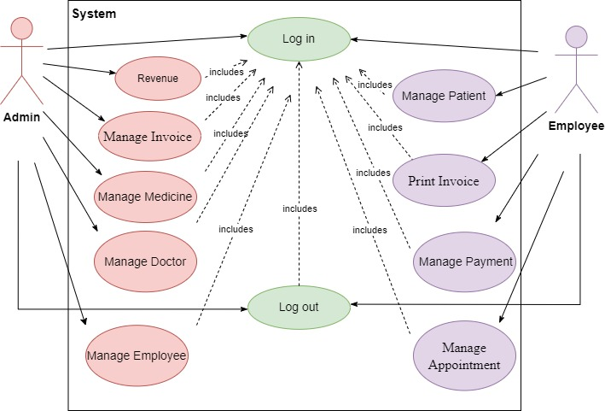
Introduce
Uscase
The Clinic Management System (CMS) is a comprehensive software solution designed to streamline the operations of medical clinics. It facilitates efficient patient management by digitizing patient records, appointment scheduling, billing, and inventory management. The system enhances patient care by enabling quick access to medical histories and lab results. Additionally, it supports administrative functions such as staff management and financial reporting. The CMS improves clinic workflow, reduces paperwork, and enhances overall service quality, ensuring a seamless experience for both patients and healthcare providers.

Slide 6
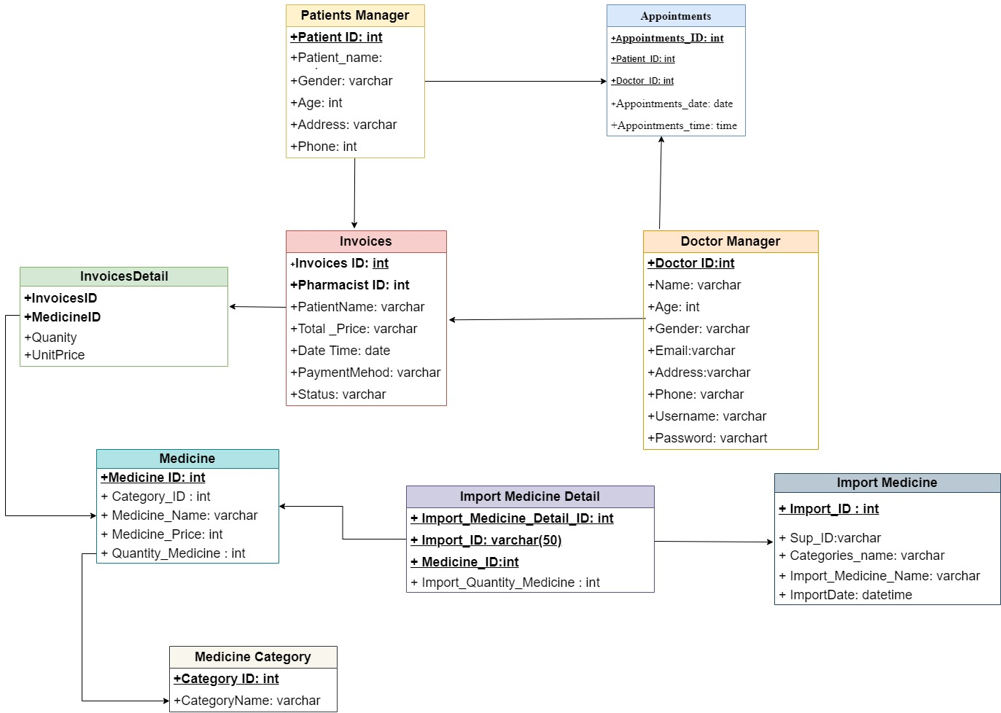
Uscase
Database

Slide 7
Database
Module & Activities
ADMIN
EMPLOYEE

Slide 8
EMPLOYEE
ADMIN
This module allow Admin to manage information consist of:
Manage Medicine
Manage Doctor
Manage Employee
Manage Invoice
Revenue
Module & Activities

Slide 9
ADMIN
1. Manage Medicine: This module allow Admin to manage information of medicine consist of add new medicine, update medicine and delete medicine
Purpose: This function allow Admin to add new,update and delete information of medicine.
Inputs:
ID of medicine
Name of medicine
Quantity medicine
Category medicine
Outputs: Display information of medicine is added,updated,deleted to table of database.
This module allow Admin to manage information consist of:
Manage Medicine
Manage Doctor
Mange Employee
Manage Invoice
Revenue

Slide 10
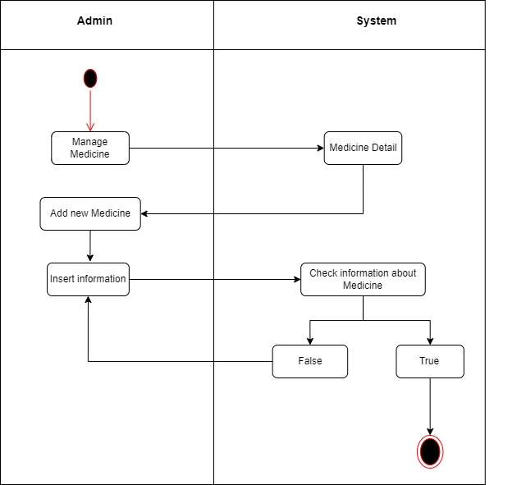
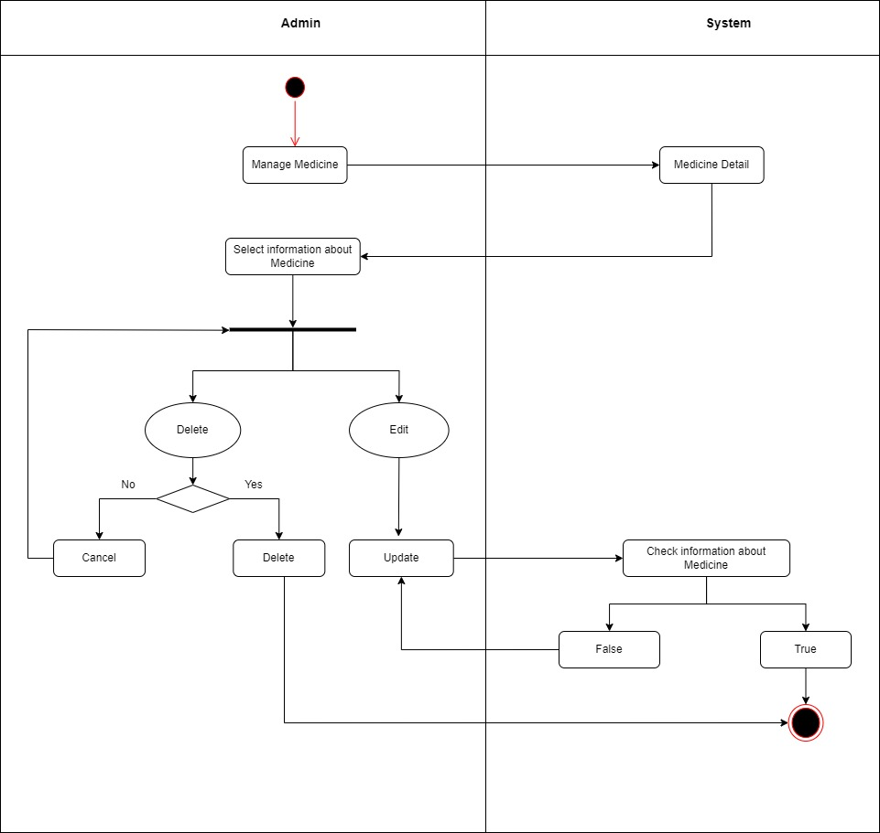
Activity Manage Medicine
1.1 Activity diagram add new medicine
1.2 Activity diagram manage medicine
1. Manage Medicine: This module allow Admin to manage information of medicine consist of add new medicine, update medicine and delete medicine
Purpose: This function allow Admin to add new,update and delete information of medicine.
Inputs:
ID of medicine
Name of medicine
Quantity medicine
Category medicine
Outputs: New information of medicine is added,updated,deleted to table of database.

Slide 11
Activity Manage Medicine
ADMIN
2. Manage Doctor: This module allow Admin to manage information of doctor consist of add new doctor, update doctor and delete doctor
Purpose: This function allow Admin to add new,update and delete information of doctor.
Inputs:
ID of medicine
Name of medicine
Quantity medicine
Category medicine
Outputs: Display information of doctor is added,updated,deleted to table of database.
1.2 Activity diagram manage medicine
1.1 Activity diagram add new medicine

Slide 12
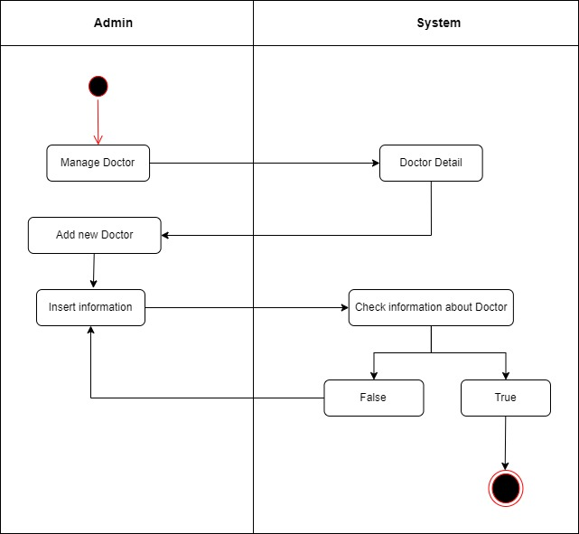
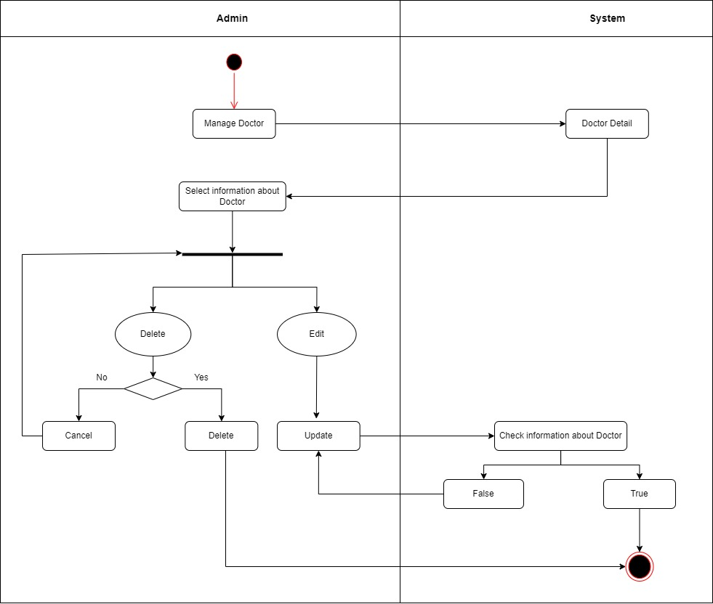
Activity Manage Doctor
2.1 Activity diagram add new doctor
2.2 Activity diagram manage doctor
2. Manage Doctor: This module allow Admin to manage information of doctor consist of add new doctor, update doctor and delete doctor
Purpose: This function allow Admin to add new,update and delete information of doctor.
Inputs:
ID of medicine
Name of medicine
Quantity medicine
Category medicine
Outputs: New information of medicine is added,updated,deleted to table of database.

Slide 13
Activity Manage Doctor
ADMIN
3. Manage Employee: This module allow Admin to manage information of employee consist of add new employee, update employee and delete employee.
Purpose: This function allow Admin to add new,update and delete information of employee.
Inputs:
Employee ID
EmployeeName
Phone
Age
Gender
Address
Email
Username
Password
Outputs: Display information of employee is added,updated,deleted to table of database.
2.1 Activity diagram add new doctor
2.2 Activity diagram manage doctor

Slide 14
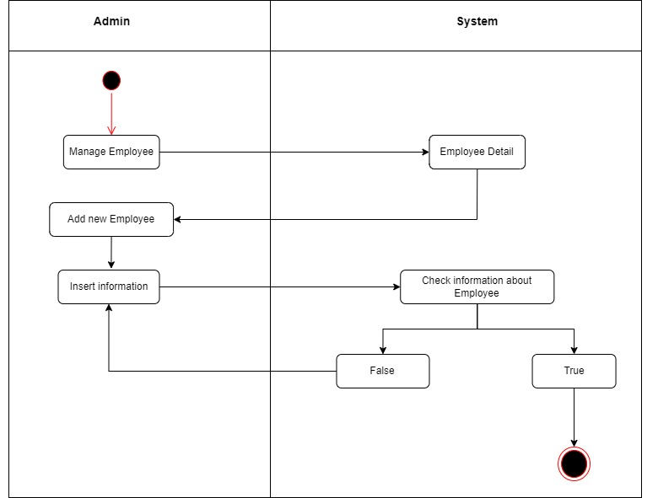
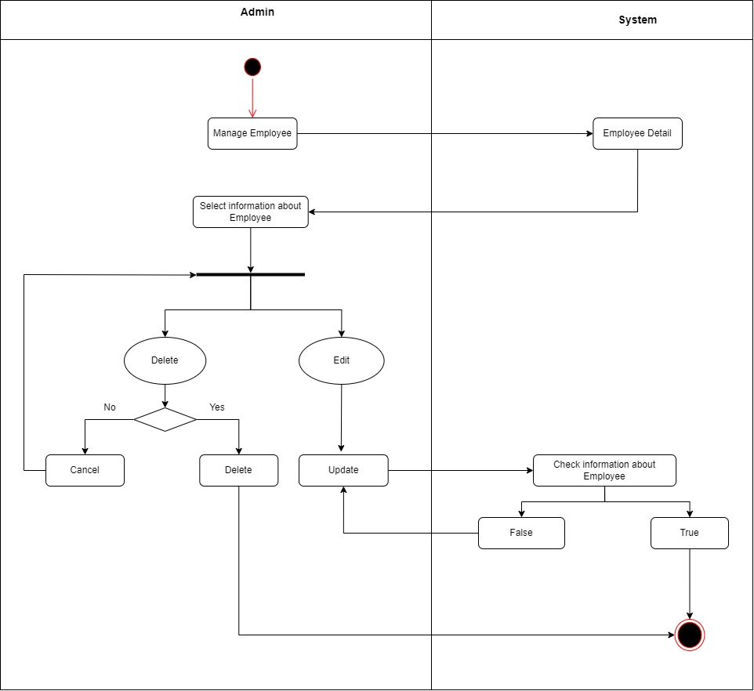
ADMIN
Activity Manage Employee
3.1 Activity diagram add new employee
3.2 Activity diagram manage employee
3. Manage Employee: This module allow Admin to manage information of employee consist of add new employee, update employee and delete employee.
Purpose: This function allow Admin to add new,update and delete information of employee.
Inputs:
Employee ID
EmployeeName
Phone
Age
Gender
Address
Email
Username
Password
Outputs: New information of employee is added,updated,deleted to table of database.

Slide 15
3.2 Activity diagram manage employee
Activity Manage Employee
ADMIN
3.1 Activity diagram add new employee
4. Manage Invoice: This module allow Admin to manage information of invoice consist of create medical invoice, update medical invoice and delete medical invoice.
Purpose: This function allow Admin to create new,update and delete information of invoice.
Inputs:
Date of medical examination
Quantity of medicin
Name of medicine
Price
Outputs: Display information of invoice is created,updated,deleted to table of database.

Slide 16
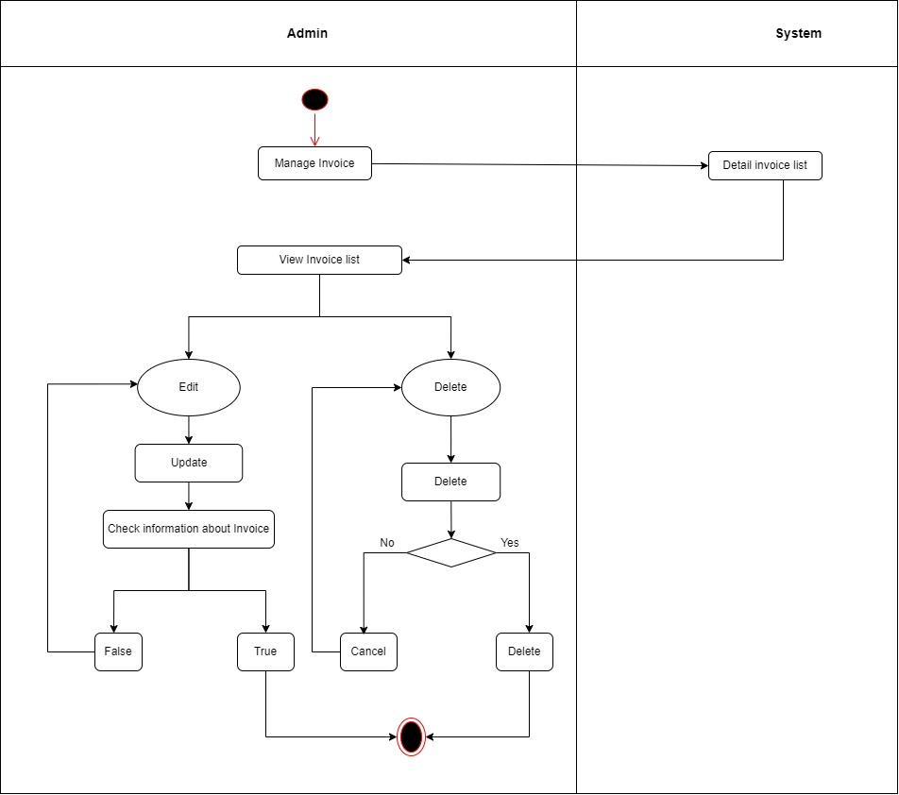
ADMIN
Activity Manage Invoice
4.1 Activity diagram manage invoice
4. Manage Invoice: This module allow Admin to manage information of invoice consist of create medical invoice, update medical invoice and delete medical invoice.
Purpose: This function allow Admin to create new,update and delete information of invoice.
Inputs:
Date of medical examination
Quantity of medicin
Name of medicine
Price
Outputs: Display information of invoice is created,updated,deleted to table of database.

Slide 17
Activity Manage Invoice
ADMIN
5. Manage Revenue:
Purpose: This module allows Admin to compile medication statistics and medical examination history .
Inputs:
Total invoice (week/month)
Quantity of medicine
Name of medicine
Type of medicine sold
Outputs: Display total invoice.
4.1 Activity diagram manage invoice

Slide 18
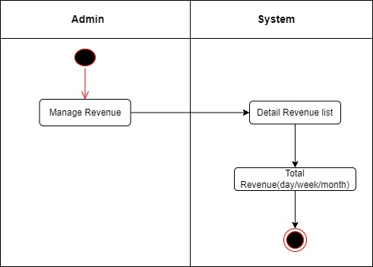
ADMIN
Activity Manage Invoice
5.1 Activity diagram manage revenue
5. Manage Revenue:
Purpose: This module allows Admin to compile medication statistics and medical examination history .
Inputs:
Total invoice (week/month)
Quantity of medicine
Name of medicine
Type of medicine sold
Outputs: Display total invoice.

Slide 19
Activity diagram manage revenue
Module & Activities
Activity Manage Invoice
ADMIN
EMPLOYEE

Slide 20
Module & Activities
EMPLOYEE
This module allow Employee to manage information consist of:
Manage Patient
Print Invoice
Manage Payment
Manage Appointment
ADMIN

Slide 21
EMPLOYEE
1. Manage Patient: This module allow Employee to manage information of medicine consist of add new patient, update patient and delete patient.
Purpose: This function allow Admin to add new,update and delete information of patient.
Inputs:
Patient ID
Patient Name
Phone
Age
Gender
Address
Outputs: Display information of patient is added,updated,delete to table of database.
This module allow Employee to manage information consist of:
Manage Patient
Priting Invoice
Manage Payment
Manage Appointment

Slide 22
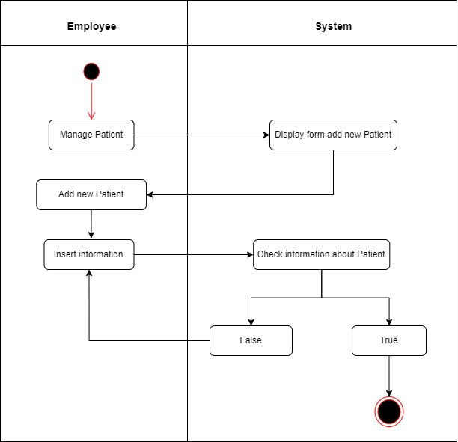
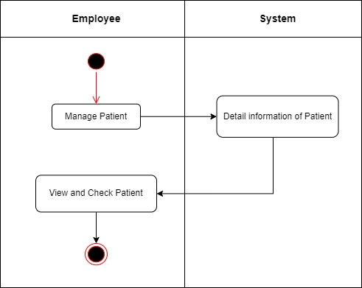
Activity Manage Patient
1.1 Activity diagram add new patient
1.2 Activity diagram manage patient
1. Manage Patient: This module allow Employee to manage information of medicine consist of add new patient, update patient and delete patient.
Purpose: This function allow Admin to add new,update and delete information of patient.
Inputs:
Patient ID
Patient Name
Phone
Age
Gender
Address
Outputs: Display information of patient is added,updated,delete to table of database.

Slide 23
Activity Manage Patient
EMPLOYEE
2. Print Invoice:
Purpose: Allow Employee to print medical prescription and invoice information.
Inputs:
Date of medical examination
Doctor Name
Patient Name
Name of medicine
Price
Payment Method
Status.
Outputs: Medical examination prescription and invoice are printed.
1.1 Activity diagram add new patient
1.2 Activity diagram manage patient

Slide 24
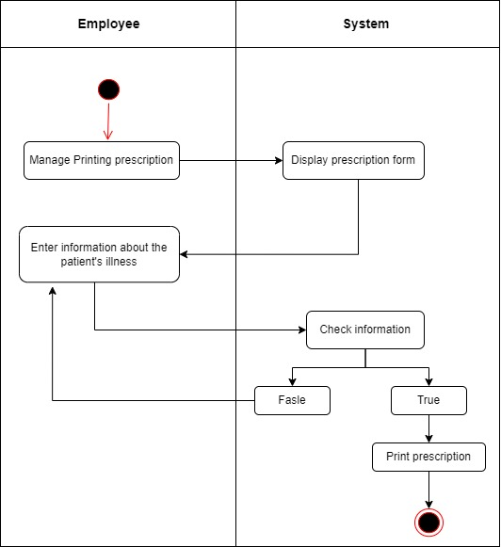
EMPLOYEE
Activity Manage Patient
2.1 Activity diagram print invoice
2. Print Invoice:
Purpose: Allow Employee to print medical prescription and invoice information.
Inputs:
Date of medical examination
Doctor Name
Patient Name
Name of medicine
Price
Payment Method
Status
Outputs: Medical examination prescription and invoice are printed.

Slide 25
Activity Manage Patient
EMPLOYEE
3. Manage Payment:
Purpose: Allow Employee to manage payment history and payment status.
Inputs:
Patient Name
Age
Gender
Address
Phone
Outputs: Display payment confirmation.
2.1 Activity diagram print invoice

Slide 26
Activity Manage Patient
EMPLOYEE
3. Manage Payment:
Purpose: Allow Employee to manage payment history and payment status.
Inputs:
Patient Name
Age
Gender
Address
Phone
Outputs: Display payment confirmation.
2.1 Activity diagram print invoice

Slide 27
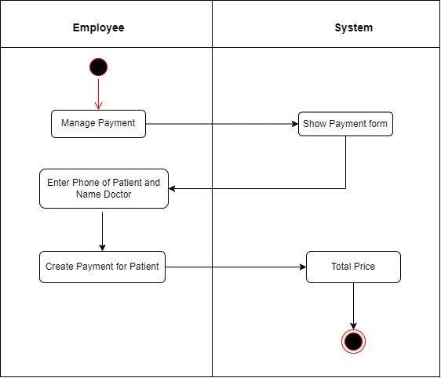
Activity Manage Payment
3.1 Activity diagram manage payment
3. Manage Payment:
Purpose: Allow Employee to manage payment history and payment status.
Inputs:
Patient Name
Age
Gender
Address
Phone
Outputs: Display payment confirmation.

Slide 28
Activity Manage Payment
EMPLOYEE
4. Manage Appointment:
Purpose: Allow Employee to manage patient appointment scheduling to save time.
Inputs:
Patient Name
Appointment Date and Time
Doctor Name
Phone
Outputs: Display confirmed appointments and updated appointment.
3.1 Activity diagram manage payment

Slide 29
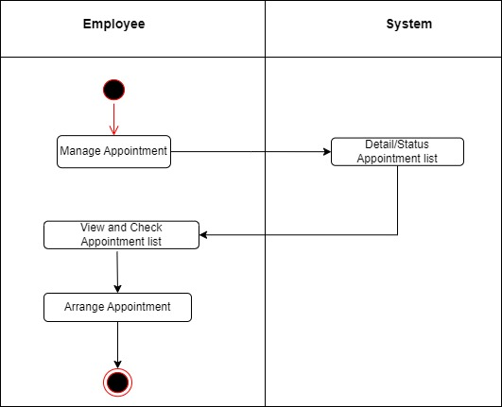
EMPLOYEE
Activity Manage Appointment
4.1 Activity diagram manage appointment
4. Manage Appointment:
Purpose: Allow Employee to manage patient appointment scheduling to save time.
Inputs:
Patient Name
Appointment Date and Time
Doctor Name
Phone
Outputs: Display confirmed appointments and updated appointment.

Slide 30
Thanks for watching !

