Slide 1
SHAH & ANCHOR KUTCHHI ENGINEERING COLLEGE
Department of Computer Engineering | Academic Year 2026-2027
PROJECT TEAM
DG
Dhruv Gala
23UF17719CM141
GroundQ
YP
Yash Pajwani
23UF16586CM037
SP
Shravan Padhar
23UF17927CM162
Syllabus-Grounded Controllable Question Generation
SS
Sahil Shah
23UF17713CM049
Using Retrieval-Augmented Generation (RAG) and Lightweight LLMs
PROJECT GUIDE
MAJOR / CAPSTONE PROJECT REVIEW - II · DESIGN & PROTOTYPE
Dr. Atul Haribhau Kachare
Professor

Slide 2






Where naive LLM assessment goes wrong
01 · THE PROBLEM
Syllabus Drift
Cognitive Collapse
Difficulty Instability
Parametric web memory invents unprescribed tools and algorithms.
Requesting Bloom L4-L6 collapses into low-level definitions.
Subjective text prompts yield erratic difficulty jumps.
Plausible Hallucination
Psychometric Flaws
Semantic Redundancy
Synthesizes incorrect facts with high linguistic confidence.
Obvious, overlapping, or grammatically leaking MCQ distractors.
Re-prompting outputs repetitive lexical paraphrases.

Slide 3






GroundQ's six golden invariants
02 · OUR ANSWER
Localhost Modular Monolith
Dual-Engine Synthesis
Full-Syllabus Stratified Stride
100% offline edge privacy; zero cloud dependencies.
Local Ollama (Qwen-2.5-7B/Mistral) + Cloud fallback option.
Page 1 to Page 200+ uniform chunk coverage.
Three-Gate Automated Validator
Anti-Predictability Option Shuffle
Immutable Provenance & Monotonic Order
Zero-tolerance grounding, cognitive & distractor gates.
Deterministic PRNG yields 25% balance (A/B/C/D).
Complete textbook byte-span audit trail.

Slide 4





A 4-tier pipeline, from syllabus to question bank
03 · SYSTEM DESIGN
1
2
3
4
Ingestion & Index
Curriculum Hierarchy
Generation Controller
Validation & Bank
Page-bounded byte chunking of PDF/DOCX syllabi.
Dense local embeddings via nomic-embed-text (768-dim).
PostgreSQL 16 + pgvector.
HNSW index (m=16, ef=64) with <50ms cosine lookup.
Automated module/unit discovery via lightweight LLM.
Interactive educator syllabus tree editor.
Foreign-key topic_chunks mapping.
Restricts generation to unit-specific chunks.
Multi-dimensional blueprint (Bloom, Difficulty, Type).
Stratified stride chunk sampling across document.
Local Ollama inference (Qwen-2.5-7B / Mistral-7B).
Cross-batch negative constraint deduplication.
Gate 1: Grounding entailment against source text.
Gate 2: Bloom cognitive verb & reasoning check.
Gate 3: Distractor psychometric bounds (0.35 - 0.80).
Monotonic sort order & auditable provenance cards.

Slide 5
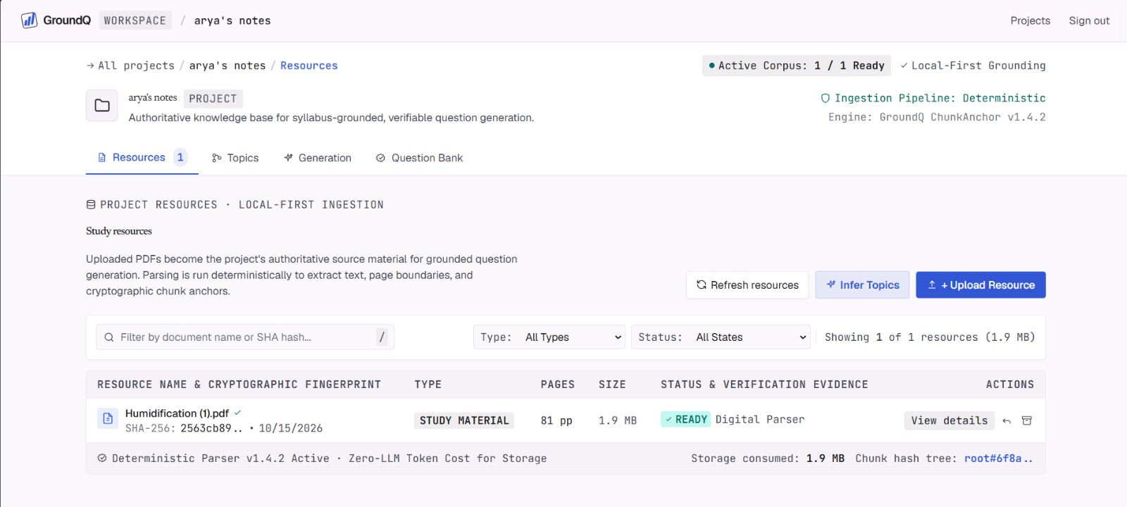
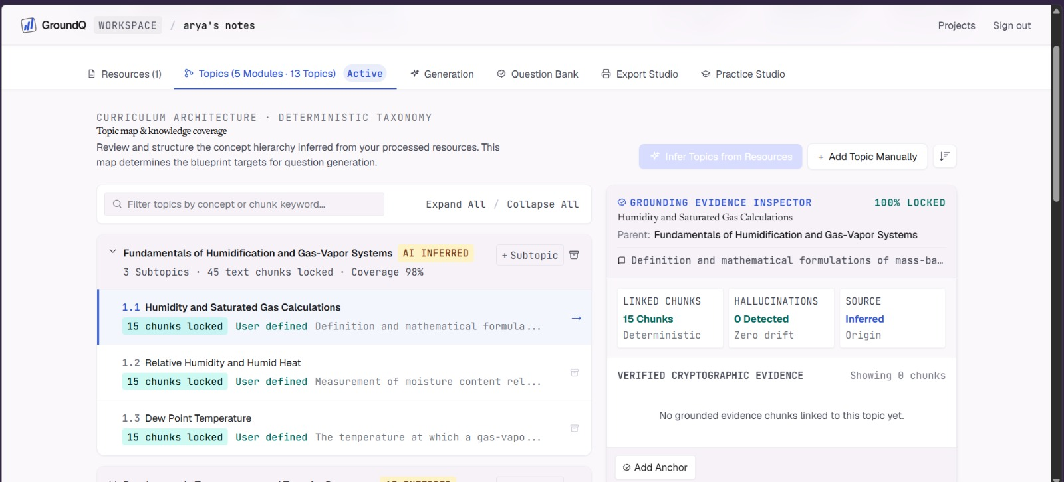
Course dashboard & curriculum extraction
04 · PROTOTYPE (1/3)
1
GroundQ Project Workspace Dashboard with course isolation, resource tracking, and assessment management.
2
Curriculum Hierarchy & Topic Extraction Interface with module trees, subtopic editors, and chunk mappings.

Slide 6
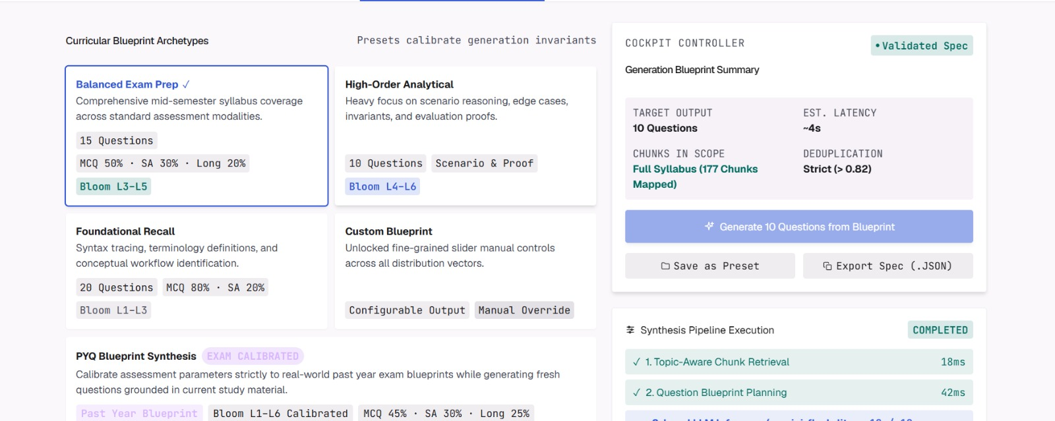
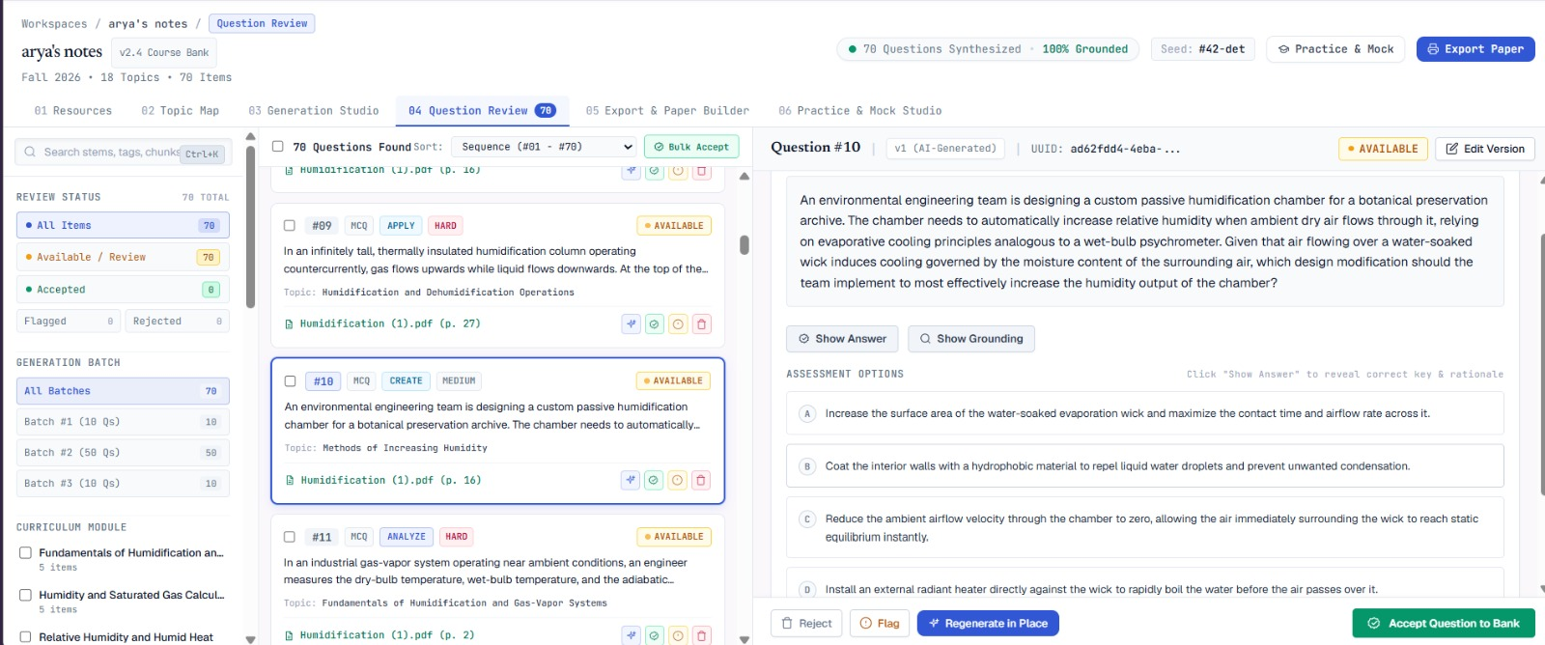
Controllable studio & provenance review
04 · PROTOTYPE (2/3)
3
Generation Blueprint Studio with multi-constraint controls (Bloom, Difficulty, Count) and dual-engine selection.
4
Question Review & Provenance Inspection Studio showing exact textbook byte-spans, verified Bloom & distractor ratings.

Slide 7
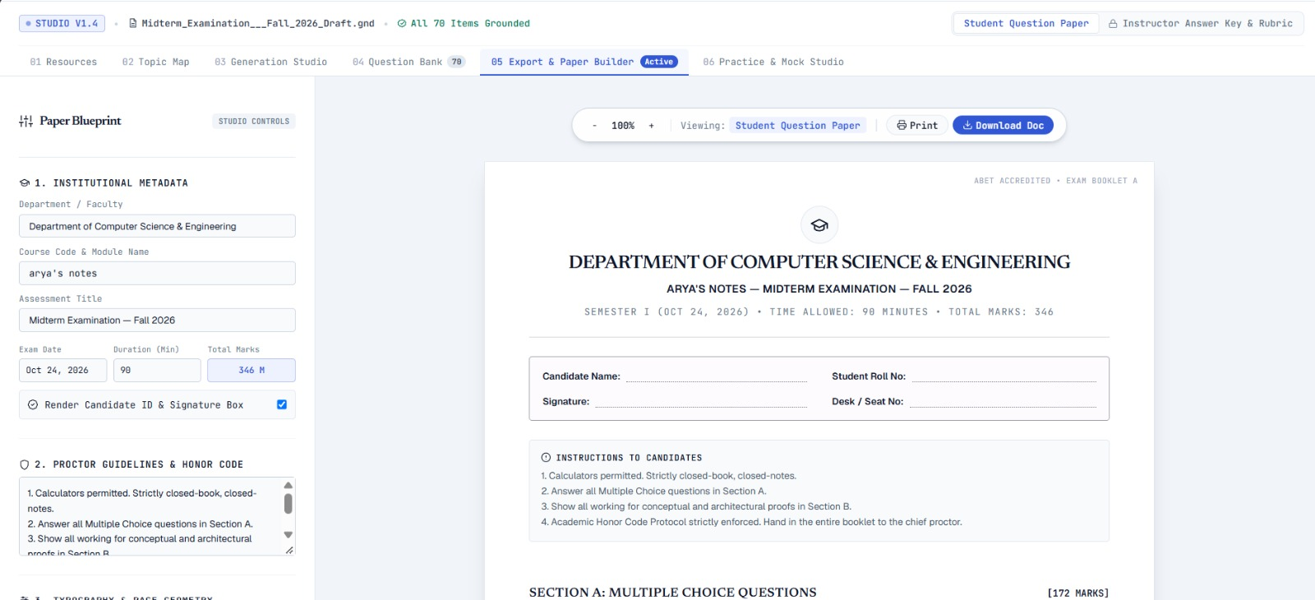
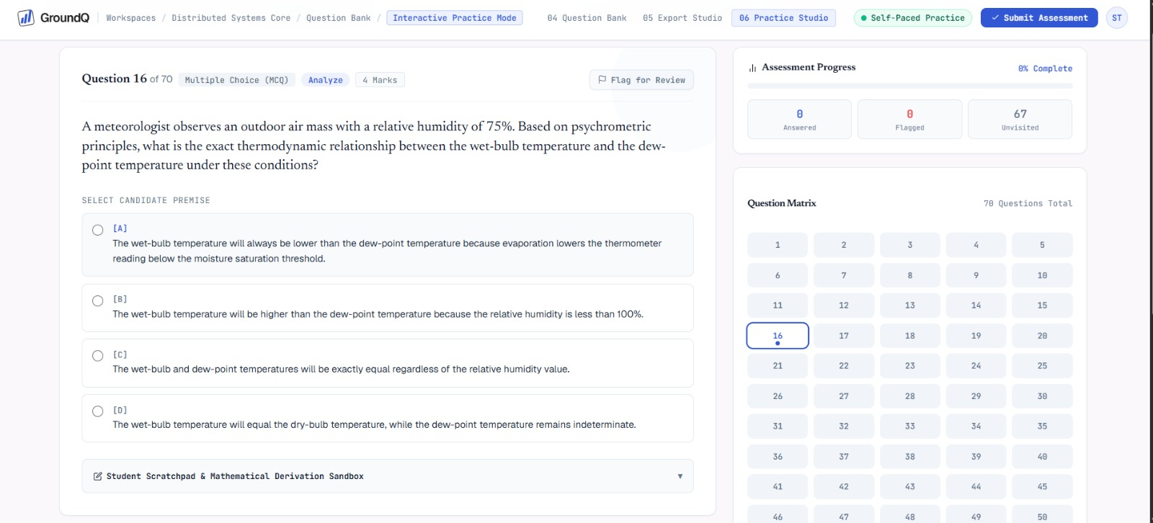
Export studio & student practice simulator
04 · PROTOTYPE (3/3)
5
Assessment Export Studio supporting clean exam PDF formatting, Word documents, JSON, and answer keys.
6
Interactive Student Assessment Simulator featuring quiz playback, instant feedback, and rationale walkthroughs.

Slide 8
5-stage ablation: every component earns its place
05 · EXPERIMENTAL EVALUATION
ID | Configuration | SAS (%) ↑ | BC (%) ↑ | HR (%) ↓ | DQ (1-5) ↑ | DR (%) ↓
A0 | Direct LLM Prompting (Baseline) | 61.5% | 48.0% | 22.5% | 2.6 | 31.0%
A1 | Direct LLM + Blueprint Constraints | 66.0% | 71.5% | 21.0% | 3.0 | 28.5%
A2 | RAG Retrieval + Blueprint (Syllabus Grounded) | 88.5% | 73.0% | 9.5% | 3.2 | 25.0%
A3 | RAG + Blueprint + Multi-Gate Validation | 94.5% | 86.5% | 3.5% | 4.0 | 18.0%
A4 | Full GroundQ Pipeline (+ Diversity Pruning) | 95.0% | 87.0% | 3.3% | 4.1 | 1.5%
21.0% → 9.5%
3.5%
18.0% → 1.5%
~19.4 s
Hallucination, A1 → A2
Hallucination, after A3
Duplicates, A3 → A4
Per validated item
RAG grounds facts: syllabus chunks lift alignment to 88.5%.
Three-gate validator lifts distractor quality to 4.0 / 5.0.
Pairwise cosine pruning removes duplicate waste.
Fully local on AMD Ryzen 5 CPU (16 GB RAM).

Slide 9


What each of us built and learned
06 · INDIVIDUAL CONTRIBUTIONS (1/2)
Dhruv Gala
Architecture & Core AI
Yash Pajwani
Vector RAG & Retrieval
23UF17719CM141
21UF16586CM037
TECHNICAL CONTRIBUTION
Modular monolith topology, QuestionGeneratorService, 3-gate validation pipeline, and stratified chunk allocation algorithm.
CHALLENGE SOLVED
Local LLMs exhibit subtle JSON schema quirks and distractor boolean anomalies; implemented regex sanitizers and defensive fallbacks.
KEY LEARNING
Defensive programming, deterministic validation gates, and prompt condition matrices govern generative AI reliability far more decisively than model scale alone.
CONCEPTS APPLIED
Monolithic modularity, strict project isolation boundaries, and textbook byte-span provenance mapping.
TECHNICAL CONTRIBUTION
Document ingestion pipeline (pdfjs-dist/mammoth), nomic-embed-text local integration, and pgvector HNSW indexing (m=16, ef=64).
CHALLENGE SOLVED
Fixed-character chunking destroys algorithmic code blocks and mathematical proofs; resolved via page-bounded byte chunking.
KEY LEARNING
Balancing HNSW construction memory overhead versus sub-50ms vector query recall speed under local workstation RAM limits.
CONCEPTS APPLIED
Vector space embeddings, approximate nearest neighbor (ANN) graph indexing, and cosine similarity distance metrics.

Slide 10


What each of us built and learned, continued
06 · INDIVIDUAL CONTRIBUTIONS (2/2)
Shravan Padhar
Full-Stack Frontend & UI
Sahil Shah
Validation & Psychometrics
23UF17927CM162
23UF17713CM049
TECHNICAL CONTRIBUTION
React 18 SPA with Vite & Tailwind CSS; Blueprint Studio, split-pane Question Review Studio, and multi-format exam export.
CHALLENGE SOLVED
Non-blocking asynchronous AI streaming without stalling browser reactivity; solved via optimistic state and polling.
KEY LEARNING
Translating complex AI parameters (Bloom levels, difficulty distributions) into intuitive, accessible pedagogical controls (WCAG AA).
CONCEPTS APPLIED
Reactive single-page architecture, component modularity, client-side caching, and responsive split-pane layouts.
TECHNICAL CONTRIBUTION
Empirical ablation study framework (A0-A4), semantic diversity pruning module, Vitest test suite, and threshold sweep.
CHALLENGE SOLVED
Distractor quality requires bounded cosine windows (0.35 <= sim <= 0.80) to eliminate trivial and synonymous distractors.
KEY LEARNING
Measuring psychometric distractor quality and conducting double-blind inter-annotator evaluation using Cohen's Kappa (κ = 0.84).
CONCEPTS APPLIED
Statistical evaluation, pairwise cosine distance matrices, and automated unit/integration test harnesses.

Slide 11



SDG mapping, societal benefit & sustainability
07 · IMPACT
SDG 4
SDG 9
PLANET
Quality Education
Innovation & Privacy
Environmental Sustainability
Democratizes assessment authoring: zero cloud subscription costs ($0.03-$0.10 per call saved).
Encourages higher-order learning: balances Bloom levels L1-L6, curbing rote exams.
Guarantees fair testing: restricts evaluation to authorized syllabus content.
Edge AI deployment: runs quantized 4-bit models locally on institutional workstations.
Data governance: exam papers and unpublished questions never leave the campus.
Resilient infrastructure: operates completely offline during network outages.
Ultra-low power: local CPUs draw <45W vs 700W cloud GPU cards.
Stratified chunk optimization reduces redundant LLM invocations by over 60%.
Drastically smaller carbon footprint than centralized commercial LLM data centers.

Slide 12

Milestones: two reviews done, two to go
08 · PROJECT MANAGEMENT
3
4
AUG-SEPT 2026
OCT-NOV 2026
JAN-FEB 2027
MAR-APR 2027
Review I
Review II
Review III
Review IV
Problem definition, literature review & architecture design.
Functional prototype, vector RAG, 3-gate validation, ablation study.
Stress testing on diverse curricula (Maths, Electronics), latency optimization.
Faculty user study, institutional pilot deployment, final defense.
COMPLETED
PROTOTYPE COMPLETED
UPCOMING
UPCOMING

Slide 13
Programme outcomes this review demonstrates
09 · REVIEW II · PO CORRELATION (NBA)
PO1
PO2
PO3
Engineering Knowledge
Problem Analysis
Solution Design
Vector transformations & cosine distance matrices.
Deconstructed LLM hallucination and cognitive collapse.
4-tier modular monolith & 3-gate validation pipeline.
LEVEL 2
LEVEL 1
LEVEL 3 - STRONG
PO4
PO5
PO6/7
Investigation
Modern Tools
Society & Environment
5-stage ablation study isolating component contributions.
Mastered Ollama, pgvector, React, TypeScript, Vitest.
Open assessment democratization & low-carbon edge AI.
LEVEL 1
LEVEL 2
LEVEL 3

Slide 14

SUMMARY OF STAGE II DELIVERABLES
Deployed full-stack functional prototype running locally on commodity PC.
Thank
you!
Provenance-grounded RAG ingestion + multi-dimensional blueprint controls.
Automated 3-gate validation (95.0% syllabus alignment, 3.3% hallucination rate).
Pairwise embedding diversity filtering (duplicate rate reduced from 31% to 1.5%).
Comprehensive documentation, IEEE paper, and verifiable engineering evidence.
Questions & technical discussion
GroundQ · Syllabus-Grounded Controllable Question Generation
Dhruv · Yash · Shravan · Sahil

