Slide 1
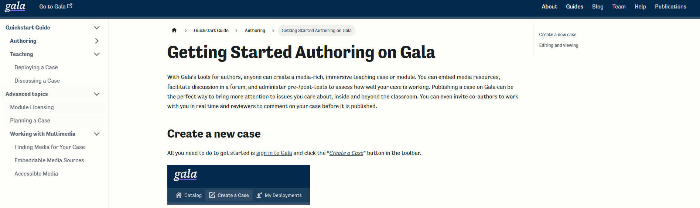
How to write a case study? Case Planning Workshop
https://docs.learngala.com/docs/

Slide 2
What is a case study? (discuss with your neighbor)
Case studies, at their most basic level, are stories. Each story is an account of a real problem, issue, or decision faced by a person or organization.
That problem, issue, or decision requires some form of analysis (S. Yaffee, pers. comm.).
Case studies are typically anchored in a specific time and place.
Case studies connect teaching and practice, often bringing the “real world” to students who otherwise may not have access to similar situations and stakeholders.

Slide 3
Today’s Plan
Planning Your Case
Write a “takeaway” statement
Write Learning Objectives
Researching for a case
Building Your Case
Problem Arc
Pedagogy – Active Learning Activities
Presentation
Authoring on Gala
Creating a case and collaborating
Case components – kicker & question, cover image, summary, location, pages, cards
Media – edgenotes and finding Media
Case Topics and Forming Case Groups
Q & A

Slide 4
Planning your Case
Write a “takeaway” statement
What should the reader take away from your case study?
“Understand the impacts of a new technology. How to best design a technology to minimize negative impacts in the future--thinking through social consequences, economic and environmental impacts.”
“Protected area decision making is highly complex. Choosing best practices for protected area enforcement does not have a clear cut, straightforward answer but requires balancing often opposing beliefs and expectations from key groups.”
“[I want to] share a framework for how a post-industrial city could revitalize communities and create jobs through urban wood, which has been seen as a waste stream but is now being turned into something useful and beautiful.”

Slide 5
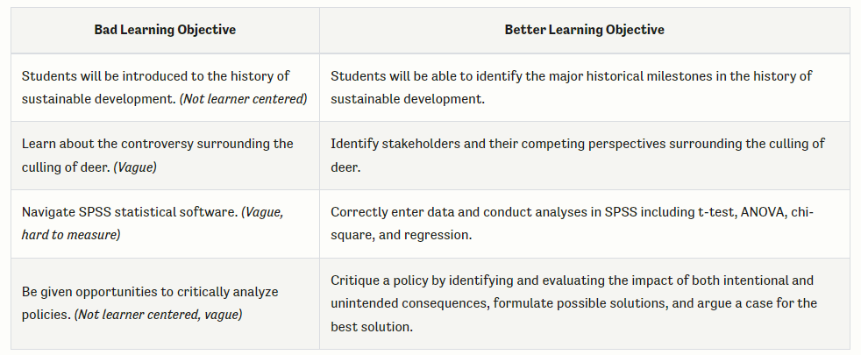
Planning your Case
Write Learning Objectives
what someone should know or be able to do at the end of a course or a lesson
generally, learner centered, measurable, and specific
use action verbs and articulate components of larger processes

Slide 6
Planning your Case
Write Learning Objectives
Recognize the costs to Great Lakes fisheries associated with Sea Lamprey invasions
Compare Sea Lamprey control methods and identify their benefits and drawbacks
Analyze trends in Sea Lamprey status within and across lakes
Evaluate the success and sustainability of Sea Lamprey control

Slide 7
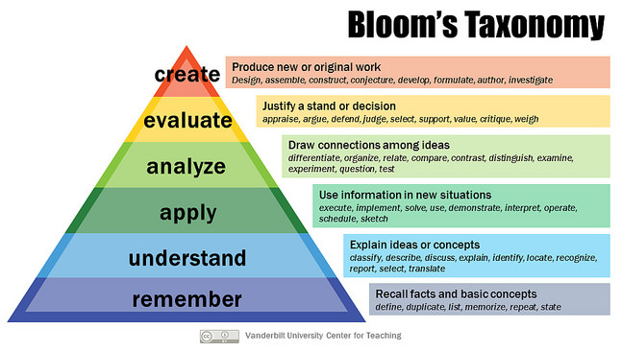
Notes:
Create– Mastery of a topic– the reason you are developing cases.

Slide 8
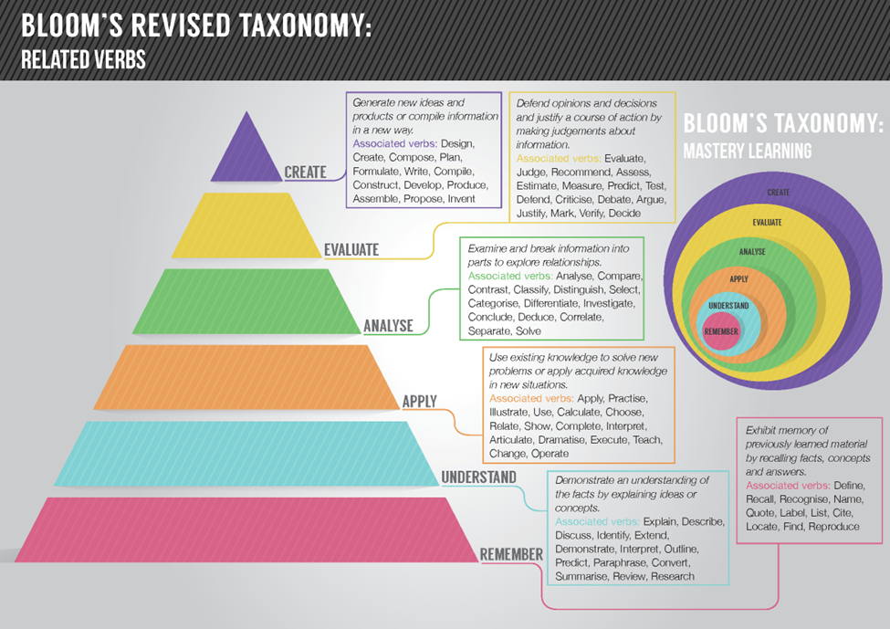

Slide 9
Planning your Case
Researching for a case - what information do you need to find? Who should you talk to?
Because cases are anchored in a specific time and place, provide real-world context in a way that is both factually accurate and interesting. It may be important to:
Provide historical context for a scenario.
Represent a range of perspectives on an issue.
Take extra initiative to understand marginalized perspectives or challenge a dominant narrative.
Convincingly represent real-life actors.
Create an engaged-learning exercise that mimics the way that problems are solved by practitioners in the field.

Slide 10
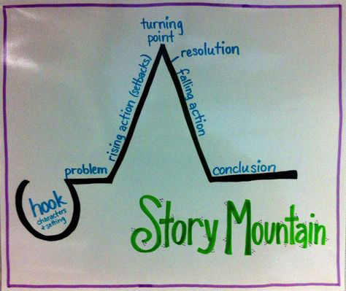
Building your case
Some tools:
Problem Arc Structure
Signposting (set up a decision)
Tense (past, third person)
Protagonist – central figure
Fictionalization
Dialogue

Slide 11
Case Study Outline (Due 9am Oct 18)
OR SOONER!
[Page 1] Overview
Brief Description
Learning objectives
[Page 2 (or Pages 2-3 if necessary)] Intro/Background:
Set the scene
Introduce protagonist/decision maker
Introduce decision or question
Provide information necessary to understand the case (technical, historical, etc.)
[Pages 2 to 9] Body:
Lay out parameters of the problem
How did we get here (to this problem)?
Introduce stakeholders, perspectives, complicating factors
Analyze possible solutions
[Last Page] Conclusion:
Return to the problem
Reflect on information in case study
Pose decision or question again
Notes:
1. Sections for 8-10 pages (numbered) which you will develop in your case. Briefly described content for each page. (2 points)
2. Each team member should be identified as a leader for 2 or more pages. Each page should be assigned 2 or more team members as leading their development. (.25 points)
3. Each page (with the exception of the 'overview') should have descriptions (and links if appropriate) of 2 or more relevant 'edgenotes' that will be included. (.25 points)
4. A minimum of 3 engaged learning activities (briefly described). For each team member, at least one of the pages they are leading should have an engaged learning activity. (.25 points)
5. At the end of your document include an attribution statement of what each team member has contributed to this outline. (.25 points)

Slide 12
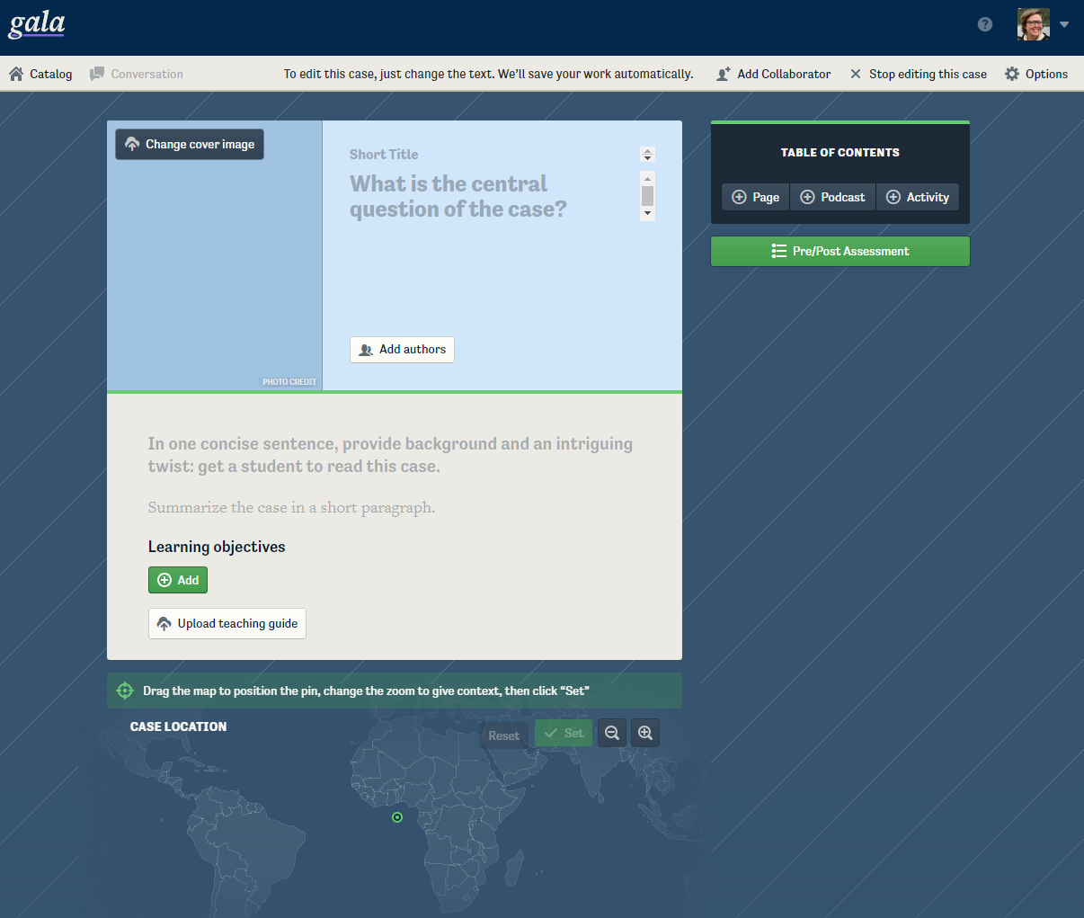

Slide 13
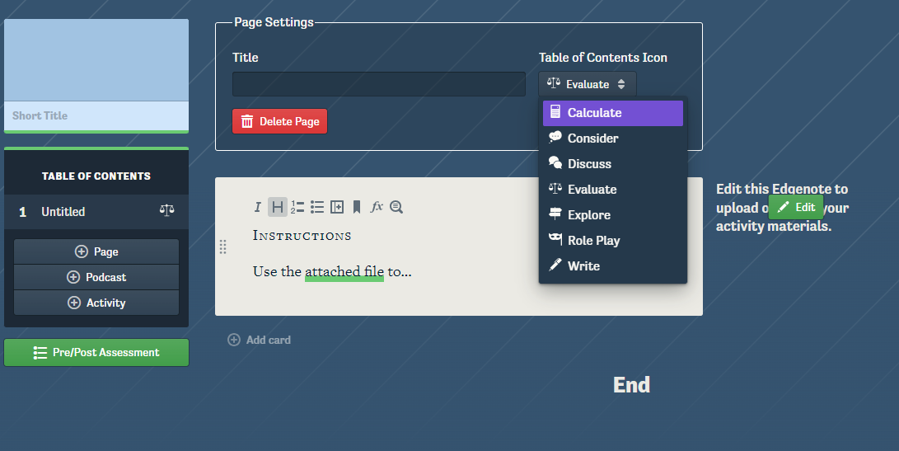
Building your case
Pedagogy – Active Learning Activities (Minimum 3, Handout)
Notes:
minimum of 3 engaged learning activities (briefly described). For each team member, at least one of the pages they are leading should have an engaged learning activity. (.25 points)

Slide 14
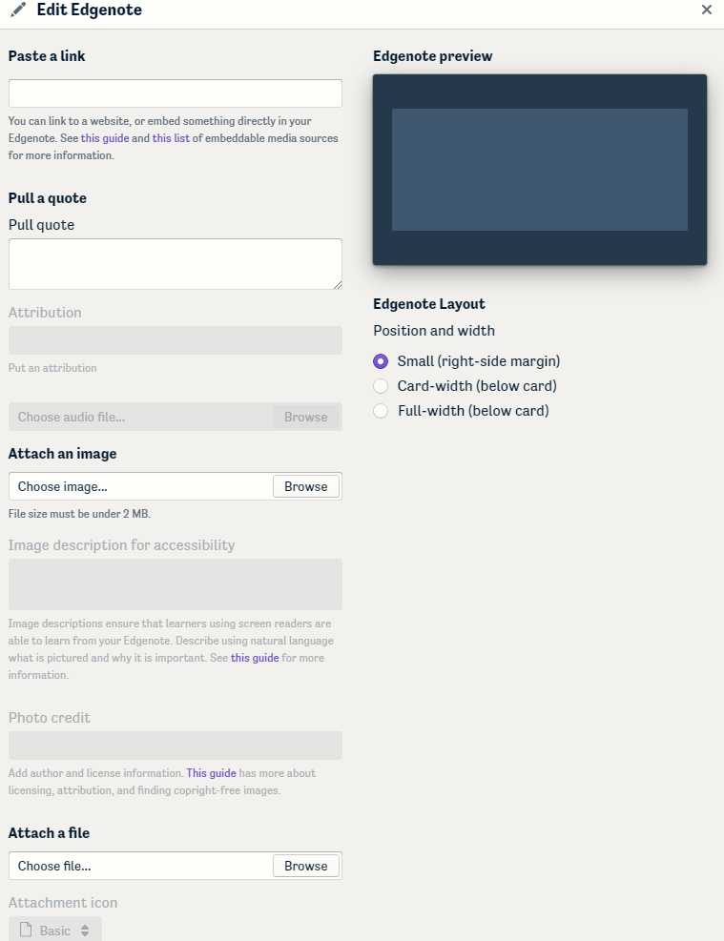
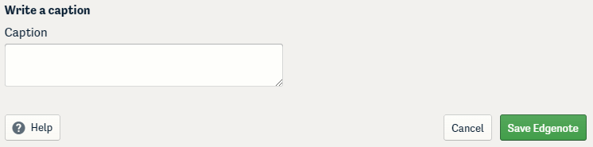
Building your case
Presentation – Edgenotes
2 or more per page
(exception is the overview)
Notes:
Each page (with the exception of the 'overview') should have descriptions (and links if appropriate) of 2 or more relevant 'edgenotes' that will be included

Slide 15
Navigating Copyright, In general:
Linking to sources (such as a website or YouTube video, as opposed to reproducing within your case study) is okay.
When embedding images, look for materials in the public domain or with a Creative Commons license. Good sources of images include:
Google image search, using the Tools menu to select Usage Rights “labeled for noncommercial reuse” (though be aware that this tool is not foolproof)
Wikimedia Commons
Creative Commons on Flickr
Government sources, which are in the public domain by default (but be aware that some government publications reproduce copyrighted materials with permission.)
Reproducing figures from academic journals usually requires permission, however, you can recreate your own figures from data–which are not subject to copyright–and using figures from an open-access journal is usually okay.

Slide 16
Presenting Content Clearly
Break it into smaller chunks- “cards”
Don’t overwhelm your reader with edgenotes
Tell readers how to interact with edgenotes in captions
E.g., Find out more about…Read up to page #...

Slide 17
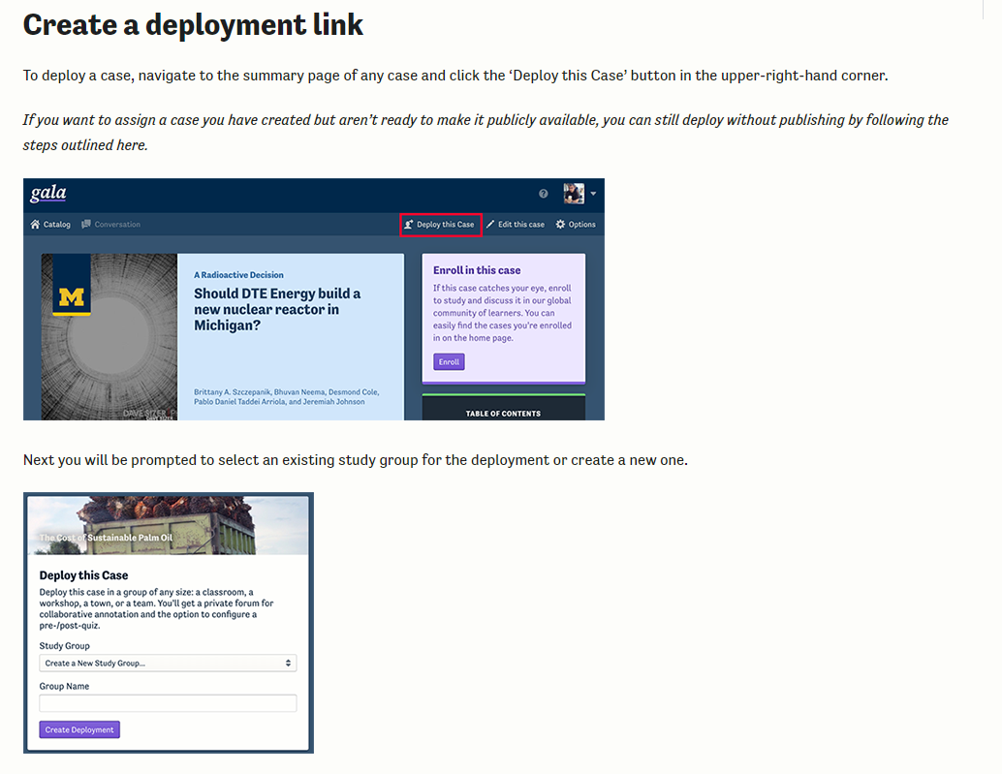
Draft case study – Due Nov 1, 11:59PM

Slide 18
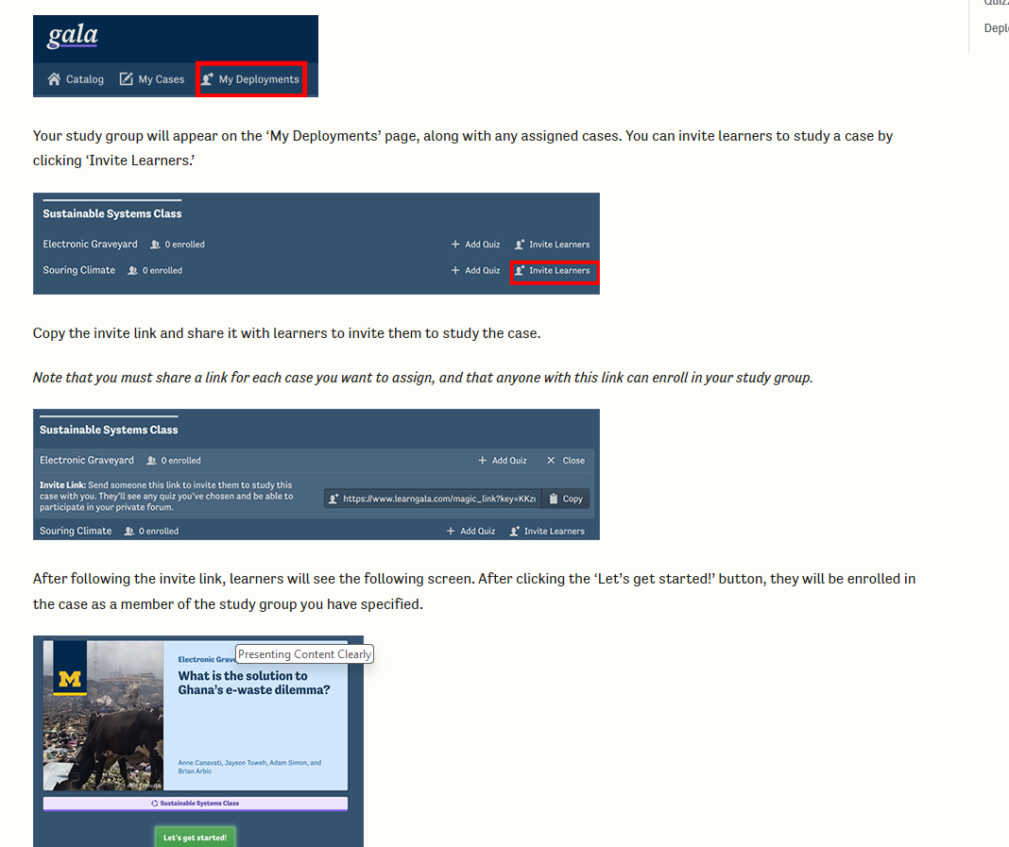

Slide 19
Today’s Plan
Planning Your Case
Write a “takeaway” statement
Write Learning Objectives
Researching for a case
Building Your Case
Problem Arc
Pedagogy – Active Learning Activities
Presentation
Authoring on Gala
Creating a case and collaborating
Case components – kicker & question, cover image, summary, location, pages, cards
Media – edgenotes and finding Media
Case Topics and Forming Case Groups (but first some business)

Slide 20
Microplastic Pollution
Underwater Preserves
Microplastic Pollution
Road Salt Pollution
Mussels/
NANPCA
Line 5 Pipeline
Microplastic Pollution
Mussels
Line 5 Pipeline
Line 5 Pipeline
PFAS
HABs
PFAS
Invasive Carp
Shipping
Pumped Hydro Storage Utility
Wetland Invasive Plant Management
Riparian Restoration
Buffalo Reef/Stamp sands
Beach Erosion
Redlining, Pollution, Revitalization
Coastal Wetland Restoration
Great Lakes Marshes
Coregonine Restoration
Notes:
Cal- Underwater preserves - knows about Line 5 case, HABs (like lake E case), Redlining (like Rouge Case), Wetlands (like All-too-common-reed?), Teresa Mussels, HABs (Meg R), Claire, Megan E no submission
I am interested in studying the invasive Quagga mussel in Lake Michigan. Introduced through ballast water in the 1980s, Quagga mussels have spread rapidly throughout the Great Lakes, colonizing much of the lakebed in Lake Michigan. Unlike their relative, the zebra mussel, Quagga mussels can thrive at greater depths and are more tolerant of colder waters, making them especially pervasive. In this case study, I will examine the ecological impacts caused by Quagga mussels, including their threats to keystone species like lake whitefish, their potential to trigger harmful algal blooms, and their role in the spread of disease. Additionally, I will compare existing control methods and explore more effective management strategies for mitigating their impact.
Reference:
Lake Whitefish (Coregonus clupeaformis) | U.S. Fish & Wildlife Service (fws.gov)
Links to an external site.
Quagga & Zebra Mussels | Center for Invasive Species Research (ucr.edu)
Links to an external site.

