Slide 1
Blazor Webassembly

Slide 2






Slide 3
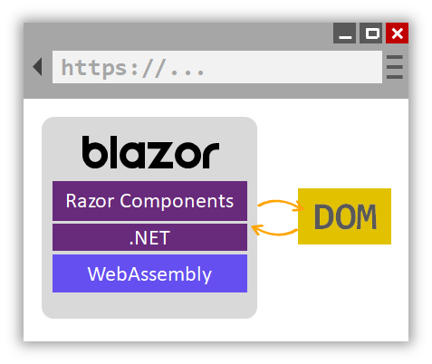

Slide 4
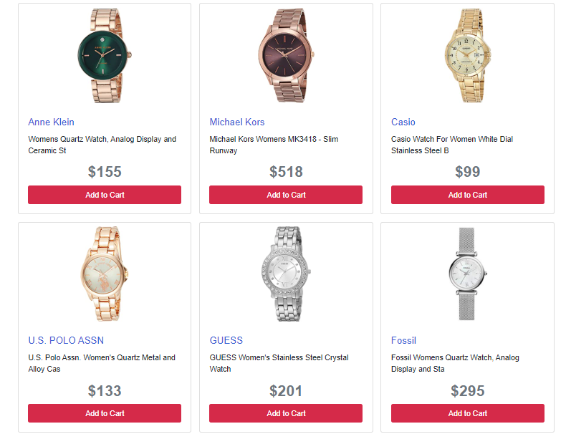

Slide 5
Hosting Models
Blazor Server
Blazor WebAssembly

Slide 6




Slide 7
Ways to build “Web App”

Slide 8



Round-Trip
https://...
JS
AJAX
.NET

Slide 9




Single-Page-Application (SPA)
https://...
.NET
JS

Slide 10
Blazor History

Slide 11
2018
Experimental Project
April 2019
Preview
September 2019
Release (Blazor Server)
May 2020
Release (Blazor Webassembly)

Slide 12
What is Blazor

Slide 13
A SPA Framework ,can . . .
Build SPA with .NET instead of JavaScript
Write components with C# and Razor
Share .NET code with both the client and the server
Interact with Javascript

Slide 14
How it works

Slide 15
Hosting Models
Blazor Server
Blazor WebAssembly

Slide 16

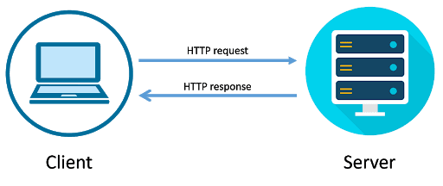
Request/Response vs Real-Time
https://youtu.be/Bsicy2KIrU8
SignalR

Slide 17
Blazor Server
Executed on the server
UI updates, event handling, and JavaScript calls are handled over a SignalR connection
https...
SignalR
DOM
Razor Components
.NET

Slide 18
Blazor Webassembly
Running client-side in the browser on WebAssembly
Dependencies, and the .NET runtime are downloaded
Executed directly on the browser UI thread
https://...
DOM
Razor Components
.NET
WebAssembly (WASM)

Slide 19
Comparison
Blazor WebAssembly
Blazor Server
Pro:
True SPA, full interactivity
Utilize client resources
Supports offline, static sites, PWA scenarios
Con:
Larger download size
Requires WebAssembly
Pro:
Smaller download size, faster load time
Running on fully featured .NET runtime
Code never leaves the server
Simplified architecture
Con:
Latency
No offline support
Consumes more server resources

Slide 20
Getting Started

Slide 21




Requirements
.NET Core SDK (3.1.300 or later)
Visual Studio
2019 16.6
Visual Studio for Mac
8.6
Visual Studio Code
+ C# extension

Slide 22
Demo: Blazor WebAssembly

Slide 23
Demo: Blazor Server

Slide 24
Getting Started

Slide 25
Dependency injection
DI

Slide 26
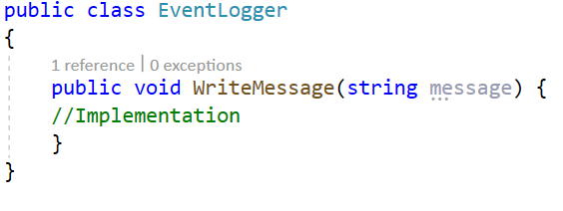
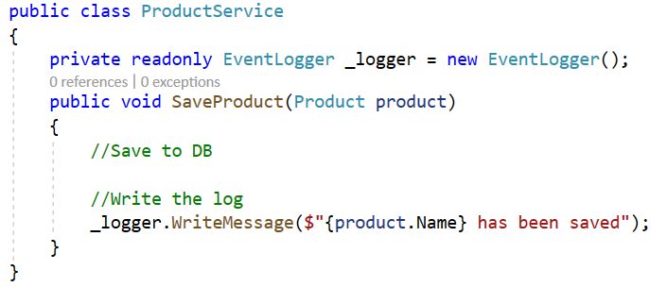
Event Logger Example

Slide 27
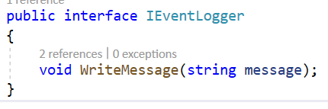
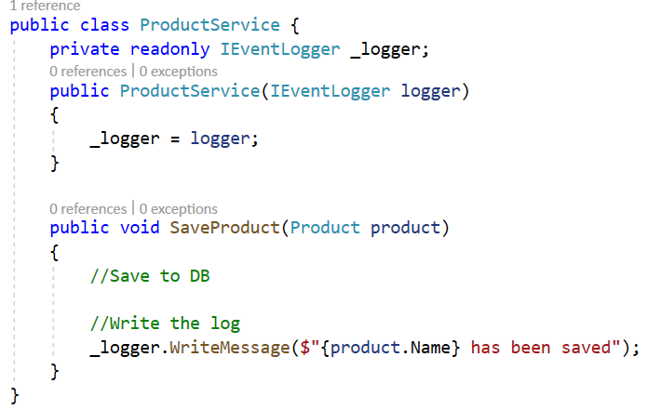
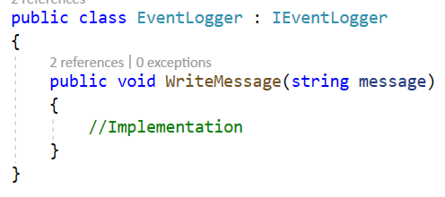
Using Dependency Injection

Slide 28
DI Container
Register
Resolve
Dispose

Slide 29
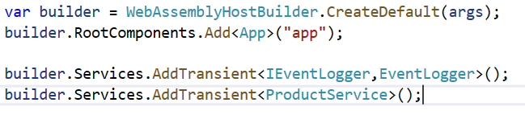
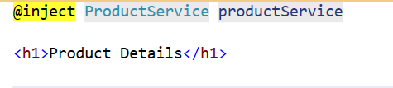
DI Container

Slide 30
Lifetime
AddTransient
Created each time requested
AddScoped
Created once per client request (connection)
AddSingletone
Created the first time they're requested

Slide 31
Razor Syntax

Slide 32
What is Razor
C#
Html
Razor is a markup syntax for embedding C# code into webpages
Extension
.cshtml in Mvc, Pages
.razor in Blazor (component)
Code is Generated to C# classes

Slide 33
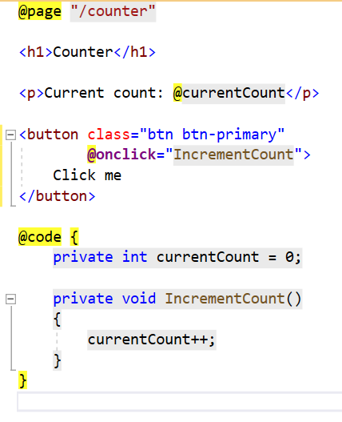
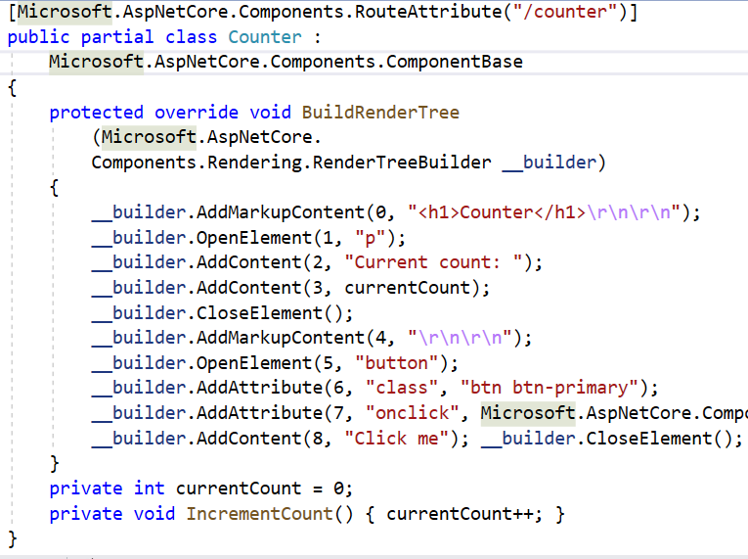
Razor Component

Slide 34
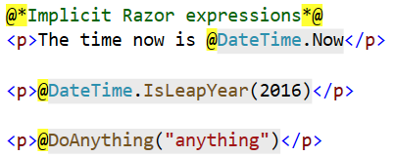
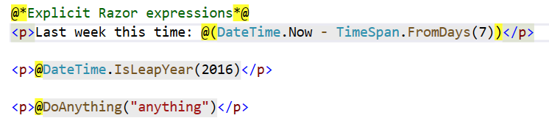
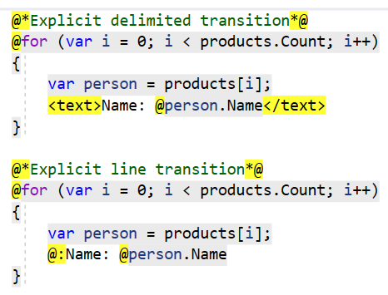
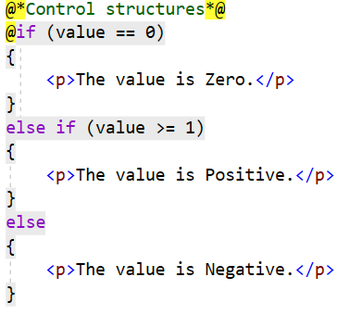
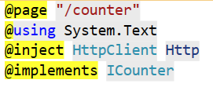

Slide 35
Project Structure

Slide 36
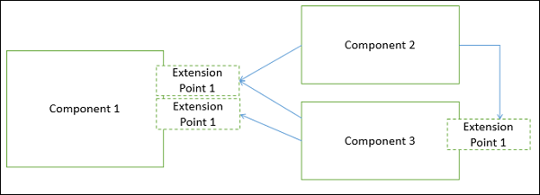
Component Based Architecture
Modular
Portable
Replaceable
Reusable
encapsulates its implementation
Exporting it as a higher-level interface.

Slide 37

Benefits
Ease of development
Reusable
Reliability
System maintenance and evolution
Independent

Slide 38
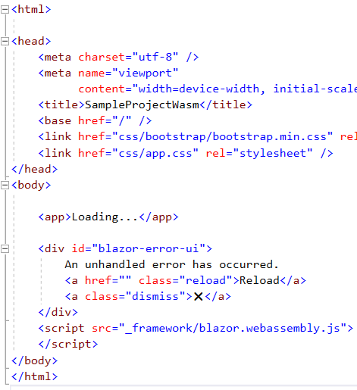
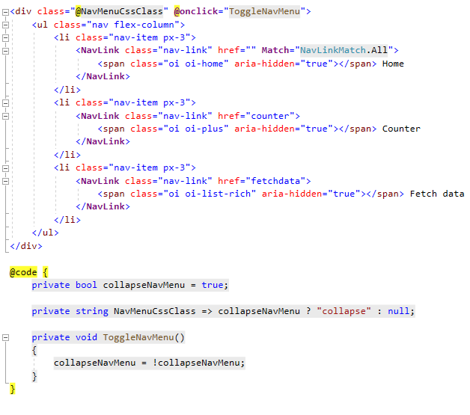
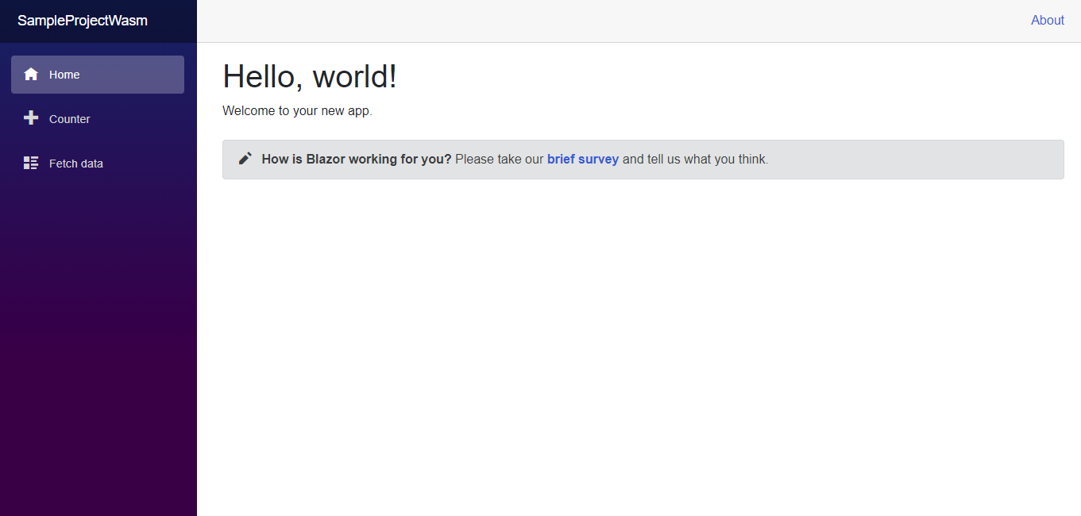
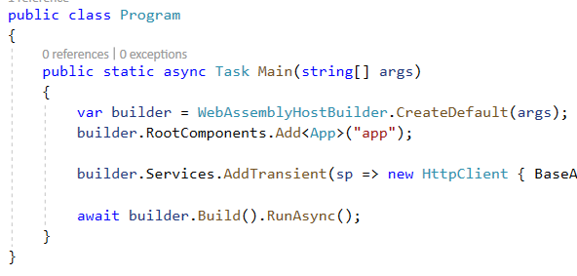
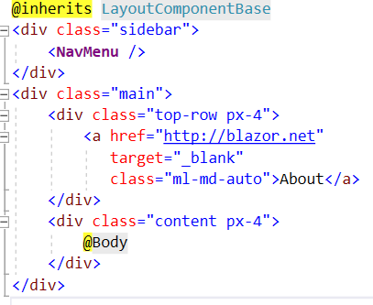
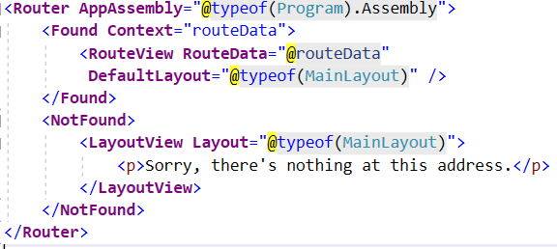
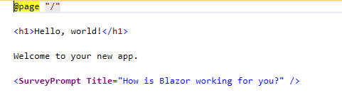
Index.html
App.razor
MainLayout.razor
NavMenu.razor
Index.razor
SurveyPrompt.razor

Slide 39
Component Model
Recap

Slide 40
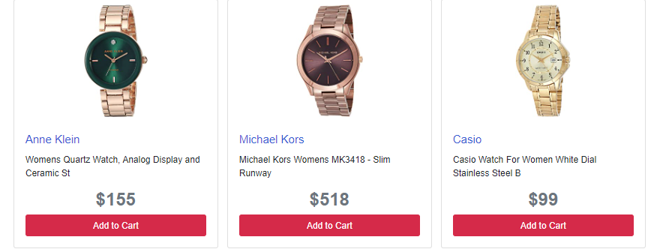
Create Component

Slide 41


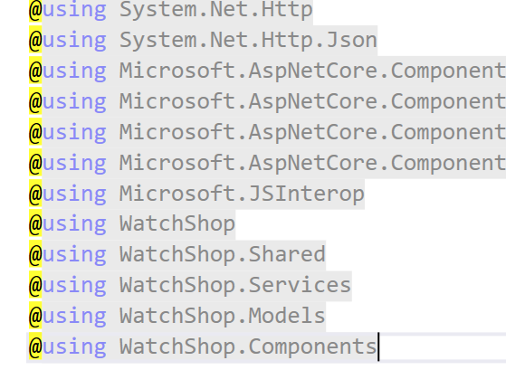
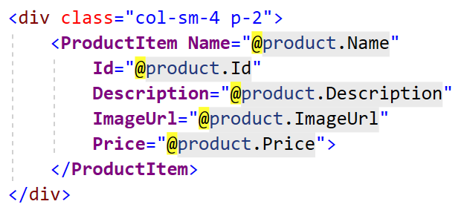
Import Component

Slide 42
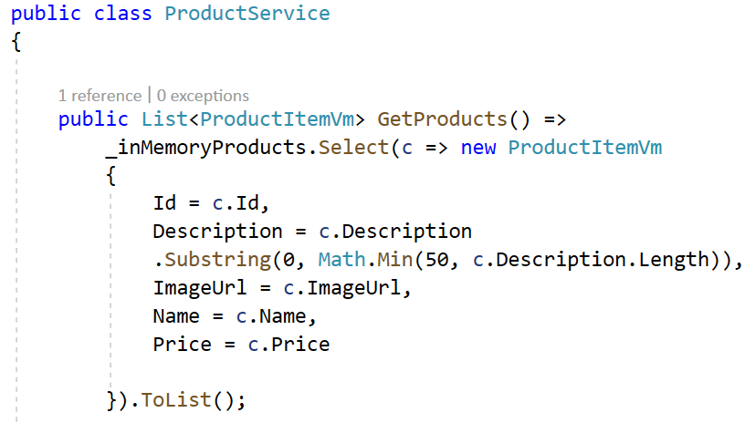


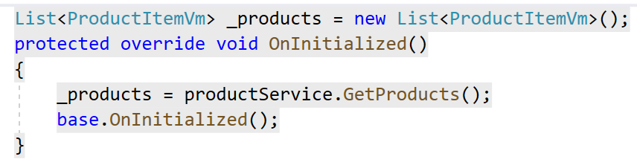
Injection

Slide 43
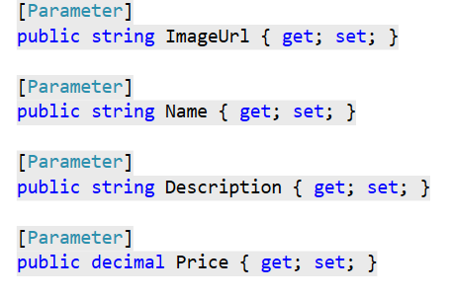
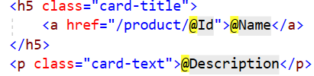
Component Parameters

Slide 44
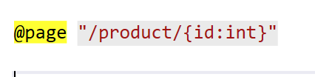
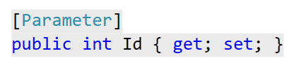
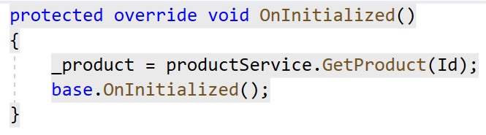
Routing

Slide 45
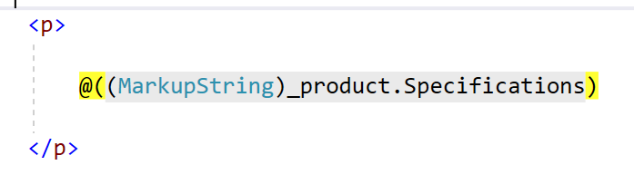
Raw Html

Slide 46
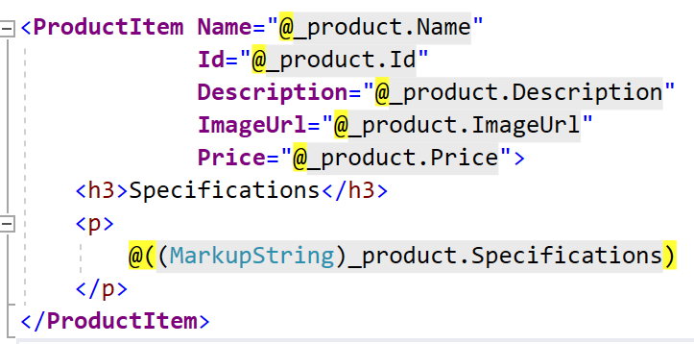
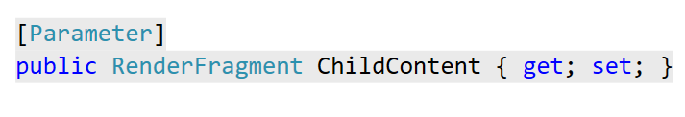
Child Contents

Slide 47
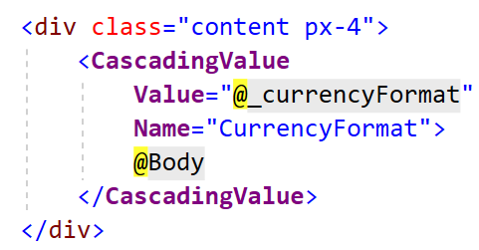
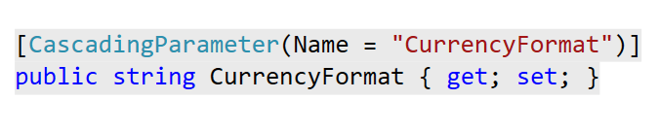
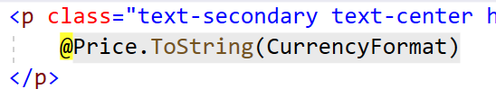
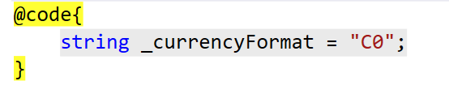
Cascading parameters

Slide 48
Render Tree

Slide 49
Memory (Virtual) DOM
DOM
Button
H2
P
Current Count:
0
Counter
Click Me

Slide 50
Incremental DOM
In-Memory (Virtual) DOM
Real DOM
DOM
Button
H2
P
Current Count:
0
Counter
Click Me
DOM
Button
H2
P
Current Count:
0
Counter
Click Me

Slide 51
Incremental DOM
In-Memory (Virtual) DOM
Real DOM
DOM
Button
H2
P
Current Count:
1
Counter
Click Me
DOM
Button
H2
P
Current Count:
0
Counter
Click Me

Slide 52
Incremental DOM
In-Memory (Virtual) DOM
Real DOM
DOM
Button
H2
P
Current Count:
1
Counter
Click Me
DOM
Button
H2
P
Current Count:
1
Counter
Click Me

Slide 53
Incremental DOM
In-Memory (Virtual) DOM
Real DOM
DOM
Button
H2
P
Current Count:
1
Counter
Click Me
DOM
Button
H2
P
Current Count:
1
Counter
Click Me

Slide 54
Events

Slide 55
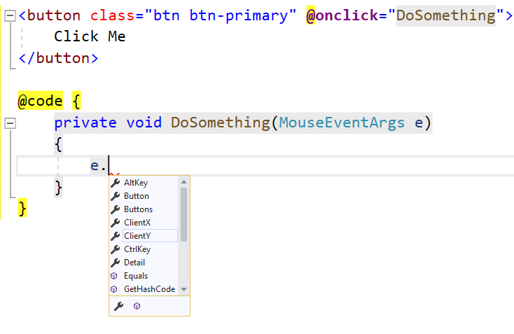
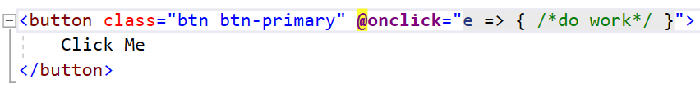
Event handling
@on{EVENT}
onclick
onkeypress
onmouseup
Accept method (delegate)
Send Argument
DragEventArgs
ClipboardEventArgs
WheelEventArgs

Slide 56
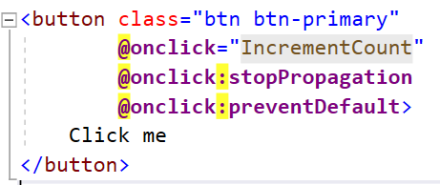
PreventDefault , stopPropagation

Slide 57
Component Interaction and StateHasChanged

Slide 58
Add to Cart
Thank you for adding (Product Name)
Add To Cart
Add To Cart
Add To Cart

Slide 59
Add to Cart
Thank you
Click
Name
ShowAddedMessage(Name)
Action<String>
Require StateHasChanged()
Add To Cart
Func<String, Task >
EventCallback<string>

Slide 60
StateHasChanged()
notifies the component that its state has changed
Causes the component to be Rerendered
But why
Blazor Detect changes always when action happen (ex: Button Click)
Some time can't detect depend on how action triggered (ex: Timer)

Slide 61
Lifecycle

Slide 62
SetParametersAsync
OnInitialized / OnInitializedAsync
OnParametersSet / OnParametersSetAsync
OnAfterRender / OnAfterRenderAsync
After the component is created
Called when Component parameter changed or (Complex Type !!!!)
Called after parameters assigned
Initialized once (not with parameters change or url change)
Called when Component parameter changed or (Complex Type !!!!)
Called after parameters assigned Before Rendering the tree
Called after rendering the tree
Has “firstRender” parameter to avoid infinite rendering
Has “ParameterView” parameter all new component parameter values

Slide 63
StateHasChanged
IDisposable.Dispose
ShouldRender
Notifies the component that its state has changed
Executed after component removed
Return Boolean
Causes the component to be Rerendered
Unhook events, Cancel long running tasks
Control component rendering

Slide 64
State Management

Slide 65
Before we begin
Review Lifecycle Video

Slide 66
What do we mean by state management
Component 02
Component 01
User Info
Component 03
In Parent component
Shared in all application

Slide 67
How
Component Parameter
Cascading Parameter
State Container

Slide 68
Example
Home
EditProfile
Welcome

