Slide 1
PreSigned-Url Or Valet-Key
Object Storage

Slide 2


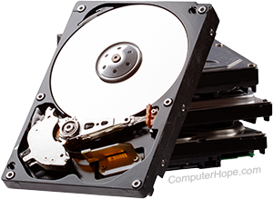
Upload File
Upload File
Write
Ok
Ok
Writer
Server Application must be involved

Slide 3

Read File
Request
Read
File Stream
Data
Reader
Server Application must be involved

Slide 4
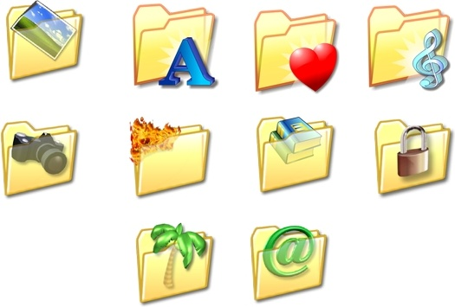
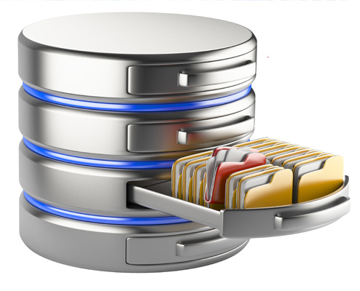


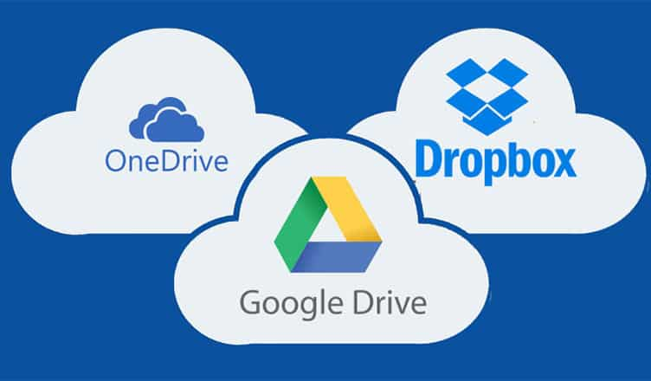
Options To Store Files

Slide 5
Object Storage
Object storage is a storage architecture for unstructured data.
It uses objects, each with a unique identifier and metadata, for easy access and retrieval.
Objects can be stored on-premises or in the cloud.
Object storage is useful for storing static content, data archives, and backups.
It offers benefits such as scalability, reduced complexity, searchability, resiliency, and cost efficiency.
Cloud object storage is the primary format for most major cloud service providers.
Object storage has use cases such as cloud-native apps, big data analytics, IoT, rich media storage and delivery, backup and archiving, and more.

Slide 6
Upload With Valet Key
Request URL
Response with URL
Notify Server
Get The URL
Writer
Request URL
Upload File Using the URL
Ok

Slide 7
Read With Valet Key
Request To URI
Response URI
Response URI
Request To URI
Reader
Request File By URI
Response with file contents

Slide 8


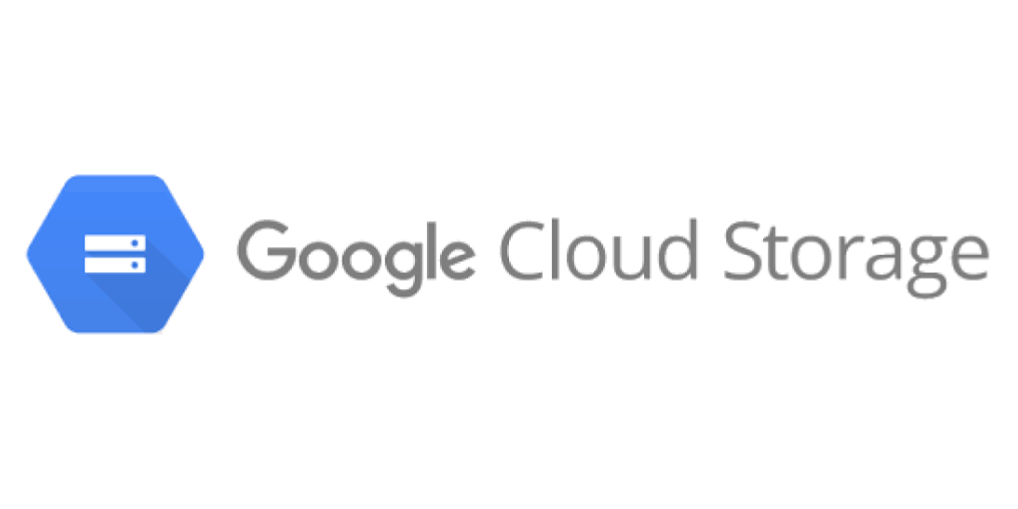
Cloud Object Storage
And S3 Compatible

