Slide 1
React & Redux
Gal Amouyal

Slide 2
About me
Software Engineer
FullStack Developer
Team leader IBM Trusteer
Active Lecture in John Bryce

Slide 3

Contact
galamouyal88@gmail.com
https://www.linkedin.com/in/gal-amouyal-a8707092/
https://github.com/galamo

Slide 4

Course timeline
17.7
19.7
24.7
4.8
16.8

Slide 5
Time
9:00
npm start
10:30 – 10:45
Loading Coffee
10:45 – 12:30
Lecture
12:30 – 13:30
lunch
13:30 – 15:00
Lecture
15:00 – 15:20
Sweet Break
15:20 – 16:30
Lecture

Slide 6
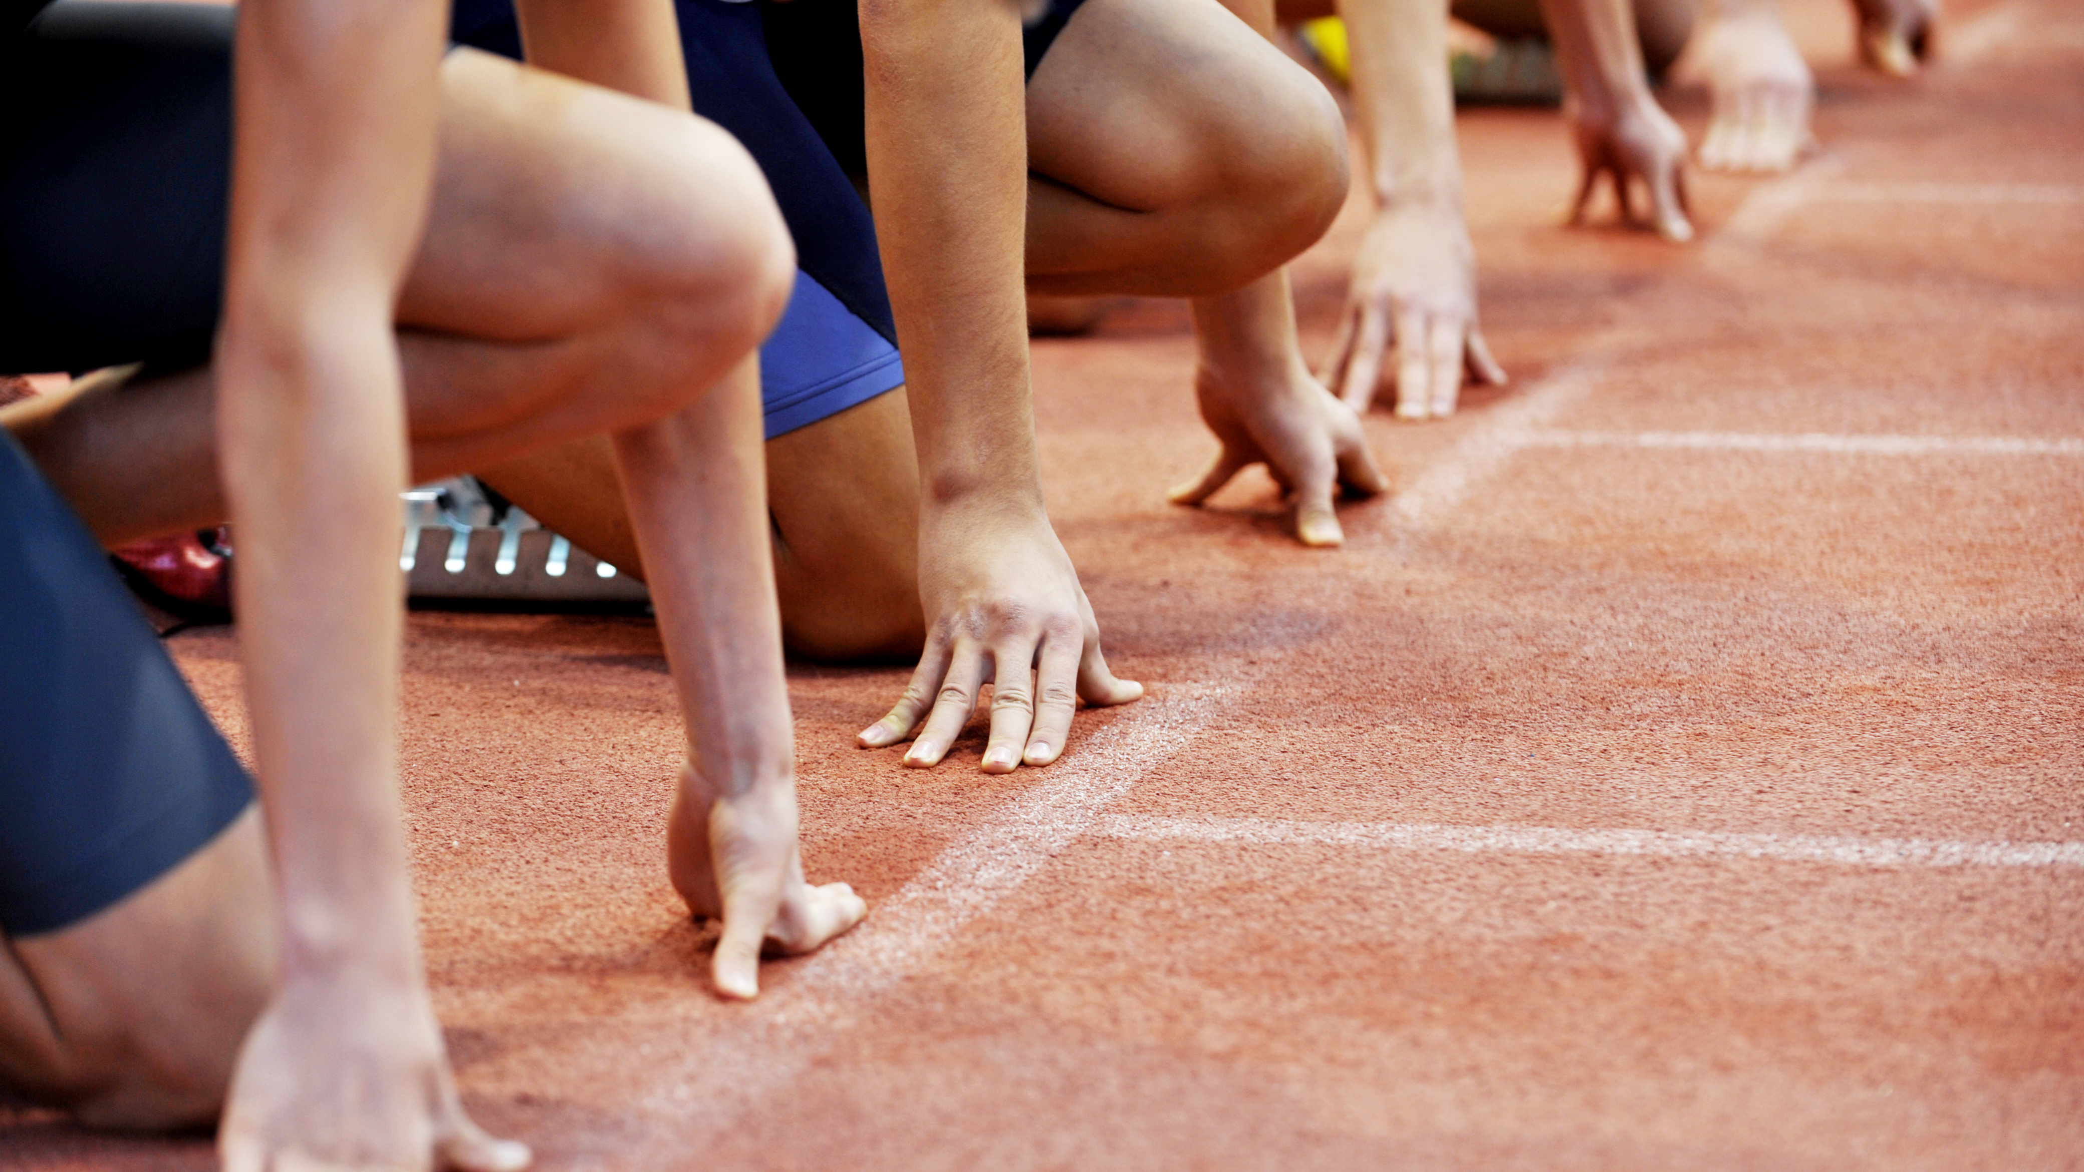
Before we start

