Slide 1



React
Gal Amouyal gal.amouyal@ibm.com https://github.com/galamo

Slide 2
React
JavaScript library for building user interfaces

Slide 3
Agenda
SPA
JavaScript & async operations
JavaScript single threaded
Event loop
Functional programing
JavaScript for react
Objects Copy
Async await
Higher order functions
Imperative vs declarative
ECMA Latest features
Development tools - vite

Slide 4
Agenda
TypeScript
Interfaces
Types
Generics
Type declaration (intersection & Union)

Slide 5
Agenda
React Concept
TSX
Folder recommendation structure
Component architecture
The virtual DOM
Diffing Algorithm

Slide 6
Agenda
Basic components
State & props
Stateless VS statefull components
Function components
Managing component state
High Order Components
Children
Render props

Slide 7
Agenda
React Hooks
useState
useEffect
useMemo
useCallback
useDefferedValue
useTransition
useRef ( useRef vs useState )

Slide 8
Agenda
Lazy loading
Managing global state with useContext & useReducer
Using Axios interceptors
Using redux toolkit vs Managing state with useContext & useReducer

Slide 9
Agenda
When should we use MF’s
Major features distinction
Advantages
React solution
Webpack Or Vite configuration
Example of MF’s with react
Build time integration - libraries
Run time integration – MF’s

Slide 10
Eco System
Routing – React router DOM
React redux
Material Design / Bootstrap

Slide 11
References
React Official Docs - https://react.dev/

Slide 12



React VS Angular

Slide 13
React
Google
JavaScript Framework
Full MVC
Regular DOM
Bi-Directional
TypeScript, HTML
Facebook 2011
JavaScript Library
View
Virtual DOM
Uni-directional
JSX, JS, Typescript

Slide 14
About React
React is a JavaScript library - one of the most popular ones, with over 140,000 stars on GitHub
Open-source project
React is used to build user interfaces (UI) on the front end.
View layer
Declarative
Efficient
Component based

Slide 15
React’s past and future
Fiber engine
Hooks
New lifecycle
Concurrent
Suspense
New Dev tools
https://reactjs.org/blog

Slide 16

Before we start…

Slide 17


Slide 18
Do we know JavaScript ?

Slide 19
What is the Call Stack ? Is it part of V8 ?
Part of V8 Engine ( in case chrome & nodejs)
Model that implemented by different browsers
Use to keep track on function invocations

Slide 20

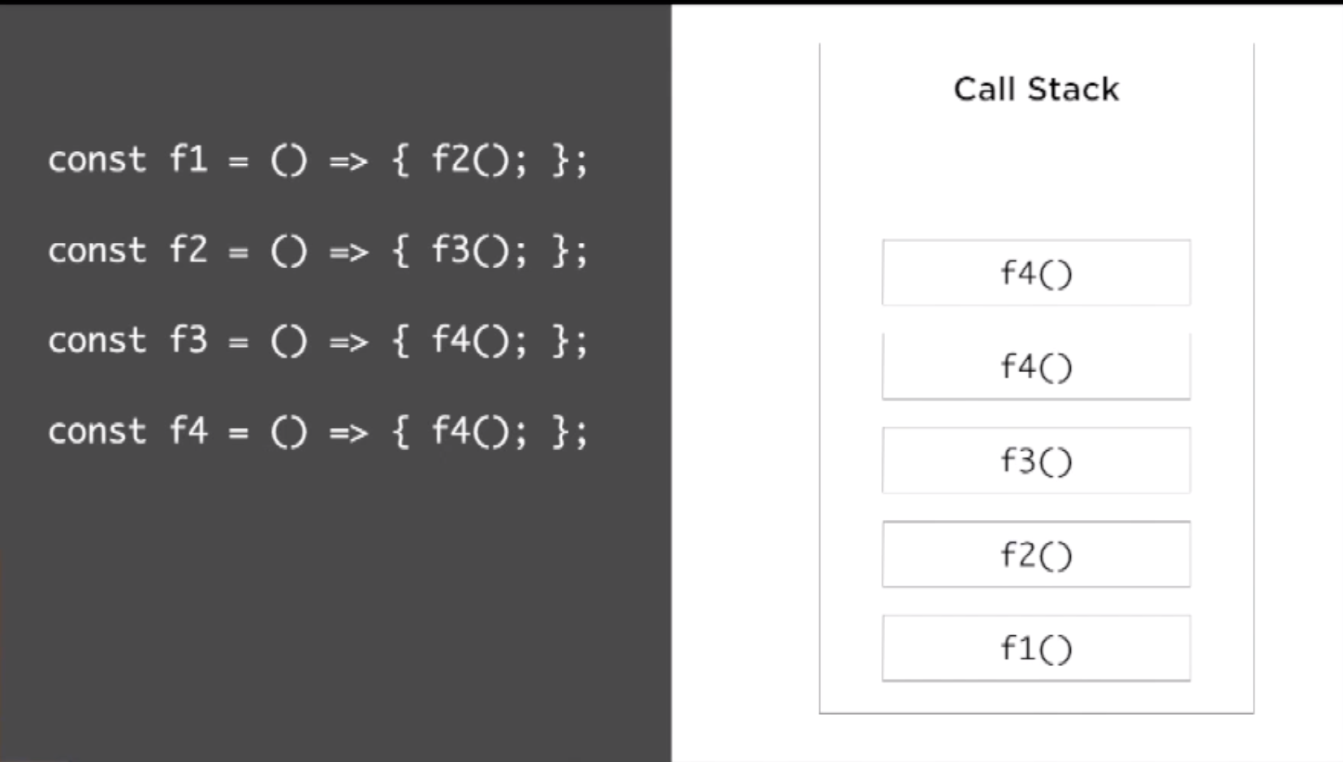
Busy Call Stack

Slide 21

What is the Event Loop? Is it part of V8 ?

Slide 22

Event Loop
Handles external events and convert them into callback invocation

Slide 23
Event Loop
A loop that picks events from the event queue and pushes their callbacks to call stack

Slide 24
Event Loop - example
Example

Slide 25
JavaScript for react
ECMA Latest features
Const
Let
Template strings
Arrow functions
Destructuring Objects & Arrays
Object literals
Async/Await
Es6 modules

Slide 26
Functional Programming
JavaScript functions are first class citizens
Last ECMA new features – Arrow functions, Promises etc..
Functions can represent data
Higher order function
Part of declarative programing

Slide 27
Imperative vs Declarative
Imperative
Declarative
How it Happen?
What should happen?

Slide 28

Let's do a little experiment
Ready ?

Slide 29
This code …
const string = "What is this code doing?";
let result = "";
for (let i = 0; i < string.length; i++) {
if (string[i] === " ") {
result += "-";
} else {
result += string[i];
}
}

Slide 30
Ready…
Ready ?

Slide 31
This code …
const string = "Restaurants in Tel aviv";
const urlFriendly = string.replace(/ /g, "-");

Slide 32
And the winner is ?
Replace the string to URL friendly

Slide 33

Round 2…
Ready ?

Slide 34
This code …
const users = [”Adi", ”Noa", ”Eitan"];
const newUsers = [];
for (let index = 0; index < users.length; index++) {
if (users[index].length > 3) {
newUsers.push(users[index]);
}
}

Slide 35

Easy…

Slide 36
…
const users = [”Adi", ”Noa", ”Eitan"];
const newUsers = users.filter(user => user.length > 3);

Slide 37

Filter!!!

Slide 38
Imperative vs Declarative - Welcome
const target = document.getElementById("target");
const wrapper = document.createElement("div");
const headline = document.createElement("h1");
wrapper.id = "welcome";
headline.innerText = "Hello World";
wrapper.appendChild(headline);
target.appendChild(wrapper);

Slide 39
React way
const { render } = ReactDOM;
const Welcome = () => (
<div id="welcome">
<h1>Hello World</h1>
</div>
);
render(<Welcome />, document.getElementById("target"));
The render function uses the instructions declared in the component to build the DOM, abstracting away the details of how the DOM is to be rendered

Slide 40
More functional Concepts
Immutability
Pure functions
Data transformations - High order function
recursion

Slide 41
Immutability
Unchangeable
Data is immutable
Return a Copy

Slide 42
mutation - exmaple
let color_book = {
title: "book",
color: "#00FF00",
rating: 0
};
function rateColor(color, rating) {
color.rating = rating;
return color;
}
console.log(rateColor(color_book, 5).rating); // 5
console.log(color_book.rating); // 5

Slide 43
Immutability - exmaple
const rateColor = function(color, rating) {
return Object.assign({}, color, { rating: rating });
};
console.log(rateColor(color_book, 5).rating); // 5
console.log(color_book.rating); // 4

Slide 44
Immutability - example
const rateColor = (color, rating) => ({
...color,
rating
});

Slide 45
Pure function
Returns a value that is computed based on its arguments
At least one argument
Always return a value or another function
No side effects
Arguments as immutable data
Testable

Slide 46
Pure function - example
const frederick = {
name: "Frederick Douglass",
canRead: false,
canWrite: false
};
const selfEducate = person => ({
...person,
canRead: true,
canWrite: true
});
console.log(selfEducate(frederick));
console.log(frederick);

Slide 47
DOM Side effects
function Header(text) {
let h1 = document.createElement("h1");
h1.innerText = text;
document.body.appendChild(h1);
}
Header("Header() caused side effects");

Slide 48
Pure function \ component – react way
const header = text => <h1> {text} </h1>;

Slide 49
Higher order functions
Manipulate other functions
Takes functions as arguments
Return functions

Slide 50
Higher order functions
const invokeIf = (condition, fnTrue, fnFalse) =>
condition ? fnTrue() : fnFalse();
const showWelcome = () => console.log("Welcome!!!");
const showUnauthorized = () => console.log("Unauthorized!!!");
invokeIf(true, showWelcome, showUnauthorized); // "Welcome!!!"
invokeIf(false, showWelcome, showUnauthorized); // "Unauthorized!!!"

Slide 51
Data Transformation
Reduce
Map
Filter
Find
Findindex

Slide 52
Data Transformation
const editName = (oldName, name, arr) => {
return arr.map(item => {
return item.name === oldName ? { ...item, name } : item;
});
};

Slide 53
Composition
Small pure functions, focus each function in a specific task
Combine functions to larger function
Chainable

Slide 54
Composition
const civilianHours = clockTime => ({
...clockTime,
hours: clockTime.hours > 12 ? clockTime.hours - 12 : clockTime.hours
});
const appendAMPM = clockTime => ({
...clockTime,
ampm: clockTime.hours >= 12 ? "PM" : "AM"
});
const both = date => appendAMPM(civilianHours(date));

Slide 55
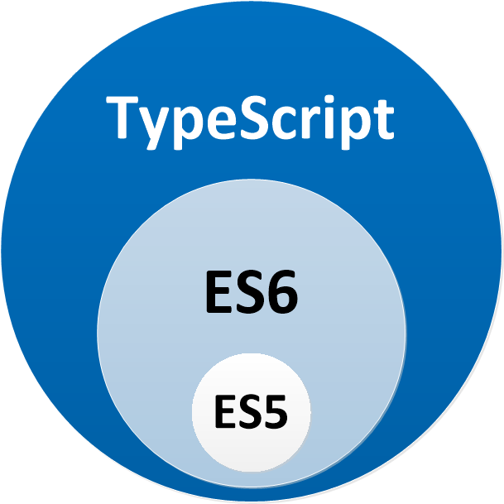
Typescript

Slide 56
Typescript
Microsoft
JavaScript that scales
Typescript compiler
Interfaces
Strongly types
Classes modifiers
More…

Slide 57
React core concepts
React Element
JSX
Components and props
Virtual DOM
Render
State
Lifecycle

Slide 58
Thinking in react
Break The UI Into A Component Hierarchy
Data Model
Identify The Minimal Representation Of UI State
Identify Where Your State Should Live
Add Inverse Data Flow

Slide 59
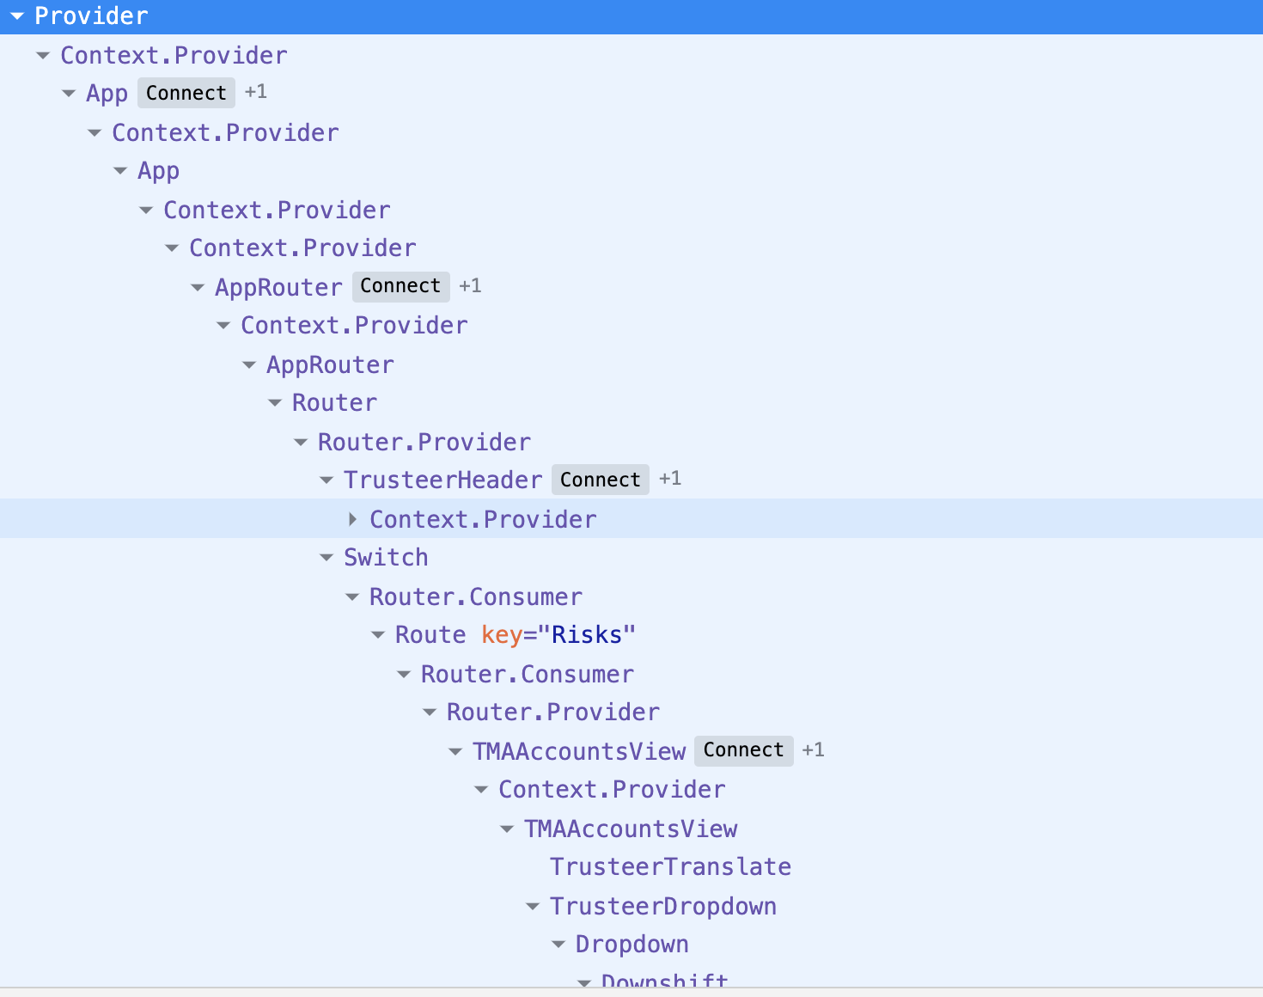
React Component Hierarchy

Slide 60
How react works
Can use 2 minimal libs
React - Generate views
React DOM - render the UI in the browser
React designed to update the DOM for us

Slide 61


React Create App
Create react app is a comfortable environment for learning React and is the best way to start building a new single-page application in React.

Slide 62
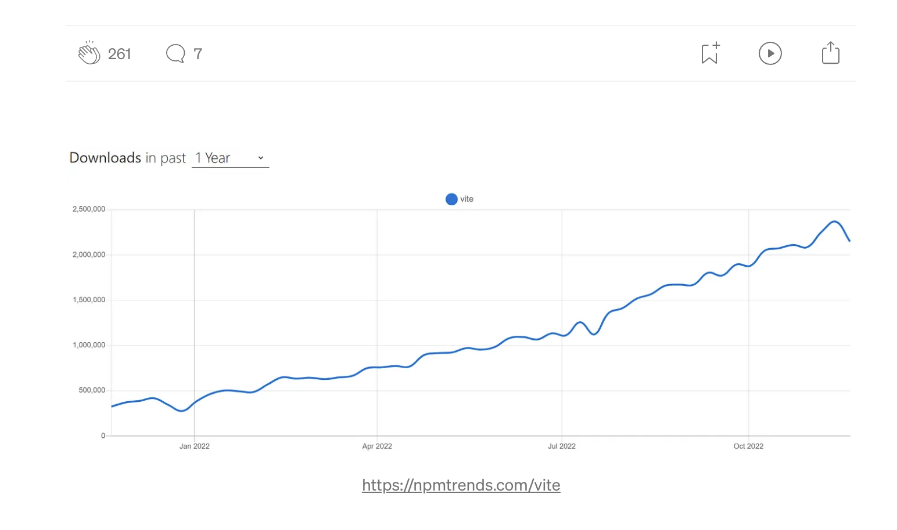
Vite

Slide 63
Vite
Native ES modules
Rollup

Slide 64
React Create App
npm install -g create-react-app

Slide 65
Vite new project
https://vitejs.dev/guide/

Slide 66
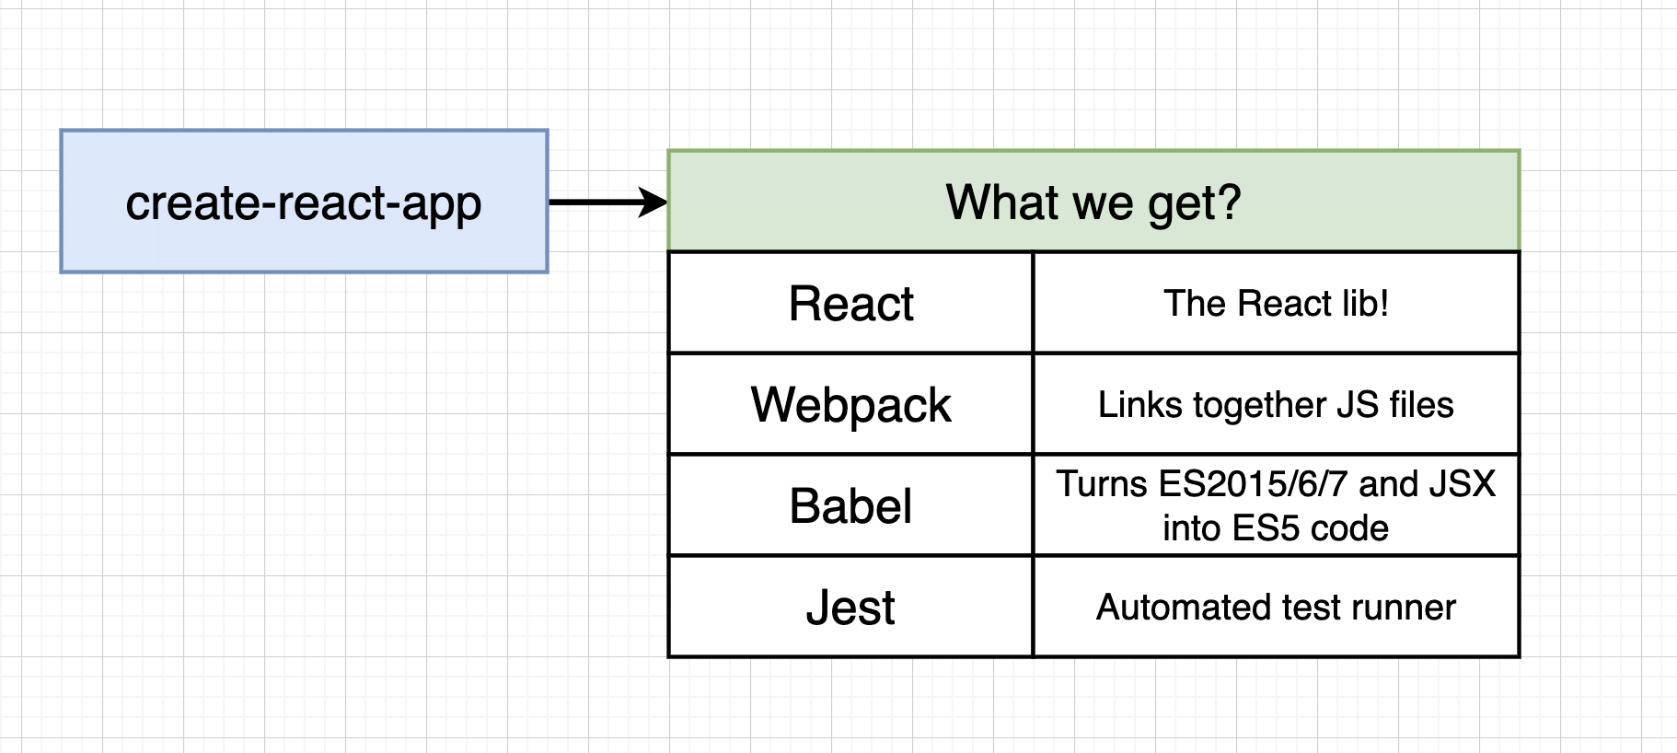
React CLI

Slide 67
Project Structure
Ui Components
Main Components – Pages
Utils
Configurations
State management – redux

Slide 68
DOM Element
Browser DOM
DOM Elements
DOM Elements
DOM Elements

Slide 69
React Element
React DOM
React Elements
React Elements
React Elements

Slide 70
React Element
The most atomic Unit in react
React elements are the instructions for how the browser DOM should be created.
HTML Tags are become DOM elements when the browser loads the HTML
React.CreateElement – working with the DOM API
Instructions for what we want React to build
Rendering and reconciling the elements

Slide 71
React Element
<h1 id=”h1-app">Application Header</h1>
{
$$typeof: Symbol(React.element),
"type": "h1",
"key": null,
"ref": null,
"props": {id: ”h1-app", children: "Application Heade "},
"_owner": null,
"_store": {}
}

Slide 72
React Children
React renders child elements using props.children
Element tree
<ul>
<li>2 lb salmon</li>
<li>5 sprigs fresh rosemary</li>
<li>2 tablespoons olive oil</li>
<li>2 small lemons</li>
<li>1 teaspoon kosher salt</li>
<li>4 cloves of chopped garlic</li>
</ul>

Slide 73
React Children
React.createElement(
"ul",
null,
React.createElement("li", null, "2 lb salmon"),
React.createElement("li", null, "5 sprigs fresh rosemary"),
React.createElement("li", null, "2 tablespoons olive oil"),
React.createElement("li", null, "2 small lemons"),
React.createElement("li", null, "1 teaspoon kosher salt"),
React.createElement("li", null, "4 cloves of chopped garlic")
);

Slide 74
ClassName in react
HTML Elements use class attribute
Class is reserved word
React use className
Style object is also available

Slide 75
ClassName in react
React.createElement(
"ul",
{ className: ” ingredients " },
ingredients.map(item => React.createElement("li", null, item))
);
const items = [
"2 lb salmon",
"5 sprigs fresh rosemary",
"2 tablespoons olive oil",
"2 small lemons",
"1 teaspoon kosher salt",
"4 cloves of chopped garlic"
];

Slide 76
Problem
Writing all our application with Create Element
is time consuming

Slide 77

Solution
JSX
on the beach!

Slide 78
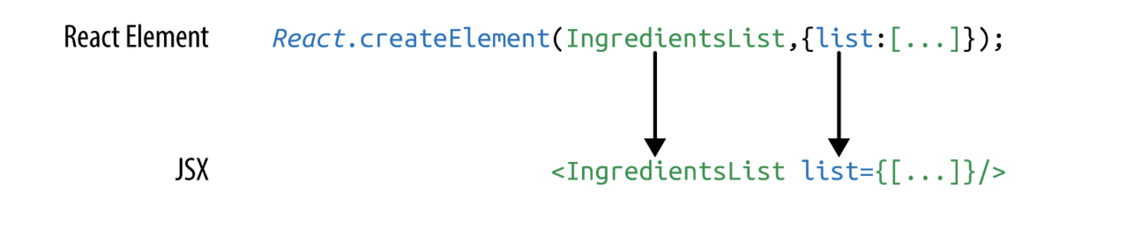
JSX
concise syntax
Easy to create DOM trees with attributes
More readable like HTML & XML
Using JS expressions ..{}

Slide 79
Mapping Arrays with JSX
<ul>
{props.ingredients.map((ingredient, i) => (
<li key={i}>{ingredient}</li>
))}
</ul>

Slide 80
Babel
Convert our fancy source code into something
that the browser can interpret

Slide 81
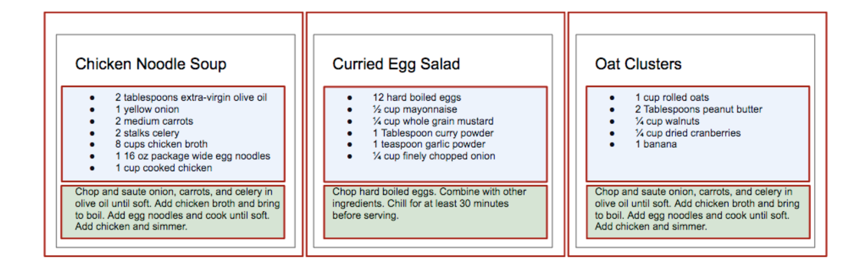
Components
User interface is made up of parts
When we put them all together we are getting user interface
Independent
reusable pieces

Slide 82
Components
Class
Function

Slide 83
Function Component
import React from "react";
interface Props {
title: string;
color: string;
}
function Header(props: Props) {
const { title, color } = props;
return (
<h1 className="jumbotron" style={{ color }}>
{" "}
{title}{" "}
</h1>
);
}

Slide 84
Class Component
export class Header extends React.Component<Props, any> {
constructor(props: Props) {
super(props);
}
render() {
const { title, color } = this.props;
return (
<h1 className="jumbotron" style={{ color }}>
{title}
</h1>
);
}
}

Slide 85
Props
Object
Props are stands for properties which passed to the components
Props are read only
Props can contain primitive and complex data

Slide 86
React Fragments
Container
Avoid DIV Hell

Slide 87
Stateless Component
Component is just a plain JavaScript function
which takes props as an argument and
returns a react element

Slide 88
Stateful Component
Component that contains State object
and reflect their state with the render process

Slide 89
The State
The state of a React application is driven by data that has the ability to change
Reflect the content - UI

Slide 90
Using the state
Don’t change the state directly
Use setState mothod
React may batch multiple setState() calls into a single update for performance
State updates are merged

Slide 91
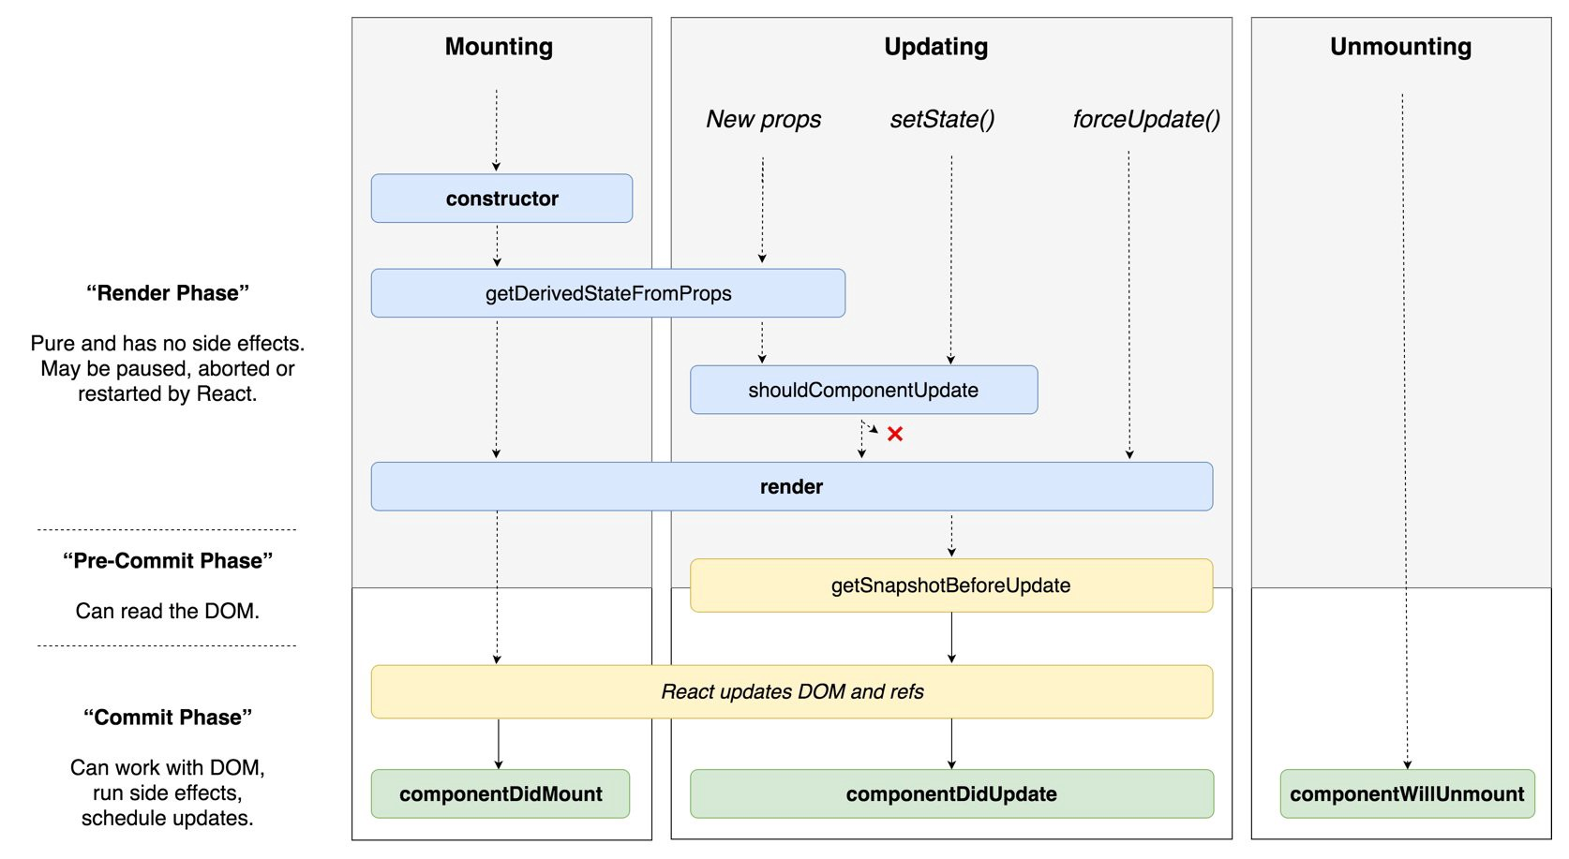
Components lifecycle methods

Slide 92
mounting
These methods are called in the following order when an instance of a component is being created and inserted into the DOM:
constructor()
static getDerivedStateFromProps()
render()
componentDidMount()

Slide 93
getDerivedStateFromProps()
Before render
Return object that updates the state
When state depends on props – AntiPattern
Fetch data on props changed

Slide 94
render()
React Element tree is created
React updates his virtual DOM

Slide 95
ComponentDidMount()
Invoked immediately after a component is mounted - inserted into the tree
Call remote endpoint
Subscriptions

Slide 96
Updating
An update can be caused by changes to props or state. These methods are called in the following order when a component is being re-rendered:
static getDerivedStateFromProps()
shouldComponentUpdate()
render()
getSnapshotBeforeUpdate()
componentDidUpdate()

Slide 97
shouldComponentUpdate()
Invoked before rendering when new props or state are being received.
Help us to decide if the state changes need to affect the component render
Return Boolean value
Default true

Slide 98
getSnapshotBeforeUpdate()
Before the last render committed to the DOM
Capture information from the DOM
passed as a parameter to componentDidUpdate()

Slide 99
componentDidUpdate()
Invoked immediately after updating occurs
Not after initial render
SetState ? Be carful from infinite loop

Slide 100
Unmount
This method is called when a component is being removed from the DOM:
ComponentWillUnmount()

Slide 101
Routing
Navigation Bar
<Link to="/home">Home</Link>
Single Route = Page
<BrowserRouter>
<Switch>
<Route path="/signIn" component={SignIn} />
<Route path="/signup" component={SignUp} />
<Route path="/home" component={Home} />
<Route path="**" component={() => <h1> Not Found! </h1>} />
</Switch>
</BrowserRouter>

Slide 102
Routing
npm I react-router-dom

Slide 103
Virtual DOM
Real DOM – Document Object Model
Tree Data structure – Fast
UI re-rendering or repainting is heavy
Virtual DOM – virtual representation, saved in memory
Every time that our state changed the virtual DOM is updated

Slide 104
Virtual DOM
State changed => New virtual tree created
The tree is compared or “diffed” with the previous
Calculates the best possible way to apply the changes

Slide 105
How does React use Virtual DOM
React use observable pattern
Listen to state changes
New version of virtual DOM diffing with the old
Once react know what object are changed
It updated only the changed object on the real DOM

Slide 106
Virtual DOM – batch update
React follow a batch update mechanism to update the real DOM
No manipulating the DOM every single change

Slide 107
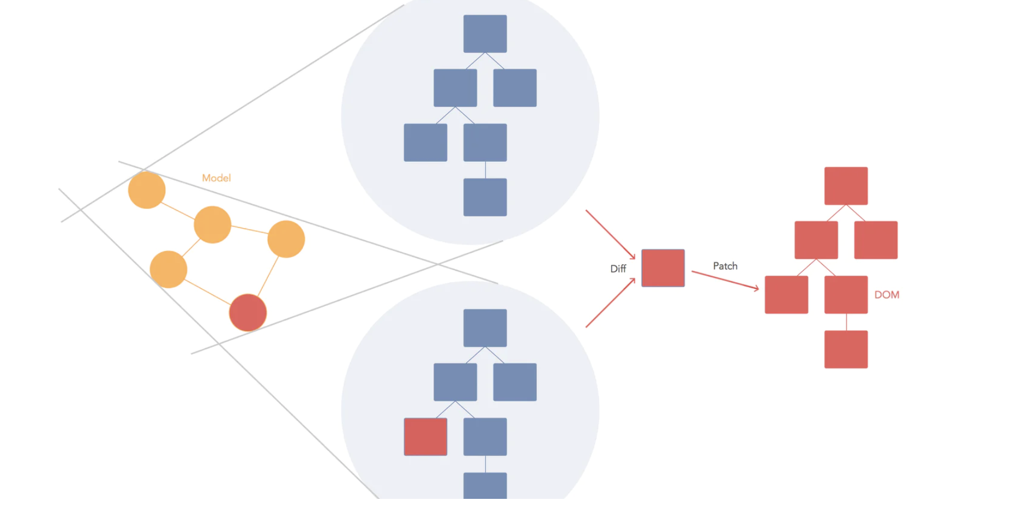
Virtual DOM

Slide 108
Reconciliation
Two elements of different types will produce different trees.
The developer can hint at which child elements may be stable across different renders with a key prop.

Slide 109
Reconciliation – The Diffing Algorithm
Root element type – different ?
DOM element same type, check the attribute
Children's compare
Using the Key

Slide 110
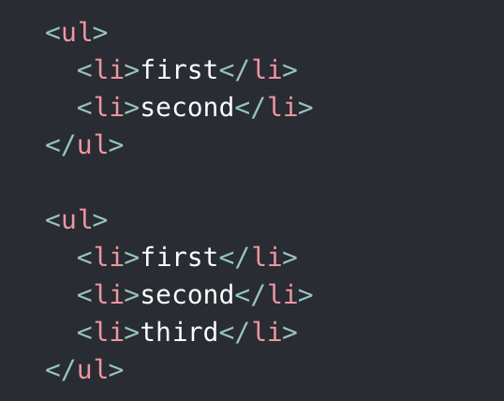
Reconciliation – Children's
React iterates both lists and generate mutation over the diff

Slide 111
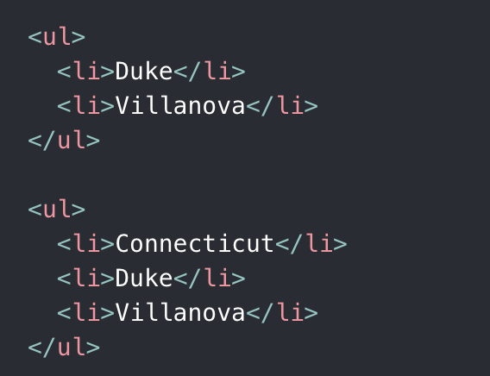
Reconciliation – Children's
React will Mutate every child

Slide 112
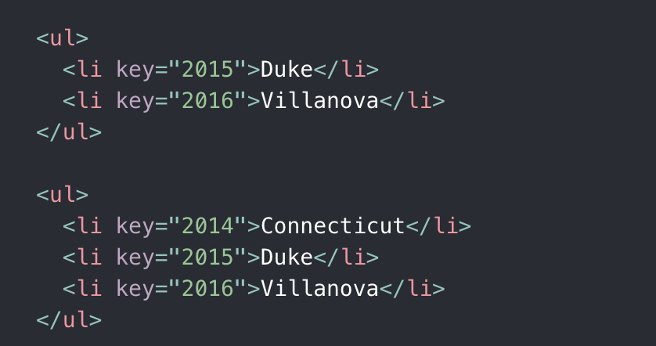

Slide 113
HOC
A higher-order component is a function that takes a component and returns a new component.
Reuse Logic

Slide 114
HOC
Take a Component as argument
Return Component

Slide 115
What sucks ?
It’s hard to reuse stateful logic between components
Complex components become hard to understand
Classes confuse both people and machines

Slide 116
Hooks
React Hooks are functions that let us hook into the React state and lifecycle features from function components

Slide 117
Rules of Hooks
Only call Hooks at the top level. Don’t call Hooks inside loops, conditions, or nested functions.
Only call Hooks from React function components.

Slide 118
useState
Managing state inside function component

Slide 119
useEffect
For side effects – event handlers, async request, etc…

Slide 120
Authentication HOC
Sync - check if token exist
Async – Validate the token
Return the relevant component

Slide 121
useEffect
For side effects – event handlers, async request, etc…

Slide 122
useRef
Access the DOM directly
Mutating ref

Slide 123
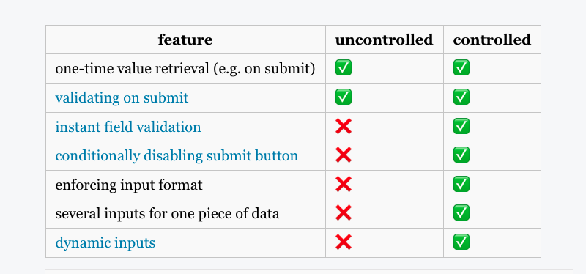
Controller components vs uncontrolled

Slide 124
React Render phases
Since React 18 React divide the render phase into two main parts

Slide 125
React Render phases
1. Render Phase ( Sometime calls Reconciliation )
2. Commit Phase

Slide 126
1. Render Phase
React Decide which changes need to be Done in the DOM, Compare the Current State and the Next State
Create or updates the Virtual DOM
Which components need to re-render or reused
** No Dom manipulation – only calculation
** Concurrent mode handle high priority updates
** No side effects, no Ref’s
** useMemo useCallback

Slide 127
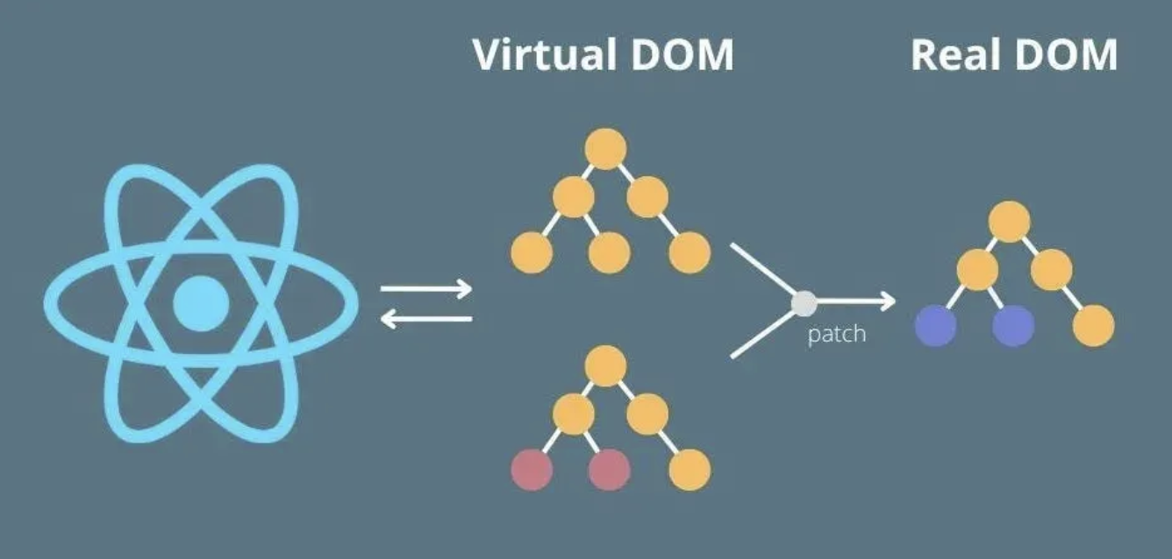
2. Commit Phase
Changes Applied to the DOM (batch update)
Lifecycle methods called
Refs Attached + useEffectLayout Callback
Painting
useEffect
Commit => Paint => Effects

Slide 128
useLayoutEffect & useEffect
useLayoutEffect:
Runs after DOM updates Runs before the browser paints Blocks visual updates (synchronous) Best when reading or modifying layout to avoid flicker
useEffect:
Runs after paint Does not block the browser Best for non-visual effects

Slide 129
useCallback & useMemo
The React useCallback Hook returns a memoized callback function.
The React useMemo Hook returns a memoized value.

Slide 130
Code splitting
your app grows, your bundle will grow too
“splitting” your bundle
Webpack

Slide 131
Suspense
Suspense is not a data fetching library. React API mechanism for handling async loading components
We should make it as easy as possible to build apps that start fast and stay fast
Suspense is a feature for managing asynchronous operations in a React app. It lets your components communicate to React that they’re waiting for some data.

Slide 132
Suspense
Parallel data and view trees
Fetch in event handlers
Load data incrementally
Treat code like data

Slide 133
ErrorBoundry
getDerivedStateFromError – (render) Updates component state after an error happens in a child component.
componentDidCatch (commit) - Runs after rendering the fallback UI and is used to log or report the error.

Slide 134
Authentication - JWT
JWT stands for JSON Web Token.
Used mainly for authentication and secure data exchange.
Contains encoded header, payload, and signature.
Stateless — no need to store session data on the server.
Signed to ensure integrity, so it can't be tampered with.
Sent typically in HTTP headers with each request.

Slide 135
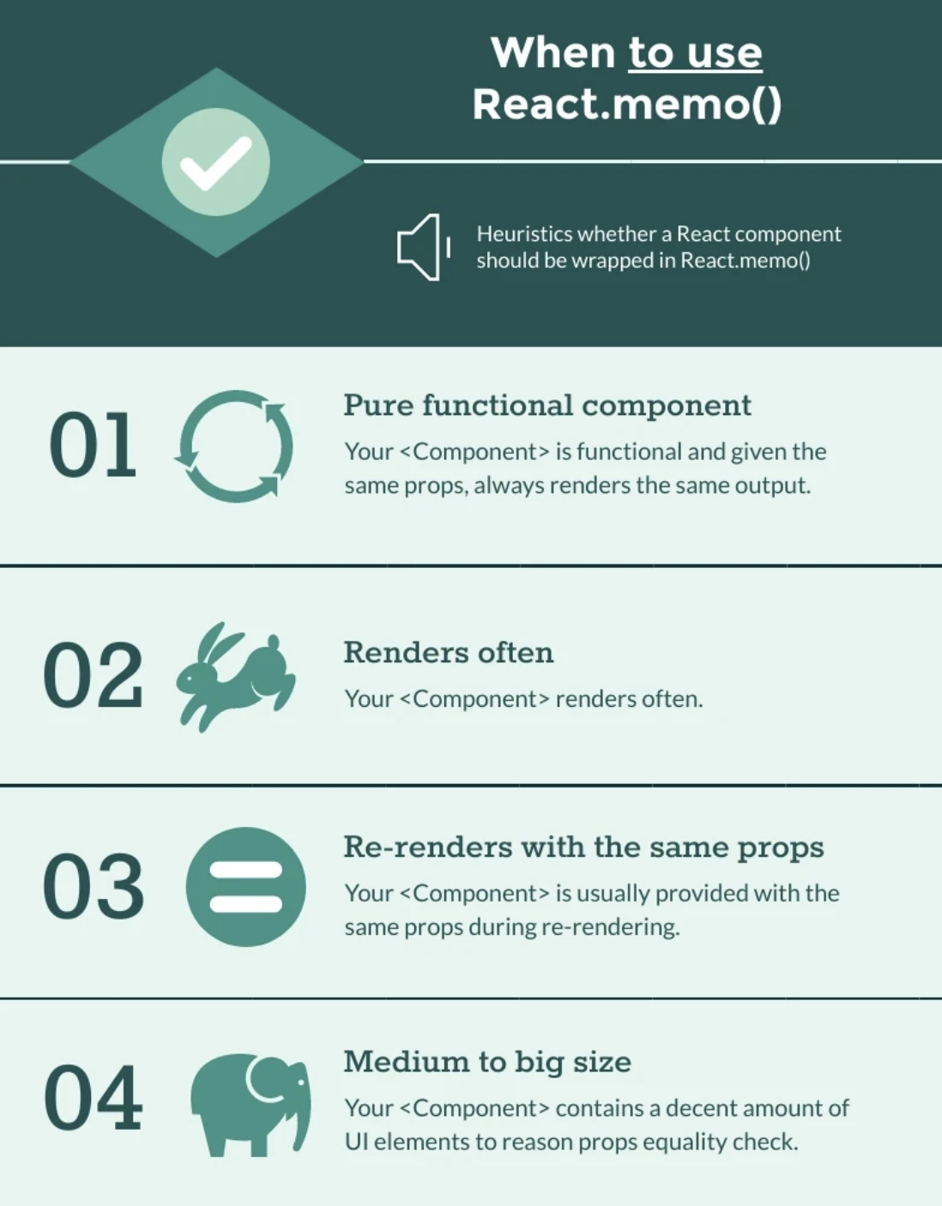
React.memo

Slide 136
React.memo

Slide 137
Problem – Global State Management
Inputs
Forms
Routing
Date pickers
Menus
Tabs
Filters

Slide 138
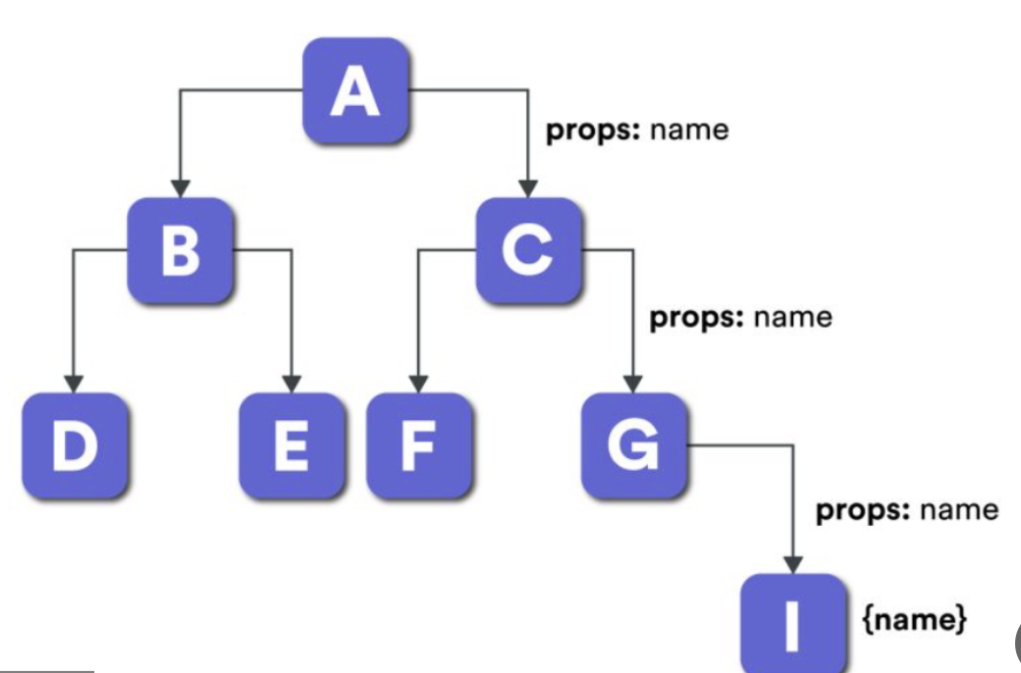
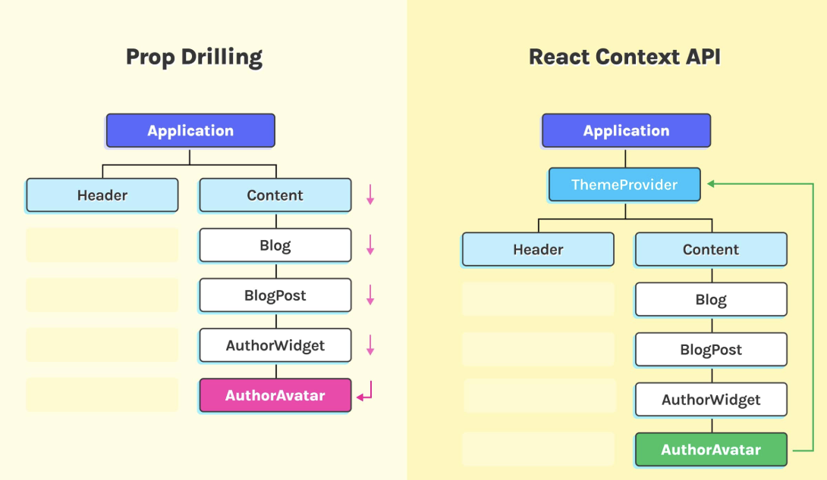
Problem

Slide 139
React Context
Context is React's built-in solution for passing data through the component tree without prop drilling.

Slide 140
React Context
useContext
CustomHook

Slide 141
useReducer
Complex state logic: Multiple related state values updated together
Predictable updates: All state changes go through one function
Easier testing: Pure reducer function can be tested independently
Better debugging: Can log all actions and state changes
State history: Easy to implement undo/redo
Next state depends on previous state: Guaranteed consistency

Slide 142

Problem – Global State Management
Data

Slide 143
Redux
The application has a central / root state.
A state change triggers View updates.
Only special functions can change the state.
A user interaction triggers these special, state changing functions.
Only one change takes place at a time.

Slide 144
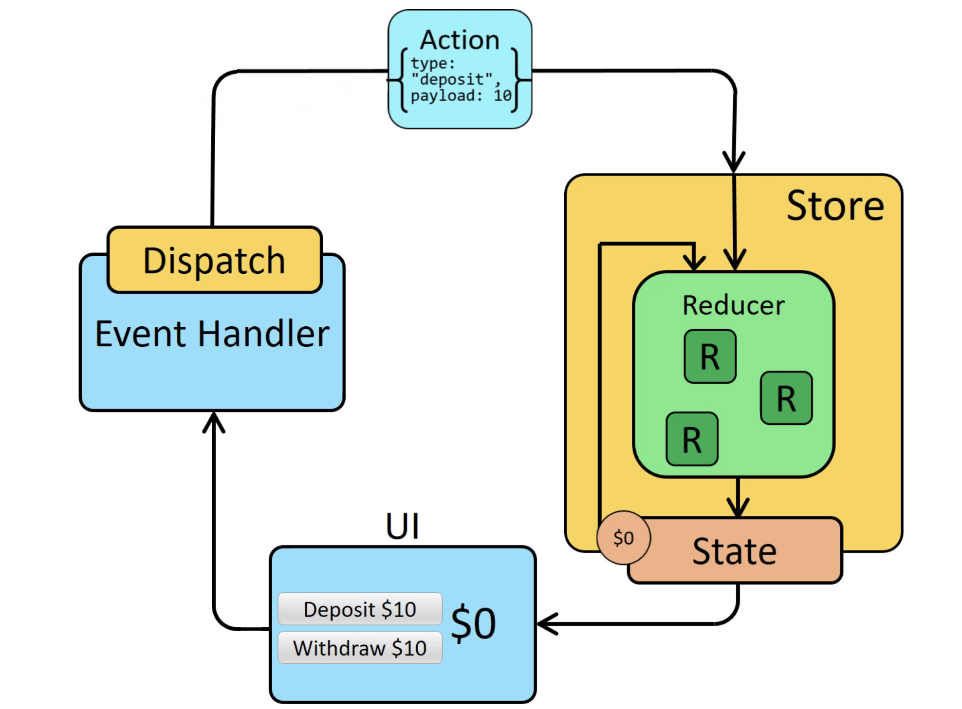
Redux

Slide 145
Terminology
Store – The centralized container that holds the entire application's state.
State – The current snapshot of data stored in Redux, managed globally.
Dispatch – The function used to send actions to update the state.
Reducer – A pure function that determines how the state changes based on actions
Action – A plain JavaScript object describing what change should happen in the state.

Slide 146
Introduction
What is Redux Toolkit?
Official, recommended way to write Redux logic
Simplifies Redux usage by reducing boilerplate
Includes utilities for state management, immutability, and async logic
Optimized for better performance and developer experience

Slide 147
Introduction
Why Redux Toolkit?
Provides a simple and powerful API
Reduces complexity with createSlice and configureStore
Built-in support for immutability with Immer
Streamlined async logic with createAsyncThunk

Slide 148
Key features
createSlice: Simplifies reducer and action creation
configureStore: Simplifies store setup
createAsyncThunk: Streamlines async logic (e.g., API calls)
Middleware and DevTools are built-in
Better default settings and performance optimizations

Slide 149
Setting Up Redux Toolkit
npm install @reduxjs/toolkit react-redux

Slide 150
Configure store
import { configureStore } from '@reduxjs/toolkit' export const store = configureStore({ reducer: { posts: postsReducer, comments: commentsReducer, users: usersReducer } }) // Infer the `RootState`, `AppDispatch`, and `AppStore` types from the store itself export type RootState = ReturnType<typeof store.getState> // Inferred type: {posts: PostsState, comments: CommentsState, users: UsersState} export type AppDispatch = typeof store.dispatch export type AppStore = typeof store
app/store.ts

Slide 151
Creating Hooks
import { useDispatch, useSelector } from 'react-redux' import type { AppDispatch, RootState } from './store' // Use throughout your app instead of plain `useDispatch` and `useSelector` export const useAppDispatch = useDispatch.withTypes<AppDispatch>() export const useAppSelector = useSelector.withTypes<RootState>()
app/hooks.ts

Slide 152
Configure reducer
export const counterSlice = createSlice({ name: 'counter', initialState, reducers: { increment: state => { state.value += 1 }, decrement: state => { state.value -= 1 }, incrementByAmount: (state, action: PayloadAction<number>) => { state.value += action.payload } } })
features/counter/counterSlice.ts
import { createSlice, PayloadAction } from '@reduxjs/toolkit' import type { RootState } from '../../app/store' // Define a type for the slice state export interface CounterState { value: number } // Define the initial state using that type const initialState: CounterState = { value: 0 }

Slide 153
Configure reducer
features/counter/counterSlice.ts
export const { increment, decrement, incrementByAmount } = counterSlice.actions // Other code such as selectors can use the imported `RootState` type export const selectCount = (state: RootState) => state.counter.value export default counterSlice.reducer

Slide 154
Component level
features/counter/Counter.tsx
import React from 'react' import { useAppSelector, useAppDispatch } from 'app/hooks' import { decrement, increment } from './counterSlice' export function Counter() { // The `state` arg is correctly typed as `RootState` already const count = useAppSelector(state => state.counter.value) const dispatch = useAppDispatch() // omit rendering logic }

Slide 155
Full Example
https://codesandbox.io/p/sandbox/github/reduxjs/redux/tree/master/examples/counter-ts?from-embed

Slide 156
Redux Example
https://github.com/galamo/Elbit-React-2024/tree/master/react-client-application/src/store

Slide 157
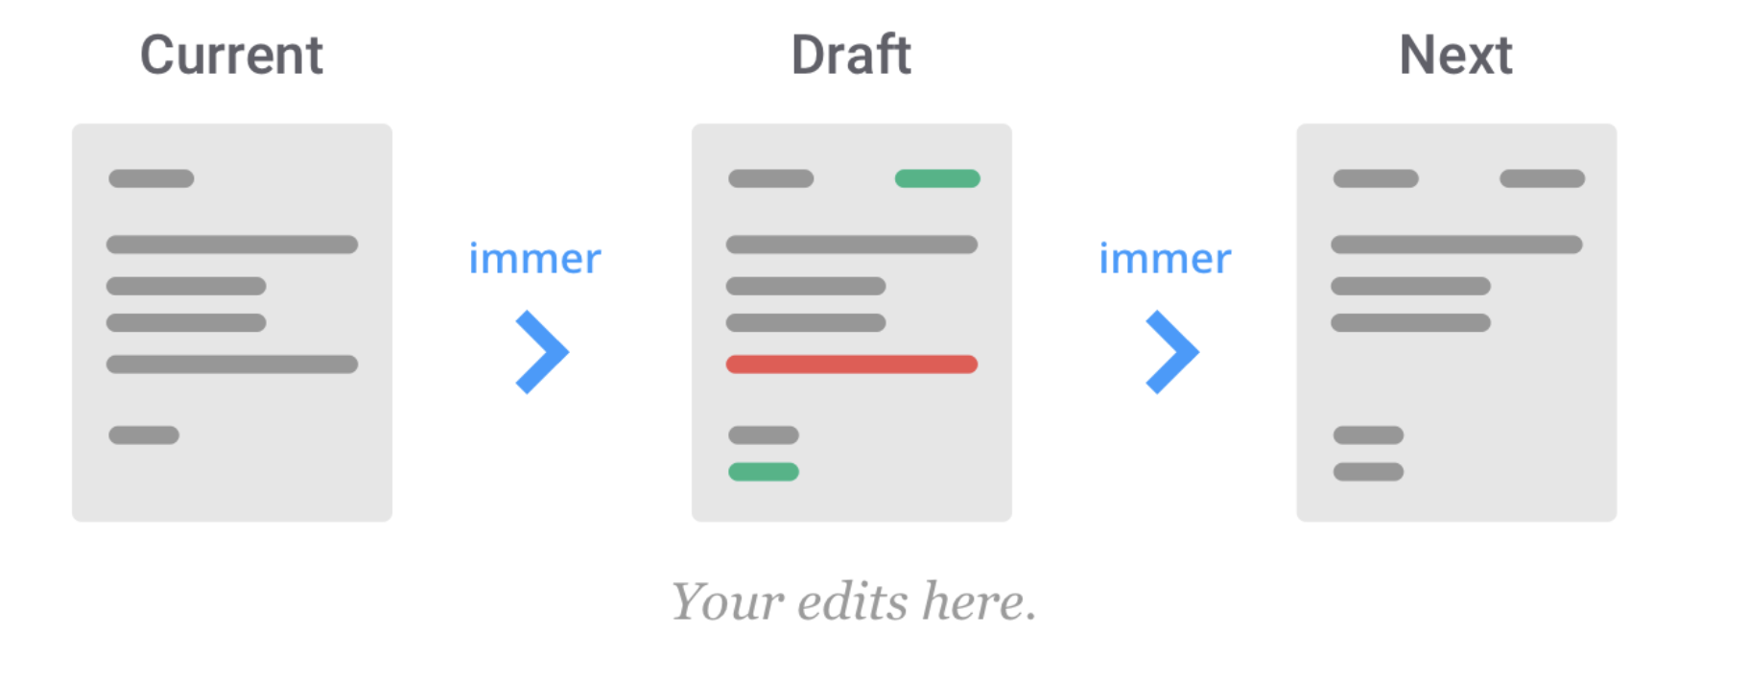
Redux toolkit with immer

Slide 158
Using immer.js
Redux Toolkit's createReducer and createSlice automatically use Immer internally to let you write simpler immutable update logic using "mutating" syntax. This helps simplify most reducer implementations.

Slide 159
Basics of Immutability
"Mutable" means "changeable". If something is "immutable", it can never be changed.
const obj = { a: 1, b: 2 } // still the same object outside, but the contents have changed obj.b = 3 const arr = ['a', 'b'] // In the same way, we can change the contents of this array arr.push('c') arr[1] = 'd'

Slide 160
Basics of Immutability
In order to update values immutably, your code must make copies of existing objects/arrays, and then modify the copies.
const obj = { a: { c: 3 }, b: 2 } // To safely update obj.a.c, we have to copy each piece
const obj2 = { // copy obj ...obj, // overwrite a a: { // copy obj.a ...obj.a, // overwrite c c: 42, }, }
const arr = ['a', 'b'] // Create a new copy of arr, with "c" appended to the end const arr2 = arr.concat('c') // or, we can make a copy of the original array: const arr3 = arr.slice() // and mutate the copy: arr3.push('c')

Slide 161
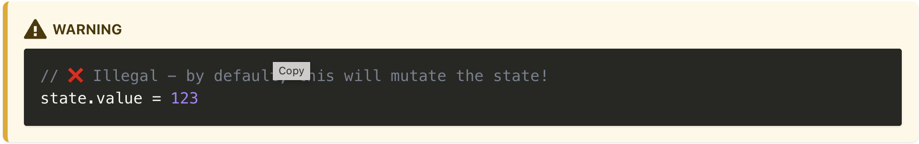
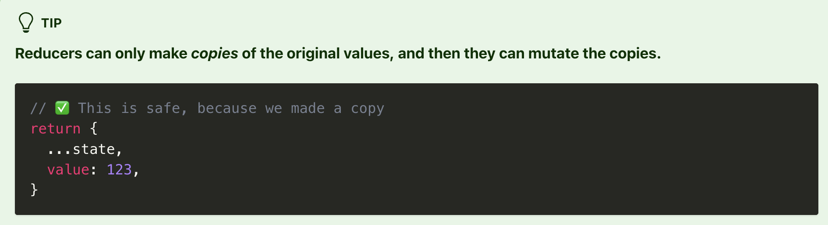
Reducers and Immutable Updates
One of the primary rules of Redux is that our reducers are never allowed to mutate the original / current state values!

Slide 162
Copy of every level nesting – Copy Hell
A critical rule of immutable updates is that you must make a copy of every level of nesting that needs to be updated.
function handwrittenReducer(state, action) { return { ...state, first: { ...state.first, second: { ...state.first.second, [action.someId]: { ...state.first.second[action.someId], fourth: action.someValue}
}} }
}

Slide 163
Immutable Updates with Immer
Immer is a library that simplifies the process of writing immutable update logic.
You can mutate the object straight like the following JS code, immer will take care behind the scene to the copy & assign
const baseState = [ { todo: 'Learn typescript', }, { todo: 'Try immer', }, ]
baseState.push({ todo: 'Tweet about it' })

Slide 164
Redux Toolkit and Immer
Immer is a library that simplifies the process of writing immutable update logic.
You can mutate the object straight like the following JS code, immer will take care behind the scene to the copy & assign
const todosSlice = createSlice({ name: 'todos', initialState: [], reducers: { todoAdded(state, action) { state.push(action.payload)
}
}
})

Slide 165
Redux Toolkit and Immer
const todosSlice = createSlice({ name: 'todos', initialState: [], reducers: { fixedTodoToggled(state, action) { const todo = state.find((todo) => todo.id === action.payload) if (todo) { todo.completed = !todo.completed } }, }, })

Slide 166
Alternatives to redux
MobX
useContext

Slide 167
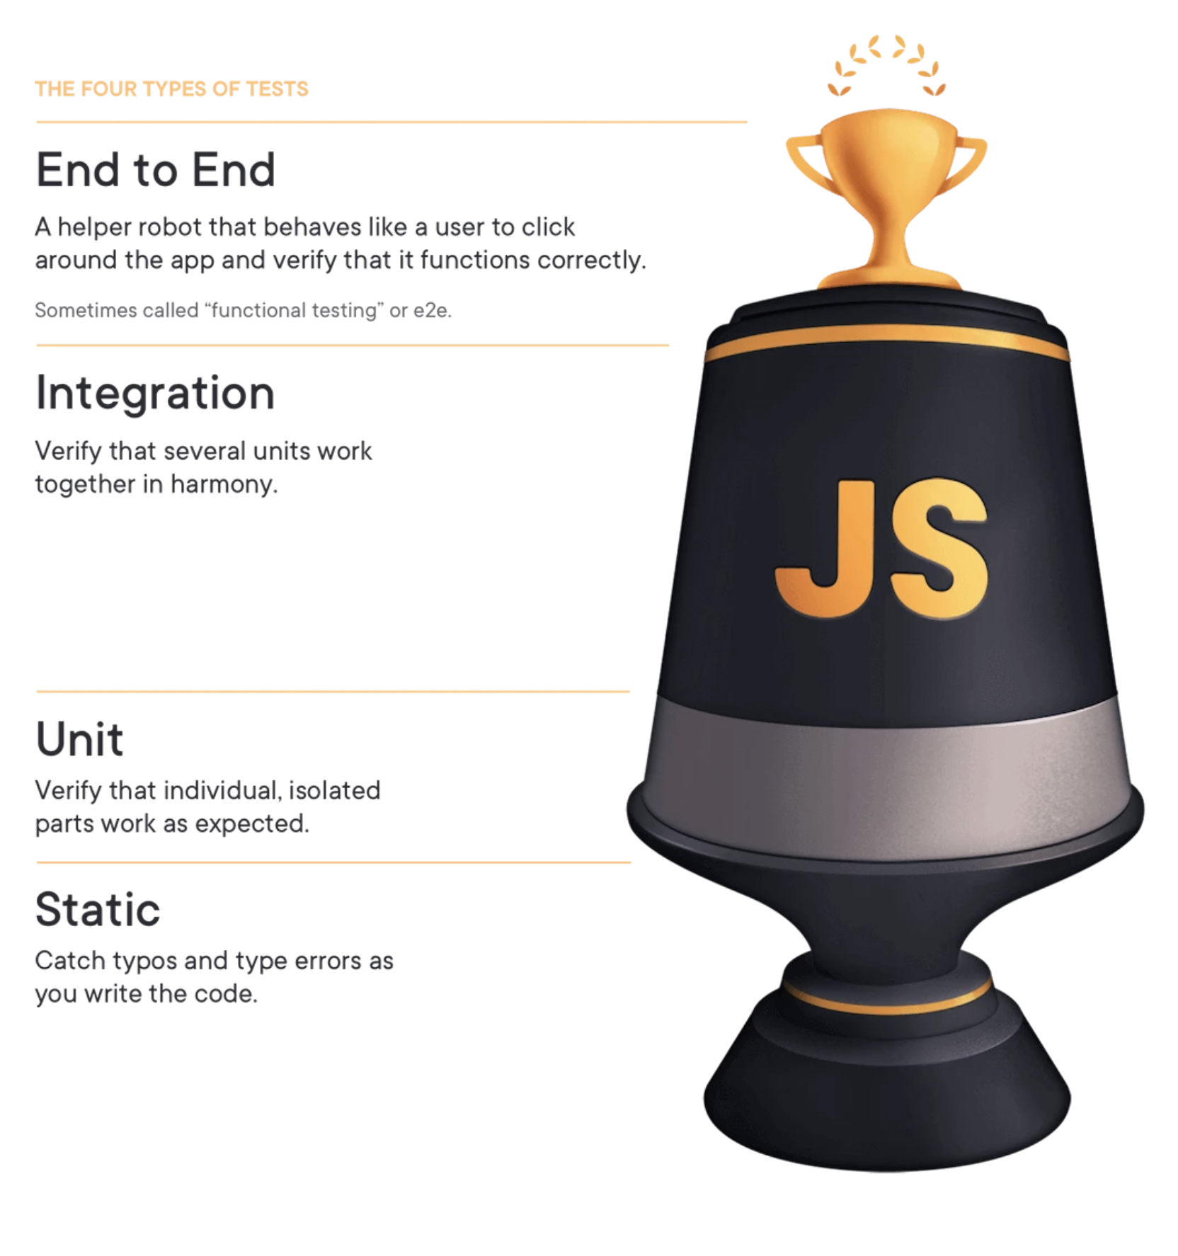
React Testing

Slide 168
Testing tradeoffs
Cost
Speed
Complexity

Slide 169
Distinctions
I don't really care about the distinctions.

Slide 170
Testing options
Rendering component trees
Running a complete app

Slide 171
Testing tradeoffs
Iteration speed vs Realistic environment
How much to mock

Slide 172
Tools
Jest ( using jsdom )
React Testing library

Slide 173
Style Components
Using tagged template literals and arrow functions in ES6+ and CSS, styled-components is a React-specific CSS-in-JS styling solution that creates a platform for developers to write actual CSS code to style React components.

Slide 174
State management compare
Zustand Redux
Tanstack

Slide 175


THANKS! galamouyal88@gmail.com

