Slide 1

Service Mesh
Make Micro services great again

Slide 2
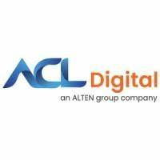
Service Mesh
What is a Service Mesh ?
A service mesh is a dedicated infrastructure layer built into an application that controls service-to-service communication in a micro service architecture.
It allows you to transparently add capabilities such as observability, traffic management, and security, without adding them to your own code.
Why service mesh ?
Connect
Circuit breaking
Blue/Green deployments
Control traffic flow
Security
mTLS for internal communications
Authentication and authorization of workloads
Automatic certificate provisioning & rotation
Traffic Management
L7 Load Balancing
L7 Traffic Steering
Resilience (Timeout, retries) & Robustness
Observability
Layer 7 Visibility
Logging & Monitoring
Distributed tracing

Slide 3
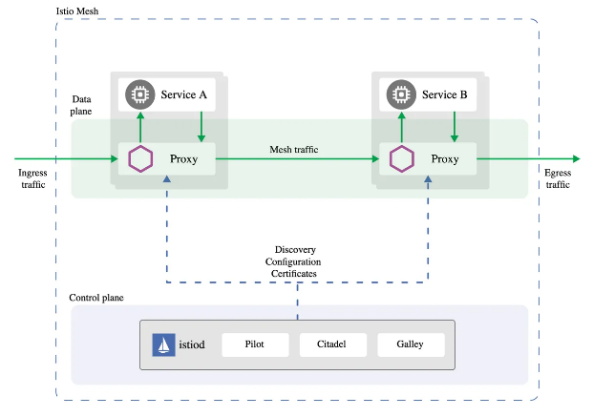
ISTIO & Envoy
Istio is an open source implementation of the service mesh that layers transparently onto existing distributed applications.
Istio is the path to load balancing, service-to-service authentication, and monitoring
Istio has two components: the data plane and the control plane.
The data plane is the communication between services. Service mesh uses a proxy to intercept all your network traffic, allowing a broad set of application-aware features based on configuration you set.
The control plane takes your desired configuration, and its view of the services, and dynamically programs the proxy servers, updating them as the rules or the environment changes.
An Envoy proxy is deployed along with each service that you start in your cluster, or runs alongside services running on VMs.

Slide 4
Service Mesh Vendors
Tetrate
Aspen Mesh
Kong Mesh
Tetrate is one of the first startups to offer a commercial version of Envoy and Istio.
Enterprise customers can rely on Tetrate to access tested and trusted builds of Envoy and Istio that are backed by professional services and support.
One of Tetrate’s founding goals is to enable customers to manage their applications everywhere from edge to workload, between services and VMs, in datacenters and the cloud.
Aspen Mesh takes Istio a step further, providing more advanced features for enterprise organizations including mTLS, fine-grained RBAC, policy frameworks, Istio Vet, SSO and more.
BIG-IP SPK (Service Proxy for Kubernetes) and Carrier-Grade Aspen Mesh are the first offerings in a 5G portfolio that will accelerate digital transformation for service providers and their customers.
Enterprise service mesh based on Kuma for multi-cloud and multi-cluster on both Kubernetes and VMs
Built on top of Envoy, Kong Mesh is a modern control plane focused on simplicity, security and scalability.
A Kong Mesh and Intel Crypto NI based Service Mesh implementation provides faster Microservice to Microservice encrypted communication.

Slide 5
Service Mesh Vendors
OpenShift
HashiCorp
Buoyant
Redhat OpenShift delivers a complete application platform for both traditional and cloud-native applications allowing them to run anywhere.
Openshift service mesh is based on Open source projects Istio, Jaegar and Kiali
Openshift service mesh installs a multi-tenant control plane by default.
HashiCorp’s Consul is a multi-cloud service networking platform that connects and secures services across any runtime platform and public or private cloud.
Consul is a service mesh solution providing a full featured control plane with service discovery, configuration, and segmentation functionality.
Consul ships with a simple built-in proxy so that everything works out of the box, but also supports 3rd party proxy integrations such as Envoy.
Linkerd is world’s fastest, lightest service mesh
Ultra light, ultra simple, ultra powerful.
Linkerd is significantly lighter and simpler than Istio
Linkerd uses an ultralight “micro-proxy” called Linkerd2-proxy, which is built in Rust for safety and performance
CNCF Graduated Project

Slide 6
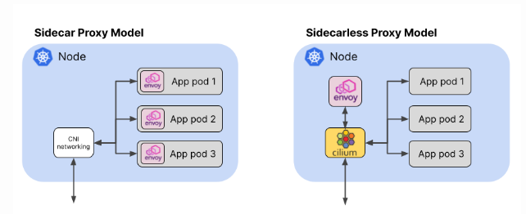
Service Mesh Vendors
Gloo Mesh – Solo.io
Future of Service Mesh - eBPF
Gloo Mesh Enterprise is a multicluster and multimesh management plane that is based on hardened, open-source projects like Envoy and Istio.
These apps can run in different virtual machines (VMs) or Kubernetes clusters on premises or in various cloud providers, and even in different service meshes.
Solo.io’s push toward eBPF-based solutions offers opportunities for new innovations
Future of Service Mesh happens in and around Data Plane
eBPF is a kernel technology that allows custom programs to run in the kernel as ‘Sandboxed’ Program.
The eBPF-based Cilium project (which recently joined the Cloud Computing Foundation at Incubation level) brings this “sidecarless” model to the world of service mesh. As well as the conventional sidecar model.
Cilium supports running a service mesh data plane using a single Envoy proxy instance per node.

Slide 7
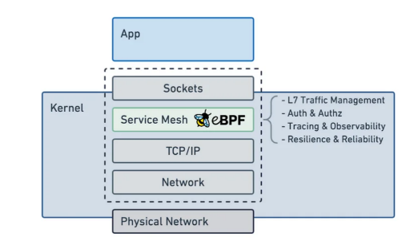
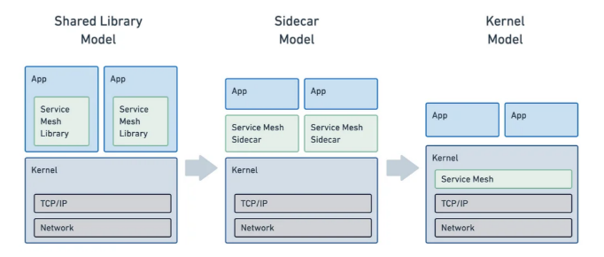
eBPF – Alternate to Sidecar Approach
eBPF allows to dynamically extend the functionality of the Linux kernel.
eBPF is widely supported in the kernel versions used in Linux production distributions.
Enterprises can take advantage of it for a more efficient networking solution, and as a more efficient data plane for service mesh.
When a use case cannot be implemented with an eBPF-only approach, the mesh can fall back onto a per-node proxy model that directly integrates the proxy with the socket layer of the kernel.
eBPF is the answer to provide a native and highly efficient service mesh implementation.

Slide 8
Tetrate
Why Tetrate?
TSB Environment
TSB Objectives
Tetrate was selected as Gartner Cool Vendor for Cloud Computing.
Tetrate built and launched GetEnvoy, an open-source project to make it easier to adopt, use and extend the Envoy Proxy within the wider community.
Tetrate built and launched GetIstio, an open-source project to make it easier to deploy, use and maintain certified Istio distributions.
Tetrate built and launched Tetrate Service Bridge (TSB), an enterprise grade, comprehensive service mesh platform that provides a unified and consistent way to secure and manage services.
Tetrate remains a top contributors and maintainers to the open-source projects Istio and Envoy Proxy and Apache SkyWalking.
A single pane for managing a heterogeneous environment of Kubernetes, Virtual Machines, bare metal servers, on-premises and cloud -- all in one place, and in a standardized, controlled way.
It is a proprietary platform that makes it easier to manage Istio, which provides an abstracted network that sits between applications and a traditional network to control the additional traffic that containers, VMs, and microservices bring to the table.
By connecting traditional and modern workloads seamlessly, TSB makes it faster and safer to modernize and incrementally migrate, without fear of downtime.
TSB enables management of all four dimensions of APP SCOR (Security, Connectivity, Observability, Reliability)
As the number of clusters, network environments and user permissions become more complex, there is a need to build another management plane above Istio’s control plane for hybrid cloud management.
Multi-cluster, multi-cloud, hybrid cloud - connect and manage applications across clusters, clouds, and data centers.
Supports any of the upstream conformant distributions of Kubernetes from major cloud vendors, which includes, but is not limited to Google Kubernetes Engine (GKE), Amazon Elastic Kubernetes Service (EKS), Azure Kubernetes Service (AKS), Openshift, and Mirantis Kubernetes Engine (MKE).
Tetrate Service Bridge also supports onboarding Virtual Machine (VM) and bare-metal workloads to the mesh.
The only application connectivity platform with zero trust built in.

Slide 9
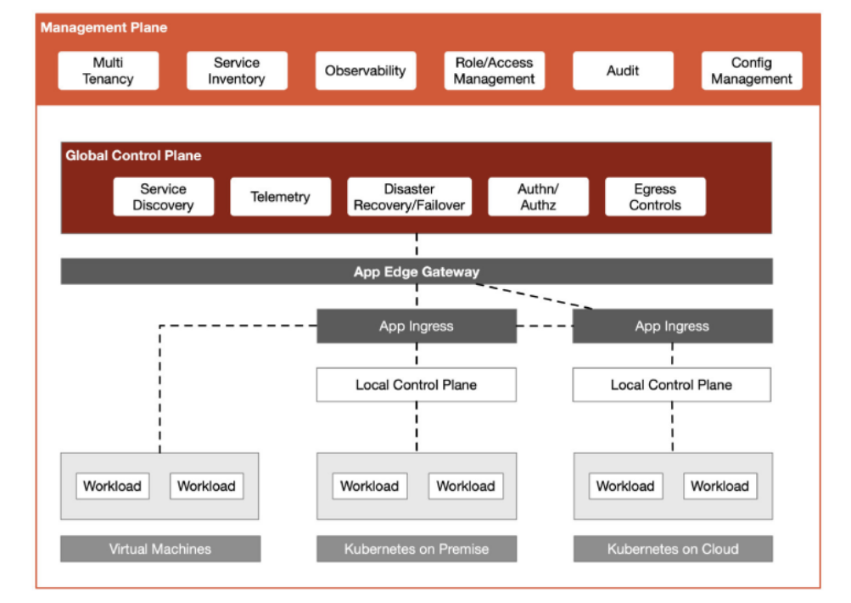
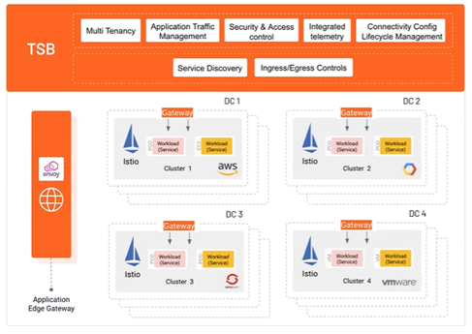
TSB Architecture
TSB is comprised of four layers: the data plane, local control planes, the global control plane (typically called the "Cross Cluster Control Plane" or "XCP" ), and the management plane.
TSB – Management Plane for Multi Mesh

Slide 10
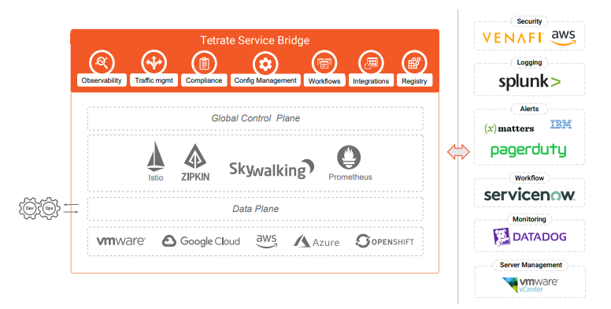
TSB Integration with Tools
TSB ships with a rich set of integrations to ease the adoption of the platform in your enterprise infrastructure.
VMware vSphere® to simplify onboarding of VMs in the enterprise.
Venafi® Trust Protection Platform as a common store for all certificates in the enterprise.
ServiceNow® to kick off workflows for change requests
Zipkin, mTLS & JWT authentication, authorization controls, ingress and egress gateways for flexible routing controls, request tracing.
ApacheSkyWalking for metrics that can be piped to a Prometheus service or to your inhouse Elasticsearch

Slide 11
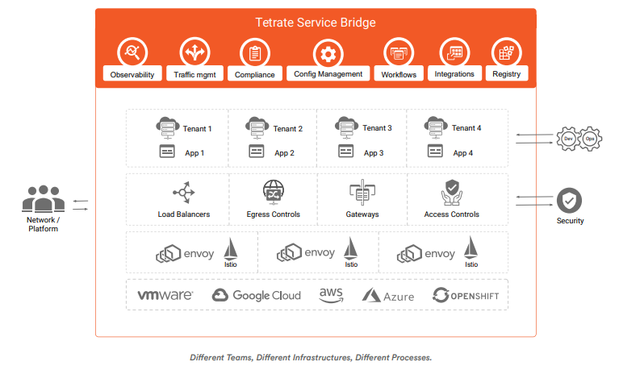
ACL Service Offerings with TSB
Unified mesh capabilities : TSB packages an application edge gateway for external traffic, an ingress controller to route traffic to workloads in an environment, and a service mesh for connectivity between workloads.
Multcluster, multicloud: TSB supports deployments across AWS, Azure, and GCP as well as on-premises virtual machine(VM) and bare-metal compute services.
Flexible operational model: TSB is available as a customer-managed or fully-managed offering. Tetrate also offers a hardened, production-grade Istio distribution with maintenance and commercial support offerings.
Open-source commitment: The founders of Tetrate are variously co-founders of and core contributors to Istio, Envoy, and Apache SkyWalking. Tetrate continues to be a leading contributor to those projects.
TSB – One Operator Experience for All

Slide 12
PoC Possibilities
To validate the below functionalities on any heterogeneous environment (GCP/ AWS/ Azure/ Vmware / Openshift / BareMetal) with onboarding different workloads for 5G/SASE/SDWAN Capabilities.
High Level Use cases:
5G – With Intel SGX Platform (Protecting Private Keys)
Key Management
Edge Computing
Digital Wallet
Blockchain
Applications at Runtime
Privacy Enhancing Analytics and Workloads
SASE - Delivers end-to-end security , Visibility and Telemetry for 5G Infrastructure and services
CASB (Cloud Access Security Broker)
SWG ( Secure Web Gateway)
ZTNA (Zero Touch Network Access)
DLP (Data Loss Protection)
RBI (Remote Browser Isolation)
FWaaS (Firewall as a Service)
SDWAN
Branch Connectivity
Cloud Connectivity
Centralized Management

Slide 13
PoC Objective
Perform a POC using TSB Platform to assess the following capabilities:
Onboard Open source/Commercial CNFs with 5G workloads (capabilities to realize the benefits of 5G/MEC )
Connectivity between Traditional and Modern workloads
Multi cluster, Multi-cloud and Multi-tenant capability
Ingress/Egress Traffic Management
Security (End-to-end mTLS)
Observability
Life cycle Management
Global Management Plane
Automatic upgrading (Data plane and Control plane)

Slide 14
Service Mesh – features
Service Discovery – Access other services in the network using simple names
Encryption – Eliminate unencrypted traffic between services in a scalable and automated way
Authentication and Authorization - Determine who is making a request and determine what is allowed to do before the request even reaches your service
Load Balancing – Distribute load across service instances in accordance with a desired pattern.
Circuit breaking – Stop traffic to struggling service and control damage from worst-case scenarios
Auto scaling – Add or remove service instances automatically based on specific criteria
Canary Deployments – Roll out features or versions of a service only to subset of users.
Blue/Green Deployments – Roll out that hot new feature, but be prepared to instatantly roll back.
Health Checking – Determine which service instances are in ship shape and respond to cases they are not.
Load shedding – Re-route traffic in response to a temporary spike in usage.
Traffic shadowing – Send a single request to multiple places
Isolation – Divide your mesh into mini meshes.
Telemetry – Gather all information from all the services
Protocol canonicalization – Translate one encoding to other transparently
Auditing
Visualization
Retries, rate limiting and timeouts
Topology-aware routing
Zero Trust Security

Slide 15
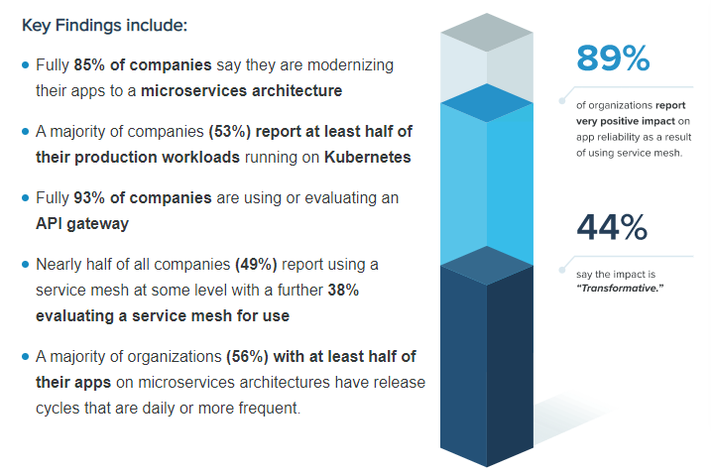
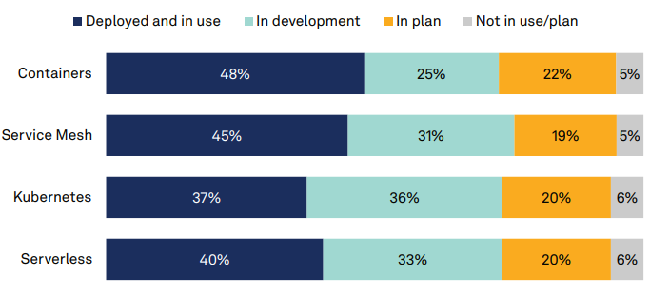
Service Mesh Adoption Survey - 2022
https://malaysiadailypost.com/service-mesh-market-report-by-product-type-application-modulus-end-users-geography-competitive-analysis-and-the-impact-of-covid-19-report/

Slide 16
Service Mesh Market Dynamics - 2022
The Major Key Players Listed in Service Mesh Market Report are:
Buoyant
HashiCorp
F5, Inc.
Kong Inc.
Solo.io
Tetrate
Amazon Web Services
Traefik Labs
A10 Networks
Red Hat (IBM)
https://malaysiadailypost.com/service-mesh-market-report-by-product-type-application-modulus-end-users-geography-competitive-analysis-and-the-impact-of-covid-19-report/

Slide 17
ACL Executional Approach
Technology Leadership
Strategic partnerships – Tetrate, Rafay Systems, …..
Joint PoCs
Solution Engineering - Synergy Areas, Collaboration of vendors
Business Opportunity – Application development and deployment services
Service Mesh organized workloads in
Public
Private
Hybrid and
Enterprise cloud deployments
Developing and showcasing use cases for specific segments and verticals – 5G, SD-WAN, SASE
Long term - Scalable and Evolving platform with CNCF components
Target Customers – EN and NN
Marketing Collaterals
Email, PPT, Demo, Whitepaper, Brochures, Forums – TIP, TMF, MWC
Developing engineering teams – HR/TAG
Architects, Leads, Senior Engineers, Fresher hiring/training

Slide 18
Service Mesh Practice
Business Case Proposal & Go-to-Market Development
Go-to-Market Plan & Sales Team Enablement
Target Portfolio Listing
Business Case Development with a Flow Chart
ROI/TCO Analysis and Action Plan
Solution Approach
Solution Scoping & Fit Assessment
Solution Architecture
Solution Roadmap Development
Migration & Implementation Planning
Business Transformation & Optimization
Business Process Management
Business Readiness & Execution Planning
Customer Experience Design
Workforce Training & Performance Management

Slide 19
Thank you..

