Slide 1
Annual Review for
Galasa 25th April 2024

Slide 2

Galasa
Brief Description:
Galasa is an application integration test framework designed to make hybrid cloud application and platform testing easier.
TSC Chairperson:
Louisa Seers – louisase@uk.ibm.com
TSC Members and Affiliations:
Louisa Seers – Chairperson – IBM
Venkatauday Balabhadrapatruni – Broadcom
Savvas Kyriacou – IBM
Mike Cobbett – IBM
Will Yates – IBM
Eamonn Mansour – IBM
Jade Carino – IBM
James Davies – IBM
Petr Plavjanik – Broadcom
Roger Brooks – IBM
Michelle Harris – Macro 4
Dom Starkey – Macro 4
Caroline McNamara – IBM
Key Links:
Github: www.github.com/galasa-dev
Website: www.galasa.dev
Mailing lists:
Galasa TSC - galasa-tsc-private@lists.openmainframeproject.org
OpenSSF Best Practice Badge URL: https://www.bestpractices.dev/en/projects/8343
Contributed by:
IBM, Macro 4, Broadcom

Slide 3
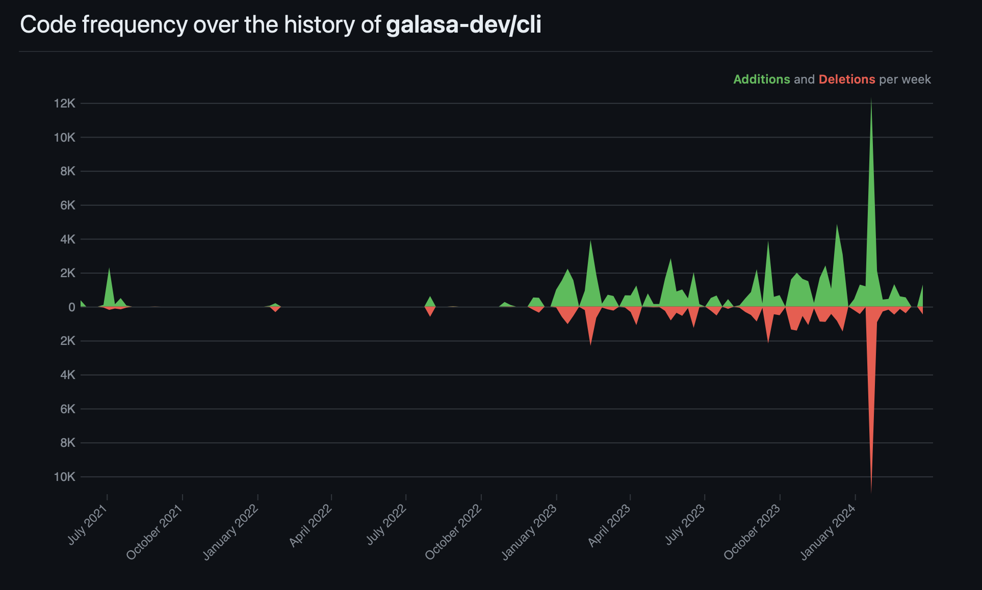
Contributions for galasa-dev/cli

Slide 4
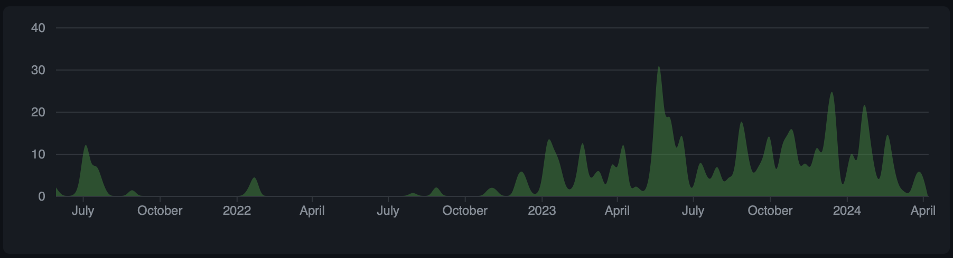
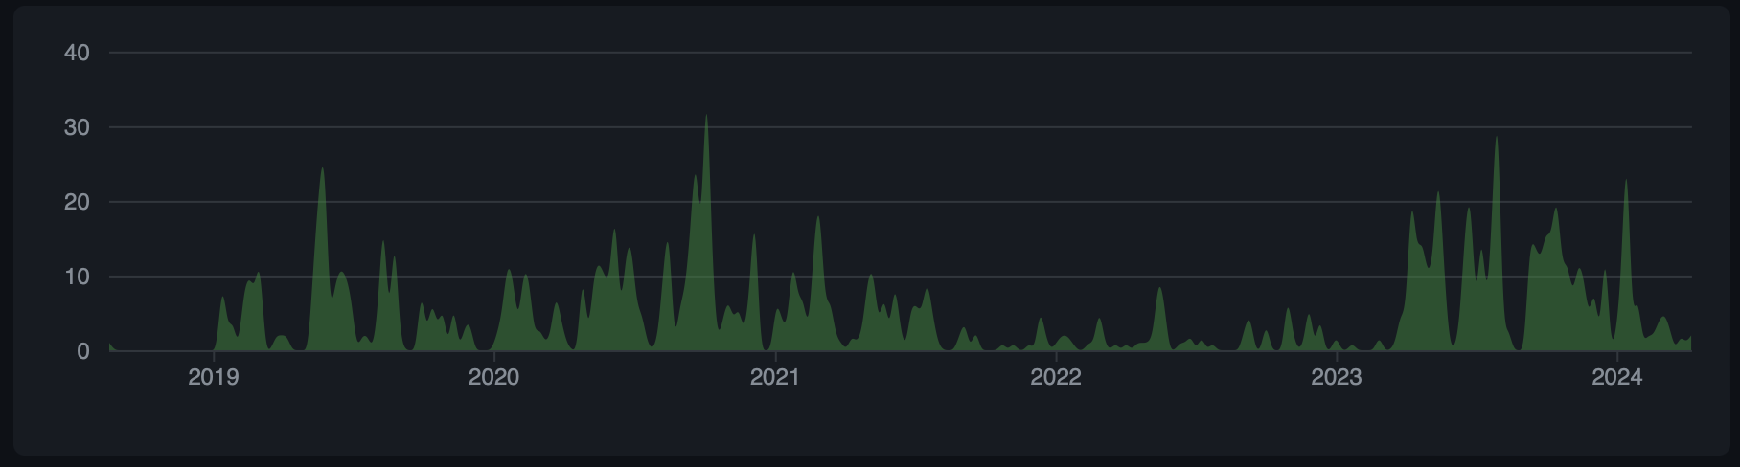
Contributions to cli and framework repositories
CLI
Framework

Slide 5
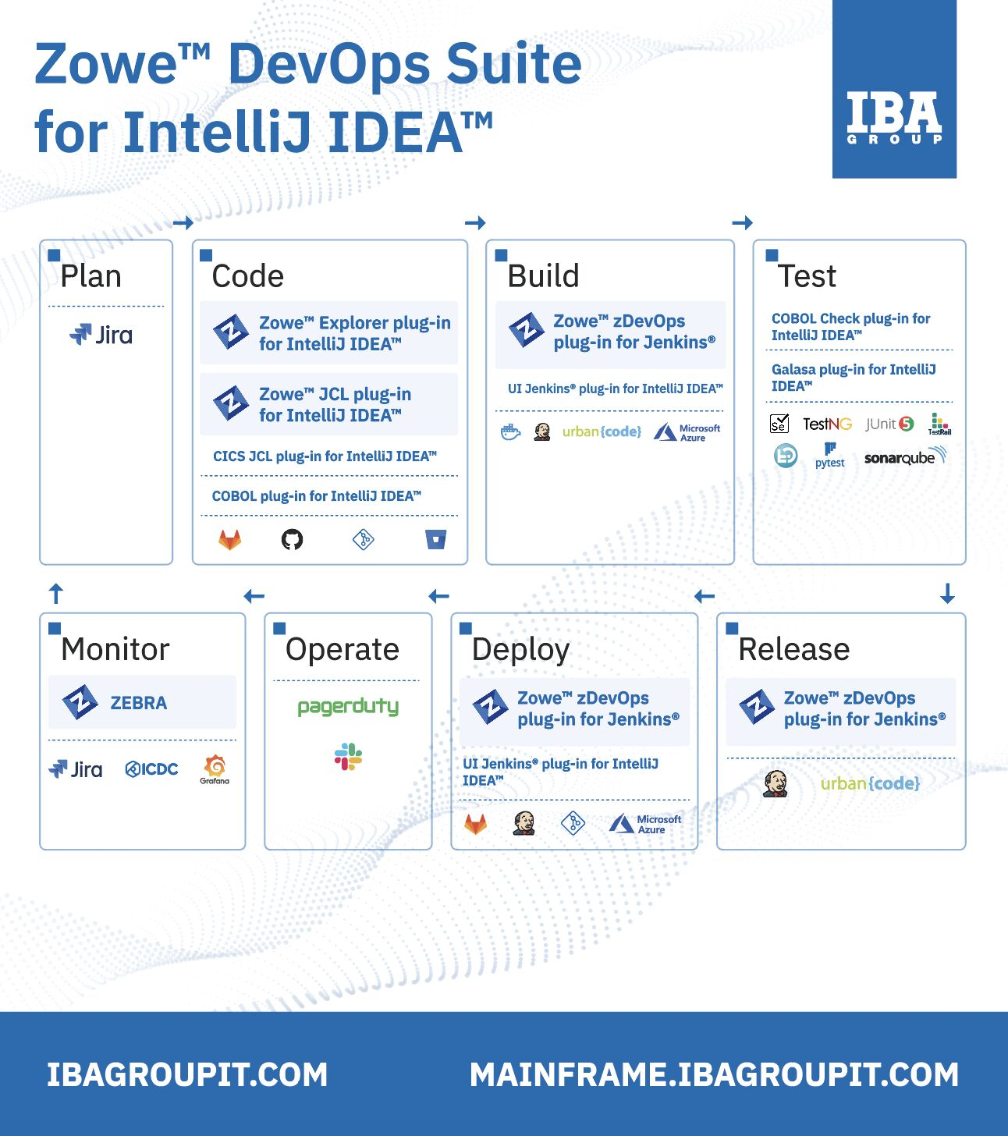



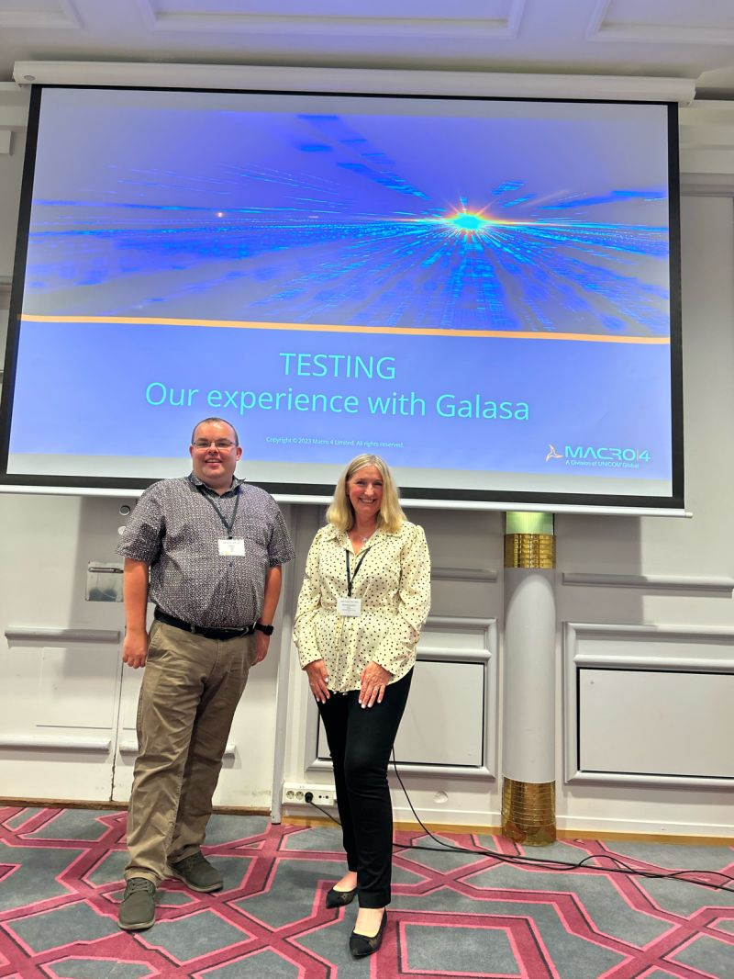
Organizations contributing and/or using in production
Companies part of the TSC

Slide 6
Key Achievements in the past year
Technical
Released versions 0.27.0 to 0.32.0
Galasa now has a comprehensive CLI which has replaced the Eclipse plug-in – for example creating example projects, logging into a remote ecosystem, manipulating the configuration property store test and manager parameters, listing historical and active runs
Changing infrastructure to a more stable account before our internal servers were shut off. Roadmap item for 1H 2024 is to migrate to OMP IBM Cloud.
Configuration property store changes with the ability to model infrastructure as code
continued…
Gherkin functionality improved
Restructuring documentation from the CLI viewpoint, using any IDE, or automation framework.
Improving security and authentication in Galasa:
Use a new web UI to allocate personal access tokens
Ports to internal services (etcd and couchdb) no longer accessible outside of the Kubernetes cluster.
Rest authorisation API to swap personal access tokens with JWT access tokens
All rest calls demand a JWT access token
Authorise your CLI tool to talk to an ecosystem using an access token

Slide 7
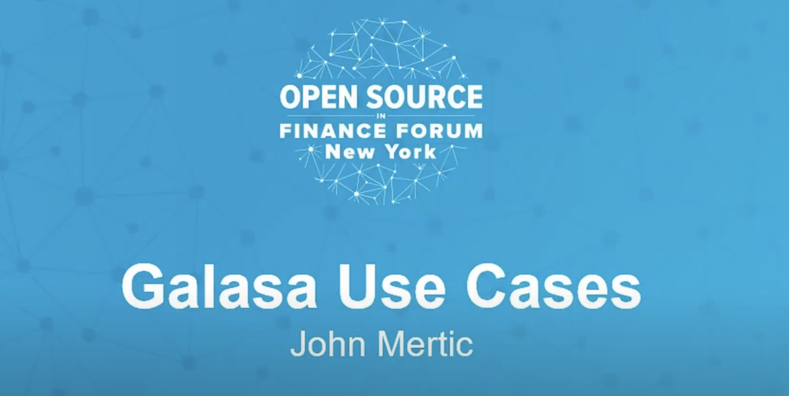
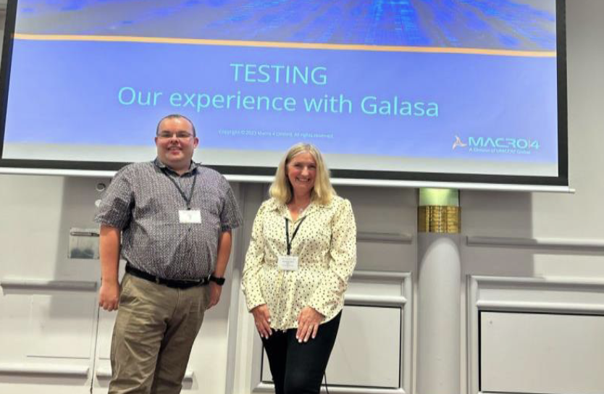
Other Key Achievements
Other
Press Release went out in September 2023
3 companies joined the TSC (Macro 4, Broadcom, IBM)
Released 6 blogs on the OMP website
Nominated for the DevOps Dozen Award 2023
Written an article for the Systems Journal
Conferences Galasa has been presented in:
GSE UK Virtual 2023
GSE Nordics 2023
SHARE New Orleans 2023
OMP Summit at TechXchange 2023
GSE UK 2023
SHARE Orlando 2024

Slide 8
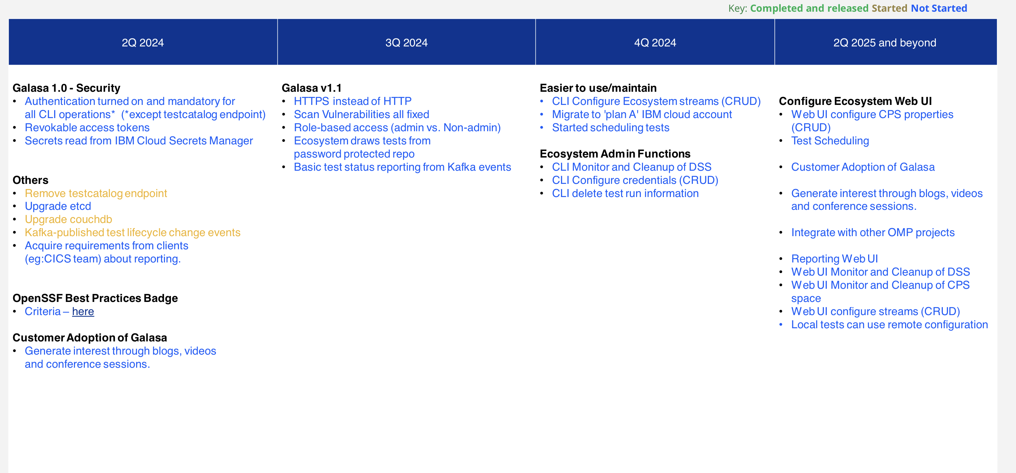
Galasa Roadmap

Slide 9
Areas Galasa could use help on
Current Challenges for Galasa
Attracting a diverse contributor base for committing code.
Creating a TSC Charter to help the TSC on things like – how do we decide voting members, voting on a release cadence for new versions, and how to ensure committers, contributors, and TSC members.

Slide 10
Feedback on working with the Open Mainframe Project
Feedback
Helpful overall, no general problems with the OMP or the Linux Foundation.
Great PR with Mae in working on regular blogs to keep a drumbeat of material from a variety of sources.
Took a while to get a cloud account organised. Hope to move to it at some point soon.
Security scans work, though problems remain about how to show current vs. historic results.
Currently working with LF to get LFX Insights working for Galasa.

Slide 11
TAC Open Discussion

