Slide 1

Trino

Slide 2
What is Trino?
טרינו הוא כלי שנועד לתשאל ביעילות כמויות עצומות של נתונים באמצעות שאילתות מבוזרות.
אם אתם עובדים עם נתונים בגודל טרה או פטה בייט סביר להניח שאתם משתמשים בכלים שיש להם אינטרקציה עם hadoop וHDFS.
טרינו תוכנן כחלופה לכלים שמתשאלית HDFS באמצעות pipelines של MapReduce כמו Hive או Pig אבל טרינו לא מוגבל לגשת רק לHDFS.
טרינו יכול וגם הורחב לפעול מעל מקורות שונים של נתונים כמו מסדי נתונים נתונים רלציוניים, מסדי נתונים לא רלציוניים , object storage וכו.

Slide 3
What Trino is ?
טרינו נועד לתפל בdata warehousing וAnalitics:
data analysis.
איחוד כמויות מידע גדולות ויצירת דוחות.
עומסי עבודה אלה מסווגים לעיתים קרובות כ Online Analytical Processing (OLAP).

Slide 4
What Trino is not?
אל תתבלבלו עם העובדה שטרינו מבין SQL ותחשבו שהוא מספק את התכונות של בסיס נתונים סטנדרטי.
טרינו הוא לא general purpose relational database.
הוא לא תחליף למסדי נתונים כמו MySQL, PostgreSQL או Oracle.
טרינו לא נועד לטפל בonline transaction processing.
זה גם נכון עבור מסדי נתונים רבים אחרים שתוכננו ומותאימים לאחסן נתונים או לניתוח נתונים.

Slide 5
Trino concepts

Slide 6
Trino concepts – Server Types
There are two types of Trino servers
Coordinator
Workers

Slide 7
Trino concepts - Coordinator
הcoordinator בtrino זה השרת שאחראי על:
parsing statements
planning queries
managing Trino worker nodes
זהו "המוח" של טרינו והוא גם הnode שאליו מתחבר לקוח כדי להגיש שאילתות לביצוע.
הcoordinator עוקב אחר הפעילות על כל worker ומתאם את ביצוע השאילתה.
הcoordinator יוצר מודל הגיוני של שאילתה הכוללת סדרת שלבים (stages), המתורגמת לאחר מכן לסדרת משימות (tasks) מחוברות הפועלות על cluster של trino workers.
הcoordinator מדבר עם הworkers דרך REST API.

Slide 8
Trino concepts - Worker
Worker זה מי שאחראי שביצוע taskים ועיבוד של המידע.
Workerים שולפים את המידע מconnectors ומחליפים נתוני ביניים זה עם זה.
שtrino worker מתחיל, הוא מעדכן את הdiscovery server (coordinator) ואז הוא מוכן לקבל משימות ממנו.

Slide 9
Trino concepts - Connector
Connector מתאים את טרינו למקור נתונים כמו hive או relational database.
אתם יכולים לחשוב על connector כמו שאתם חושבים על driver בשביל DB.
טרינו מכיל כמה connectors מובנים:
Connector for JMX
System connector (נותן גישה לטבלאות built-in)
Hive connector
TPCH connector (בשביל benchmarks)

Slide 10
Trino concepts - Catalog
Catalog מכיל סכמות ומפנה למקור נתונים דרך connector.
לדוגמא אפשר להגדיר קטלוג לpostgreSQL שיתחבר לDB מסוג PostgreSQL בעזרת PostgreSQL connector.
שאתם מריצים שאילתות בטרינו, אתם עושים את זה מול catalog אחד או יותר.

Slide 11

Trino concepts - Schema
סכמות הן דרך לארגן טבלאות.
קטלוג וסכמה ביחד, מגדירים טבלאות שיכולות להיות מתושאלות.
שניגשים לhive או relational database, סכמה בטרינו זה כמו סכמה במקור הנתונים.

Slide 12
Trino concepts - Table
טבלה היא קבוצה של שורות לא מסודרות שמאורגנות בעמודות עם שם וטיפוס
זה כמו בכל DB רלציוני
שאתם ניגשים לטבלאות בטרינו זה תמיד עדיף לגשת לשמות המלאים שלהן: <catalog_name>.<schema_name>.<table_name>

Slide 13
Trino concepts – Query execution
טרינו מריץ sql statements והופך את הstatements האלה לqueries.
שאילתות אלה מבוצעות על cluster מבוזר של coordinator אחד וכמה workers.

Slide 14
Trino concepts - Statement
טרינו מריץ ANSI-compatible SQL statements.
Statement זה ANSI SQL string שמורכבת מ clauses, expressions, וpredicates.
במילים אחרות statement זאת ההצגה הטקסטואלית של SQL statement.

Slide 15

Trino concepts - Query
שtrino מפרסר statement, הוא הופך אותה ל query ויוצר distributed query plan.
ה query plan מובן לאחר מכן כסדר של stageים קשורים שרצים על הworkers .
אפשר לחשוב על statement כטקסט SQL שמועבר לטרינו, בעוד ש query מיוחס כקונפיגורציה ו components שייועדם להריץ את הstatement.
query מכיל stages, tasks, splits, connectors ועוד חלקים ומקורות מידע שעובדים ביחד כדי להפיק תוצאה.

Slide 16
Trino concepts - Stage
שtrino מריץ query, הוא עושה זאת על ידי פירוק הביצוע להיררכיה של שלבים (stages).
היררכיית השלבים הכוללת שאילתה דומה לעץ.
לכל שאילתה יש שלב שורש, האחראי על איחוד הפלט משלבים אחרים.
Stages הם מה שה coordinator משתמש בשביל למדל את השאילתה המבוזרת אבל השלבים עצמם לא רצים על הworkers.

Slide 17
Trino concepts - Task
כדי להבין כיצד מתבצעת שלב, עליכם להבין כי שלב מיושם כסדרה של משימות המופצות ברשת של trino workers.
ה taskים הן "סוס העבודה" בארכיטקטורה של טרינו, כאשר תוכנית שאילתות מבוזרת מפורקת לסדרת שלבים, המתורגמים לאחר מכן למשימות, אשר פועלות לאחר מכן או מעבדות splits.
למשימה של טרינו יש קלטים ופלטים, וכמו שניתן לבצע שלב במקביל על ידי סדרת משימות, משימה מבוצעת במקביל לסדרת דרייברים.

Slide 18
Trino concepts - Split
Tasks operate on splits, which are sections of a larger data set.
Stages at the lowest level of a distributed query plan retrieve data via splits from connectors, and intermediate stages at a higher level of a distributed query plan retrieve data from other stages.
When Trino is scheduling a query, the coordinator queries a connector for a list of all splits that are available for a table.
The coordinator keeps track of which machines are running which tasks, and what splits are being processed by which tasks.

Slide 19
Trino concepts - Driver
Tasks מכילים אחד או יותר parallel drivers.
Drivers עובדים על מידע ומאחדים operators להפיק פלט שלאחר מכן מאוחד על ידי task ואז מועבר ל task אחר בstage אחר.
driver הוא רצף של אופרטורים, או שאתם יכולים לחשוב על driver שרצף פיזי של אופרטורים בזיכרון.
זוהי הרבה הנמוכה ביותר של מקביליות בארכיטקטורה של טרינו.
לדרייבר יש פלט וקלט.

Slide 20
Trino concepts - Operator
מפעיל צורך, מעבד ומפיק נתונים.
לדוגמא, table scan מפיק מידע מ connector ומייצר מידע שיכול להיות משומש על ידי אופרטורים אחרים, וfilter operator צורכת מידע ומפיקה תת קבוצה על ידי הפעלת פרדיקט על המידע הנכנס .

Slide 21
Trino concepts - Exchange
חילופי מידע בין nodeים שונים לשלבים שונים של השאילתה.
Taskים מייצרים מידע ל output buffer וצורכים מידע מ tasks אחרים בעזרת exchange client.

Slide 22
Trino clients

Slide 23
Trino clients
Trino has libraries/drivers for various languages and platforms:
JDBC driver for Java/JVM
ODBC driver for Windows
Go
Node.js
Python
R
Ruby

Slide 24
Web UI

Slide 25
Web UI
Trino provides a web-based user interface (UI) for monitoring a Trino cluster and managing queries.
The Web UI is accessible on the coordinator via HTTP/HTTPS, using the corresponding port number specified in the coordinator

Slide 26
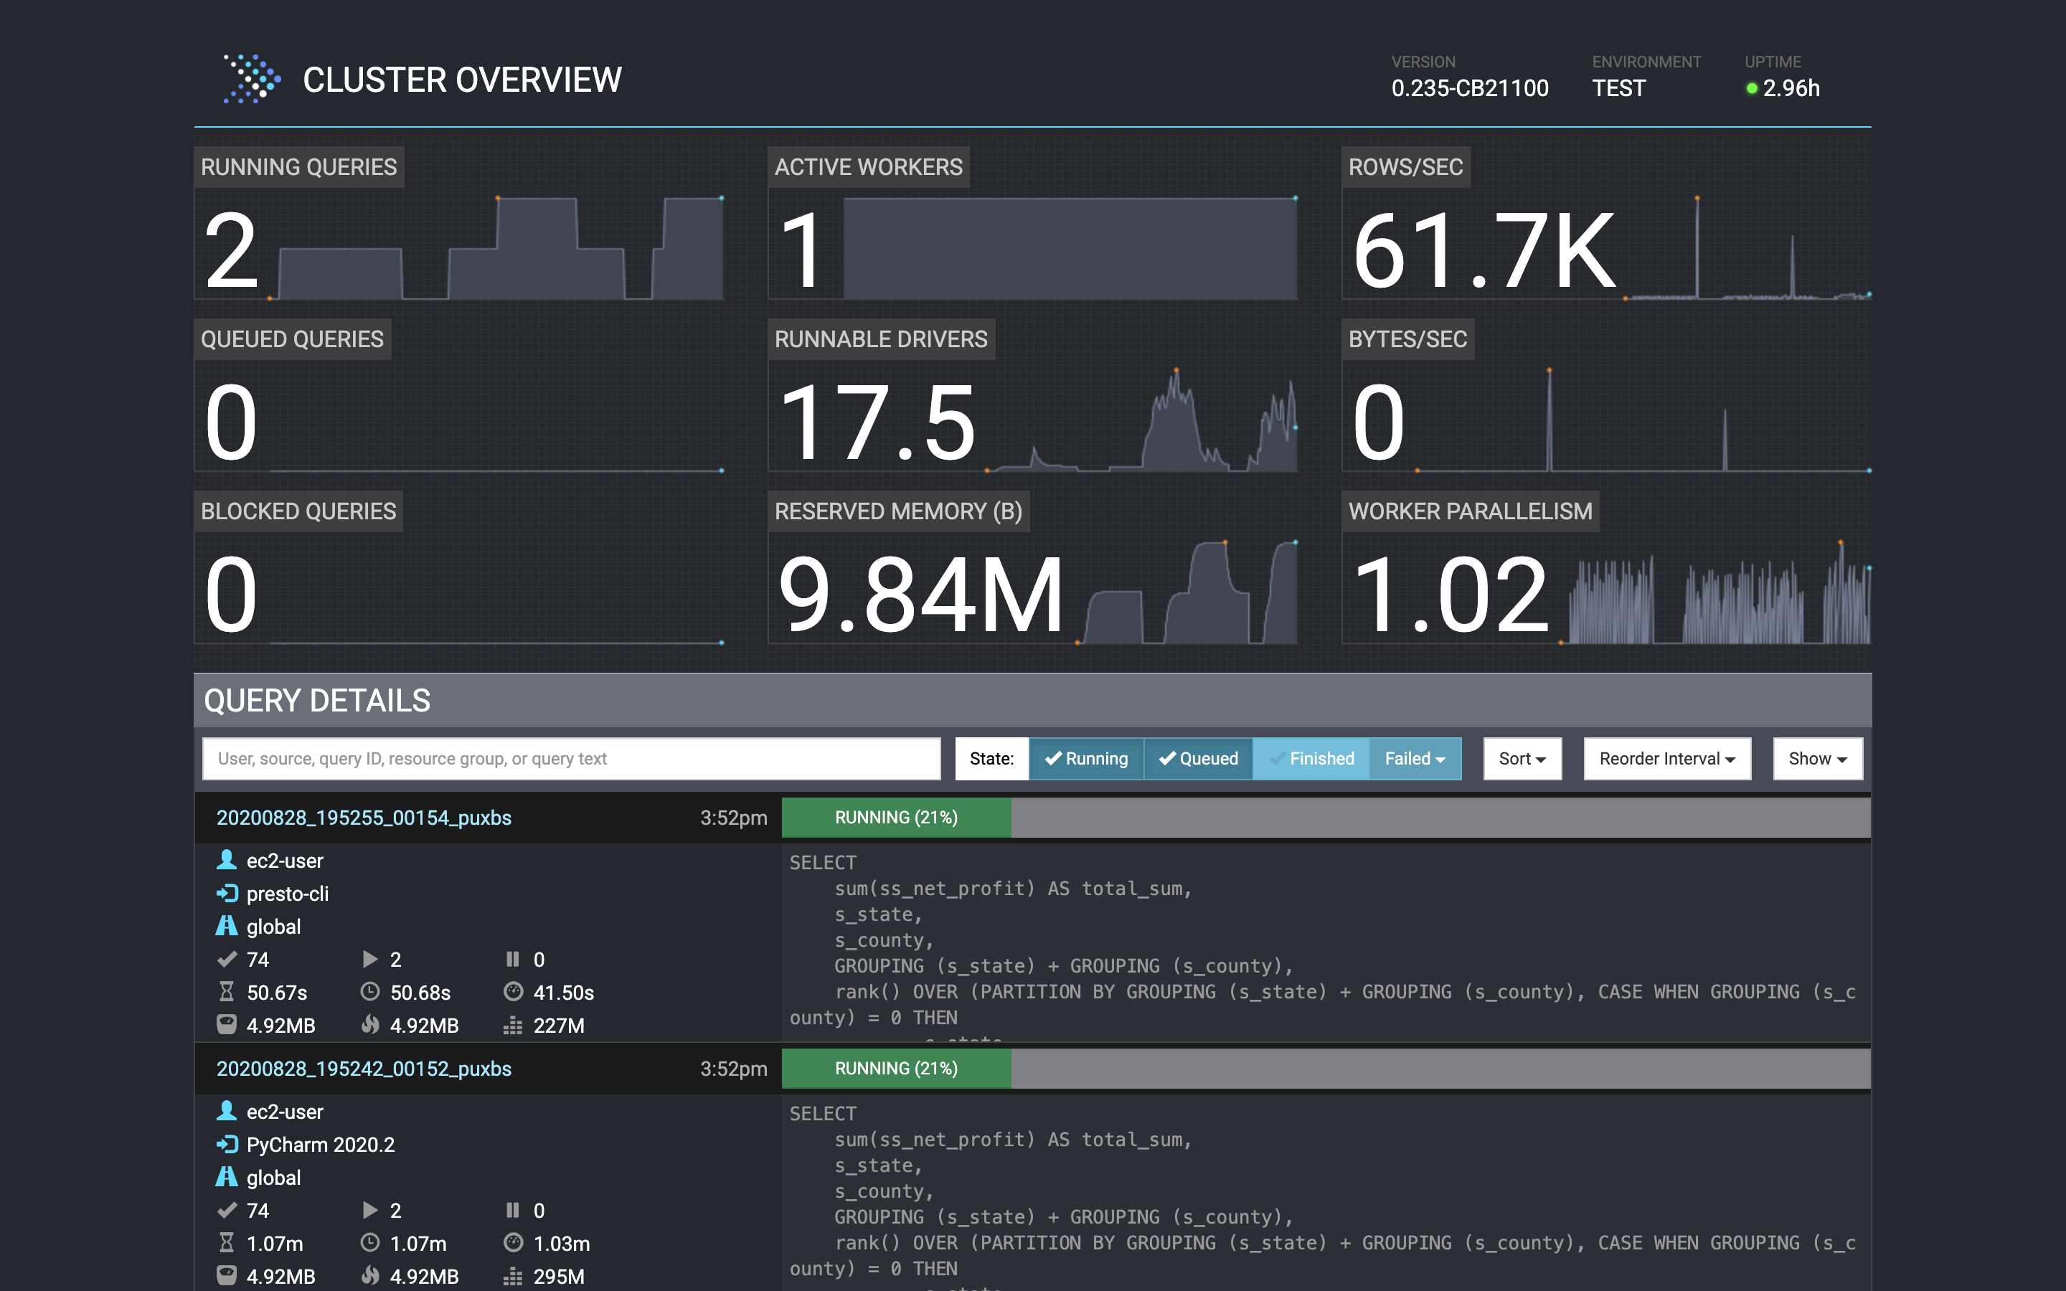
Web UI
The main page has a list of queries along with information like unique query ID, query text, query state, percentage completed, username and source from which this query originated.
The currently running queries are at the top of the page, followed by the most recently completed or failed queries.

Slide 27
Web UI
The possible query states are as follows:
QUEUED – Query has been accepted and is awaiting execution.
PLANNING – Query is being planned.
STARTING – Query execution is being started.
RUNNING – Query has at least one running task.
BLOCKED – Query is blocked and is waiting for resources (buffer space, memory, splits, etc.).
FINISHING – Query is finishing (e.g. commit for autocommit queries).
FINISHED – Query has finished executing and all output has been consumed.
FAILED – Query execution failed.

Slide 28
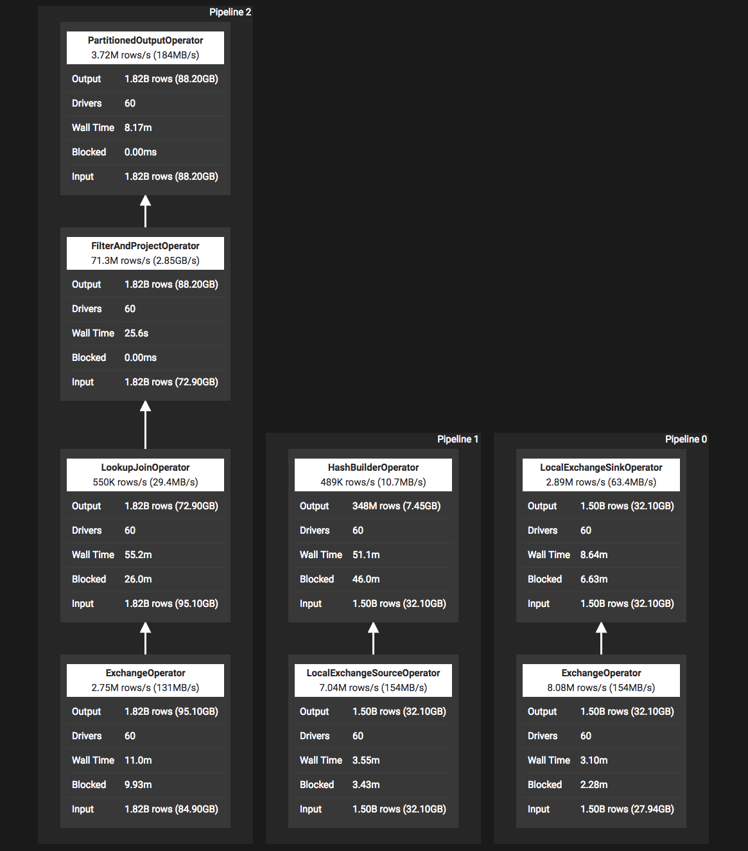
Web UI
For more detailed information about a query, simply click the query ID link.
The query detail page has a summary section, graphical representation of various stages of the query and a list of tasks.
Each task ID can be clicked to get more information about that task.

Slide 29
Query Optimizers

Slide 30
Table statistics
Trino supports statistics based optimizations for queries.
For a query to take advantage of these optimizations, Trino must have statistical information for the tables in that query.
The following statistics are available in Trino:
For a table:
row count: the total number of rows in the table
For each column in a table:
data size: the size of the data that needs to be read
nulls fraction: the fraction of null values
distinct value count: the number of distinct values
low value: the smallest value in the column
high value: the largest value in the column

Slide 31
Table Statistics
The set of statistics available for a particular query depends on the connector being used and can also vary by table.
For example, the Hive connector does not currently provide statistics on data size.
Table statistics can be displayed via the Trino SQL interface using the SHOW STATS command.
For the Hive connector, refer to the Hive connector documentation to learn how to update table statistics.

Slide 32
Cost in EXPLAIN
During planning, the cost associated with each node of the plan is computed based on the table statistics for the tables in the query.
This calculated cost is printed as part of the output of an EXPLAIN statement.
Cost information is displayed in the plan tree using the format {rows: XX (XX), cpu: XX, memory: XX, network: XX}
rows refers to the expected number of rows output by each plan node during execution.
The value in the parentheses following the number of rows refers to the expected size of the data output by each plan node in bytes.

Slide 33
Cost in EXPLAIN
Other parameters indicate the estimated amount of CPU, memory, and network utilized by the execution of a plan node.
These values do not represent any actual unit, but are numbers that are used to compare the relative costs between plan nodes, allowing the optimizer to choose the best plan for executing a query.
If any of the values is not known, a ? is printed.

Slide 34
Cost in EXPLAIN
EXPLAIN SELECT comment FROM tpch.sf1.nation WHERE nationkey > 3;
- Output[comment] => [[comment]]
Estimates: {rows: 22 (1.69kB), cpu: 6148.25, memory: 0.00, network: 1734.25}
- RemoteExchange[GATHER] => [[comment]]
Estimates: {rows: 22 (1.69kB), cpu: 6148.25, memory: 0.00, network: 1734.25}
- ScanFilterProject[table = tpch:nation:sf1.0, filterPredicate = ("nationkey" > BIGINT '3')] => [[comment]]
Estimates: {rows: 25 (1.94kB), cpu: 2207.00, memory: 0.00, network: 0.00}/{rows: 22 (1.69kB), cpu: 4414.00, memory: 0.00, network: 0.00}/{rows: 22 (1.69kB), cpu: 6148.25, memory: 0.00, network: 0.00}
nationkey := tpch:nationkey
comment := tpch:comment

Slide 35
Cost in EXPLAIN
Generally, there is only one cost printed for each plan node.
However, when a Scan operator is combined with a Filter and/or Project operator, then multiple cost structures are printed, each corresponding to an individual logical part of the combined operator.
For example, three cost structures are printed for a ScanFilterProject operator, corresponding to the Scan, Filter, and Project parts of the operator, in that order.

Slide 36
Cost Based Optimizations
Trino supports several cost based optimizations:
Join enumeration
Join distribution selection

Slide 37
Cost Based Optimizations - join enumeration
The order in which joins are executed in a query can have a significant impact on the query’s performance.
The aspect of join ordering that has the largest impact on performance is the size of the data being processed and transferred over the network.
If a join, that produces a lot of data, is performed early in the execution, then subsequent stages need to process large amounts of data for longer than necessary, increasing the time and resources needed for the query.

Slide 38
Cost Based Optimizations - join enumeration
With cost based join enumeration, Trino uses Table statistics provided by connectors to estimate the costs for different join orders and automatically picks the join order with the lowest computed costs.
The join enumeration strategy is governed by the join_reordering_strategy session property, with the optimizer.join-reordering-strategy configuration property providing the default value.
The valid values are:
AUTOMATIC (default) - full automatic join enumeration enabled
ELIMINATE_CROSS_JOINS - eliminate unnecessary cross joins
NONE - purely syntactic join order
If using AUTOMATIC and statistics are not available, or if for any other reason a cost could not be computed, the ELIMINATE_CROSS_JOINS strategy is used instead.

Slide 39
Cost Based Optimization – join distribution selection
I will not explain this as this is more complicated and who wants to read it can do so here: https://trino.io/docs/current/optimizer/cost-based-optimizations.html

Slide 40
Pushdown
Trino can push down the processing of queries, or parts of queries, into the connected data source.
This means that a specific predicate, aggregation function, or other operation, is passed through to the underlying database or storage system for processing.
The results of this pushdown can include the following benefits:
improved overall query performance
reduced network traffic between Trino and the data source
reduced load on the remote data source
Support for pushdown is specific to each connector and the relevant underlying database or storage system.

Slide 41
Aggregation Pushdown
Aggregation pushdown can take place provided the following conditions are satisfied:
If aggregation pushdown is generally supported by the connector.
If pushdown of the specific function or functions is supported by the connector.
If the query structure allows pushdown to take place.
You can check if pushdown for a specific query is performed by looking at the EXPLAIN plan of the query.
If an aggregate function is successfully pushed down to the connector, the explain plan does not show that Aggregate operator.
The explain plan only shows the operations that are performed by Trino.

Slide 42
Aggregation Pushdown
As an example, we loaded the TPCH data set into a PostgreSQL database and then queried it using the PostgreSQL connector:
SELECT regionkey, count(*) FROM nation GROUP BY regionkey;
You can get the explain plan by prepending the above query with EXPLAIN:
EXPLAIN SELECT regionkey, count(*) FROM nation GROUP BY regionkey;

Slide 43
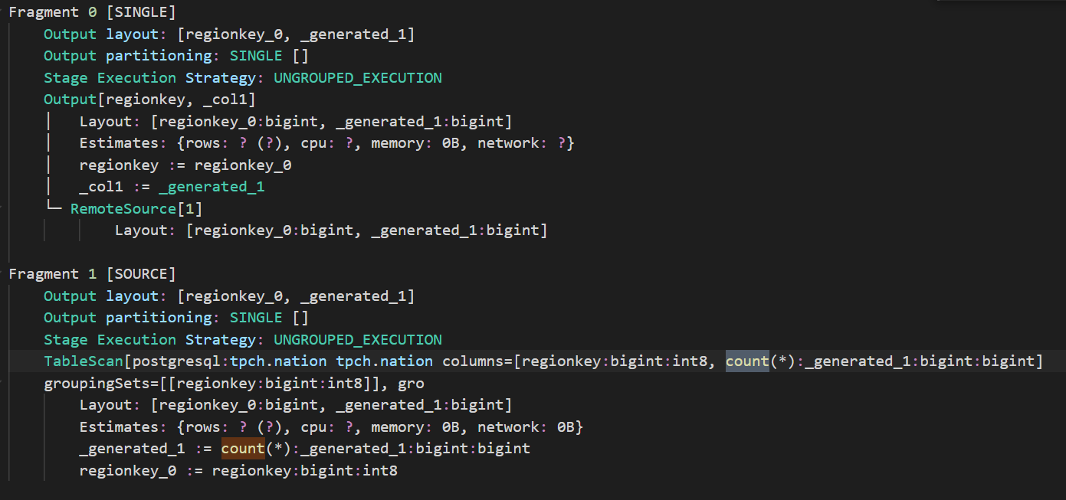
Aggregation Pushdown
The explain plan for this query does not show any Aggregate operator with the count function, as this operation is now performed by the connector.
You can see the count(*) function as part of the PostgreSQL TableScan operator. This shows you that the pushdown was successful.

Slide 44
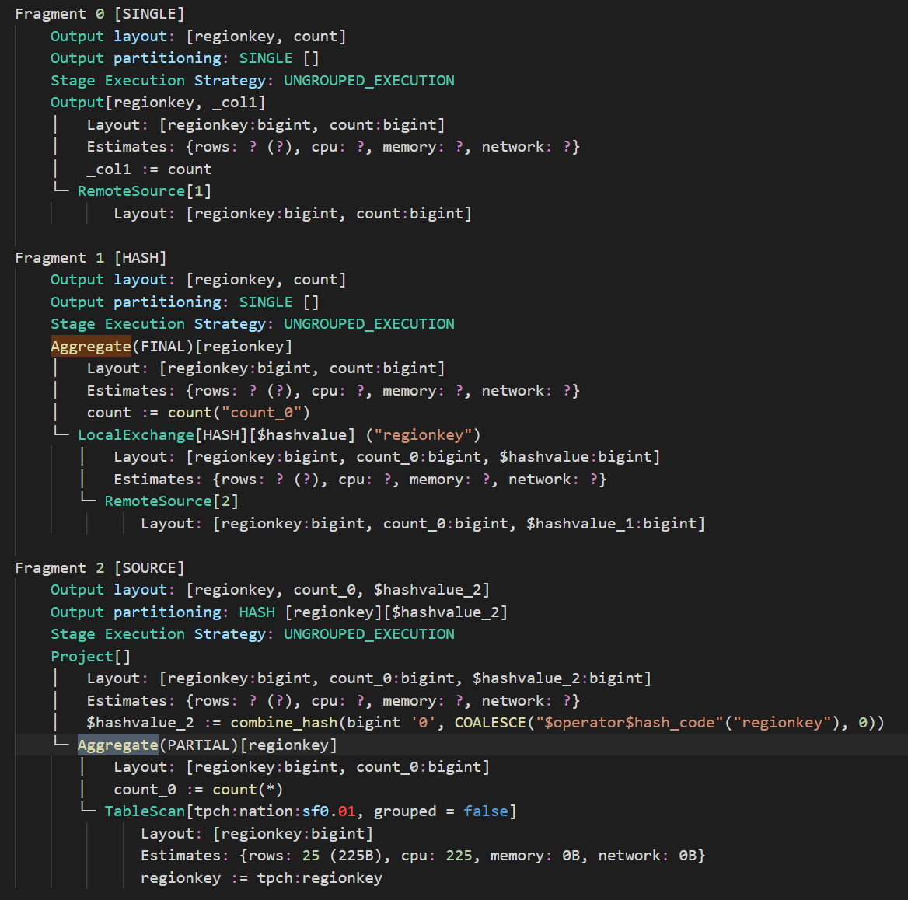
Aggregation Pushdown
A number of factors can prevent a push down:
adding a condition to the query
using a different aggregate function that cannot be pushed down into the connector
using a connector without pushdown support for the specific function
As a result, the explain plan shows the Aggregate operation being performed by Trino.
This is a clear sign that now pushdown to the remote data source is not performed, and instead Trino performs the aggregate processing.

Slide 45
Aggregation Pushdown - Limitations
Pushdown does not support a number of more complex statements:
complex grouping operations such as ROLLUP, CUBE, or GROUPING SETS
expressions inside the aggregation function call: sum(a * b)
coercions: sum(integer_column)
aggregations with ordering
aggregations with filter

Slide 46
connectors

Slide 47
Connectors
Some of the useful connectors are:
Hive – to query s3 via the hive metastore
Kafka – to query kafka records
Elasticsearch
Postgresql
MySql
MongoDB
Redis
Etc...

Slide 48
Hive connector
The hive connector allows querying data stored in Hadoop Distributed File System(HDFS) or I object storage systems such as S3.
Metadata about how the data files are mapped to shcemas and tables. This metadata is stored in a DB, such as postgresql, and is accessed via the Hive metastore service.

Slide 49
Hive connector
The following file types are supported for the Hive connector:
ORC
Parquet
Avro
RCText (RCFile using ColumnarSerDe)
RCBinary (RCFile using LazyBinaryColumnarSerDe)
SequenceFile
JSON (using org.apache.hive.hcatalog.data.JsonSerDe) (JsonPerLine objects).
CSV (using org.apache.hadoop.hive.serde2.OpenCSVSerde)
TextFile

Slide 50
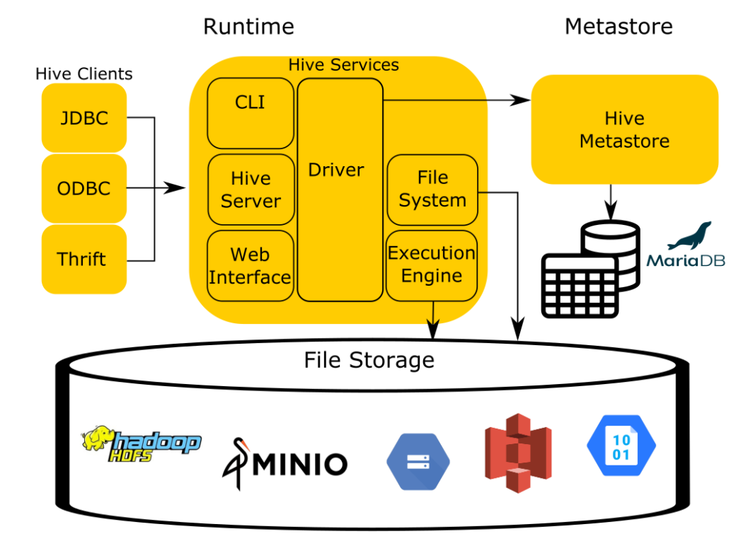
Hive connector
To understand Trino's hive connector, you first need to know a few high level components of the Hive architecture

Slide 51
Hive connector
You can simplify the Hive architecture to four components:
The runtime
The storage
Hive Metastore Service (HMS)
Hive’s data organization specification (not included in the image)

Slide 52
Hive – The runtime
The runtime contains the logic of the query engine.
It translates the SQL - esque Hive Query Language(HQL) into MapReduce jobs that run over files stored in the filesystem.

Slide 53
Hive – The storage
The storage component stores files in various formats and index structures to recall these files.
Traditionally, Hive runs on top of the Hadoop Distributed Filesystem (HDFS).
As cloud-based options became more prevalent, object storage like Amazon S3, Azure Blob Storage, Google Cloud Storage, and others needed to be leveraged as well and replaced HDFS as the storage component.

Slide 54
Hive – Hive Metastore Service
In order for Hive to process these files, it must have a mapping from SQL tables in the runtime to files and directories in the storage component.
To accomplish this, Hive uses metastore to manage the metadata about the files such as table columns, file locations, file formats, etc…

Slide 55
Hive – Hive’s data organization specification
The documentation of this element only exists in the code in Hive and has been reverse engineered to be used by other systems like Trino to remain compatible with other systems.

Slide 56
Hive Connector
Trino reuses all of these conponents except for the runtime. This is the same approach most compute engine takes when dealing with data in object stores, specifically, Trino, Spark, Drill, and Impala.

Slide 57
Trino runtime
More businesses want to run fast interactive queries over their big data instead of running jobs that take hours and produce possibly undesirable results.
Many companies have petabytes of data and metadata in their data warehouse.
Since only the runtime that executed Hive queries needs replacement, the Trino engine utilizes the existing metastore metadata and files residing in storage, and the Trino runtime effectively replaces the Hive runtime responsible for analyzing the data.

Slide 58
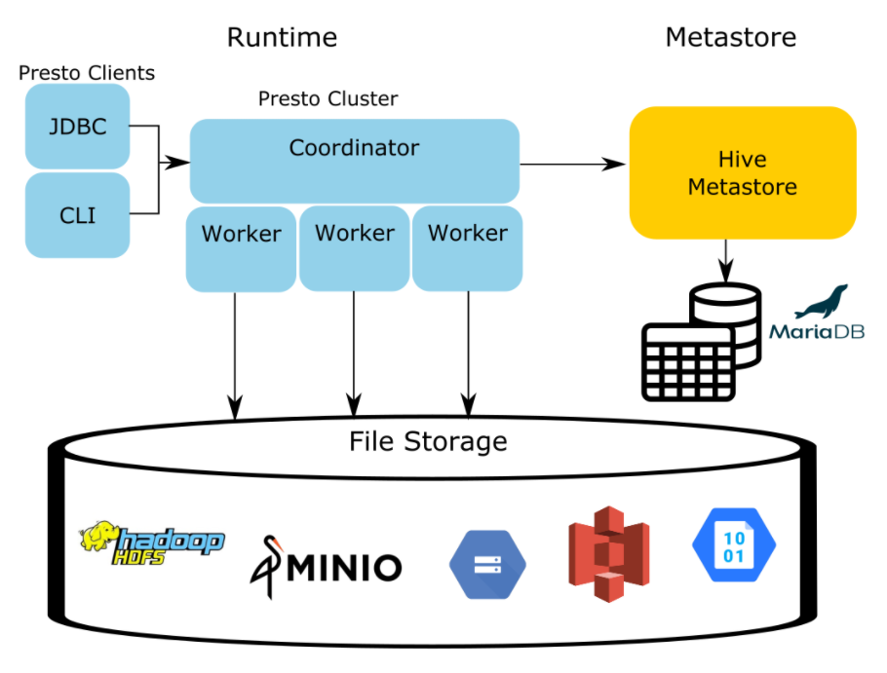
Presto Architecture

Slide 59
Hive Connector
First, you have to create a catalog with the appropriate s3 creds.
After that you need to create schema in Trino for your tables to be part of. CREATE SCHEMA hive_test.test_schema;
hive_test is the name of our catalog.
test_schema will be the name of our schema.

Slide 60
Hive Connector
Now, we can create a table :
CREATE TABLE hive.web.page_views ( view_time timestamp, user_id bigint, page_url varchar, ds date, country varchar ) WITH ( format = 'JSON', partitioned_by = ARRAY['ds', 'country'], external_location = 's3://my-bucket/' );

Slide 61
Hive connector – Special columns
In addition to the defined columns, the Hive connector automatically exposes metadata in a number of hidden columns in each table.
You can use these columns in your SQL statements like any other column.
$bucket: Bucket number for this row
$path: Full file system path name of the file for this row
$file_modified_time: Date and time of the last modification of the file for this row
$file_size: Size of the file for this row
$partition: Partition name for this row

Slide 62
Dynamic filtering
The Hive connector supports the dynamic filtering optimization.
Dynamic partition pruning is supported for partitioned tables stored in any file format for broadcast as well as partitioned joins.
For tables stored in ORC or Parquet file format, dynamic filters are also pushed into local table scan on worker nodes for broadcast joins.
Dynamic filter predicates pushed into the ORC and Parquet readers are used to perform stripe or row-group pruning and save on disk I/O.

Slide 63
Dynamic filtering –what is it?
Dynamic filtering optimizations significantly improve the performance of queries with selective joins by avoiding reading of data that would be filtered by join condition.
Consider the following query which captures a common pattern of a fact table sales joined with a filtered dimension table items:
SELECT * FROM sales JOIN items ON sales.item_id = items.id WHERE items.price > 1000;

Slide 64
Dynamic filtering
Without dynamic filtering, Trino pushes predicates for the dimension table to the table scan on items, and it scans all the data in the fact table since there are no filters on sales in the query.
The join operator ends up throwing away most of the probe-side rows as the join criteria is highly selective.
When dynamic filtering is enabled, Trino collects candidate values for join condition from the processed dimension table on the right side of join.
In the case of broadcast joins, the runtime predicates generated from this collection are pushed into the local table scan on the left side of the join running on the same worker.

Slide 65
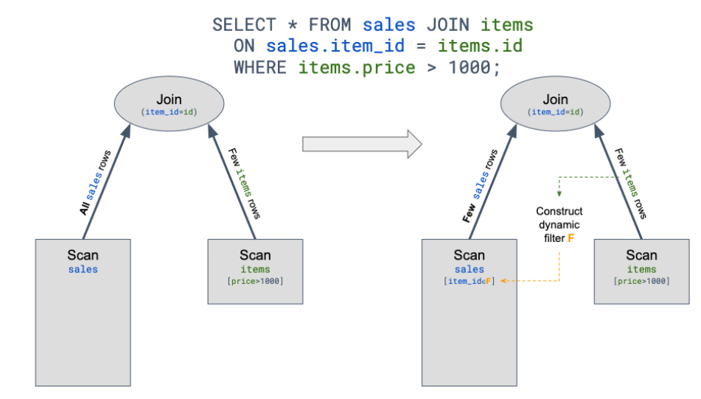
Dynamic filtering

Slide 66
Dynamic filtering
For example, in the case of the Hive connector, dynamic filters are used to skip loading of partitions which don’t match the join criteria. This is known as dynamic partition pruning.
The results of dynamic filtering optimization can include the following benefits:
improved overall query performance
reduced network traffic between Trino and the data source
reduced load on the remote data source

Slide 67
Analysis and confirmation
Dynamic filtering depends on a number of factors:
Planner support for dynamic filtering for a given join operation in Trino.
Currently inner and right joins with =, <, <=, >, >= or IS NOT DISTINCT FROM join conditions, and semi-joins with IN conditions are supported.
Connector support for utilizing dynamic filters pushed into the table scan at runtime.
For example, the Hive connector can push dynamic filters into ORC and Parquet readers to perform stripe or row-group pruning.
Connector support for utilizing dynamic filters at the splits enumeration stage.
Size of right (build) side of the join.

Slide 68
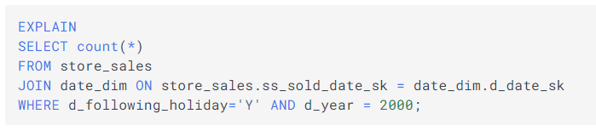
Analysis and confirmation
You can take a closer look at the EXPLAIN plan of the query to analyze if the planner is adding dynamic filters to a specific query’s plan.
For example, the explain plan for the query can be obtained by running the following statement:

Slide 69
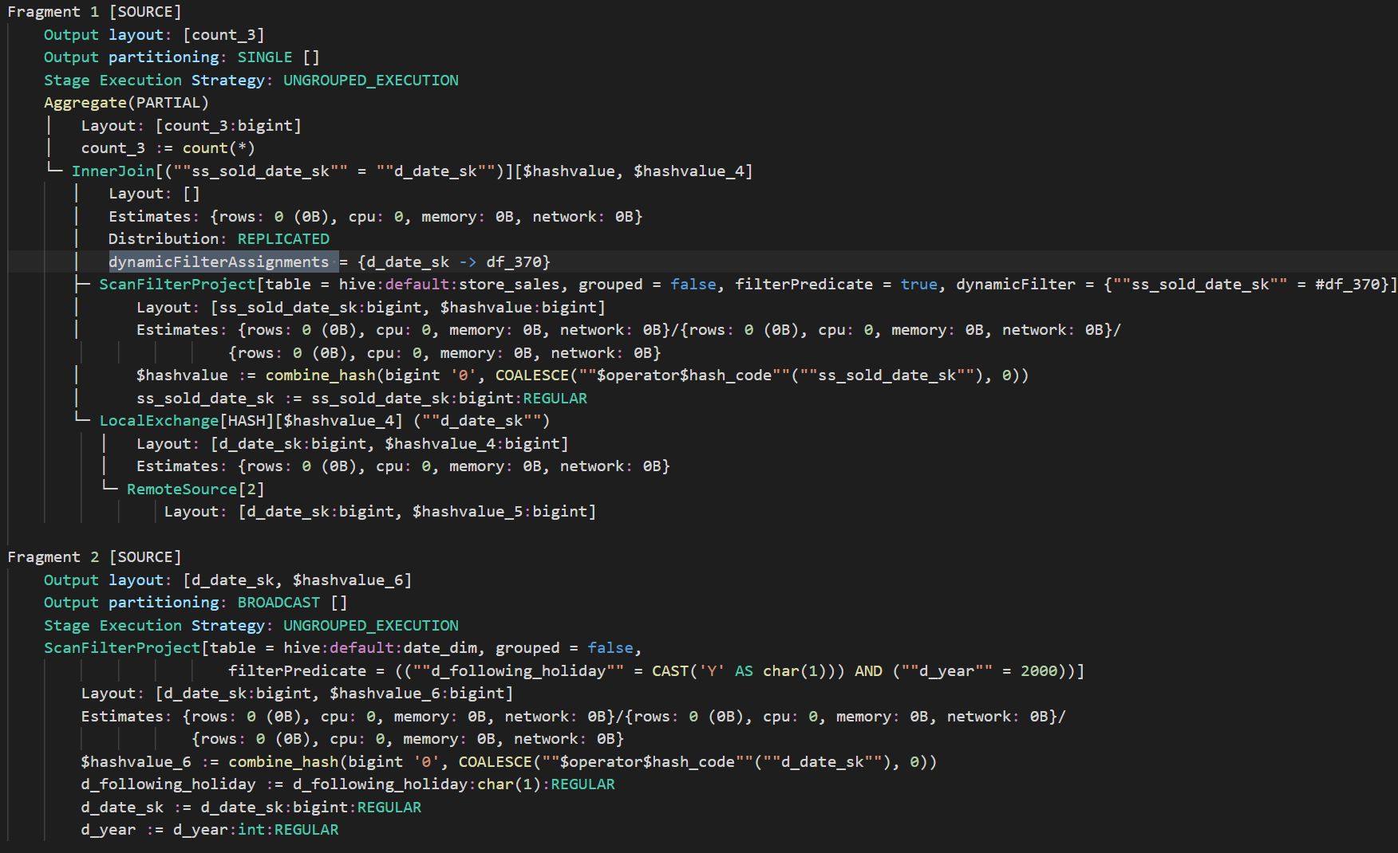
Analysis and confirmation
The explain plan for this query shows dynamicFilterAssignments in the InnerJoin node with dynamic filter df_370 collected from build symbol d_date_sk.
You can also see the dynamicFilter predicate as part of the Hive ScanFilterProject operator where df_370 is associated with probe symbol ss_sold_date_sk.
This shows you that the planner is successful in pushing dynamic filters down to the connector in the query plan.

Slide 70


Dynamic filter collection thresholds
In order for dynamic filtering to work, the smaller dimension table needs to be chosen as a join’s build side (right side).
The cost-based optimizer can automatically do this using table statistics provided by connectors.
Therefore, it is recommended to keep table statistics up to date and rely on the CBO to correctly choose the smaller table on the build side of join.

Slide 71
Dynamic filtering limitations
Dynamic filtering is currently implemented only for Hive and Memory connectors.
Push down of dynamic filters into local table scan on worker nodes is limited to broadcast joins.
Min-max dynamic filter collection is not supported for DOUBLE, REAL and unorderable data types.
Dynamic filtering is not supported for DOUBLE and REAL data types when using IS NOT DISTINCT FROM predicate.
Dynamic filtering is supported when the join key contains a cast from the build key type to the probe key type.

