Slide 1
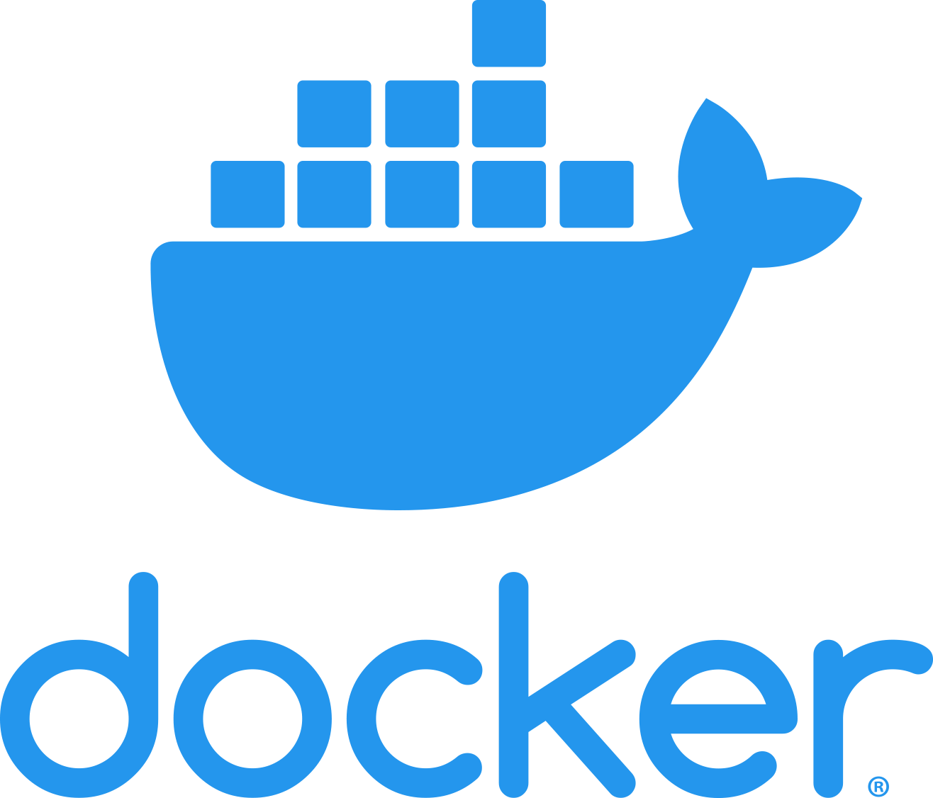
A very informal introduction to Docker
Federico Galatolo

Slide 2
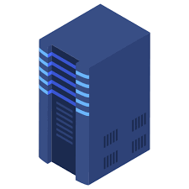
Once upon a time...
Webserver
Database Server
Reverse Proxy
Webserver

Slide 3
And then was the cloud...
Datacenter
Database
Webserver
Webserver

Slide 4
OS Architecture
GNU Coreutils
GNU Coreutils
Applications
GNU
GNU C Library
GNU C Library
Kernel
Kernel
Linux
Hardware

Slide 5
VM Architecture
GNU Coreutils
Applications
GNU C Library
Kernel
Virtual Hardware
GNU Coreutils
Hypervisor
GNU C Library
Kernel
Hardware

Slide 6
VMs Architecture
GNU Coreutils
Applications
GNU Coreutils
Applications
GNU Coreutils
Applications
GNU C Library
GNU C Library
GNU C Library
Kernel
Kernel
Kernel
Virtual Hardware
Virtual Hardware
Virtual Hardware
Hypervisor
Too much overhead

Slide 7
Linux Containers
GNU Coreutils
Applications
GNU C Library
Kernel
Virtual Hardware
GNU Coreutils
Hypervisor
GNU C Library
Kernel
Hardware

Slide 8
Linux Container
GNU Coreutils
Applications
GNU C Library

Slide 9
Linux Containers Architecture
GNU Coreutils
Applications
GNU Coreutils
Applications
GNU C Library
GNU C Library
Linux Containers Interface
Kernel
Hardware

Slide 10
Containers VS VMs: Open a File in VM
Application
Open a File
GNU C Library
open(file)
Kernel
HD Block
Virtual Hardware
Virtual HD Location
Hypervisor
Locate Virt. HD file and offset
GNU C Library
open(virt_hd_file)
Kernel
HD Block
Virtual Hardware
HD Location

Slide 11
Containers VS VMs: Open a File in Container
Application
Open a File
GNU C Library
open(file)
Linux Containers Interface
open(container_file)
Kernel
HD Block
Hardware
HD Location

Slide 12
Linux Containers
Basically zero overhead and host-like performances
GNU Coreutils
Applications
GNU C Library
VM-like isolation
Lightweight and portable
But can we do better?

Slide 13
Linux Containers
Application
What if some applications use the same linux distribution or libraries?
Library
Library
Library
GNU Coreutils
Linux Distribution
How to handle updates?
GNU C Library

Slide 14
Wouldn't be nice if ...?
Distribution
Distribution
Distribution V2
Distribution V2
Libraries
Libraries
Application 1
Application 2

Slide 15
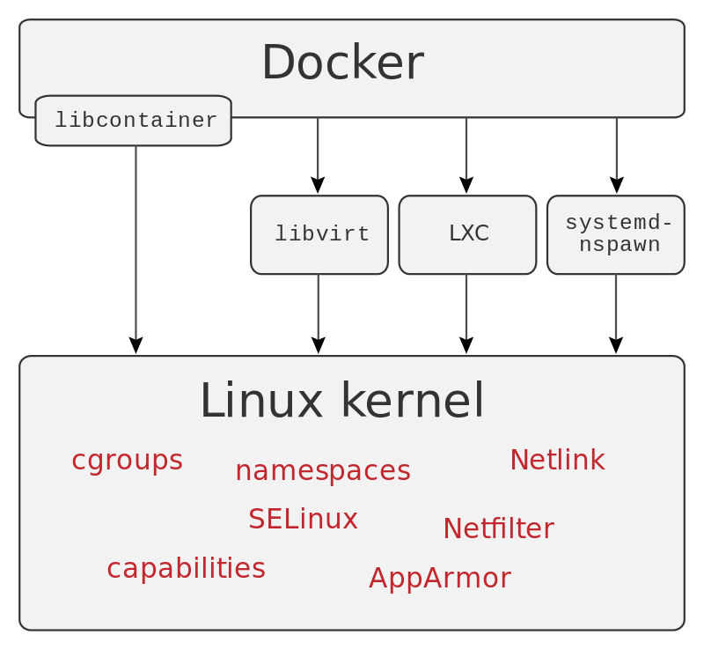
Docker
Docker is an interface to easily manage containers
It can use different containers backends (even full virtualization)
Handle containers in a onion-like structure

Slide 16
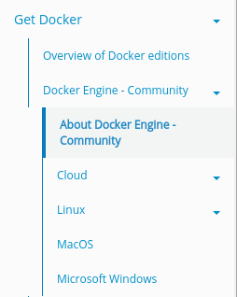
Time to get your hads dirty
Download and install docker:
https://docs.docker.com/install/

Slide 17
Dockerfile(1)
The Dockerfile is a file with which you can specify a docker image.
It is a plaintext file representing a sequence of steps needed to create your image.
Each command creates a “layer”
FROM <image>
Use <image> as base image
RUN <cmd>
Run the command <cmd>
CMD <cmd>
Specify the command to run your application

Slide 18
Docker: build and run a container
Build a container
docker build -t <container name> <Dockerfile path>
Run a container
docker run <container name>
Hello world Example

Slide 19
Docker EXPOSE
Host
EXPOSE <port>
Docker
docker -p <host_ip>:<host_port>
:<container_port>/
<protocol>
Container
iptables?

Slide 20
Dockerfile(2)
COPY <host src> <container dst>
Copy a file/folder from host <host src> to container <container dst>
EXPOSE <port>/<protocol>
Expose the container port <port> to docker
Hello world v2 Example
Echo Server Example

Slide 21
Docker Volumes
Volumes are a way to mount host folders in container ones
Container
Host
/
/home/user/website
etc
bin
var
...
...

Slide 22
Docker Volumes
docker -v <host_path>:<container_path>
Mount <host_path> host folder into <container_path> container folder
Docker volumes are way more complex than this. But for now this is enough
Hello world v3 Example
Python webserver Example

Slide 23
Docker CLI isnt enough
Docker CLI interface is amazing!
Manage lifecycle of container with a bunch of batch scripts?
Maybe there is a better way

Slide 24
Docker Compose
With Docker Compose you can define and control an entire architecture with one yaml file
Services
Volumes
Networks
Connections
Dependencies
...

Slide 25
YAML
YAML is a human readable serialization language, easier than XML and JSON.
field: value
- for list elements
indentation spaces for objects
That's all

Slide 26
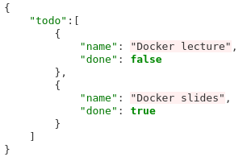
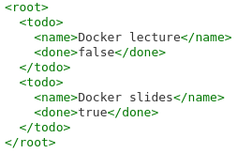
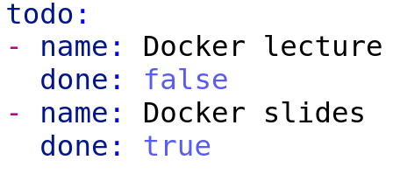
YAML: Example
XML
JSON
YAML

Slide 27
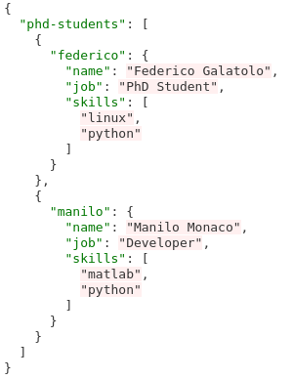
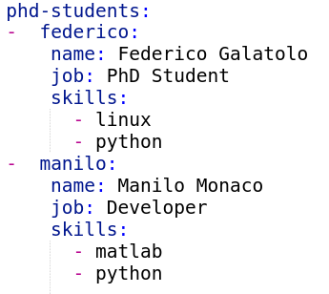
YAML: Example 2

Slide 28
Docker Compose
version: <docker-compose-version>
services:
service-name:
image: <docker-image>
build: <path-to-dockerfile>
ports:
<host-port>:<container-port>
...
volumes:
<host-path>:<container-path>
...
environment:
ENV_VAR=value
...
deploy:
replicas: <number_of_replicas>
....
Works only in “swarm” mode

Slide 29
Docker Compose CLI
Uses the file “docker-compose.yml” by default, you can specify a different yaml file with -f
docker-compose up
Starts all the containers
docker-compose stop
Stops all the containers
docker-compose build
Builds all the containers that use the “build” keyword
You can start the containers in detached mode with -d
You can add the flag --compatibility to use “swarm” features

Slide 30
Docker internal DNS
Docker SDN (Software Defined Network) has its own DNS resolver
You can use the container name to resolve its ip
If you scale a container (with docker-compose scale o replicas) the internal DNS will round-robin all the containers
Do NOT use this as redundancy but always use a proper reverse proxy

Slide 31
Let's build a LEMP stack
Docker
Load
Balancer
Load
Balancer
Webserver
PHP Server
...
...
Database
Webserver
PHP Server
linux-nginx-php-mysql

Slide 32
Let's build a LEMP stack: Webserver
Docker
Webserver

Slide 33

Let's build a LEMP stack: Webserver
https://hub.docker.com/_/nginx
Default configuration file location: /etc/nginx/conf.d/default.conf

Slide 34
OT: nginx
nginx (pronounced “Engine-X”) is an high performance
Web Server
Reverse Proxy
Load Balancer
HTTP Cache
...
Very easy to configure and manage. Used by 30% of the websites worldwide

Slide 35
OT: nginx basic webserver
server {
listen <port>;
location <regex> {
root <path>;
}
location <regex> {
root <path>;
}
}
server {
listen 80;
location / {
root /var/www;
location /images/ {
root /data/images;
}
}

Slide 36
OT: nginx basic reverse proxy
upstream <name> {
server host1:port;
server host2:port;
....
}
server {
listen <port>
location <regex> {
proxy_pass <proto>://<name>
}
}
upstream revhttp {
server http-1:8080;
server http-2:8080;
}
server {
listen 80
location / {
proxy_pass http://revhttp;
}
}

Slide 37
Let's build a LEMP stack: PHP
Docker
Webserver
PHP Server
php-fpm

Slide 38
OT: Why php-fpm?
Apache php_mod | php-fpm reverse proxy
PHP execute in the same machine of the webserver | PHP execute in a different machine than the webserver
PHP interpreter is always loaded | PHP interpreter is loaded only for php content
Scale websever = scale php | Scale webserver only or php only (or both)
Apache is slow | php-fpm is webserver agnostic
PHP Server
Webserver
PHP Server

Slide 39
How php-fpm with nginx?
server {
listen 80;
location / {
root /website;
location ~ \.php$ {
try_files $uri =404;
fastcgi_split_path_info ^(.+\.php)(/.+)$;
fastcgi_pass php:9000;
fastcgi_index index.php;
include fastcgi_params;
fastcgi_param SCRIPT_FILENAME $document_root$fastcgi_script_name;
fastcgi_param PATH_INFO $fastcgi_path_info;
}
}
}
Assuming php-fpm running on port 9000 of host “php”
fastcgi_pass beheaves like proxy_pass it accepts both an host or an upstream

Slide 40
Let's build a LEMP stack: PHP Load Balancer
Docker
Load
Balancer
PHP Server
...
Webserver
PHP Server
You just need to scale the php container and add a couple of lines to the webserver configuration

Slide 41
Let's build a LEMP stack: HTTP Load Balancer
Docker
Load
Balancer
Load
Balancer
Webserver
PHP Server
...
...
Webserver
PHP Server
Scale the webserver container, add another container just for the HTTP reverse proxy and expose its port to the host.

Slide 42
Let's build a LEMP stack: MySQL Server
Docker
Load
Balancer
Load
Balancer
Webserver
PHP Server
...
...
Database
Webserver
PHP Server

Slide 43
Let's build a LEMP stack: MySQL Server
php:7-fpm does not have mysqli installed:
Create your own container with a Dockerfile
Start from php:7-fpm
Execute docker-php-ext-install mysqli
Use this image in your docker-compose (with “build”)
Use the mysql image mysql:5.7
set the environment variable MYSQL_ROOT_PASSWORD

