Slide 1
Machine Learning Theory and Frameworks
In less than two hours

Slide 2
Quick Recap: ML
Dataset
X | Y
f(x)
Good?
Bad?
Error?
X
Y
Training

Slide 3
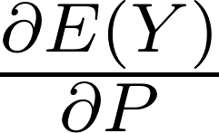
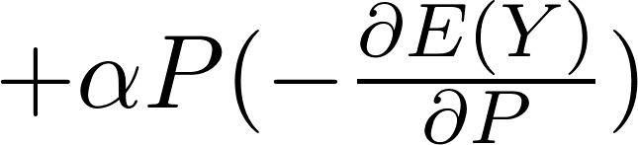


Quick Recap: SGD
Most of the times we use SGD (Stochastic Gradient Descend) to train our ML models
f(x)
E(Y)
X
Y
P

Slide 4
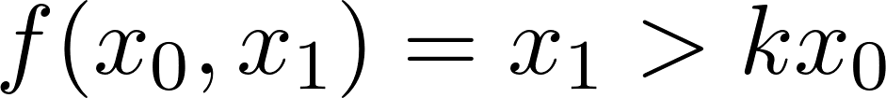
Quick Recap: SGD
x₁
x₀

Slide 5
Quick Recap: SGD
x₁
E
x₀
k

Slide 6
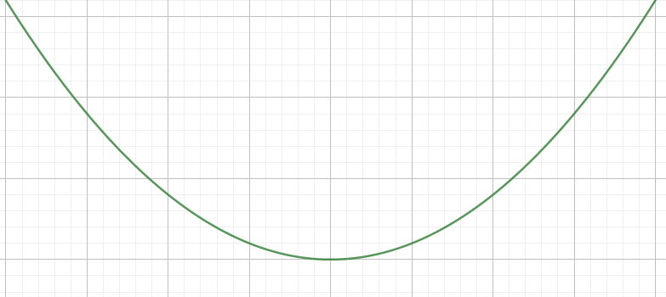
Quick Recap: SGD
Wrong!

Slide 7
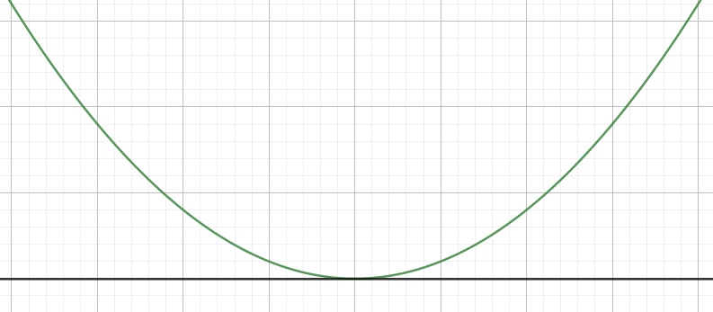
Quick Recap: SGD
E
k

Slide 8


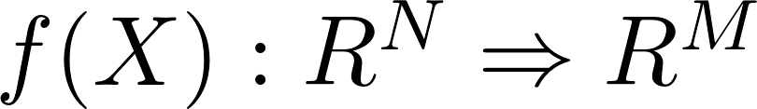
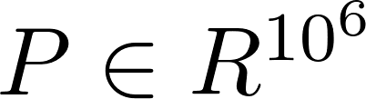
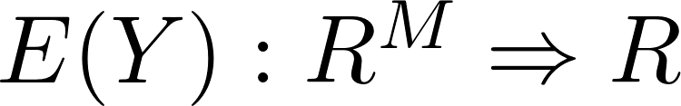
Quick Recap: SGD
You are computing a gradient
OK!
Sounds fair!
Of course!
No problem!
Never forget this!

Slide 9
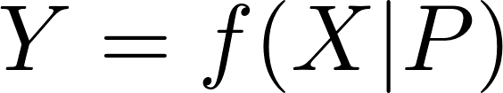
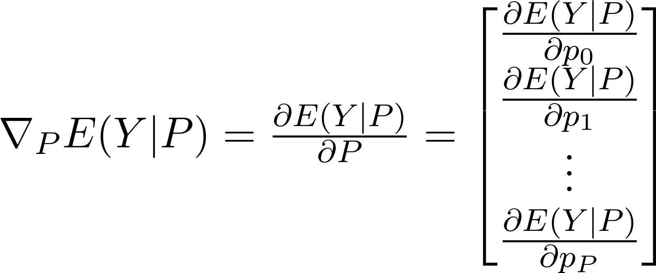
Quick Recap: SGD
You are computing a gradient

Slide 10
What is actually going on?
X
Y
f(x)
E
mean(...)

Slide 11
Why is stochastic?
Using all the dataset is impossibile
So we use little chunks called batches
X
Y
f(x)
E
mean(...)

Slide 12
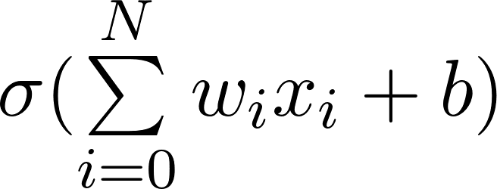
Artificial Neural Networks: Topological view
x₀
y₀
x₁
y₁
x₂

Slide 13
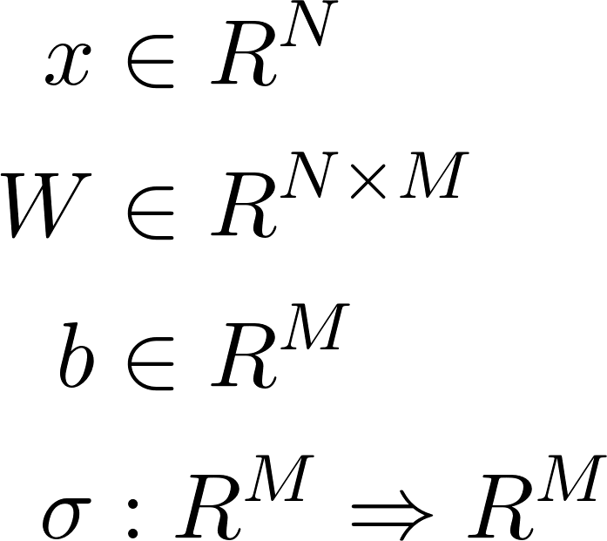
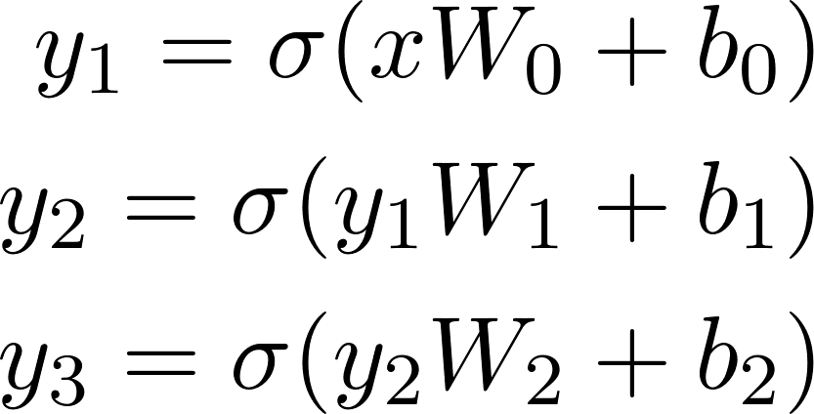
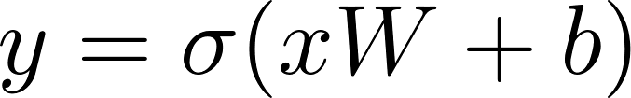
Artificial Neural Networks: Mathematical View

Slide 14
NN Architectures can be wild!
Auto Encoders
X
X'

Slide 15
NN Architectures can be wild!
GANs
Discriminator
X
Z
Generator
Perceptual NN

Slide 16
Do I need to compute the gradients by hand?
Nope
All ML frameworks use Computational Graphs

Slide 17
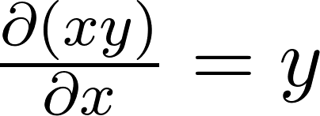
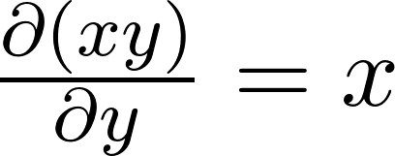
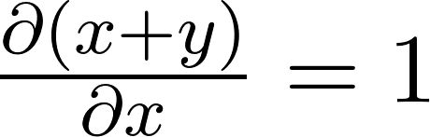
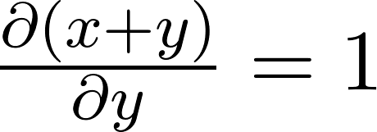
Computational Graphs
x+y
x*y
+
*
x
y
x
y

Slide 18
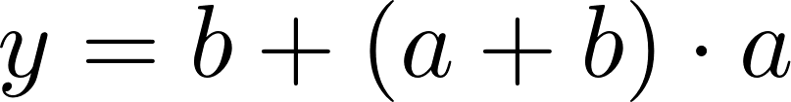
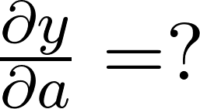
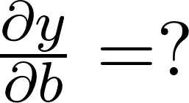
Computational Graphs
a
a+b
1
+
a+b
*
(a+b)*a
1
+
y
a
1
b
1

Slide 19
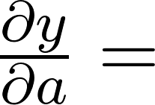
Computational Graphs
For all the paths from y to a: multiply over the edges. Sum all the results.
a
a+b
1
+
a+b
*
(a+b)*a
1
+
y
a
1
b
1
a+b
+a
= 2a+b

Slide 20
Pytorch
Pytorch is a Computational-Graph based ML framwork
Python interface, C++/Cuda implementation
Object Oriented Interface
Supports CPU/GPU/Multi-GPU transparently
Very well documented
Almost everything you need is implemented in it
pip install torch

Slide 21
Pytorch: torch.nn.Module
Building block for a ML architecture
forward(self, x) [not implemented]
The forward logic of your module
parameters(self) [implemented]
Collection of paremters of all the class attributes
to(self, device) [implemented]
Move all the parameters to device

Slide 22
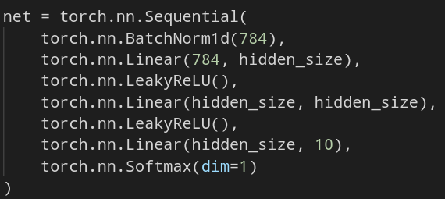
Pytorch: torch.nn.Sequential
BN
Lin
LR
Lin
LR
Lin
SM
X
Y

Slide 23
Pytorch: torch.utils.data.Dataset
Abstract dataset representation
__getitem__(self, i) [not implemented]
You have to return a tuple with
i-th input element of the dataset
i-th output element of the dataset
__len__(self) [not implemented]
You have to return the lenght of the dataset

Slide 24
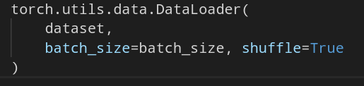
Pytorch: torch.utils.data.DataLoader
Creates batches from a Dataset object
Positional arguments
Dataset object
Keywords arguments
batch_size: size of the batches
shuffle: shuffle the dataset?

Slide 25
Pytorch: Other useful stuff
torch.nn
package with every possibile NN building block
torch.optim
package with dozens of SGD algorithms
torchvision
package with dozens of vision datasets (MNIST, CIFAR, ImageNet,...)
In every scalar tensor you can call .backward() to compute the gradient
Let us build a simple NN

Slide 26
Tensorboard
Traking and visualization framework for:
Tracking scalars (loss, accuracy, etc...)
Traking histograms (weights, gradients, etc..)
Traking Computational Graphs
Displaying text, images, etc...
Part of the Tensorflow framework but can be used as standalone

Slide 27
tensorboardX (tb wrapper)
writer = SummaryWriter()
writer.add_scalar(“<name>”, <value>, <iter>)
Log a scalar values (loss, accuracy, ...)
writer.add_image(“<name>”, <value>, <iter>)
Log an image (PIL, np.matrix, ...)
writer.add_histogram(“<name>”, <value>, <iter>)
Log an histogram(weights, gradients, etc...)
writer.add_audio
writer.add_text
....
pip install tensorboardx tensorboard==1.13.0 tensorflow==1.13.1
Let us integrate it into our NN

Slide 28
What if I told you...
That exists a framework that does:
Training, testing and validation
Early stopping managing
Tensorboard logging
Checkpointing and retraining
...
With minimal coding required

Slide 29
pytorch-lightning
Define
Model
Dataset
Training/testing/validation step
That's all

Slide 30
LightningModule interface
forward(self, x):
The forward logic (as in pytorch)
*_step(self, batch, batch_nb):
The *_step logic
*_end(self, outputs):
The * phase end logic
outputs are all the intermediate returns of the *_step function calls
*_loader(self):
Must returns the DataLoader for the * phase
configure_optimizers(self).
Must return a list of optimizer to use in training
Where * can be “train” “test” or “validation”

Slide 31
pytorch-lightning
The train_step() function must return a dictionary with the “loss” key
Every function that returns a dictionary with the key
log
every key gets logged in tensorboard as scalar
progress_bar
every key get prompted in the * phase progress bar
Training/Testing
Instanciate your model
Create a Trainer() object
trainer.fit(model)
trainer.test(model)
Let us integrate our model in pytorch-lightning

Slide 32
Ray
Ray is massive framework for scaling ML training
We are going to see just its “tune”
ray.tune is a framework for hyperparameters tuning at any scale (from a single computer to clusters of GPUs)
Let us do an hyperparameter search with ray

