Slide 1

NewSQL
Andy Pavlo
November 7, 2026

Slide 2
Administrivia
Sign up for course mailing list.
Email Stan if you’re still not registered.

Slide 3
Outline
The Last Decade of Databases
NewSQL Introduction
H-Store

Slide 4
Early-2000s
All the big players were heavyweight and expensive.
  Oracle, DB2, Sybase, SQL Server, etc.
Open-source databases were missing important features.
  Postgres, mSQL, and MySQL.

Slide 5
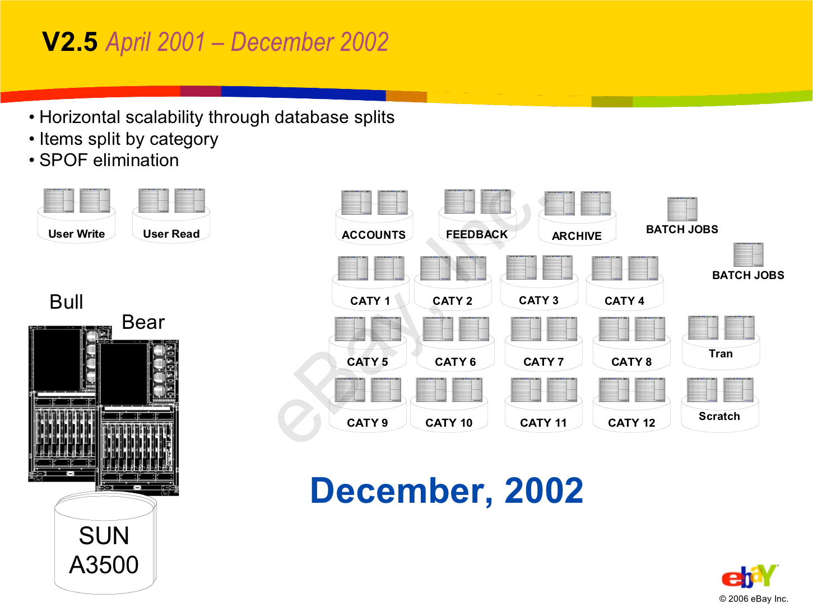
Push functionality to application:
  Joins
  Referential integrity
  Sorting done
No distributed transactions.
Randy Shoup - “The eBay Architecture”
http://highscalability.com/ebay-architecture

Slide 6
Mid-2000s
MySQL + InnoDB is widely adopted by new web companies:
  Supported transactions, replication, recovery.
  Still must use custom middleware to scale out across multiple machines.
  Memcache for caching queries.

Slide 7
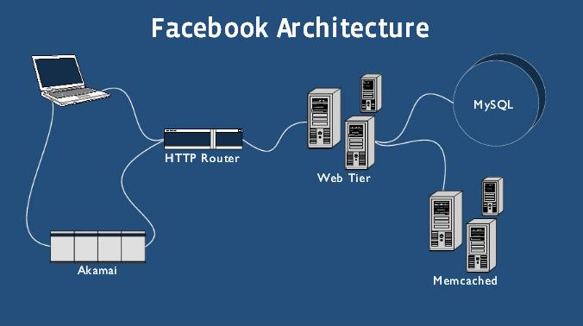
Scale out using custom middleware.
Store ~75% of database in Memcache.
No distributed transactions.
Jay Thadeshwar -“Technology Used by Facebook”
http://www.techthebest.com/2011/11/29/technology-used-in-facebook/

Slide 8
Late-2000s
NoSQL systems are able to scale horizontally right out of the box:
  Schemaless.
  Using custom APIs instead of SQL.
  Not ACID (i.e., eventual consistency)
  Many are based on Google’s BigTable or Amazon’s Dynamo systems.

Slide 9
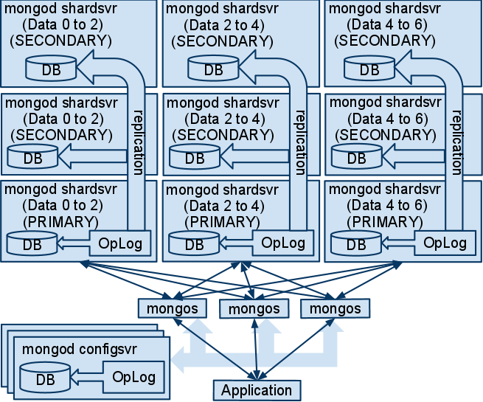
MongoDB Architecture
Easy to use.
Becoming more like a DBMS over time.
No transactions.
Nathan Tippy- “MongoDB”
http://sett.ociweb.com/sett/settAug2011.html

Slide 10
Early-2010s
New DBMSs that can scale across multiple machines natively and provide ACID guarantees.
  MySQL Middleware
  Brand New Architectures

Slide 11


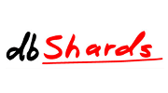













NewSQL

Slide 12
451 Group’s Definition
A DBMS that delivers the scalability and flexibility promised by NoSQL while retaining the support for SQL queries and/or ACID, or to improve performance for appropriate workloads.
Matt Aslett – “How Will The Database Incumbents Respond To NoSQL And NewSQL?”
https://www.451research.com/report-short?entityId=66963

Slide 13
Stonebraker’s Definition
SQL as the primary interface.
ACID support for transactions
Non-locking concurrency control.
High per-node performance.
Parallel, shared-nothing architecture.
Michael Stonebraker- “New SQL: An Alternative to NoSQL and Old SQL for New OLTP Apps”
http://cacm.acm.org/blogs/blog-cacm/109710

Slide 14
On-Line
Transaction
Processing

Slide 15
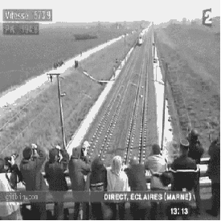


OLTP Transactions
Fast
Repetitive
Small

Slide 16
Workload Characterization
Complex
Data Warehouses
Social
Networks
Operation Complexity
OLTP
Simple
Writes
Reads
Workload Focus
Michael Stonebraker – “Ten Rules For Scalable Performance In Simple Operation' Datastores”
http://cacm.acm.org/magazines/2011/6/108651

Slide 17
Transaction Bottlenecks
Disk Reads/Writes
  Persistent Data, Undo/Redo Logs
Network Communication
  Intra-Node, Client-Server
Concurrency Control
  Locking, Latching

Slide 18
An Ideal OLTP System
Main Memory Only
No Multi-processor Overhead
High Scalability
High Availability
Autonomic Configuration

Slide 19

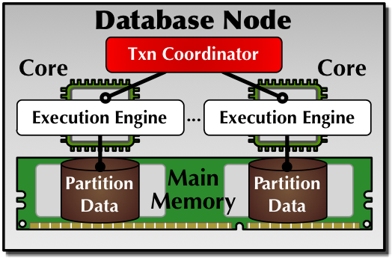
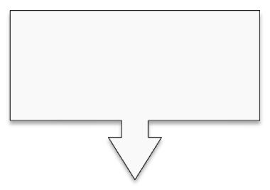
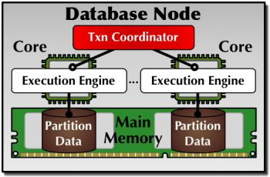
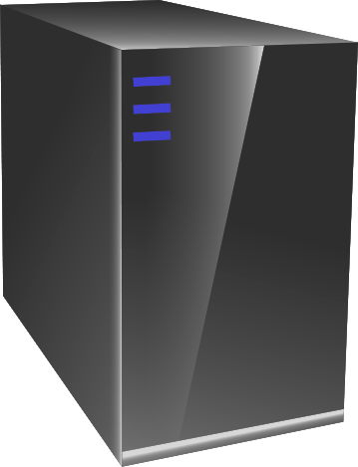

Procedure Name
Input Parameters
Client
Application

Slide 20
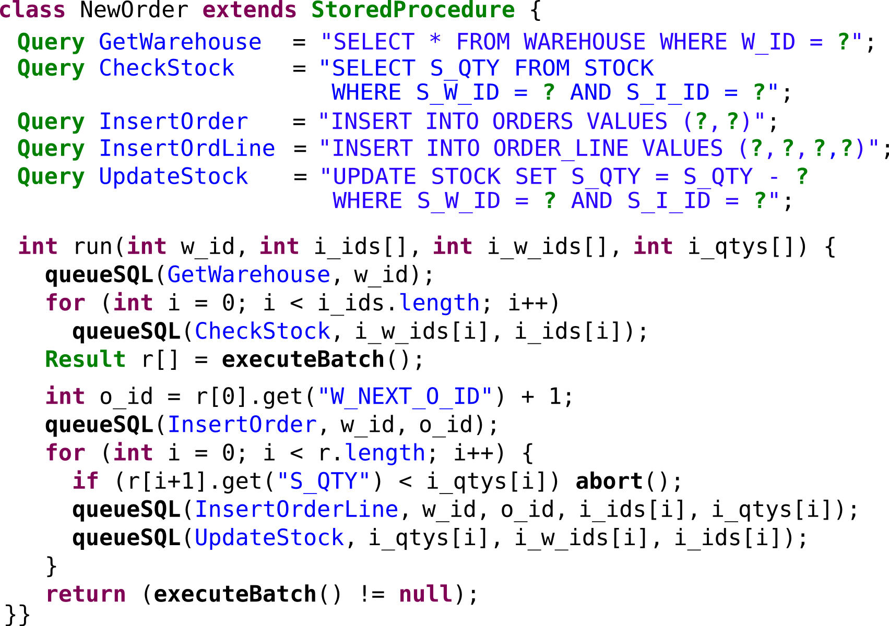

Slide 21
Database Partitioning
TPC-C Schema
Schema Tree
WAREHOUSE
WAREHOUSE
ITEM
DISTRICT
STOCK
DISTRICT
STOCK
CUSTOMER
CUSTOMER
ORDERS
ITEM
ORDERS
ORDER_ITEM
Replicated
ORDER_ITEM

Slide 22
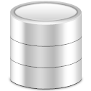
Database Partitioning
Schema Tree
Partitions
P1
P2
P3
P4
P5
WAREHOUSE
P1
P2
P3
P4
P5
P1
P2
P3
P4
P5
P1
P2
DISTRICT
STOCK
ITEM
ITEM
P1
P2
P3
P4
P5
CUSTOMER
P3
P4
ITEM
ITEM
P1
P2
P3
P4
P5
ORDERS
ITEM
ITEM
ITEM
ITEMj
ITEM
ITEM
Replicated
P1
P2
P3
P4
P5
P5
ORDER_ITEM
ITEM

Slide 23


Distributed Transaction Protocol
Procedure Name
Input Parameters
<Timestamp, Counter, SiteId>
#2084922509960152064
P1
#208…
#216…
#229…
#231…
P2
#208…
#229…
#231…
P1
P2

Slide 24

Distributed Transaction Protocol
TransactionPrepare Request
Two-Phase
Commit
TransactionPrepare Response
TransactionWork Request
TransactionInit Response
TransactionInit Request
TransactionWork Response
TransactionFinish Request
#2084922509960152064
TransactionFinish Response
P1
P2
P3
P4

Slide 25
H-Store vs. VoltDB
An incestuous past
  H-Store merged with Horizontica (Spring 2008)
  VoltDB forked from H-Store (Fall 2008)
  H-Store forked back from VoltDB (Winter 2009)
Major differences:
  Support for arbitrary transactions.
  Google Protocol Buffer Network Communication

