Slide 1
实习答辩报告
汇报人：张诗媛
指导老师：刘璐
广发基金量化支持部
2026年5月25日

Slide 2
Part 1 成长—价值风格轮动复盘
BLABLABLA
01 blabla
02 blabla
03 blabla

Slide 3

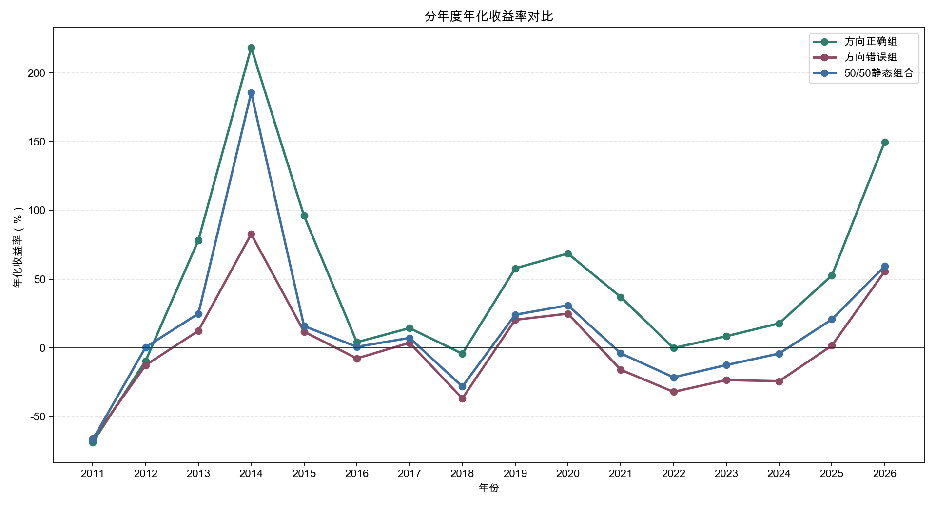
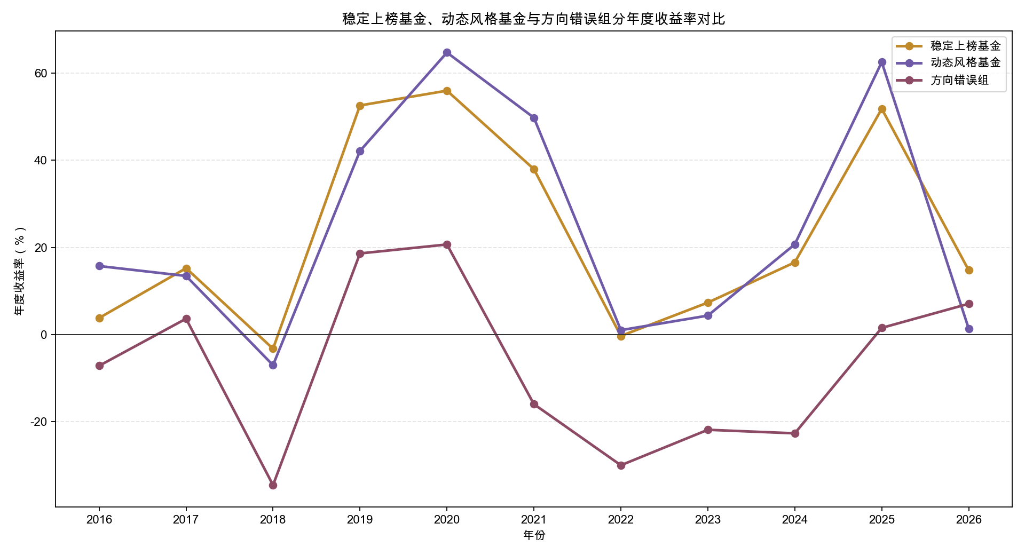
公募基金：成长价值风格轮动总览
成长—价值风格轮动识别框架
基准因子：国证成长、国证价值、GC007（现金因子）
参数设置：52周滚动RBSA分解
参数设置：52周滚动RBSA分解
判断风格正误：未来4周成长指数与价值指数的相对表现
4

Slide 4
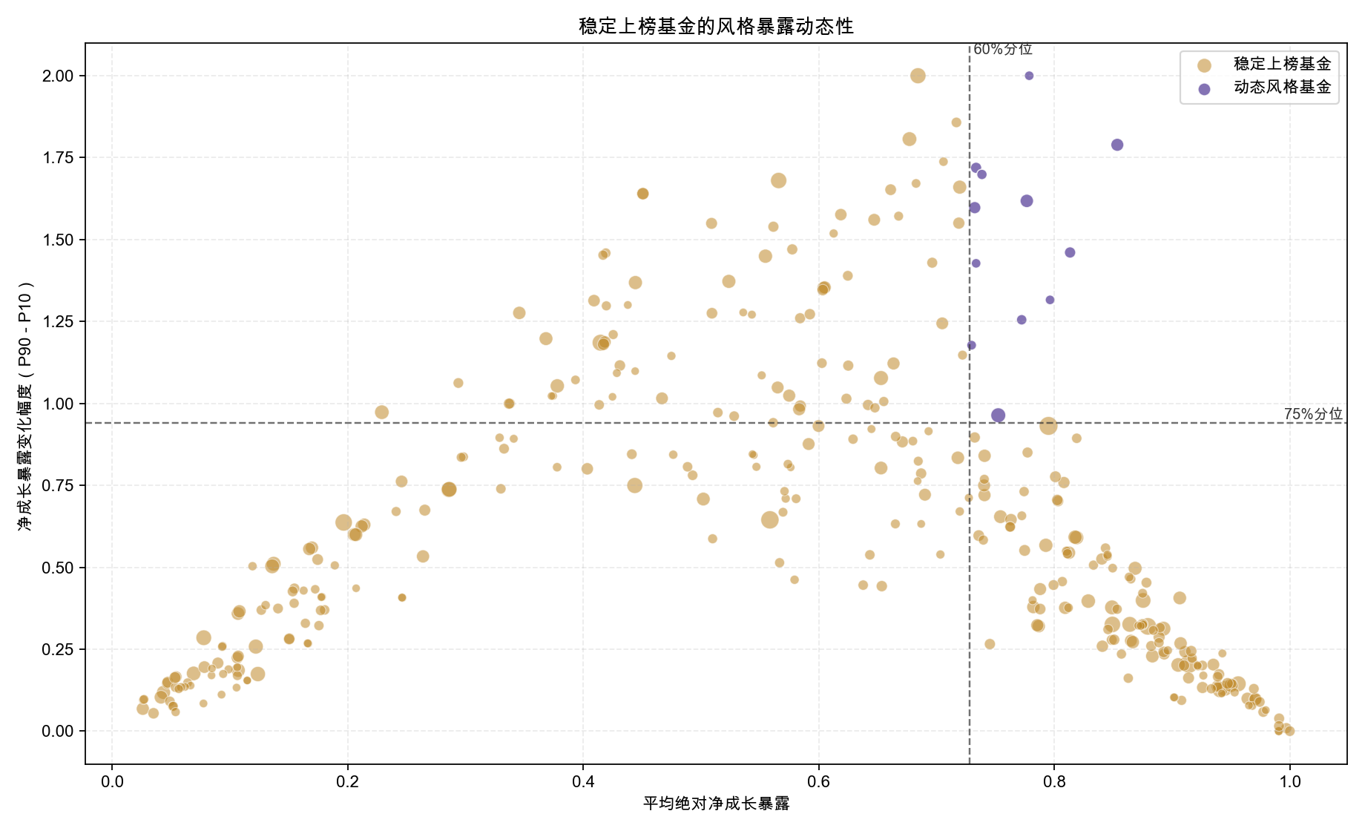
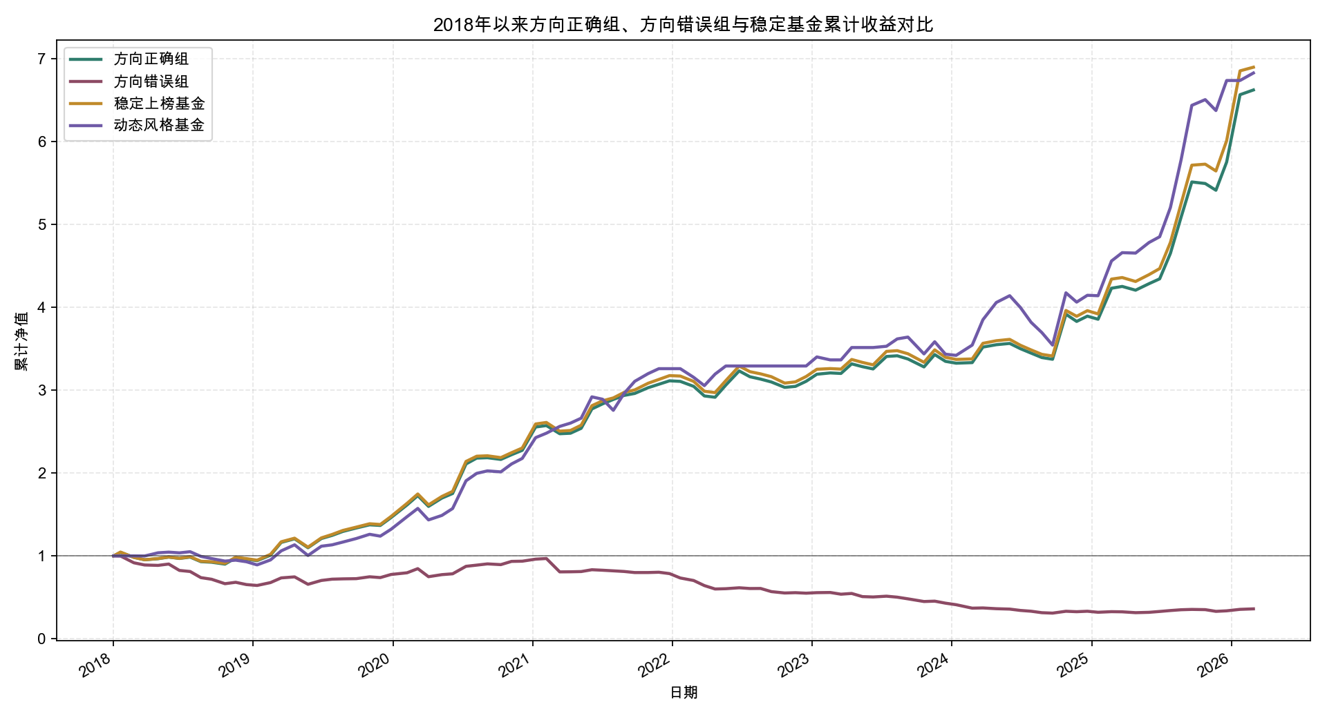
公募基金：成长价值风格轮动总览
4

Slide 5
Part 2 XXXXXXXXXXXXX
BLABLABLA
01 blabla
02 blabla
03 blabla

Slide 6
XXXXXXXXX
69

Slide 7
Part 3 XXXXXXXXXXXX
BLABLABLA
01 blabla
02 blabla
03 blabla

Slide 8
XXXXXXXXX
69

Slide 9
重要提示 Disclaimer
1、本文所载内容仅供参考，不视为任何形式的要约、要约邀请或承诺。本文引用的信息来源于已公开的资料，除广发基金管理有限公司（以下称“本公司”）依法应当披露的信息外，本公司对该等信息的准确性、完整性或可靠性不作任何保证，本公司或本公司的任何董事或雇员并不就该等数据之任何错误或遗漏承担责任（包括任何第三者责任）。除另有说明外，本文所载相关个人观点、分析、建议、模型等内容仅反映作者于本文发出当日的见解和看法，并不代表本公司的立场，本文作者亦可在未加通知的情况下对任何内容进行更改。
2、本文所述任何投资(如有)都包含相应的风险，并不适合所有投资者。据此投资的证券、基金等资产价值或收益会有波动。本文没有考虑单个投资者投资目标、财务状况、风险承受能力或个别需求，相关观点在任何时候均不构成对投资者的投资建议。投资者应当充分考虑自身特定状况，并完整理解和使用本文内容，不应视本文为做出投资决策的唯一参考因素。投资者应咨询专业顾问，自主判断证券、基金的投资价值，自主做出投资决策，并自行承担投资风险，对依据或者使用本文所造成的一切后果，本公司及作者均不承担任何法律责任。
3、本公司作为基金管理人承诺以恪尽职守、诚实信用、勤勉尽责的原则管理和运用基金资产，但不保证基金一定盈利，也不保证最低收益。本公司旗下基金的过往业绩及其净值高低并不预示其未来业绩表现，个别基金的业绩不构成对其他基金业绩表现的保证。本公司提醒投资者基金投资的“买者自负”原则，在做出投资决策后，基金运营状况与基金净值变化引致的投资风险，由投资者自行负担。
4、投资者在做出投资决策前应仔细阅读基金合同、招募说明书以及本公司在中国证监会指定信息披露媒介上发布的正式公告和有关信息。任何在本文中出现的信息（包括但不仅限于评论、预测、图表、指标、理论等）仅作参考，不应作为投资者投资决策与基金交易的依据。投资者应当在基金销售机构办理基金销售业务的营业场所或按销售机构提供的其他方式办理基金份额的申购与赎回，但基金并不是销售机构的存款或负债，也没有经销售机构担保或者背书，销售机构并不能保证其收益或本金安全。
5、本文的著作权受法律保护，未经书面许可，任何机构和个人不得以任何形式发表、署名、修改、复制、转载或传播。本文可能包含了专有信息、保密信息或其他受法律保护的信息，若您并非指定收件人，请立即通知发件人并予以销毁或删除，且不得复制或使用本文，亦不得向任何其他人披露本文内容。
1.All information contained herein is used for reference only, and does not serve as an offer, an invitation to offer or any commitment of whatever form. Unless those are disclosed by GF Fund Management Co., LTD (hereinafter “the Company”) as required by law, the information referred to herein is sourced from public materials, hence the accuracy, completeness and reliability are not guaranteed by the Company. Neither the Company nor any of its directors or employees shall have any liability (including any third party liability) for any error or omission in respect of such information. Unless otherwise specified, the individual opinions, analysis, suggestions or models contained herein only reflect the opinions and views of the author on the date of issuance hereof, which do not represent the position of the Company, and can be modified by the author without any notice.
2.Any investment (if any) referred to herein involve relevant risks, and is not suitable for all the investors. The return or value of the securities, the funds and other assets invested on the basis thereof may fluctuate. This material does not take into consideration the investment goal, financial condition, risk tolerance or specific demand of any single investor. No opinion shall at any time constitute an investment suggestion to any investor. Investors shall take full account their respective conditions, and understand and use this material as a whole, instead of treating this material as the only reference for making any investment decisions. Investors shall seek advice from professional advisors, make judgment at its own discretion on the investment value of securities and funds, make independent investment decisions and take their own investment risks. Neither the Company nor the author hereof shall have any legal liability for any consequence as a result of the reliance on, or use of this material.
3.the Company, as the fund manager, undertakes to fulfill its duties faithfully and diligently in managing and operating the assets of the fund, but does not guarantee the profit or the minimum return of the fund. The historical performance and net value of funds under management by the Company do not predict their future performance, nor shall the performance of certain funds constitute any guarantee for the performance of any other funds. Please note that investors shall take the risks of any investment they have made into the fund. After making any investment decision, the investors shall be solely liable for any investment risk arising from any change to the performance and net value of the fund.
4.Before making any investment decisions, investors shall read carefully the fund contract, the fund prospectus and any official announcement and the relevant information published by the Company on any information disclosure media as designated by the China Securities Regulatory Commission. Information contained in this material (including but not limited to reviews, predictions, charts, index, theories etc.) is used for reference only, and shall not be regarded as a basis for investors to make any investment decision or fund transaction. Investors shall subscribe for and redeem any fund units at the place of business of the fund distribution institutions where they carry out fund distribution business or otherwise as provided by the fund distribution institutions. Funds are not the deposit or debts of the distribution institutions and are not guaranteed or endorsed by the distribution institutions. The distribution institutions do not guarantee the return or safety of the principal of the fund.
5.The copyright of this material is protected by laws. This material cannot be published, executed, revised, duplicated, reproduced or disseminated by any institution or individual in any manner without the prior written consent of the Company. This material may contain proprietary or confidential information or other legally protected information. If you are not the intended recipient of this material, please immediately notify the sender, and destroy and delete this material. It is not permitted to copy or use this material, or to disclose the content of this material to any other person.

Slide 11
附录
A1

