Slide 1

LED INSPECTOR
Faculty für Informatik und Automatisierung
Mohamed Marzouk
Muhammad Adil Nawaz
Master Program RCSE
TU Ilmenau

Slide 2
Agenda
Introduction to LED
Problem Statement
Design & Implementation
Live Demo
Q & A

Slide 3
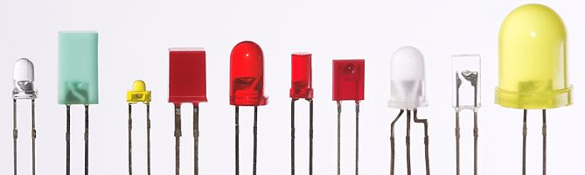
Introduction
P-n junction diode that emits light when activated.
Effect of Electroluminescence.
https://en.wikipedia.org/wiki/Light-emitting_diode

Slide 4
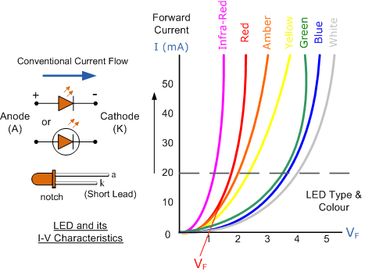
LED types and I-V Characteristics
http://www.electronics-tutorials.ws/diode/diode_8.html
Current only flows in forward direction.
Different LEDs can have different visible light (red, yellow, blue, white,..etc.)
Different operational voltage applies for different LED types

Slide 5
Problem statement
The user has LEDs for which the operating voltage is not known.
To avoid burning the LED, the user needs to identify the operating voltage.
Also the correct serial resistor need to be calculated.

Slide 6
Design and Implementation
Basic idea:
Connect the led to a serial resistor
Apply a gradually-increasing voltage across the LED-Resistor
Measure the current across the resistor
Once the rated current (20 m Amps) is reached, the operating voltage is the current voltage across the LED
Given the calculated LED operation voltage, the correct serial resistor for various input voltage can be calculated using Ohm’s law.

Slide 7
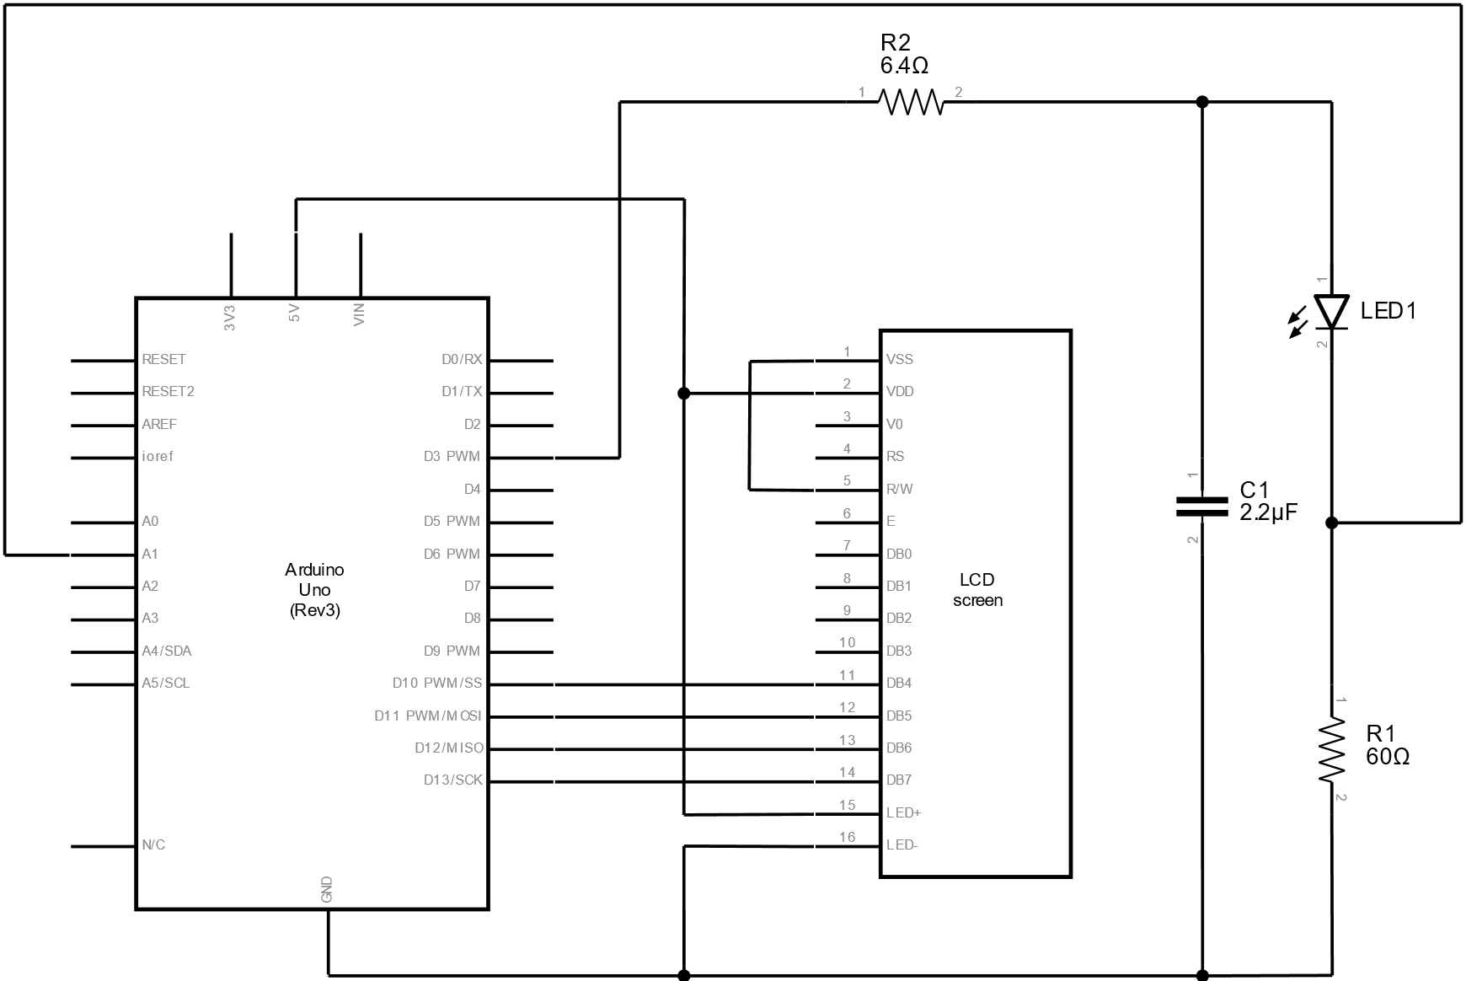
Design and Implementation

Slide 8
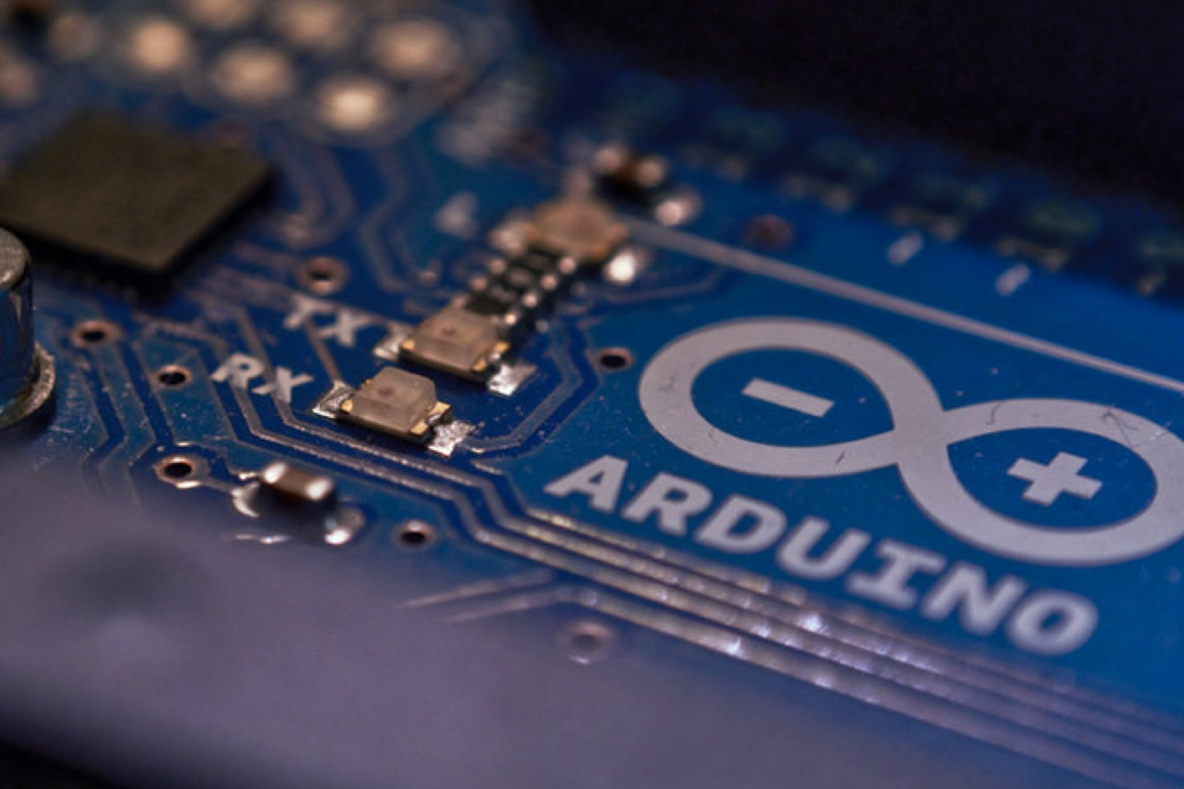
Live Demo
http://www.modeso.ch/blog-posts/arduino-with-weight-sensor.html

Slide 9

http://www.ala.org/bbooks/bannedbooksweek/ideasandresources/colleaguesqanda

