Slide 1


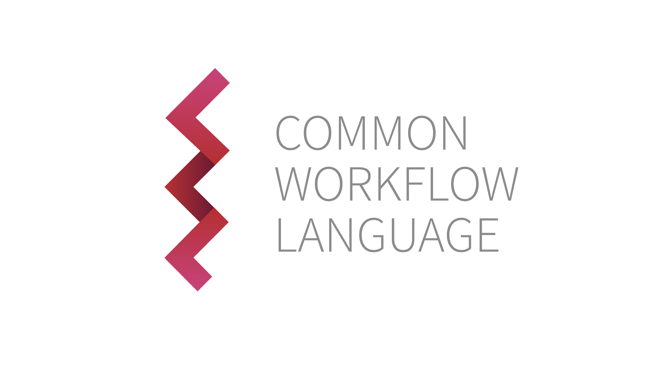



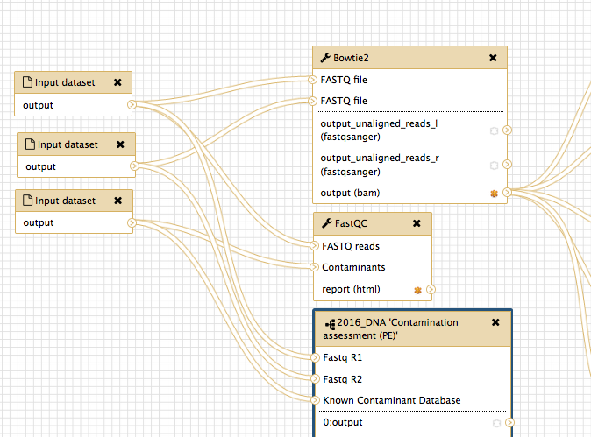
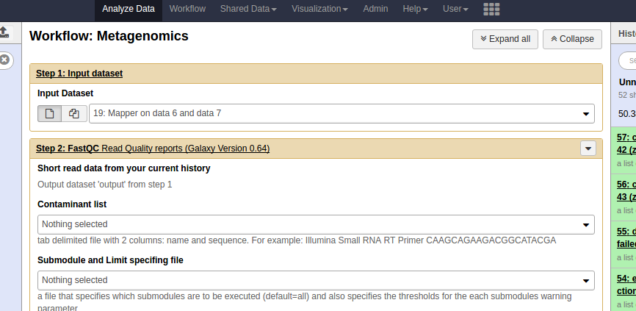



A Scientific Workflow SDK
John Chilton, Aysam Guerler, and the Galaxy Team
github.com/galaxyproject/planemo
@jmchilton
@galaxyproject #usegalaxy
@commonwl #CommonWL
Galaxy Workflow Enhancements
What is the CWL?
Routinely scales to tens of thousands of datasets
Thanki, et al. 10.7490/f1000research.1112472.1
Blankenberg & Carnahan-Craig 10.7490/f1000research.1112712.1
New JavaScript driven user interface (unified across application).
Nested workflows, more input types, and module types
http://www.commonwl.org/
After 4 draft iterations, version 1.0 of the spec was released this summer.
Global effort to build a workflow definition standard that can be used by many platforms.
Leveraged by both Global Alliance for Genomic Health (GA4GH) and ELIXIR efforts.
Collaborators include representatives from Seven Bridge Genomics, Curoverse, and the Galaxy Project.
Work in progress to support it in various projects including Galaxy, Nextflow, and Apache Taverna.
Nested Workflows in Action
Image and workflow thanks to Brad
Langhorst at New England BioLabs.
Build CWL Tools
#!/usr/bin/env cwl-runner
cwlVersion: 'cwl:draft-3'
class: CommandLineTool
id: "seqtk_seq"
label: "Convert to FASTA (seqtk)"
requirements:
- class: DockerRequirement
dockerPull: dukegcb/seqtk
inputs:
- id: input1
type: File
description: TODO
inputBinding:
position: 1
prefix: "-a"
outputs:
- id: output1
type: File
outputBinding:
glob: out
baseCommand: ["seqtk", "seq"]
arguments: []
stdout: out
description: |
Usage: seqtk seq [options] <in.fq>|<in.fa>
...
New Workflow Run User Interface
$ planemo tool_init \
--cwl \
--id 'seqtk_seq' \
--name 'Convert to FASTA (seqtk)' \
--example_command \
'seqtk seq -a 2.fastq > 2.fasta' \
--example_input 2.fastq \
--example_output 2.fasta \
--container 'dukegcb/seqtk' \
--test_case \
--help_from_command 'seqtk seq'
What is Planemo?
Presented in 2015 – a command-line utility or SDK used extensively to build Galaxy tools.
Trivial to install – available on PyPI, Homebrew, and Conda.
Write Galaxy tools without installing Galaxy or really needing to know about Galaxy at all.
Used extensively by dozens of Galaxy tool authors. Makes it painless to lint, test, and publish Galaxy tools.
Focus on artifacts and developer processes (CLI, Github, Travis CI).
Example driven documentation @ planemo.readthedocs.io.
Planemo can quickly bootstrap either Galaxy tools or CWL tool from example commands. Including a test case, help text, and container.
Lint, Run, and Test CWL Artifacts
Planemo now features support for CWL tools and workflows.
$ planemo lint <workflow.cwl>
Check CWL artifact (tool or workflow) for common mistakes and best practices. Technique
used frequently to speed up development of Galaxy tools.
$ planemo run --engine=cwltool <workflow.cwl> <job.json>
Run a CWL artifact (tool or workflow) using either the experimental support in
Galaxy or using the reference implementation (cwltool). Advanced options available
when running through reference implementation as explained below.
$ planemo test --engine=cwltool <workflow.cwl>
The same test case description format can be used to describe tests for Galaxy tools and
Workflows as well as CWL tools and workflows. Advanced features such as reporting
options (HTML, Markdown, text), test sharing, advanced output assertions, etc... available
for Galaxy within Planemo are also available for CWL using the CWL reference implementation.
$ planemo serve <tool.cwl>
For CWL tools only, launch a fork of Galaxy instance with the specified tool loaded.
Planemo for Galaxy Workflows
Planemo now works with workflows, clusters, and production databases.
$ planemo serve <workflow.ga>
Brings up a Galaxy interface with the workflow loaded, install all tools and dependencies
as needed.
$ planemo run <workflow.ga> <job.json>
Startup a Galaxy instance and run the workflow with supplied inputs.
Drive worklfow programatically without dealing with API or configuring
Galaxy manually.
$ planemo test <workflow.ga>
Load test case associated with workflow and run it. Produce HTML report.
Format 2 Galaxy Workflows
Biocontainers, CWL, & Galaxy
Existing workflow techniques are better than ever – extracting workflows from interactive analysis histories and the graphical workflow editor. These techniques are great for users without strong computational backgrounds. However, Format 2 workflows is a YAML specification geared toward developers and bioinformaticians who want to use text editors, CLI tools, Git(hub), etc....
class: GalaxyWorkflow
inputs:
- id: outer_input
steps:
- tool_id: cat1
label: first_cat
state:
input1: {$link: outer_input}
- run:
class: GalaxyWorkflow
inputs:
- id: inner_input
outputs:
- id: workflow_output
source: random_lines#out_file1
steps:
- tool_id: random_lines1
label: random_lines
state:
num_lines: 1
input: {$link: inner_input}
seed_source:
seed_source_selector: set_seed
seed: asdf
label: nested_workflow
connect:
inner_input: first_cat#out_file1
...
BioConda is a community maintained set of software package target biological data analyses built on Conda.
  Ideal for HPC - it doesn't require root to install packages and works on old operating systems.
  Ideal for reproducible science - multiple versions of packages may be installed simultaneously.
Biocontainers – Systematically creates best practice minimal Docker containers for each Bioconda package.
  Ecosystem allows same binaries to used inside and outside of Docker.
  Provides more transparency, functionality, and usability than black box Dockerfiles.
  Over 1800 containers available today!
Simple software package annotations on either Galaxy or CWL
tools allows use of these packages – inside of Docker or outside,
using Galaxy or the reference CWL implementation.
class: GalaxyWorkflow
name: "Test Workflow"
tools:
- name: text_processing
owner: bgruening
inputs:
- id: input1
outputs:
- id: wf_output_1
source: sort#outfile
steps:
- id: sed
tool_id: tp_sed_tool
state:
infile:
$link: input1
code: "s/ World//g"
- id: sort
tool_id: tp_sort_header_tool
state:
infile:
$link: sed#output
style: h #Human readable
SYNTAX
EXAMPLES
This project was supported by NIH/NHGRI Grant U41 HG005542. Additional funding was provided by Huck Institutes for the Life Sciences at Penn State and, in part, under a grant with the Pennsylvania Department of Health using Tobacco Settlement Funds. The Department specifically disclaims responsibility for any analyses, interpretations or conclusions.

