Slide 1
Demo overview
“Virtual implementation”
User Servers
Web interface
e
e
e
e
e
e
e
Blockchain on Amazon Servers
*Pictures from the internet
Notes:
User servers issue the Register and Validate commands to the blockchain

Slide 2
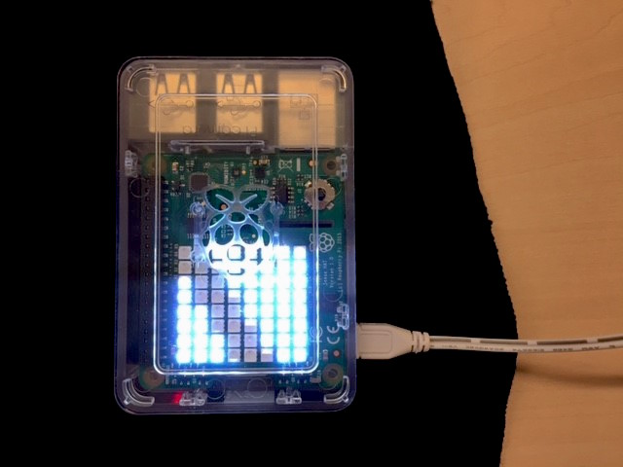
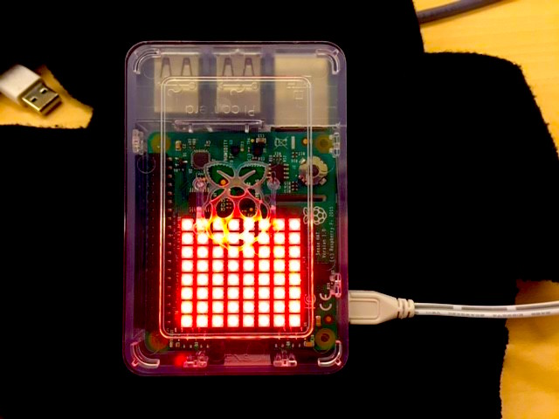
Demo overview
“Tangible implementation”
User Servers
Web interface
e
e
e
Brand devices
e
e
e
e
Non-brand devices
Blockchain on Raspberri Pi cluster
*Pictures from the internet
Notes:
User servers issue the Register and Validate commands to the blockchain

Slide 3
Demo architecture
Brand device (RPi)
User Servers
HTTP client
Web Server
Brand devices network
HTTP client
Brand bridge
Non-brand device (RPi)
Contract App
HTTP client
HUE device
Brand device
Private blockchain
Admin UI
eth node
eth node
HTTP client
eth node
eth node

Slide 4
Device registration
Brand Server
Device reg. interface
Web server
Contract
App
HTTP client
Private
blockchain
Brand bridge
Register(dev,acc)
Register_bc(dev,acc)
Register(dev,acc)
Register(dev)
Register(dev)

