Slide 1
MSc Computer Vision
Two-Step Unsupervised Domain Adaptation for Semantic Segmentation Under Adverse Weather
SegFormer-B2 · Mean Teacher · GTA5 → Cityscapes → ACDC
Gal Hanuna
May 2026

Slide 2
Motivation
Why adverse-weather UDA matters
The Problem
Domain Shift
• Models trained on clean/synthetic data fail under fog, rain, snow, and night
• Collecting labeled data for every condition and city is prohibitively expensive
• Deployment in new regions or weather requires re-annotation — not scalable
GTA5 (Synthetic, clean)
↓
Cityscapes (Real, clean)
The Opportunity
↓
• Large synthetic datasets (GTA5) are free to generate at scale
• Real clean-weather data (Cityscapes) is already labeled
• UDA transfers knowledge without any target-domain annotations
ACDC (Real, adverse)

Slide 3
Research Question & Two-Step Pipeline
"Does a second adaptation step from Cityscapes to ACDC improve segmentation on ACDC, and which weather conditions benefit most or remain hardest?"
The Two-Step Pipeline
GTA5
Cityscapes
ACDC
Step 1 GTA5 → CS
Step 2 CS → ACDC
24,966 labeled synthetic pairs
2,975 labeled real images
400 unlabeled per condition
Key design insight:
The GTA5→ACDC gap is too large for one step. Factoring it into two smaller hops lets each step exploit a clear intermediate signal. Step 2 also uses Cityscapes ground-truth labels as a supervised source — free supervision that a direct single-step approach would lack.

Slide 4
Method
SegFormer-B2 + Mean Teacher pseudo-labeling
SegFormer-B2 Backbone
Mean Teacher Framework
• ~25M parameters, Mix Transformer (MiT) encoder
• No positional encoding → robust to geometric distortions
• Multi-scale features: strides {4,8,16,32}
• Fits 20 GB VRAM at batch size 2 per domain
Labeled Source
GTA5 (Step 1) or Cityscapes (Step 2)
Student
Trained on source labels + target pseudo-labels
Teacher (EMA)
Exponential moving avg of student weights
Training
• AdamW, lr=6×10⁻⁵, polynomial decay, bfloat16
• Pseudo-label threshold τ=0.9 (both steps)
• EMA decay 0.9999
Pseudo-labels
Teacher predictions on unlabeled target (confidence ≥ τ = 0.9 only)

Slide 5
Results
Two runs — both confirm Step 2 helps
Partial-data run (Step 1: 30.30% CS val)
Key takeaways
Overall
Fog
Rain
Snow
Night
• Step 2 always helps — +5.5 to +6.1 pp overall
• Fog benefits most in both runs
• Full-data run: every condition improves
• Night: regresses in partial, improves in full-data
• Full-data fog crosses 49% — approaching supervised range
Before Step 2
27.20%
33.4%
30.7%
29.4%
11.5%
After Step 2
32.72%
45.7%
40.1%
38.0%
8.4%
Δ (partial)
+5.52 pp
+12.3
+9.4
+8.6
−3.1
Full-data run (Step 1: 38.90% CS val)
Overall
Fog
Rain
Snow
Night
Before Step 2
32.07%
40.54%
35.89%
33.38%
15.02%
After Step 2
38.18%
49.08%
42.71%
40.54%
16.77%
Absolute mIoU context
Δ (full-data)
+6.11 pp
+8.54
+6.83
+7.16
+1.74
Numbers reflect fully unsupervised adaptation — zero ACDC labels at any stage. The scientific contribution is the delta, not the absolute level. Night suppresses the overall average; fog/rain/snow alone reach 40–49%.

Slide 6
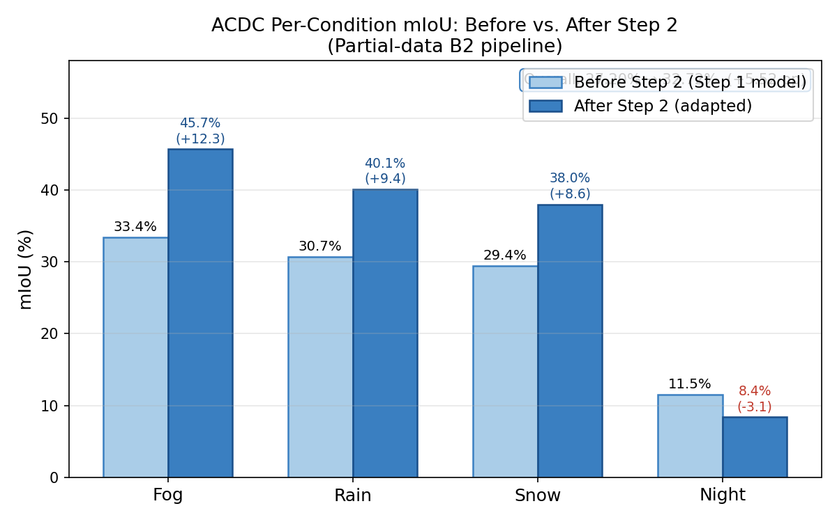
Per-Condition Results
Before vs. After Step 2 — partial-data B2 pipeline

Slide 7
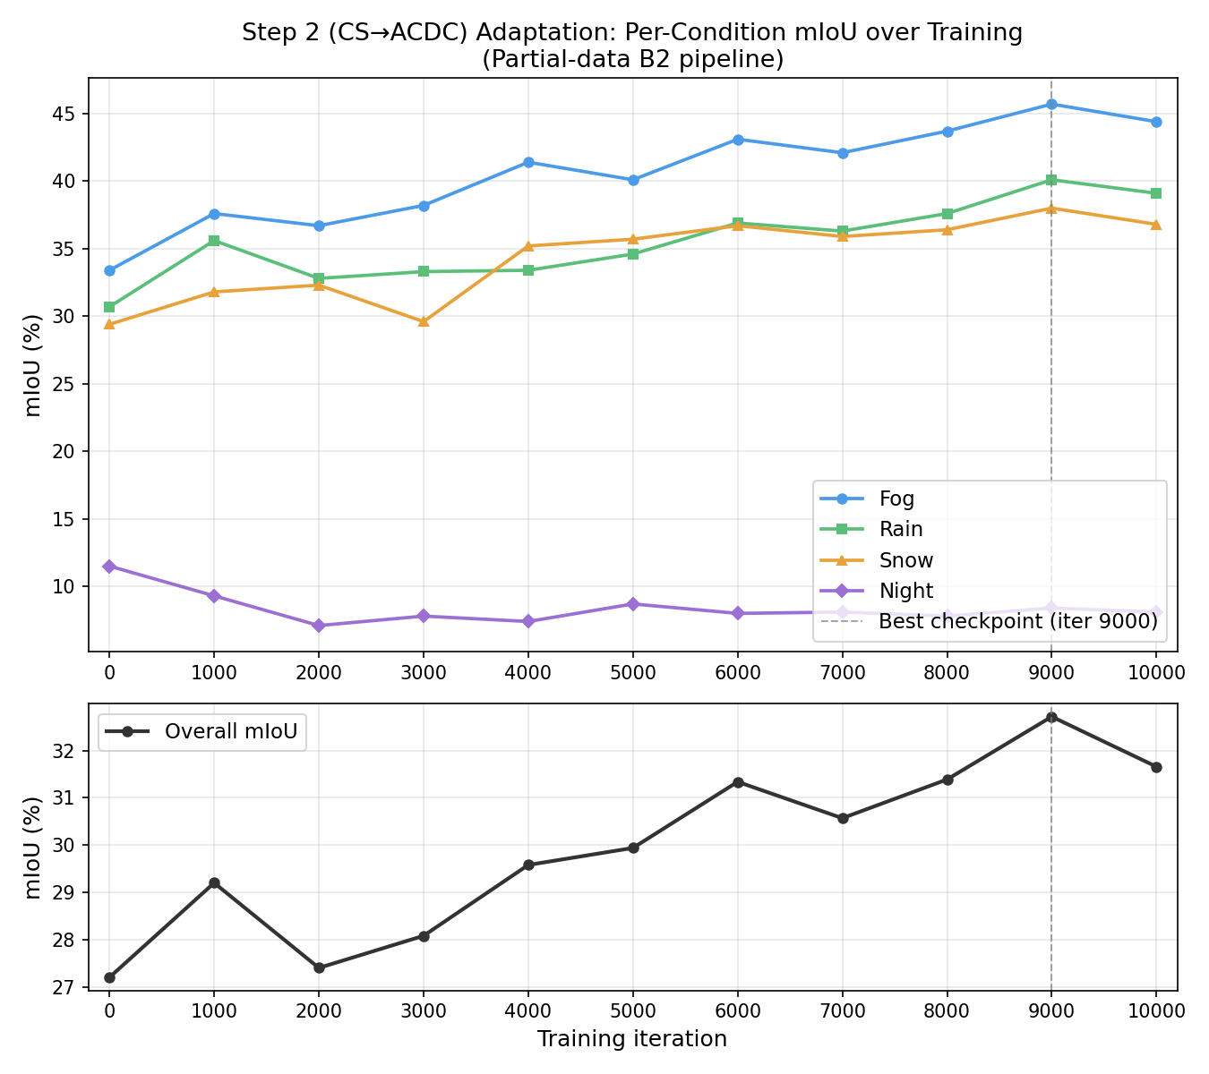
Step 2 Adaptation Curve
Per-condition mIoU over training — partial-data run

Slide 8
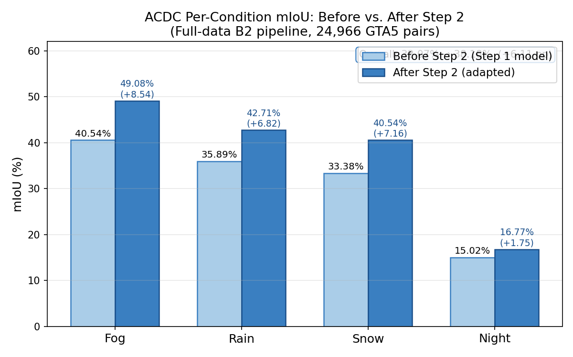
Per-Condition Results — Full-Data Pipeline
Before vs. After Step 2 — 24,966 GTA5 pairs, Step 1: 38.90% CS val

Slide 9
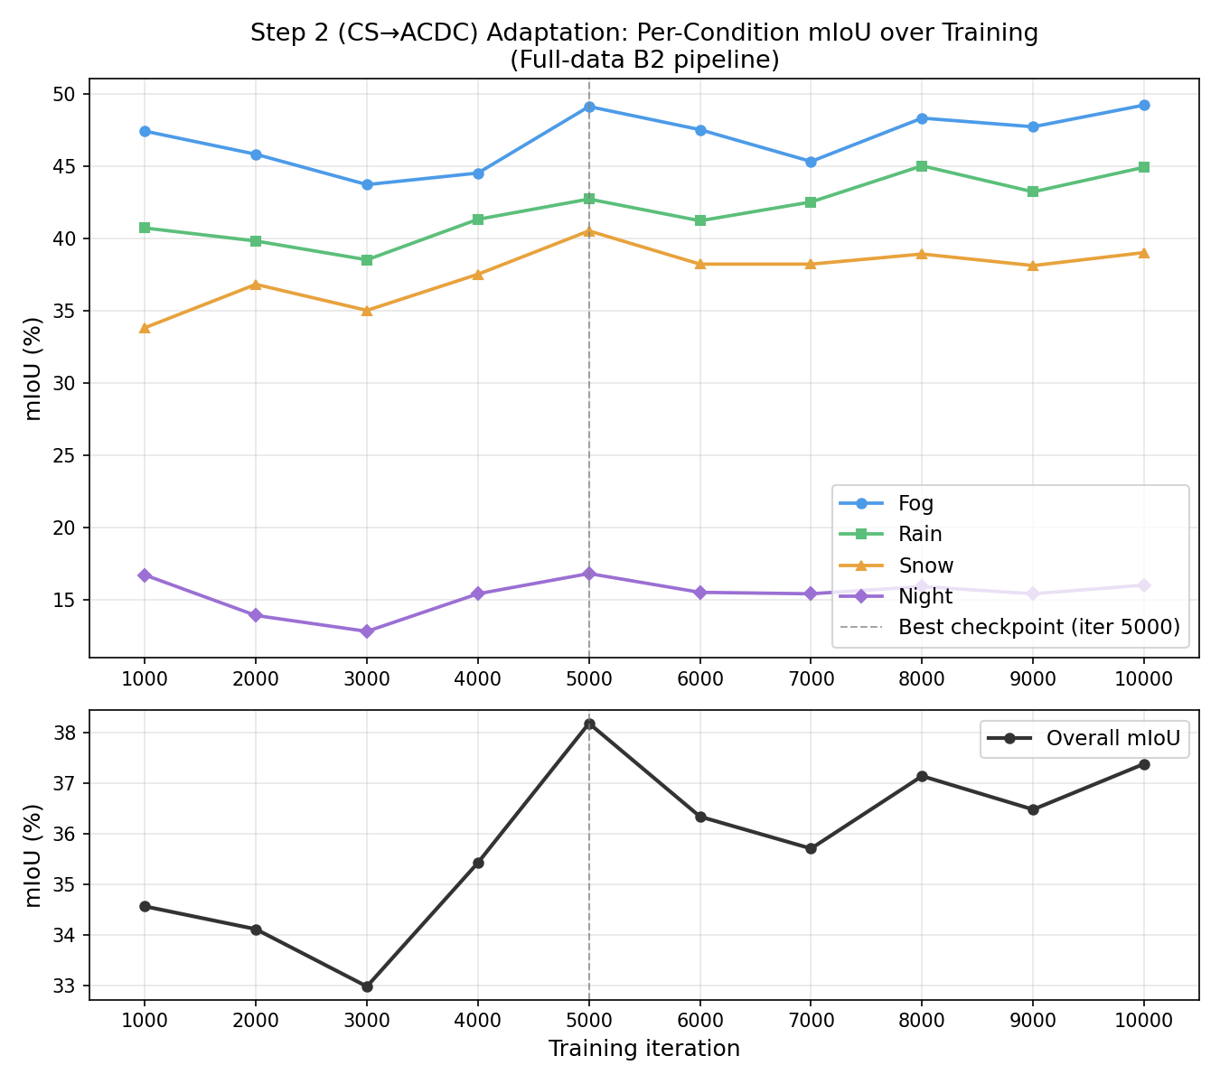
Step 2 Adaptation Curve — Full-Data Pipeline
All four conditions improve, including night — best checkpoint at iter 5,000

Slide 10
Key Finding: The Natural Experiment
One variable changed — night flips
The two runs are identical except for Step 1 dataset size. Everything else — backbone, training procedure, Step 2 config — is the same.
Partial-data
Full-data
Step 1: 30.30% CS val (~10K GTA5 pairs)
Step 1: 38.90% CS val (24,966 GTA5 pairs)
Night Before:
11.5%
Night Before:
15.02%
Night After:
8.4%
Night After:
16.77%
−3.1 pp REGRESSION
+1.74 pp IMPROVEMENT
→ Step 1 quality is the causal mechanism for night adaptation, not the method itself.

Slide 11
Broader Applicability
The principle extends beyond autonomous driving
Two-step UDA applies whenever a large domain gap can be factored through a labeled intermediate domain:
Autonomous Driving
Medical Imaging
Satellite Imagery
Outdoor Robotics
Synthetic game data → Clean real scenes → Adverse weather
Synthetic scans → One scanner type → Noisier scanner
One season/region → Intermediate domain → Target region
Simulation → Controlled env → Unstructured env
Structural requirement for two-step UDA:
Labeled synthetic source · Accessible labeled intermediate domain · Hard unlabeled final target Where the direct source→target gap is too large to bridge in one step.

Slide 12
Conclusion
• Step 2 consistently improves ACDC segmentation — +5.52 pp (partial) and +6.11 pp (full-data)
• Fog benefits most; rain and snow improve substantially; night is the hardest condition
• Full-data run: every condition improves, including night (+1.74 pp)
• Natural experiment: the two runs isolate Step 1 quality as the causal mechanism for night behavior
• Night regression is NOT a fundamental limitation — it is a consequence of a weak Step 1 model
• Sequential UDA factorizes hard domain gaps; Step 1 quality is the primary design lever
• Principle generalises beyond autonomous driving to any multi-hop domain adaptation setting

Slide 13
Thank you
Questions?
github.com/galbe/weather-uda-segformer

