Slide 1
Paint Sales Forecasting System
AI Boot Camp Project 2
Team Members:
Gale Gates
Steven Hill
Tatiana Lee
Terry Welsh

Slide 2
Project Overview
Project Objective
Develop a model to forecast sales of paint products in stores.
Improve inventory management.
Optimize sales strategies.
Anticipate customer demand.

Slide 3
Project Overview
Key Components
Items considered core relevance with our project and research
Historical sales data analysis.
Incorporation of seasonality.
Consideration of economic conditions.

Slide 4
Project Overview
Overview of data collection, cleanup and exploration process
Data Preparation
Historical sales data: Includes features like date, quantity sold, store location, pricing, etc.
Target Variable: Sales volume in gallons
Features: Date (converted to numeric format) - Price

Slide 5
Project Overview
Overview of data collection, cleanup and exploration process
Data Preprocessing
Transform provided data into a stable format that can be shaped into a dataframe
Handle missing values: Impute or drop rows/columns with significant missing data, and scaling data where required.
Convert data to numeric and datetime formats for regression analysis

Slide 6
Project Overview
Overview of data collection, cleanup and exploration process
Data Exploration
Trending of given data to observe values over time
Plotting data points to identify anomalies
Research for required format required for models selected

Slide 7
Project Overview
Approach taken to achieve goals
Team divided up tasks and focused on their specific tasks to execute different models.
Identify and transform data
Explore Sales data and prepare to use with models
Build models and predict future sales

Slide 8
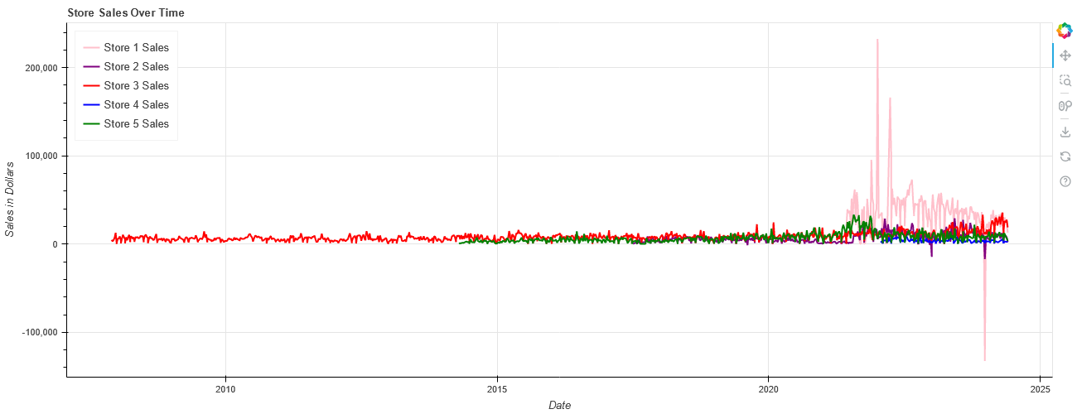
Overall Sales per store for years in operation

Slide 9
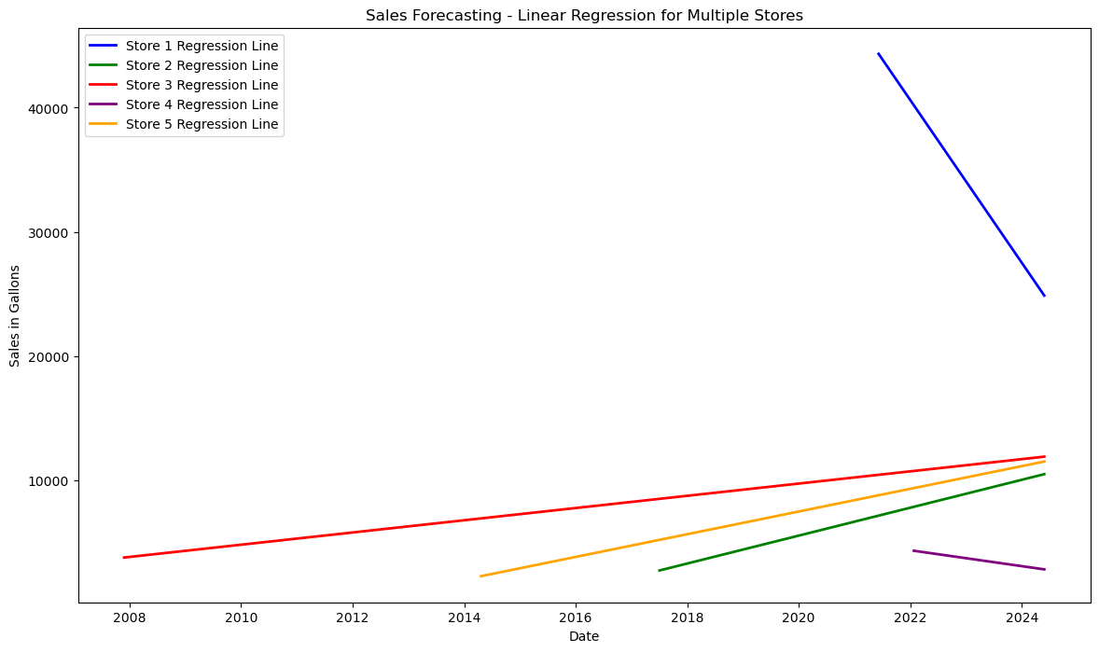
Linear Regression
Notes:
Our group chose linear regression as our initial approach because it provides a simple baseline for understanding the relationship between our features (date) and the target variable (sales). The graph shows the sales trends for the five stores over time.
store 1 - blue line shows a steep decline in sales, particularly noticeable after 2020.
store 2 - green line, store 3 - red line, and store 5 - yellow line show a steady increase in sales over the years.
store 4 - purple line shows a relatively flat trend, indicating stable sales with little change over time.

Slide 10
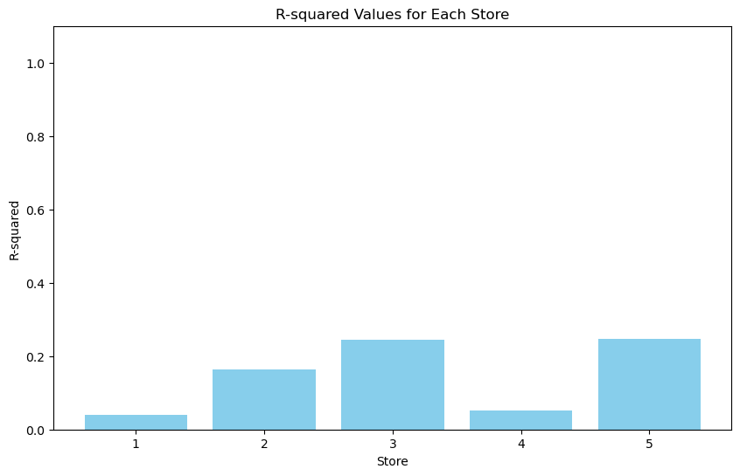
Evaluating the model
Store 1 R-squared: 0.039465408247932765
Store 2 R-squared: 0.16395653918063002
Store 3 R-squared: 0.24418909055509908
Store 4 R-squared: 0.052728537432494504
Store 5 R-squared: 0.2479839423028064
Notes:
Our goal was to determine how well the sales data for each store can be predicted using a linear regression model based on the date.
The bar graph visually represents the R-squared value for each store, making it easy to compare the strength of the linear relationship between date and sales across different stores. The R-squared values for all stores are relatively low, suggesting that the date alone is not a strong predictor of sales. However, it is important to highlight that Stores 3 and 5 have the highest R-squared values, indicating a slightly stronger relationship between date and sales compared to other stores.

Slide 11
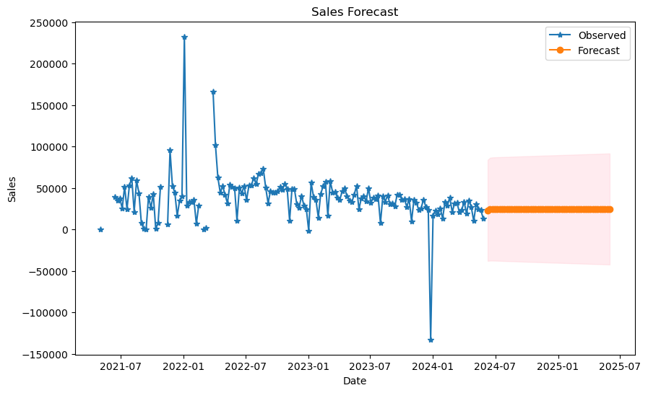
ARIMA (AutoRegressive Integrated Moving Average) / SARIMA
ARIMA Forecast for Store 1
Notes:
I opted to try out some new models for forecasting the sales. All the ARIMA forecasts look similar to this one for Store 1, with relatively flat lines and wide confidence interval. Due to this, I decided to use a SARIMA model to see if we could capture the seasonality.

Slide 12
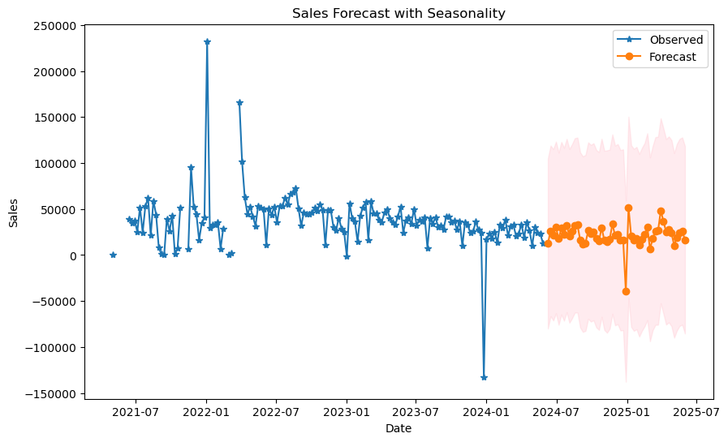
ARIMA / SARIMA (Seasonal AutoRegressive Integrated Moving Average)
SARIMA for Store 1
Notes:
This forecast shows a wider confidence interval and shows that the model is keeping account of the seasonality but is still having issues with the variability in the data.

Slide 13
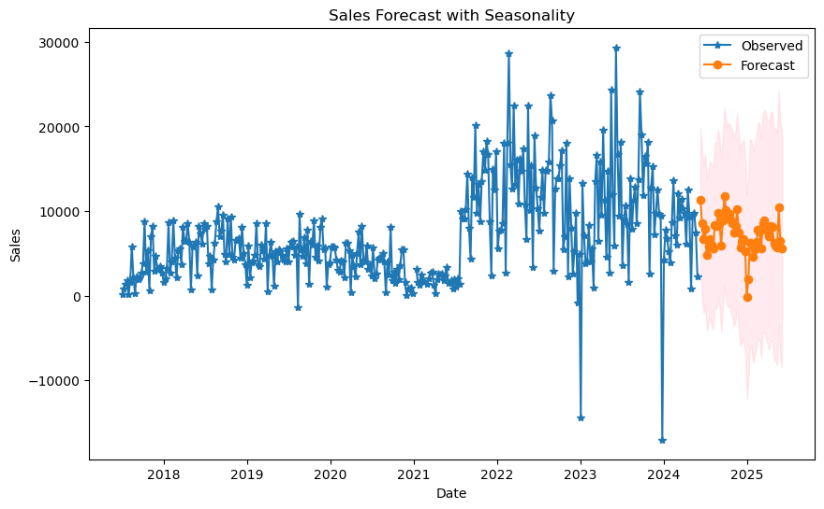
ARIMA / SARIMA
SARIMA for Store 2
Notes:
As I continued using the SARIMA model for the rest of the stores it was apparent that the model’s confidence interval is more accurate plus the forecast shows a better fit for the data.

Slide 14
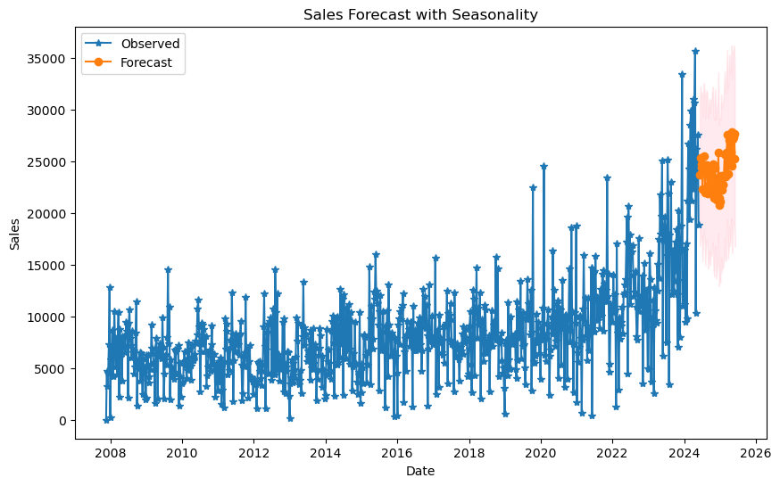
ARIMA / SARIMA
SARIMA for Store 3
Notes:
Unlike the ARIMA model that corresponds to this SARIMA forecast, this forecast captures the upward trend and the periodic patterns better than the ARIMA whereas it forecasted a flat line.

Slide 15
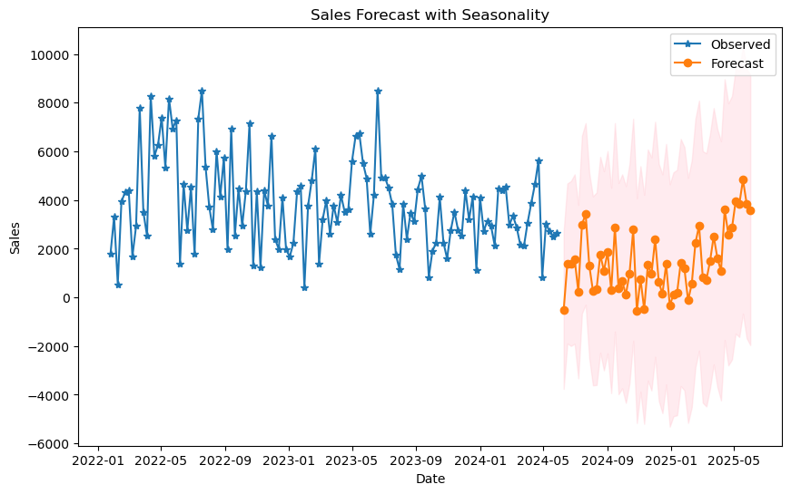
ARIMA / SARIMA
SARIMA for Store 4
Notes:
This SARIMA model shows a much wider confidence interval and appears to do a better job at capturing the seasonality.

Slide 16
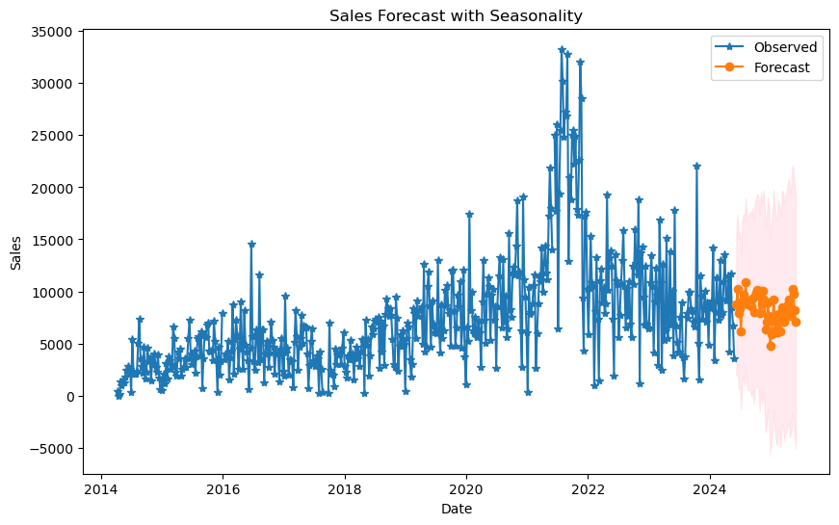
ARIMA / SARIMA
SARIMA for Store 5
Notes:
The SARIMA model shows a forecast with much narrower confidence intervals. It also seems to align better with the observed historical data.

Slide 17
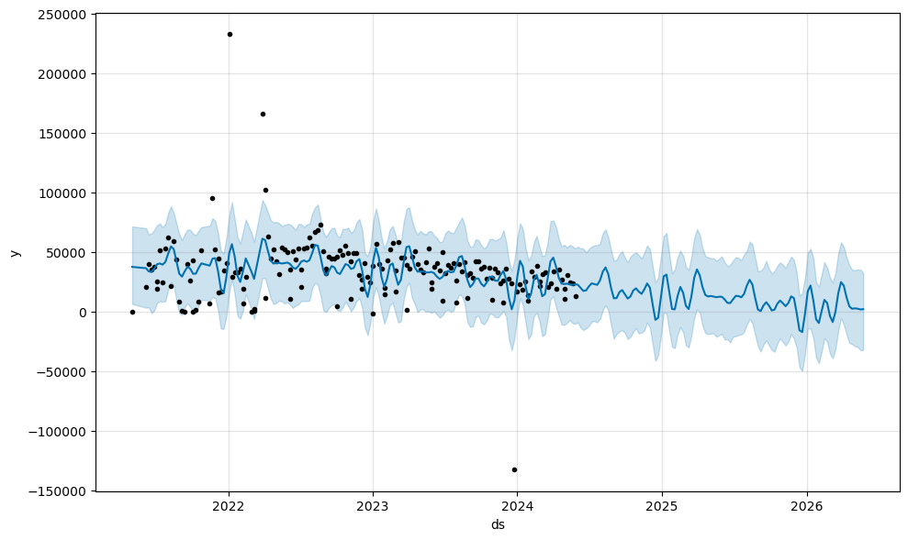
Prophet predictions-Store#1

Slide 18
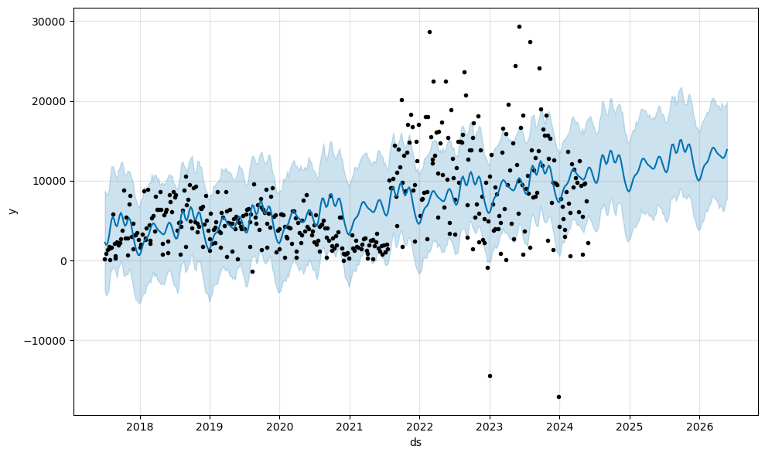
Prophet predictions-Store#2

Slide 19
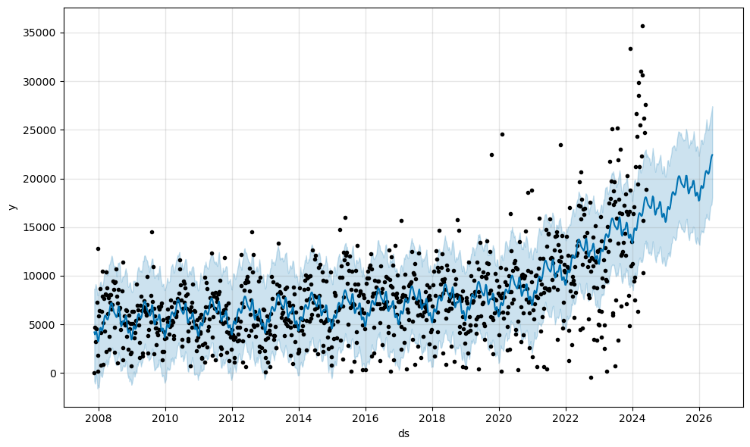
Prophet predictions-Store#3

Slide 20
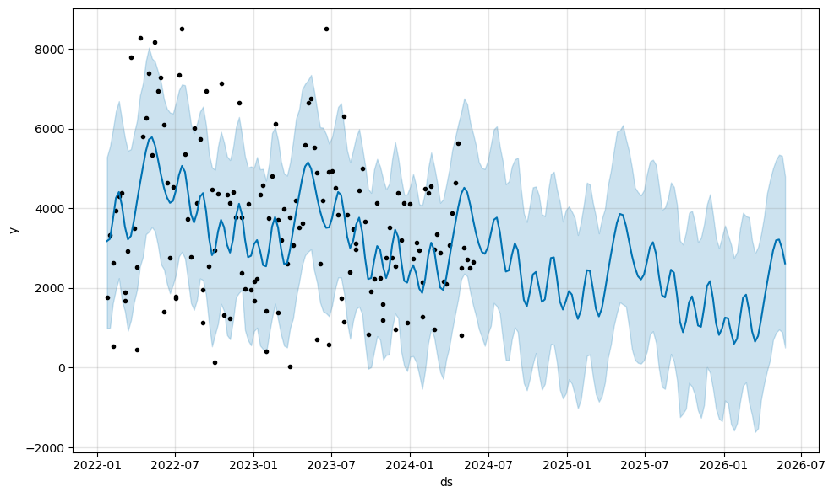
Prophet predictions-Store#4

Slide 21
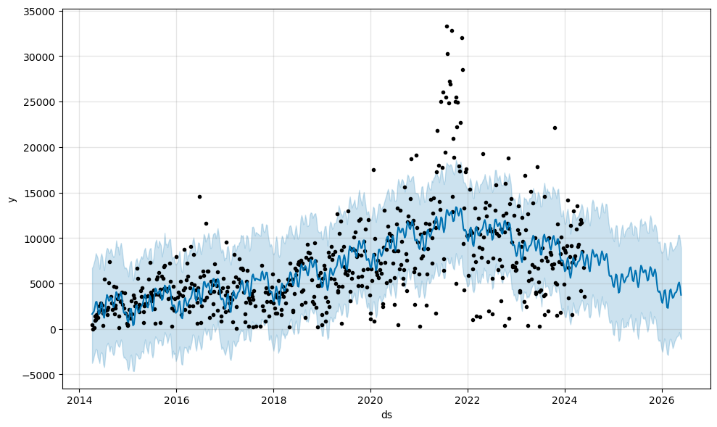
Prophet predictions-Store#5

Slide 22
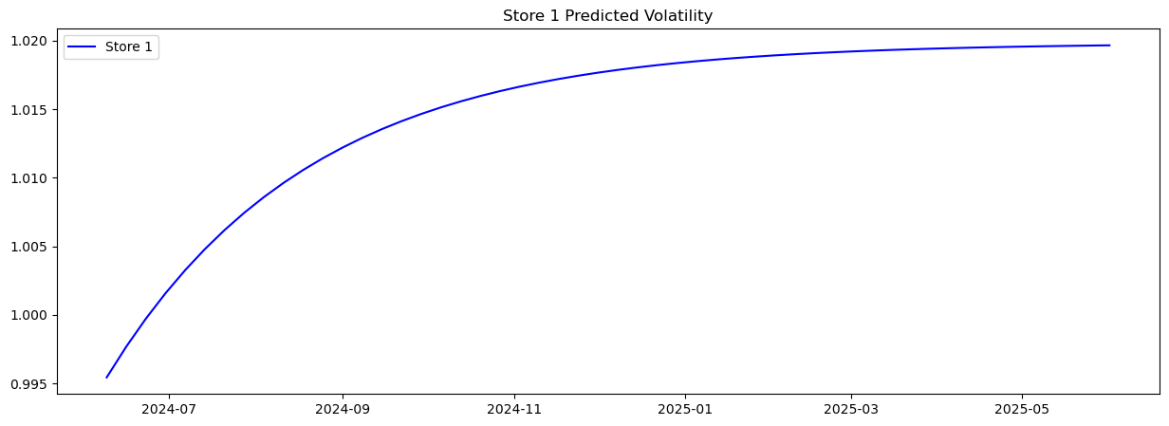
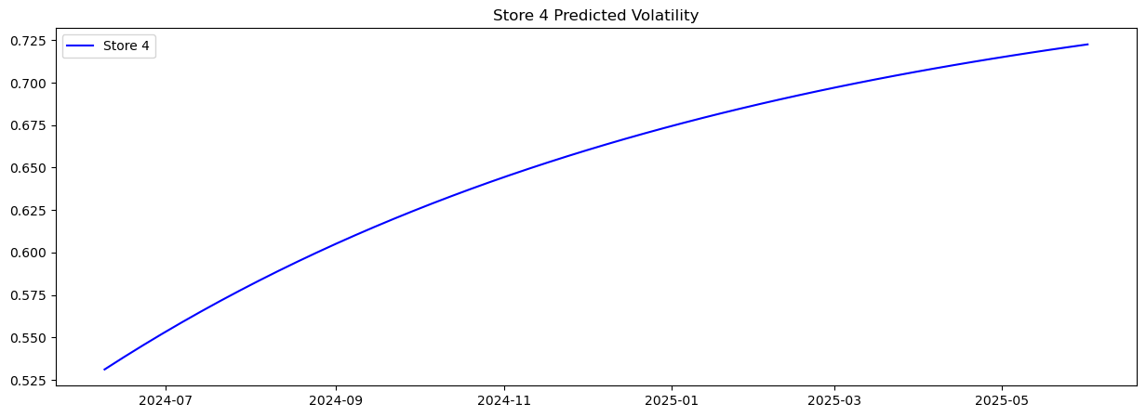
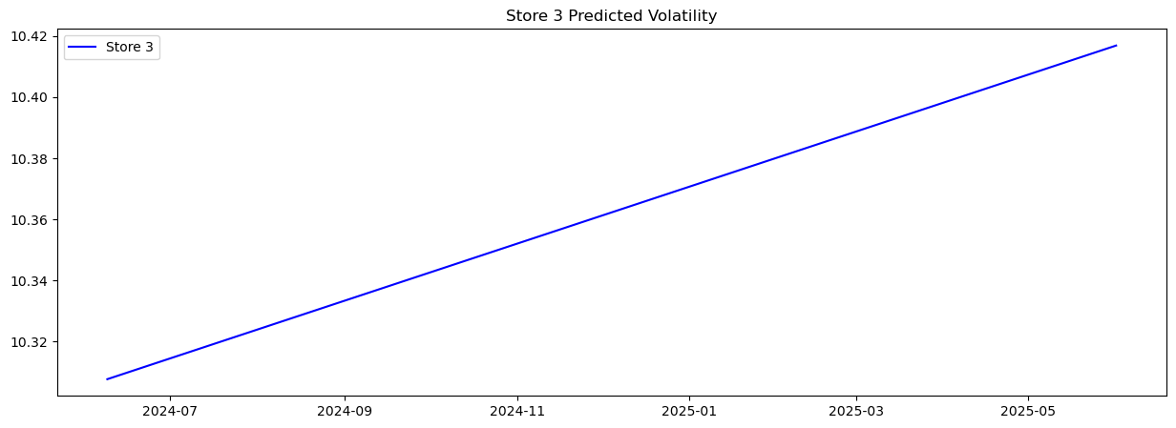
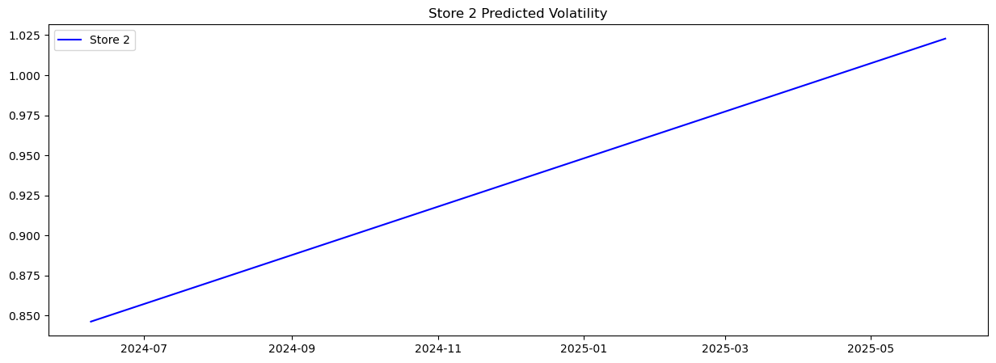
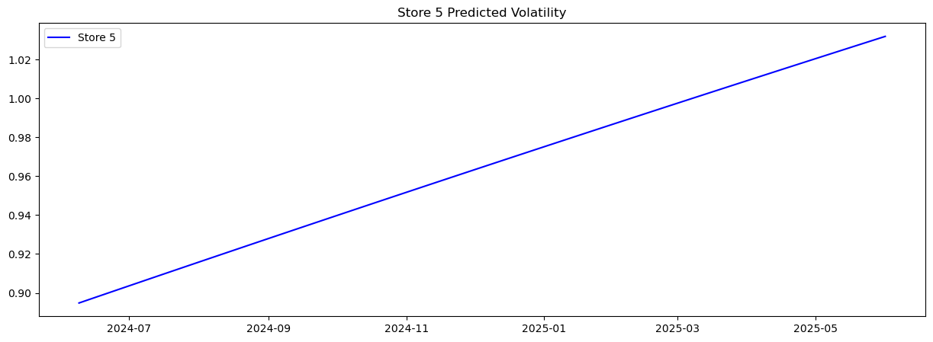
GARCH (Generalized Autoregressive Conditional Heteroskedasticity) model - Volatility forecasts

Slide 23
The project successfully identified the most suitable forecasting model (SARIMA) for paint sales across multiple stores. While initial models like linear regression and ARIMA had limitations, the SARIMA model effectively captured seasonality and provided accurate forecasts. The use of Prophet as an alternative model further validated these findings. Despite facing data and technical challenges, the project laid a strong foundation for future enhancements, including the integration of external data and real-time forecasting capabilities. By addressing these areas, the forecasting system can become a valuable tool for inventory management, sales optimization, and demand anticipation. Should be noted that there was a clear observation related to Covid in the stores data that were open before and after this global pandemic. Overall all stores do show they are profitable and will continue to produce for the business, but with this data they can now focus advertising efforts on the stores that have not been producing as well as others.
Summary

Slide 24
Technologies and Techniques:
Scikit-learn for machine learning models.
Pandas for data manipulation and cleaning.
Matplotlib/Pandas plotting for visualization.
Prophet for time series analysis.
Arch model for volatility prediction.
Statsmodel - ARIMA/SARIMA time series prediction.
Bokeh for trend visualizations.
Python as the programming language.
Summary

Slide 25
Model choice:
Start with linear regression.
Progress to Prophet for time series forecasting.
ARIMA / SARIMA
Garch model
Summary

Slide 26
Data issues:
Data source provided poor formatted data for use
Missing values and inconsistencies in historical sales data.
Challenges in incorporating external data like economic indicators and weather conditions.
Problems Encountered

Slide 27
Technical Challenges:
Handling different data types (datetime, numerical, categorical).
Converting datetime data to a suitable numeric format for model input.
Ensuring data preprocessing steps do not introduce biases or errors.
Problems Encountered

Slide 28
Modeling Difficulties:
Selecting the appropriate model for initial and advanced stages.
Balancing model complexity with performance and interpretability.
Problems Encountered

Slide 29
Data Enhancement:
Integrate more detailed external data (e.g., economic forecasts, advanced weather data).
Collect and include data on customer demographics and buying behaviors.
Model Improvement:
Experiment with additional machine learning models
Explore ensemble methods for improved prediction accuracy.
Future Considerations
Notes:
Data Enhancement:
To take our sales forecasting to the next level, we need to look beyond our internal data. By integrating more detailed external data like economic trends and advanced weather data, we can gain a deeper understanding of the factors influencing our sales.
In addition, understanding our customers is key to accurate forecasting. By collecting data on customer demographics, we can tailor our models to account for different customer segments.
Model Improvement:
Furthermore, we could explore more advanced machine learning models to help us capture more complex patterns in our data and boost our prediction accuracy. For example the long short-term memory (LSTM) networks, are particularly well-suited for time series forecasting. They can handle seasonality, trends, and other intricate patterns that a simpler model might miss.

Slide 30
System Deployment:
Develop a real-time forecasting system that updates predictions based on new sales data.
Implement a user-friendly interface for store managers to access forecast and insights.
Evaluation and Feedback:
Continuously evaluate model performance with new data.
Gather feedback from stakeholders to refine the model and improve its usefulness.
Future Considerations
Notes:
system development:
To make our sales forecasting truly effective, we need to develop a real-time forecasting system. This system will continuously update predictions as new sales data come in.
It is crucial that our store managers can easily access and understand the forecast that adjust dynamically based on the latest data. This will allow us to respond quickly to changing market conditions and make more informed decisions.
Evaluation and feedback:
Once our system is up and running, we need to continuously evaluate the model’s performance with the new data to make sure our predictions match actual sales and making adjustments as needed to keep the model accurate and reliable.
Feedback from our stakeholders is invaluable. We need to actively gather input from store managers, sales team, to understand how the model is performing in the real world. This feedback will help us refine the model and make it more useful.

