Slide 1
Solar Proposal – A Project to Identify Promising Stock Opportunities
AI Boot Camp Project 1
Team Members:
Gale Gates
Steven Hill
Tatiana Lee
Terry Welsh

Slide 2
Project Overview
Project Purpose / Description
This project aims to develop a data-driven approach to analyzing the stock market. By leveraging historical data and identifying trends, we will create a framework to answer critical questions like which stocks are on the rise, which hold long-term potential, and how different sectors are performing.

Slide 3
Project Overview
Goals/Questions to be addressed
Which stock is trending up or down?
What stock is likely to perform the best over the next 6 months based on historical data?
How are stocks performing compared to each other in this market segment?
Is there any specific seasonality that shows why this market moves?

Slide 4
Project Overview
Overview of data collection, cleanup and exploration process
We gathered stock price data from Yahoo Finance for the specified period, ranging from January 1st, 2020, to April 10th, 2024. We then combined the collected data and ensured consistent time intervals across the datasets. This steps guarantees uniformity in the data for accurate trend analysis.

Slide 5
Project Overview
Approach taken to achieve goals
We primarily focused on technical analysis to identify trends and predict future performance. To identify trending stocks for visualization (CSIQ, DQ, ENPH, FSLR, JKS, SEDG, SPWR), we used time series plots to spot trends and calculated statistics like mean, standard deviation, and skewness to understand return patterns. Finally, linear regression helped uncover long-term trends, guiding the data visualization process.

Slide 6
Which Stock is Trending Up or Down?
This questions aims to identify stocks that are currently experiencing significant price movements, either upwards or downwards. By understanding these trends, investors can potentially capitalize on short-term opportunities.

Slide 7
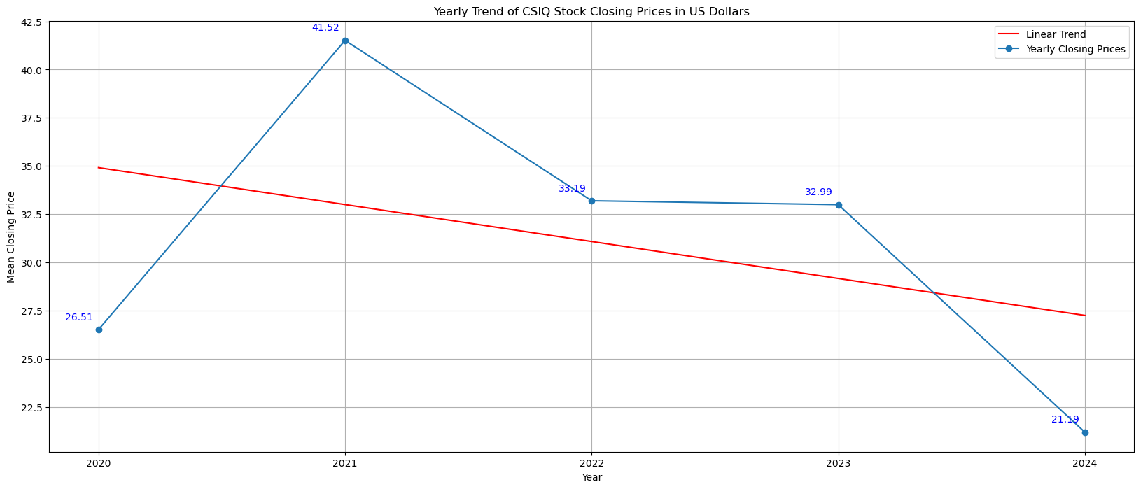
Canadian Solar Industry Inc. (CSIQ)

Slide 8
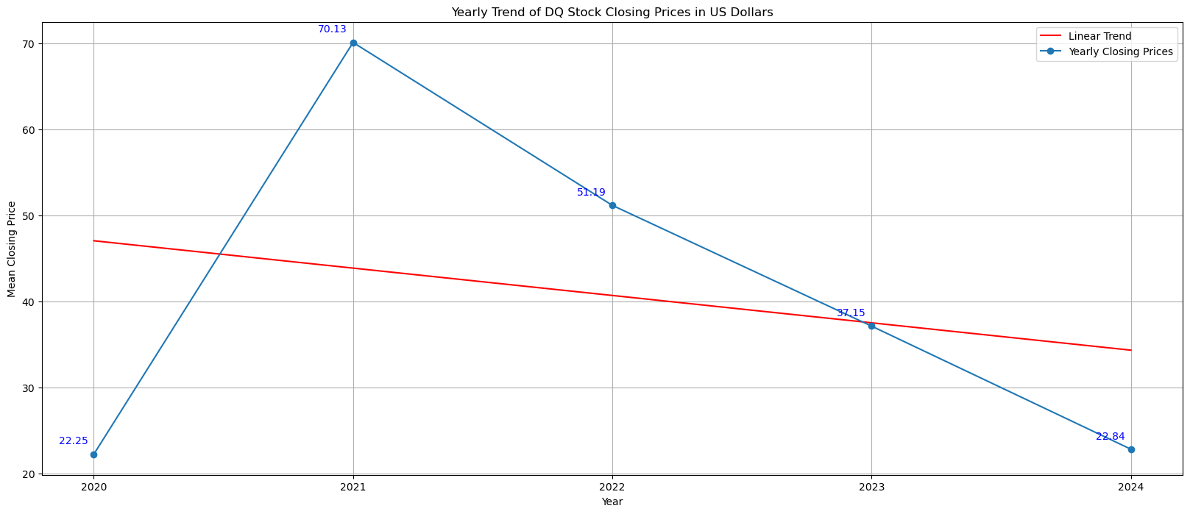
Daqo New Energy Corp. (DQ)

Slide 9
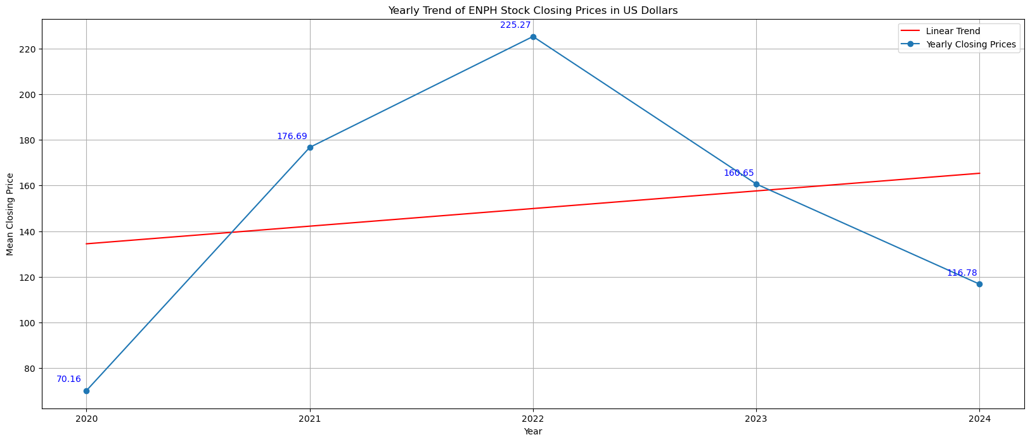
Enphase Energy, Inc. (ENPH)

Slide 10
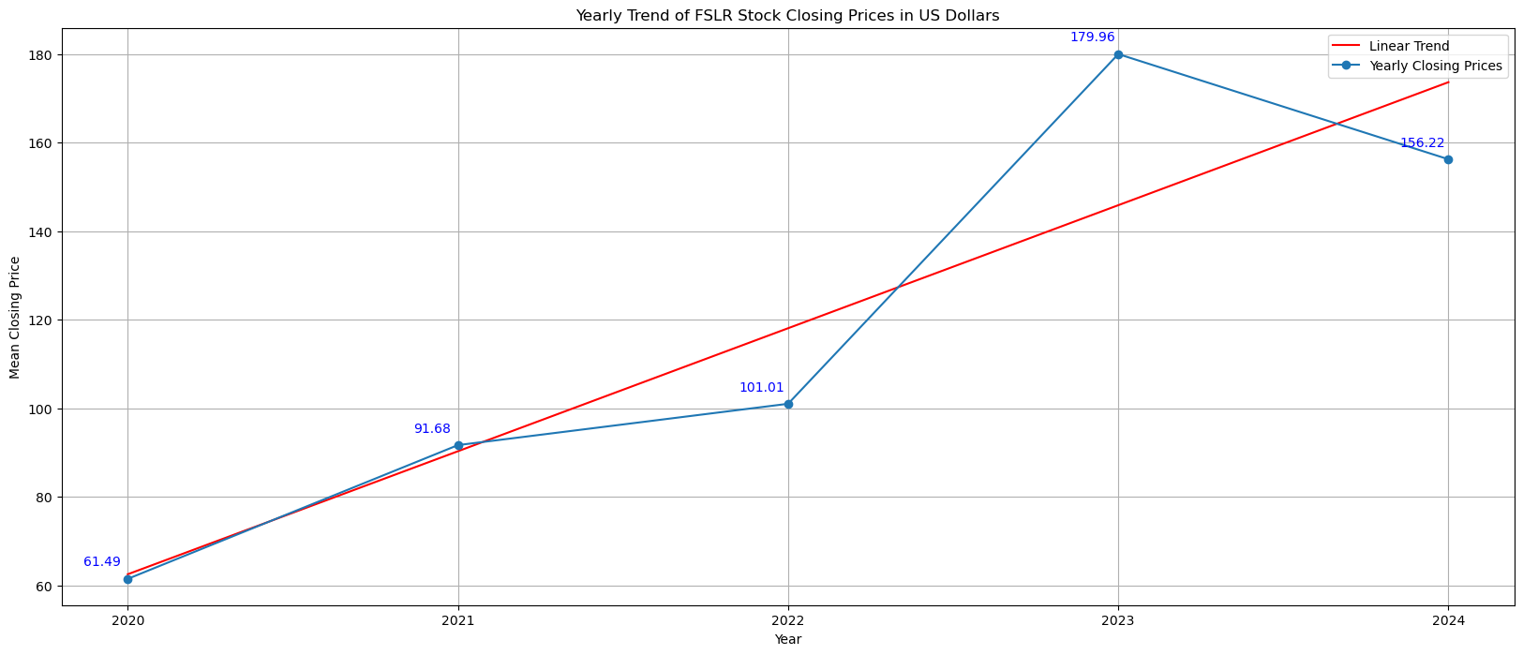
First Solar, Inc. (FSLR)

Slide 11
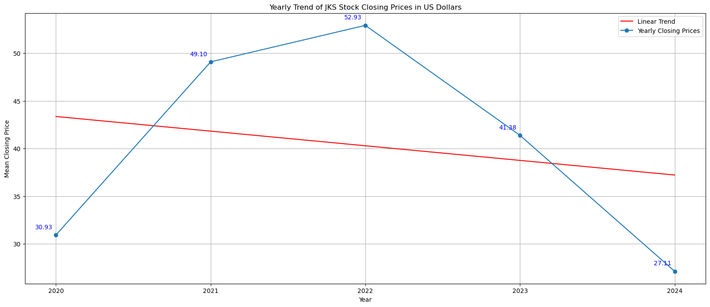
JinkoSolar Holding Co., Ltd. (JKS)

Slide 12
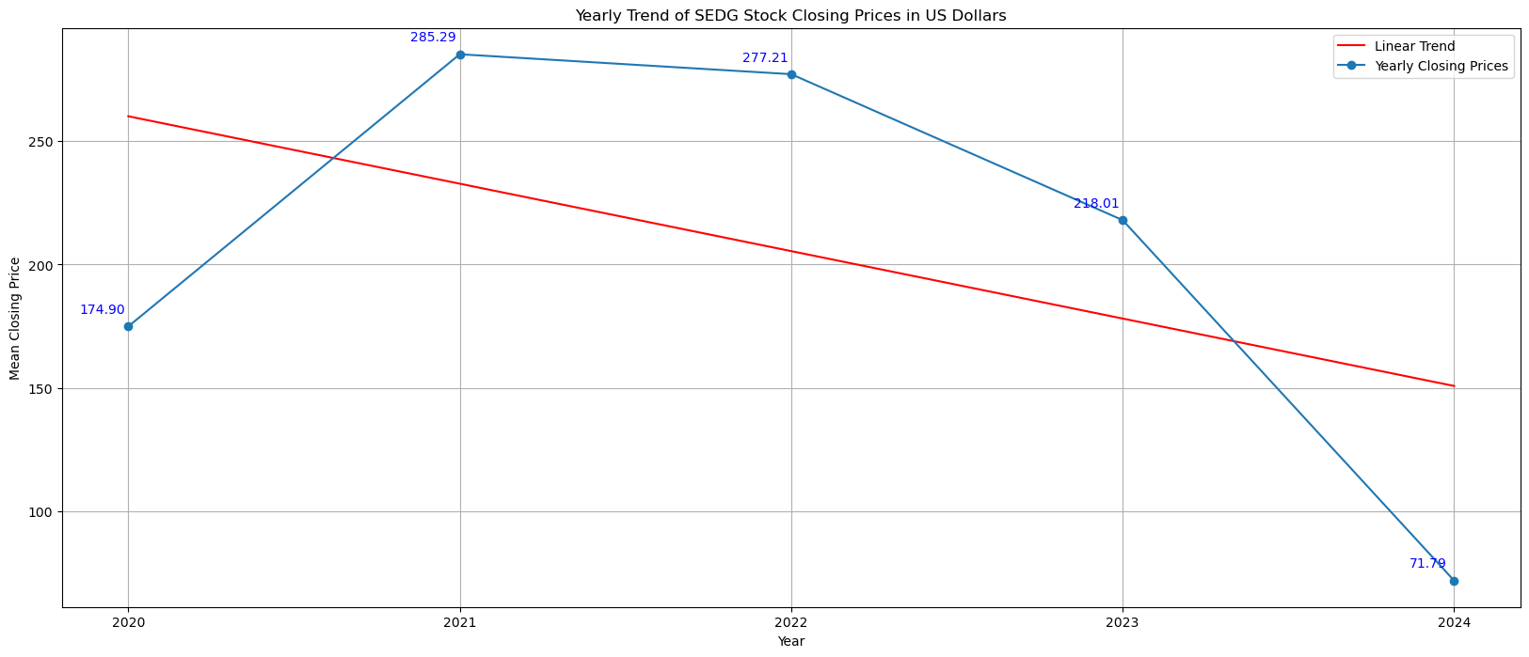
SolarEdge Technologies, Inc. (SEDG)

Slide 13
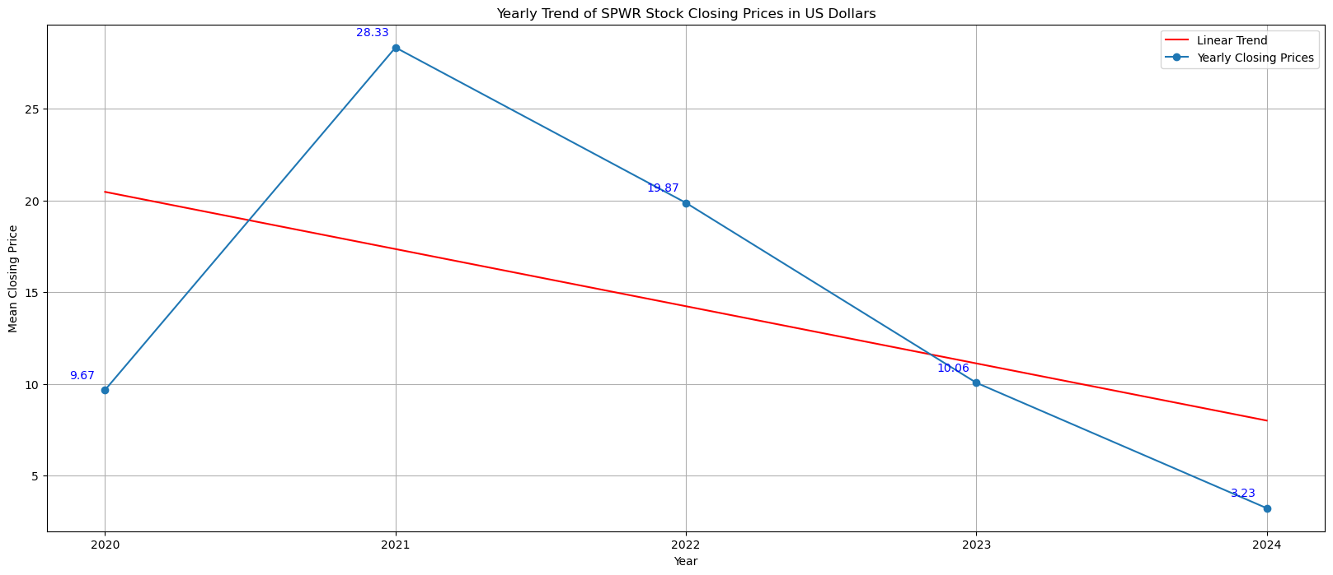
SunPower Corporation (SPWR)

Slide 14
What stock is likely to perform the best over the next 6 months based on historical data?
Provide a summary of the results with the supporting visualizations (at least 2 per question)
This question delves into predicting future stock performance using historical data analysis. By leveraging past trends and market patterns, the project seeks to recommend stocks with promising potential for the next 6 months.

Slide 16
How are stocks performing compared to each other in this market segment?
Provide a summary of the results with the supporting visualizations (at least 2 per question)
This question focuses on relative stock performance within a specific market segment. Analyzing this data can help investors identify outperformers and underperformers, enabling them to make informed investment decision.

Slide 18
Is there any specific seasonality that shows why this market moves?
Provide a summary of the results with the supporting visualizations (at least 2 per question)
This question explores the presence of seasonal trends that influence market movements. By understanding these seasonal patterns, investors can potentially adjust their strategies to align with cyclical market fluctuations.

Slide 20
Result/Conclusion 2
Provide a summary of the results with the supporting visualizations (at least 2 per question)
Text

Slide 21
Result/Conclusion 3
Provide a summary of the results with the supporting visualizations (at least 2 per question)
Text

Slide 22
First
Summary
Second

Slide 23
Text
Problems Encountered

Slide 24
Summarize any additional questions that surfaced, what your group might research next if more time was available, or share a plan for future development.
Text
Future Considerations

